Slide 1

Project Presentation
Brain Stroke Analysis and Prediction
Akhil Pratyush Simhambhatla
Gokul Ragunandhan Narayanasamy
Venkata Mani Babu Karri

Slide 2

Objective of the project
To develop a system that provides insight into the prevalence of Brain stroke amongst different demographics, reviewing and analyzing the primary risk factors associated with the occurrence of the stroke and the factors that cause the stroke in the first place.
This system also helps us in developing intuitive Machine learning models that can help us in predicting the occurrence.

Slide 3
Dataset Used
Data includes parameters such as Gender, Age, Hypertension, Heart disease, Marital Status, Nature of Work, Type of Residence, Blood glucose level, BMI, and Smoking Status.
Data was taken from the open-source platform Kaggle.

Slide 4
Models Used
Logistic Regression.
Decision Trees.
Random Forest.
K Nearest Neighbors.
Naive Bayes.

Slide 5
Steps:
Data Collection (Choosing Dataset from Kaggle)
Data Cleaning
Data Analysis using Spark SQL
Exploratory Data Analysis using python functions
Fitting multiple models for the dataset using python inbuilt functions and Spark MLlib
Testing the models and getting the predictions

Slide 6
Data Cleaning and Analysis
Once the data is collected, we then started working on it. We converted the CSV file to a data frame using pandas and performed multiple data-cleaning operations on it. They include:
Removal of any negative values
Removal of any unnecessary punctuations and white spaces.
Removal of unnecessary attributes.
Removal of Zero values.
Encoding and indexing descriptive data into numerical data.
Dropping any unnecessary columns if any.

Slide 7
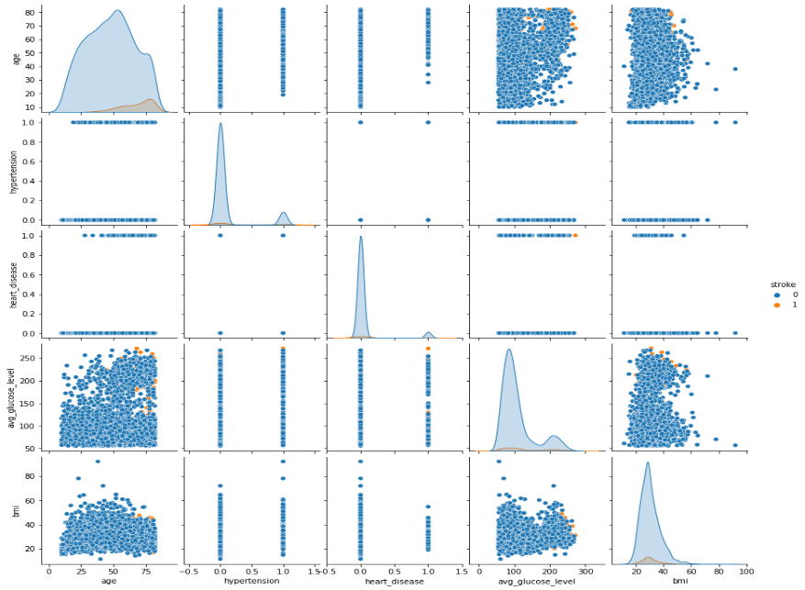
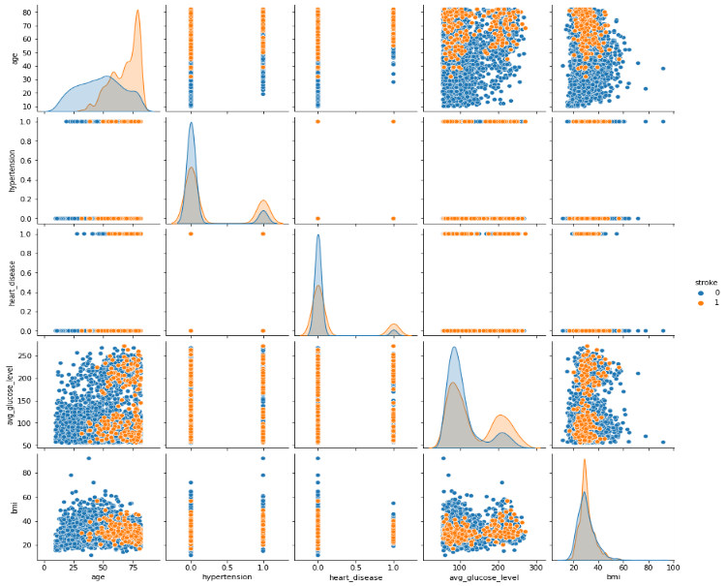
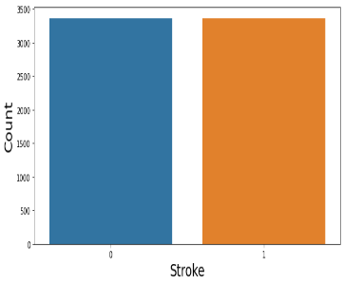
Up Sampling the Data
Pair Plots that show the relationship between independent and dependent variable (stroke) between normal and Up Sampled Data.
The above view shows the increase in stroke patient count after up-sampling.
Notes:
After doing this, we created a pair plot to see the relationship between the independent variables and the dependent variable (Stroke) and as the data was unbalanced, we decided to up sample the data by adding necessary entries to the dataset. Previously the data was not reliable to fit any data as the data was very less to train the models. Once the data was up sampled , we ran the same data cleaning steps again and you can see the before and after pair plots. The dots in blue are independent variables and the dots in orange are dependent variables.

Slide 8
Preliminary Analysis using Spark SQL
After cleaning the data, we used Spark SQL to do a preliminary analysis of the data we ended up with. This analysis gave us a rudimentary insight into how the data is behaving and what factors are impacting the stroke victims majorly.
Some findings are:
Female Population is suffering more from stroke
People having heart stroke are more susceptible to getting brain stroke
People getting brain stroke have more BMI than normal people
People with more Hypertension are also falling into the stroke category.
People with high blood sugar are also victims of brain stroke
People in their ages ranging from 50-80 are more affected by stroke.
Smoking also has an important role in causing the stroke
People who are married are more susceptible to stroke.
People who are working in Private firms tend to get strokes more than people
working for government firms.
All this can be seen with numerical proofs in the code. We have drawn multiple graphs to explain the same.
A small snippet of the SQL output is provided.
Effect_of_marriage | Stroke_victims
No | 336
Yes | 3028
Effect_of_marriage | Heart_stroke_victims
No | 110
Yes | 733
Type_of_work | Heart_stroke_victims
Self-employed | 173
govt_job | 114
private | 556
People_with_heart_disease_and_stroke | 654

Slide 9
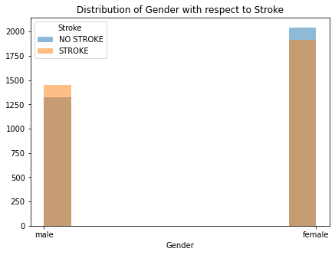
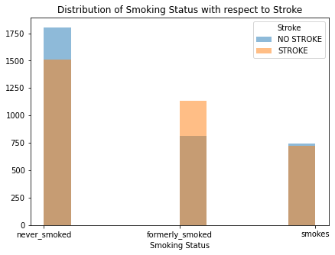
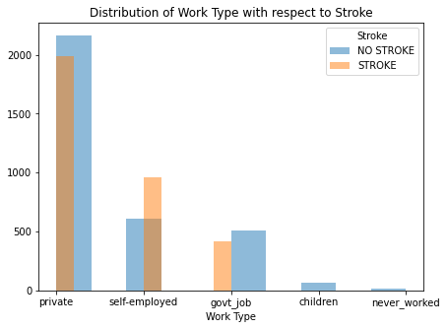
Further Analysis and supporting graphs
These supporting graphs are drawn using matplotlib to further enhance our findings done through Spark SQL.
Notes:
The above figure shows the spread of stroke disease across certain important parameters.
Figure 1 shows that the male gender has a higher stroke compared to females.
Figure 2 shows that people who Formerly smoked have a higher stroke rate when compared to non-smokers and current smokers.
Figure 3 shows that people who are self-employed have been admitted more with stroke disease compared to other sectors.

Slide 10
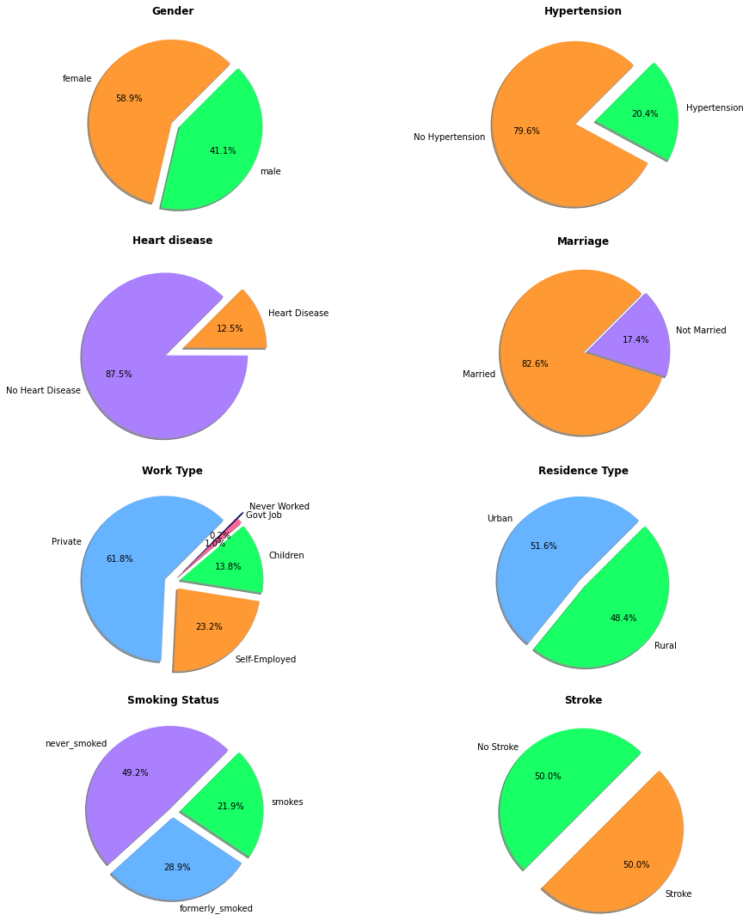
Exploratory Data Analysis using python
Distribution of each parameter through Pie Chart:
Notes:
The above shows the distribution of each parameter with its categories.
We could see that the Female gender population is higher compared to the male population.
Around 20% of the population has hypertension.
Around 13% of the population has heart disease.
Around 82% of the population is married.
Ratio of urban to rural population remains equal.
Around 50% of the population never had a smoking habit.
The up-sampled data has almost 50% of the people with stroke identified.

Slide 11
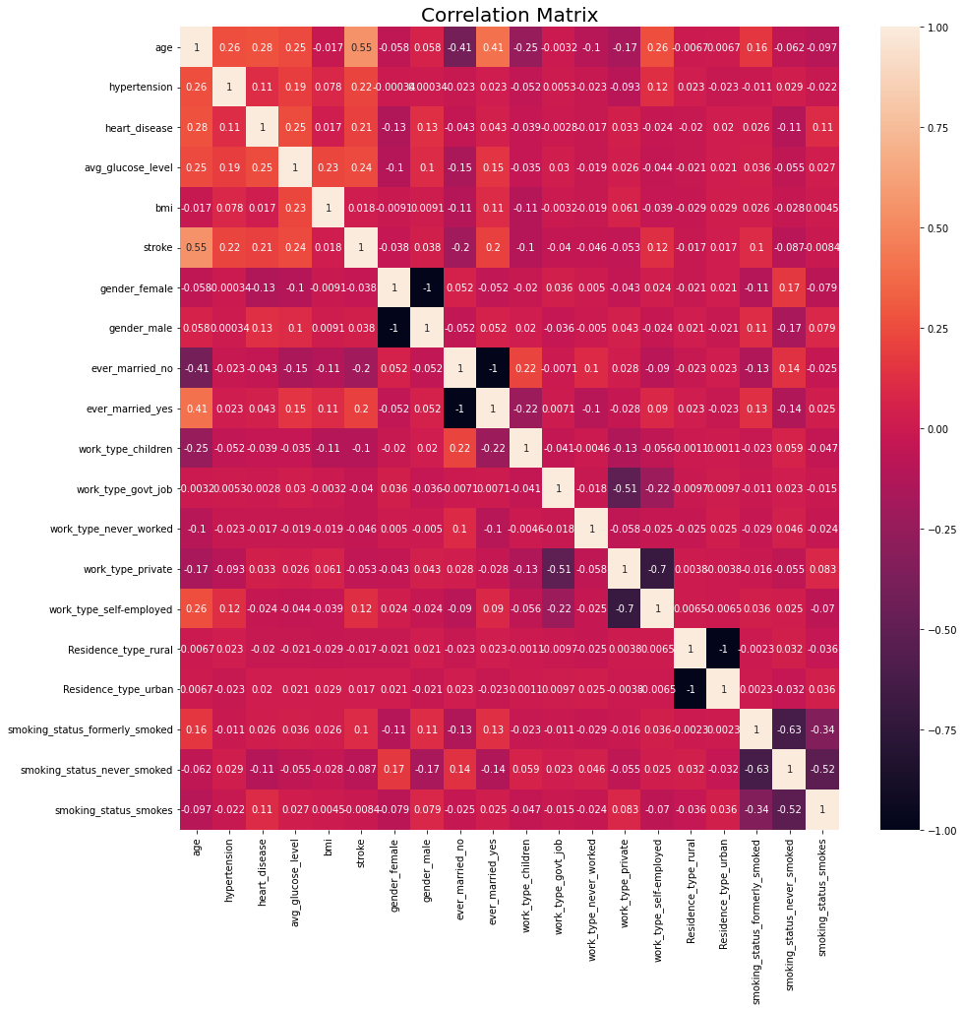
Exploratory Data Analysis using python
Correlation Between All the Parameters is shown in Heat Map:
Parameters w.r.t to Stroke | Correlation Co.efficient
age | 0.552833
avg_glucose_level | 0.243669
hypertension | 0.222758
heart_disease | 0.20873
ever_married_yes | 0.195374
work_type_self-employed | 0.123466
smoking_status_formerly_smoked | 0.103848
gender_male | 0.037938
bmi | 0.017751
Residence_type_urban | 0.0171
smoking_status_smokes | -0.00835
Residence_type_rural | -0.0171
gender_female | -0.037938
work_type_govt_job | -0.040167
work_type_never_worked | -0.045674
work_type_private | -0.053411
smoking_status_never_smoked | -0.087269
work_type_children | -0.101816
ever_married_no | -0.195374
Notes:
The Correlation between stroke w.r.t other parameters has been plotted in a heat map:
From the above figure we could see that age is the highest correlated parameter followed by blood glucose level, Hypertension, Heart disease, etc…
Whereas Smoking habit, Work type, and Marital status have the weakest correlation to stroke.

Slide 12
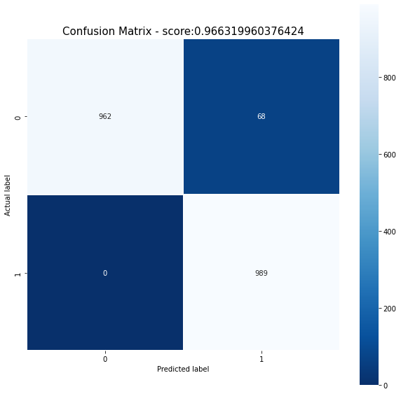

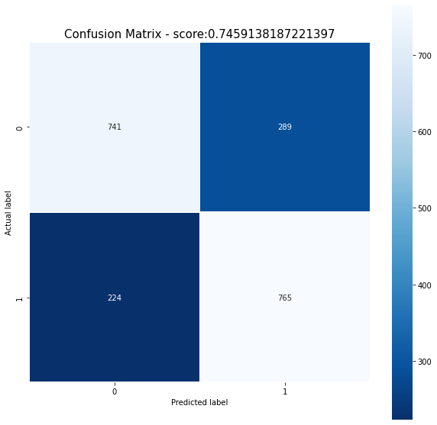
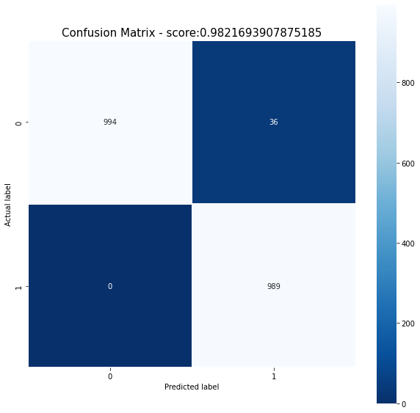
Confusion Matrix for the predicted Models
Decision Tree:
K Nearest Neighbor:
Logistic Regression:
Random Forest:
Notes:
The above images show the confusion matrix for the models:
K Nearest Neighbor and Decision Tree has an accuracy score of 0.97.
Random forest has the highest accuracy score of 0.98.
We could see that Logistic regression and Naïve Bayes have the lowest accuracy score of around .75.

Slide 13
Spark MLlib
MLlib is Apache Spark’s library for machine learning.
It has APIs in Java, Python, Scala and R. For this project we are using Python (PySpark).
It consists of various machine learning algorithms including regression, classification, clustering etc.
It also has other utilities in Statistics, Linear Algebra and ML workflow.
Spark works much faster than MapReduce, which helps in running iterations for quality results.
It also works with various data sources.

Slide 14
Goal
Goal: To predict brain stroke using Spark MLlib Models.
Models Used: Logistic Regression, Random Forest, Naïve Bayes, Decision Tree.
Data Split: Train-70%, Test-30%

Slide 15
Steps
Spark Session:
Creating a Spark Session to start programming with Dataset using Spark.
Spark Dataframe Operations:
Reading File, Defining Schema, Count.
Data Exploration.
Encode Categorical Variables:
a. String Indexing: Converting Categorical Values into Numerical Values.
b. One Hot Encoding: Encoding above generated Numerical Values.
Vector Assembler:
Assembling all updated columns and other columns into a single vector column.
Model Selection:
Selecting model and giving feature column and label column.
Building ML Pipelines:
Using the pipeline to apply all the above transformations in a single step.
Data Splitting:
Splitting data into Training Data and Testing Data.
Model Training
Model Testing
Results:
Calculating the accuracy.

Slide 16
Results:
Spark MLlib
Scikit-learn
Model | Accuracy(%)
Logistic Regression | 76.99
Random Forest | 77.13
Naïve Bayes | 71.87
Decision Tree | 78.59
Model | Accuracy(%)
Logistic Regression | 74.70
Random Forest | 97.20
Naïve Bayes | 74.78
KNN | 91.2
Decision Tree | 96.5

Slide 17
Thank You !!!

Slide 18
References
“Machine Learning Library (MLlib) Guide” , https://spark.apache.org/docs/latest/ml-guide.html
“Pythonic Data cleaning using Numpy and Pandas”, https://realpython.com/python-data-cleaning-numpy-pandas/
“Scikit-Learn ,Machine learning in python”, https://realpython.com/python-data-cleaning-numpy-pandas/
“Spark SQL, DataFrames and Datasets Guide”, https://spark.apache.org/docs/latest/sql-programming-guide.html
“Upsampling and Downsampling Imbalanced Data in Python”, https://wellsr.com/python/upsampling-and-downsampling-imbalanced-data-in-python/
“Python | Pandas DataFrame”, https://www.geeksforgeeks.org/python-pandas-dataframe/
“How to use Confusion Matrix in Scikit-Learn (with Example)”, https://www.jcchouinard.com/confusion-matrix-in-scikit-learn/
“Evaluation Metrics - spark.mllib”, https://home.apache.org/~pwendell/spark-nightly/spark-branch-1.6-docs/spark-2.0.0-SNAPSHOT-2016_06_05_11_01-4e767d0-docs/mllib-evaluation-metrics.html

