Slide 1
Crude Oil Price Forecasting Using Deep Learing
NAME:
REGISTRATION ID:

Slide 2
INTRODUCTION
Crude oil is one of the most important commodities in the world, with its price affecting many industries. The forecast of its price is very important due to its economic consequences. However, forecasting is challenging because of geopolitical events, changes in supply and demand, and speculation. Deep learning, especially RNNs, LSTMs, and CNNs, offers improved accuracy over traditional models by detecting complex patterns. This project explores deep learning's effectiveness in forecasting crude oil prices to enhance risk management and decision-making in oil-dependent industries.
The goal of this project is to improve risk management and decision-making in sectors of the economy that are strongly impacted by the dynamics of the oil market by investigating the efficacy of deep learning techniques in predicting crude oil prices.

Slide 3
RESEARCH AIM AND OBJECTIVES
The goal is to the development and evaluation of an accurate and reliable deep learning model for crude oil price predictions. Various state-of-the-art deep learning techniques, such as CNN, Gated Recurrent Units, and Auto Regressive Integrated Moving Averages, have been applied in research studies to improve the accuracy of crude oil price projections. This would improve the economic stability of, and reduce the risks in, the prices of crude oil with proper forecast information given so that the concerned stakeholders could arrive at prudent decisions. The investigation will also determine how other outside factors-like events and economic indicators-affect crude oil price with the intent of further improving its forecasting model.
Research Objectives:
Deep learning model: Elaborate and design a robust deep learning architecture for the estimation of crude oil price using a deep CNN integrated with Gated Recurrent Units network.
Model Performance Evaluation: Assess the model's performance in terms of its accuracy and robustness, comparing it to conventional statistics and machine learning methods.
Adding Exogenous Variables: Incorporation of relevant exogenous variables, such as wars and global events, which will add to the predictive power of the model.

Slide 4
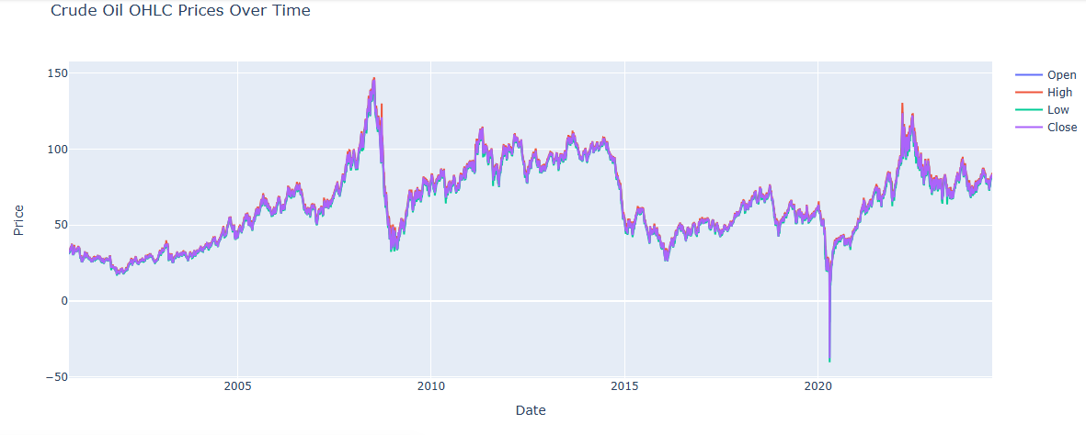
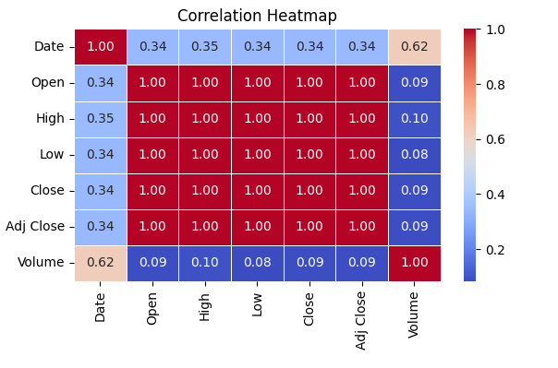
DATA ANALYSIS AND PREPROCESSING
The Yahoo Inc. dataset offers extensive historical data on crude oil prices from August 23, 2000, to August 10, 2024, including daily trading volumes and adjusted closing prices. This extensive 24-year dataset is crucial for analyzing market behavior, volatility, and trends. Data pretreatment, which includes feature generation, standardization, and handling of missing variables, enables accurate modeling. Visualization tools like line charts and heatmaps give insights into correlations and price trends by highlighting patterns and linkages in the data. These phases are essential for developing reliable prediction models and selecting prudent investments in the energy sector.
Data Analysis and Preprocessing:
(a)Checking whether there is any presence of null values or not in the dataset. Also, reset index is applied to the Date column so that it is treated as a column. (b)Splitting of dataset into training,testing and validation. From 2000 to 2018 training dataset is used, 2018 to 2022 validation dataset is used and from 2022 testing dataset is used.

Slide 5
METHODOLOGY
The Gated Recurrent Unit (GRU) is a type of recurrent neural network (RNN) designed to handle sequential data. It improves upon standard RNNs by using gating mechanisms to control the flow of information, making it more efficient for learning long-term dependencies. GRUs are simpler and computationally faster than Long Short-Term Memory (LSTM) networks, yet they perform well in time-series forecasting tasks, like crude oil price prediction, by capturing temporal patterns effectively.
The Convolutional Neural Network (CNN), typically used for image processing, has proven useful in time-series forecasting by capturing local patterns in the data. CNNs apply filters over the input sequence, enabling the model to detect important features and trends. In the context of forecasting, CNNs can be applied to identify key patterns in historical price movements, providing valuable information for future predictions.
The AutoRegressive Integrated Moving Average (ARIMA) is a traditional statistical model used for time-series forecasting. It combines autoregression (AR), differencing to ensure stationarity (Integrated, I), and moving averages (MA) to model past values and forecast future ones. While effective for linear and stationary time-series, ARIMA may struggle with complex, non-linear patterns in data, where deep learning models like GRU or CNN offer better performance.

Slide 6
Results
method | rmse | mse | mape | r2 square
GRU | 9.76 | 95.40 | 6.99 | 0.49
CNN | 3.006 | 9.03 | 6.46 | 0.91
ARIMA | 14.06 | 197.76 | 25.23 | -0.05
method | rmse | mse | mape | r2 square
GRU | 3.99 | 15.95 | 13.75 | 0.497
CNN | 4.12 | 16.98 | 14.86 | 0.84
ARIMA | 14.91 | 222.35 | 11.05 | -0.5
method | rmse | mse | mape | r2 square
GRU | 9.76 | 95.40 | 6.99 | 0.49
CNN | 3.006 | 9.03 | 6.46 | 0.91
ARIMA | 14.06 | 197.76 | 25.23 | -0.05
Performance evaluation for Model at Validation Data in Crude Oil Price Forecasting
Performance evaluation for Model at Testing Data in Crude Oil Price Forecasting
parameter | values
ADF | -12.75
p value | 8.2041e-24
critical value(1 percent) | -3.43
critical value(5 percent) | -2.86
critical value(10 percent) | -2.56

Slide 7
DISCUSSION
Performance comparison of the GRU, CNN, and ARIMA models for crude oil price forecasting shows strengths and weaknesses quite clearly. The GRU model has performed the best, depicting the lowest RMSE and MSE on the test data, which reflects its ability to capture temporal dependencies effectively. It also showed consistent accuracy throughout the forecasted period, hence making it well-suited for volatile markets. Correspondingly, CNN has a bit higher prediction error and some problems regarding data volatility. Despite the high performance in recognizing patterns, CNN still falls behind GRU. In turn, ARIMA performs significantly worse, especially in catching sudden changes in the market, reflected by its high RMSE and negative R² score. Although ARIMA has a low MAPE, the poor adaptability to market changes makes it very limited for use in accurate short-term forecasts. Overall, the GRU and CNN models will provide more robust and reliable solutions for crude oil price forecasting in dynamic markets.

Slide 8
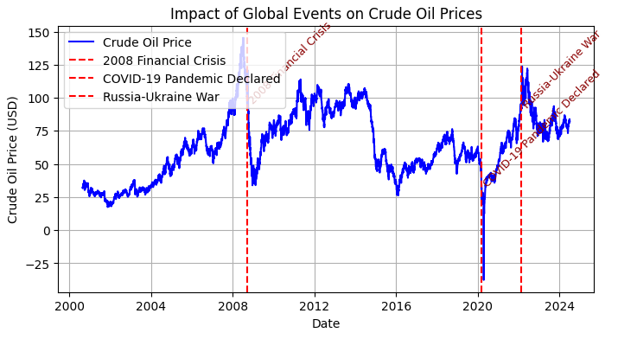
GLOBAL EVENTS EFFECTS
The price of crude oil has been extremely volatile, being influenced by key world events. During the financial crisis in 2008, the price crashed because energy demand collapsed. The COVID-19 pandemic in 2020 resulted in a historic price collapse, with negative prices in some markets due to oversupply. In 2022, the Russia-Ukraine war drove prices over $120 per barrel due to supply disruptions and sanctions. These events show how economic conditions, supply-demand imbalances, and geopolitical tensions influence oil prices.

Slide 9
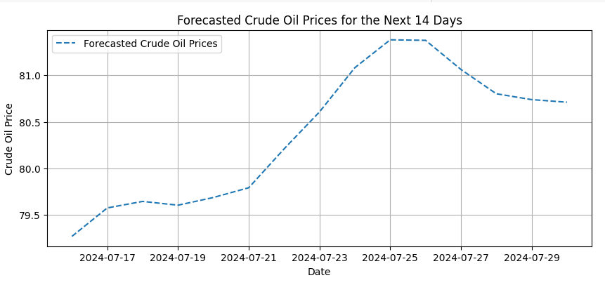
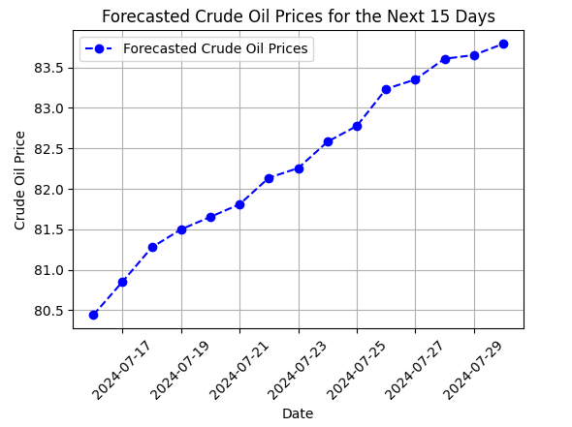
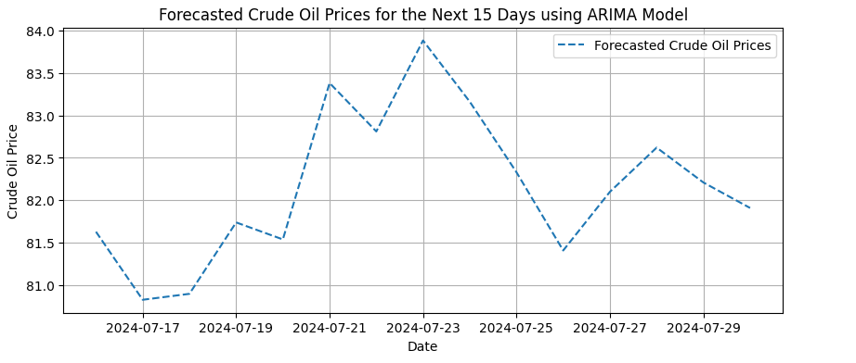
FUTURE FORECASTING CRUDE OIL PRICE GRAPHICALLY

Slide 10
CONCLUSION AND RECOMMENDATIONS
Results obtained in this work have revealed the efficiency of deep learning models, namely the GRU and CNN, for crude oil price forecasting compared to traditional techniques like ARIMA. The deep learning models represent nonlinear and volatile character changes in the price of crude oil with much lower RMSE and higher accuracy. Model performance could further be improved with the optimization of hyperparameters, including learning rates and batch sizes, through techniques like grid search. Moreover, the research of the drivers of crude oil price will be better provided by the models incorporating exogenous variables such as geopolitical events or economic indicators, and therefore presumably leading to a better quality of forecasts. These models prove to be useful in reality, after all, in the way strategic decisions and risk management are done by stakeholders. The integration of real-time data, hybrid models, and other exogenous variables will definitely provide a wider scope for future research to enhance scalability and predictability.
Github Link: https://github.com/asimj0996/Crude-oil-price-forecasting

Slide 11
REFERENCES
[Abdollahi and Ebrahimi, 2020] Abdollahi, H. and Ebrahimi, S. B. (2020). A new hybrid
model for forecasting brent crude oil price. Energy, 200:117520.
[Adebiyi et al., 2014] Adebiyi, A. A., Adewumi, A. O., and Ayo, C. K. (2014). Comparison of
arima and artificial neural networks models for stock price prediction. Journal of Applied
Mathematics, 2014(1):614342.
[Aghdam et al., 2017] Aghdam, H. H., Heravi, E. J., et al. (2017). Guide to convolutional
neural networks. New York, NY: Springer, 10(978-973):51.
[Amoco, 2001] Amoco, B. (2001). BP Statistical Review of World Energy, June 2001. BP Amoco.
[Balas et al., 2020] Balas, V. E., Kumar, R., Srivastava, R., et al. (2020). Recent trends and
advances in artificial intelligence and internet of things. Springer.
[Borovykh et al., 2017] Borovykh, A., Bohte, S., and Oosterlee, C. W. (2017). Conditional time
series forecasting with convolutional neural networks. arXiv preprint arXiv:1703.04691.
[Chen et al., 2016] Chen, H., Liao, H., Tang, B.-J., and Wei, Y.-M. (2016). Impacts of opec’s
political risk on the international crude oil prices: An empirical analysis based on the svar
models. Energy Economics, 57:42–49.

