Slide 1
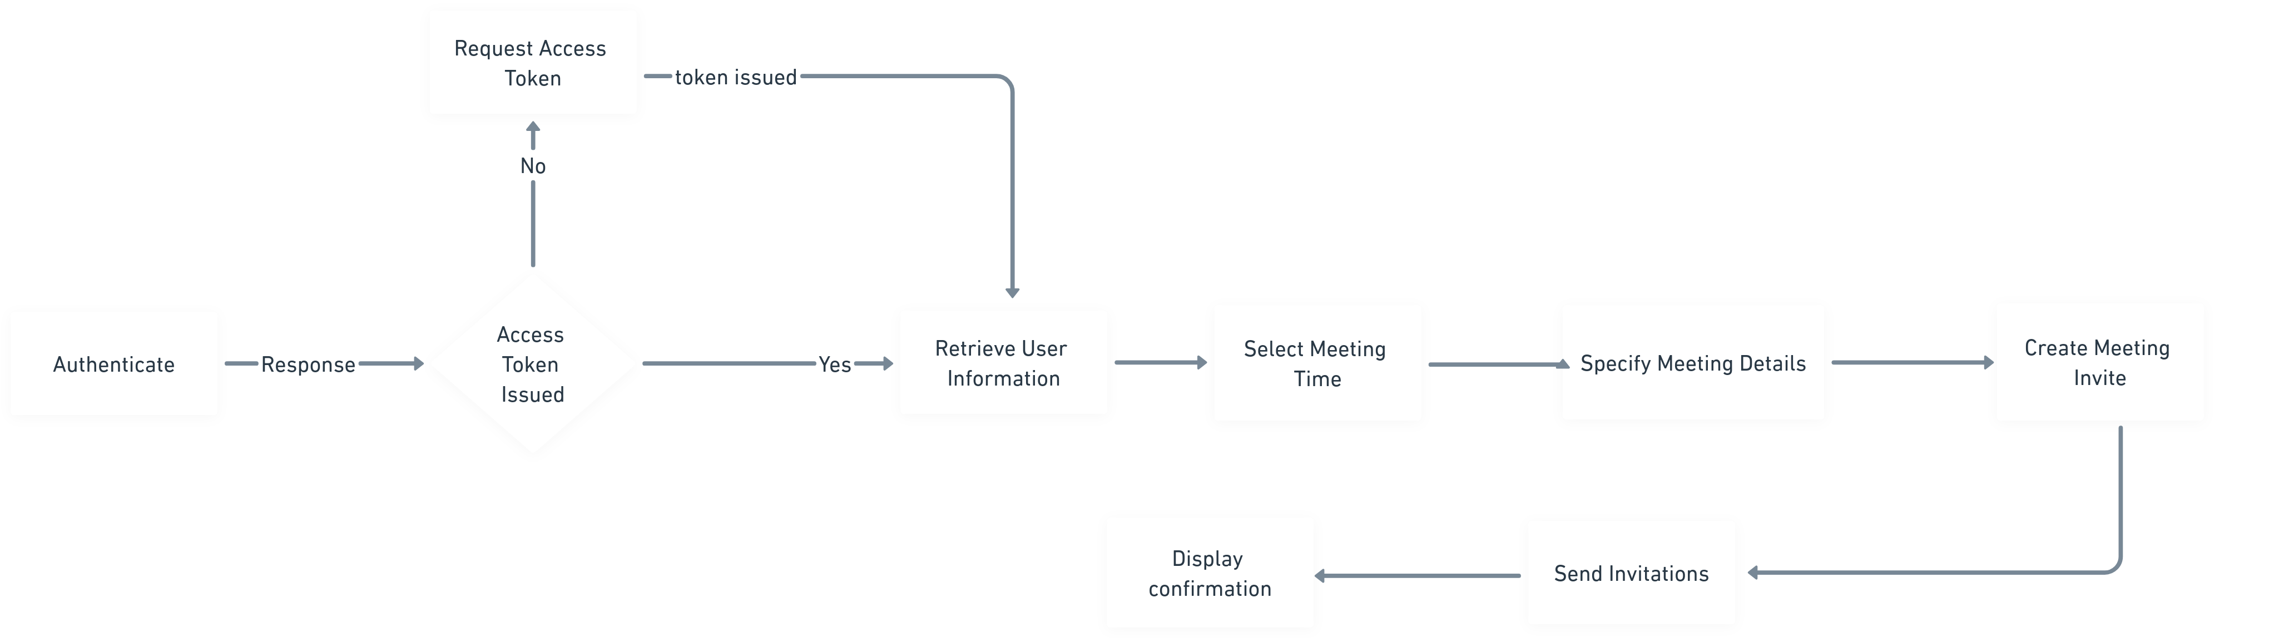
Higher Level flow of POC:

Slide 2
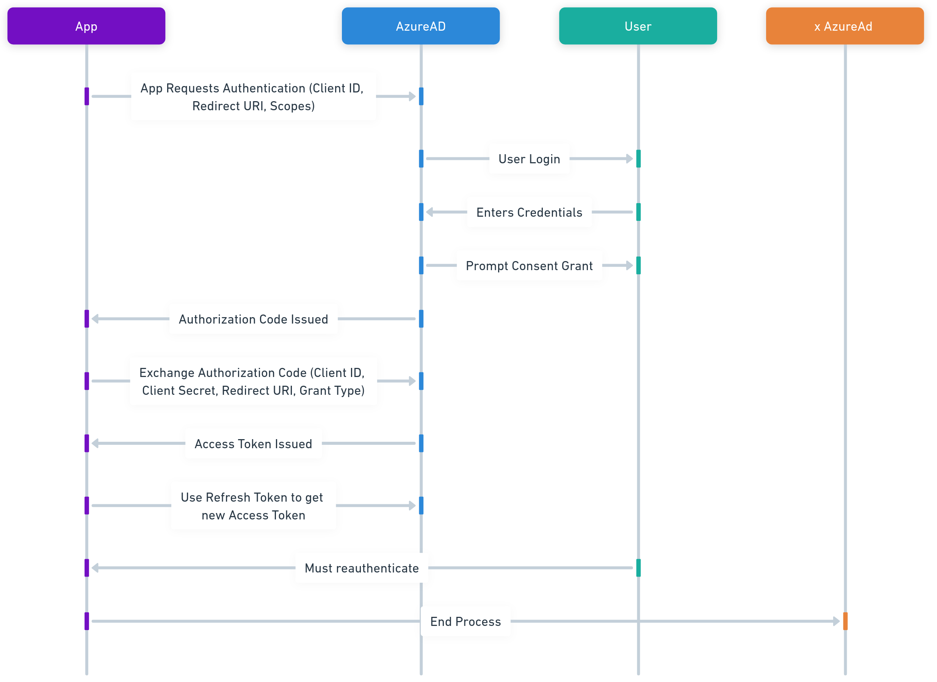
Authentication Flow

