Slide 1
RoboShot
-Screen Capture Utility

Slide 2
RoboShot
Roboshot is a small tool to help you take screenshots and create a MS word document.
Main aim of the tool is reduce the 4 steps of screen capturing to just one click.
You can select any filename and also select the location where you want to store the file.

Slide 3




RoboShot
This tool will always stay on top on other applications.
It has 3 buttons : Capture,Doc and refresh.
When clicked on the screenshot of the current ACTIVE window is taken and is stored in the program.
User can continue taking screenshots as many required by clicking on capture button.
When finished taking screenshots user can click the button to generate a word file to store the screenshots taken.
Button is used to flush out any screenshots taken so as to take a new set of screenshots

Slide 4
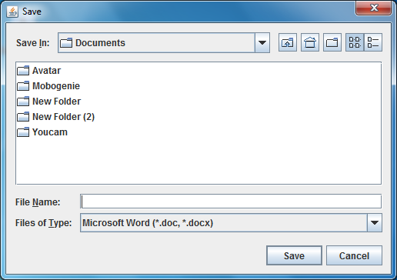
RoboShot
After clicking on Doc a Pop Up like above will appear.
User can type the file name and select the desired location to save the file.

Slide 5
RoboShot
Advantages:
Reduces time and effort to take screenshot paste it in a doc and resume testing. This will make testing faster.
Can be used in other manual testing projects where there is no automation of screenshots.
Simple GUI and easy to use.
Uses not more than 80 MB of virtual memory.
Future Enhancements:
Image Palette can be added to editing and managing screenshots before saving.

Slide 6
RoboShot
Appendix:

