Slide 1

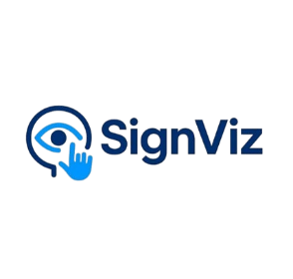
SignViz Interactive Learning Platform For Deaf Students
Group Members:
Muhammad Asim Khan
Muhammad Mursaleen
Supervisor: Mr. Bilal
Industrial Partner: Victoriam AI

Slide 2
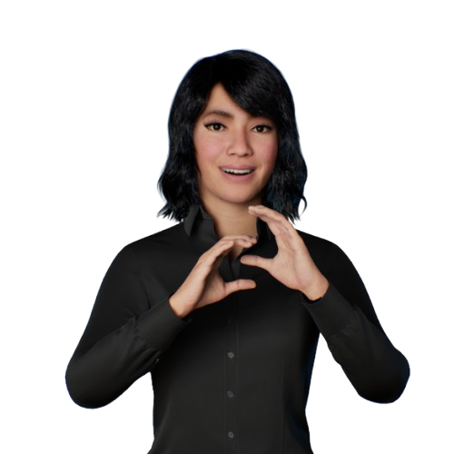
Introduction
Online learning platforms offer quality education through video-based courses. However, these platforms mainly rely on audio and subtitles, which are not fully accessible for deaf learners who use sign language.
Our project solves this problem by converting existing lecture videos into ASL-based sign language lectures, bridging accessibility gap in education.

Slide 3
Objectives
Develop a web-based interactive learning platform
Automate the conversion of lecture videos into ASL
based content
Improve accessibility for deaf learners in online education

Slide 4
Literature Review
Sign language translation research has evolved using deep learning and 3D avatar technologies.
Hand Talk – avatar-based sign language translation
Lifeprint – ASL dictionary and learning resources
Signapse – avatar-based web content translator
Existing systems lack full video-to-sign conversion

Slide 5
System Overview
Web-based interactive learning platform
Accepts pre-recorded lecture videos
Works on video URL as well
Automated processing pipeline
Targets deaf learners and learning platforms

Slide 6
Processing Pipeline
Video Upload
Audio Extraction
Speech-to-Text Conversion
Text-to-ASL Gloss Transformation
Avatar-Based Sign Generation
Visual Sign Language Output

Slide 7
Functional Requirements
FR-01: The system shall allow deaf users to sign up and log in securely.
FR-02: The system shall allow users to view and update their profile.
FR-03: The system shall allow users to upload video lectures.
FR-04: The system shall allow users to manage their uploaded content.
FR-05: The system shall allow users to convert lecture videos to Avatar
FR-06: The system shall allow users to organize their library.

Slide 8
Non-Functional Requirements
Performance: support 1000 users at a time
Scalability: system shall support the addition of thousands of lecture videos without system failure.
Security: system secure user profile and user library
Compatibility: system shall operate correctly on modern web browsers i.e. Chrome, Edge.
Reliability: 99% system availability, excluding scheduled maintenance

Slide 9
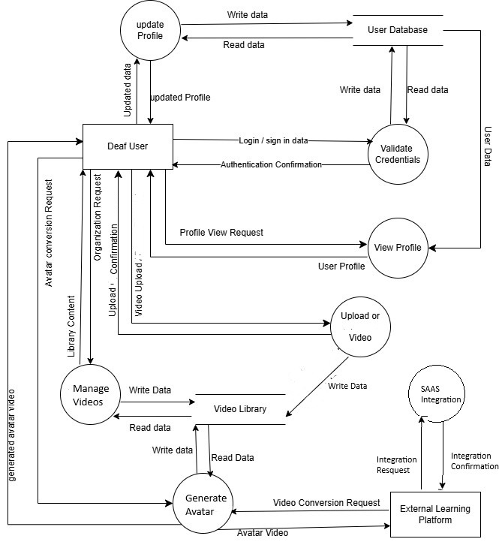
Data Flow Diagrams Level 1

Slide 10
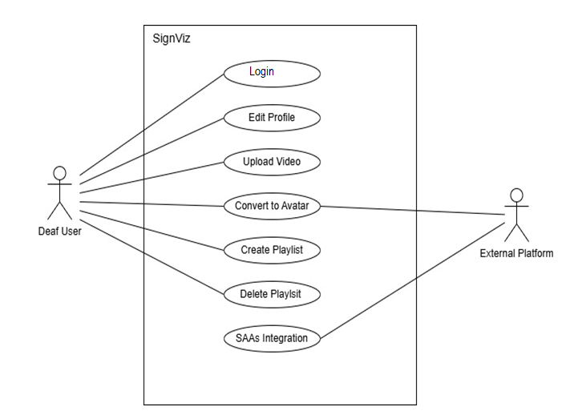
USE CASE DIAGRAM

Slide 11
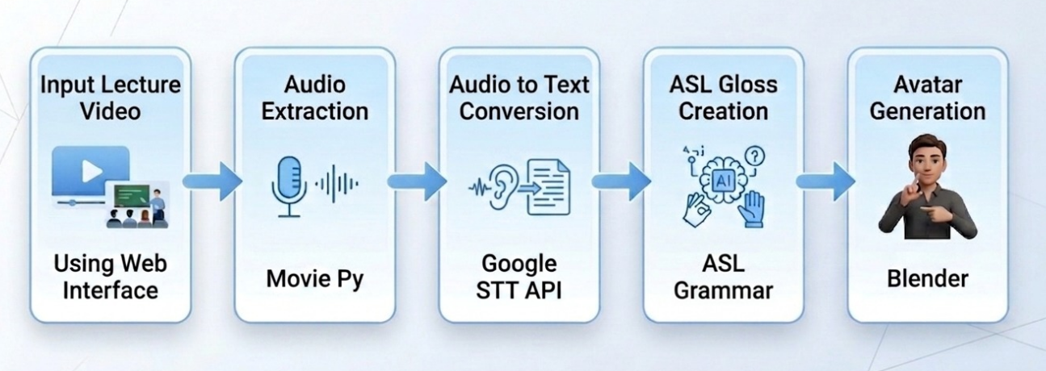
Architecture Diagram

Slide 12
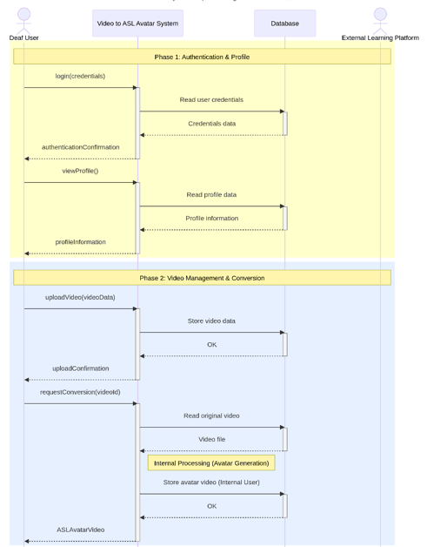
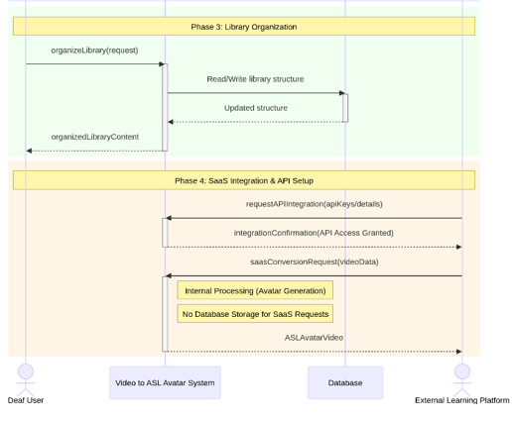
System Sequence Diagram

Slide 13
User Interfaces

Slide 14
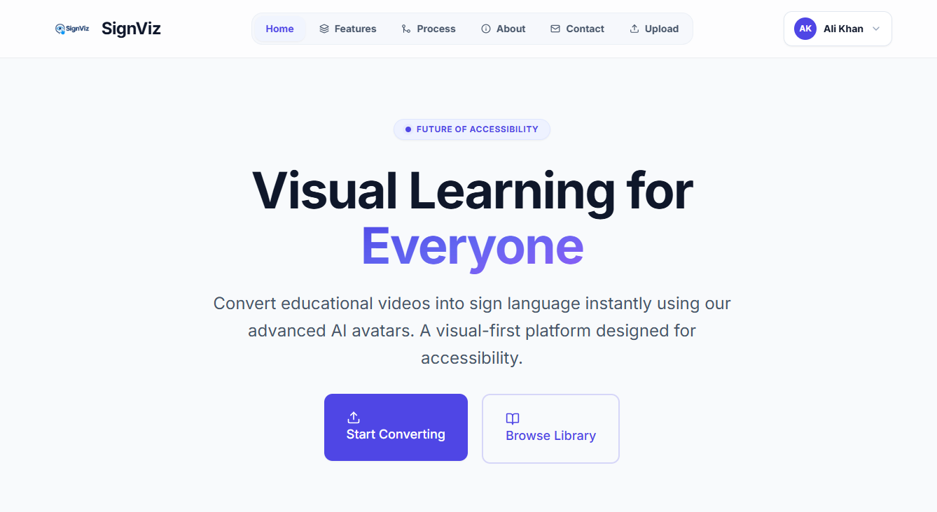
HOME PAGE

Slide 15
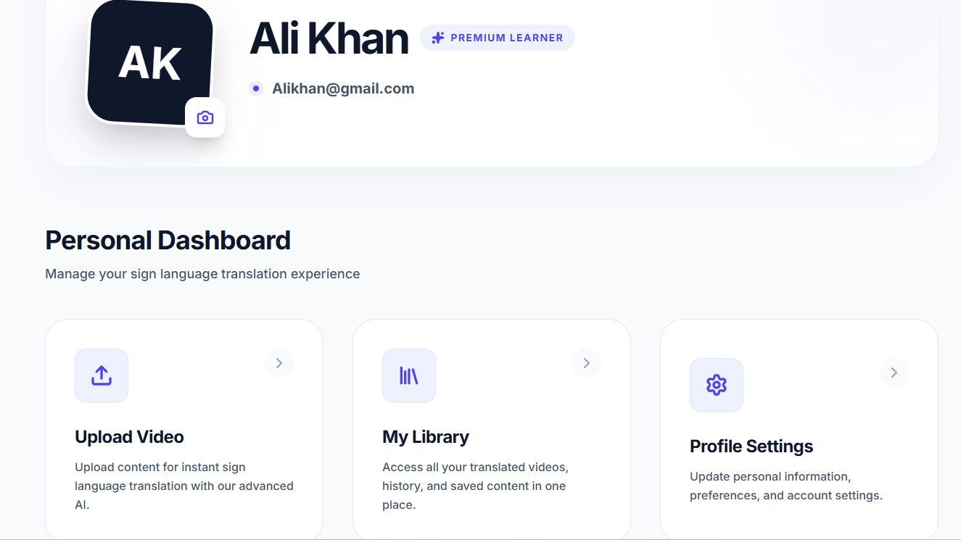
DASHBOARD

Slide 16
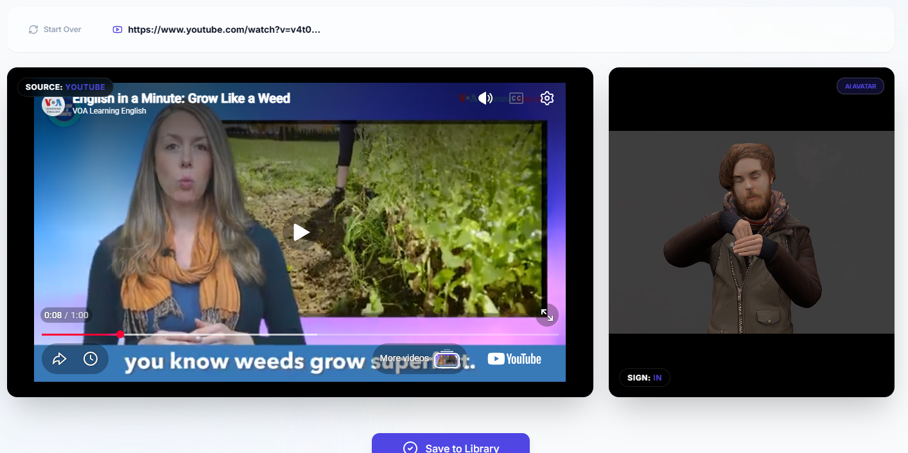
TRANSLATION PAGE

Slide 17
Conclusion
SignViz addresses the accessibility gap in online education by providing an automated system for converting lecture videos into ASL based sign language content. It improves the accessibility gap and enable deaf students to learn at the same pace as of Normal student.

Slide 18
Thank You
Department of Computer Science
Namal University, Mianwali

