Slide 1


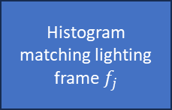


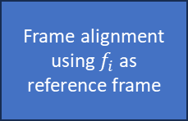

$$f_{1}$$
$$f_{2}$$
Yes
No
Get the best frame containing max info. (saliency map)
Dynamic?
User provided the reference frame?
Yes
$$f_{i}$$
Compute fusion weights and weight normalization
Histogram matching lighting frame $f_{j}$
Frame alignment using $f_{i}$ as reference frame
$$f_{i}$$
$$f_{n}$$
Gaussian Pyramid of normalized wights
Laplacian Pyramid of frames
Fused Pyramid and HDR generation and Tone mapping
User-Aligned Adaptive Fusion (UAAF) –A system wherein the geometric alignment and photometric fusion of multi-exposure frames are independently controlled by user-selected reference and style frames.
An interactive HDR generation interface allowing real-time adjustment of geometric and photometric fusion parameters based on user preferences.

