Slide 1
Multi-label Medical Image Retrieval Using Deep Neural Hashing
Asim Manna
Notes:
Good morning everyone. In this presentation I will be presenting my 1st phd extension seminar on multi........

Slide 2
Outline
Introduction
Current Challenges
Objectives
Methods
Work Progress
Take Home Message
Notes:
In this talk, first I will discuss about medical image retrieval and motivation behind to employ deep neural hashing for medical image retrieval. Next, I will outline the current challenges that need to be addressed. To address these challenges, I propose 4 objectives and discuss the work progress of these objectives. In last I conclude this talk with take home message.

Slide 3
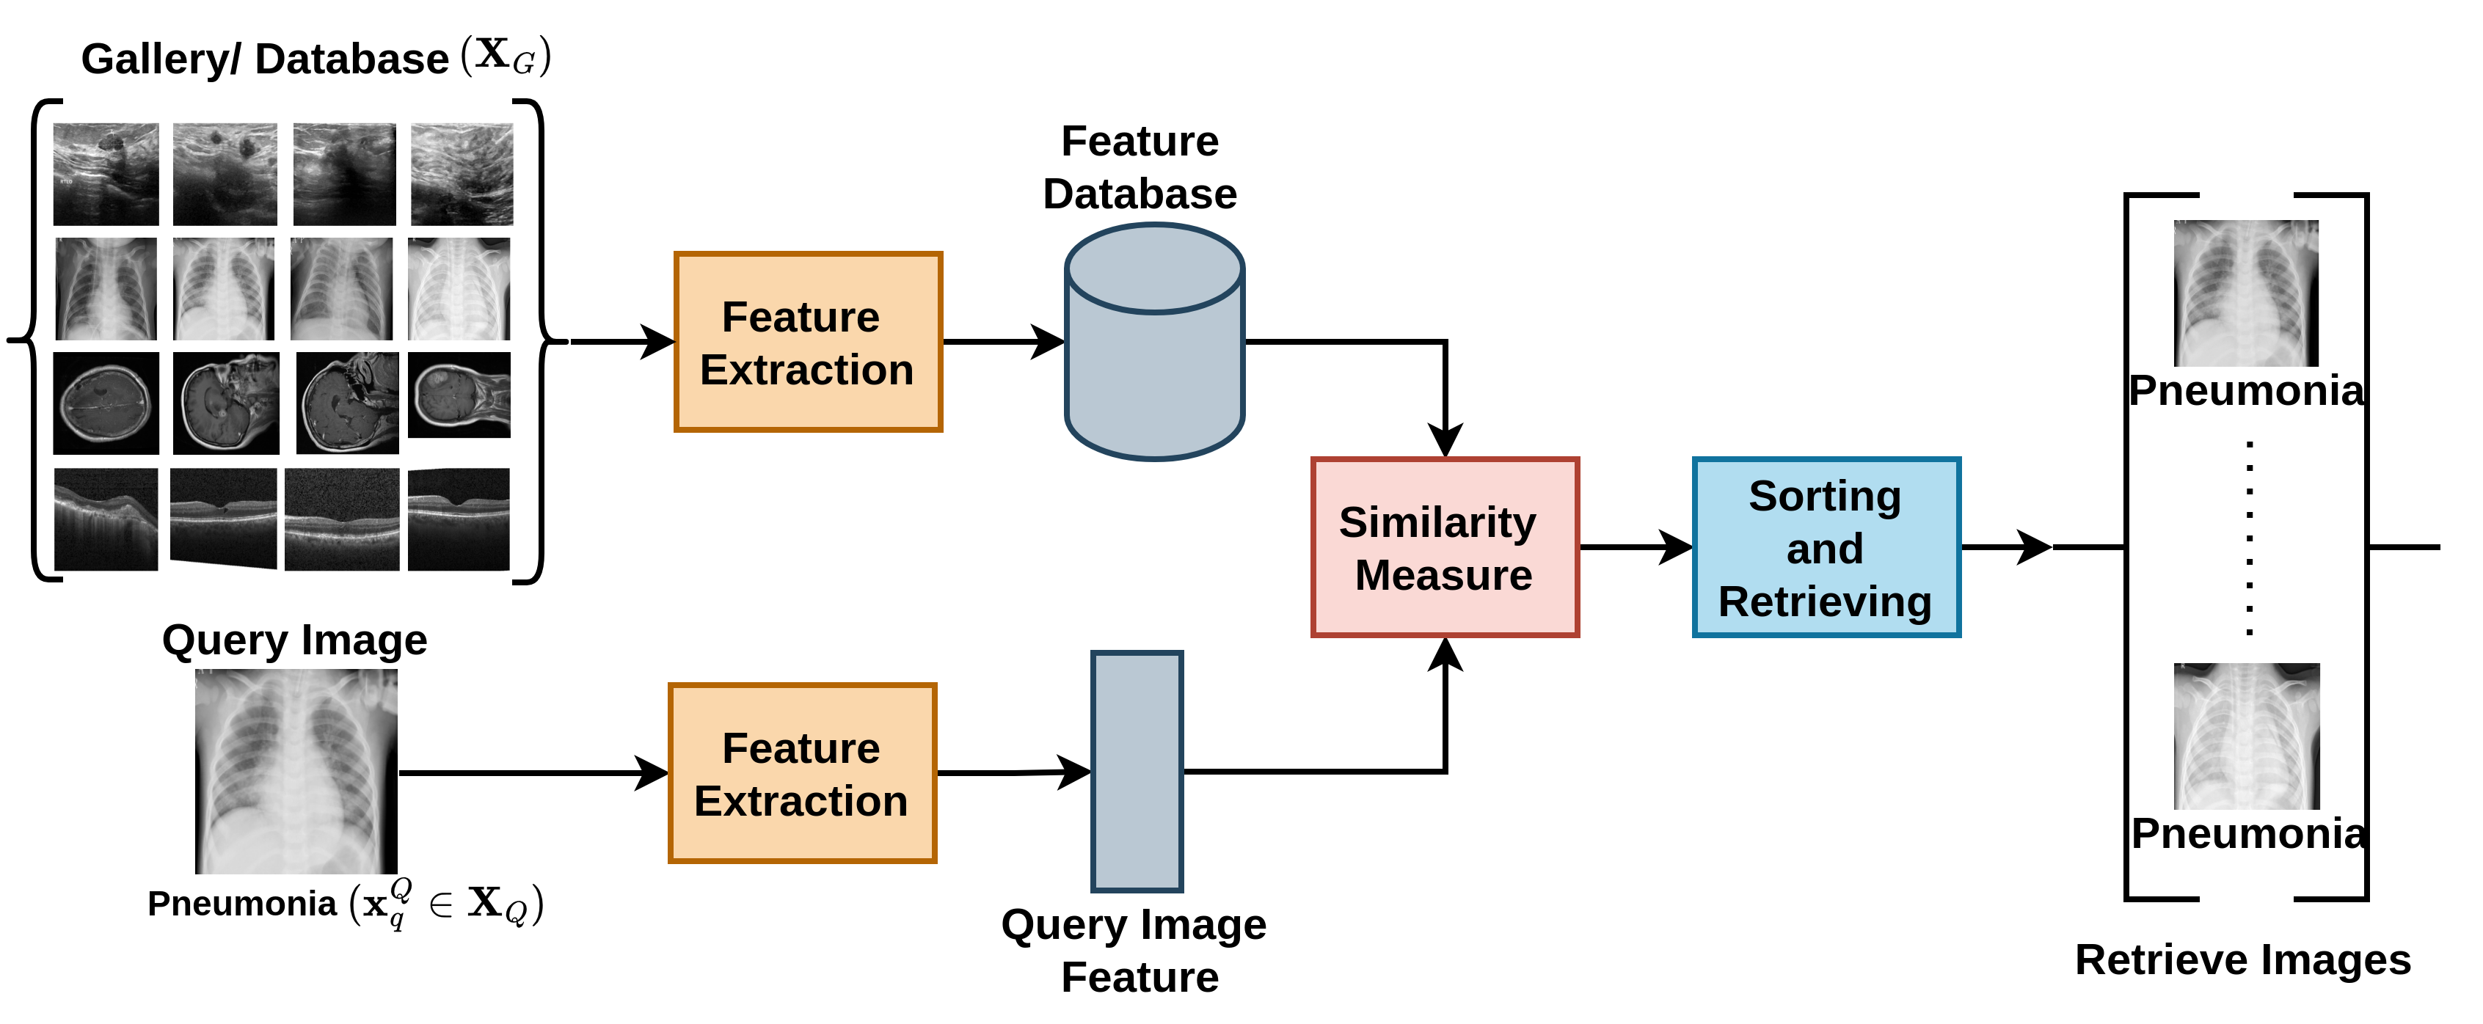
Content Based Medical Image Retrieval (CBMIR)
Notes:
The idea of Content Based Medical Image Retrieval or shortly CBMIR is that we have one gallery set say X_G and I have one query image from query set. After that, feature extraction process is employed on all gallery images and the query image. The feature extraction is based on what information we want to extract. The we measure the similarity between each gallery image and the query image. This similarity measurement based on different kind of metrics for example, eucledian metric, cosine similarity metric. Then we sort the gallery images in ascending order and collect the top retrieval images similar to the query image.

Slide 4
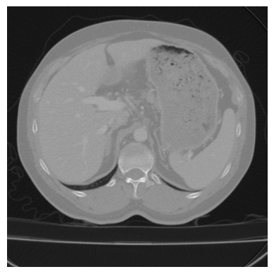
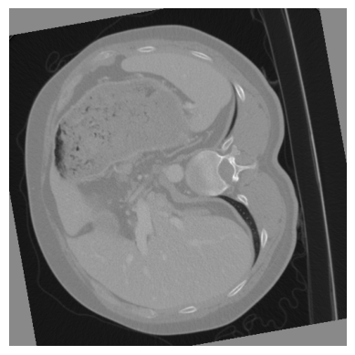
Hashing was Introduced for Cryptography
Hashing is a one-way function to transfer data from high dimensional to low dimensional.
Example: SHA, MD5 etc.
Need identical hash code for similar images for image retrieval task.
But fails to carry similarity between two similar images.
Cryptographic Hash
1000100010
0100101011
Non-identical hash codes
Notes:
Now before coming to the method of this objective, we need to discuss that how hashing can be used for image retrieval and prior art on image retrieval using DNH

Slide 5


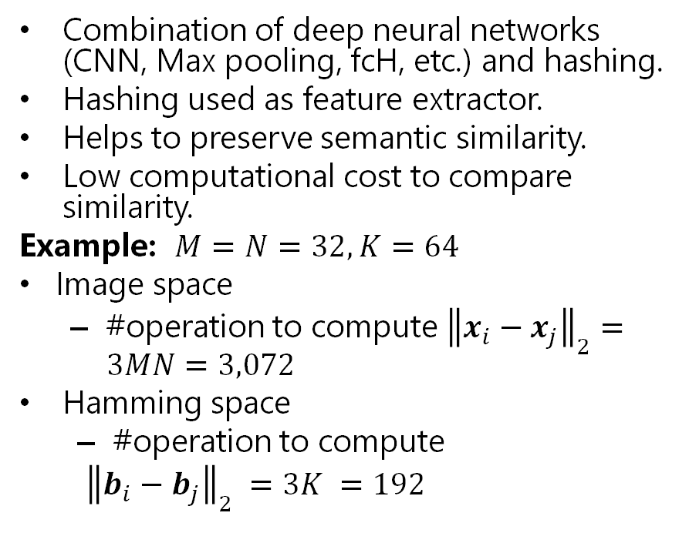




Deep Neural Hashing for Image Retrieval
Combination of deep neural networks (CNN, Max pooling, fcH, etc.) and hashing.
Hashing used as feature extractor.
Helps to preserve semantic similarity.
Low computational cost to compare similarity.
Example: $M=N=32, K=64$
Image space
#operation to compute ${\left\|x_{i}−x_{j}\right\|}_{2}=3MN=3,072$
Hamming space
#operation to compute
${\left\|b_{i}−b_{j}\right\|}_{2} =3K =192$
$$x_{i}∈ℝ^{M ×N}$$
$$x_{j}∈ ℝ^{M ×N}$$
$${\left\|x_{i}−x_{j}\right\|}_{2}$$
DNH
$${\left\|b_{i}−b_{j}\right\|}_{2}$$
1000100010
1000100010
$$b_{i}∈ ℝ^{K ×1}$$
$$b_{j}∈ ℝ^{K ×1}$$
$$K≪MN$$

Slide 6
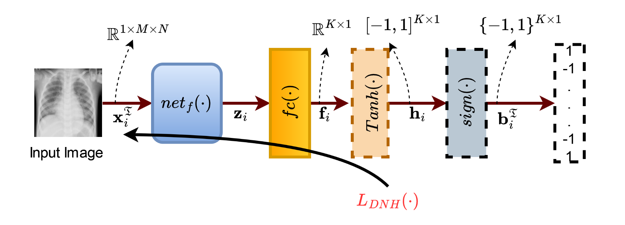
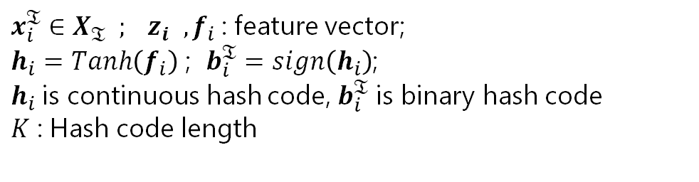
Deep Neural Hashing Network (DNHN)
Hash code generation from a image using DNHN
$x_{i}^{𝔗}∈X_{𝔗} ; z_{i }, f_{i}$: feature vector;
$h_{i}=Tanh\left(f_{i}\right)$ ; $b_{i}^{𝔗}=sign\left(h_{i}\right)$;
$h_{i}$is continuous hash code, $b_{i}^{𝔗}$ is binary hash code
$K$ : Hash code length
Notes:
Now we will discuss how deep neural hashing network looks like or how can we generate hash vector from images…… Any contribution designing a network will be on net_f. The following layers should present in the last.

Slide 7
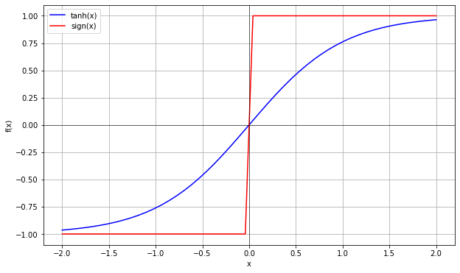
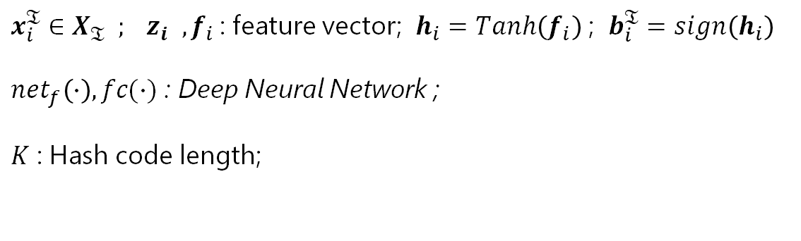
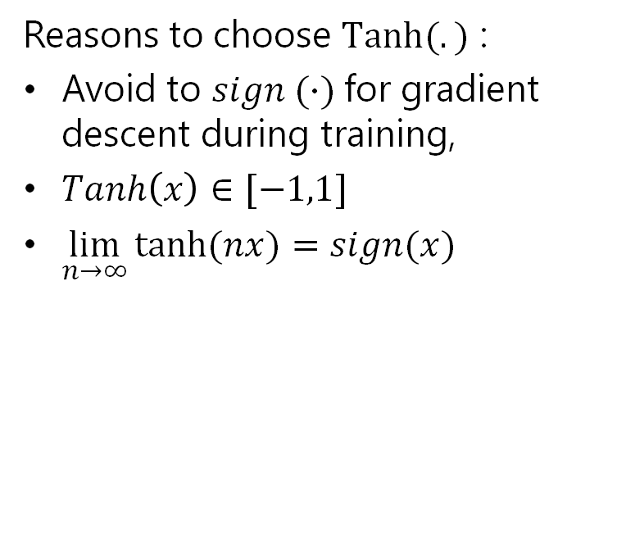
Deep Neural Hashing Network (DNHN)
Reasons to choose $Tanh⁡(.)$ :
Avoid to $sign ⁡(∙)$for gradient descent during training,
$Tanh\left(x\right)∈[−1,1]$
$\lim_{n→∞}{tanh⁡(nx)}=sign⁡(x)$
$x_{i}^{𝔗}∈X_{𝔗} ; z_{i }, f_{i}$: feature vector; $h_{i}=Tanh\left(f_{i}\right)$ ; $b_{i}^{𝔗}=sign\left(h_{i}\right)$
$net_{f}\left(∙\right), fc(∙)$ : Deep Neural Network ;
$K$ : Hash code length;
Notes:
Since sign(.) is not a continuous function, so we can not use this during training. Tanh(.) is used during training. And both these function have same range [-1, 1]. So, during training we use continuous hash value h_i and during we use binary hash code b_i.

Slide 8
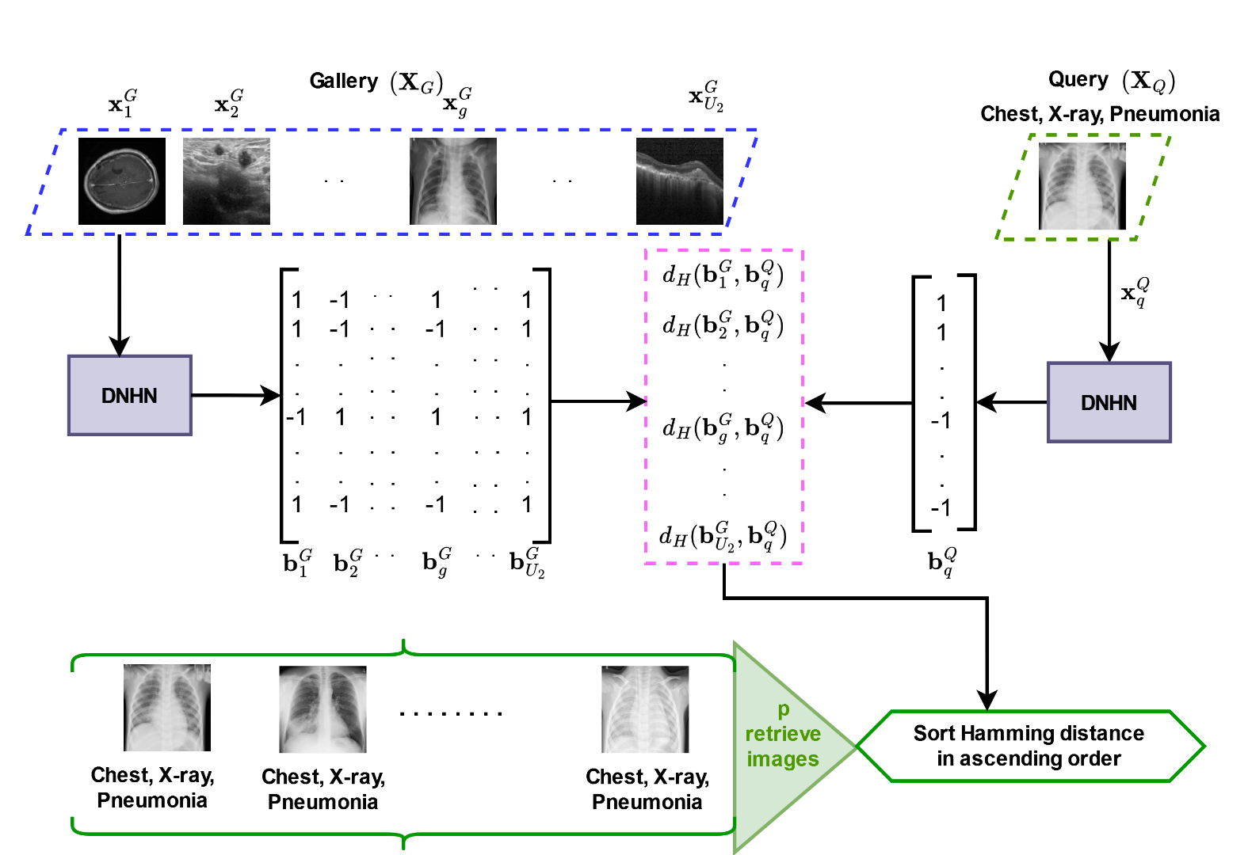
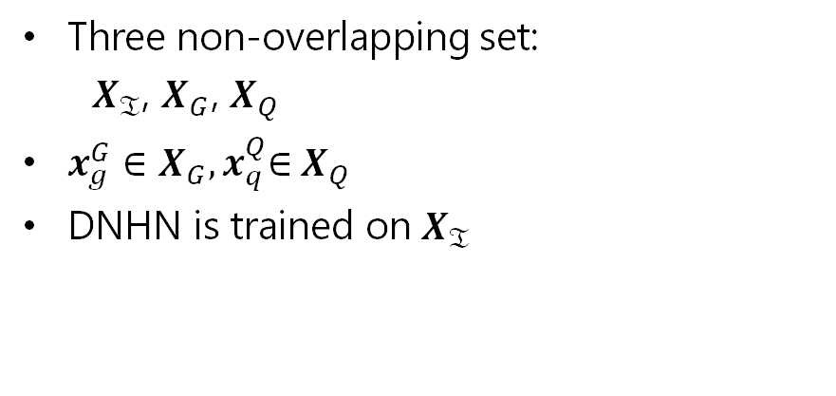
Medical Image Retrieval Using DNH
Three non-overlapping set:
${ X}_{𝔗}$, $X_{G}$, $X_{Q}$
$x_{g}^{G}∈X_{G},x_{q}^{Q}$∈$X_{Q}$
DNHN is trained on $X_{𝔗}$
Notes:
So, once DNH model is trained, our next phase is inference part. How can we retrieve images using deep neural hashing. To execute this we need three non-overlapping image set trainset, gallery set, and query set.

Slide 9
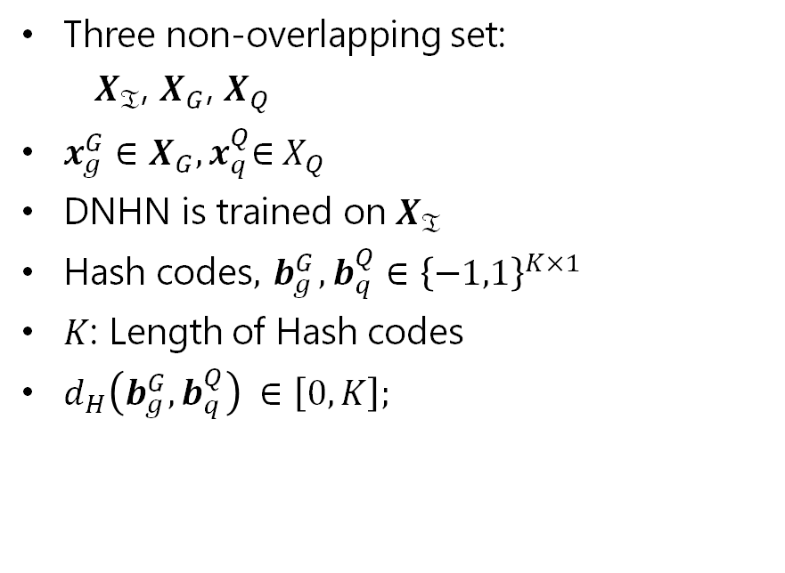
Medical Image Retrieval Using DNH
Three non-overlapping set:
${ X}_{𝔗}$, $X_{G}$, $X_{Q}$
$x_{g}^{G}∈X_{G},x_{q}^{Q}$∈$X_{Q}$
DNHN is trained on $X_{𝔗}$
Hash codes$, { b}_{g}^{G}, b_{q}^{Q}∈{\left\{−1,1\right\}}^{K×1}$
$K$: Length of Hash codes
$d_{H}\left(b_{g}^{G}, b_{q}^{Q}\right) ∈\left[0, K\right];$
Notes:
So, once DNH model is trained, our next phase is inference part. How can we retrieve images using deep neural hashing. To execute this we need three non-overlapping image set trainset, gallery set, and query set.

Slide 10
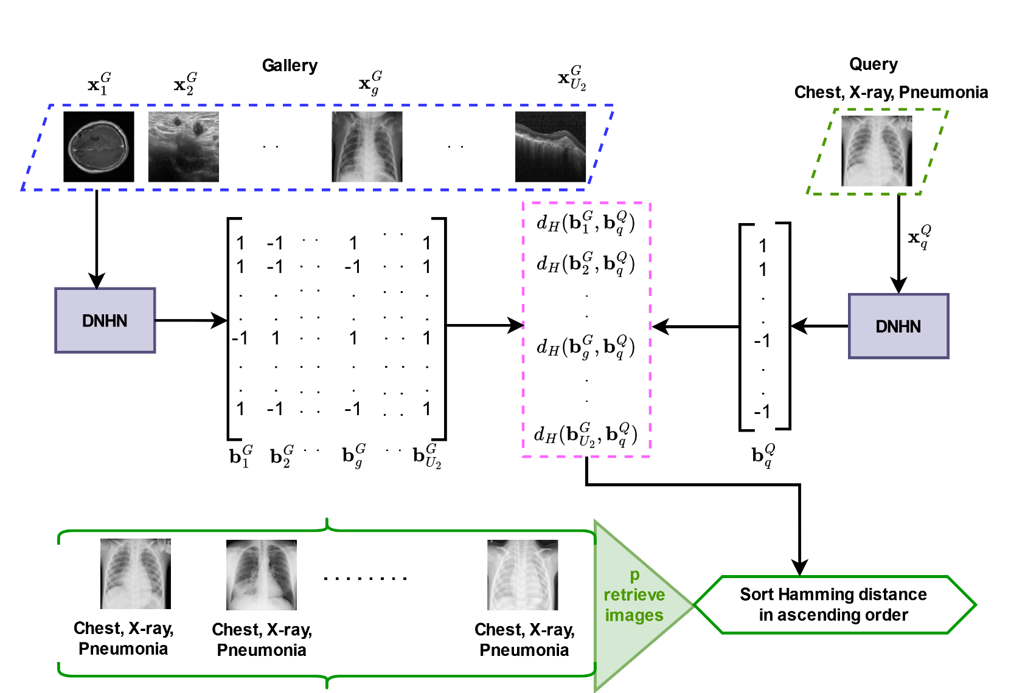
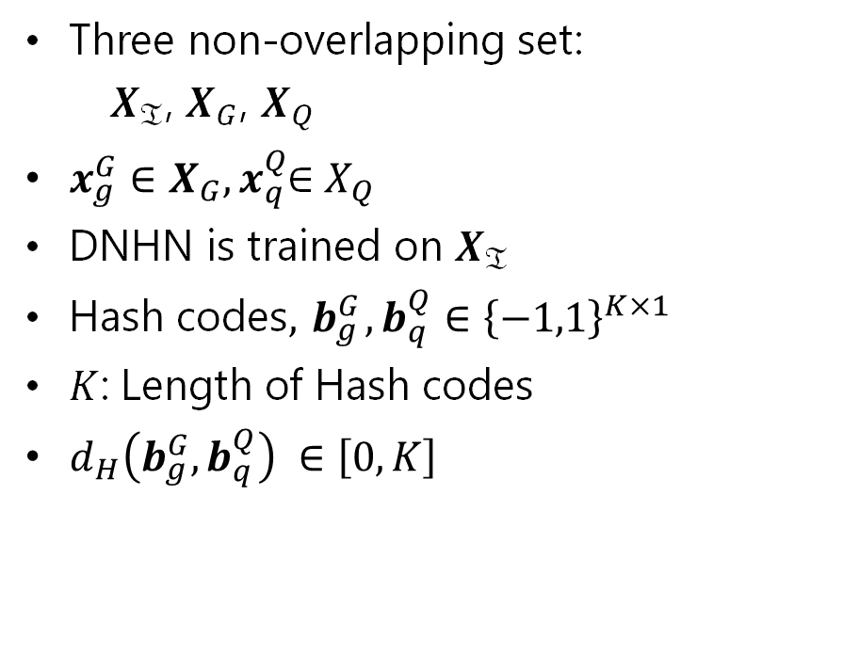
Medical Image Retrieval Using DNH
Three non-overlapping set:
${ X}_{𝔗}$, $X_{G}$, $X_{Q}$
$x_{g}^{G}∈X_{G},x_{q}^{Q}$∈$X_{Q}$
DNHN is trained on $X_{𝔗}$
Hash codes$, { b}_{g}^{G}, b_{q}^{Q}∈{\left\{−1,1\right\}}^{K×1}$
$K$: Length of Hash codes
$d_{H}\left(b_{g}^{G}, b_{q}^{Q}\right) ∈\left[0, K\right]$
Notes:
So, once DNH model is trained, our next phase is inference part. How can we retrieve images using deep neural hashing. To execute this we need three non-overlapping image set trainset, gallery set, and query set.

Slide 11
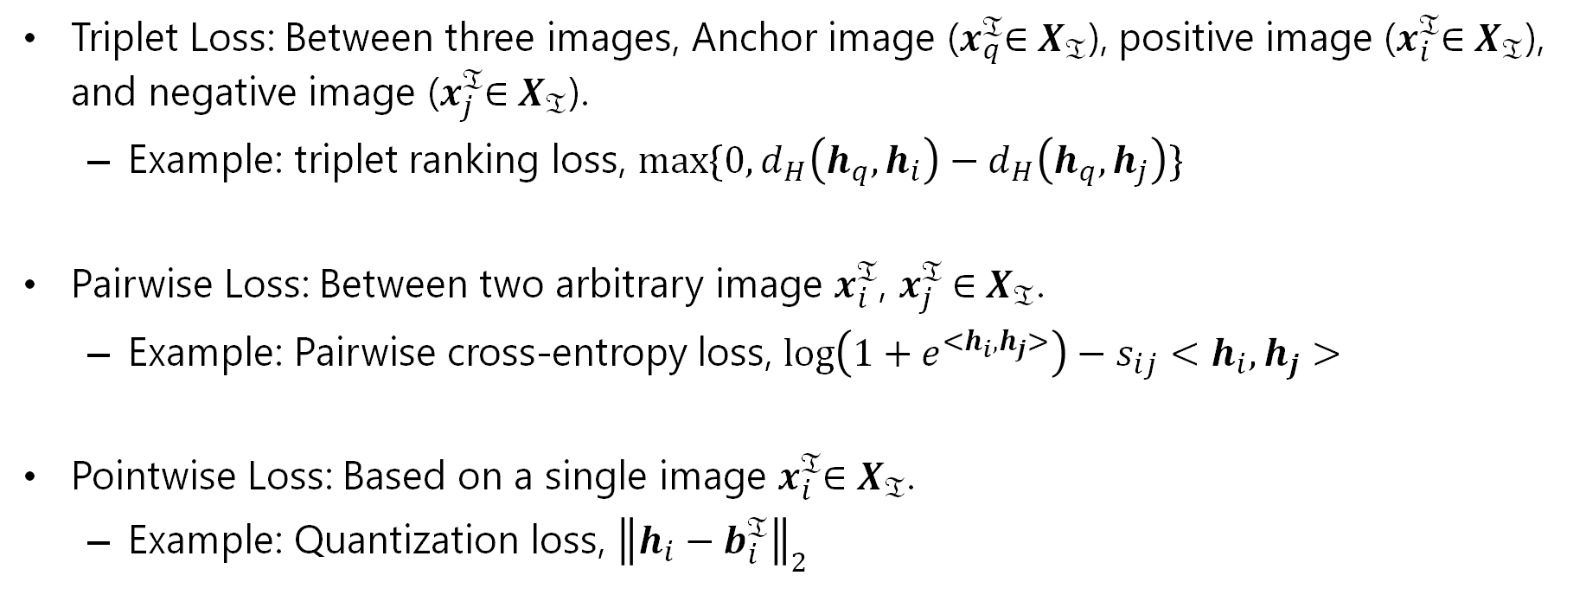
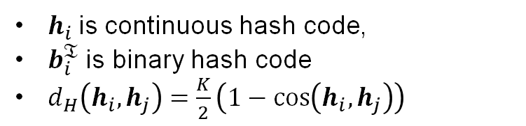
Loss Function of DNH
Triplet Loss: Between three images, Anchor image ($x_{q}^{𝔗}$∈$X_{𝔗}$), positive image ($x_{i}^{𝔗}$∈$X_{𝔗}$), and negative image ($x_{j}^{𝔗}$∈$X_{𝔗}$).
Example: triplet ranking loss, $max⁡\{0, d_{H}\left(h_{q}, h_{i}\right)−d_{H}\left(h_{q}, h_{j}\right)\}$
Pairwise Loss: Between two arbitrary image $x_{i}^{𝔗}$, $x_{j}^{𝔗}$∈$X_{𝔗}$.
Example: Pairwise cross-entropy loss, $\log\left(1+e^{<h_{i}, h_{j}>}\right)−s_{ij}<h_{i}, h_{j}>$
Pointwise Loss: Based on a single image $x_{i}^{𝔗}$∈$X_{𝔗}$.
Example: Quantization loss, ${\left\|h_{i}−b_{i}^{𝔗}\right\|}_{2}$
$h_{i}$is continuous hash code,
$b_{i}^{𝔗}$ is binary hash code
$d_{H}\left(h_{i},h_{j}\right)=\frac{K}{2}\left(1−\cos\left(h_{i},h_{j}\right)\right)$
Notes:
Now we will discuss the different types of losses used for deep neural hashing. In deep neural hashing there are no major different between networks. The challenge is that we are comparing the similarity using low dimensional hash code instead of image space and also we want to preserve the similarity in hash space or hamming space. So, designing loss function is important task for deep neural hashing.
Here we will discuss three types of loss.

Slide 12
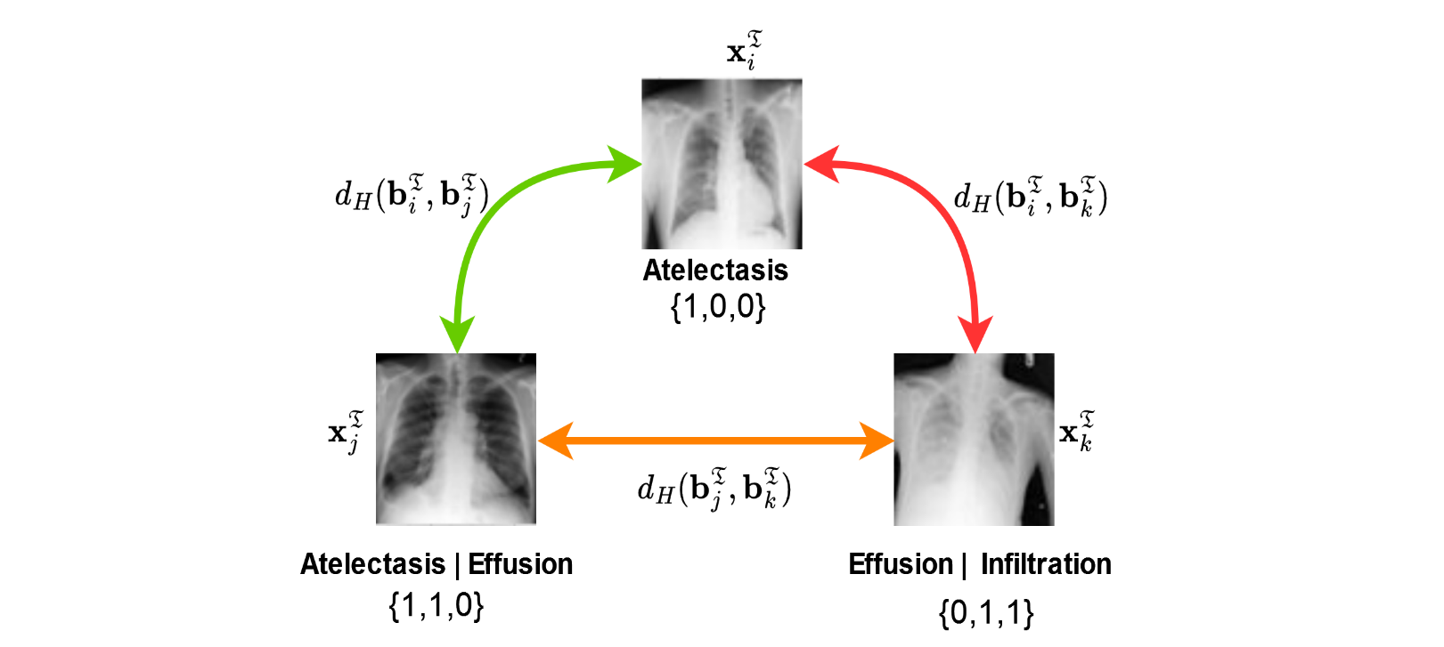
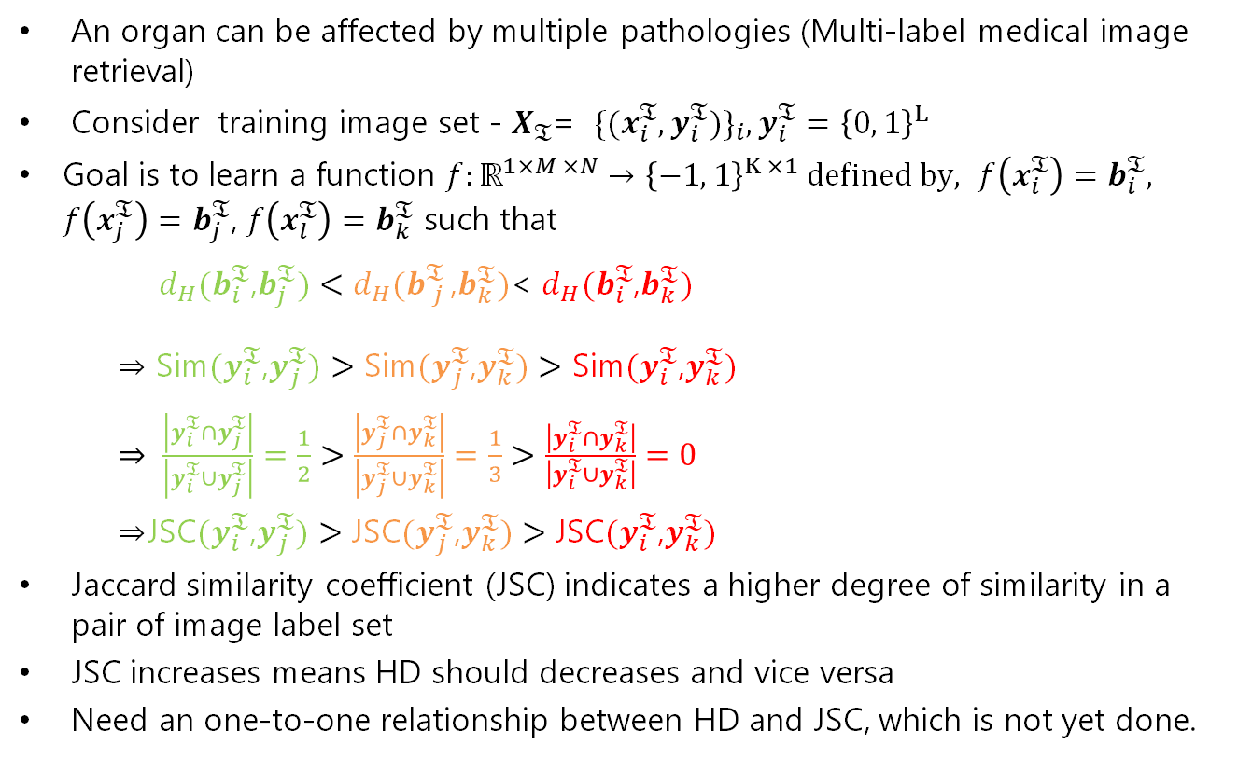
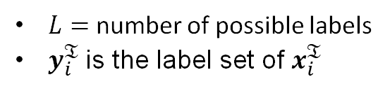
Problem Formulation
An organ can be affected by multiple pathologies (Multi-label medical image retrieval)
Consider training image set - $X_{𝔗}$= ${\{(x_{i}^{𝔗},y_{i}^{𝔗})\}}_{i},y_{i}^{𝔗}={\left\{0, 1\right\}}^{L }$
Goal is to learn a function $f:ℝ^{1×M ×N}→{\left\{−1, 1\right\}}^{K ×1} defined by, f\left(x_{i}^{𝔗}\right)=b_{i}^{𝔗},$ $f\left(x_{j}^{𝔗}\right)=b_{j}^{𝔗}$, $f\left(x_{l}^{𝔗}\right)=b_{k}^{𝔗}$ such that
$d_{H}(b_{i}^{𝔗}$,$b_{j}^{𝔗})<$ $d_{H}(b_{\begin{aligned}j \\ \end{aligned}}^{𝔗}$,$b_{k}^{𝔗})$< $d_{H}(b_{i}^{𝔗}$,$b_{k}^{𝔗})$
$⇒$ Sim$(y_{i}^{𝔗}$,$y_{j}^{𝔗})>$ Sim$(y_{j}^{𝔗}$,$y_{k}^{𝔗})>$ Sim$(y_{i}^{𝔗}$,$y_{k}^{𝔗})$
$⇒ \frac{\left|y_{i}^{𝔗}∩y_{j}^{𝔗}\right|}{\left|y_{i}^{𝔗}∪y_{j}^{𝔗}\right|}=\frac{1}{2}>\frac{\left|y_{j}^{𝔗}∩y_{k}^{𝔗}\right|}{\left|y_{j}^{𝔗}∪y_{k}^{𝔗}\right|}=\frac{1}{3}>\frac{\left|y_{i}^{𝔗}∩y_{k}^{𝔗}\right|}{\left|y_{i}^{𝔗}∪y_{k}^{𝔗}\right|}=0$
$⇒$JSC$(y_{i}^{𝔗}$,$y_{j}^{𝔗})>$ JSC$(y_{j}^{𝔗}$,$y_{k}^{𝔗})>$ JSC$(y_{i}^{𝔗}$,$y_{k}^{𝔗})$
Jaccard similarity coefficient (JSC) indicates a higher degree of similarity in a pair of image label set
JSC increases means HD should decreases and vice versa
Need an one-to-one relationship between HD and JSC, which is not yet done.
$L=$ number of possible labels
$y_{i}^{𝔗}$ is the label set of $x_{i}^{𝔗}$
Notes:
Now, coming to the problem formulation of objective. I will define it mathematically to better understand.

Slide 13

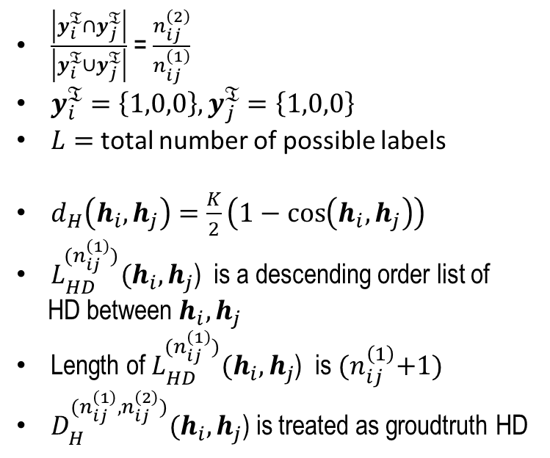
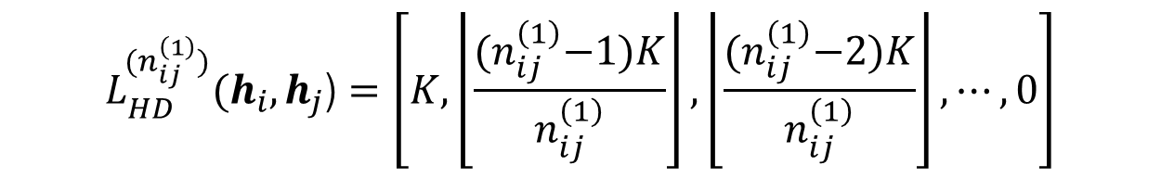

Solution
($n_{ij}^{\left(1\right)}+1)$ points
$\frac{\left|y_{i}^{𝔗}∩y_{j}^{𝔗}\right|}{\left|y_{i}^{𝔗}∪y_{j}^{𝔗}\right|}$ = $\frac{n_{ij}^{\left(2\right)}}{n_{ij}^{\left(1\right)}}$
$y_{i}^{𝔗}=\left\{1,0,0\right\},y_{j}^{𝔗}=\left\{1,0,0\right\}$
$L=$ total number of possible labels
$d_{H}\left(h_{i},h_{j}\right)=\frac{K}{2}\left(1−\cos\left(h_{i},h_{j}\right)\right)$
$L_{HD}^{{(n}_{ij}^{\left(1\right)})}(h_{i},h_{j}$) is a descending order list of
HD between $h_{i},h_{j}$
Length of $L_{HD}^{{(n}_{ij}^{\left(1\right)})}(h_{i},h_{j}$) is ${(n}_{ij}^{\left(1\right)}+1)$
$D_{H}^{{(n}_{ij}^{\left(1\right)},n_{ij}^{\left(2\right)})}(h_{i},h_{j}$) is treated as groudtruth HD
0
$$K$$
$$L_{HD}^{{(n}_{ij}^{\left(1\right)})}(h_{i},h_{j}\text{)}=\left[K,\left\lfloor \frac{{(n}_{ij}^{\left(1\right)}−1)K}{n_{ij}^{\left(1\right)}}\right\rfloor ,\left\lfloor \frac{{(n}_{ij}^{\left(1\right)}−2)K}{n_{ij}^{\left(1\right)}}\right\rfloor ,⋯,0\right]$$
$${0≤D}_{H}^{{(n}_{ij}^{\left(1\right)},n_{ij}^{\left(2\right)})}\left(h_{i},h_{j}\right)=L_{HD}^{{(n}_{ij}^{\left(1\right)})}(h_{i},h_{j}\text{)}\text{[}n_{ij}^{\left(2\right)}]≤K$$
Notes:
Now, coming to the problem formulation of objective. I will define it mathematically to better understand.

Slide 14
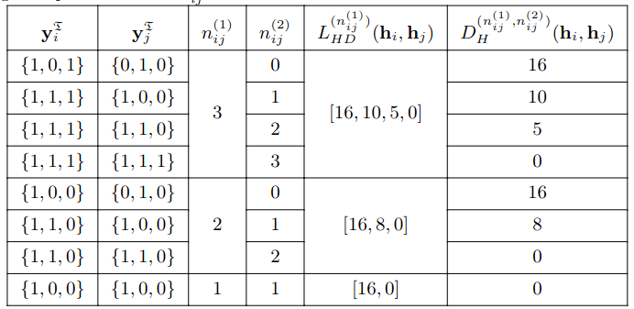
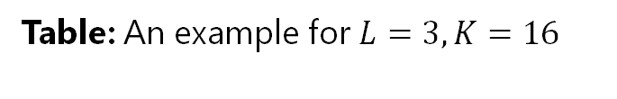
Example
Table: An example for $L=3, K=16$
Notes:
Now, coming to the problem formulation of objective. I will define it mathematically to better understand.

Slide 15
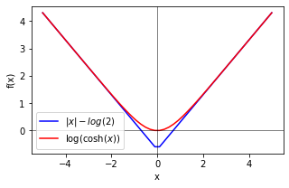
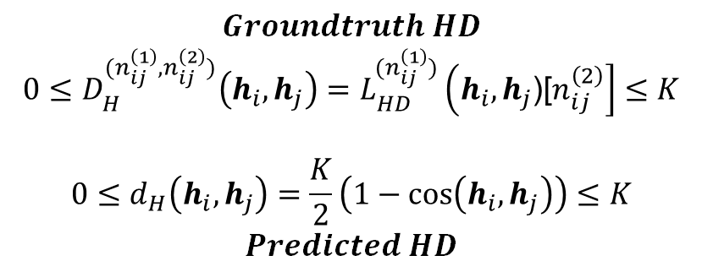
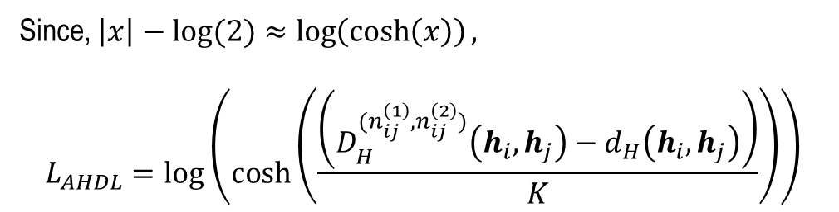
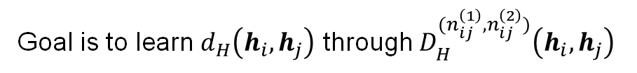
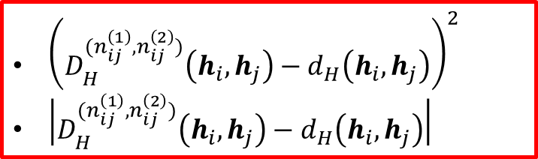
Adaptive HD Loss
Goal is to learn $d_{H}\left(h_{i},h_{j}\right)$ through $D_{H}^{{(n}_{ij}^{\left(1\right)},n_{ij}^{\left(2\right)})}\left(h_{i},h_{j}\right)$
${\left(D_{H}^{{(n}_{ij}^{\left(1\right)},n_{ij}^{\left(2\right)})}\left(h_{i},h_{j}\right)−d_{H}\left(h_{i},h_{j}\right)\right)}^{2}$
$\left|D_{H}^{{(n}_{ij}^{\left(1\right)},n_{ij}^{\left(2\right)})}\left(h_{i},h_{j}\right)−d_{H}\left(h_{i},h_{j}\right)\right|$
Since, $\left|x\right|−log⁡(2)≈\log\left(\cosh\left(x\right)\right),$
$$L_{AHDL}=\log\left(\cosh\left(\frac{\left(D_{H}^{{(n}_{ij}^{\left(1\right)},n_{ij}^{\left(2\right)})}\left(h_{i},h_{j}\right)−d_{H}\left(h_{i},h_{j}\right)\right)}{K}\right)\right)$$
$$Groundtruth HD$$
$${0≤D}_{H}^{{(n}_{ij}^{\left(1\right)},n_{ij}^{\left(2\right)})}\left(h_{i},h_{j}\right)=L_{HD}^{{(n}_{ij}^{\left(1\right)})}\left(h_{i},h_{j}\text{)}\text{[}n_{ij}^{\left(2\right)}\right]≤K$$
$${0≤d}_{H}\left(h_{i},h_{j}\right)=\frac{K}{2}\left(1−\cos\left(h_{i},h_{j}\right)\right)≤K$$
$$Predicted HD$$
Notes:
Now, coming to the problem formulation of objective. I will define it mathematically to better understand.

Slide 16
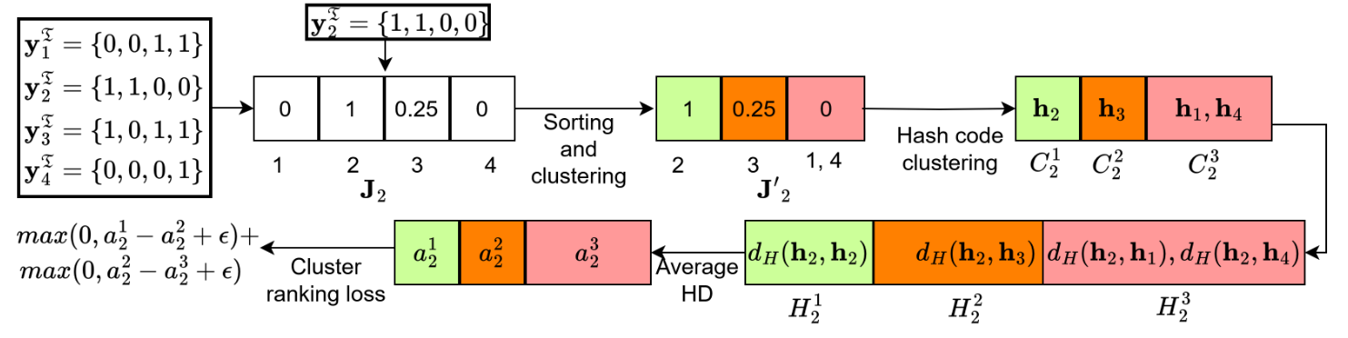

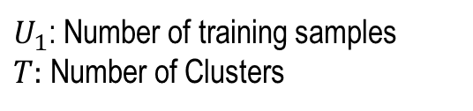
Cluster Ranking Loss
$U_{1}$: Number of training samples
$T:$ Number of Clusters

Slide 17
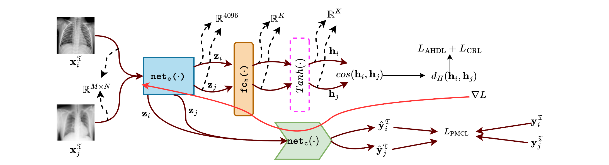
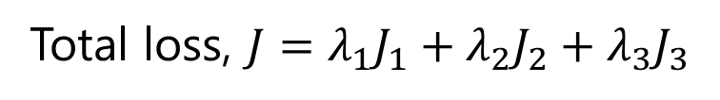
Overall Loss
Total loss, $J={λ_{1}J}_{1}+λ_{2}J_{2}+λ_{3}J_{3}$
Overall training pipeline

Slide 18
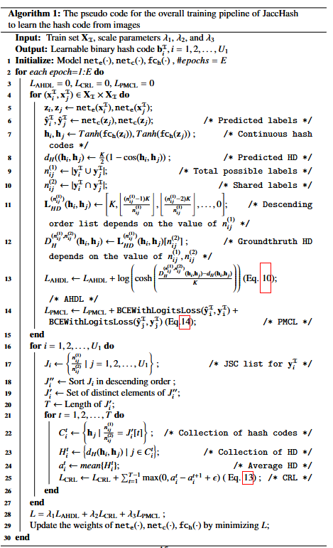
Overall Training pipeline

Slide 19
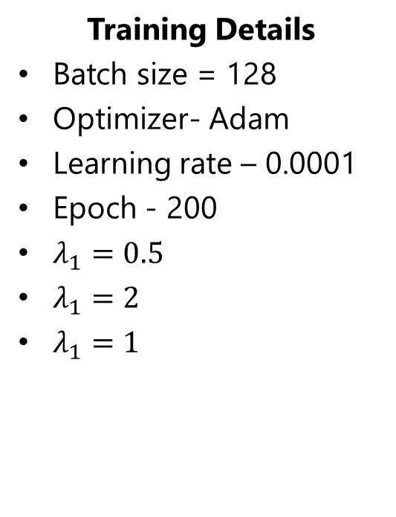
Experimental Setup
Training Details
Batch size = 128
Optimizer- Adam
Learning rate – 0.0001
Epoch - 200
$λ_{1}=0.5$
$λ_{1}=2$
$λ_{1}=1$
Dataset-I
NIH Chest X-ray (https://www.kaggle.com/datasets/nih-chest-xrays/data)
Number of pathology-13
Train images – 38,610
Gallery images – 10,296
Query images- 2,574
Dataset-II
CheXPert (https://www.kaggle.com/datasets/ashery/chexpert)
Number of pathology- 14
Train images – 75,631
Gallery images – 20,000
Query images- 3,000
Notes:
Now, coming to the problem formulation of objective. I will define it mathematically to better understand.

Slide 20
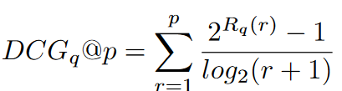
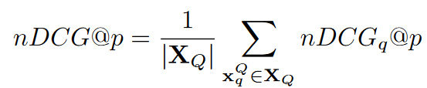

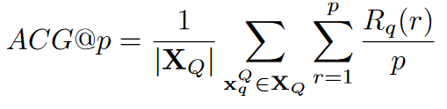
Evaluation Metrics
Normalized discounted cumulative gain,
Average cumulative gain,
Query Image ($x_{q}^{Q}),\text{top}\text{−}\text{p} \text{retrieval}\text{, }$r-th retrieved Image ($x_{r}^{G})$,
Notes:
Now, coming to the problem formulation of objective. I will define it mathematically to better understand.

Slide 21
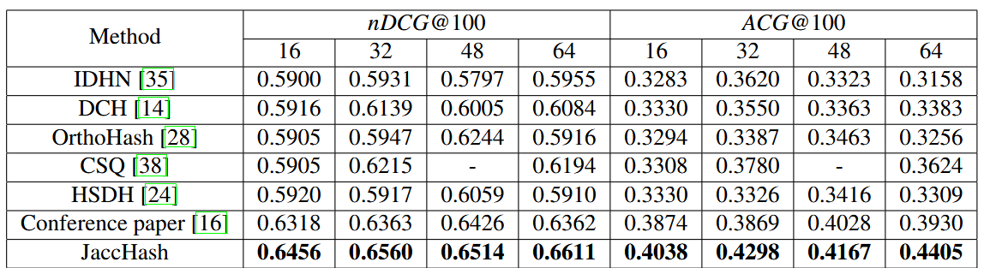
Quantitative Results
Results on Dataset -I

Slide 22
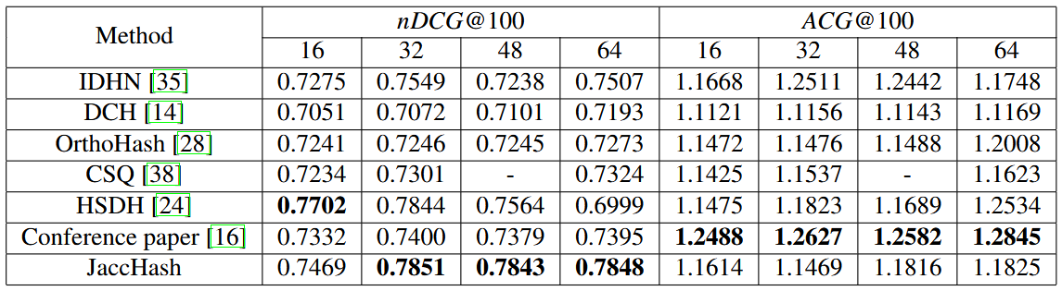
Quantitative Results
Results on Dataset -II

Slide 23
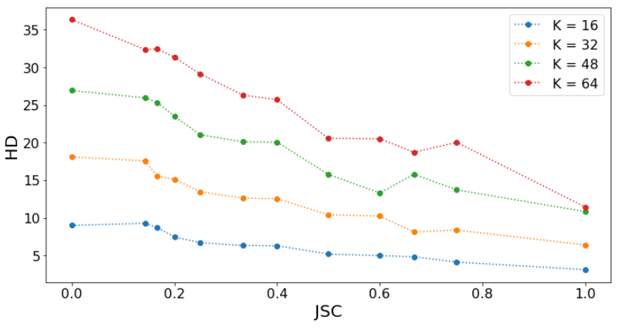
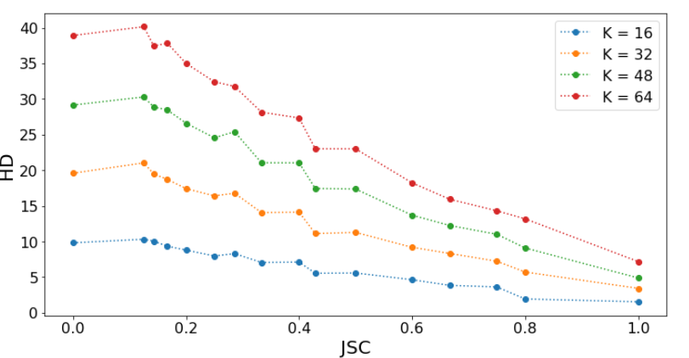
JSC vs HD
Dataset -I
Dataset -II

Slide 24
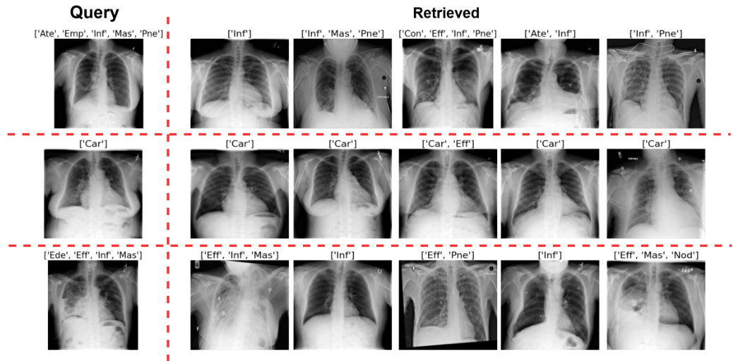
Qualitative Results
Atelectasis (’Ate’), Pneumonia (’Pnea’),
Consolidation (’Con’), Effusion (’Eff’),
Infiltration (’Inf’), Pneumothorax (’Pne’), Mass (’Mas’),
Cardiomegaly (’Car’), Edema (’Ede’)
Top-5 retrieved images

Slide 25
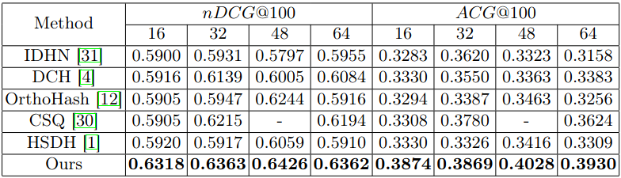
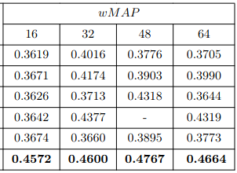
Results
Table: Comparision with SOTA for different hash code lengths
Notes:
Now, coming to the problem formulation of objective. I will define it mathematically to better understand.

Slide 26
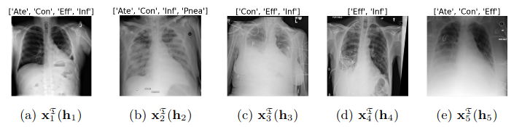
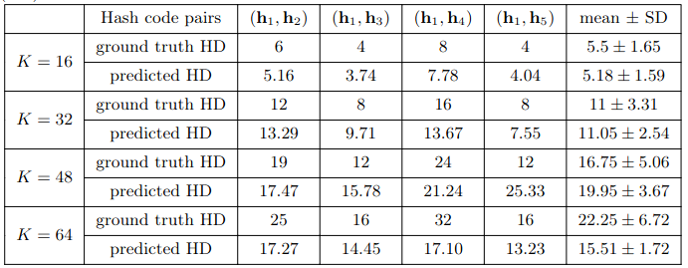
Results
Table: Comparision between groundtruth HD and predicted HD
Notes:
Now, coming to the problem formulation of objective. I will define it mathematically to better understand.

Slide 27
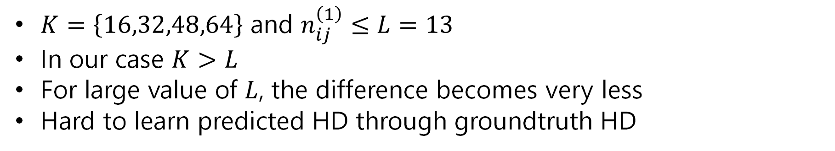
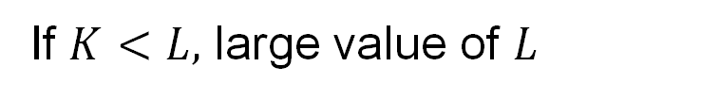
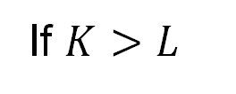
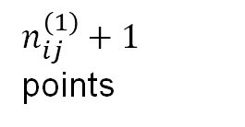
Limitation and Future Work
$K=\left\{16,32,48,64\right\}$ and $n_{ij}^{\left(1\right)}≤L=13$
In our case $K>L$
For large value of $L$, the difference becomes very less
Hard to learn predicted HD through groundtruth HD
0
$$K$$
If $K>L$
0
$$K$$
If $K<L,$ large value of $L$
$n_{ij}^{\left(1\right)}+1$ points

Slide 28
Take Home Message
Hash code learning through deep neural network
Multi-label medical image retrieval with respect to pathology/symptoms.
Image similarity through Hamming distance.
Establish one-to-one relation between JSC and HD
Metric for multi-label retrieval performance: nDCG, ACG

Slide 29
Publications
Manna, A. and Sheet, D., 2025. Learning Neural Networks for Multi-label Medical Image Retrieval Using Hamming Distance Fabricated with Jaccard Similarity Coefficient. In International Conference on Pattern Recognition (pp. 251-266). Springer, Cham.
Github link: https://github.com/asimmanna17/RRPR2024
Code and Results are verified by Reproducible Research in Pattern Recognition

Slide 30
Questions?

