Slide 1



One door refrigerator
below
₹13,000
₹ 14,000
₹14,500

Slide 2
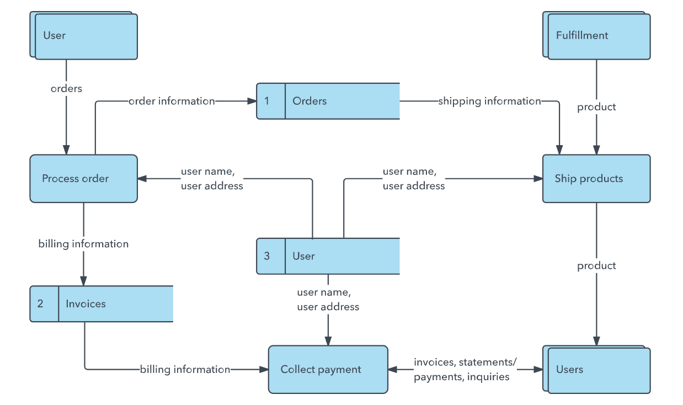
Example DFD

Slide 3
DFD for Pricing comparison analysis Dashboard
Home Work
Due Date: 5/3/2018
Owner: Nitesh + Punit
Store Owner
User id & password
Login
Product list
List of products
Product Catalog
Amazon Price List
Dashboard
Competitor product Data store
Flipkart

Slide 4
UML Diagram
Home Work
Due Date: 5/3/2018
Owner: Nitesh

Slide 5
Home Work
Due Date: 5/3/2018
Owner: Punit
ER Diagram

Slide 6
http://sneakpeekit.com/
Home Work
Due Date: 9/3/2018
Owner: Nitesh + Punit
1: Login Page
2: Product list
3: Dashboard

