Slide 1
Organizational Units
Antonette Simms

Slide 2
What is the Purpose of OUs

Slide 3
Organizational Units
The organizational unit most of the time referred to as an OU. An OU is a container within a directory service, such as an active directory and Windows environment. Which has many purposes to help organize and manage resources within a network or domain.

Slide 4

Organizational Structure
OUs allow administrators to reflect the organizational structure of the company or institution within the directory service. The OUs can represent departments, teams, or locations.

Slide 5
Administrative delegation
OUs enable administrators to give out administrative tasks to specific individuals or groups by assigning permissions to an OU. This helps administrators because it allows those individual groups to gain control over the objects within the OU, but it also allows the administrator not to have to give administrative rights to the entire directory.

Slide 6
GPOs (group policy application)
GPOs can be linked to OUs to apply specific configurations, settings, and policies to the objects contained within them. This enables facilities to improve processes and drive values in all areas of the organization.

Slide 7
Security boundaries
03
OUs can help with security boundaries because they allow administrators to apply security, permissions, and access controls at the level They deem necessary. This helps to ensure that only authorized users have access to specific resources and can perform certain actions within the OU. keeping everyone safe and data protected.

Slide 8
Management
Management by organizing objects into OU’s administrators can easily locate and manage the resources within the directory structure. This helps make administrative tasks more efficient and helps make troubleshooting easier.

Slide 9
OU Design Process
Identify administrative needs
Security requirements
Define Naming Conventions
Implement and Test
Hierarchical structure
Review
This would consist of identifying who will be responsible for managing users, computers, groups, and other resources within the OU.
Determining the security requirements for each OU and who should have access also While considering the level of permission they require.
Testing the OU structure in policies to ensure they are functioning as intended and organized requirement
Establishing a clear and consistent naming convention for OUs
Designing the structure based on the use of the organizations, hierarchy and administrative needs, such as parent OUs having child OU’s representing subunits or departments .
It is important to regularly review the OU design to ensure that it continues to meet the organizations requirement as the organization evolves and it also benefits to make any necessary adjustments or changes to the organizational structure or security .

Slide 10
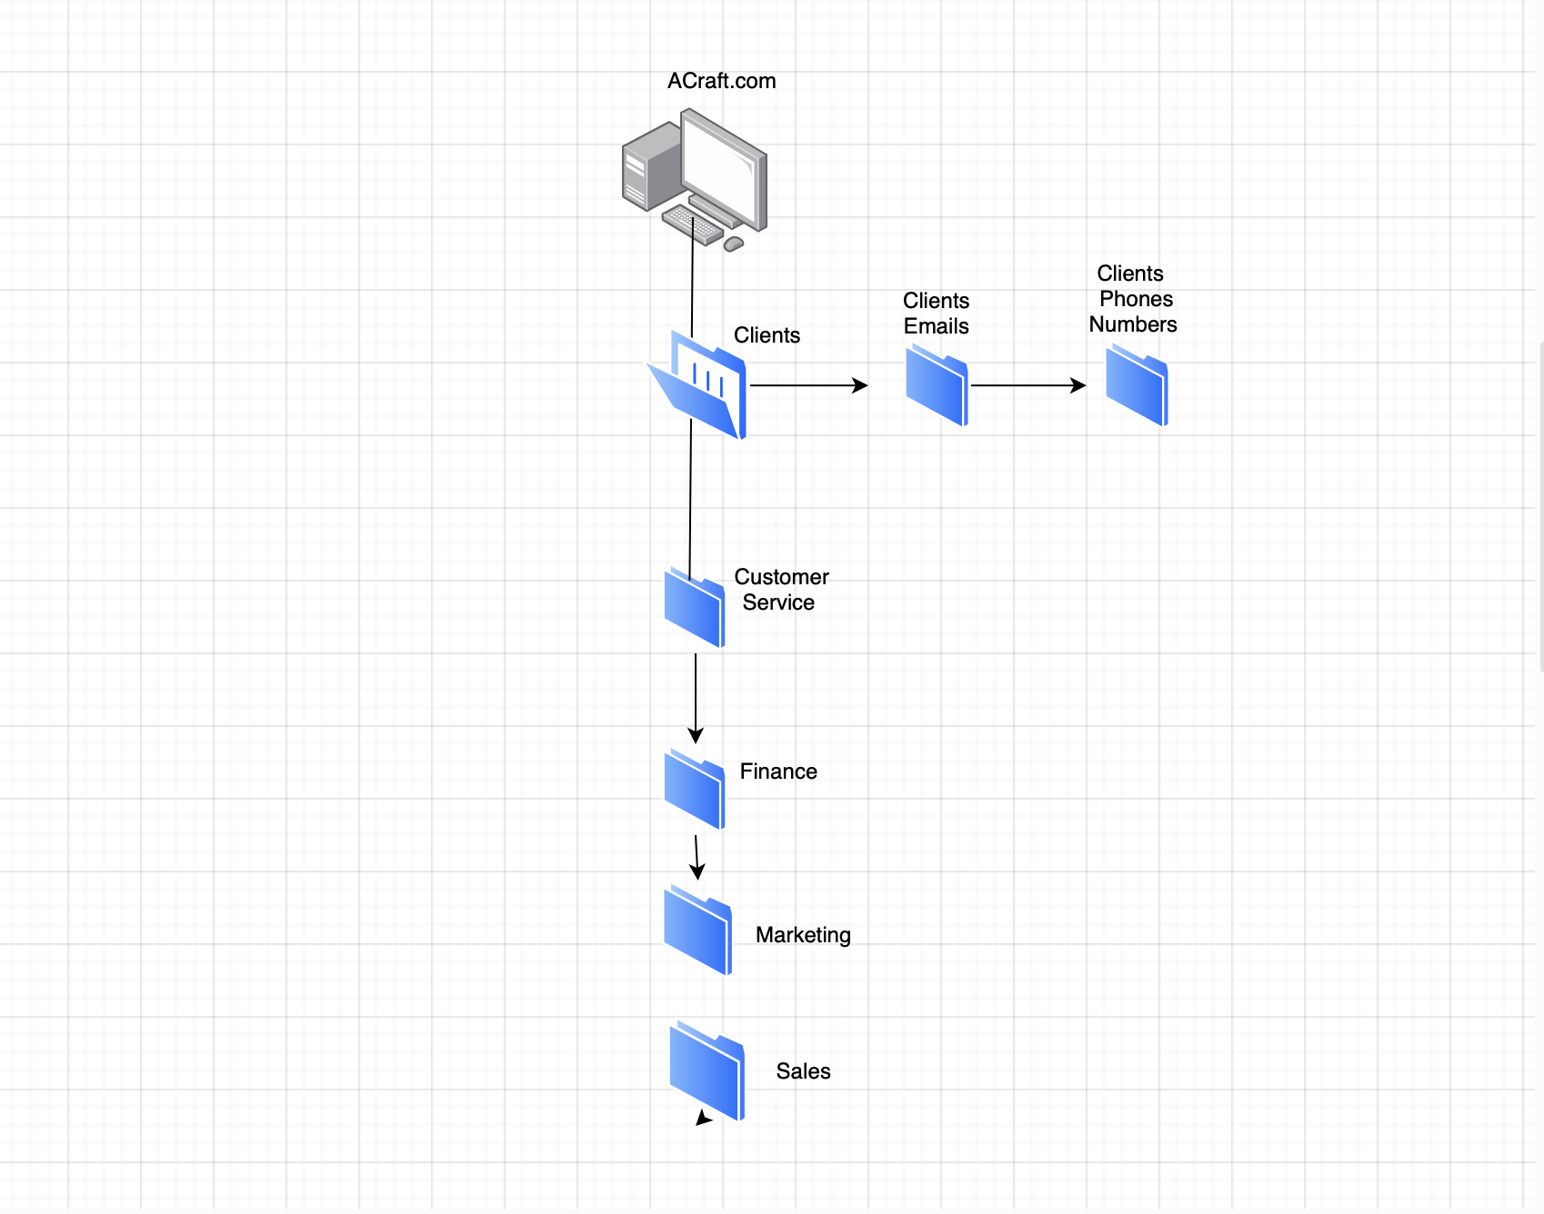
OU Design

Slide 11

CONCLUSIONS
What is the purpose of OUs
Keeps objects organized
Delegate administrative permission
Manage group policy application
To Sum up everything that was said these are the three main purposes we need to keep an eye on.

Slide 12
References
Zola, A. (2023) What is Organizational Unit (OU)?: Definition from TechTarget, SearchWindowsServer. Available at: https://www.techtarget.com/searchwindowsserver/definition/organizational-unit-OU#:~:text=What%20is%20an%20organizational%20unit%20in%20Active%20Directory%3F,Policy%20settings%20or%20account%20permissions. (Accessed: 27 February 2024).
What is an organizational unit (OU)? | windows server 2019 | WS-011 | EP 06 (2021) YouTube. Available at: https://www.youtube.com/watch?v=hOTj5rFxptU (Accessed: 27 February 2024).

Slide 13
Thanks!
Do you have any questions?
Please keep this slide for attribution

