Slide 1
Market Microstructure and High-Frequency Finance
PROJECT
Małgorzata Konopacka, Artur Simon

Slide 2
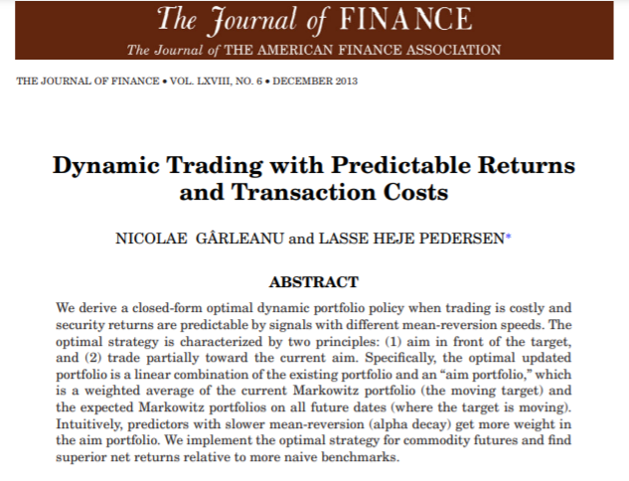
Introduction

Slide 3

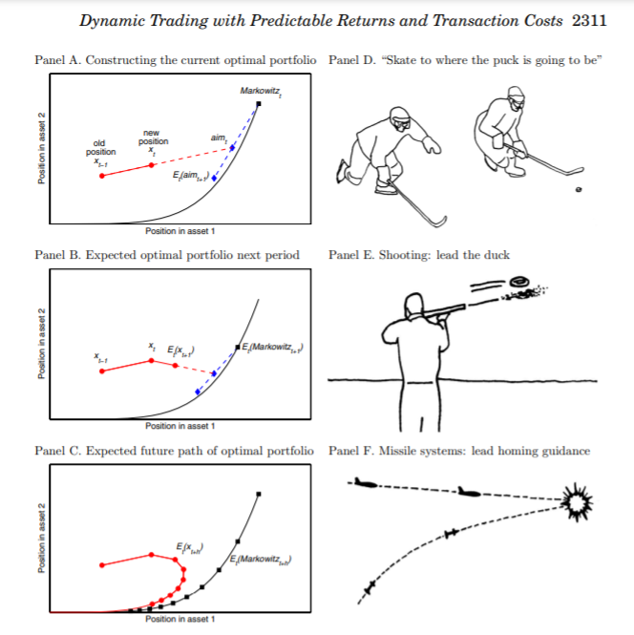

Slide 4


Model
We consider an economy with S securities traded at each time $t∈\{…,−1,0,1,…\}$. The securities’ price changes between times $t$ and $t+1$ in excess of the risk-free rate return, $p_{t+1}−\left(1+r^{f}\right)p_{t}$, are collected in an $S×1$ vector $r_{t+1}$ given by
$$r_{t+1}=Bf_{t}+u_{t+1}$$
$${var}_{t}\left(u_{t+1}\right)=Σ$$

Slide 5

Model cont.
The return-predicting factor $f_{t}$ is known to the investor already at time t and it evolves according to
$$Δf_{t+1}=−Φf_{t}+ε_{t+1}$$

Slide 6


Model cont.
The investor’s objective is to choose the dynamic trading strategy $\left(x_{0},x_{1},…\right)$ to maximize the present value of all future expected excess returns, penalized for risks and trading costs,
$$\underset{x_{0},x_{1},…}{\text{max}}E_{0}[Σ_{t}{\left(1−ρ\right)}^{t+1}\left(x_{t}^{T}r_{t+1}−\frac{γ}{2}x_{t}^{T}Σx_{t}\right)−\frac{{\left(1−ρ\right)}^{t}}{2}Δx_{t}^{T}ΛΔx_{t}]$$
$$Λ=λΣ$$

Slide 7

Model cont.
The optimal portfolio is a weighted average of the existing portfolio $x_{t−1}$ and the aim portfolio:
$$x_{t}=\left(1−\frac{α}{λ}\right)x_{t−1}+\frac{α}{λ}aim_{t}$$
$$α=\frac{−\left(γ\left(1−ρ\right)+λρ\right)+\sqrt{{\left(γ\left(1−ρ\right)+λρ\right)}^{2}+4γλ{\left(1−ρ\right)}^{2}}}{2\left(1−ρ\right)}$$

Slide 8
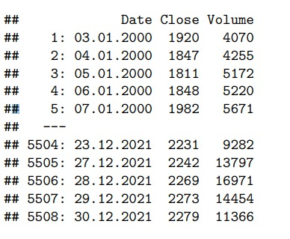
DAta: WIG20 Futures

Slide 9
Summary Statistics
Average Price | Standard deviation | Contract Multiplayer | Daily Trading Volume (Contracts)
PLN 43589.02 | PLN 663.76 | 20 | 25682.09

Slide 10

RETurn predictions
$$r_{t+1}=β_{0}+β_{1}×f_{t}^{5D}+β_{2}×f_{t}^{1Y}+β_{3}×f_{t}^{5Y}+u_{t+1}$$
$r_{t+1}$ - daily future price change
$f_{t}^{5D}$, $f_{t}^{1Y}$, $f_{t}^{5Y}$ - average 5 days’/1years’/5 years’ price change divided by the past 5 days’/1 years’/5 years’ standard deviation of daily price changes

Slide 11

Shocks
$$Δf_{t+1}^{5D}=−0.2519f_{t}^{5D}+ε_{t+1}^{5D}$$
$$Δf_{t+1}^{1Y}=−0.0034f_{t}^{1Y}+ε_{t+1}^{1Y}$$
$$Δf_{t+1}^{5Y}=−0.0001f_{t}^{5Y}+ε_{t+1}^{5Y}$$
$$ε_{t}^{5D}∼𝒩(μ^{5D}, σ^{5D})$$
$$ε_{t}^{1Y}∼𝒩(μ^{1Y}, σ^{1Y})$$
$$ε_{t}^{5Y}∼𝒩(μ^{5Y}, σ^{5Y})$$

Slide 12

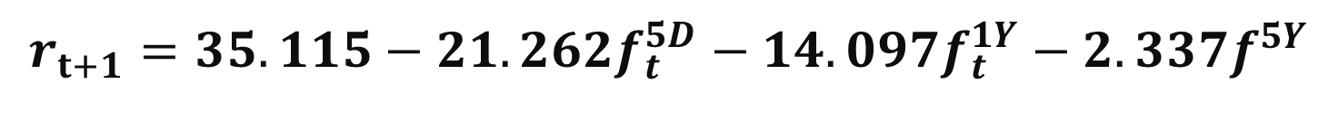
Linear model
$$r_{t+1}=35.115−21.262f_{t}^{5D}−14.097f_{t}^{1Y}−2.337f^{5Y}$$
$$γ={10}^{−6}$$
$$ρ=1−\text{exp}\left(−0.02/260\right)$$

Slide 13

Transaction costs
$λ$ is the scalar of transaction costs.
The 1.59 % of the daily volume in a stock have a price impact of about 0.1 %.
$1.59\%×Volume×\frac{λ}{2}×σ^{2}=0.1\%×Price$

Slide 14

Example 1 Timing a Single Security
There is only one security. In this case, $σ^{2}=Σ$ and $B=\left(β^{1},…,β^{K}\right)$. Assuming that $Φ$ is diagonal, we obtain the optimal timing portfolio:
$$x_{t}=\left(1−\frac{α}{λ}\right)x_{t−1}+\frac{α}{λ}\frac{1}{γσ^{2}}\sum_{i=1}^{K}{\frac{β^{i}}{1+φ^{i}α/γ}}f_{t}^{i}$$

Slide 15

Example 2 Markowitz model
The aim portfolio in their dynamic setting turns out to be closely related to the optimal portfolio in a static model without transaction costs ($Λ$ = 0).
$$Markovitz_{t}={\left(γΣ\right)}^{−1}Bf_{t}$$

Slide 16

Example 3 static model
This model involves current expected returns, risk, and transaction costs.
$$\underset{x_{t}}{\text{max}}x_{t}^{T}E_{t}\left(r_{t+1}\right)−\frac{γ}{2}x_{t}^{T}Σx_{t}−\frac{λ}{2}Δx_{t}^{T}ΣΔx_{t}$$
$$x_{t}=\frac{λ}{γ+λ}x_{t−1}+\frac{λ}{γ+λ}{\left(γΣ\right)}^{−1}E_{t}\left(r_{t+1}\right)=x_{t−1}+\frac{γ}{γ+λ}\left(Markovitz_{t}−x_{t−1}\right)$$

Slide 17
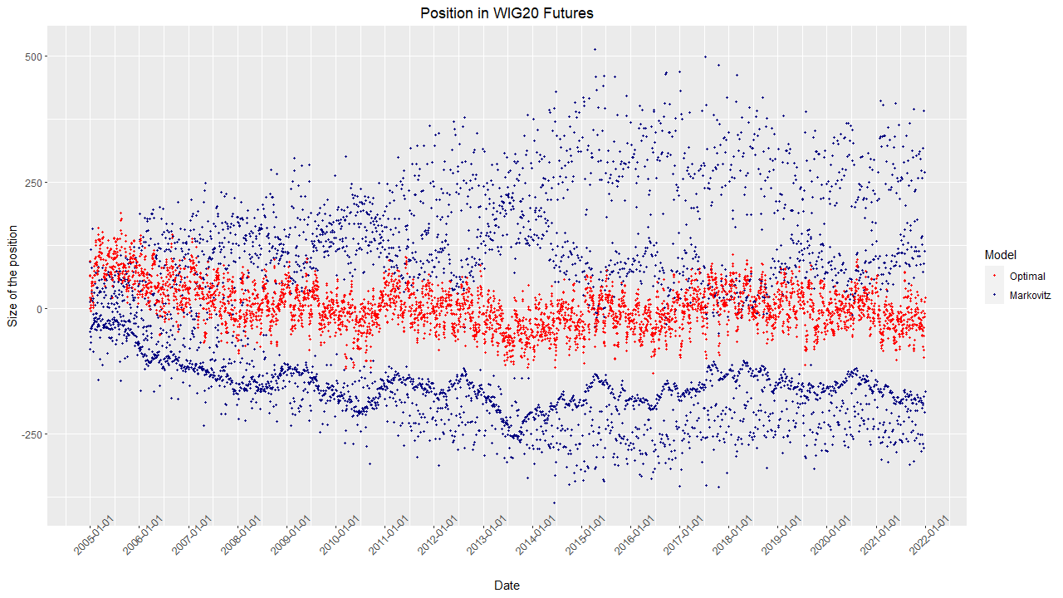

Slide 18
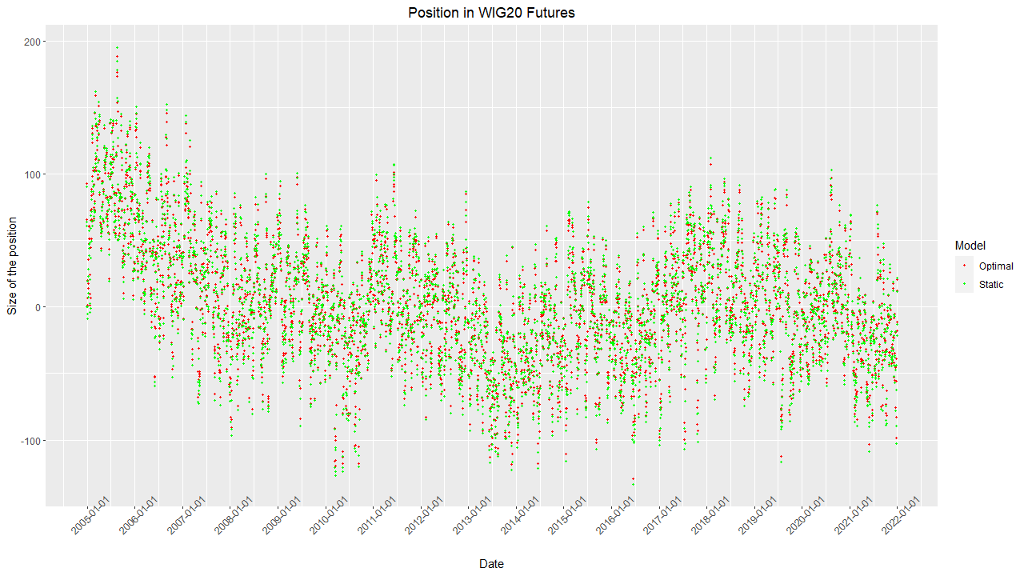

Slide 19
Sharpe ratios
Model | Daily | Annualized
Optimal | 0.031 | 0.496
Static | 0.030 | 0.482
Markowitz | 0.017 | 0.274

Slide 20
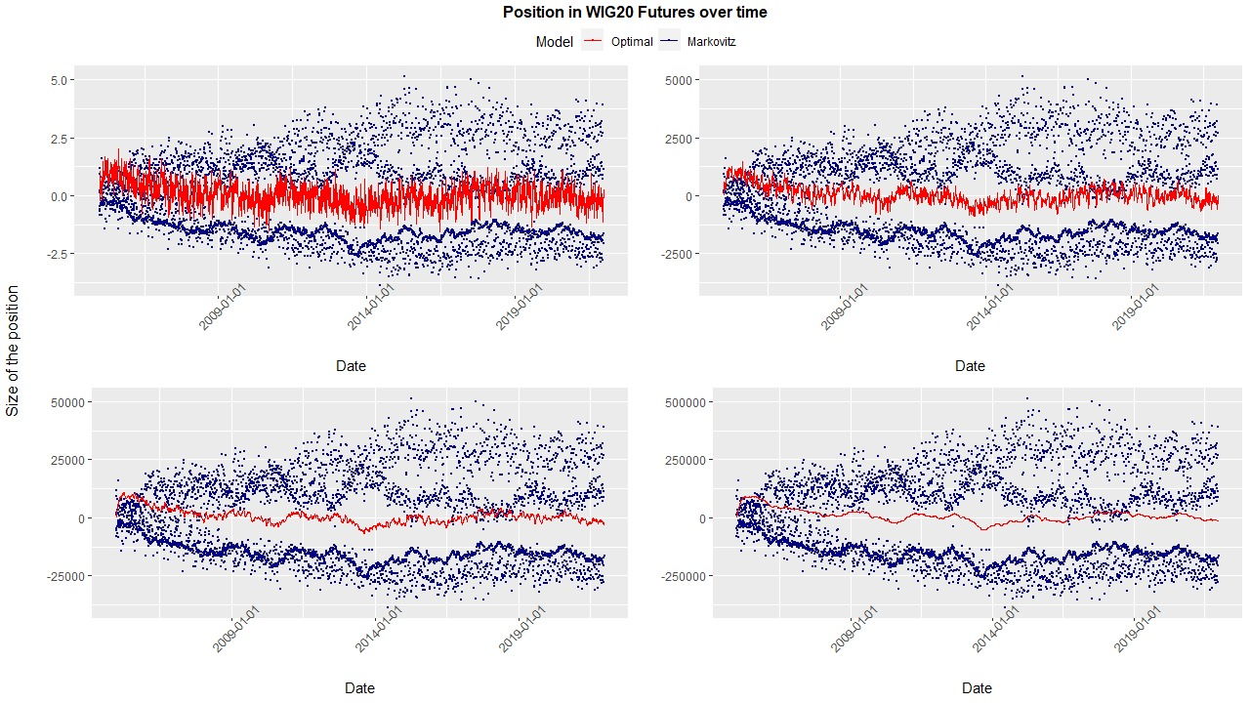

$$γ= \begin{matrix}{10}^{−4} & {10}^{−7} \\ {10}^{−8} & {10}^{−9}\end{matrix}$$

Slide 21
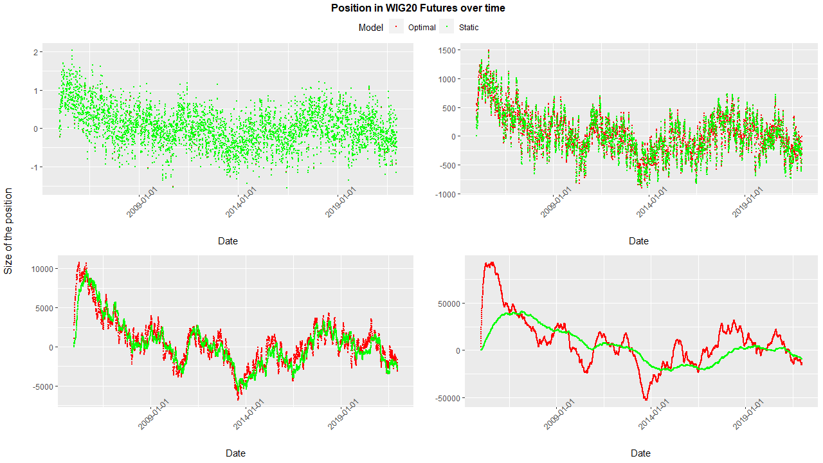

$$γ= \begin{matrix}{10}^{−4} & {10}^{−7} \\ {10}^{−8} & {10}^{−9}\end{matrix}$$

Slide 22
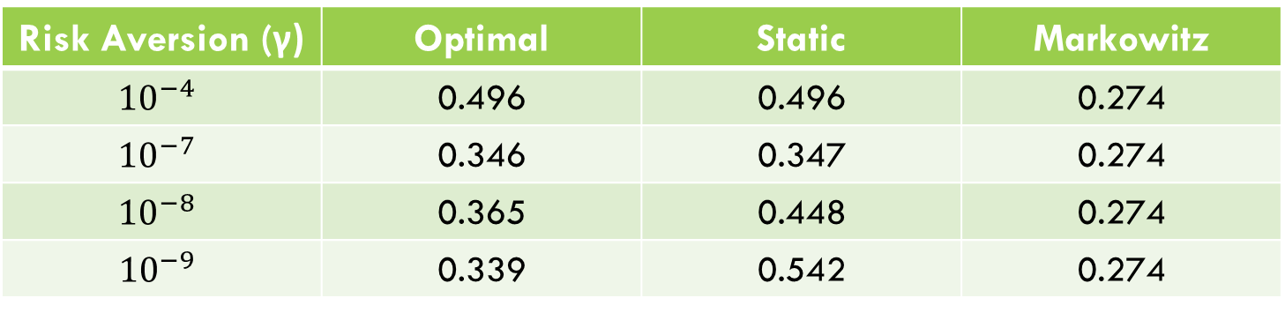
Annualized sharpe ratios for different risk aversions
Risk Aversion (γ) | Optimal | Static | Markowitz
$${10}^{−4}$$ | 0.496 | 0.496 | 0.274
$${10}^{−7}$$ | 0.346 | 0.347 | 0.274
$${10}^{−8}$$ | 0.365 | 0.448 | 0.274
$${10}^{−9}$$ | 0.339 | 0.542 | 0.274

Slide 23
Thank you for your attention

