Slide 1
Predictive Modeling Approaches for Detection of
Alzheimer’s Disease Using the NACC Dataset
College of Computing and Technology, Lipscomb University
Mingjian Shi and Alex Simonian

Slide 2

Introduction
Alzheimer’s disease (AD) is a serious form of dementia in older adults. It affects an estimated 46.8 million people worldwide and is expected to double in the next 20 years.
Alzheimer’s is progressive and irreversible. While there are seven distinct stages of the disease, the stages of cognitive impairment are indicated in this dataset as:
Normal
Mild Cognitive Impairment (MCI)
Impaired
Dementia

Slide 3
Goal:
The goal of this research is to build a model to identify individuals or subpopulations at high risk of developing Alzheimer disease
Motivation:
A skilled specialist physician can diagnose AD with more than 90% accuracy at the later stages but this accuracy decreases at the early stages of dementia

Slide 4
Dataset:
The National Alzheimer's Coordinating Center (NACC)
The NACC database is made up of three main research data sets:
From 2005 to the present, ADCs (Alzheimer's Disease Centers) have been contributing data to the Uniform Data Set (UDS), using a prospective, standardized, and longitudinal clinical evaluation of the subjects in the National Institute on Aging's ADC Program.
In 2012, a new module was added to the UDS to collect detailed clinical information related to frontotemporal lobar degeneration (FTLD). The FTLD Module is voluntarily completed by ADCs.
Beginning in 1984 and ending with the 2005 implementation of the UDS, brief, single-record descriptions of ADC subjects were collected retrospectively to form the Minimum Data Set (MDS).
The Neuropathology Data Set (NP) contains autopsy data for a subset of both MDS and UDS subjects.

Slide 5
Dataset:
The file is in CSV (Comma Separate Value) format and consists in 47673 instances and 193 variables. Each observation represents an individual's visit to a medical facility. Some individuals have multiple visits, so for a few patients, there are multiple rows related to the same patient.

Slide 6
Potential Predictors 📊
AGE (VISITYR - BIRTHYR) | DIABETES
SEX (Male, Female) | CBSTROKE (Stroke resent or remote, etc)
EDUCATION (0-25 years of education) | HYPERTENSION
NACCFAM (Subjects reporting at least one parent, sibling, or child with dementia) | DEP2YRS (Active depression in the last two years)
SMOKING (TOBAC30: Smoked cigarettes in last 30 days TOBAC100: Smoked more than 100 cigarettes in life SMOKYRS: Total years smoked cigarettes PACKSPER: Average number of packs smoked per day QUITSMOK: If the subject quit smoking, age a which she/he last smoked) | NACCBMI (MI = ( weight (lbs) × 703 ) ÷ height (in) ²) Underweight: BMI is less than 18.5 Normal weight: BMI is 18.5 to 24.9 Overweight: BMI is 25 to 29.9 Obese: BMI is 30 or more
ALCOHOL (Alcohol abuse) | NACCNE4S (Number of APOE e4 alleles)
NACCUDSD (Cognitive status at UDS visit: normal,amnestic or non-amnestic,dementia) | NPTHAL (Thal phase for amyloid plaques (A score))
CVHATT (Heart attack/cardiac arrest) | NACCAPOE (APOE genotype)

Slide 7
Wrangling the Data 🤠
Variable selection (choosing relevant factors)
Encoding. Check Data Dictionary
NA values. Impute or discard? Drop ~10977 records.
Feature engineer smoking variables into one HEAVY_SMOKER (PACKSPER x SMOKYRS).
Correct data types (categorical, numeric, int)
Multiple visits problem
Check for multicollinearity

Slide 8
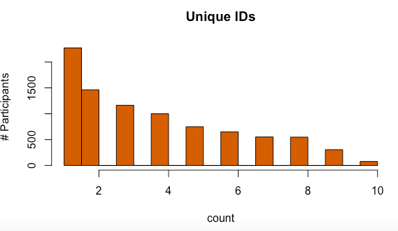
Preprocessing 🤖
Select the latest record for the participant based on latest year
visited. Starting with 32109 records and now down to 8784!
# check for duplicated survey results by same participant
uniq_ids <- aggregate(data.frame(count = Data_Subset$NACCID), list(value = Data_Subset$NACCID), length)
# we only want the latest observation from the participant
# we should end up with 8784 observations
Data_Subset <- setDT(Data_Subset)[,.SD[which.max(VISITYR)],keyby=NACCID]

Slide 9
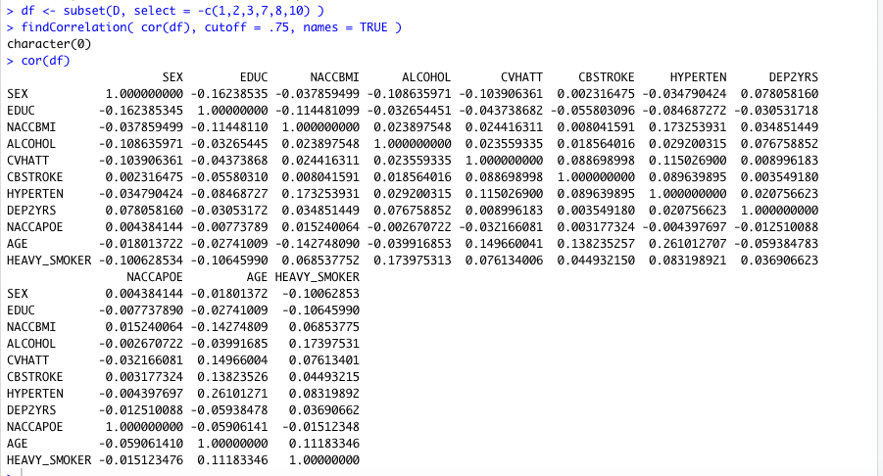
Preprocessing
Multicollinearity exists whenever an independent variable is is correlated with one or more of the other independent variables a in a multiple regression equation. Can lead to unreliable regression coefficients. Fortunately, no large pairwise correlations exist in this data set.

Slide 10
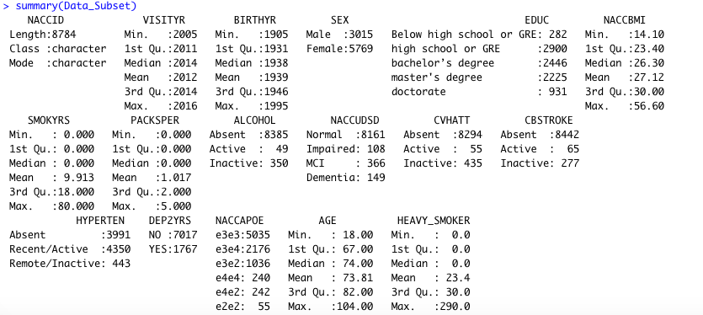
Descriptive Statistics

Slide 11
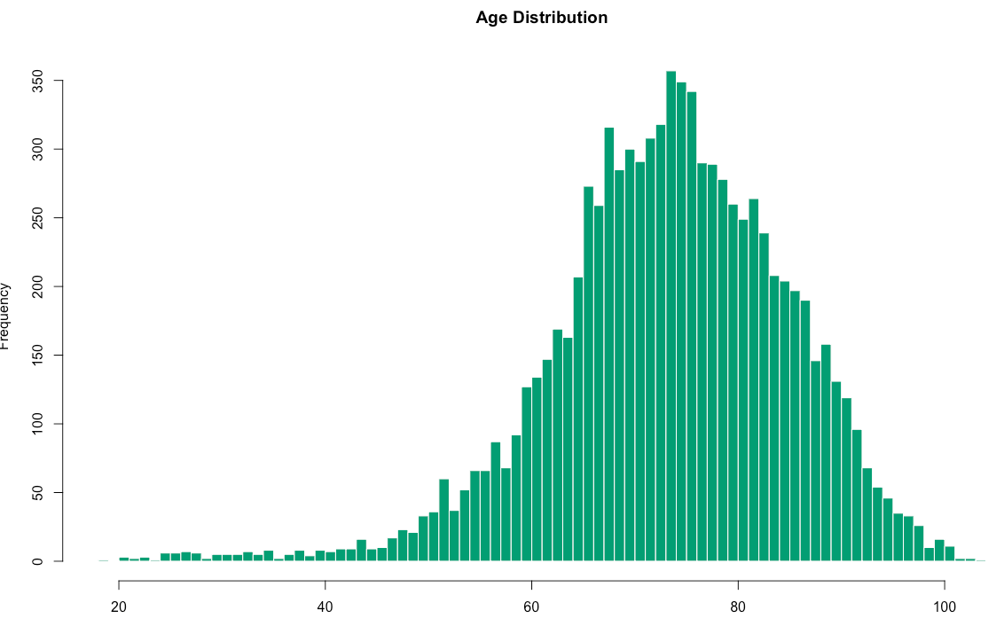

Slide 12
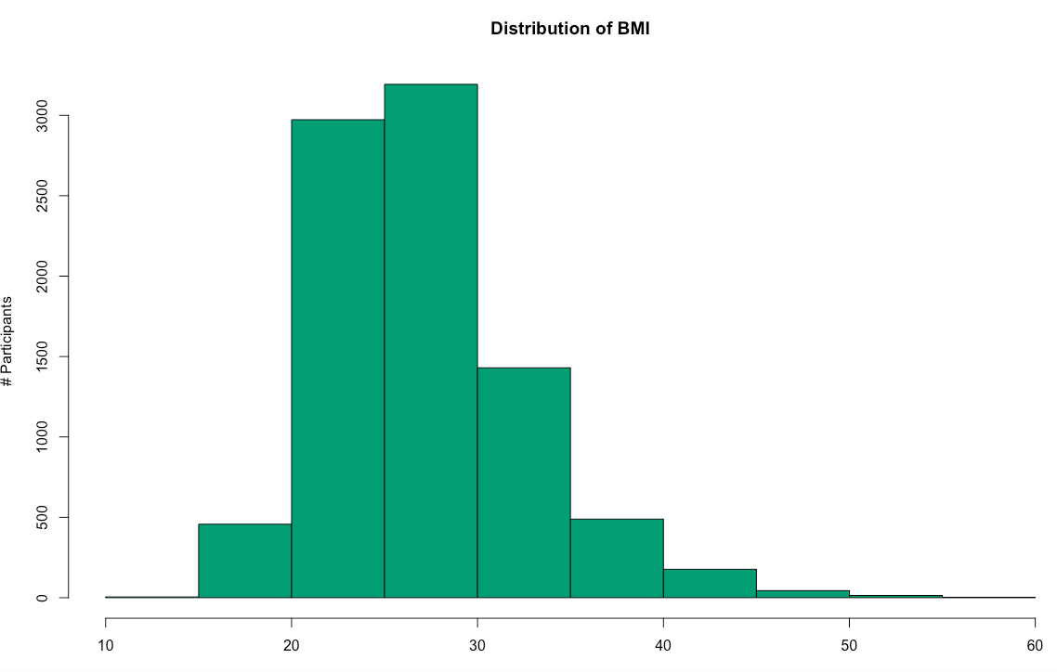

Slide 13
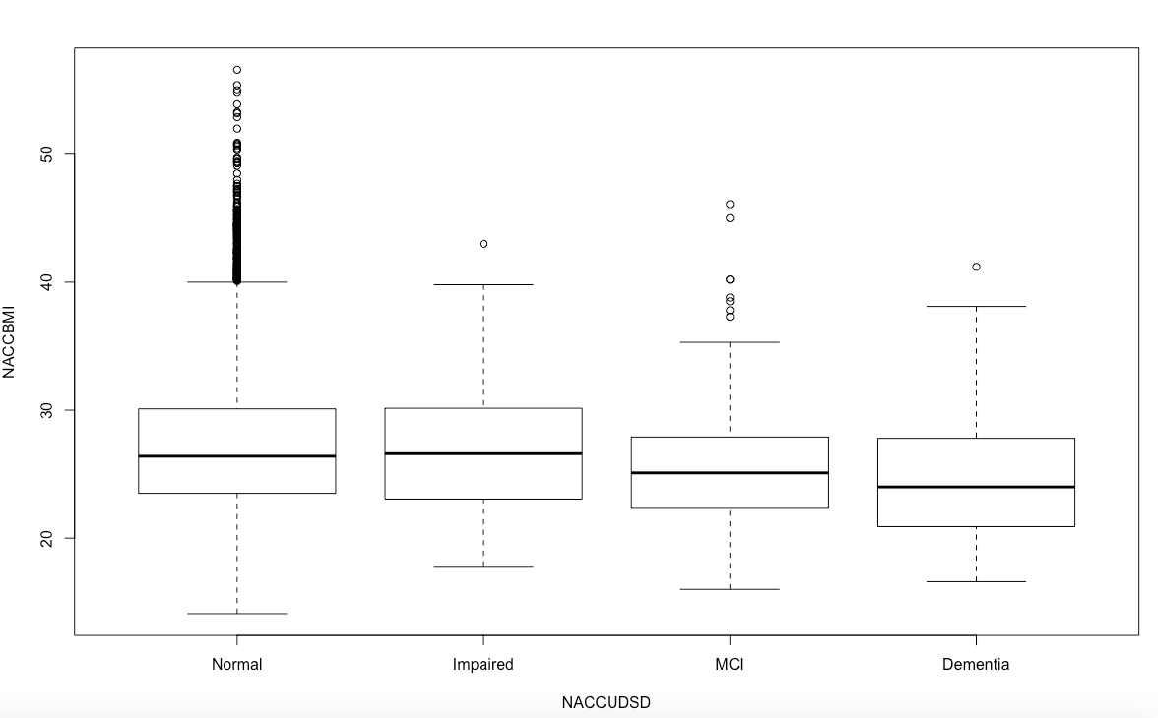

Slide 14
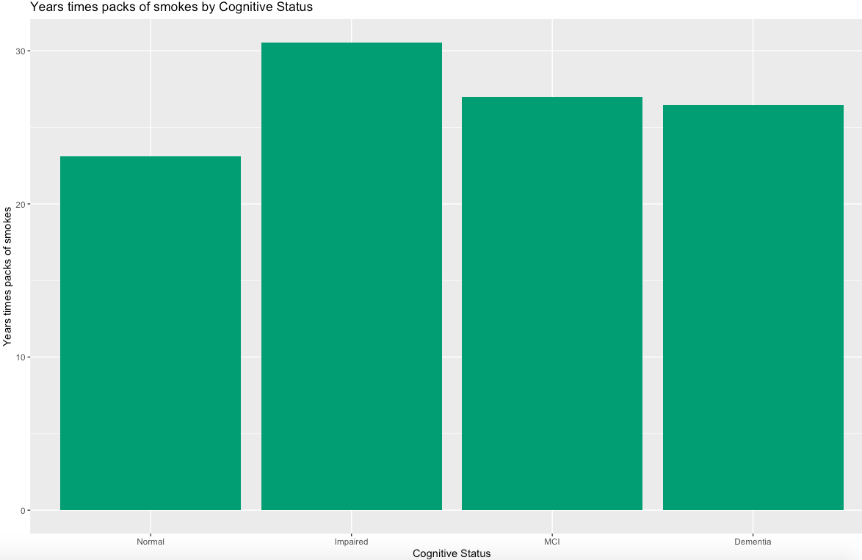

Slide 15
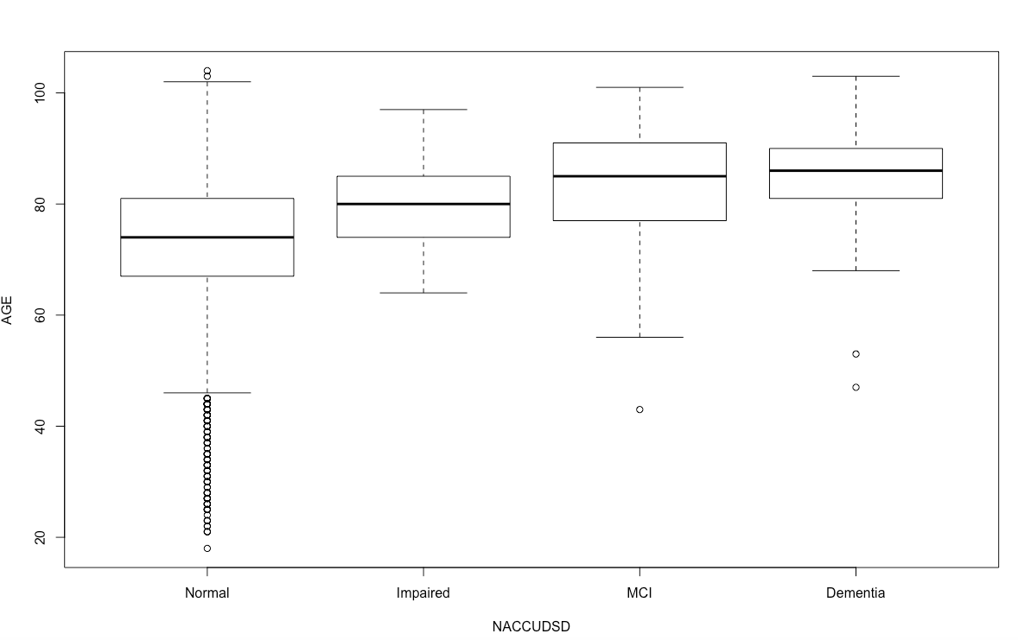

Slide 16
Predictive Analysis
Supervised learning models are divided into regression (continuous DV) vs classification (discrete DV). Easy to implement and interpret. For these, 80:20 rule applies for outcome versus work. Most importantly, focus first on variables and feature engineering. Goal is to predict a categorical response from the predictors available. We want to estimate f for inference, more so than prediction. We want to see what the affect that X1,…,Xp has on Y.
Model candidates
Multinomial regression
Logisitic regression
Decision trees

Slide 17
Multinomial Logistic Regression
Extension of binomial regression to allow for multiple categories. Ideally, we want our model to predict where in the stages of Alzheimers a participant would end up, since there are various levels.
Frequencies of alternatives:
Dementia Impaired MCI Normal
0.016963 0.012295 0.041667 0.929076

Slide 18
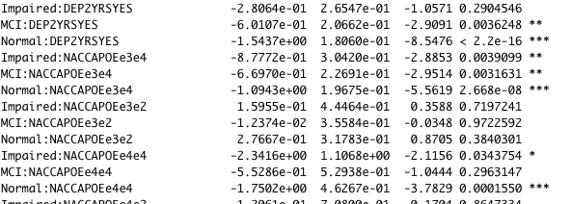
Multinomial Logistic Regression
Lots of coefficients! One for every outcome x predictor = 44. Values with Pr(>|z|), probability of observing the estimated parameter value by chance, below .05 are usually good predictors.

Slide 19
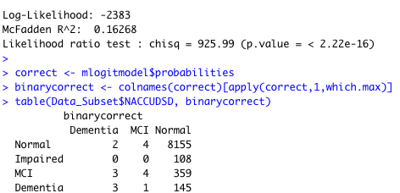
Multinomial Logistic Regression
Did well for predicting Normal, but not so hot for the other categories.

Slide 20
Data Splitting
75% Training
25% Test
We have to train our model and to determine if it is any good (training), we need to see how well in performs and generalizes to unseen data (test). Model could just follow the noise and fit the training data well but not generalize (overfitting).
5 Cross Fold Validation - resampling method to train your data on the model and to generalize better.

Slide 21
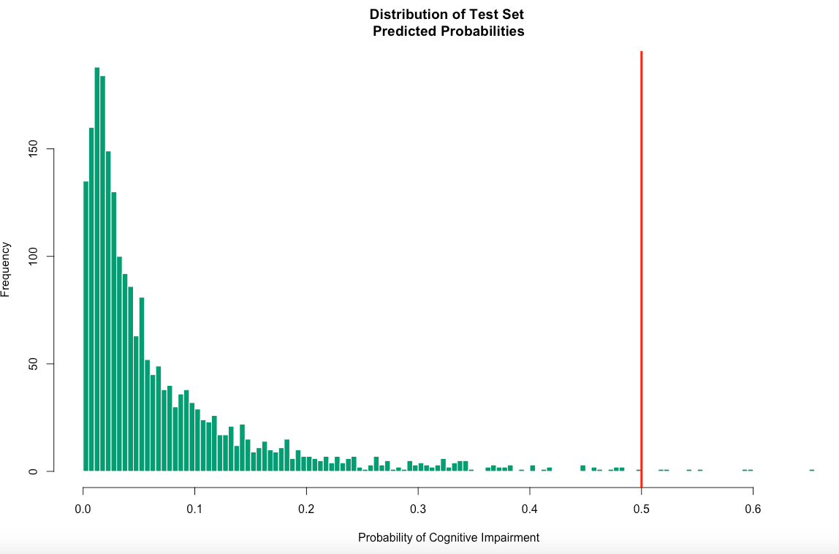
Logistic Regression

Slide 22
Logistic Regression
Estimate Std. Error z value Pr(>|z|)
DEP2YRSYES 1.124127 0.112077 10.030 < 2e-16 ***
NACCAPOEe3e4 0.603378 0.121904 4.950 7.44e-07 ***
AGE 0.105729 0.006291 16.807 < 2e-16 ***
HEAVY_SMOKER -0.001180 0.001202 -0.982 0.326197
Depression in the last two years, NACCAPOEe3e4, and AGE seem to have an effect that predicts cognitive impairment. Smoking, not so much. In fact, studies have shown that there is no link with the effects of nicotine and cognitive impairment.

Slide 23
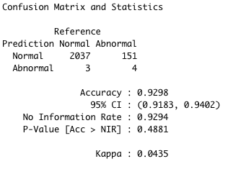
Confusion Matrix
Way too many false positives. Beware. The accuracy may be high, but this data set is very imbalanced. Binary classifiers don’t tend to generalize well against data sets such as these.

Slide 24
Decision Trees
Tells us which predictors are useful and puts them in conditional buckets.
Robust to issues like predictors with skewed distributions because the underlying math does not depend on estimating parameter values and having nice, normally distributed predictors.
Tree building process will automatically find the interactions that matter.

Slide 25
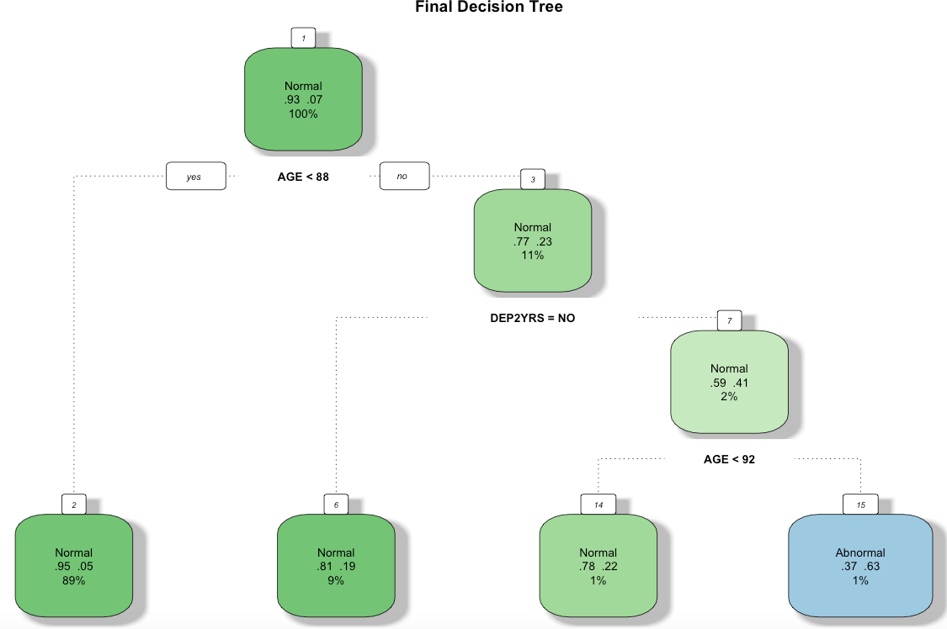

Slide 26
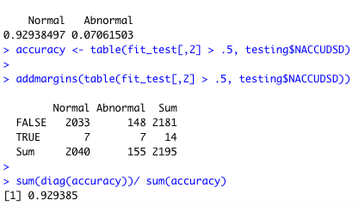
Confusion Matrix
Again, like the Logistic Regression, way too many false positives here.

Slide 27
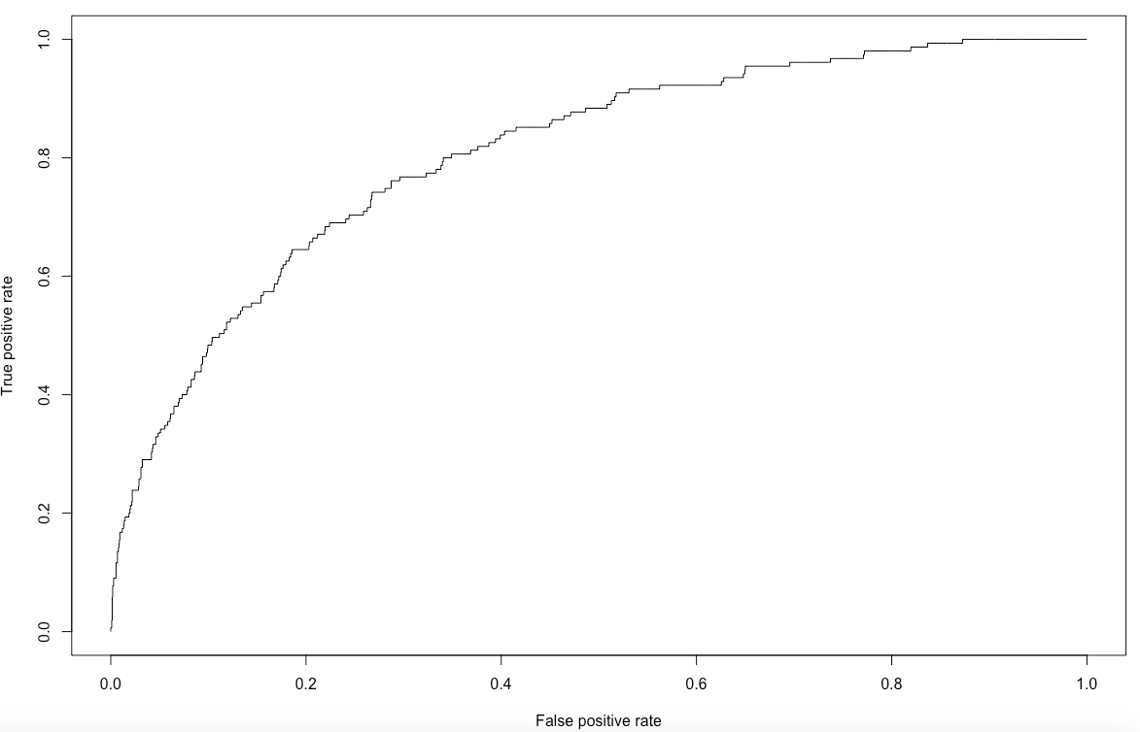
Interpreting the AUC the ROC
Optimal Point

Slide 28
Considerations for the Future
We will study and analyze other research papers.
Hoping to better understand methods that have already been used.
Analyze other research papers hoping to find missing links.
Understanding how far deep we need to performing our regressions.
Gain more insight of AD
Research recent breakthrough in medicines
Research recent breakthrough in treatments
Compare our dataset with current datasets
Utilize (any) new discovery as a mechanism to re-model our data
Dealing with imbalance datasets
Accuracy is not the best metric. Confusion matrix and ROC curve.
Try a variety of ML algorithms.
ML algorithms are not a black box.
Oversample the minority and under sample the majority class.
Get more data

