Slide 1
Writer’s Workshop
Part 1: Writing Strategies
Part 2: Focused writing
Part 3: Course surveys

Slide 2
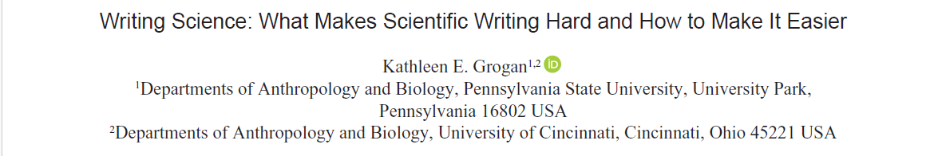
Set yourself up for success!
An excerpt from the Ecological Society of America
https://esajournals.onlinelibrary.wiley.com/doi/full/10.1002/bes2.1800

Slide 3
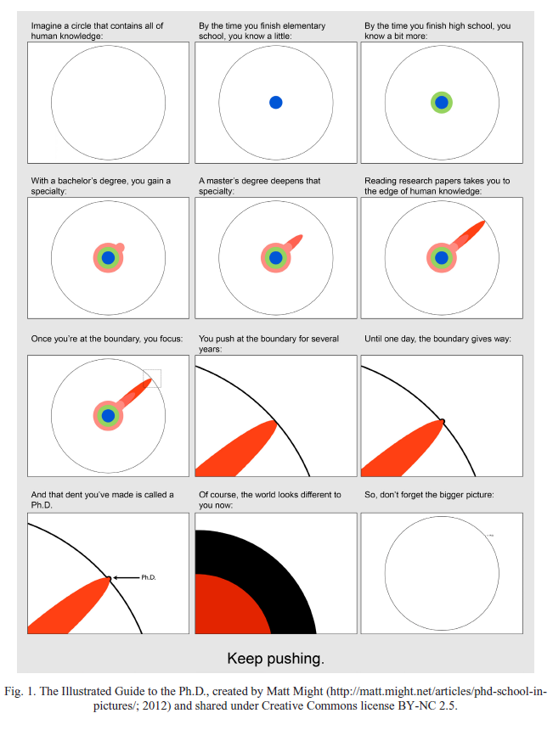
Academic writing can be difficult because:
You are at the forefront of knowledge, and very few people have written about the topic
You are opening yourself up for criticism (peer-review)
The scientific process can be meandering and convoluted

Slide 4

Adopt a growth mindset
Scientific writing is a skill that you develop and practice. It is a skill to be learned, not an innate talent that only some folks have.
A consistent training plan is crucial for developing the skill

Slide 5

Generate content or copyedit, not both simultaneously
Content generation is about getting words on the page
Embrace the terrible first draft!
Proofreading is more efficient when it is strategic
Credit: Photo by Ron Lach

Slide 6
Writing Is Revising
“Published authors know that revision is the heart of producing effective writing…Developing writers don’t know this. They think of revising as a chore assigned because they aren’t good writers and can’t get their writing right the first time.”
–Kathleen Dudden Rowlands in “Slay the Monster! Replacing Form-First Pedagogy with Effective Writing Instruction”

Slide 7

Avoid the rabbit hole of the “perfect” citation
A “quick citation check” can turn into a rabbit hole of endless literature searching
Give yourself 1-2 minutes to find a citation, otherwise simply insert a placeholder [INSERT CITATION HERE]
1-2 minutes!
Insert comment - ”find references on eDNA for cryptic species”

Slide 8
Don’t stop in the “Chasm of Despair”
It’s much easier to return to writing when your last memory is positive
Try not to stop when you’re stuck, frustrated, or suffering from writer’s block
Push through and keep writing (e.g. 2-4 more sentences, edit one more paragraph)

Slide 9
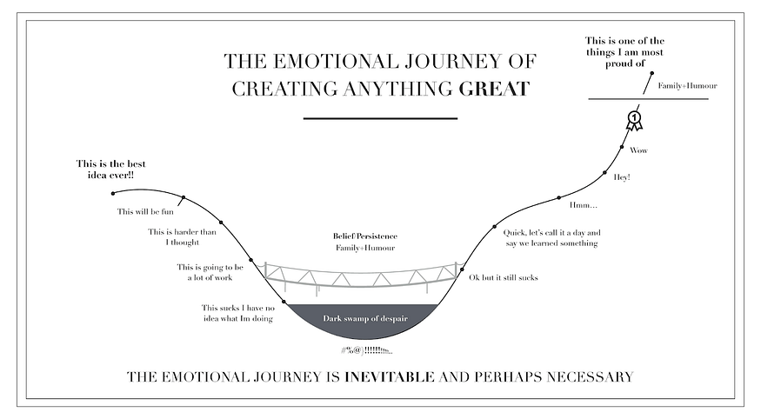

Slide 10
Set concrete goals
S.M.A.R.T writing plan
Specific
Measurable
Achievable
Relevant
Time-bound

Slide 11
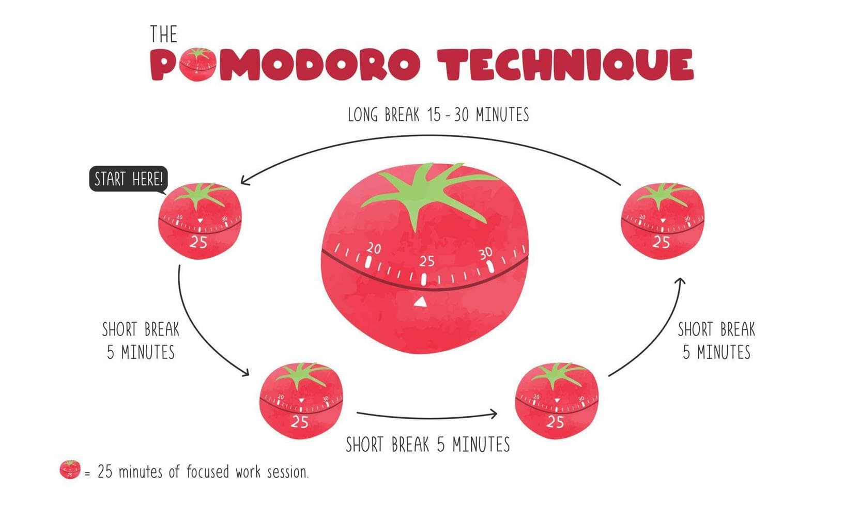
Online “Pomodoro” timers
Cirillo, F. (2018). The Pomodoro technique: The acclaimed time-management system that has transformed how we work. Currency.

Slide 12
Writer’s Workshop
Decide on your first writing task
Free-write “warm up”
3x25-minute writing blocks separated by 5 minute breaks

