Slide 1
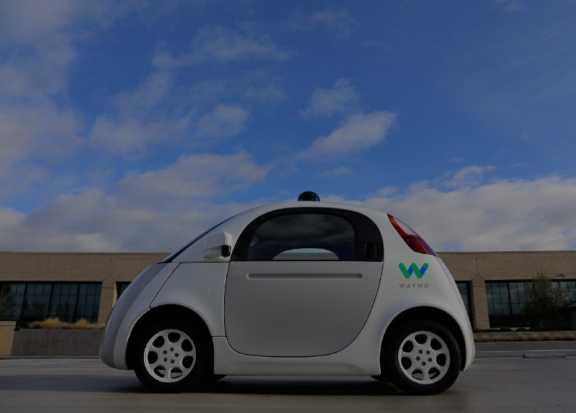
Open-Sourcing Self-Driving Cars
Alexey Simonov

Slide 2
Open Sourcing Self-Driving Cars
Outline
I. Brief History
II. Open Source, DIY, Udacity
III. DEMO: Behaviour Cloning
Alexey Simonov

Slide 3
Open Sourcing Self-Driving Cars
I. Brief History of Self-driving Cars
1920s, 50s, 90s …
2005 DARPA Grand Challenge – 132 Miles of Fully Autonomous Desert Driving
Winner: robot Stanley by Stanford Team
http://www.cs.stanford.edu/people/dstavens/thesis/David_Stavens_PhD_Dissertation.pdf
2007 DARPA Urban Challenge – 60 Miles of ‘Urban’ Driving
Winner: CMU/GM team.
Second Place: robot Junior by Stanford Team
http://robots.stanford.edu/papers/junior08.pdf
2009 Google X
Mostly Stanford team develops the first prototypes of Google autonomous cars
~2014 Everyone: big car manufacturers, ridesharing companies, OEM suppliers etc start working on mass-market SDC technology
2017: most companies promise Level 5 autonomy by 2020
Alexey Simonov

Slide 4
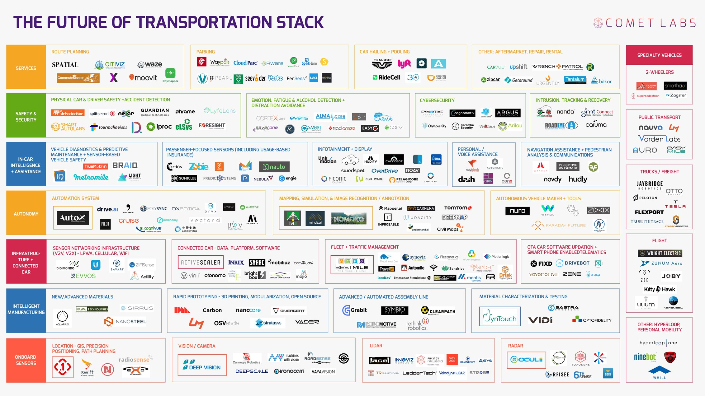
Open Sourcing Self-Driving Cars
I. Brief History of SDC: 2017
Comet Labs: 263 Companies Racing Towards Autonomous Cars
Alexey Simonov

Slide 5
Open Sourcing Self-Driving Cars
I. Brief History of SDC: Main Catalysts
Why now?
Main catalysts:
Advances in car technology
Electric powertrain
Drive-by-wire controls
Advanced driver assistance systems
Cheaper and better sensors: cameras, RADARs, LIDARs
Connectivity/Cloud/Big Data
detailed 3D maps
traffic, driving patterns data
other crowd-sourced data
AI / Machine Learning / Computer Vision
Better compute capabilities at ‘The Edge’ – GPUs, ASICs etc
State of the art results in image recognition/classification
State of the art results in reinforcement learning
Alexey Simonov

Slide 6
Open Sourcing Self-Driving Cars
II. Open Source: It is all about SOFTWARE
Logical Next Step: Open-Source [self-driving cars]
We know this in PyData community ☺
Seriously?
Well, it turns out it is [almost] all about software.
Autonomous car is a ROBOT, which does the following, in a loop:
Perceive the world through sensors (HARDWARE)
Make sense of the world and plan an action (SOFTWARE)
Execute the action (HARDWARE)
The main complexity is in step 2, which is all about SOFTWARE.
https://www.quora.com/How-do-I-build-a-self-driving-car-from-scratch
Alexey Simonov

Slide 7
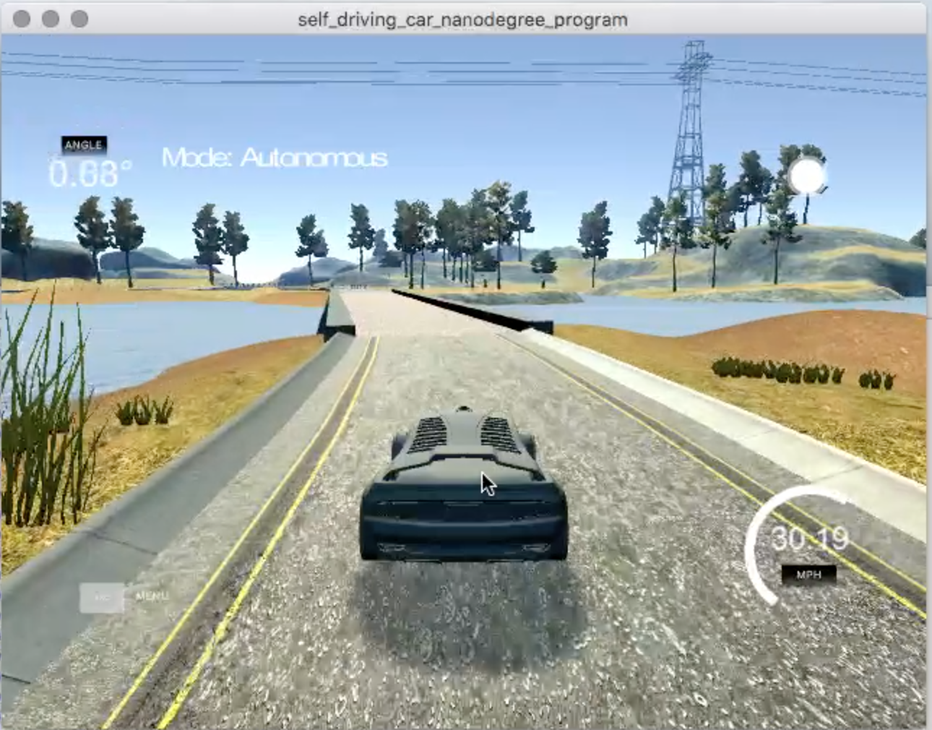
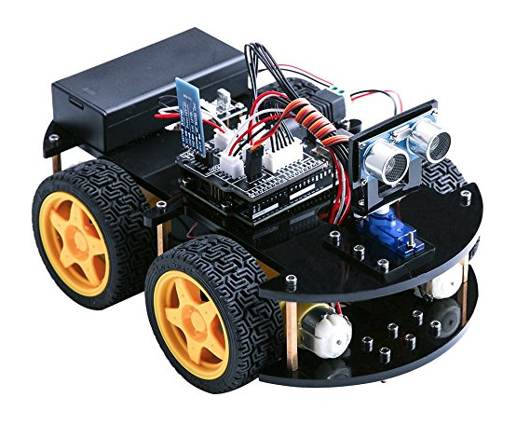
Open Sourcing Self-Driving Cars
II. Open Source: Hacking, DIY
So, how do I hack a self-driving car?
medium,
full
simulator
toy
Alexey Simonov

Slide 8
Open Sourcing Self-Driving Cars
II. Open Source: Hacking, DIY, Udacity
So, how do I hack a self-driving car?
Size:
simulator,
toy,
medium,
full
Sensors are getting cheap: cameras, radars, even LIDARs
Drive-by-wire Kits available to public
http://oscc.io/ - 1000$ Kia Soul 2014+, https://github.com/PolySync/OSCC
http://www.autonomoustuff.com/wp-content/uploads/2016/08/ADAS-Development-Vehicle-Kit.pdf - Lincoln MKZ or Ford Fusion
Computation capabilities increase (GPUs, FPGAs/ASICs)
Advances in [Open-Source] Deep Learning
Tensorflow and other frameworks
Open-source trained models for object detection, image segmentation, visual SLAM
Open Data Sets
http://synthia-dataset.net/
http://www.cvlibs.net/datasets/kitti/
http://ori.ox.ac.uk/the-oxford-robotcar-dataset/
…
Alexey Simonov

Slide 9
Open Sourcing Self-Driving Cars
II. DIY and Open Source (2)
DIY Car Kits:
https://mit-racecar.github.io/hardware/ - based on https://traxxas.com plus NVIDIA Jetson plus cameras, laser range sensors, IMU and ECU for wheel odometry
https://diyrobocars.com/raspberrypiarduino-car/ -- and many other designs
https://docs.google.com/spreadsheets/d/1iaOru6va1LXjhXfBtYTWhAH_3DQlvVIdpRZ0NJh-7q8/edit?usp=sharing -- possible configuration
Meetups:
https://www.meetup.com/DIYRobocars -- California
Open Source Projects:
https://github.com/OSSDC -- Open Source Self Driving Car Initiative
http://comma.ai/
Alexey Simonov

Slide 10
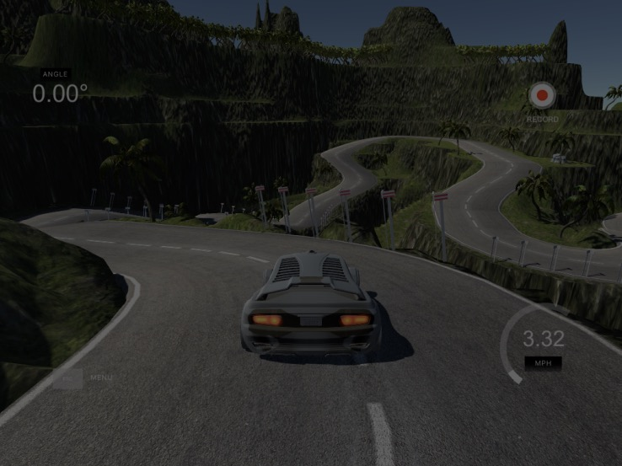
Thank you!
Questions?
Alexey Simonov
https://www.linkedin.com/in/alexeysimonov/

