Slide 1
Salary Analysis from Real Data Use ML to conduct salary analysis from an uneasy dataset and evaluate models’ performance.

Slide 2
CONTENTS
INTRODUCTION 3
BUSINESS CONTEXT 4
RELEVANCE 5
STAKEHOLDER BENEFIT 6
JUPYTER LAB VISUALS 7
FINAL MODEL ANALYSIS & INSIGHTS 16

Slide 3
Introduction
In earlier projects, I presented about employee turnover rates in the tech industry with an intentionally biased approach relating to certain variables.
Following, I wanted to emphasize how companies use ML to predict customer churn. This is a very important topic as profitability and customer retention are key factors in running a successful enterprise.
Today, based on real life data, I want to engage in salary analysis using a messy data set and real-life feature inputs. I will use multiple models and concepts learned in class to layout the results. This differs from the supervised thinking approach I took in past presentations, that were “if, then” structure based, based on the problem and corresponding data sets.
Use a real-life, messy data set, per the parameters of the project.

Slide 4
Business Context
What the dataset is about:
The data set was “live” and always changing. Technically, depending on the data pull, the data set results could vary based on the entry of survey respondents.
35% of the variables are free form text entry, which results in heavy data cleaning.
A considerable amount of time was spent cleaning the data. I think, in the real world, as an aspiring data scientist, that this is a good business case for what we will do in the future.

Slide 5
Why The Analysis Matters:
Salary analysis isn't just about cutting costs or paying fairly—it's a strategic tool to drive workforce effectiveness, fairness, and competitiveness.
Attracting and Retaining Talent – ensures companies can attract top talent in a tight job market
Ensuring Pay Equity – helps uncover gender pay gaps, racial disparities, and other inequalities
Budgeting and Financial Planning – helps align compensation with business goals and budget constraints
Performance and Productivity Insights – links salary with performance data to evaluate ROI per employee
Market Positioning – helps companies position themselves as employers of choice in their industry
Compliance with Regulations – salary audits help maintain compliance with labor laws
Internal Pay Structure Optimization – ensures logical pay hierarchies across job roles and levels

Slide 6
Stakeholder Benefit:
Stakeholders benefit both strategically and operationally by driving fairness, compliance, financial efficiency, and talent competitiveness.
Executives/ Leadership – enables alignment of compensation with business goals and growth plans
HR & Compensation Teams – ensures adherence to labor laws, avoiding fines and lawsuits
Hiring Managers – helps forecast salary ranges and set realistic compensation expectations
Employees – when communicated well, shows that pay decisions are based on data, not bias
Investors / Shareholders – helps ensure payroll (often a company’s biggest expense) is spent wisely

Slide 7
JUPYTER LAB
NOTEBOOK AND VISUAL AIDS

Slide 8
EDA VISUALS AND PERFORMANCE PLOTTING
KEY TERMS TO CONSIDER:
RMSE measures the average magnitude of prediction errors in your model. It tells you how far, on average, your predicted values are from the actual values. The lower the score, the better.
MAE measures the average absolute difference between your model's predictions and the actual values. The lower the score, the better as it relates to model errors.
The R² score tells you how well your model explains the variance in the target variable. It measures the proportion of the variance in the actual values that can be explained by the model's predictions. The higher the better approaching 1.0.

Slide 9
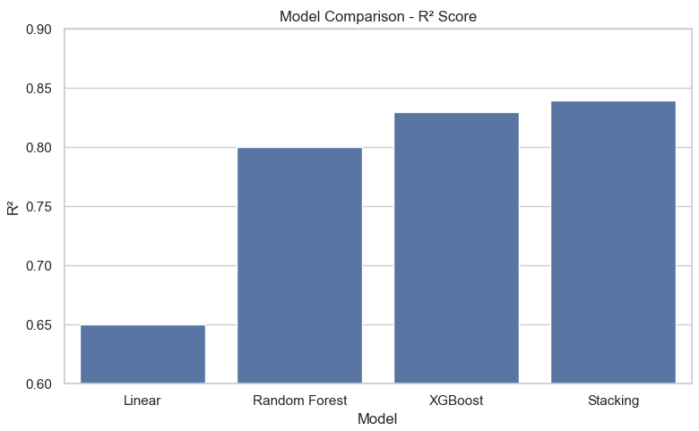

Slide 10
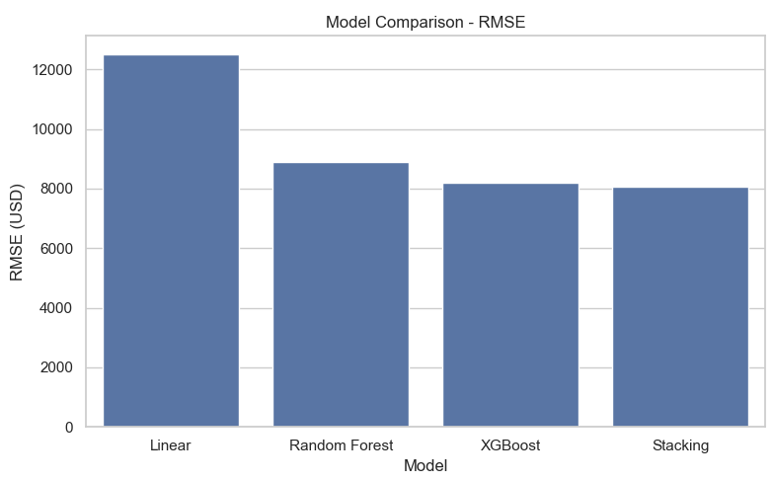
RMSE: LOWER IS BETTER. WILL THIS CARRY FORWARD IN THE FINAL RESULTS?

Slide 11
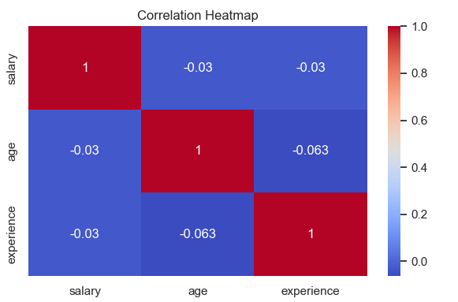

Slide 12
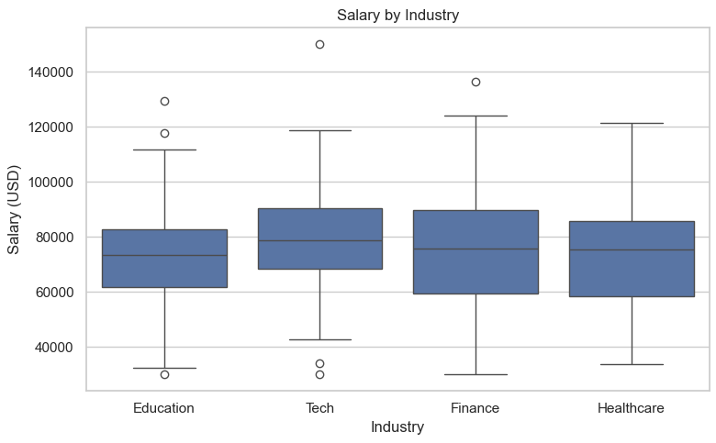

Slide 13
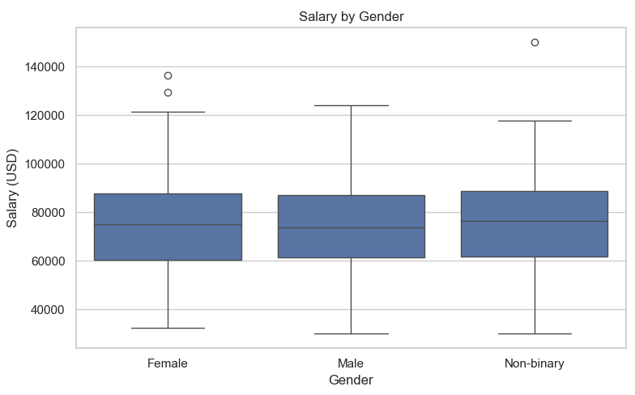

Slide 15
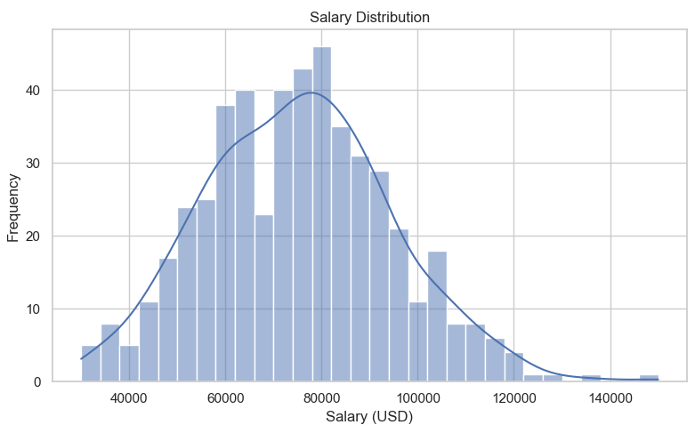

Slide 16
Final Model Analysis & Insights

Slide 17
Final Model Analysis and Insights
MODEL | RMSE | MAE | R2 | NOTES
LINEAR | 34172.71 | 27014.32 | 0.1429 | BASELINE MODEL. WEAK PREDICTIVE POWER
RIDGE | 34172.55 | 27014.37 | 0.1429 | SAME AS LINEAR; REGULARIZATION HAD MINIMAL EFFECT
RFOREST | 32575.32 | 24927.76 | 0.2211 | BIG IMPROVEMENT; NON- LINEAR RELATIONSHIPS CAPTURED
XGBOOST | 31691.66 | 24560.50 | 0.2628 | STRONGER; BETTER GENERALIZATION AND FEATURE HANDLING
STACKING | 31449.98 | 24536.50 | 0.2740 | BEST PERFORMER OVERALL; ENSEMBLE GAINS
Stacking performed best // Key features: experience, industry, age // Next Steps: add more contextual features
Linear & Ridge are nearly identical, suggesting minimal multicollinearity issues or limited benefit from regularization.
Random Forest gives a ~6% RMSE improvement over Linear and captures non-linear patterns.
XGBoost improves further, showing its strength in tabular data with complex feature interactions.
Stacking provides the best performance, indicating that combining models (e.g., linear + tree-based) leverages their complementary strengths.

Slide 18
THANK YOU
Adam Simpson
Institute of Data
Data Science Mini Project 3
June 30 2025

