Slide 1
Predicting Employee Attrition

Slide 2

Project Outline
Problem Selection Background
Business Problem
Stakeholders
Data Science Problem
Data Overview
Results and Insights
Future Work
Lab Exploration

Slide 3

Problem Selection Background
I spoke with a Data Scientist at my company who explained their role in the project approval process.
Data Scientists make model predictions to assess if projects add value.
Stakeholders present their business cases to the Executive Leadership Team (ELT).
ELT decides which projects to approve (“greenlight”).
After approval, Data Scientists evaluate the project’s feasibility by analyzing constraints, challenges, data, and other relevant information.

Slide 4

Business Problem
Employee attrition leads to significant productivity losses and increased hiring costs.
The goal is to develop a predictive model that identifies employees at risk of leaving, allowing for proactive retention strategies.
Objective: Predict employee attrition risk and identify contributing factors to enable proactive HR interventions.

Slide 5
Business Problem Justified
Employee turnover costs businesses a great deal of money, time and resources.
These costs are both direct and hidden and can take significant chunks of money from your budget.
Understanding where these costs come from and how to calculate them can help you estimate how expensive high employee turnover is.
Source: The Real Cost of Employee Turnover Now

Slide 6
Business Problem Justified
Recruiting takes time: multiple rounds of interviews are time consuming, candidate and interview debriefing, time lost engaging in the process
Lowered productivity: loss in real job performance, or vacancy produces a risk of zero production
Overworked remaining staff: loss in quality of work, goodwill, engagement; often hard to quantify in dollars
Lost of knowledge: Innate, artful experience, soft skills, and relationships are lost, in addition to the “why” behind the “what” and other relevant information
Turnover rates are higher than before: rates were 23% higher in 2024, than in 2019.
Replacement cost: between 50% and 4x an employees’ annual salary; thus, the ROI for investing in retention programs is clear: a loyal and experienced team will contribute directly to the company’s bottom line
Sources: 6 Reasons You Should Avoid the Hidden Costs of Employee Turnover // The Real Cost of Employee Turnover Now

Slide 7
Stakeholders
Senior
Leadership
Human
Resources
Potential Expansion: Employee Engagement Team
Improves Retention and Reduces Turnover
Boosts Productivity and Performance
Enhances Employee Experience and Morale
Drives Culture and Values
Supports Leadership with Data and Insights
Encourages Innovation and Collaboration
Finance
Department
7

Slide 8

Data Science Problem
Problem Type: Binary Classification (Attrition: Yes/No)
Challenge: Address class imbalance and identify meaningful predictors.
Solution: Machine learning-based predictive modeling. Build a classification model that predicts employee attrition using structured HR data.

Slide 9

Data Overview
Dataset Overview
Exploratory Data Analysis
Feature Engineering
Modeling Approach
Evaluation Metrics & Model Comparison
Results and Insights
Future Work

Slide 10

Dataset Overview
Source: IBM HR Analytics Employee Attrition dataset (Kaggle)
Records: 1470 employees
Features: 35 employee and job-related variables
Target Variable: Attrition (Yes/No)
Simulated NLP exercise

Slide 11
Exploratory Data Analysis
Monthly Income
Employees with higher salaries tend to stay
In real life scenarios, sentiment could have considerable predictive power
Age
Older employees are less likely to leave
Attrition rate 16% - imbalanced data indicator.
The correlation heatmap confirmed that no single variable strongly predicts attrition on its own.
However, moderate positive correlations with variables like OverTime suggest that workload pressure may drive attrition.
Sentiment analysis could reveal valuable insights if real employee feedback were available.

Slide 12
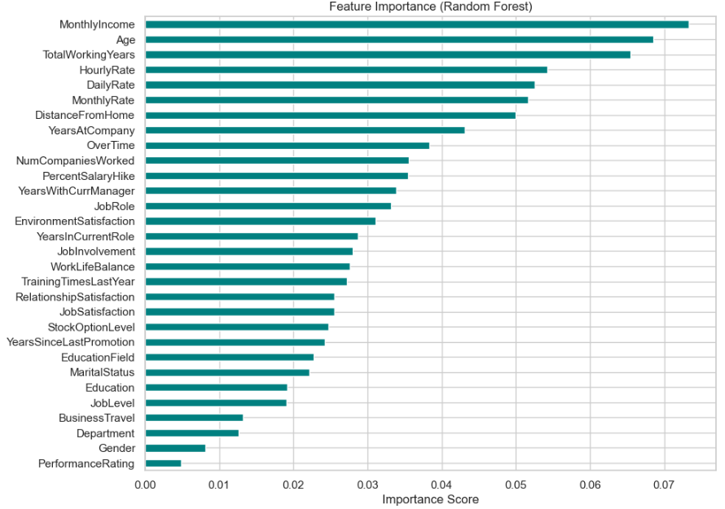
Feature Engineering
Categorical variables encoded using LabelEncoder
Scaling applied to numeric variables
Features with low variance removed
Weak correlations, but feature combinations matter

Slide 13
Metrics & Model Comparison
Model | Accuracy | Precision 0 employee stayed 1 employee left | F1 0 employee stayed 1 employee left | Recall | ROC – AUC
Logistic Regression | .87 | .89 / .69 | .93 / .49 | .97 / .38 | .80592
Random Forest | .84 | .85 / .46 | .91 / .20 | .97 / .13 | .78766
XGBoost | .85 | .87 / .56 | .91 / .31 | .97 / .21 | .75803
Ensemble | .87 | .87 / .79 | .93 / .36 | .99 / .23 | .81591

Slide 14
Results and Insights
Struggling to Catch Employees Likely to Leave (Attrition Cases)
Our focus is predicting who might leave
Models are missing most actual leavers:
Logistic Regression identifies only 38% of leavers
Random Forest and XGBoost find even fewer (13-21%)
The Ensemble Model improves slightly but still only finds 23%
Why?
Only about 16% of employees in the data leave
Models prefer predicting “No Attrition” to maximize overall accuracy

Slide 15

Results and Insights
ROC-AUC Scores Show Reasonable Potential
ROC-AUC (area under the curve) measures the model's ability to distinguish between leavers and stayers:
Models score between 0.75 and 0.82.
This suggests the models are capable, but thresholds and balance need adjusting.

Slide 16

Results and Insights
Overall prediction accuracy looks good, but is misleading
All models show high accuracy (.86% avg)
But this is because most employees stay, and the models mostly predict STAY correctly.
This is known as the accuracy trap in imbalanced problems.

Slide 17

What This Means for the Business
If deployed now, the models would miss most employees likely to leave.
This limits the model’s usefulness for proactive HR interventions.
Simple Analogy:
The model is a security guard trying to stop people from leaving.
Right now, the guard stops almost everyone who wasn’t going to leave—but misses most of the real leavers.
The guard needs better clues (features) or to be told to pay more attention to potential leavers (adjust model focus)

Slide 18
Future Work
Rebalance the models to focus more on catching potential leavers:
Adjust how models treat minority cases (employees who leave).
Use oversampling, class weighting, or threshold adjustments.
Consider adding richer features (like real feedback text or job stress indicators).
Have predictive model ready for deployment in HR systems, dashboards, and shared sites.
Model retraining with new employee data.
Insert Employee Engagement Team as needed to secure natural feedback
Conduct post-deployment effectiveness tracking.
While sentiment scores in this project were simulated, real-world deployment could involve analyzing authentic employee surveys and performance reviews using NLP.
Strict data governance would be necessary to avoid leakage and ensure model generalization

Slide 19

Thank You
Adam Simpson // Institute of Data // Data Science Capstone Project // July 26, 2025

