Slide 1

Accountability and Time Management
Professional Practices
Govt. Graduate College Samanabad Faisalabad
Dept. of Computer Science

Slide 2

Intro to Accountability
Significance & Components
Benefits
Intro to Time Management
Time Management Techniques
Benefits

Slide 3


Accountability
Accountability
Accountability refers to the obligation and responsibility that individuals and organizations have to answer for their actions, decisions, and performance in a reliable and transparent manner. It involves being answerable for both of the successes and failures.

Slide 4

Significance
Accountability
In the workplace, accountability is important
because it:
Encourages Hard Work
Accountability makes team members feel secure in knowing that their colleagues will take responsibility
for their commitments and deliver on their promises.
Promotes trust and transparency
When people know they can count on you, they'll
want to follow your lead.
Prevents managers from taking advantage of employees
Accountability can also eliminate the time and effort
you spend on distracting activities and other
unproductive behavior.
!

Slide 5
Significance
Accountability
Helps employees perform well
Individuals who feel responsible for their actions may be more likely to perform their tasks well and efficiently.
Increases employee happiness
A workplace that values accountability may foster
greater commitment and increased employee
happiness.
!

Slide 6
Components
Accountability
Here are some key components of accountability in professionalism:
1. Responsibility:
Recognizing and accepting one's duties and obligations in a given role.
Being aware of the tasks and expectations associated with the job or profession.
2. Transparency:
Openly sharing information about decisions, actions, and processes.
Providing clear and honest communication to relevant stakeholders.

Slide 7

Components
Accountability
3. Ethical Behavior:
Adhering to a set of ethical principles and standards.
Making decisions based on moral values and professional codes of conduct.
4. Integrity:
Maintaining consistency and honesty in all actions and interactions.
Acting in a way that aligns with established principles and values.
5. Reliability:
Consistently delivering high-quality work and meeting commitments.
Being dependable and trustworthy in fulfilling responsibilities.

Slide 8
Components
Accountability
6. Adherence to Standards:
Following established guidelines, rules, and regulations within the profession.
Complying with industry standards and best practices.
7. Self-regulation:
Monitoring and evaluating one's own performance and behavior.
Taking corrective actions and seeking improvement when necessary.
8. Ownership of Mistakes:
Acknowledging errors or shortcomings without blaming others.
Taking steps to rectify mistakes and prevent their recurrence.

Slide 9
Components
Accountability
9. Accountability Structures:
Establishing mechanisms for oversight and accountability within organizations.
Clearly defining roles, responsibilities, and reporting structures.
10. Continuous Learning:
Engaging in ongoing professional development.
Staying informed about industry changes and updates.

Slide 10
Benefits
Accountability
Trust and Creditability
Improved Performance
Enhanced Collaboration
Ethical Standards
Personal Growth
Efficient Problem Resolution
Organized Culture
Adaptability to Change
Stockholders satisfaction
Risk Mitigations

Slide 11
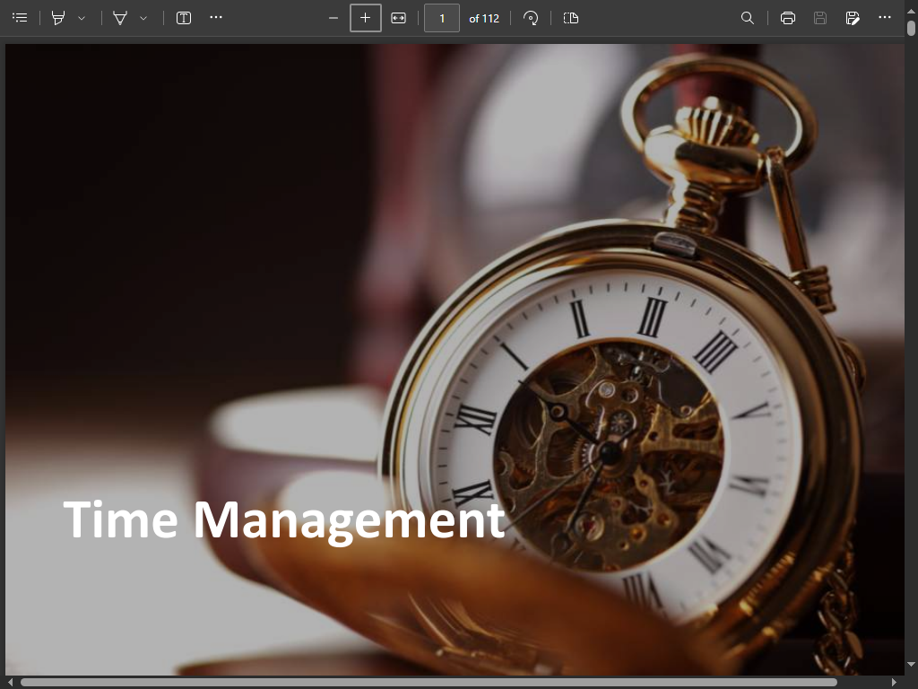

Slide 12


Time Management
Time Management
It is rightly said “Time and Tide wait for none”.
An individual should understand the value of time for him to succeed in all aspects of life.
People who waste time are the ones who fail to create an identity of their own

Slide 13
What is Time Management?
Time Management
Time management refers to;
Managing time effectively, so that the right time is allocated to the right activity.
Making the best use of time, as time is always limited.

Slide 14
Cont. …
Time Management
Effective time management allows individuals to assign specific time to activities as per their importance.
– Ask yourself “which activity is more important? How much time should be allocated to?”
– Know which work should be done earlier and which can be done a little later.
Time Management plays a very important role, not only in organizations, but also in our personal lives

Slide 15
Time Management Includes:
Time Management
Effective Planning
Setting Goals and Objectives
Setting Deadlines
Delegation of Responsibilities
Prioritizing Tasks
Spending the right time on the right activity

Slide 16
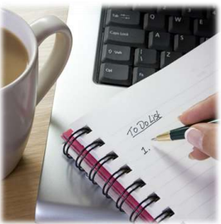
1- Effective Planning
Plan your day well in advance.
1. Prepare a To Do List or a “TASK PLAN”.
2. Order activities according to their priority.
3. Allocate suitable time to each activity.
Complete pending tasks one by one.
– Do not begin fresh work unless you have finished your previous task.
Tick the ones you have already completed.
Ensure you finish tasks within the stipulated time frame.

Slide 17
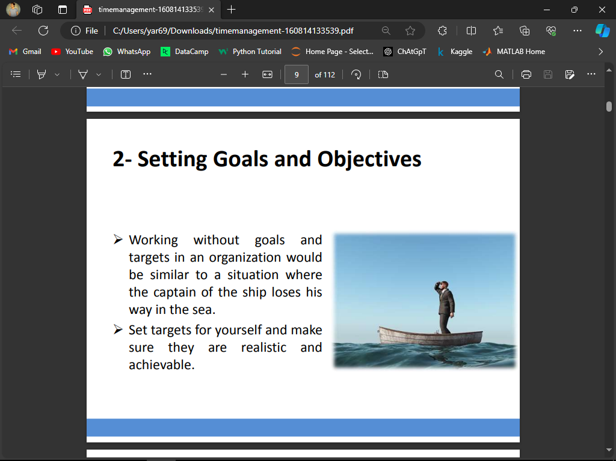
2- Setting Goals and Objectives
Working without goals and targets in an organization would be similar to a situation where the captain of the ship loses his way in the sea.
Set targets for yourself and make sure they are realistic and achievable.

Slide 18
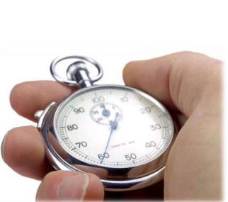
3- Setting Deadlines
Ask yourself “how much time needs to be devoted to a particular task?”
Set deadlines for every task, and be committed to.
– Do not wait for your superiors to ask you every time.
– Learn to be self driven

Slide 19
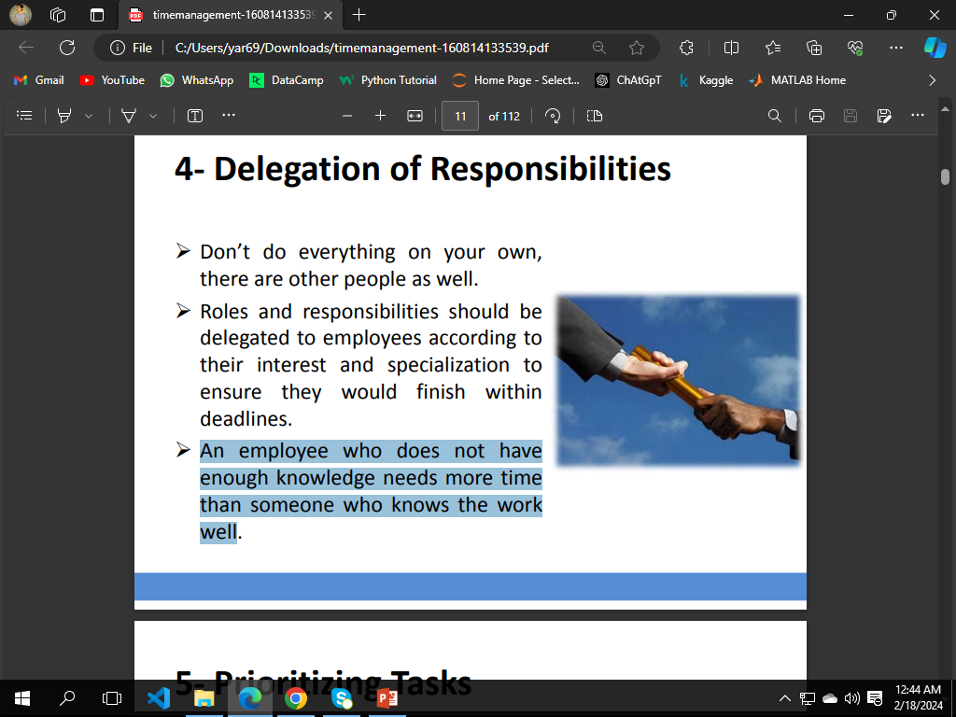
4- Delegation of Responsibilities
Don’t do everything on your own, there are other people as well.
Roles and responsibilities should be delegated to employees according to their interest and specialization to ensure they would finish within deadlines.
An employee who does not have enough knowledge needs more time than someone who knows the work well

Slide 20
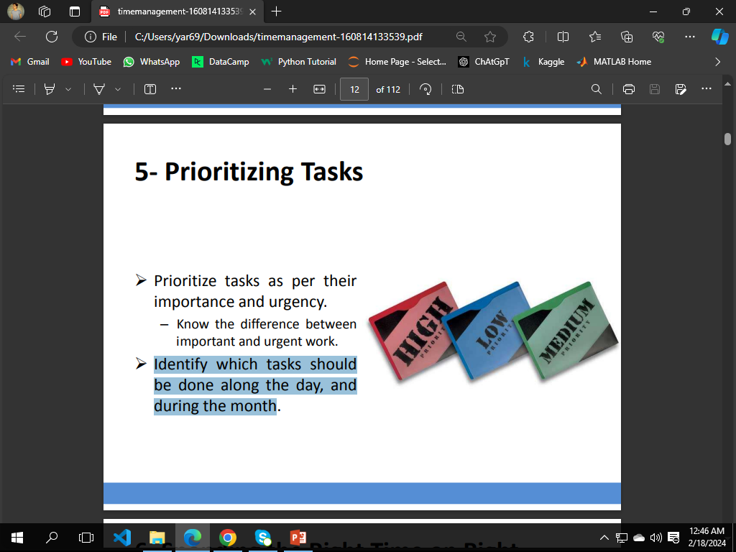
5- Priorities Tasks
Prioritize tasks as per their importance and urgency.
– Know the difference between important and urgent work.
Identify which tasks should be done along the day, and during the month.

Slide 21
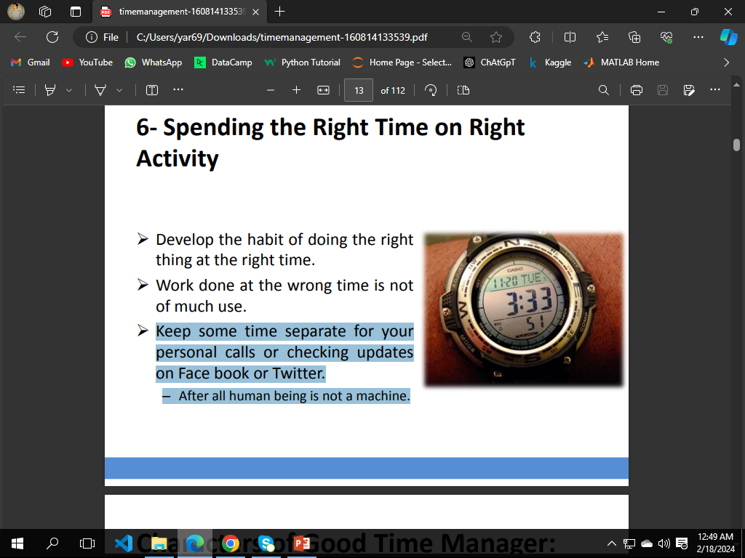
6- Spending the right time on right activity
Develop the habit of doing the right thing at the right time.
Work done at the wrong time is not of much use.
Keep some time separate for your personal calls or checking updates on Face book or Twitter.
– After all human being is not a machine.

Slide 22
Time Management Techniques
Accountability

Slide 23
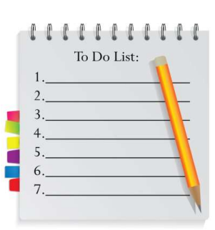
1. Set Your Priorities
Accountability
Prepare a “To Do” List or a “Task Plan” to jot down tasks you need to complete against the time slot assigned to each activity.
High priority tasks must be written on top followed by tasks which can be done a little later.
Make sure you stick to your task list.

Slide 24
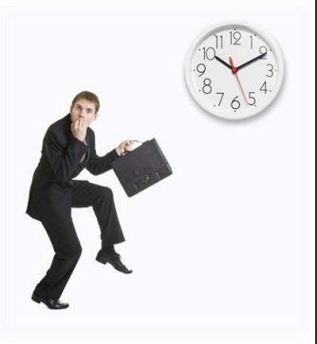
2. Finish Your Assignments on Time
Accountability
Tick the tasks you have already
Finished.

Slide 25
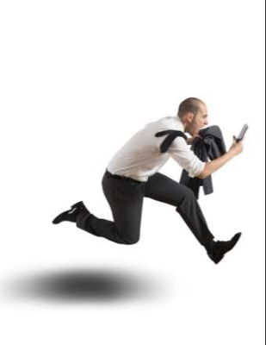
3. Differentiate b/w Urgent and Important
Accountability
Important “ … of great significance or value”
Urgent “ … requiring immediate action or attention”
Do not wait for your Boss’s Reminders.

Slide 26
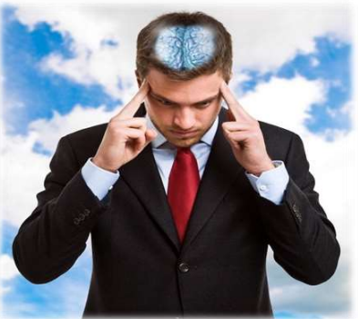
4. Stay Focused
Accountability
While doing an urgent job, do not leave your work station.
Going for strolls in the middle of an urgent work breaks continuity and makes you loose focus.

Slide 27
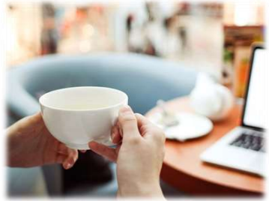
5. Add Life to Work
Accountability
In your daily schedule, you should include time for:
– Tea breaks
– Net surfing
– Personal calls

Slide 28
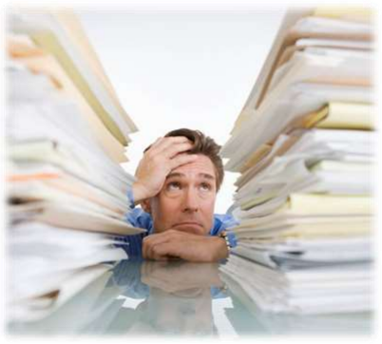
6. Don’t Overload Yourself
Accountability
Say a firm “no” to your boss if you feel you would not be able to complete a certain assignment within the assignment deadline.

Slide 29
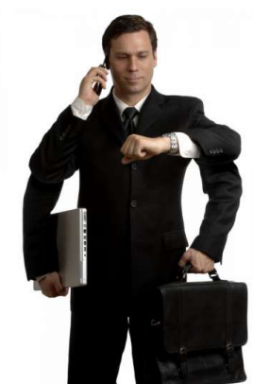
7. Be Disciplined and Punctual
Accountability
Avoid taking unnecessary leaves from work.
Reach work on time as it helps you to plan your day better.

Slide 30
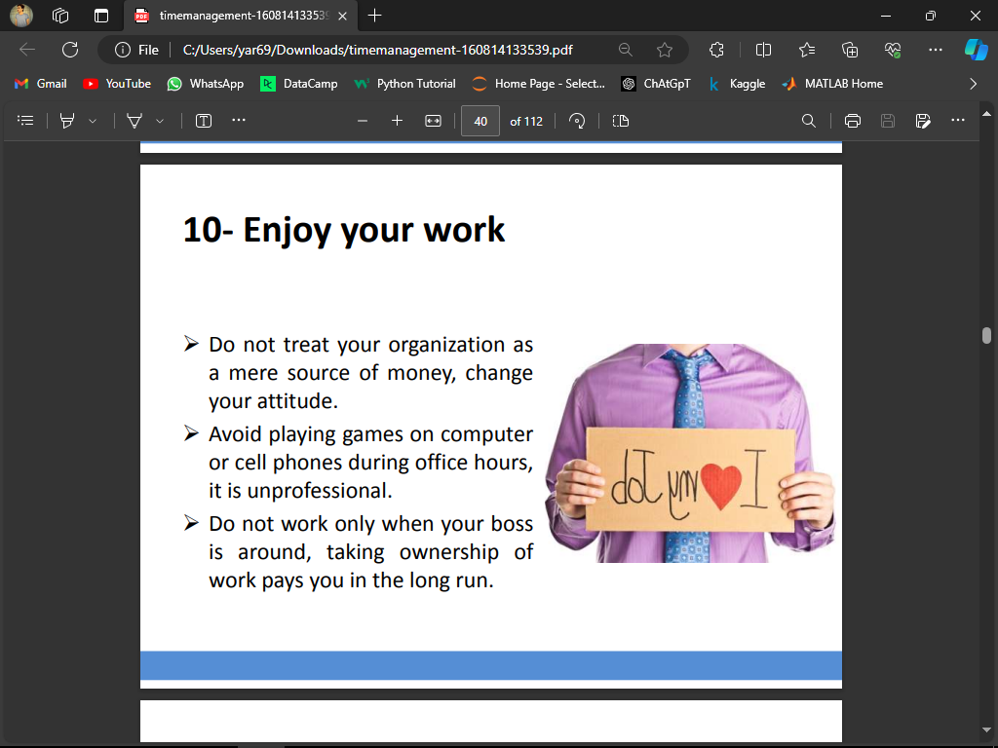
8. Enjoy Your Work
Accountability
Do not treat your organization as a mere source of money, change your attitude.
Avoid playing games on computer or cell phones during office hours, it is unprofessional.
Don not work only when your boss is around, taking ownership of work pays you in the long run.

Slide 31
Benefits
Accountability
Make you Punctual and Disciplined
Make you more Organized
Boosts your confidence and Morale
Reduce Time to Reach Goals
Make you Plan Better
Reduces Stress & Anxiety
Better Prioritizing of Tasks

