Slide 1
Data Structures & Algorithms
Week # 4: Basic Sorting Algorithms
Instructor Information:
Mr. INAM UL HAQ
Email: inamulhaq@imsciences.edu.pk

Slide 2
Sorting
Motivation
  Generally, to arrange a list of elements in some order
List of numbers
  10 20 50 30 40 60 25 (Unsorted list)
  10 20 25 30 40 50 60 (Sorted list, ascending)
  60 50 40 30 25 20 10 (Sorted list, descending)
List of alphabets
  P A K I S T A N (Unsorted list)
  A A I K N P S T (Sorted list, ascending)
  T S P N K I A A (Sorted list, descending)

Slide 3
Sorting Algorithms
Bubble Sort
Selection Sort
Insertion Sort
Quick Sort
Merge Sort
There are few more sorting algorithms; you can find them in a book on data structures and algorithms (or on the Web)

Slide 4
Bubble Sort Algorithm: Informal
Repeatedly compare the elements at consecutive locations in a given list, and do the following until the elements are in required order:
  If elements are not in the required order, swap them (change their position)
  Otherwise do nothing

Slide 5
Bubble Sort in Action: Phase 1
3
3
3
3
3
3
3
3
45
8 comparisons
15
15
15
15
15
15
15
45
3
45
45
45
45
45
45
45
15
15
40
40
40
40
40
40
40
40
40
8
8
8
8
22
22
22
22
22
12
12
12
22
8
8
8
8
8
5
5
22
12
12
12
12
12
12
22
22
5
5
5
5
5
5
5
14
14
14
14
14
14
14
14
14

Slide 6
Bubble Sort in Action: Phase 2
45
45
45
45
45
45
45
45
7 comparisons
3
3
3
3
3
3
3
40
15
15
15
15
15
15
40
3
40
40
40
40
40
40
15
15
22
22
22
22
22
22
22
22
8
8
8
14
14
14
14
14
12
12
14
8
8
8
8
8
5
14
12
12
12
12
12
12
14
5
5
5
5
5
5
5

Slide 7
Bubble Sort in Action: Phase 3
45
45
45
45
45
45
45
6 comparisons
40
40
40
40
40
40
40
3
3
3
3
3
3
22
15
15
15
15
15
22
3
22
22
22
22
22
15
15
14
14
14
14
14
14
14
8
8
12
12
12
12
12
12
12
8
8
8
8
8
5
5
5
5
5
5
5

Slide 8
Bubble Sort in Action: Phase 4
45
45
45
45
45
45
5 comparisons
40
40
40
40
40
40
22
22
22
22
22
22
3
3
3
3
3
15
15
15
15
15
15
3
14
14
14
14
14
14
12
12
12
12
12
12
8
8
8
8
8
8
5
5
5
5
5
5

Slide 9
Bubble Sort in Action: Phase 5
45
45
45
45
45
4 comparisons
40
40
40
40
40
22
22
22
22
22
15
15
15
15
15
3
3
3
3
14
14
14
14
14
3
12
12
12
12
12
8
8
8
8
8
5
5
5
5
5

Slide 10
Bubble Sort in Action: Phase 6
45
45
45
45
3 comparisons
40
40
40
40
22
22
22
22
15
15
15
15
14
14
14
14
3
3
3
12
12
12
12
3
8
8
8
8
5
5
5
5

Slide 11
Bubble Sort in Action: Phase 7
45
45
45
2 comparisons
40
40
40
22
22
22
15
15
15
14
14
14
12
12
12
3
3
8
8
8
3
5
5
5

Slide 12
Bubble Sort in Action: Phase 8
45
45
1 comparison
40
40
22
22
15
15
14
14
12
12
8
8
3
5
5
3

Slide 13
Bubble Sort Algorithm in Java
void bubbleSort(int List[])
{ int temp;
int size = List.length;
for (i = 0; i < size - 1; i++)
{
  for (j = 0; j < size – (i + 1); j++)
  {
  if (List[j] > List[j+1])
  { //swap
  temp = List[j];
  List[j] = List[j+1];
  List[j+1] = temp;
  }
  }
  }
  }
Time complexity of the Bubble Sort algorithm is O(n²). Think why?

Slide 14
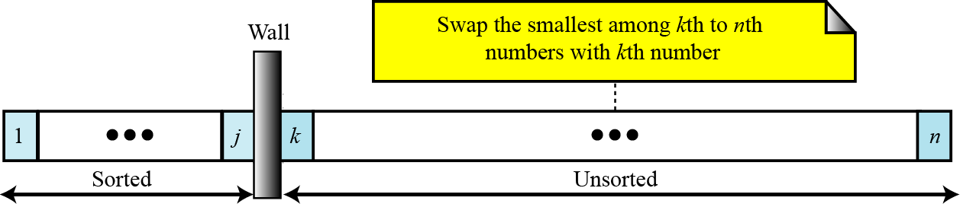
Selection Sort: Informal
Suppose we want to sort an array in ascending order:
  Locate the smallest element in the array; swap it with element at index 0
  Then, locate the next smallest element in the array; swap it with element at index 1.
  Continue until all elements are arranged in order

Slide 15
Selection Sort in Action
3
14
14
14
15
15
15
15
45
45
45
45
40
40
40
40
8
8
8
22
12
12
12
12
5
5
22
8
22
22
5
5
14
3
3
3

Slide 16
Selection Sort in Action
14
14
22
22
15
15
15
40
45
45
45
45
40
40
40
15
22
22
14
14
12
12
12
12
8
8
8
8
5
5
5
5
3
3
3
3

Slide 17
Selection Sort in Action
22
45
45
45
40
40
40
40
45
22
22
22
15
15
15
15
14
14
14
14
12
12
12
12
8
8
8
8
5
5
5
5
3
3
3
3

Slide 18
Selection Sort Algorithm in Java
void selectionSort(int List[])
{
int temp, min;
int size = List.length;
for (i = 0; i < size; i++){
min = i;
  for (j = i + 1; j < size; j++)
  {
  if (List[j] < List[min])
  {min = j; }
  }
  temp = List[min];
  List[min] = List[i]; //swap
  List[i] = temp;
  }
}
Time complexity of the Selection Sort algorithm is O(n²). Think why?

Slide 19
Bubble Sort vs. Selection Sort
Selection Sort is more efficient than Bubble Sort, because of fewer exchanges in the former
Both Bubble Sort and Selection Sort belong to the same (quadratic) complexity class (O(n²))
Bubble Sort may be easy to understand as compared to Selection Sort – What do you think?

Slide 20
Insertion Sort
Works like someone who inserts one more card at a time into a hand of cards that are already sorted
To insert 12, we need to make room for it …
6
10
24
36
12

Slide 21
Insertion Sort
… by shifting first 36 towards right…
6
10
24
36
12

Slide 22
Insertion Sort
6
10
24
… and then shifting 24 towards right
36
12

Slide 23
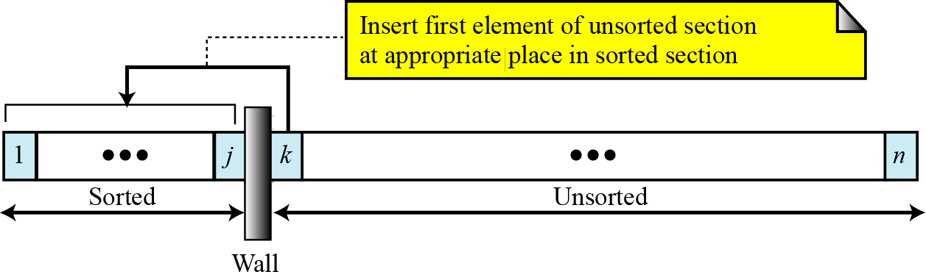
Insertion Sort
6
10
12
24
Once room is available, insert the element (12 in this case)
36

Slide 24
Insertion Sort: Informal
We divide the list into two parts: Sorted and Unsorted parts
  Initially
    the sorted part contains the first element (at index 0)
    the unsorted part contains the elements from index 1 to N-1
  Then, we move element from index 1 to an appropriate position in the sorted part, keeping order intact
  Then, we move element from index 2 to an appropriate position in the sorted part, keeping order intact
  ...
  Finally, we move element from index N-1 to an appropriate position in the sorted part, keeping order intact

Slide 25
Insertion Sort Algorithm in Java
void insertionSort(int List[]){
int temp;
int size = List.length;
for (int i = 1; i < size; i++){
int j = i;
temp = List[i];
  while (j > 0 && temp < List[j - 1]){
  List[j] = List[j - 1]; // right shifting
  j--;
  }
  List[j] = temp;
  }
}
Time complexity of the Insertion Sort algorithm is O(n²). Think why?

Slide 26

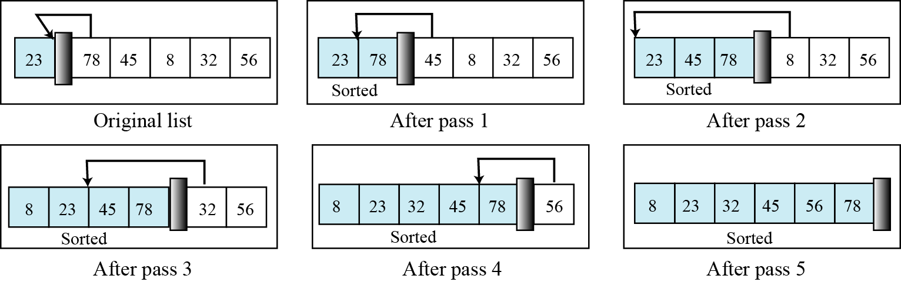
Insertion Sort example

