Slide 1
Data Structures & Algorithms
Week # 7: Recursion
Instructor Information:
Mr. INAM UL HAQ
Email: inamulhaq@imsciences.edu.pk

Slide 2
Recursion: Basic idea
We have a bigger problem whose solution is difficult to find
We divide/decompose the problem into smaller (sub) problems
  Keep on decomposing until we reach to the smallest sub-problem (base case) for which a solution is known or easy to find
  Then go back in reverse order and build upon the solutions of the sub-problems
Recursion is applied when the solution of a problem depends on the solutions to smaller instances of the same problem

Slide 3
Finding a recursive solution
Each successive recursive call should bring you closer to a situation in which the answer is known (cf. n-1 in the previous slide)
A case for which the answer is known (and can be expressed without recursion) is called a base case
Each recursive algorithm must have at least one base case, as well as the general recursive case

Slide 4


Recursion vs. Iteration: Computing N!
The factorial of a positive integer n, denoted n!, is defined as the product of the integers from 1 to n. For example, 4! = 4·3·2·1 = 24.
  Iterative Solution
  Recursive Solution

Slide 5
Recursive Function
A function which calls itself
int factorial ( int n ) {
if ( n == 0) // base case
return 1;
else // general/ recursive case
return n * factorial ( n - 1 );
}

Slide 6
Recursion in Action: factorial(n)
Base case arrived
Some concept from elementary maths: Solve the inner-most bracket, first, and then go outward
factorial (5) = 5 x factorial (4)
= 5 x (4 x factorial (3))
= 5 x (4 x (3 x factorial (2)))
= 5 x (4 x (3 x (2 x factorial (1))))
= 5 x (4 x (3 x (2 x (1 x factorial (0)))))
= 5 x (4 x (3 x (2 x (1 x 1))))
= 5 x (4 x (3 x (2 x 1)))
= 5 x (4 x (3 x 2))
= 5 x (4 x 6)
= 5 x 24
= 120

Slide 7
How to write a recursive function?
Determine the size factor (e.g. n in factorial(n))
Determine the base case(s)
  the one for which you know the answer (e.g. 0! = 1)
Determine the general case(s)
  the one where the problem is expressed as a smaller version of itself (must converge to base case)
Verify the algorithm
  use the "Three-Question-Method” – next slide

Slide 8
Three-Question Verification Method
The Base-Case Question
Is there a non-recursive way out of the function, and does the routine work correctly for this "base" case? (cf. if (n == 0) return 1)
The Smaller-Caller Question
Does each recursive call to the function involve a smaller case of the original problem, leading towards the base case? (cf. factorial(n-1))
The General-Case Question
Assuming that the recursive call(s) work correctly, does the whole function work correctly?

Slide 9
Linear Recursion
The simplest form of recursion is linear recursion, where a method is defined so that it makes at most one recursive call each time it is invoked
This type of recursion is useful when we view an algorithmic problem in terms of a first or last element plus a remaining set that has the same structure as the original set

Slide 10
Summing the Elements of an Array
We can solve this summation problem using linear recursion by observing that the sum of all n integers in an array A is:
    Equal to A[0], if n = 1, or
    The sum of the first n − 1 integers in A plus the last element
int LinearSum(int A[], n){
if n = 1 then
return A[0];
else
return A[n-1] + LinearSum(A, n-1)
}

Slide 11
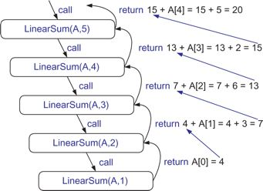
Analyzing Recursive Algorithms using Recursion Traces
Recursion trace for an execution of LinearSum(A,n) with input parameters A = [4,3,6,2,5] and n = 5

Slide 12
Linear recursion: Reversing an Array
Swap 1st and last elements, 2nd and second to last, 3rd and third to last, and so on
If an array contains only one element no need to swap (Base case)
Update i and j in such a way that they converge to the base case (i = j)
i
j
5
10
18
30
45
50
60
65
70
80

Slide 13
Linear recursion: Reversing an Array
void reverseArray(int A[], i, j){
if (i < j){
int temp = A[i];
A[i] = A[j];
A[j] = temp;
reverseArray(A, i+1, j-1)
}
// in base case, do nothing
}

Slide 14
Linear recursion: run-time analysis
Time complexity of linear recursion is proportional to the problem size
  Normally, it is equal to the number of times the function calls itself
In terms of Big-O notation time complexity of a linear recursive function/algorithm is O(n)

Slide 15
Recursion and stack management
A quick overview of stack
  Last in first out (LIFO) data structure
  Push operation adds new element at the top
  Pop operation removes the top element

Slide 16
What happens when a function is called?
The rest of the execution in “caller” is suspended
An activation record is created on stack, containing
  Return address (in the caller code)
  Current (suspended) status of the caller
Control is transferred to the “called” function
The called function is executed
Once the called function finishes its execution, the activation record is popped of, and the suspended activity resumes
  int a(int w)
  {
  return w+w;
  }
  int b(int x)
  {
  int z,y;
  z = a(x) + y;
  return z;
  }

Slide 17
What happens when a recursive function is called?
Except the fact that the calling and called functions have the same name, there is really no difference between recursive and non-recursive calls
      int f(int x){
      {
      int y;
      if(x==0)
      return 1;
      else{
      y = 2 * f(x-1);
      return y+1;
      }
      }

Slide 18
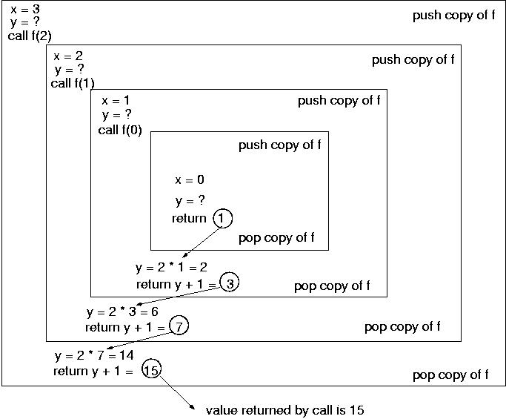
Recursion: Run-time stack tracing
2*f(2)
2*f(1)
2*f(0)
Let the function is called with parameter value 3, i.e. f(3)
=f(0)
      int f(int x){
      {
      int y;
      if(x==0)
      return 1;
      else{
      y = 2 * f(x-1);
      return y+1;
      }
      }
=f(1)
=f(2)
=f(3)

Slide 19
Recursion and stack management
A quick overview of stack
  Last in first out (LIFO) data structure
  Push operation adds new element at the top
  Pop operation removes the top element

Slide 20
Binary recursion
Binary recursion occurs whenever there are two recursive calls for each non-base case
These two calls can, for example, be used to solve two similar halves of some problem
For example, the LinearSum program can be modified as:
    recursively summing the elements in the first half of the Array
    recursively summing the elements in the second half of the Array
    adding these two sums/values together

Slide 21
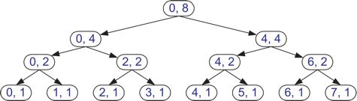
Binary Recursion: Array Sum
    A is an array, i is initialised as 0, and n is initialised as array size
int BinarySum(int A[], int i, int n){
if (n == 1)then // base case
return A[i];
else // recursive case I
return BinarySum(A, i, n/2) + BinarySum(A, i+n/2, n/2);
}
    Recursion trace for BinarySum, for n = 8 [Solve step-by-step]

Slide 22
Binary Search using Binary Recursion
    A is an array, key is the element to be found, LI is initialised as 0, and HI is initialised as array size - 1
int BinarySearch(int key, int A[], int LI, int HI){
if (LI > HI)then // key does not exist
return -1;
if (key == A[mid]) // base case
return mid;
else if (key < A[mid]) // recursive case I
BinarySearch(key, A, LI, mid - 1);
else // recursive case II
BinarySearch(key, A, mid + 1, HI);
}

Slide 23
Tail Recursion
An algorithm uses tail recursion if it uses linear recursion and the algorithm makes a recursive call as its very last operation
For instance, our reverseArray algorithm is an example of tail recursion
Tail recursion can easily be replaced by iterative code
  Embed the recursive code in a loop
  Remove the recursive call statement

Slide 24
Recursion: Do we really need it?
In some programming languages recursion is imperative
  For example, in declarative/logic languages (LISP, Prolog etc.)
  Variables can’t be updated more than once, so no looping – (think, why no looping?)
  Heavy backtracking

Slide 25
Efficiency of recursion
Recursion is not efficient because:
  It may involve much more operations than necessary (Time complexity)
  It uses the run-time stack, which involves pushing and popping a lot of data in and out of the stack, some of it may be unnecessary (Time and Space complexity)
Both the time and space complexities of recursive functions may be considerably higher than their iterative alternatives

Slide 26
Recursion: general remarks
Use recursion when:
  The depth of recursive calls is relatively “shallow” compared to the size of the problem. (factorial is deep)
  The recursive version does about the same amount of work as the non-recursive version. (fibonacci does more work)
  The recursive version is shorter and simpler than the non-recursive solution (towers of hanoi)

Slide 27
Programming Tasks
Write a recursive function to compute first N Fibonacci numbers. Test and trace for N = 6
1 1 2 3 5 8
Write a recursive function to compute power of a number (x^{n}). Test and trace for 4⁵.
THE EUCLIDEAN ALGORITHM
The Euclidean Algorithm computes the greatest common divisor of two positive integers. It is probably the oldest recursive algorithm. As originally formulated by Euclid, it says to subtract repeatedly the smaller number n from the larger number m until the resulting difference d is smaller than n. Then repeat the same steps with d in place of n and with n in place of m. Continue until the two numbers are equal. Then that number will be the greatest common divisor of the original two numbers.

Slide 28
Outlook
Next week, we’ll discuss recursive sorts

