Slide 1
Potential Flow Theory : Incompressible Flow
P M V Subbarao
Professor
Mechanical Engineering Department
IIT Delhi
A mathematical Tool to invent flow Machines.. ..

Slide 2
Basic Elements for Construction Flow Devices
Any fluid device can be constructed using following Basic elements.
The uniform flow: A source of initial momentum.
Complex function for Uniform Flow : W = Uz
The source and the sink : A source of fluid mass.
Complex function for source : W = (m/2π)ln(z)
The vortex : A source of energy and momentum.
Complex function for Uniform Flow : W = (iγ/2π)ln(z)

Slide 3
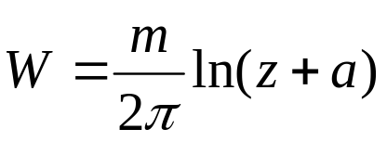
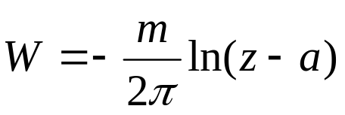
THE DIPOLE
Also called as hydrodynamic dipole.
It is created using the superposition of a source and a sink of equal intensity placed symmetrically with respect to the origin.
Complex potential of a source positioned at (-a,0):
Complex potential of a sink positioned at (a,0):
The complex potential of a dipole, if the source and the sink are positioned in (-a,0) and (a,0) respectively is :

Slide 4
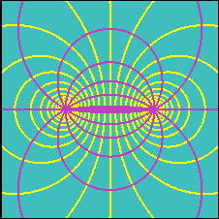
Streamlines are circles, the center of which lie on the y-axis and they converge obviously at the source and at the sink.
Equipotential lines are circles, the center of which lie on the x-axis.

Slide 5
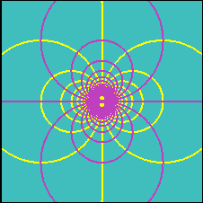
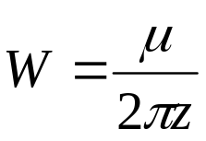
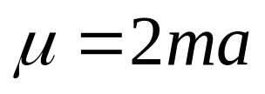
THE DOUBLET
A particular case of dipole is the so-called doublet, in which the quantity a tends to zero so that the source and sink both move towards the origin.
The complex potential of a doublet
is obtained making the limit of the dipole potential for vanishing a with the constraint that the intensity of the source and the sink must correspondingly tend to infinity as a approaches zero, the quantity

Slide 6
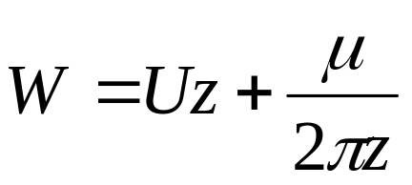
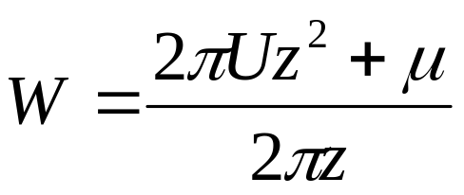
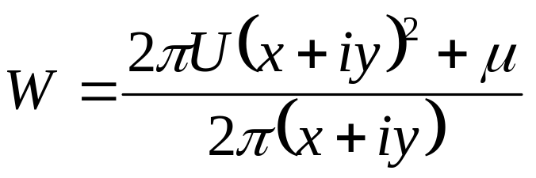
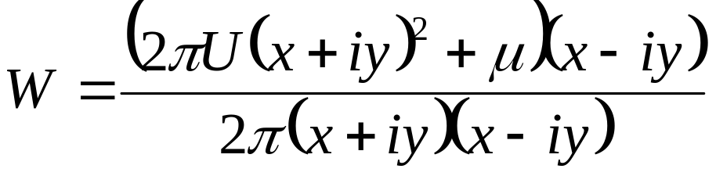
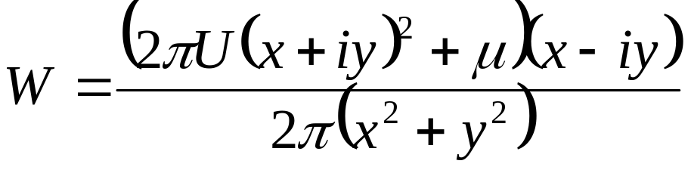
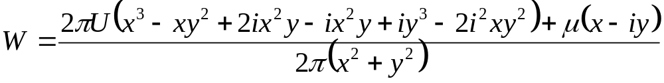
Uniform Flow Past A Doublet
The superposition of a doublet and a uniform flow gives the complex potential

Slide 7
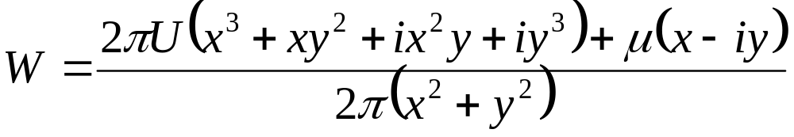
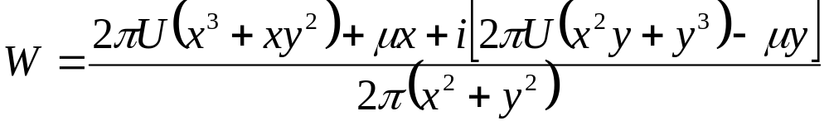
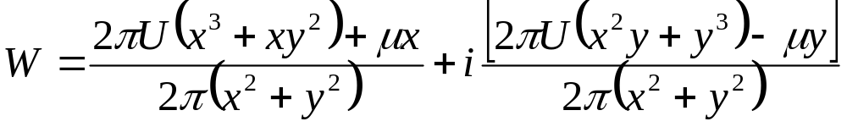

Slide 8
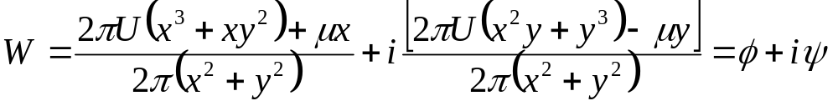
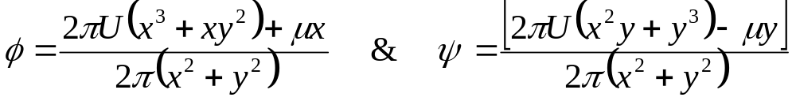
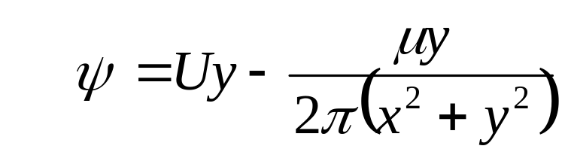
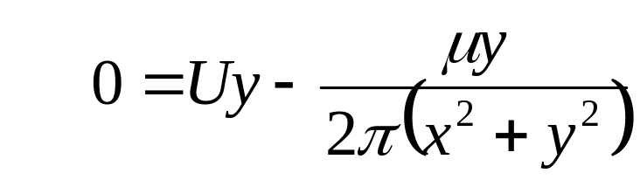
Find out a stream line corresponding to a value of steam function is zero

Slide 9
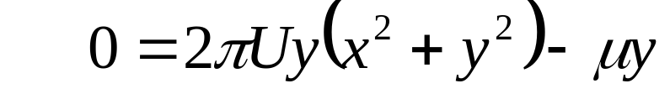
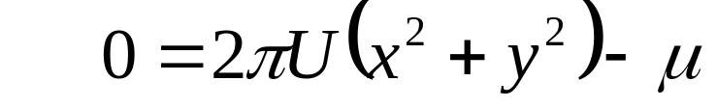
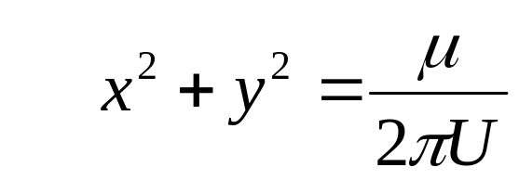
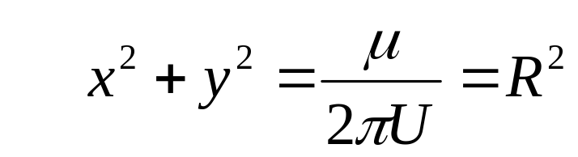
There exist a circular stream line of radium R, on which value of stream function is zero.
Any stream function of zero value is an impermeable solid wall.
Plot shapes of iso-streamlines.

Slide 10
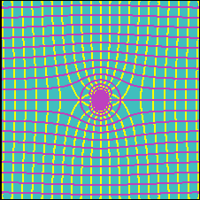
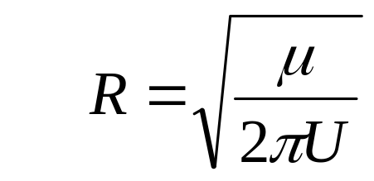
Note that one of the streamlines is closed and surrounds the origin at a constant distance equal to

Slide 11

Recalling the fact that, by definition, a streamline cannot be crossed by the fluid, this complex potential represents the irrotational flow around a cylinder of radius R approached by a uniform flow with velocity U.
Moving away from the body, the effect of the doublet decreases so that far from the cylinder we find, as expected, the undisturbed uniform flow.
In the two intersections of the x-axis with the cylinder, the velocity will be found to be zero.
These two points are thus called stagnation points.

Slide 12
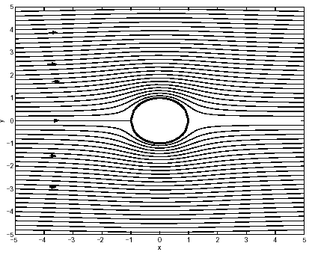

Slide 13
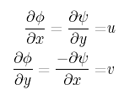
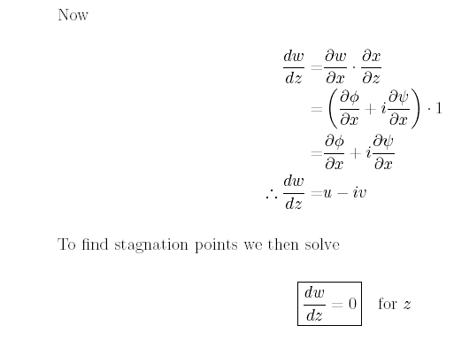
Velocity components from w

Slide 14
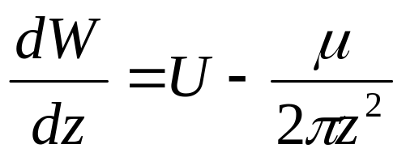
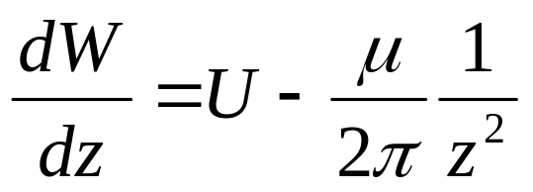
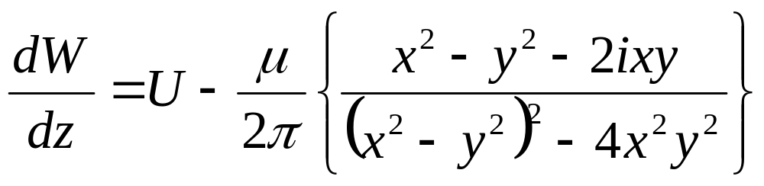
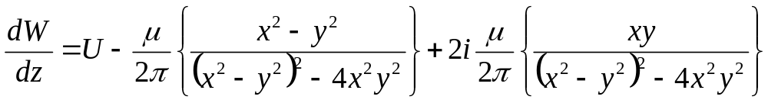
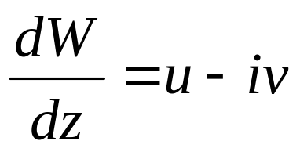
To obtain the velocity field, calculate dw/dz.

Slide 15
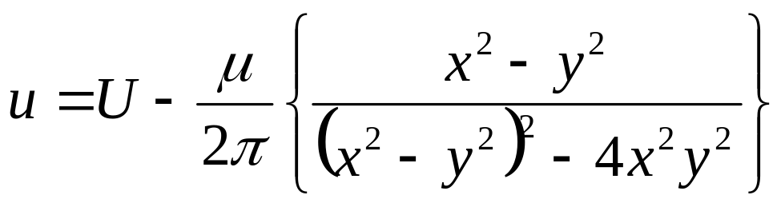
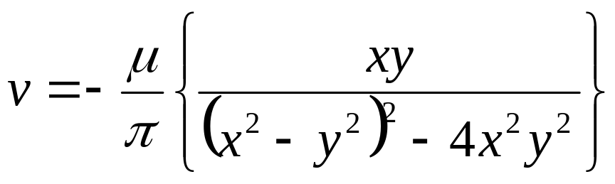

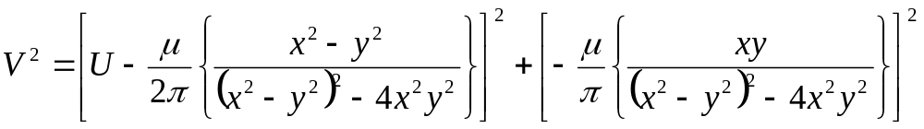
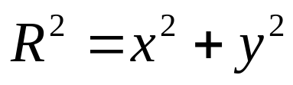
Equation of zero stream line:
with

Slide 16
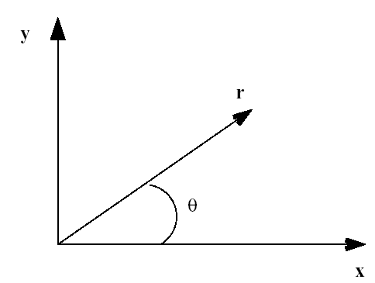
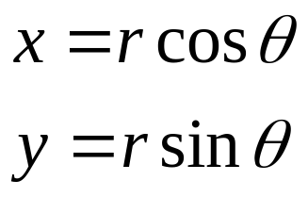
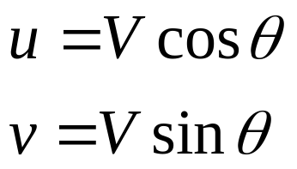
Cartesian and polar coordinate system

Slide 17
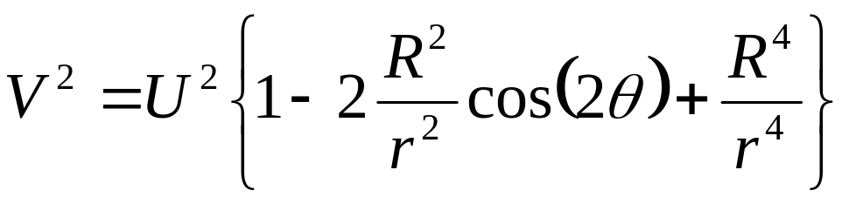
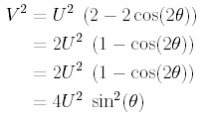
On the surface of the cylinder, r = R, so

Slide 18
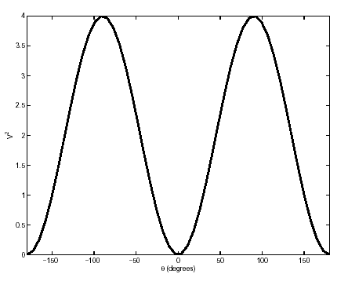
V² Distribution of flow over a circular cylinder
The velocity of the fluid is zero at = 0º and = 180º. Maximum velocity occur on the sides of the cylinder at = 90º and = -90º.

Slide 19

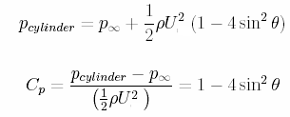
Pressure distribution on the surface of the cylinder can be found by using Benoulli’s equation.
Thus, if the flow is steady, and the pressure at a great distance is p∞,

Slide 20
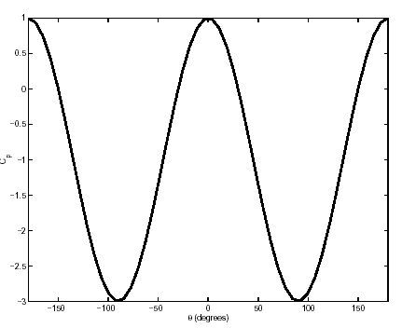
C_{p} distribution of flow over a circular cylinder

Slide 21
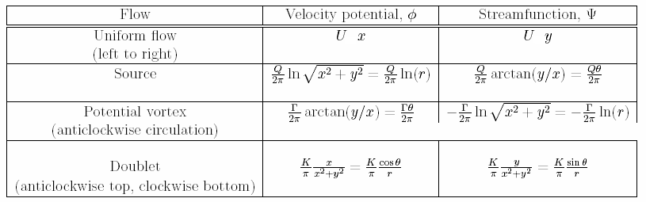

Slide 22
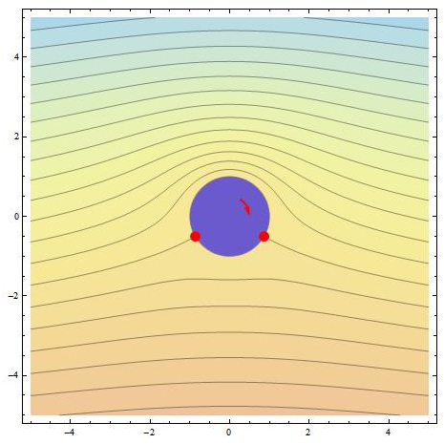
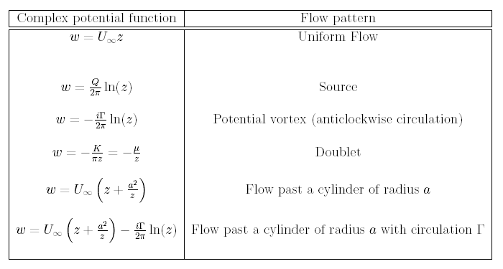

Slide 23

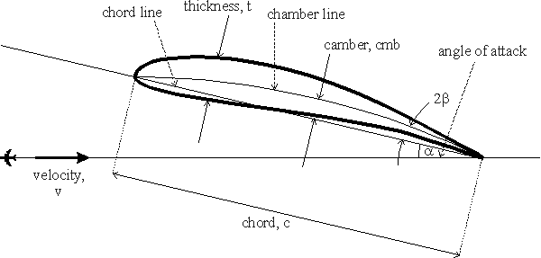
Development of an Ultimate Fluid machine

Slide 24
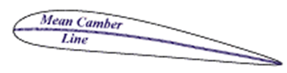


Anatomy of an airfoil
An airfoil is defined by first drawing a “mean” camber line.
The straight line that joins the leading and trailing ends of the mean camber line is called the chord line.
The length of the chord line is called chord, and given the symbol ‘c’.
To the mean camber line, a thickness distribution is added in a direction normal to the camber line to produce the final airfoil shape.
Equal amounts of thickness are added above the camber line, and below the camber line.
An airfoil with no camber (i.e. a flat straight line for camber) is a symmetric airfoil.
The angle that a freestream makes with the chord line is called the angle of attack.

Slide 25
Conformal Transformations
P M V Subbarao
Professor
Mechanical Engineering Department
IIT Delhi
A Creative Scientific Thinking .. ..

Slide 26

INTRODUCTION
A large amount of airfoil theory has been developed by distorting flow around a cylinder to flow around an airfoil.
The essential feature of the distortion is that the potential flow being distorted ends up also as potential flow.
The most common Conformal transformation is the Jowkowski transformation which is given by
To see how this transformation changes flow pattern in the z (or x - y) plane, substitute z = x + iy into the expression above to get

Slide 27






Slide 28



This means that
For a circle of radius r in Z plane x and y are related as:

Slide 29




Consider a cylinder in z plane
In ζ – plane

Slide 30


Slide 31

C=0.8

Slide 32

C=0.9

Slide 33

C=1.0

Slide 34







Slide 36
Translation Transformations
If the circle is centered in (0, 0) and the circle maps into the segment between and lying on the x axis;
If the circle is centered in (x_{c} ,0), the circle maps in an airfoil that is symmetric with respect to the x' axis;
If the circle is centered in (0,y_{c} ), the circle maps into a curved segment;
If the circle is centered in and (x_{c} , y_{c} ), the circle maps in an asymmetric airfoil.

Slide 37





Flow Over An Airfoil

Slide 38


Slide 39


Slide 40


Slide 41


Slide 42


