Slide 1
BI/DW Fundamental
Notes:
Introduce Self
Ask the Batch to Introduce themselves
Ask – What are they planning to do with their first salary at Deloitte.

Slide 2
Why data warehouse?
Data warehouse is the foundation for a successful BI program.
The concept of data warehousing is to create a central location and permanent storage space for the various data sources needed to support a company’s analysis, reporting and other BI functions.
Enhances Data Quality and Consistency
Analyze Historical Data and Gain Insights
1
Delivers Enhanced Business Intelligence
2
Saves Time
3
4
Notes:
Delivers Enhanced Business Intelligence: By providing data from various sources, managers and executives will no longer need to make business decisions based on limited data or their gut. In addition, “data warehouses and related BI can be applied directly to business processes including marketing segmentation, inventory management, financial management, and sales.”
Saves Time: Since business users can quickly access critical data from a number of sources—all in one place—they can rapidly make informed decisions on key initiatives. They won’t waste precious time retrieving data from multiple sources.
Enhances Data Quality and Consistency: A data warehouse implementation includes the conversion of data from numerous source systems into a common format. Since each data from the various departments is standardized, each department will produce results that are in line with all the other departments. So you can have more confidence in the accuracy of your data. And accurate data is the basis for strong business decisions.
Provides Historical Intelligence: A data warehouse stores large amounts of historical data so you can analyze different time periods and trends in order to make future predictions. Such data typically cannot be stored in a transactional database or used to generate reports from a transactional system.

Slide 3
Attributes of Data Warehouse
Data WareHouse
Subject Oriented
Integrated
Non-Volatile
Time Variant
Notes:
Subject Oriented - Data that gives information about a particular subject instead of about a company's ongoing operation
Integrated - Data that is gathered into the data warehouse from a variety of sources and merged into a coherent whole
Non-Volatile - Data is stable in a data warehouse. More data is added but data is never removed. This enables management to gain a consistent picture
Time Variant - All data in the data warehouse is identified with a particular time period

Slide 4
Data warehouses versus operational systems
There is a difference between the databases designed for operating the business and those for managing the business.
Characteristics | Operational systems | Data warehouse systems
Usage | Serves Operational Community/Clerical Users | Serves Managerial and Executive knowledge worker community
 | Supports day to day operational decisions | Supports tactical and strategic decisions
 | Predictable, repetitive pattern of usage | Unpredictable, changing pattern of usage
 | Application oriented | Subject oriented
Data | Data Specific to application | Data integrated by subject area from across application data sources
 | Transaction Driven | Analysis Driven
 | Holds current data | Holds near current and historical data
 | Stores Detailed Data | Stores detail and summarized data
 | Data constantly changes | Data changes through periodic updates
 | Usually process 5 to 6 records per transaction | Usually process large, unpredictable volumes of data per query
Database | Entity Relationship (ER) Model | Dimensional Model

Slide 5
DW — High level architecture
Data Acquisition
Data Integration
Data Aggregation
BI & Information delivery
Source files
ETL
ETL
ETL
ETL
ETL
Reports
Stage
ODS
DW
Data Marts
Agg. Data Marts
Source system
Reports
Taxonomy
Metadata management
Data quality management
Identity management and security
Infrastructure services
Governance

Slide 6
Technology architecture components
Below is an overview of the EIM technology architecture components:
Component | Details/key areas
Data acquisition | Operational and transactional sources: Orders, billings, payments, financial, and HR External sources: BH, customer data, other Reference and master sources: Suppliers, customer, product Unstructured: Mail, e-mail, documents, excel sheet, knowledge management, and content crawlers
Data integration | Business rule and consolidation engines: Common business rules engine, accounting engine, data quality matrices, data profiling, others Data mapping and transport: Data extract/transform/load (ETL), real-time data and message bus (EAI) and enterprise information integration (EII) Image content: Document scanning, OCR, and meta-tagging
Data aggregation | Enterprise data warehouse: Enterprise, centralized, lowest detail, data mart integration, and reference data integration Operational data store (ODS): Near real-time, limited history, operational feeds, and transactional data Data marts: Functional, plan, customer: distributed, summarized, and subject-oriented marts Business process management: Work flow and state management Content repositories: Documentation management, digital rights and asset management, messaging management, output and reports management, and images and Web content management

Slide 7
Information Delivery and Consumption
Component | Details/key areas
BI and Information Delivery | Business intelligence (BI): OLAP, ad-hoc querying and reporting, operational, reporting/analytics, data mining and forecasting Business activity monitoring: rules engine and events processing Content management: content lifecycle management, business rules, workflow, library services and full-text indexing Enterprise content management services: rule-based customization, collaboration and communication services, personalization services, environment monitoring Enterprise information portal (EIP): shared application services, extracts, application integration, content services, publish/subscribe services, search and indexing User access methods: Web portal, email and SMS, fax and printing services, pager and PDA access point System access methods: FTP and database replication, message bus, file delivery and storage media External: Reports: earned value management, government regulation, supply chain, manufacturing, financial and sale Applications: SAP, extracts, finance Internal: Reports: sales and marketing, engineering, manufacturing, finance and production Applications: LIFT MES,, procure to pay, LCS-MRO, MRO OSN, MRO TARS, EVMS, SAP upgrade

Slide 8
OLTP vs OLAP
OLTP (On-line Transaction Processing)
OLAP (On-line Analytical Processing)
Characterized by a large number of short on-line transactions (INSERT, UPDATE, DELETE).
Fast query processing
Maintaining data integrity in multi-access environments
System designed to handle a high volume transaction per second
Characterized by relatively low volume of transactions.
Queries are often complex and involve aggregations.
OLAP applications are widely used by Data Mining techniques.
In OLAP database there is aggregated, historical data, stored in multi-dimensional schemas (usually star schema)

Slide 9
Comparison OLTP vs OLAP
 | OLTP | OLAP
Source of data | Operational data; OLTPs are the original source of the data. | Consolidation data; OLAP data comes from the various OLTP Databases
Purpose of data | To control and run fundamental business tasks | To help with planning, problem solving, and decision support
What the data reveals | A snapshot of ongoing business processes | Multi-dimensional views of various kinds of business activities
Inserts and Updates | Short and fast inserts and updates initiated by end users | Periodic long-running batch jobs refresh the data
Queries | Relatively standardized and simple queries Returning relatively few records | Often complex queries involving aggregations
Processing Speed | Typically very fast | Depends on the amount of data involved; batch data refreshes and complex queries may take many hours; query speed can be improved by creating indexes
Space Requirements | Can be relatively small if historical data is archived | Larger due to the existence of aggregation structures and history data; requires more indexes than OLTP
Database Design | Highly normalized with many tables | Typically de-normalized with fewer tables; use of star and/or snowflake schemas
Backup and Recovery | Backup religiously; operational data is critical to run the business, data loss is likely to entail significant monetary loss and legal liability | Instead of regular backups, some environments may consider simply reloading the OLTP data as a recovery method

Slide 10
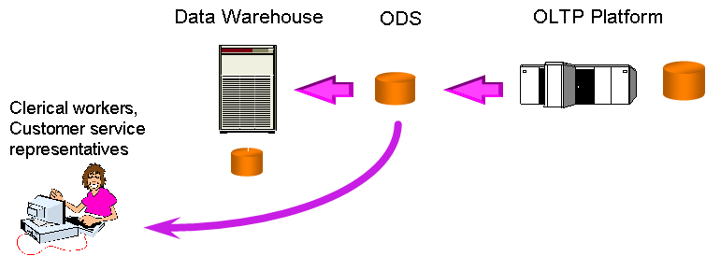
Operational Data Store (ODS)
ODS environments were originally developed for an integrated reporting database to support tactical and operational activities.
ODS has developed into a repository where we collect and integrate operational data before loading it into a data warehouse. It is a separate project from the data warehouse, and acts as a distribution centre for current valued, integrated data used to support an operational activity
Data Warehouse
ODS
OLTP Platform
Clerical workers, Customer Service representatives
Notes:
96

Slide 11
Stage area
Staging Area is temporary location where data from source systems is copied to. It is an area where a sanitized, integrated and detailed data in normalized form exists.
Integration — Accepts data from different sources
OLTP System
Stage Area
Staging is optional — In some businesses it is feasible to use ETL to copy data directly from operational databases into the Data Warehouse
Data model is required at staging area
Multiple data models may be required for parking different sources and for transformed data to be pushed out to warehouse
Data Cleansing — Staging area is used for data cleansing
OLTP System
Flat Files

Slide 12
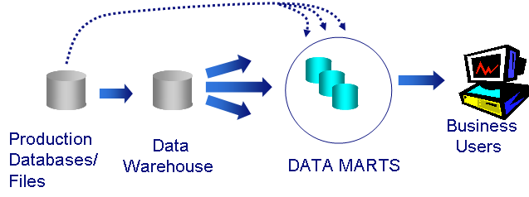
Data marts
A data mart is a decision support system focused on a specific business problem in a single business unit across all subject areas.
Data mart
The data marts are summarized and partitioned in a variety of ways to support specific functional and organizational requirements. The data mart store selected data tailored for specific reporting and analysis patterns, which is by far the most common and popular database tier. It is tightly integrated with the analytical application engines and end-user tools and is closely governed by the business areas.
Key functionalities
Predefined provisioning is the routing of data to repositories, or data marts, for specific, predefined analysis or application support
Enterprise data marts — consolidated across business units and highly-shared by functional areas
Production Databases/ Files
Business Users
Data Warehouse
Data Marts
Business unit data marts — data repository for intense analytics, modeling or mining at the business unit level
Functional data marts — supports function-specific data, e.g., Marketing, valuation, and financials
Application data marts — applications/packages, e.g., Campaign effectiveness
Notes:
96

Slide 13
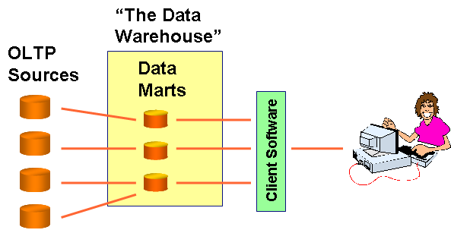
Data marts (cont.)
Data Marts are designed in many ways to provide data to the user.
Independent Data Mart
Federated Data Warehouse
OLTP Sources
“The Data Warehouse”
Data Marts
OLTP Sources
Data Marts
Client Software
Dependent Data Mart
OLTP Sources
Data Warehouse
Data Marts
Notes:
96

