Slide 1

GREAT OUTDOORS
By:
Abhishek Kushwaha
Akhil Chowdhry
Arshpreet
Ayush Agrawal
C. Sravani
Prafull Sharma

Slide 2
Epic and User stories:
Dealing with Login and Viewing sales reports.
Login:
Taking the user name as input from the user.
Check whether the user name is existed in the database or not.
If yes, ask the password as input from the user.
Validate the password by retrieving user credentials from the database.
Intimating the user about credentials.
For retailer:
If user name is not present in database, we intimate the user and suggest to create new account.
The retailer has two options.
1. Signup 2. Login

Slide 3
View sales reports:
Admin views the sales person profile to check whether the target sales person is met or not.
Admin can see the monthly ,quarterly and annual reports of each salesperson.
The target will be set by the admin for monthly and annual bonus to the sales person.
View Overall Report:
Only admin has access to view the overall report.
Requires sales report and retailer report from Sales class and Retailer class.
The report is send every 15 days.
After evaluation, the report should tell if the expectations are me, not met or exceeded.
Order cancelling:
Validates if the order exists
Checking if the order is applicable for cancellation
Validation of product to be cancelled and the quantity of product to be cancelled

Slide 4
Epic and User Stories
Update Discount:
Only admin has access to update discount.
This discount pertains to the Retailer class.
The discount should not exceed 20 % of cost savings.
The discount is proportional to the fact if targets are being met, not met or exceeded.
Order initializing:
Selecting the required quantity of products from the available ones
Removal of selected products (if the retailer has a change of mind in case)
Confirming the products to buy and upon confirmation we generate an order Id and
Maintain the list of products ordered in the current order and also we add this order to the list of orders ordered by the retailer previously

Slide 5
Admin able to see the annual, quarterly and monthly Report of Retailer depending upon choice and get alerts.
Update Bonus of Sales Person depending upon the report generated . How much he redirected offline to online sales.
Return Online Order
Initialization of Return Order by Retailer
Validation of Product Id , Order Id and Quantity of Product
Selection of Purpose Of Return
Confirmation of Return of product by Retailer
Generate Return Id
Generating Return Reports for different purpose of return

Slide 6
SalesPerson Details
Adding, Updating , Deleting Sales Person Details
Generating Sales Person Id
Generating Sales Person Target Report for monthly ,Quarterly and Annually
Checking Status of Target met, not met or Exceeded.

Slide 7
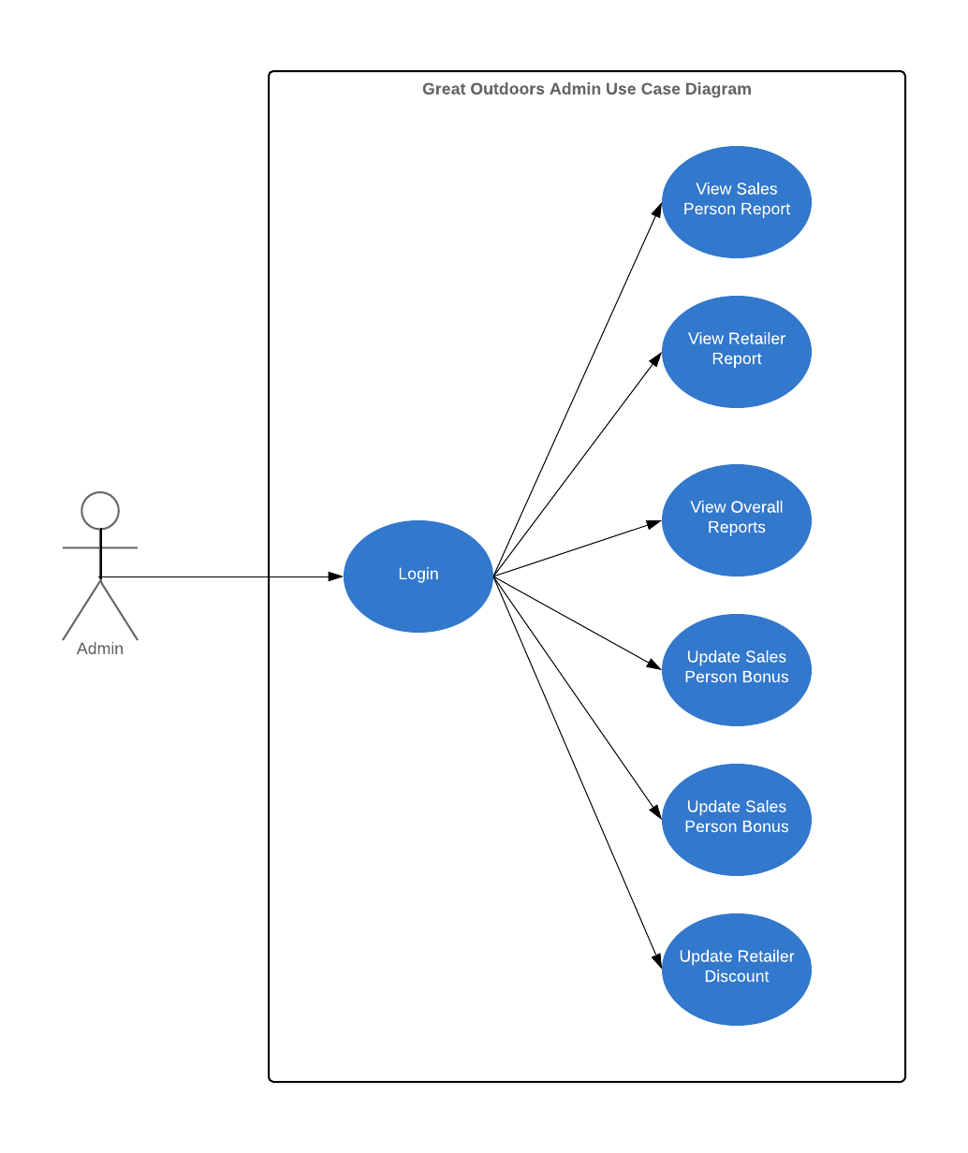
Use Case Diagram Admin

Slide 8
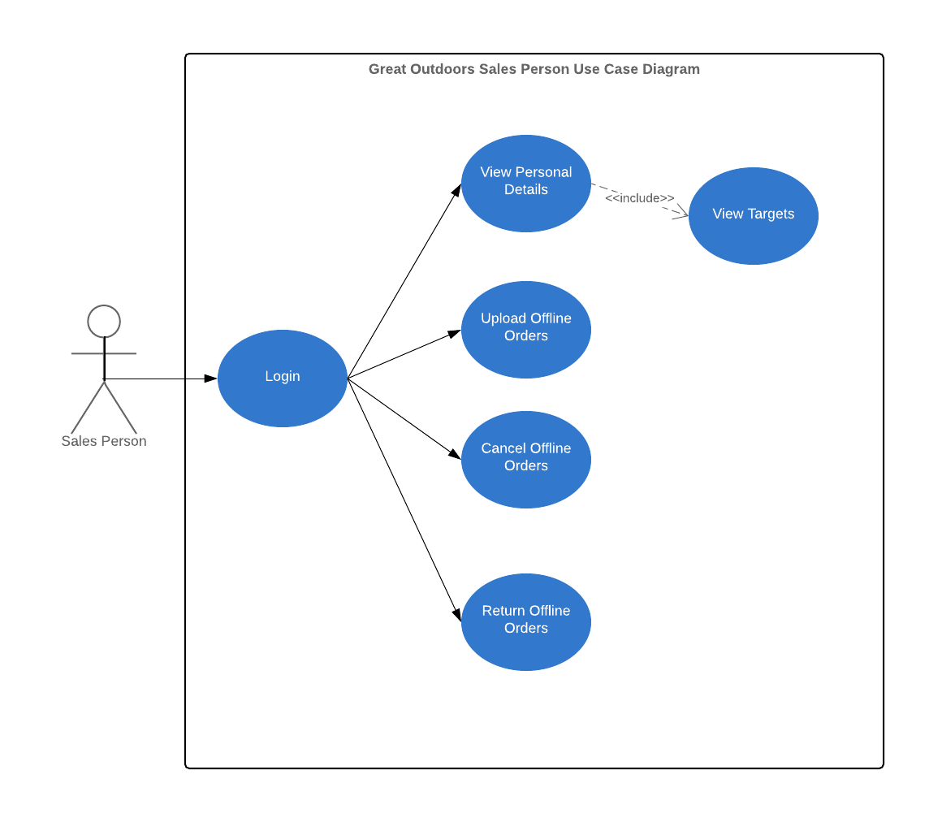
Use Case Diagram SalesPerson

Slide 9
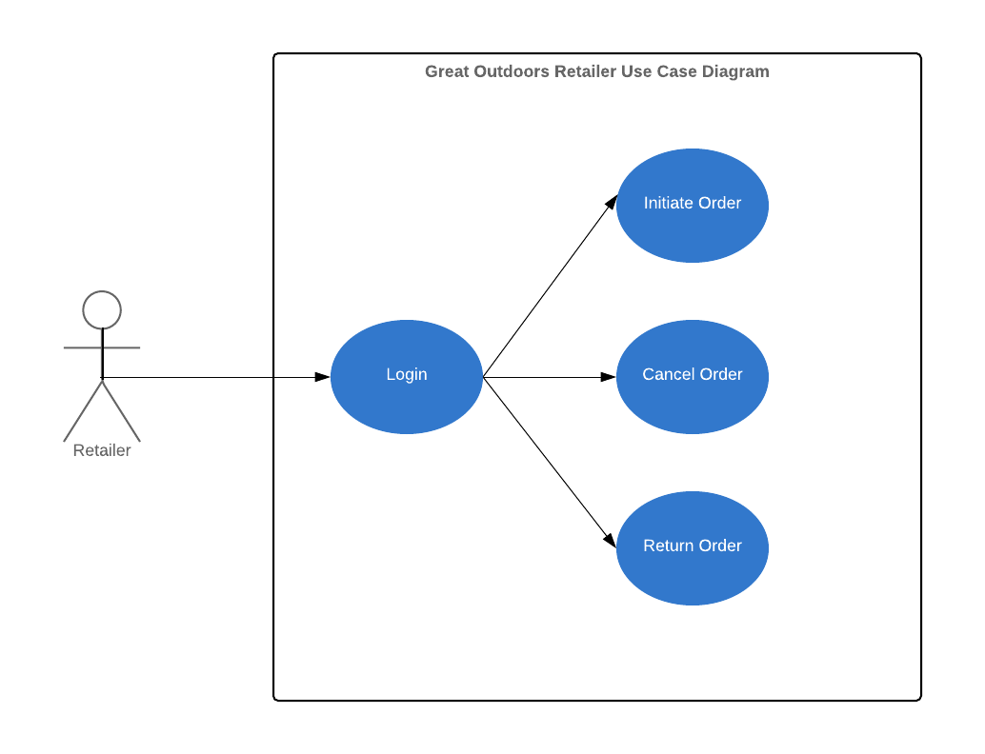
Use Case Diagram Retailer

Slide 10
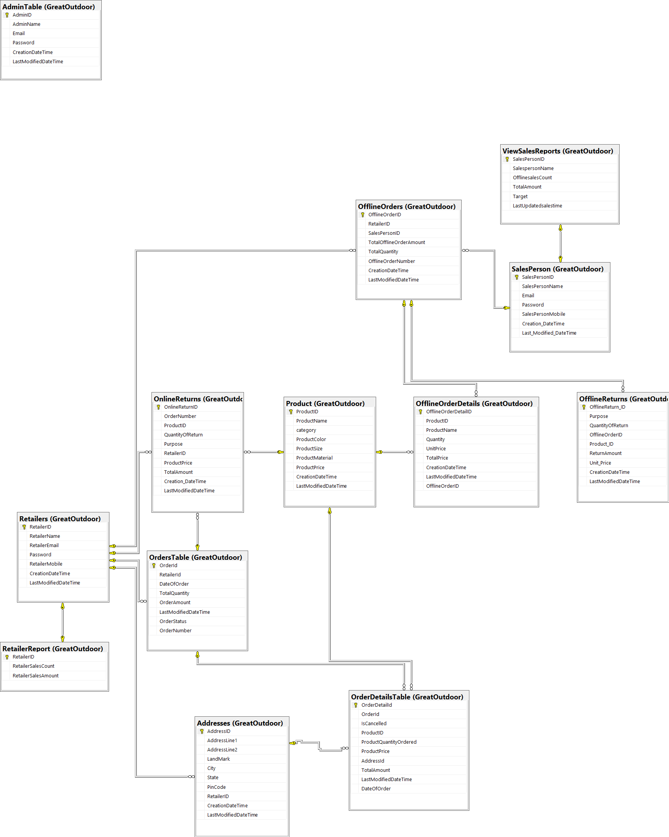
Database Diagram

Slide 11
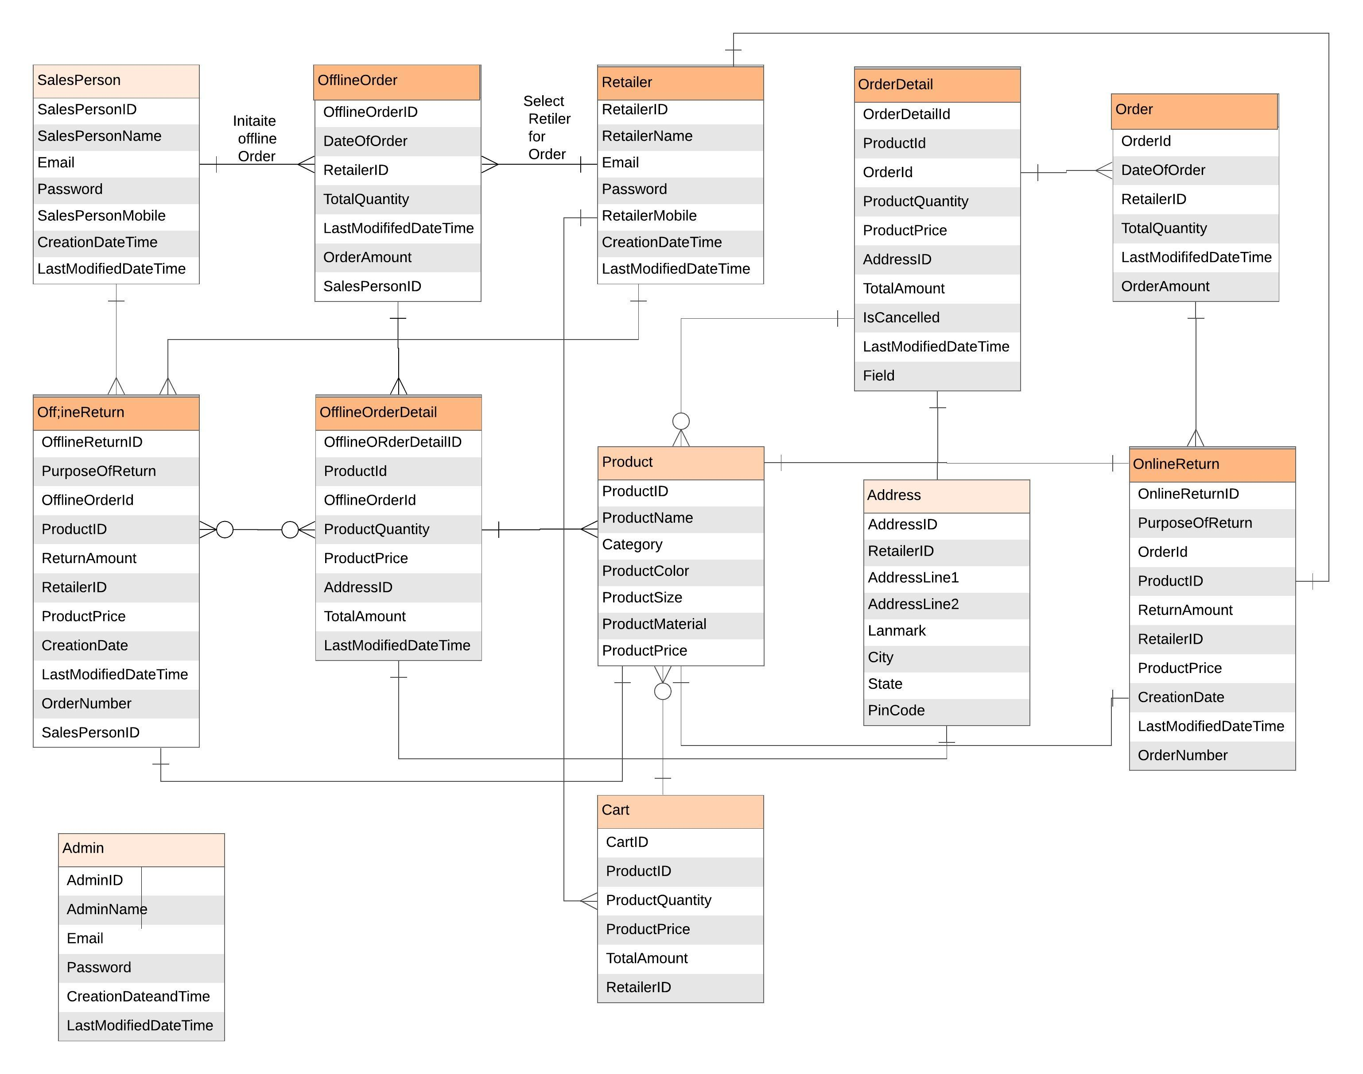
Entity Relationship Diagram

Slide 12
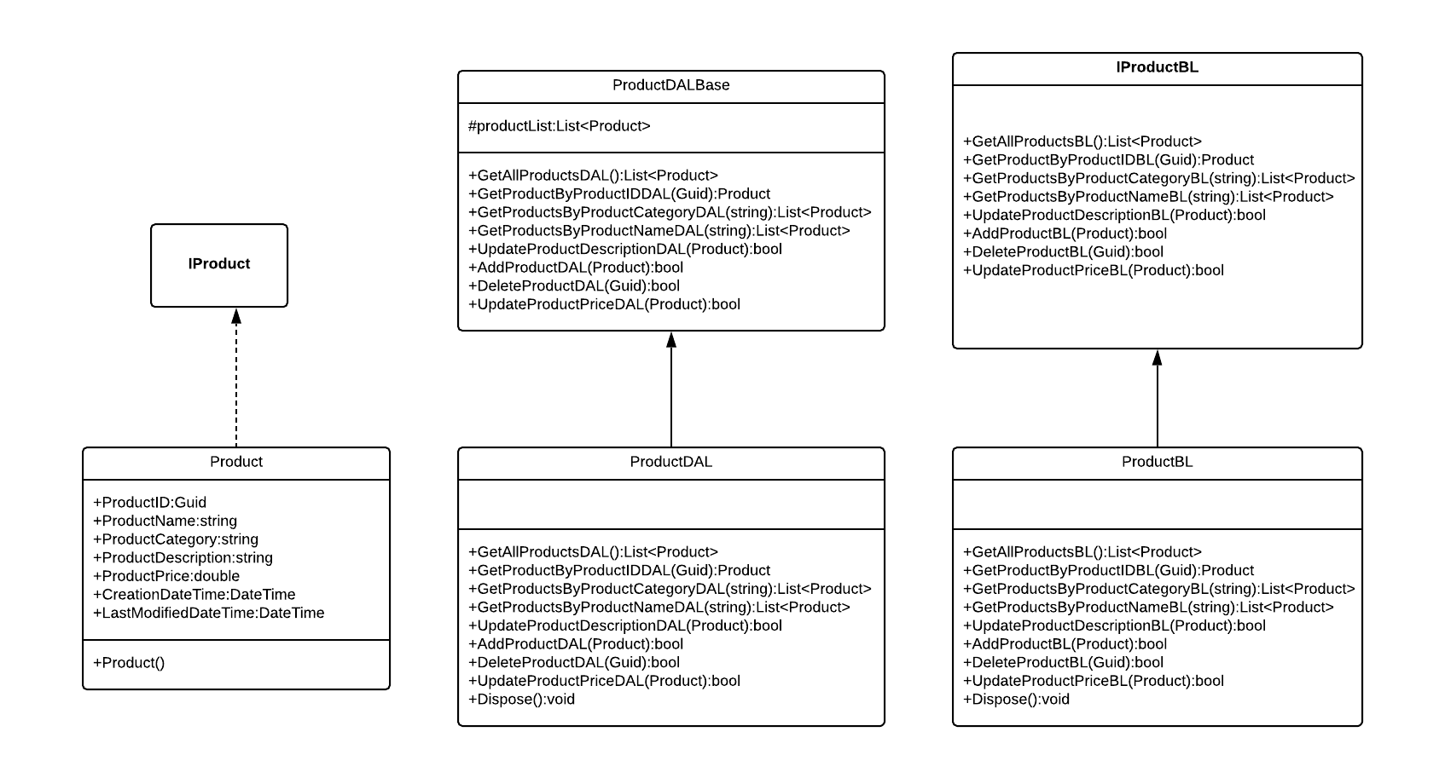
Class Diagram Product

Slide 13
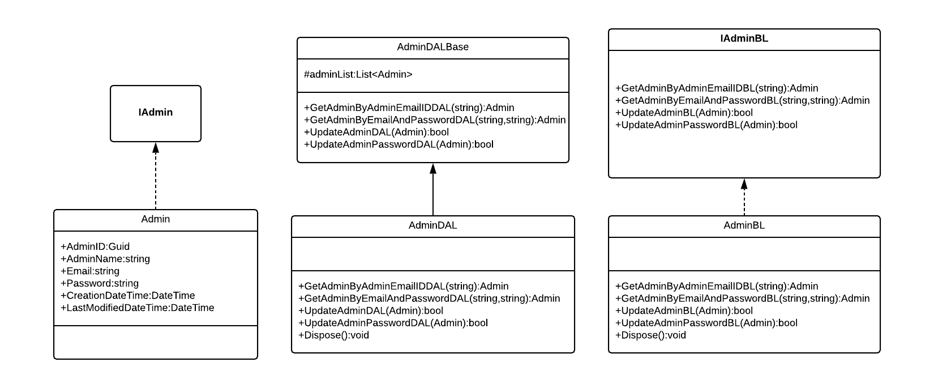
Class Diagram Admin

Slide 14
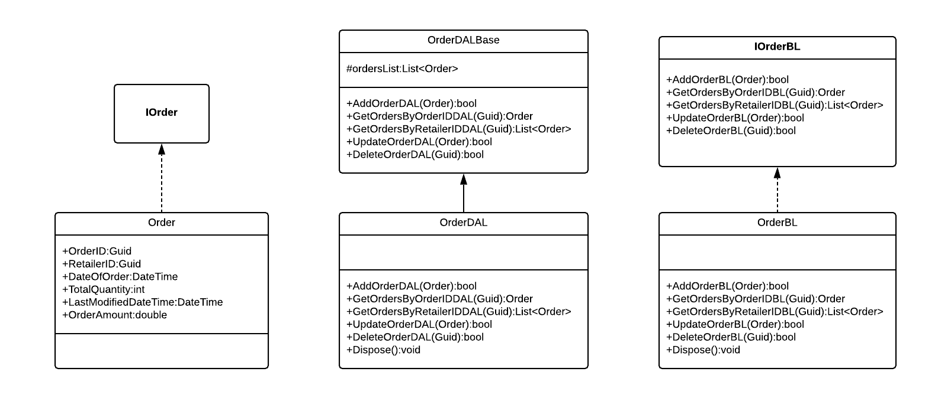
Class Diagram Order

Slide 15
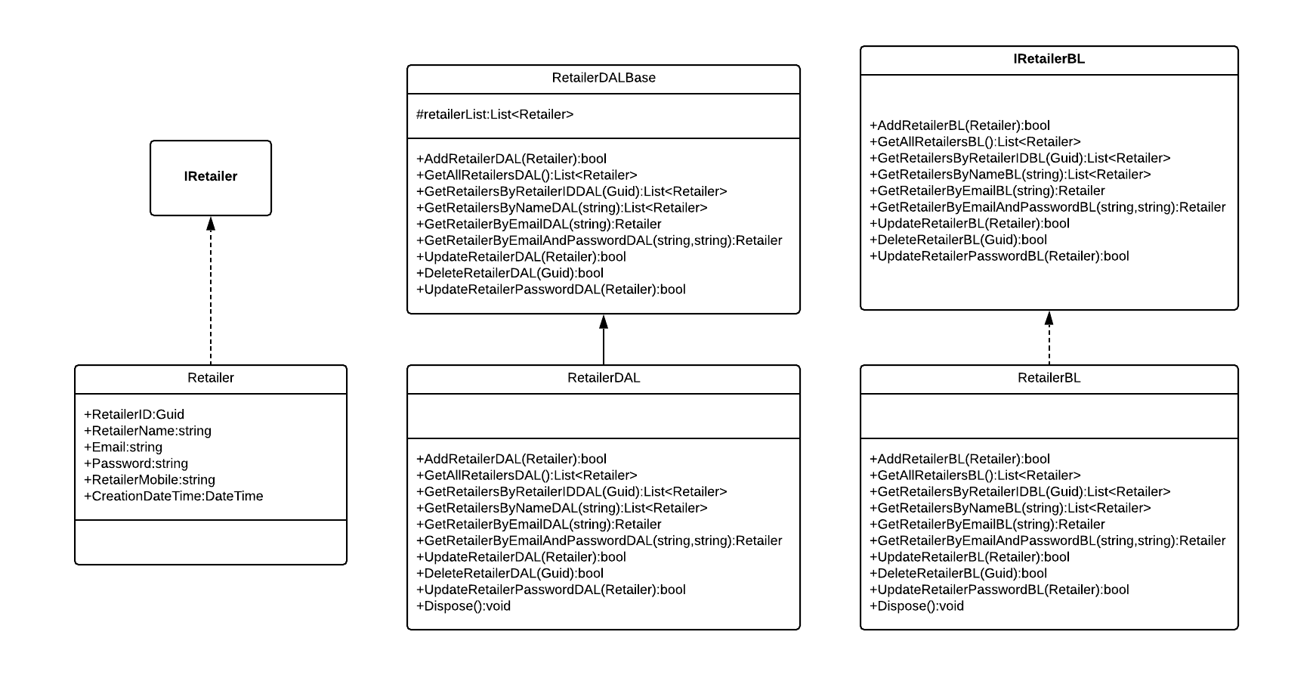
Class Diagram Retailer

Slide 16
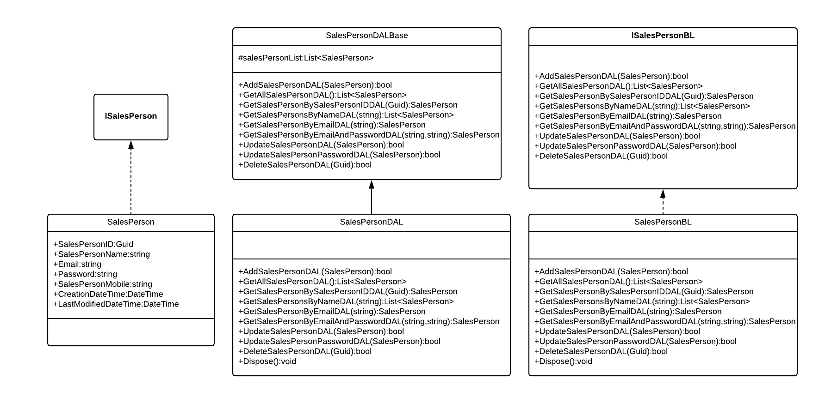
Class Diagram Sales Person

Slide 17
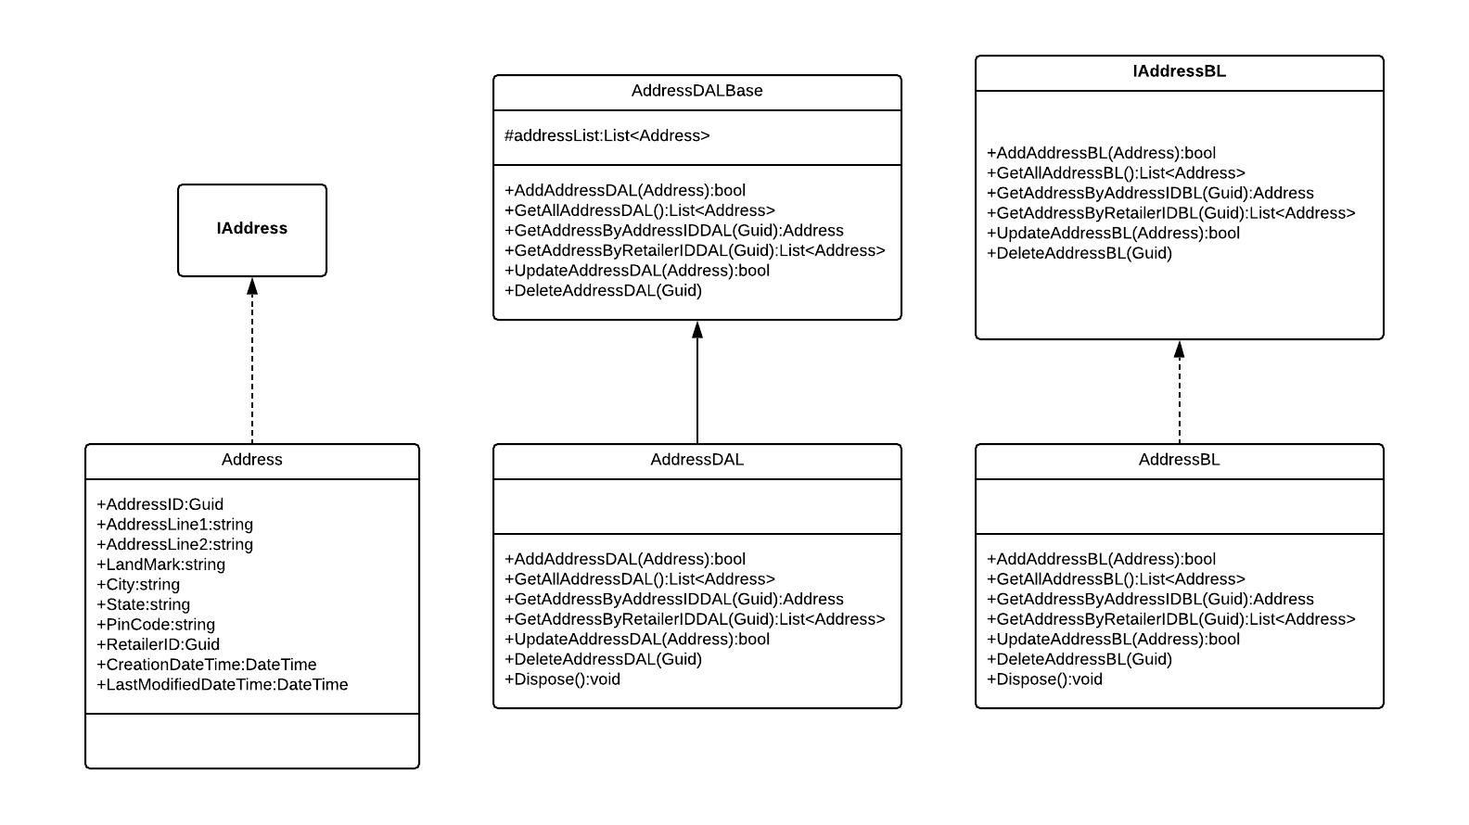
Class Diagram Address

Slide 18
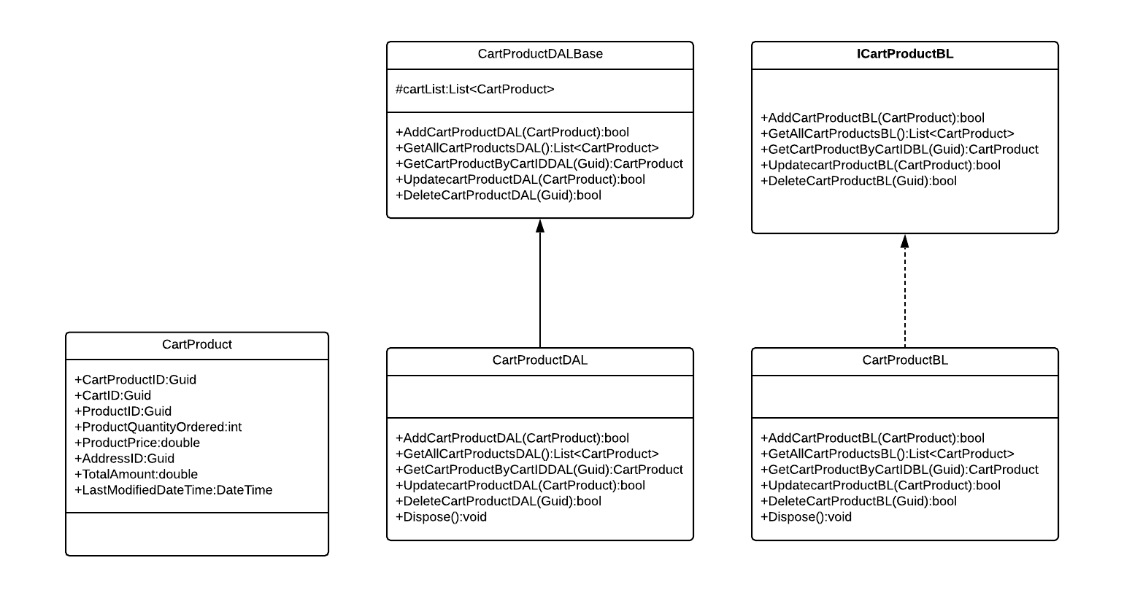
Class Diagram Cart Product

Slide 19
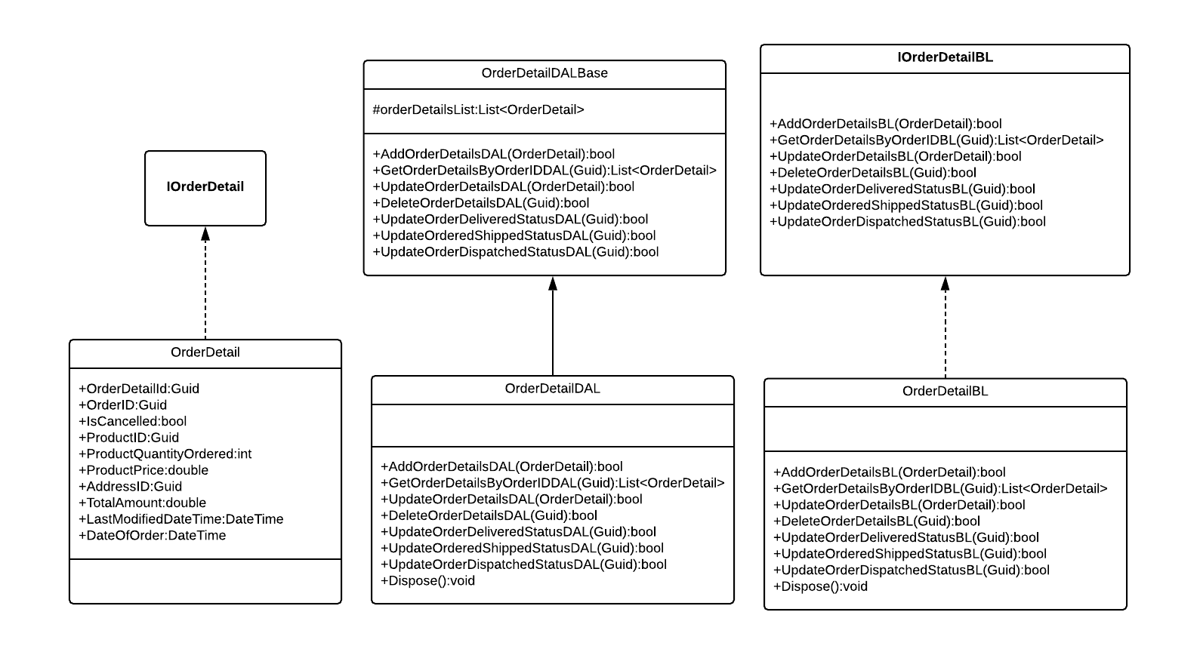
Class Diagram Order Details

Slide 20
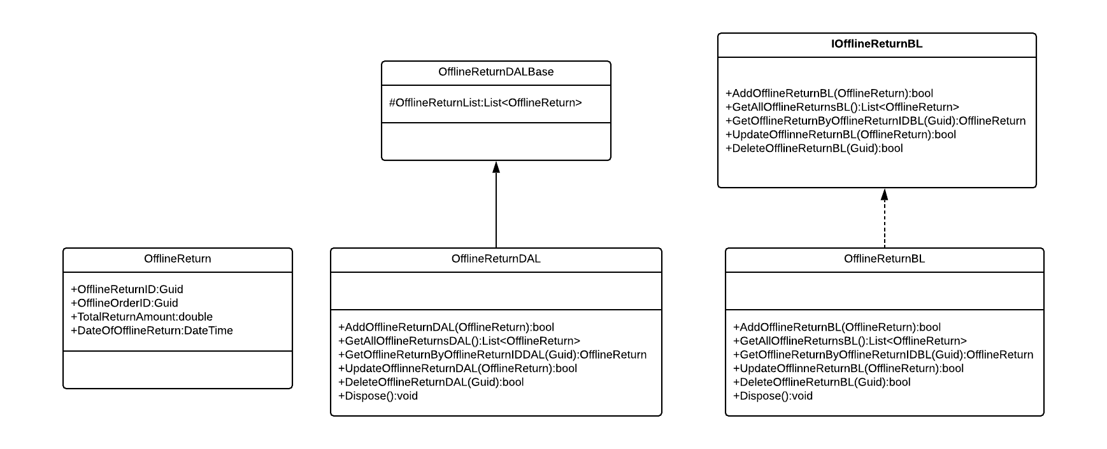
Class Diagram Offline Return

Slide 21
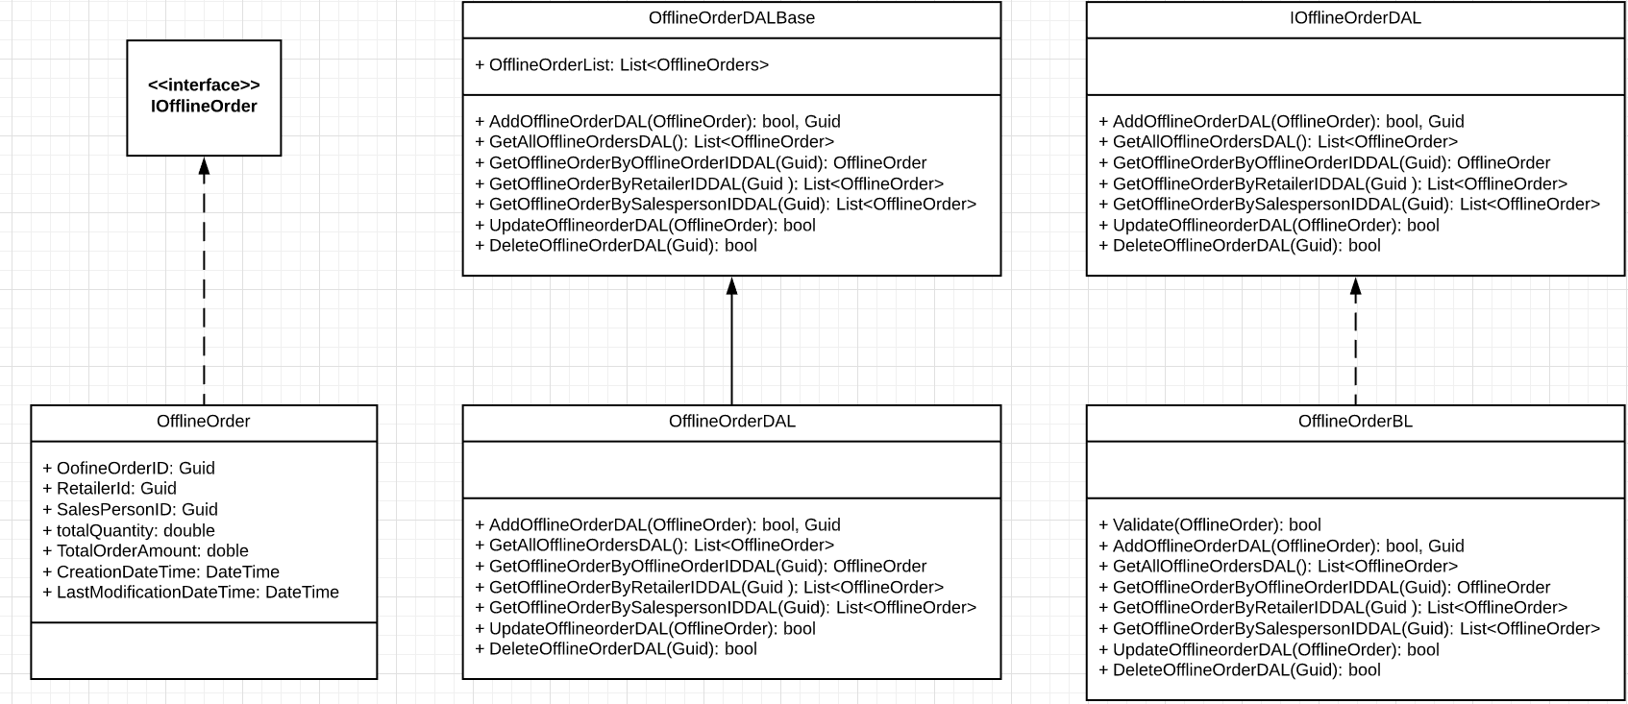
Class Diagram Offline Orders

Slide 22
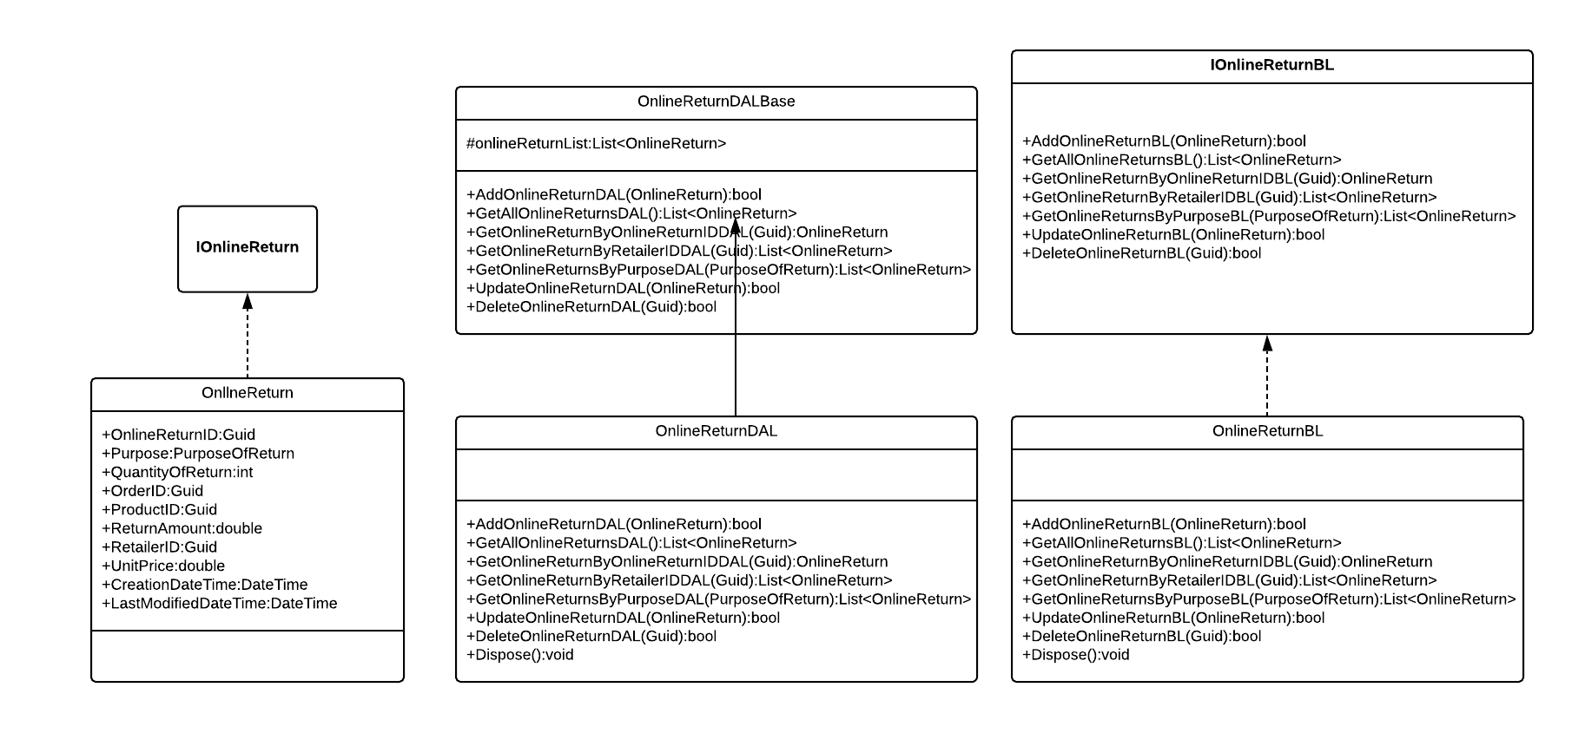
Class Diagram Online Return

Slide 23
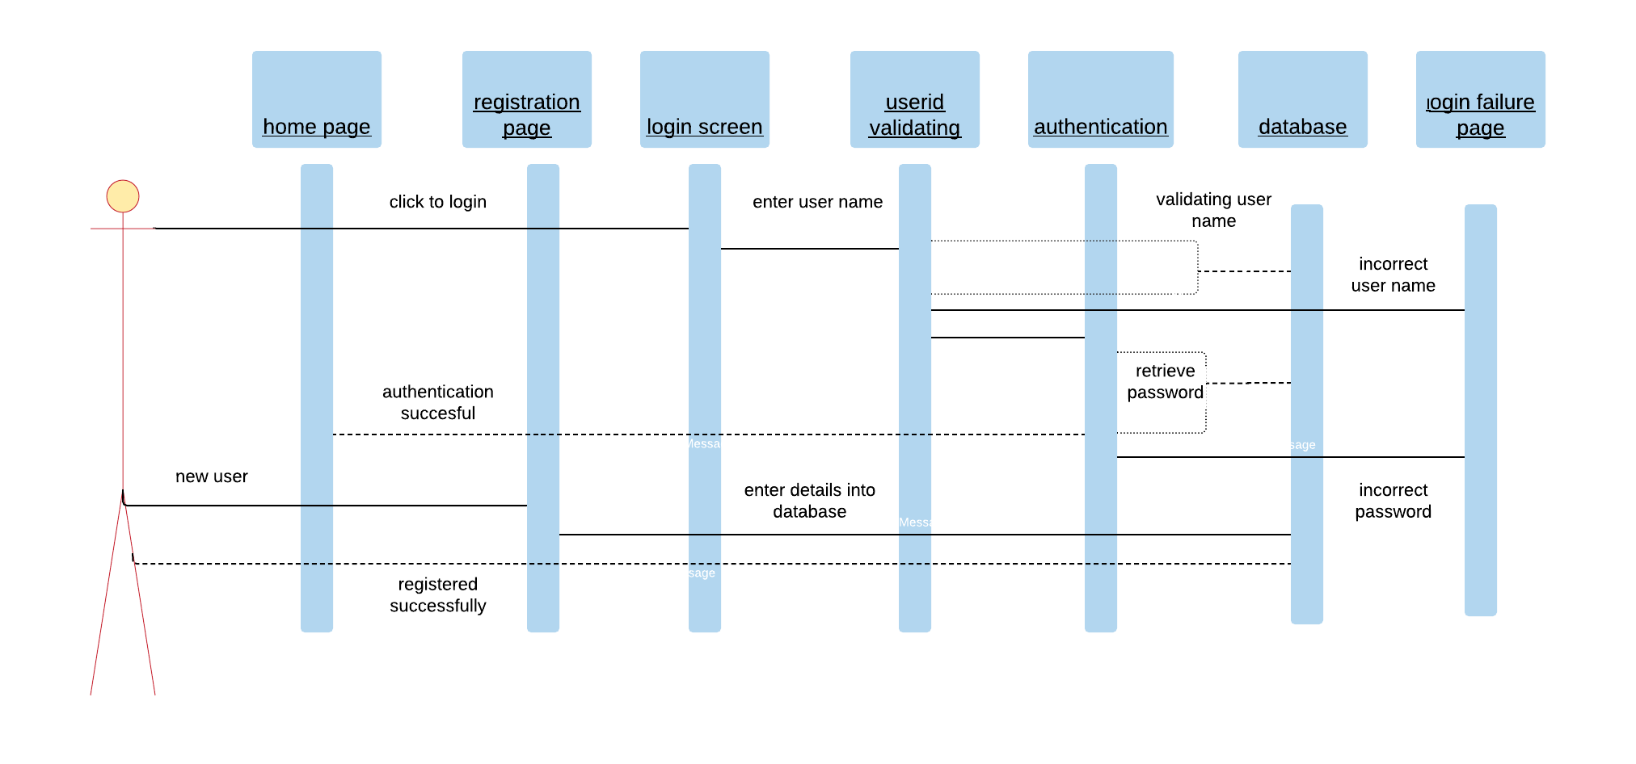
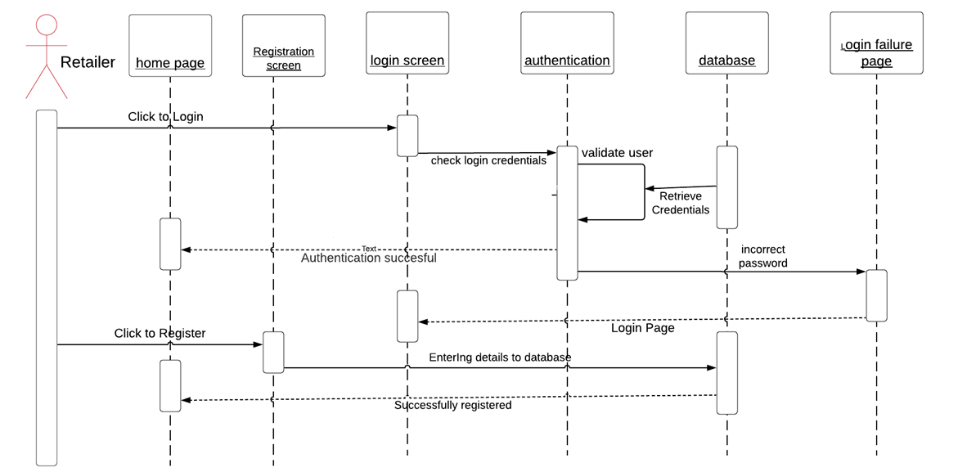
Sequence Diagram for Retailer Login Page

Slide 24
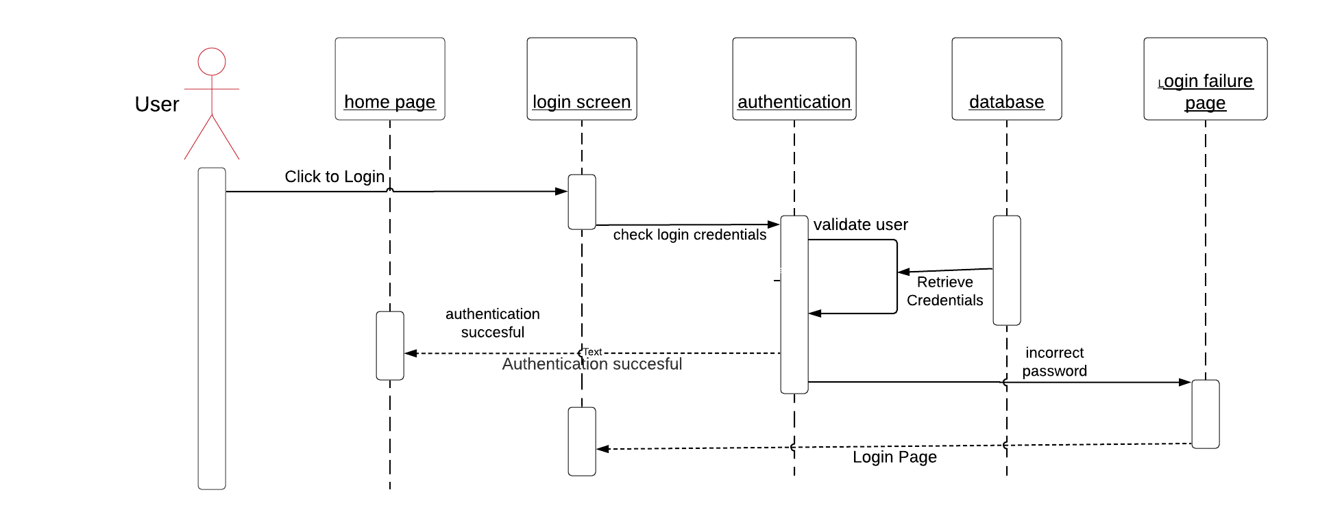
Sequence diagram for Admin and Sales Person Login Page

Slide 25
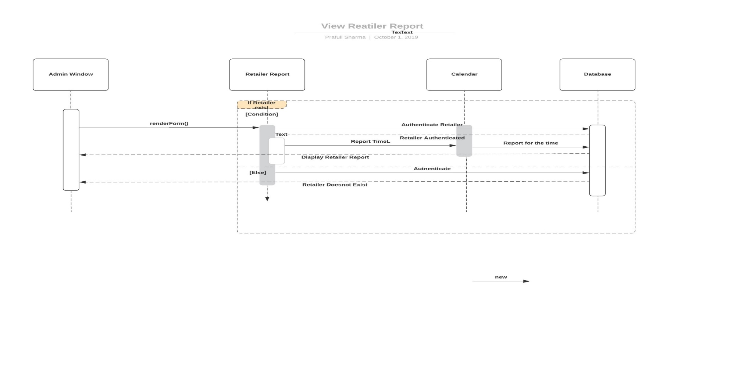
Sequence Diagram for Retailer Report

Slide 26
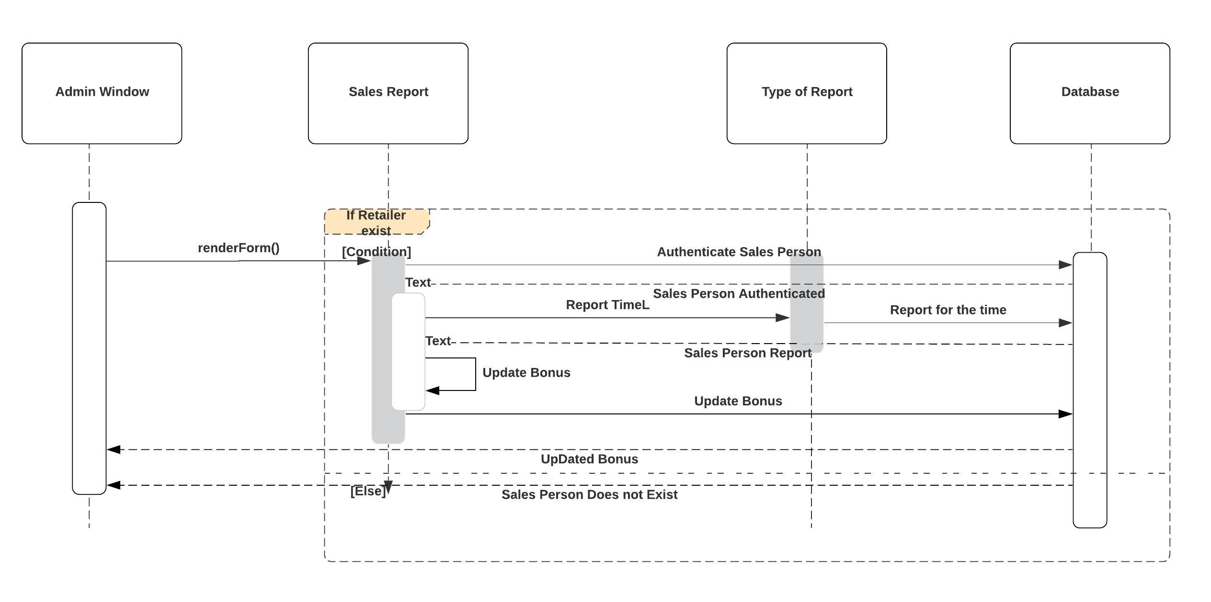
Sequence Diagram for Update Bonus

Slide 27
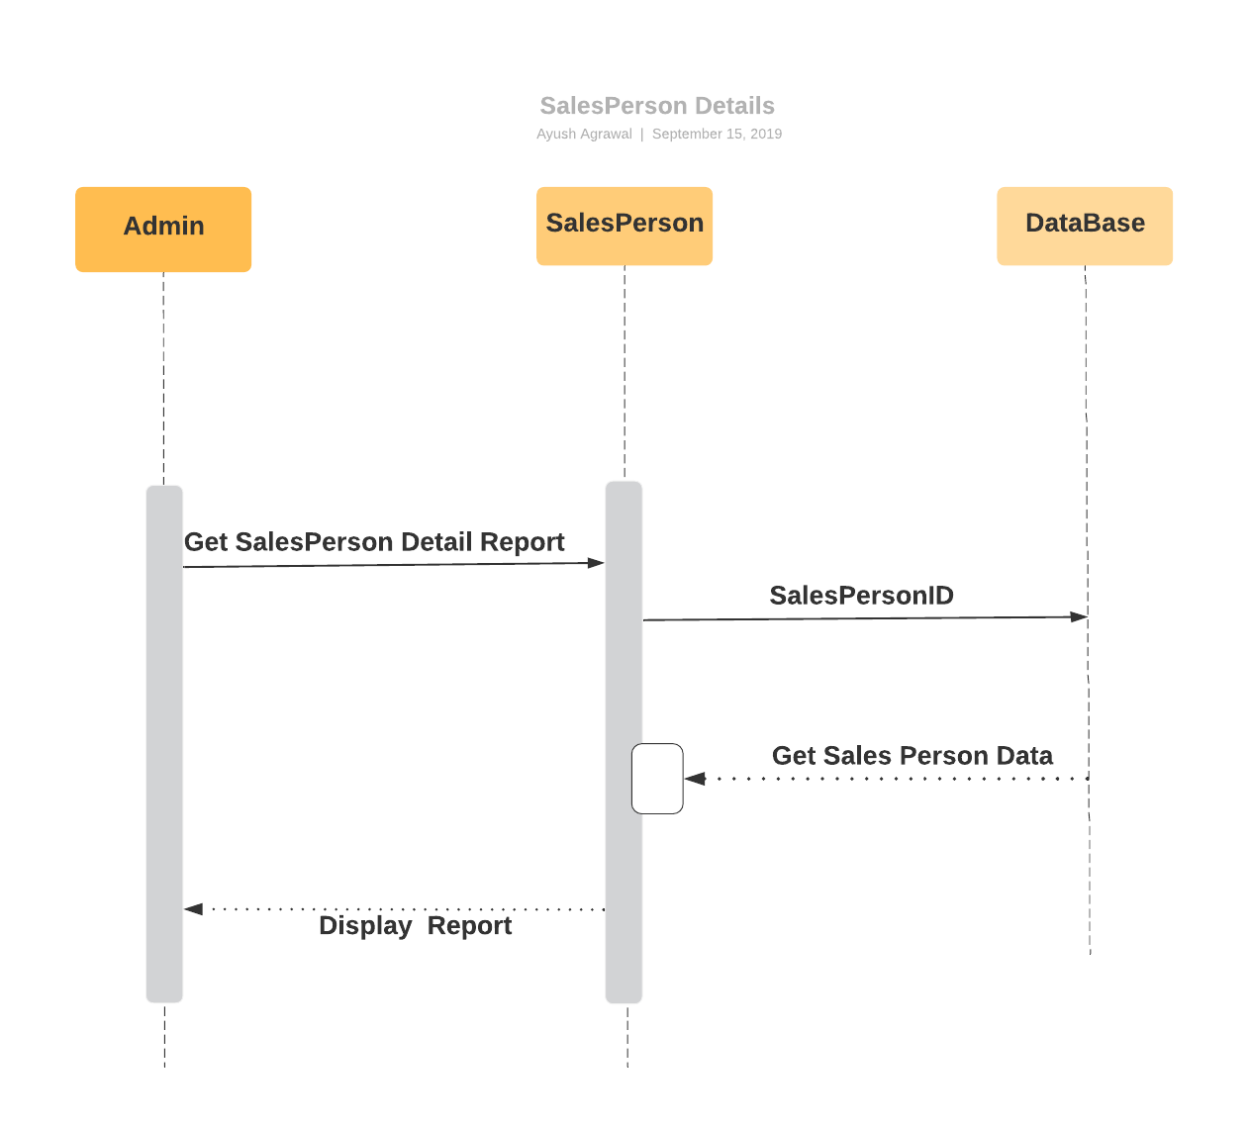
Sequence Diagram for Sales Person Details

Slide 28
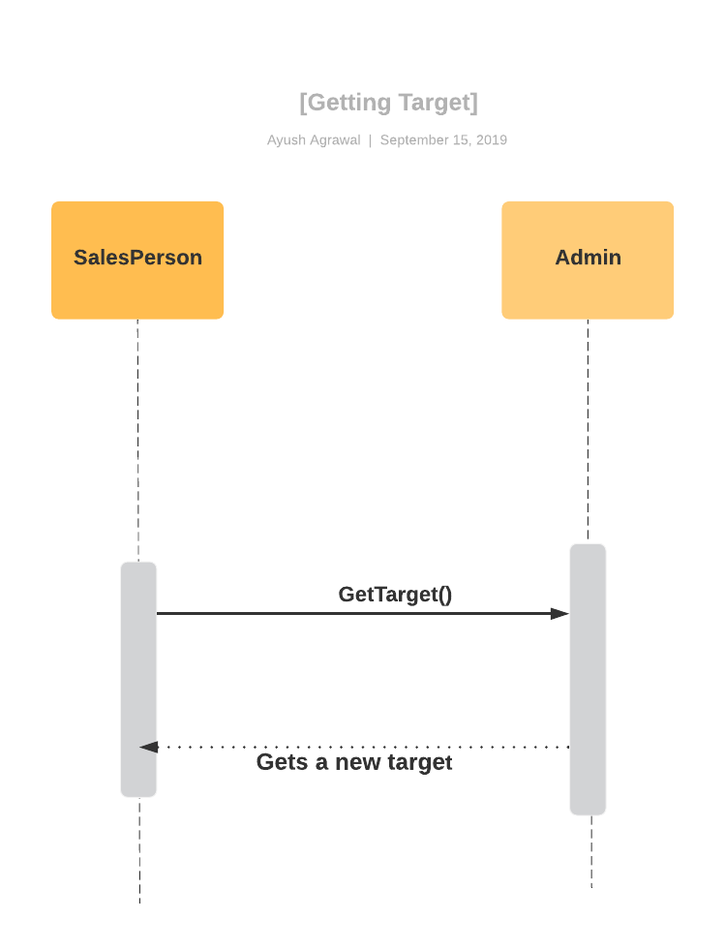
Sequence Diagram for Getting Sales Target By Sales Person

Slide 29
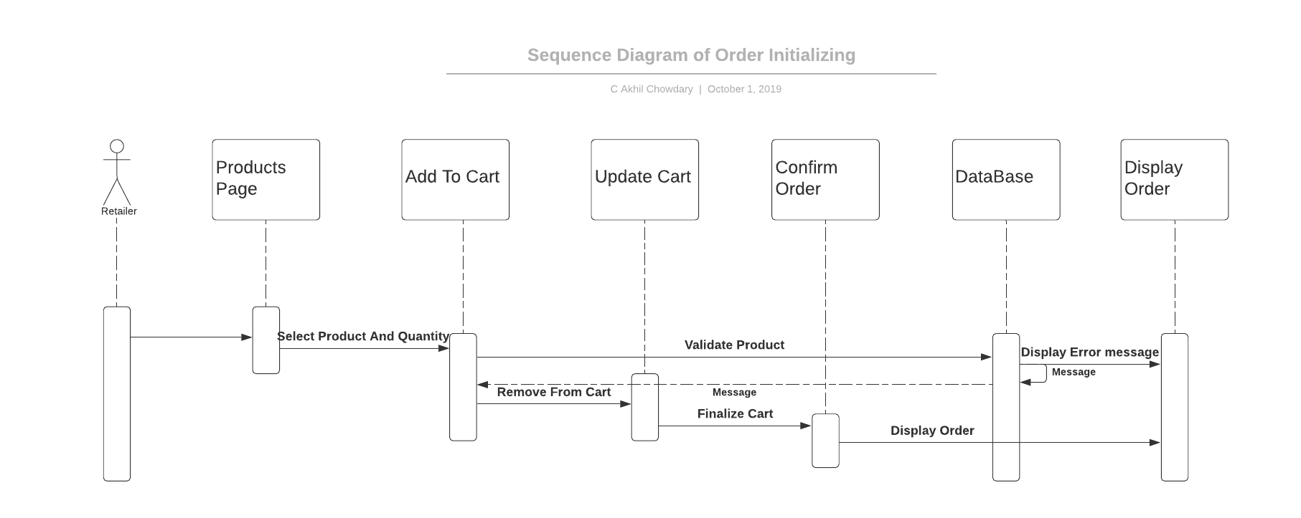
Sequence Diagram for Order Initializing

Slide 30
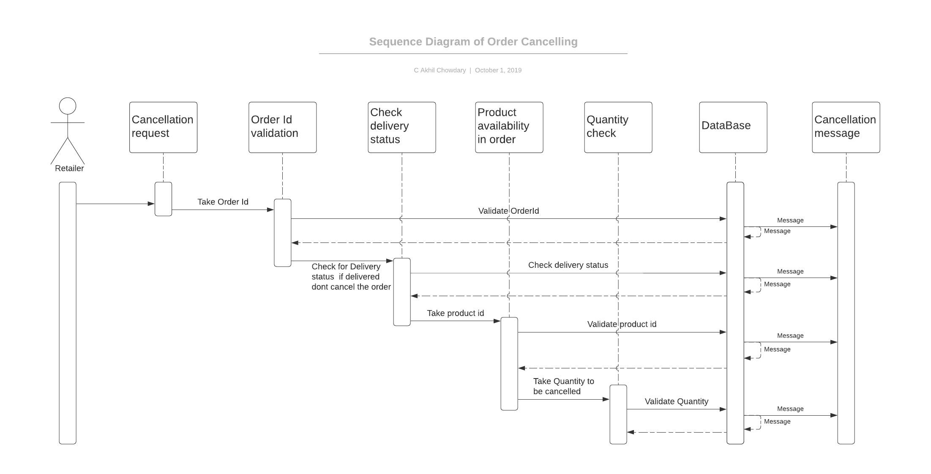
Sequence Diagram for Online Cancel

Slide 31
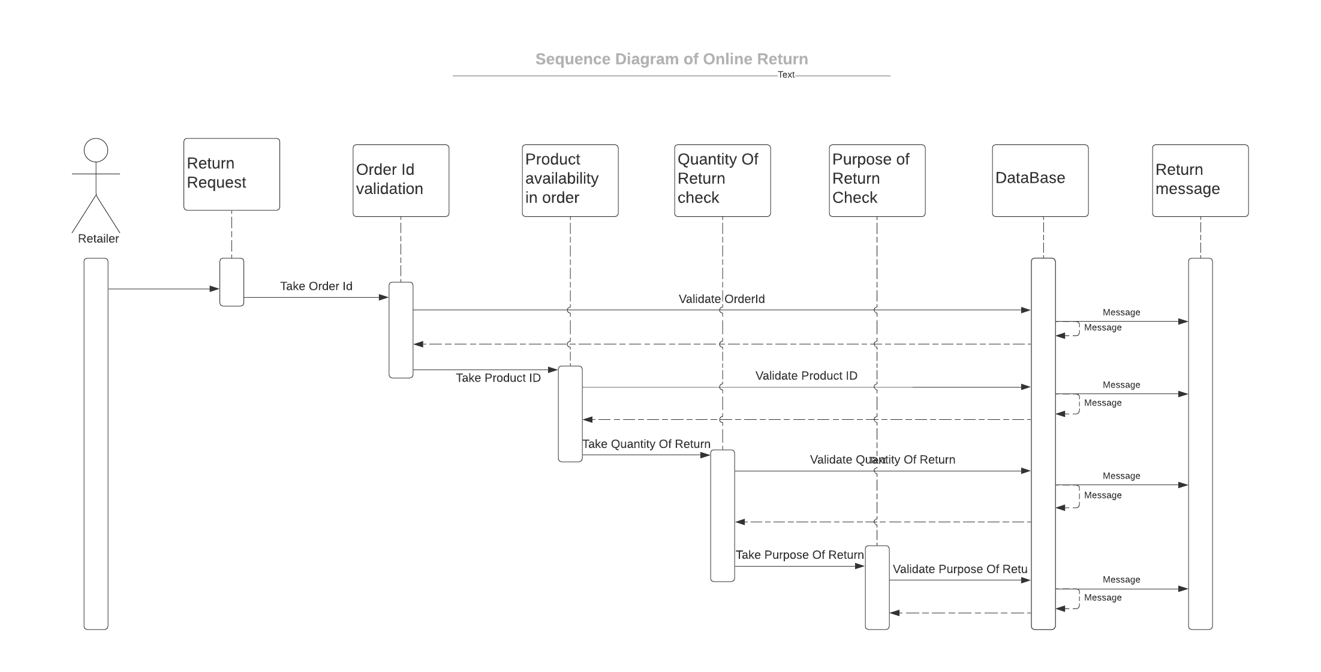
Sequence Diagram for Online Return

Slide 32
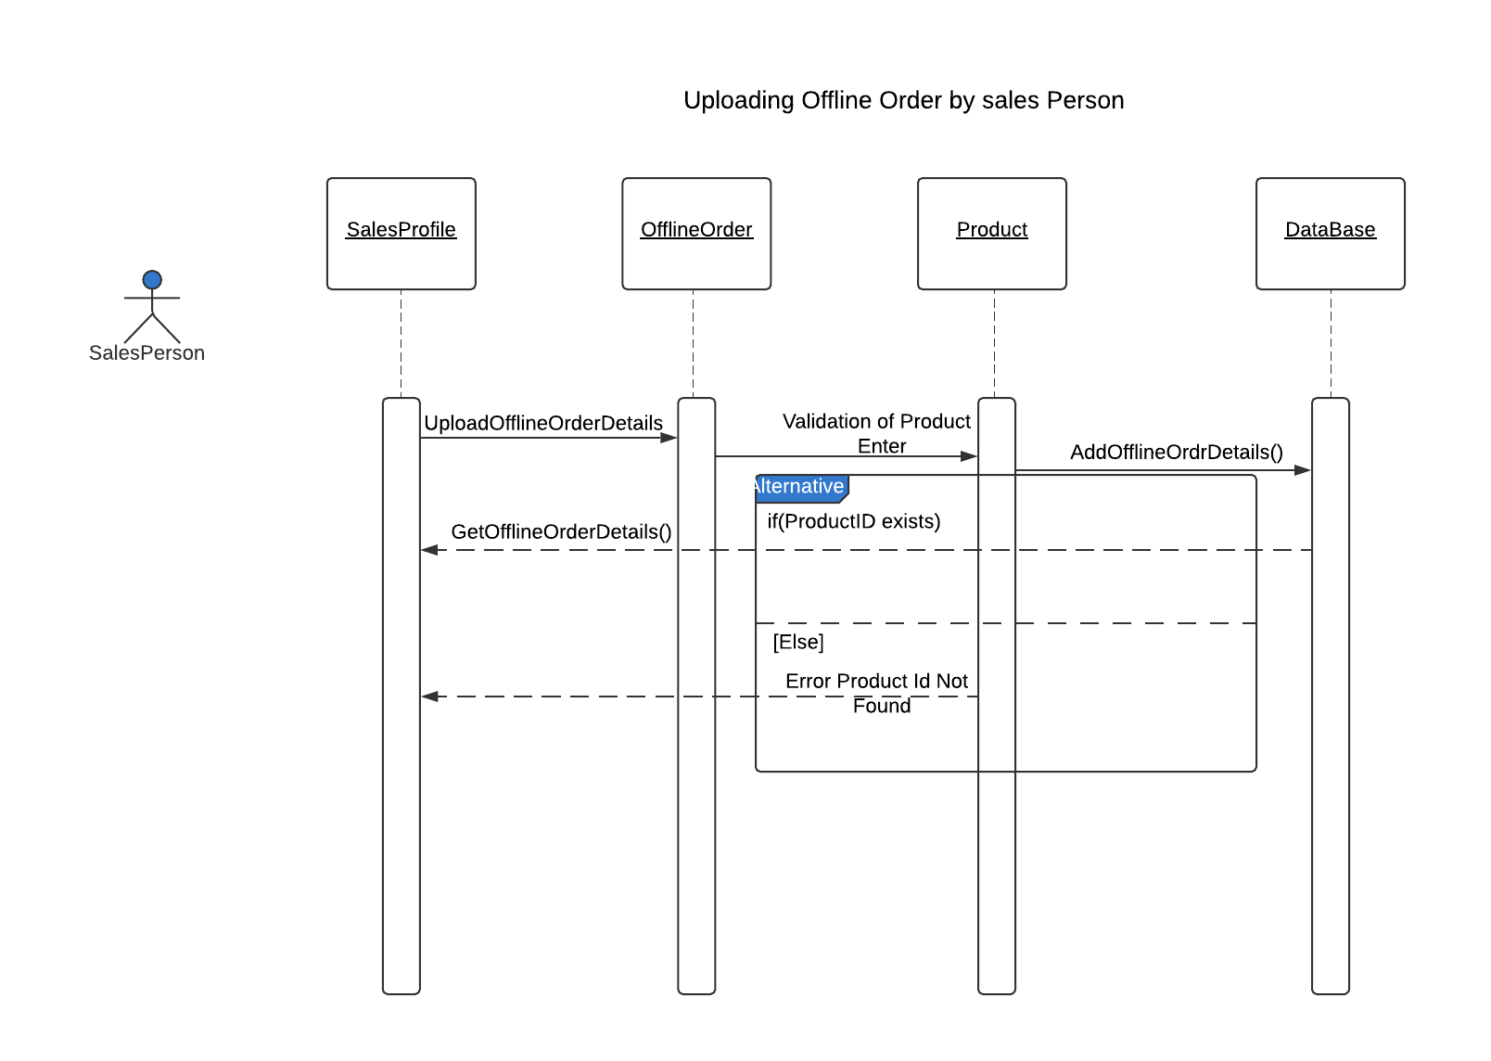
Sequence Diagram for Uploading Offline Orders

Slide 33
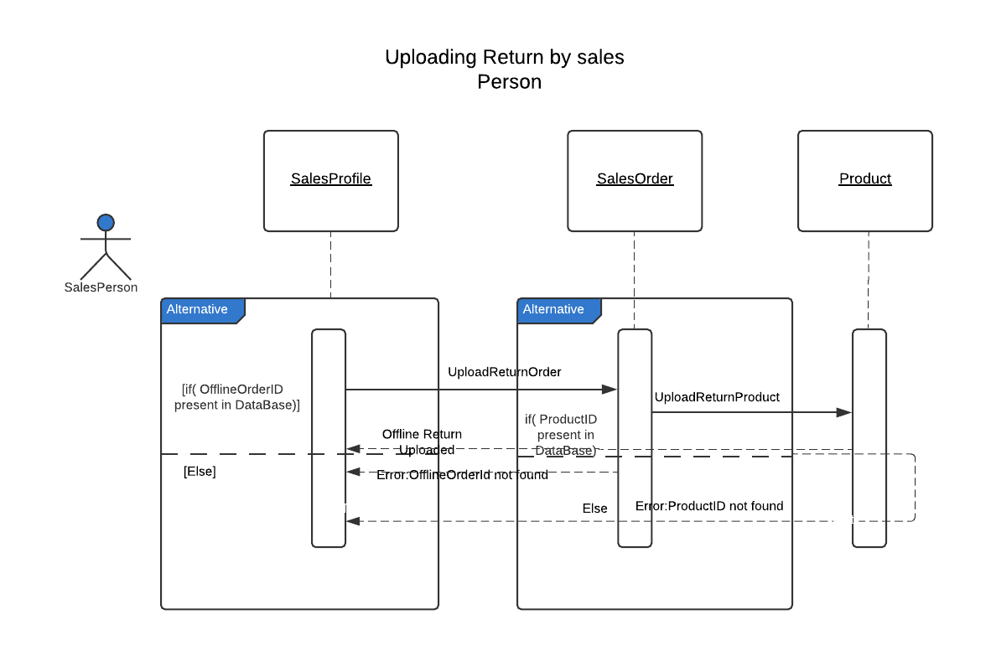
Sequence Diagram for Uploading Return By Sales Person

Slide 34
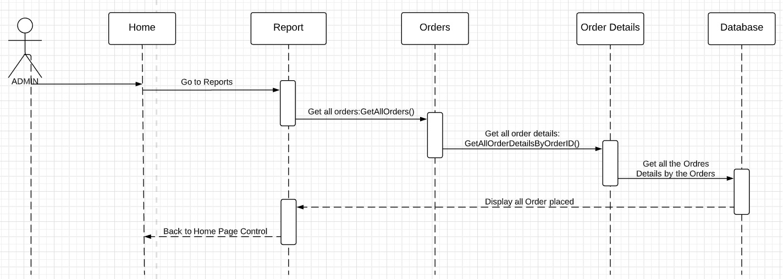
Sequence Diagram for getting Overall Report

Slide 35
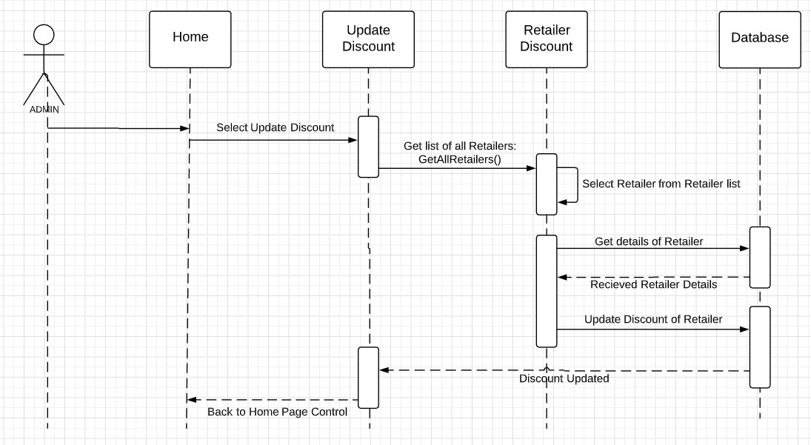
Sequence Diagram for getting Update Discount

Slide 36
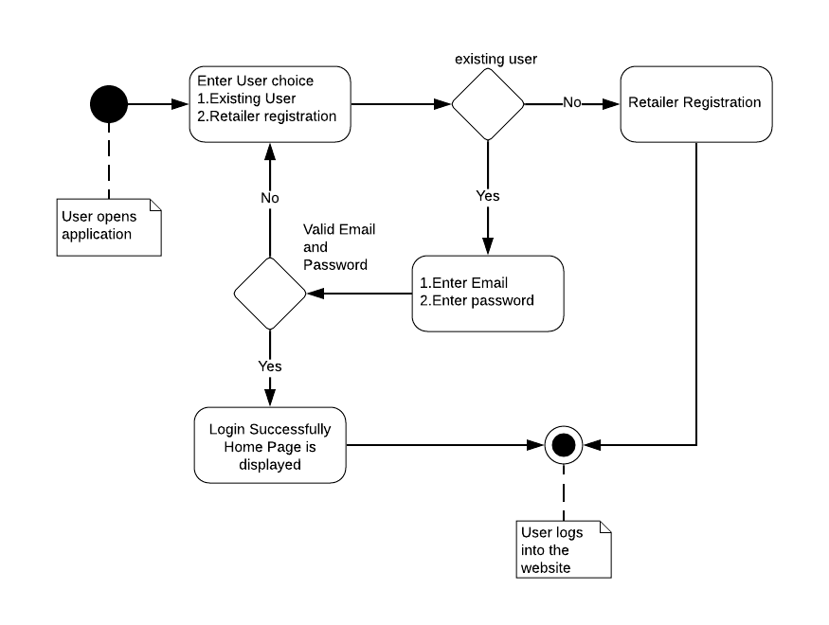
Activity diagram of Login

Slide 37
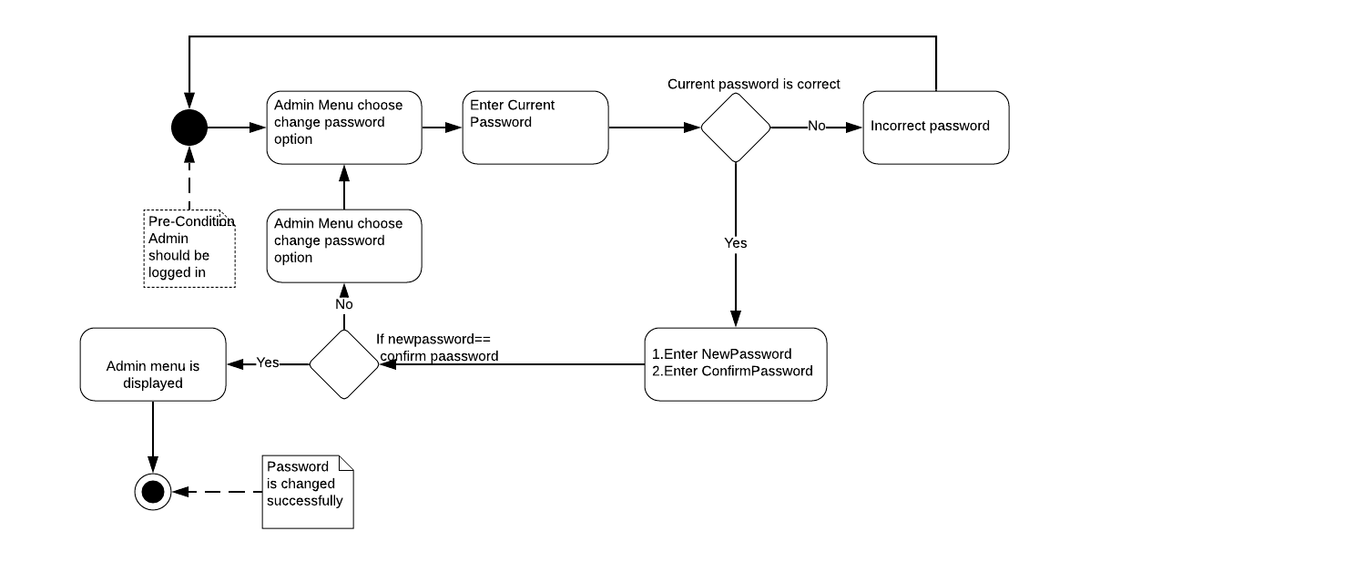
Activity diagram of Changing Admin Password

Slide 38
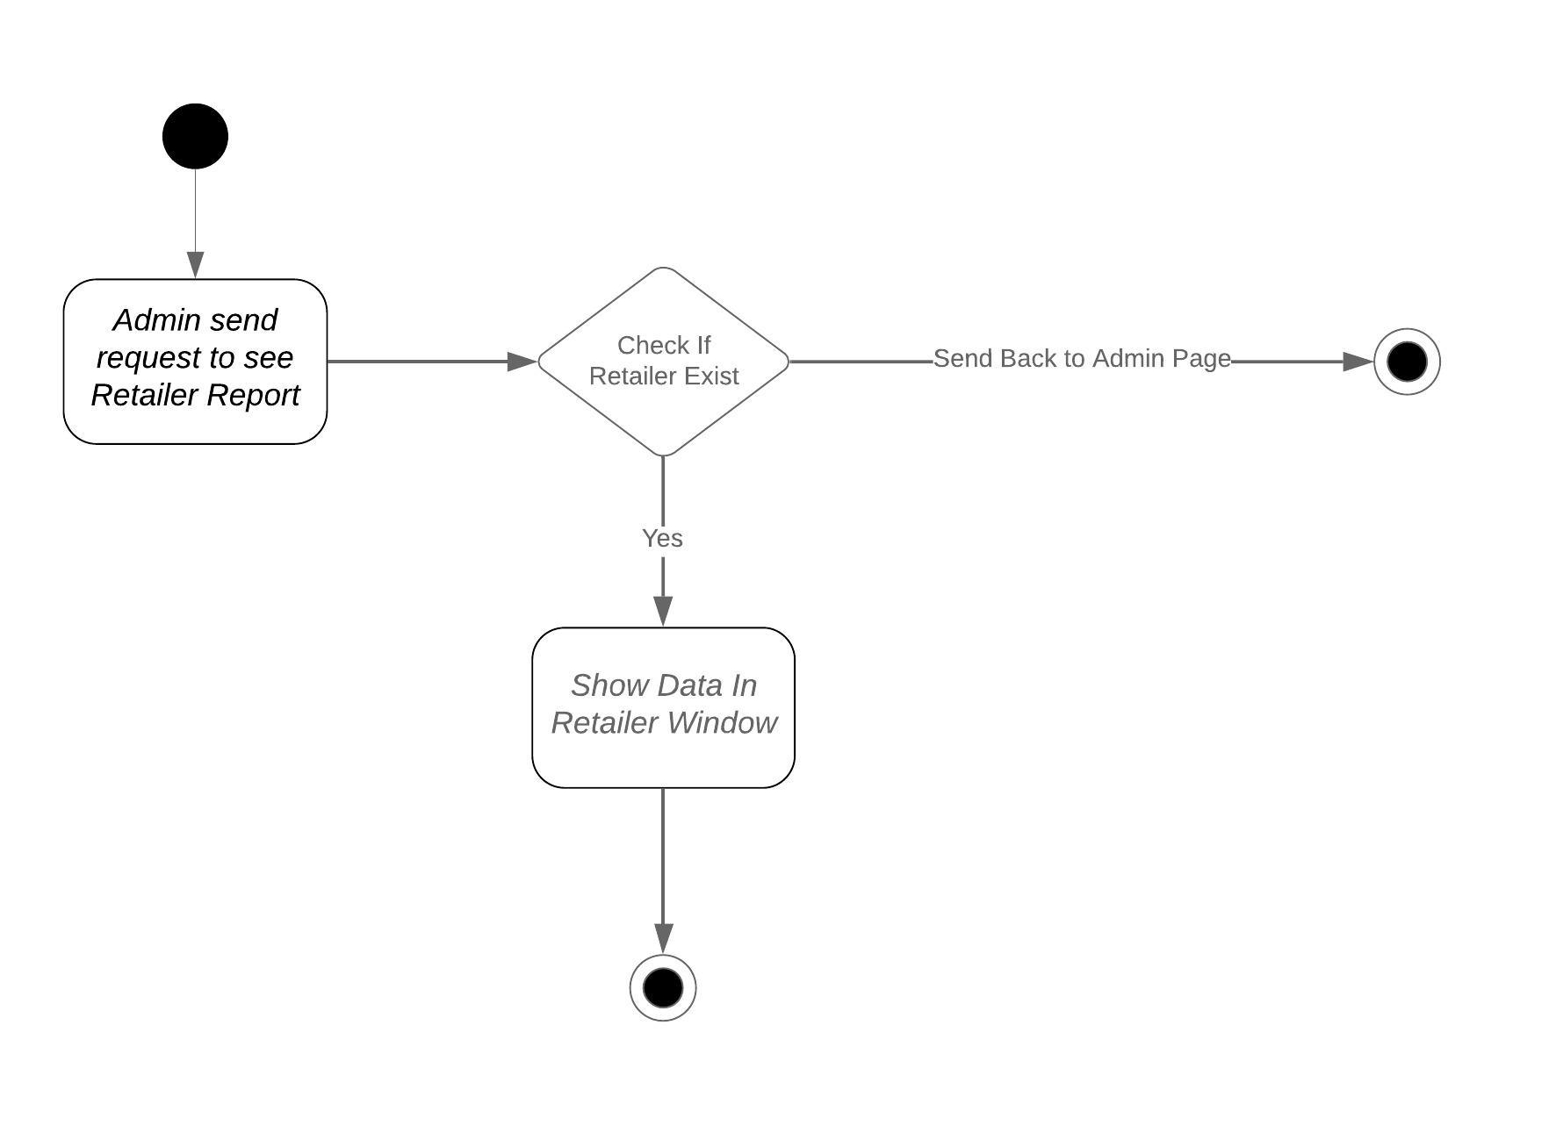
Activity Diagram for Retailer Report

Slide 39
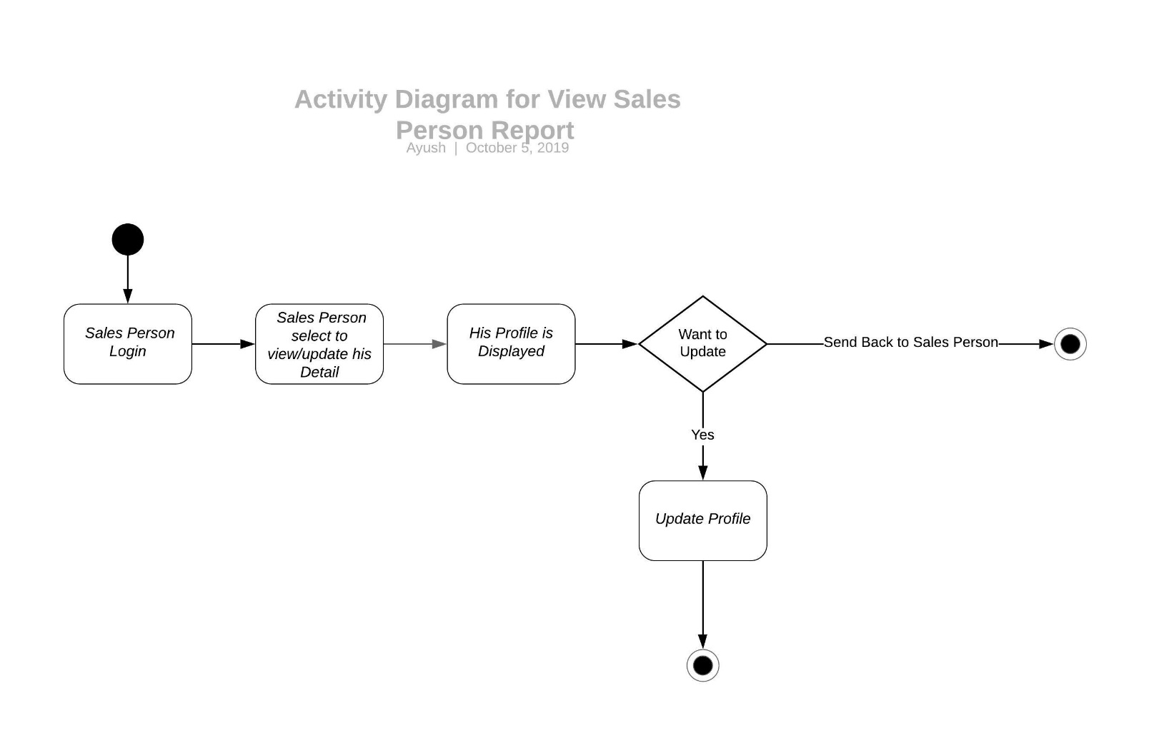
Activity Diagram for Sales Report

Slide 40
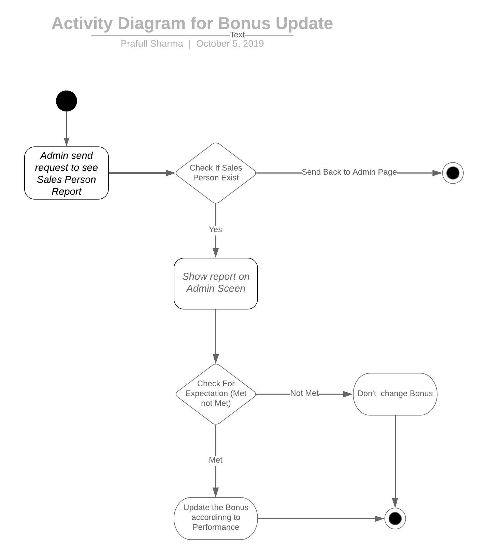
Activity Diagram for Updating Bonus

Slide 41
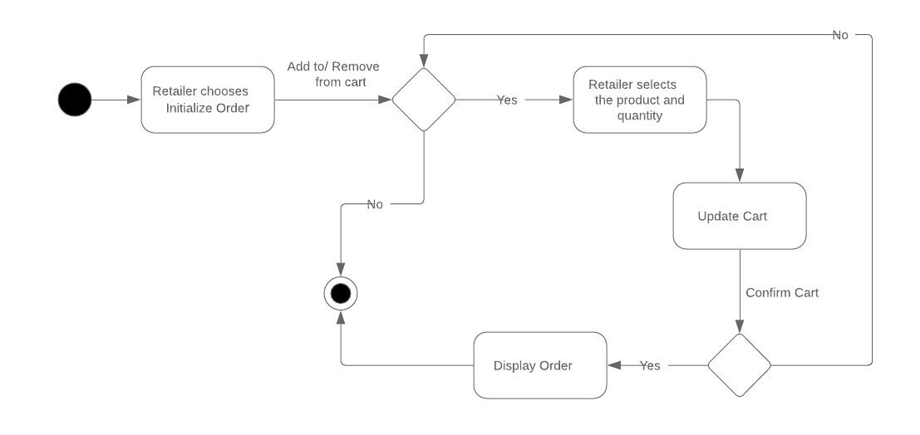
Activity diagram for Order Initializing:

Slide 42
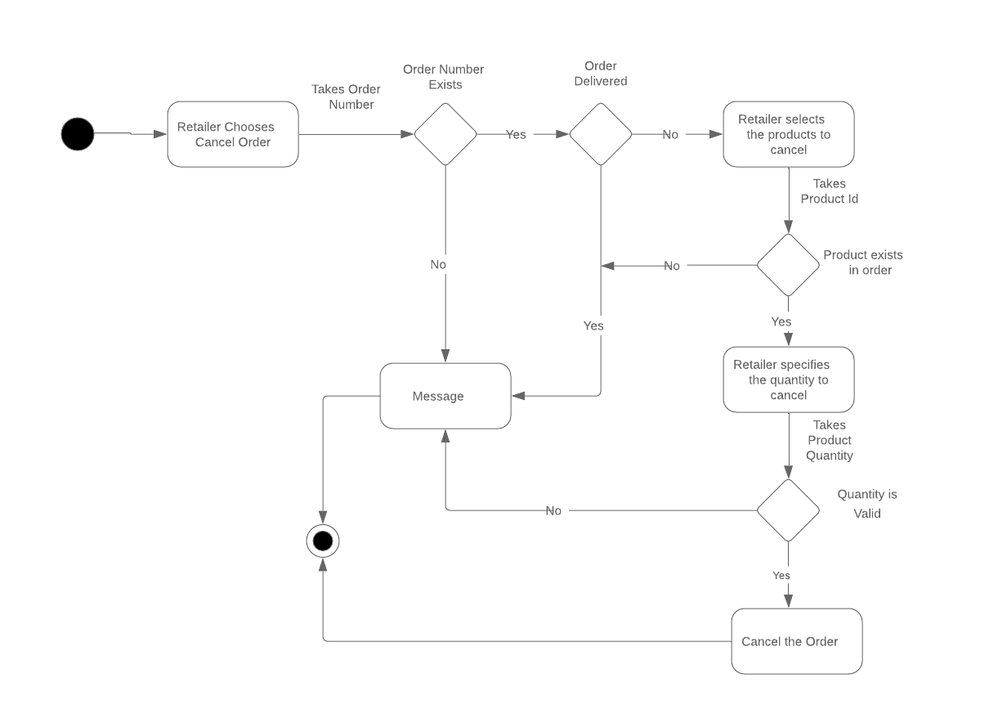
Activity diagram for Order Cancelling:

Slide 43
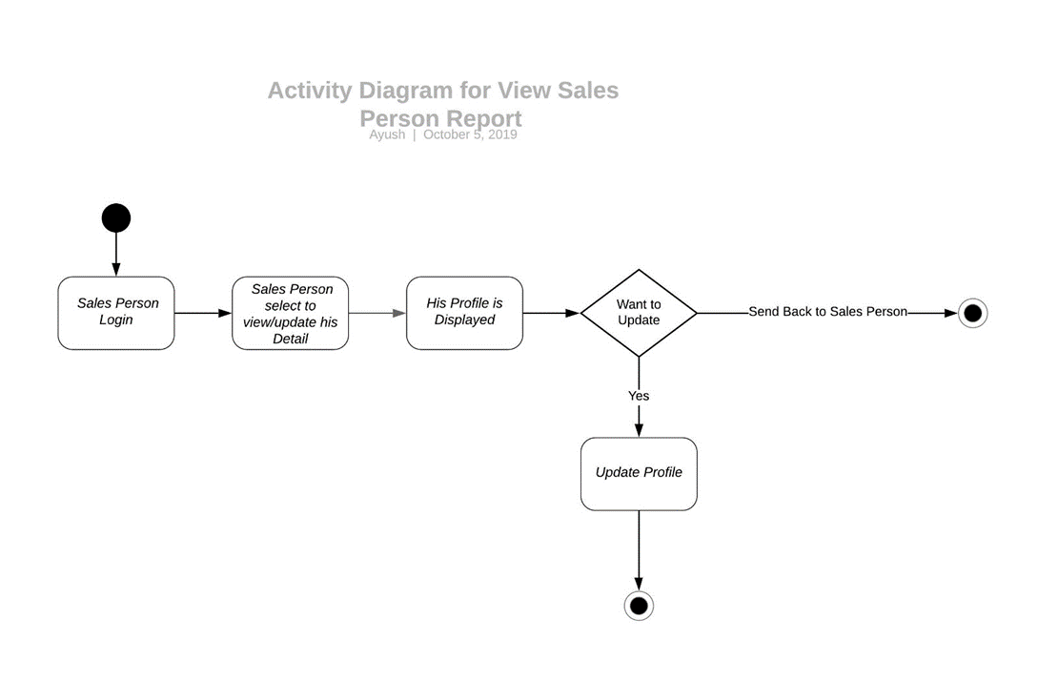
Activity Diagram for Sales Person Detail

Slide 44
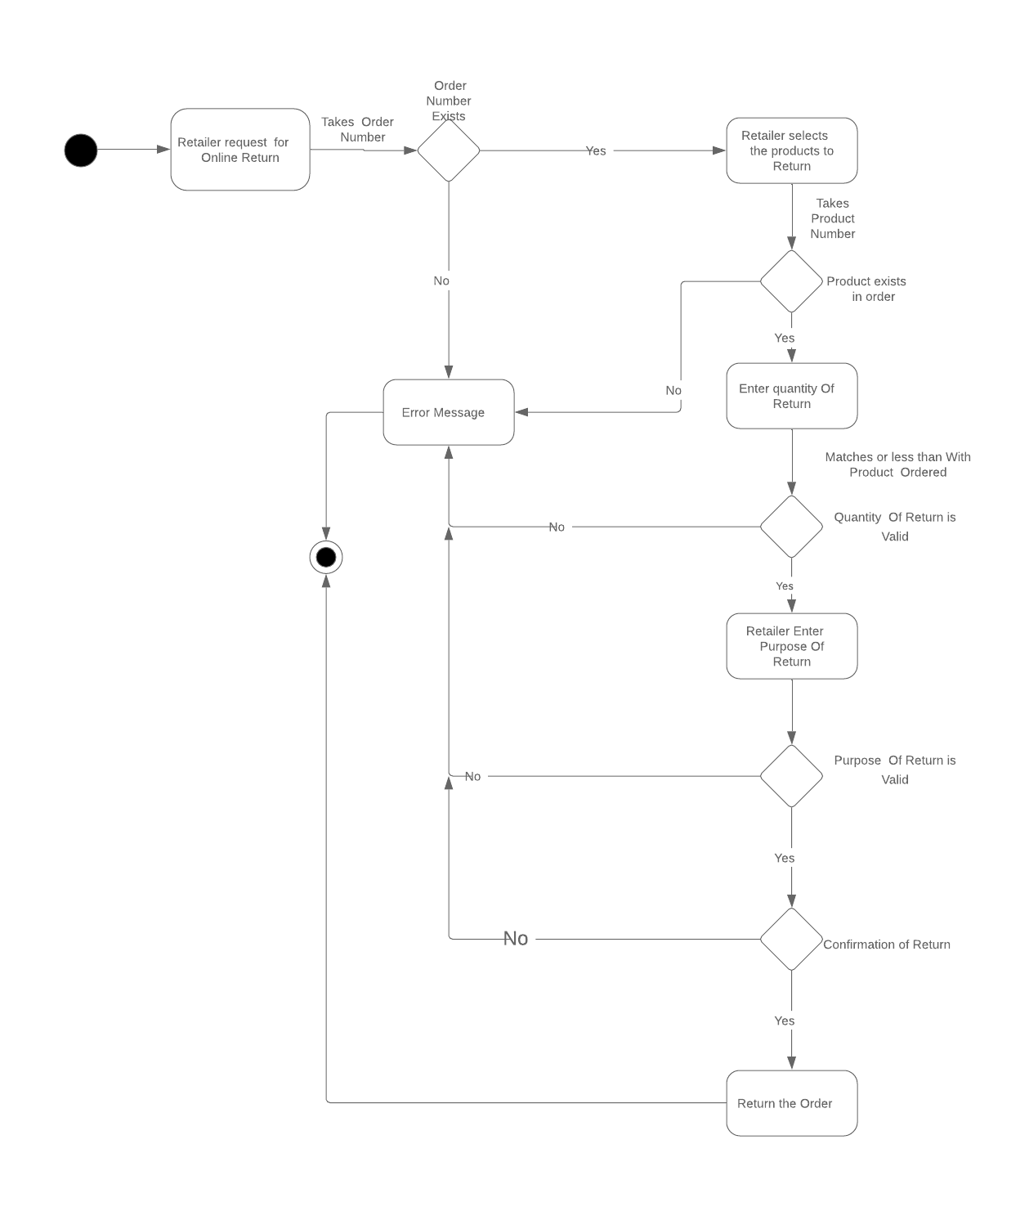
Activity Diagram for Online Return

Slide 45
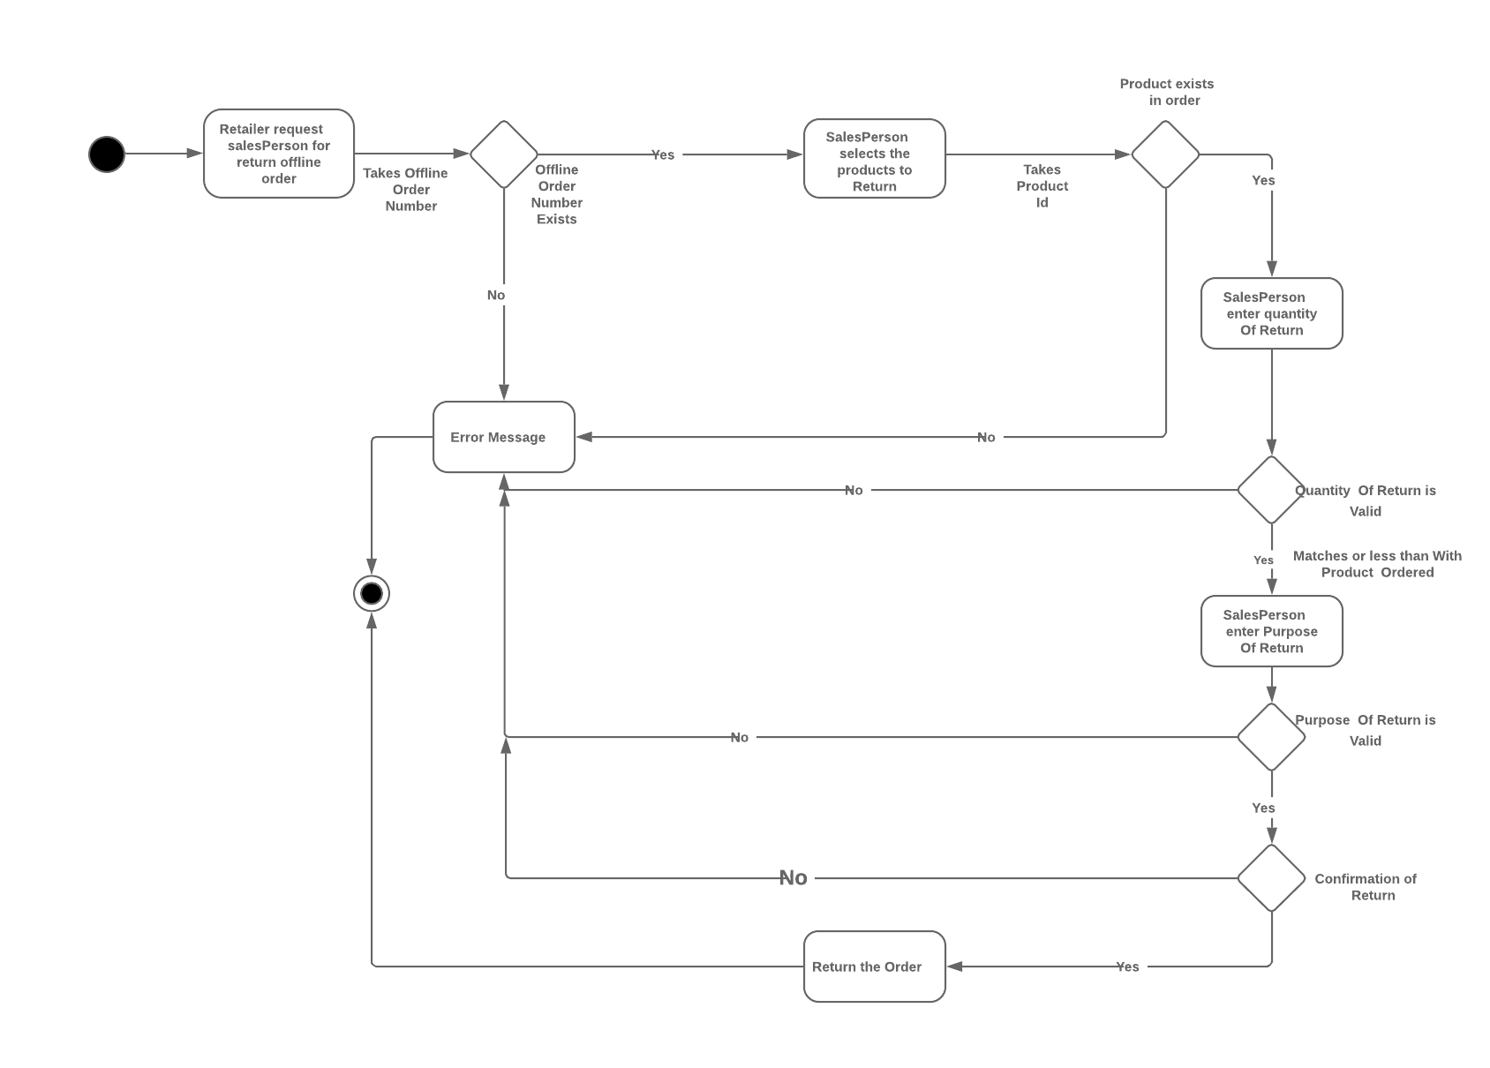
Activity Diagram for Offline Return

Slide 46
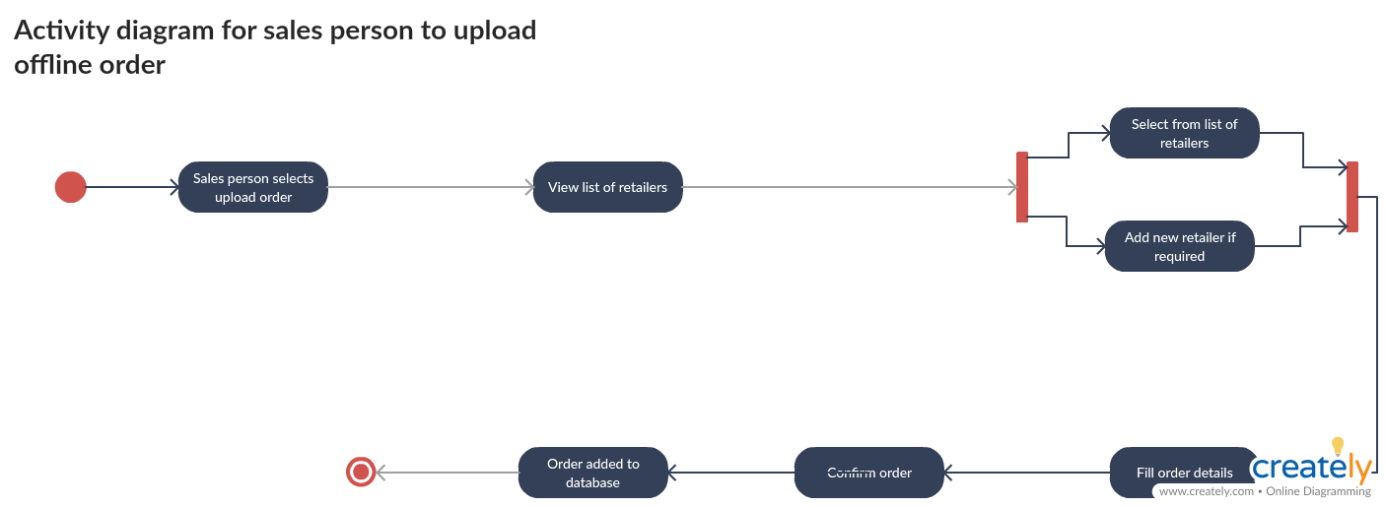

Slide 47
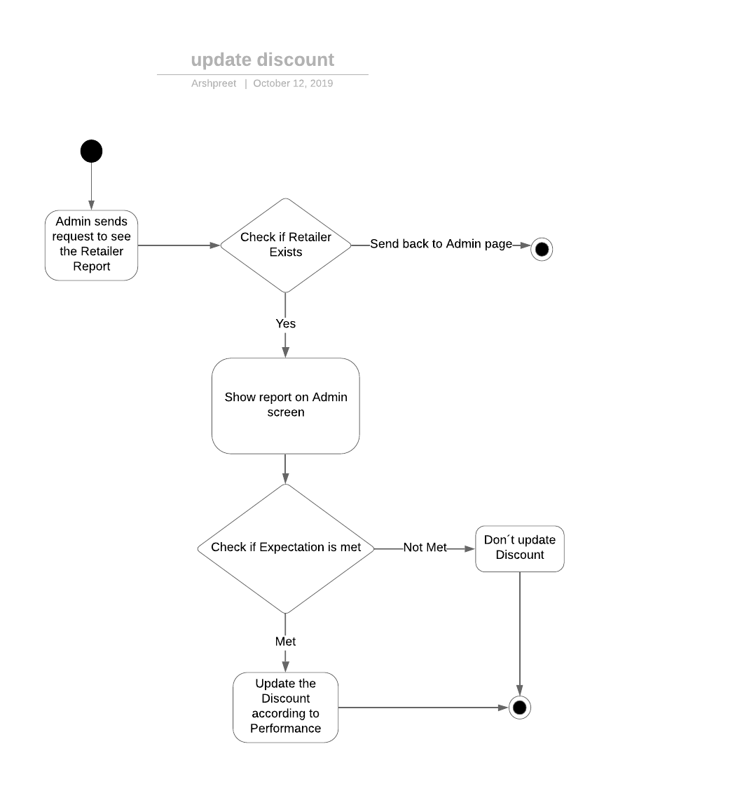
Activity Diagram for Update Discount

Slide 48
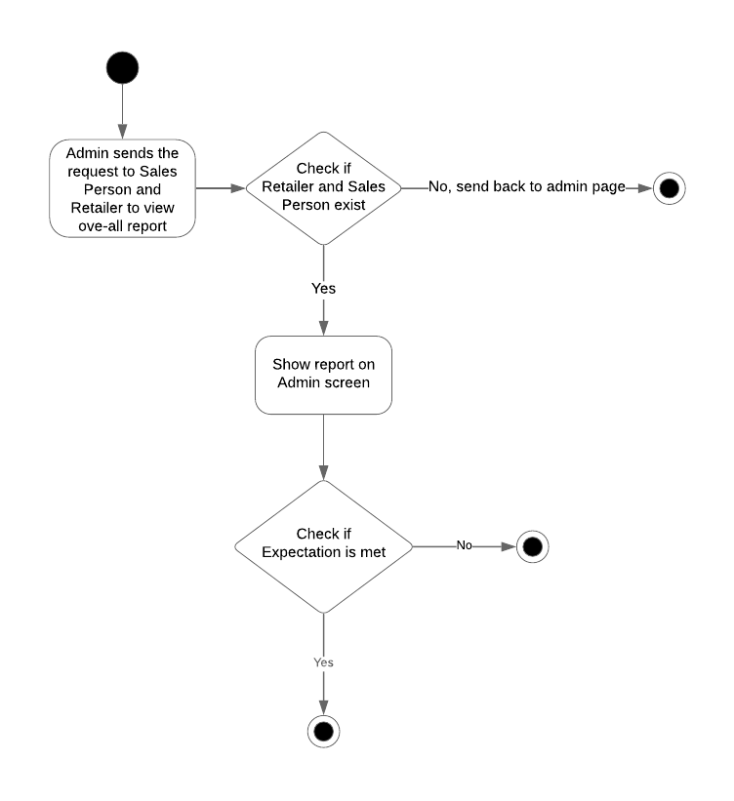
Activity Diagram for Overall Report

Slide 49
Thank you !!!

