Slide 1


GREAT OUTDOORS GROUP-B
By
Chennareddy Sravani

Slide 2
Epic and User stories:
Dealing with Login and Viewing sales reports.
Login:
Taking the user name as input from the user.
Check whether the user name is existed in the database or not.
If yes, ask the password as input from the user.
Validate the password by retrieving user credentials from the database.
Intimating the user about credentials.
For retailer:
If user name is not present in database, we intimate the user and suggest to create new account.
The retailer has two options.
1. Signup 2. Login

Slide 3
Epic and User stories:
View sales reports:
Admin views the sales person profile to check whether the target sales person is met or not.
Admin can see the monthly ,quarterly and annual reports of each salesperson.
The target will be set by the admin for monthly and annual bonus to the sales person.

Slide 4
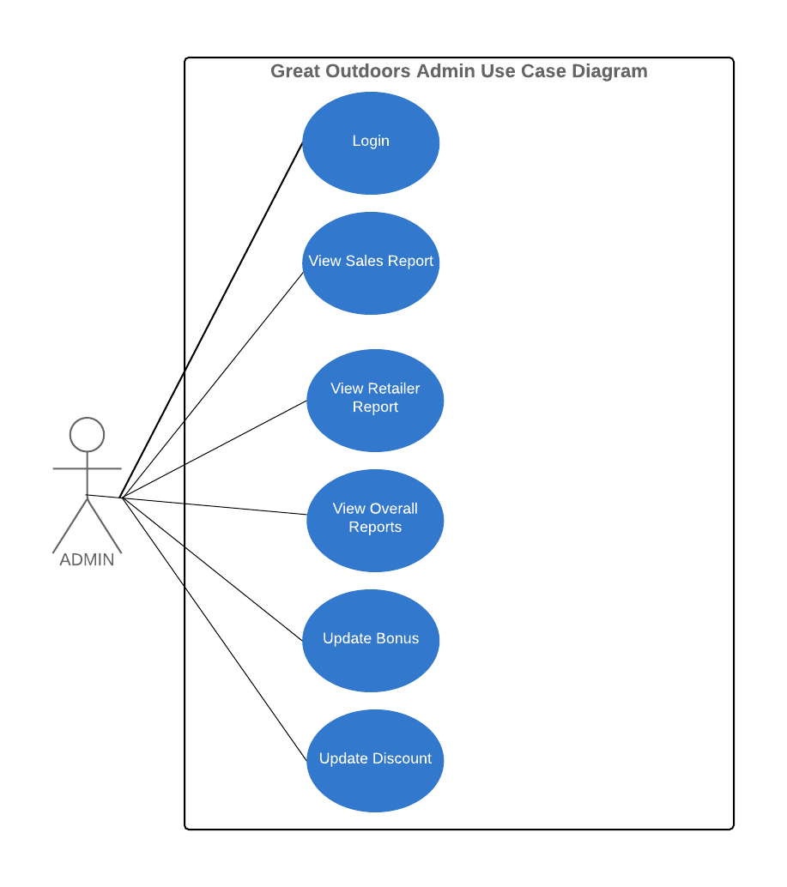

Slide 5
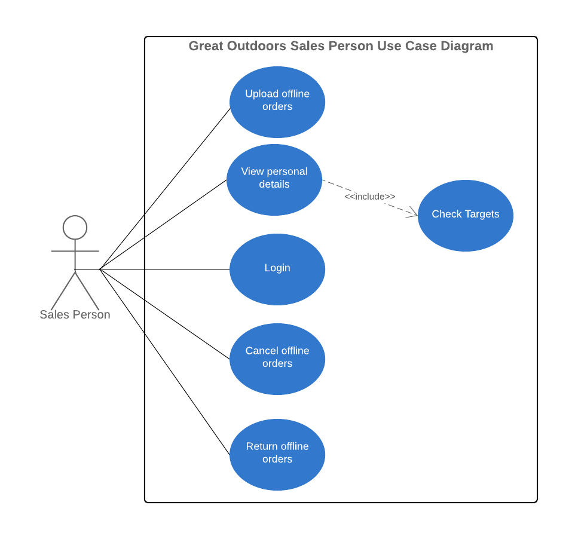

Slide 6
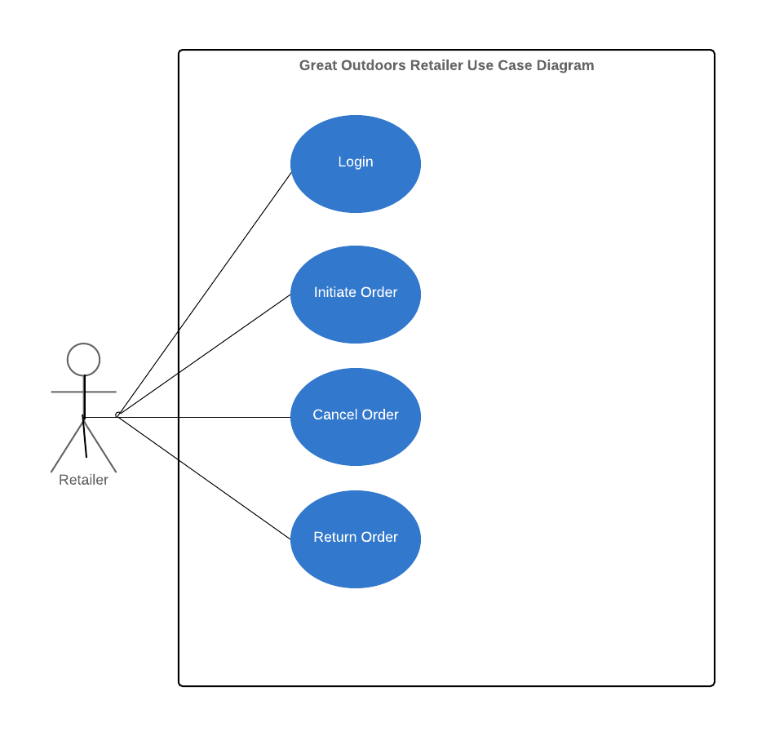

Slide 7
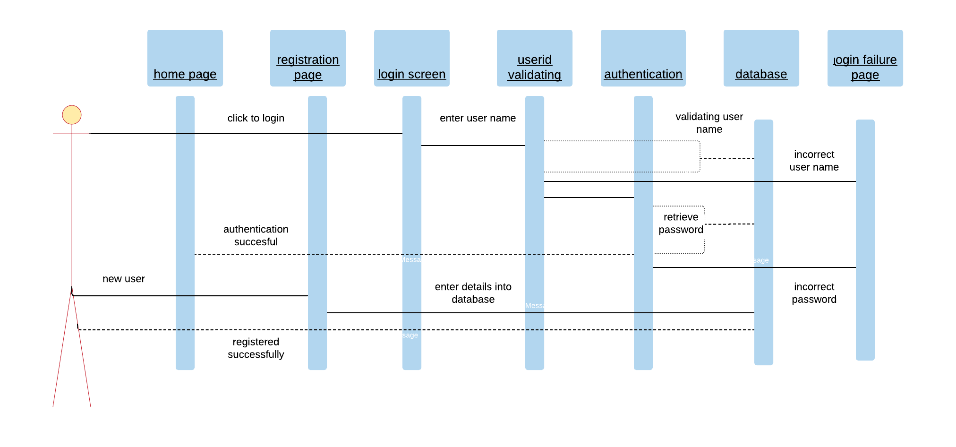
SEQUENCE DIAGRAM FOR RETAILER LOGIN PAGE

Slide 8
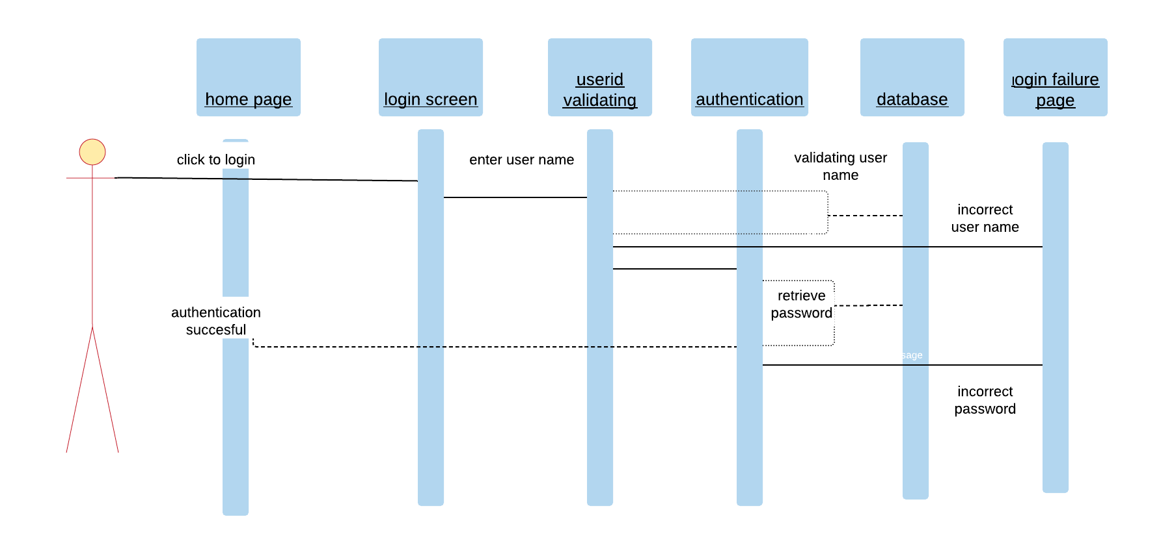
SEQUENCE DIAGRAM FOR ADMIN AND SALES LOGIN PAGE

Slide 9
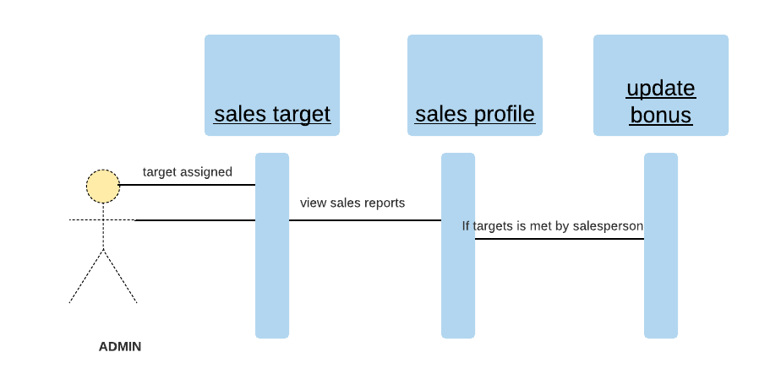
SEQUENCE DIAGRAM FOR VIEWING SALES REPORTS

Slide 10
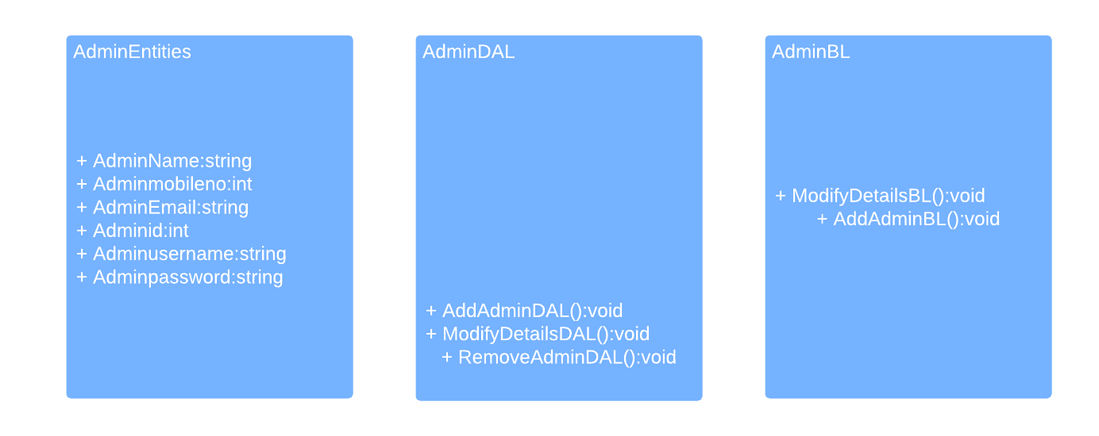
Class diagram:

Slide 11
Thank you

