Slide 1
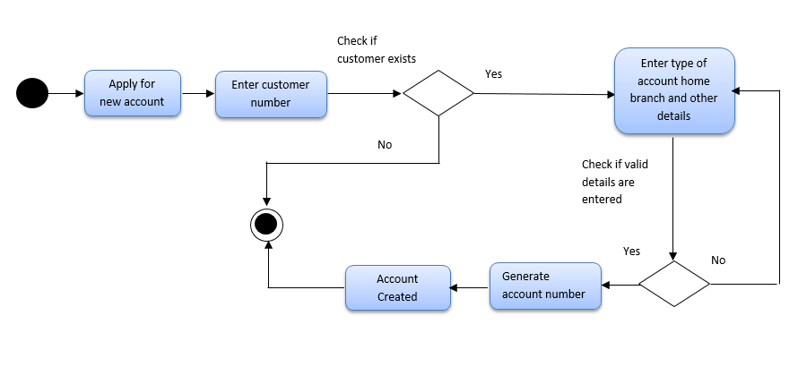
Activity Diagram for Account Creation

Slide 2
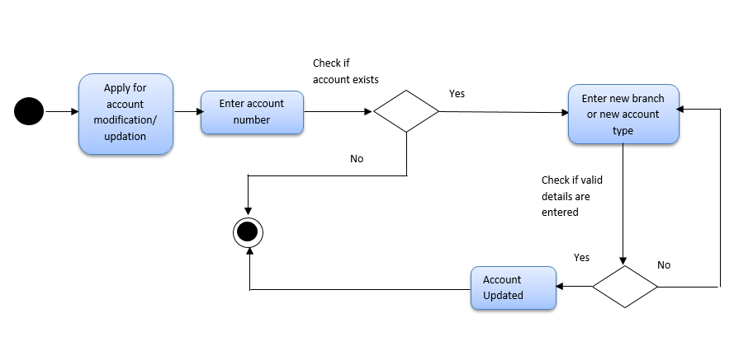
Activity Diagram for Account Updation / Modification

