Slide 1
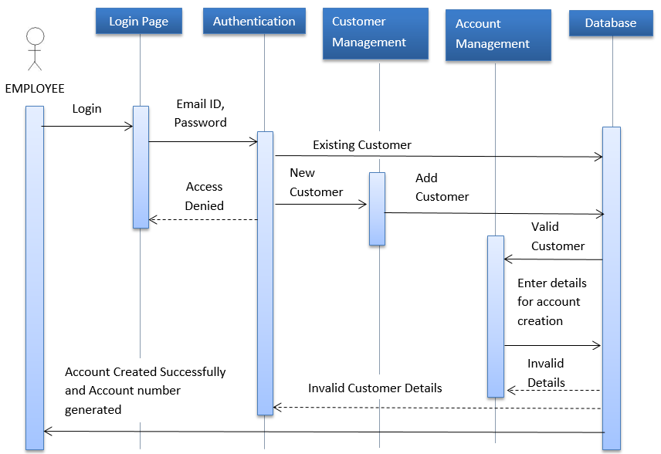
Sequence Diagram for Account Creation

Slide 2
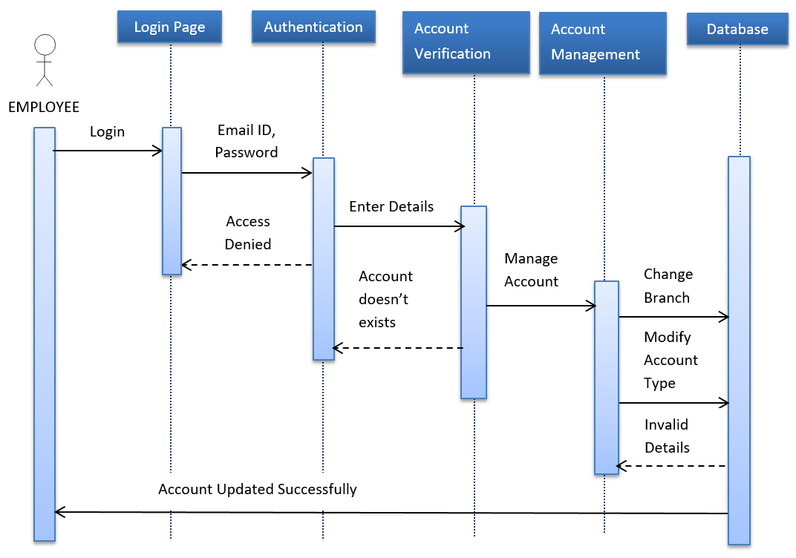
Sequence Diagram for Account Details Updation

