Slide 1
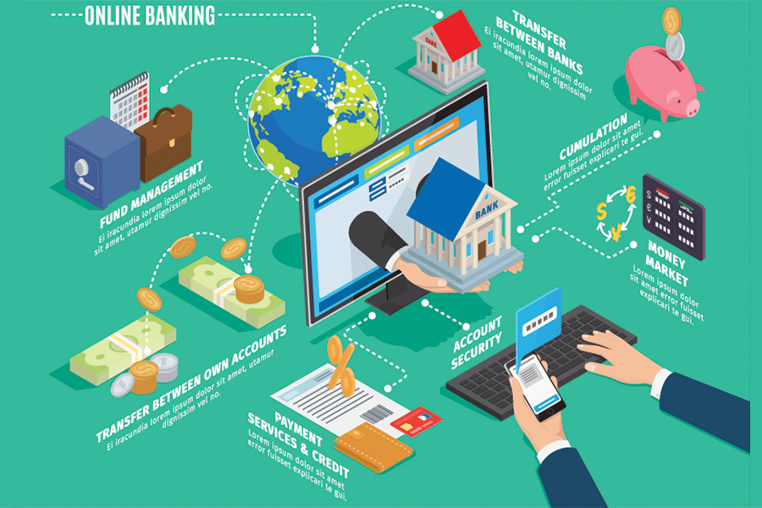
Pecunia Bank Case Study
Submitted by:
“Group - E”
Asmita Chandrakar
Akash Kumar Singh
Kata Tarunsree
Shobhit Pitale
Siddharth Taklikar

Slide 2
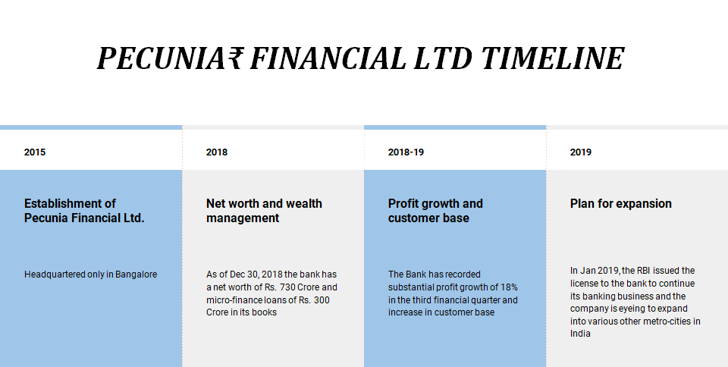

Slide 3
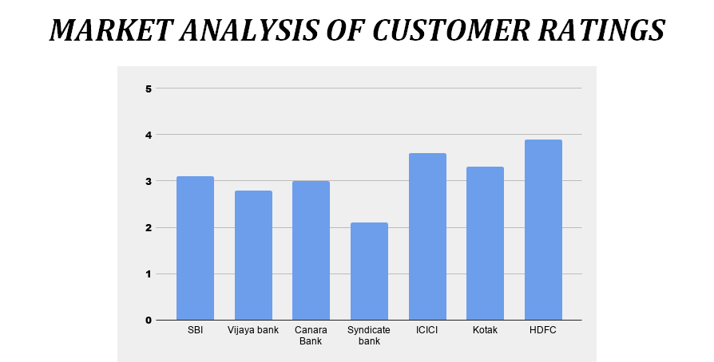

Slide 4
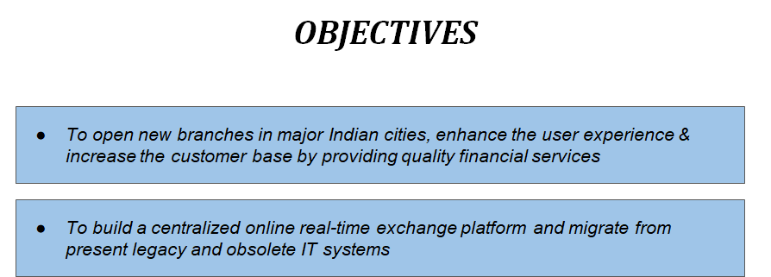

Slide 5
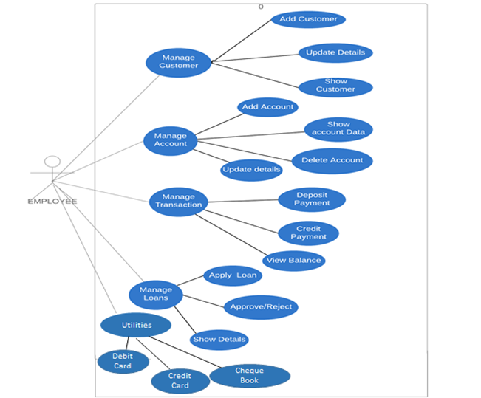
Use Case Diagram for Employee

Slide 6
Use Case Diagram for Admin
Add Employee
Update Employee
Delete Employee
ADMIN
Show Employee Details

Slide 7
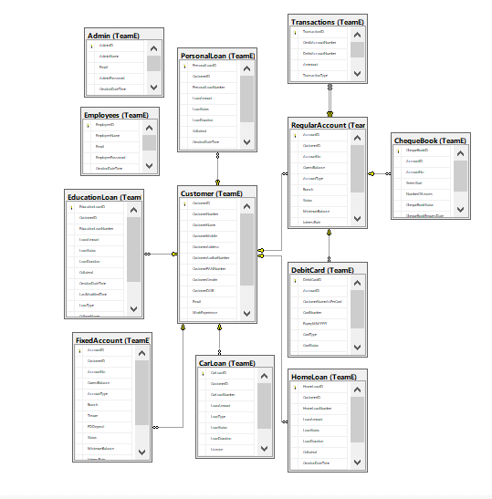
DB Diagram
Notes:
Add instructor notes here.

Slide 8
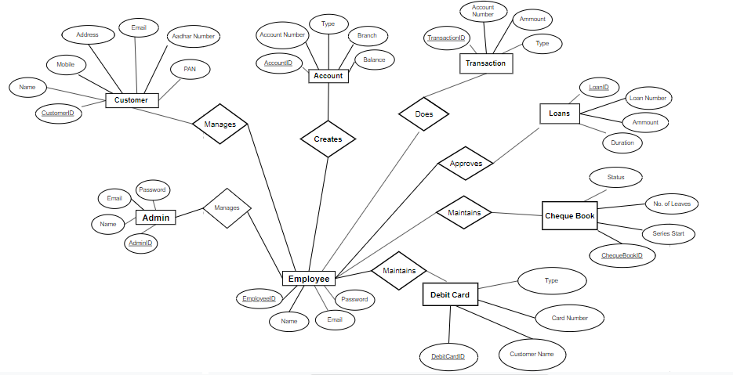
ER Diagram

Slide 9
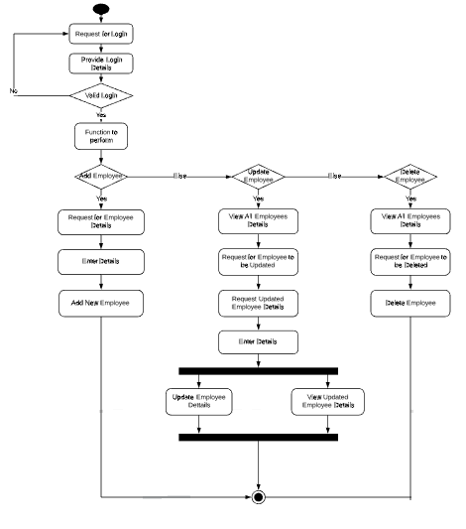
Activity diagram for managing employee

Slide 10
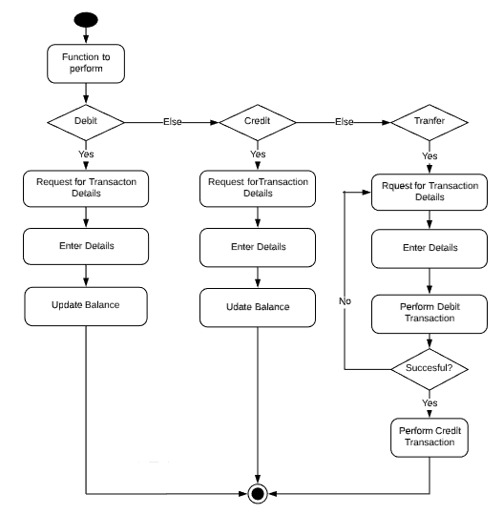
Activity Diagram for Transactions

Slide 11
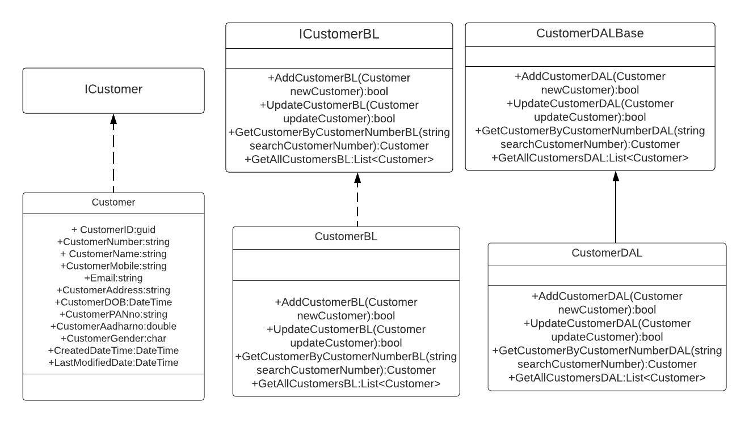
Class Diagram of Customer Class

Slide 12
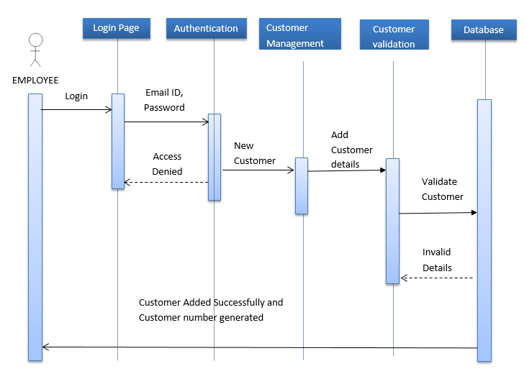
Sequence diagram for Adding Customer

Slide 13
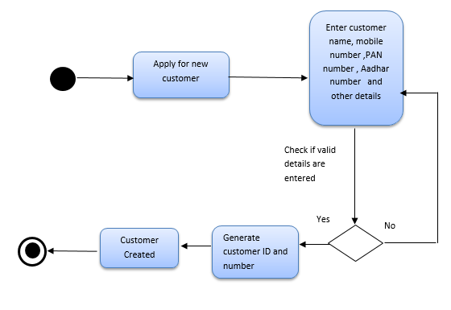
Activity diagram for Adding Customer

Slide 14
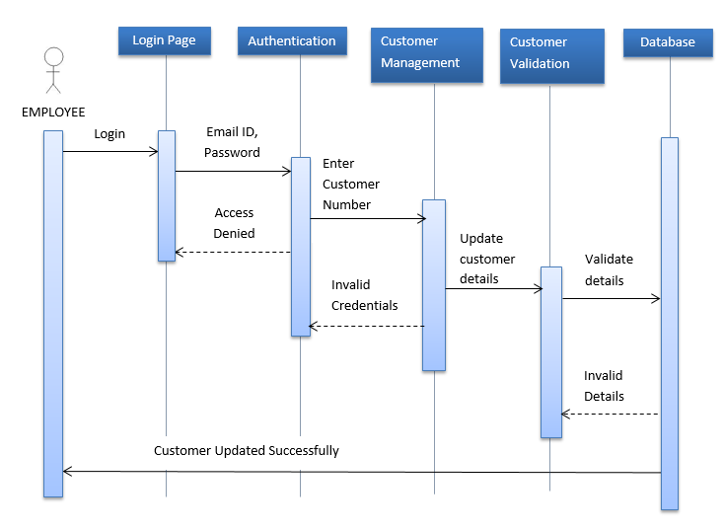
Sequence diagram for Updating Customer details

Slide 15
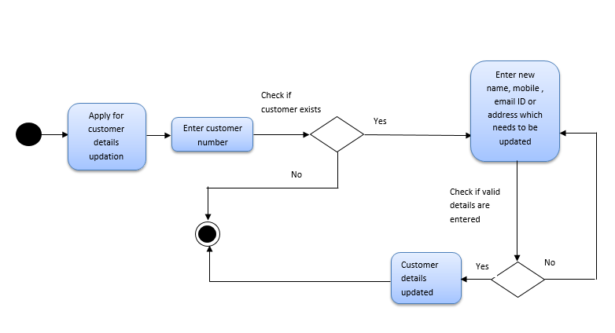
Activity diagram for Updating Customer details

Slide 16
Class Diagram of Regular Account Class
iRegularAccount
+AccountID: Guid
+CustomerID: Guid
+AccountNo: string
+CurrentBalance: double
+AccountType: string
+Branch: string
+status: string
+MinimumBalance: double
+InterestRate: double
+CreationDateTime: DateTime
+LastModifiedDateTime: DateTime
iRegularAccountBL
+CreateAccountBL (Account): bool
+GetAllAccountsBL (): List<Account>
+SearchaccountByAccountNoBL (string): Account
+GetAccountsByCustomerIDBL (Guid): List<Account>
+GetAccountsByTypeBL (string): List<Account>
+GetAccountsByBranchBL (string): List<Account>
+GetAccountsByaccountOpeningDateBL (DateTime, DateTime): List<Account>
+GetBalanceBL (string): double
+UpdateBalanceBL (string, double): bool
+UpdateBranchBL (RegularAccount): bool
+UpdateAccountTypeBL (RegularAccount): bool
+DeleteAccountBL (string): bool
RegularAccountDALBase
+CreateAccountDAL (Account): bool
+GetAllAccountsDAL (): List<Account>
+SearchaccountByAccountNoDAL (string): Account
+GetAccountsByCustomerIDDAL (Guid): List<Account>
+GetAccountsByTypeDAL (string): List<Account>
+GetAccountsByBranchDAL (string): List<Account>
+GetAccountsByaccountOpeningDateDAL (DateTime, DateTime): List<Account>
+GetBalanceDAL(string): double
+UpdateBalanceDAL (string, double): bool
+UpdateBranchDAL (RegularAccount): bool
+UpdateAccountTypeDAL (RegularAccount): bool
+DeleteAccountDAL (string): bool
RegularAccount
+AccountID: Guid
+CustomerID: Guid
+AccountNo: string
+CurrentBalance: double
+AccountType: string
+Branch: string
+status: string
+MinimumBalance: double
+InterestRate: double
+CreationDateTime: DateTime
+LastModifiedDateTime: DateTime
RegularAccountBL
+CreateAccountBL (Account): bool
+GetAllAccountsBL (): List<Account>
+SearchaccountByAccountNoBL (string): Account
+GetAccountsByCustomerIDBL (Guid): List<Account>
+GetAccountsByTypeBL (string): List<Account>
+GetAccountsByBranchBL (string): List<Account>
+GetAccountsByaccountOpeningDateBL (DateTime, DateTime): List<Account>
+GetBalanceBL (string): double
+UpdateBalanceBL (string, double): bool
+UpdateBranchBL (RegularAccount): bool
+UpdateAccountTypeBL (Account): bool
+DeleteAccountBL (string): bool
RegularAccountDAL
+CreateAccountDAL (Account): bool
+GetAllAccountsDAL (): List<Account>
+SearchaccountByAccountNoDAL (string): Account
+GetAccountsByCustomerIDDAL (Guid): List<Account>
+GetAccountsByTypeDAL (string): List<Account>
+GetAccountsByBranchDAL (string): List<Account>
+GetAccountsByaccountOpeningDateDAL (DateTime, DateTime): List<Account>
+GetBalanceDAL(string): double
+UpdateBalanceDAL (string, double): bool
+UpdateBranchDAL (Account): bool
+UpdateAccountTypeDAL (RegularAccount): bool
+DeleteAccountDAL (string): bool

Slide 17
Class Diagram of Fixed Account Class
iFixedAccountBL
+CreateAccountBL (Fixed): bool
+GetAllAccountsBL (): List<Fixed>
+SearchaccountByAccountNoBL (string): Fixed
+GetAccountsByCustomerIDBL (Guid): List<Fixed>
+GetAccountsByTypeBL (string): List<Fixed>
+GetAccountsByBranchBL (string): List<Fixed>
+GetAccountsByaccountOpeningDateBL (DateTime, DateTime): List<Account>
+GetBalanceBL (string): double
+UpdateBalanceBL (string,double): bool
+UpdateBranchBL (FixedAccount): bool
+DeleteAccountBL (string): bool
FixedAccountDALBase
+CreateAccountDAL (Fixed): bool
+GetAllAccountsDAL (): List<Fixed>
+SearchaccountByAccountNoDAL (string): Fixed
+GetAccountsByCustomerIDDAL (Guid): List<Fixed>
+GetAccountsByTypeDAL (string): List<Fixed>
+GetAccountsByBranchDAL (string): List<Fixed>
+GetAccountsByaccountOpeningDateDAL (DateTime, DateTime): List<Fixed>
+GetBalanceDAL(string): double
+UpdateBalanceDAL (string, double): bool
+UpdateBranchDAL (FixedAccount): bool
+DeleteAccountDAL (string): bool
iRegularAccount
+AccountID: Guid
+CustomerID: Guid
+AccountNo: string
+CurrentBalance: double
+AccountType: string
+Branch: string
+status: string
+MinimumBalance: double
+InterestRate: double
+CreationDateTime: DateTime
+LastModifiedDateTime: DateTime
iFixedAccount
+Tenure: double
+FDDeposit: double
FixedAccount
+AccountID: Guid
+AccountNo: string
+CurrentBalance: double
+AccountType: string
+Branch: string
+status: string
+MinimumBalance: double
+InterestRate: double
+Tenure: double
+FDDeposit: double
+CreationDateTime: DateTime
+LastModifiedDateTime: DateTime
FixedAccountBL
+CreateAccountBL (Fixed): bool
+GetAllAccountsBL (): List<Fixed>
+SearchaccountByAccountNoBL (string): Fixed
+GetAccountsByCustomerIDBL (Guid): List<Fixed>
+GetAccountsByTypeBL (string): List<Fixed>
+GetAccountsByBranchBL (string): List<Fixed>
+GetAccountsByaccountOpeningDateBL (DateTime, DateTime): List<Account>
+GetBalanceBL (string): double
+UpdateBalanceBL (string, double): bool
+UpdateBranchBL (FixedAccount): bool
+DeleteAccountBL (string): bool
FixedAccountDAL
+CreateAccountDAL (Fixed): bool
+GetAllAccountsDAL (): List<Fixed>
+SearchaccountByAccountNoDAL (string): Fixed
+GetAccountsByCustomerIDDAL (Guid): List<Fixed>
+GetAccountsByTypeDAL (string): List<Fixed>
+GetAccountsByBranchDAL (string): List<Fixed>
+GetAccountsByaccountOpeningDateDAL (DateTime, DateTime): List<Fixed>
+GetBalanceDAL(string): double
+UpdateBalanceDAL (FixedAccount): bool
+UpdateBranchDAL (FixedAccount): bool
+DeleteAccountDAL (string): bool

Slide 18
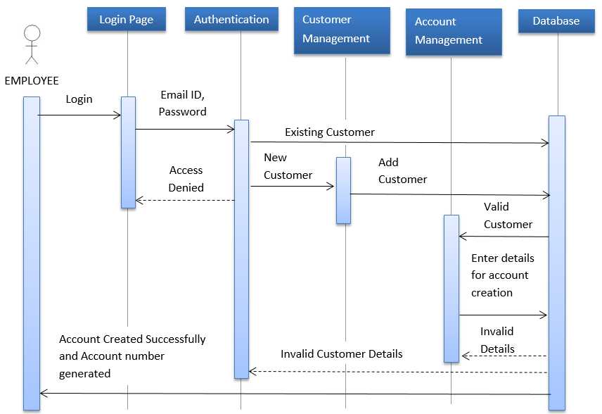
Sequence Diagram for Account Creation

Slide 19
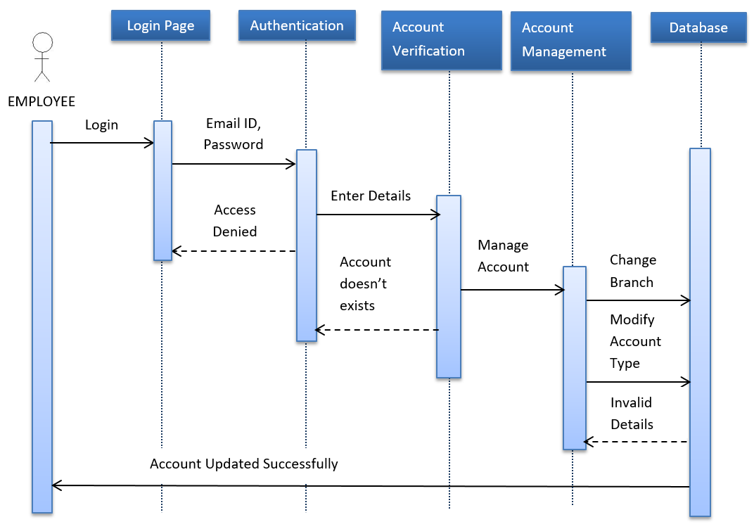
Sequence Diagram for Account Details Updation

Slide 20
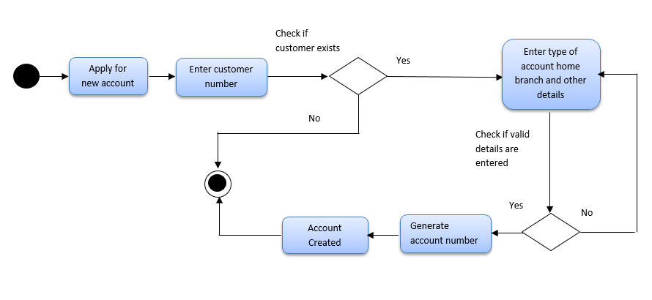
Activity Diagram for Account Creation

Slide 21
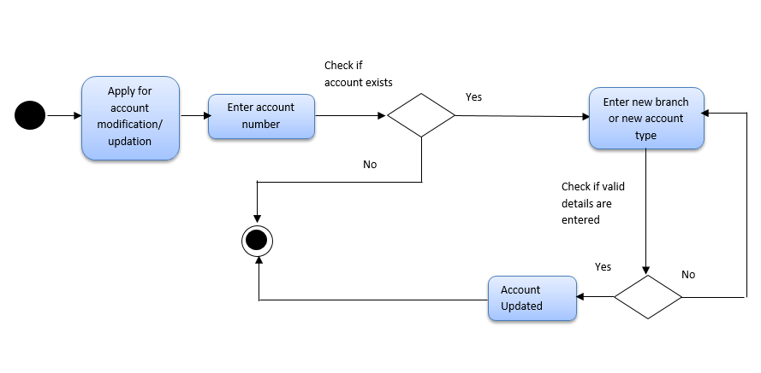
Activity Diagram for Account Updation / Modification

Slide 22
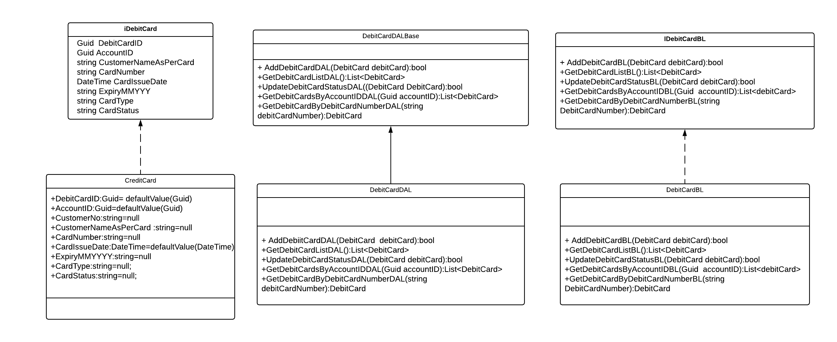
Class Diagram of Debit Card Class

Slide 23
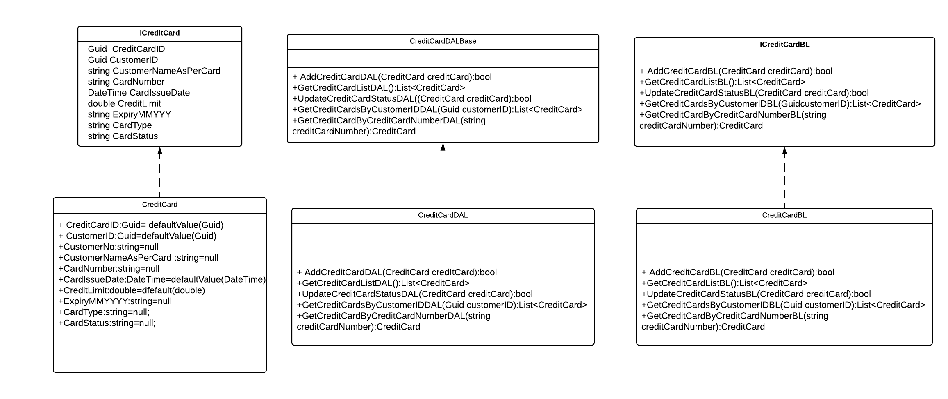
Class Diagram of Cheque Book Class

Slide 24
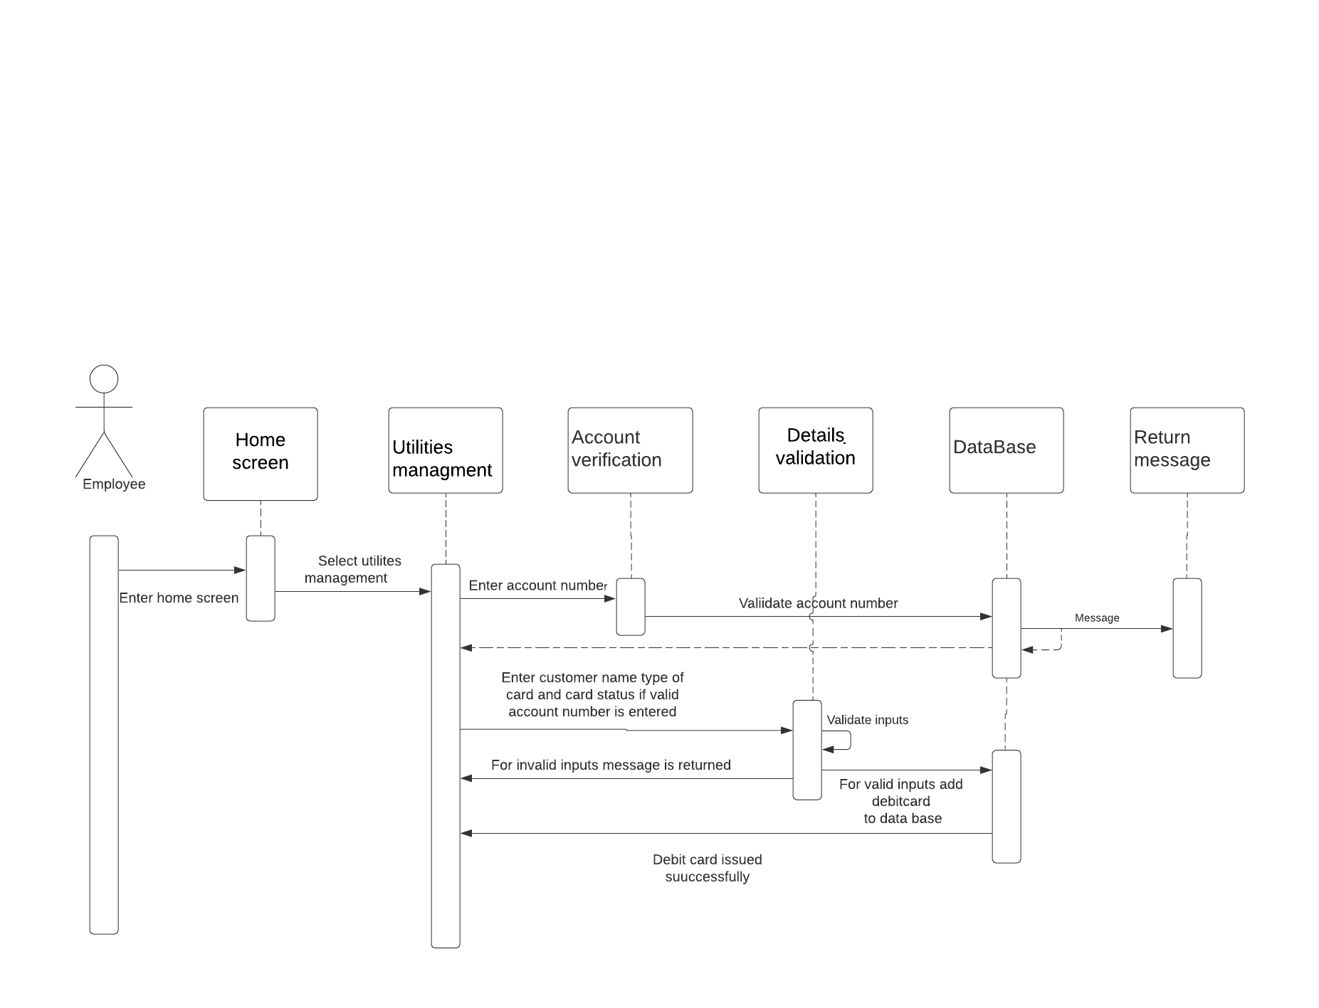
Sequence Diagram for Debit Card Issue

Slide 25
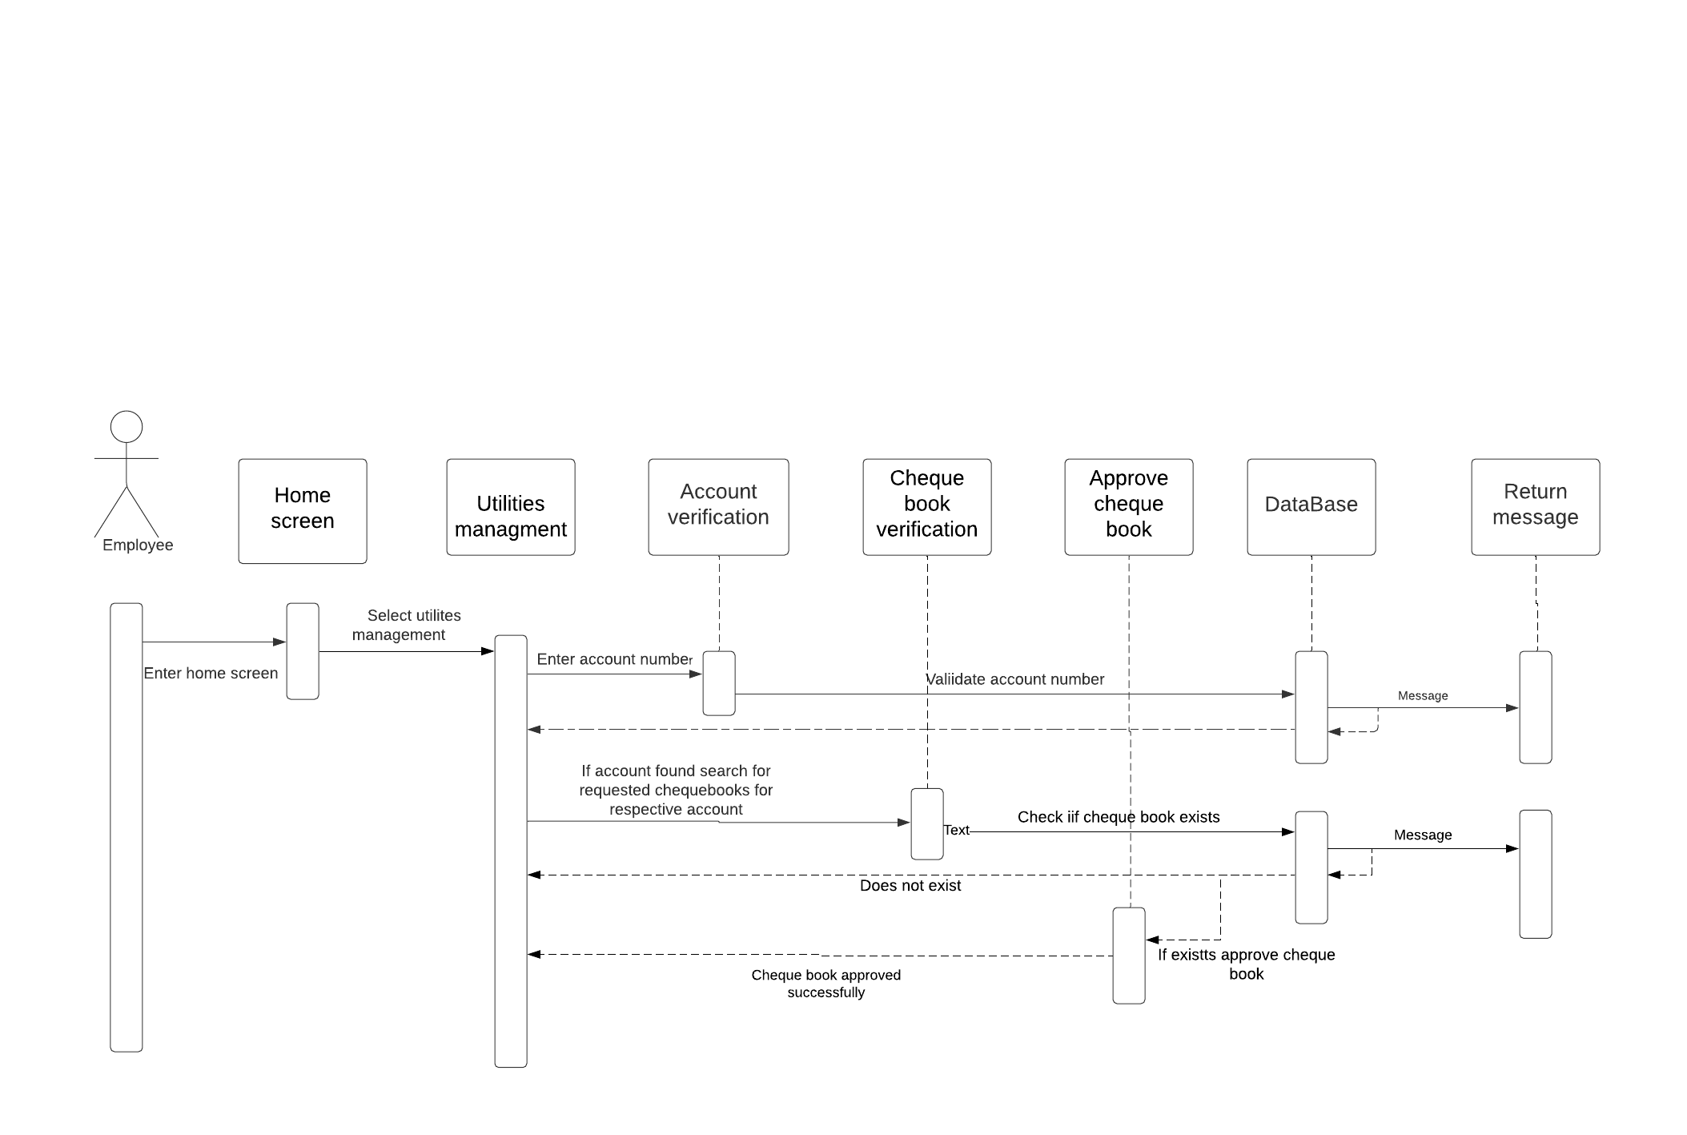
Sequence Diagram of Cheque Book Application

Slide 26
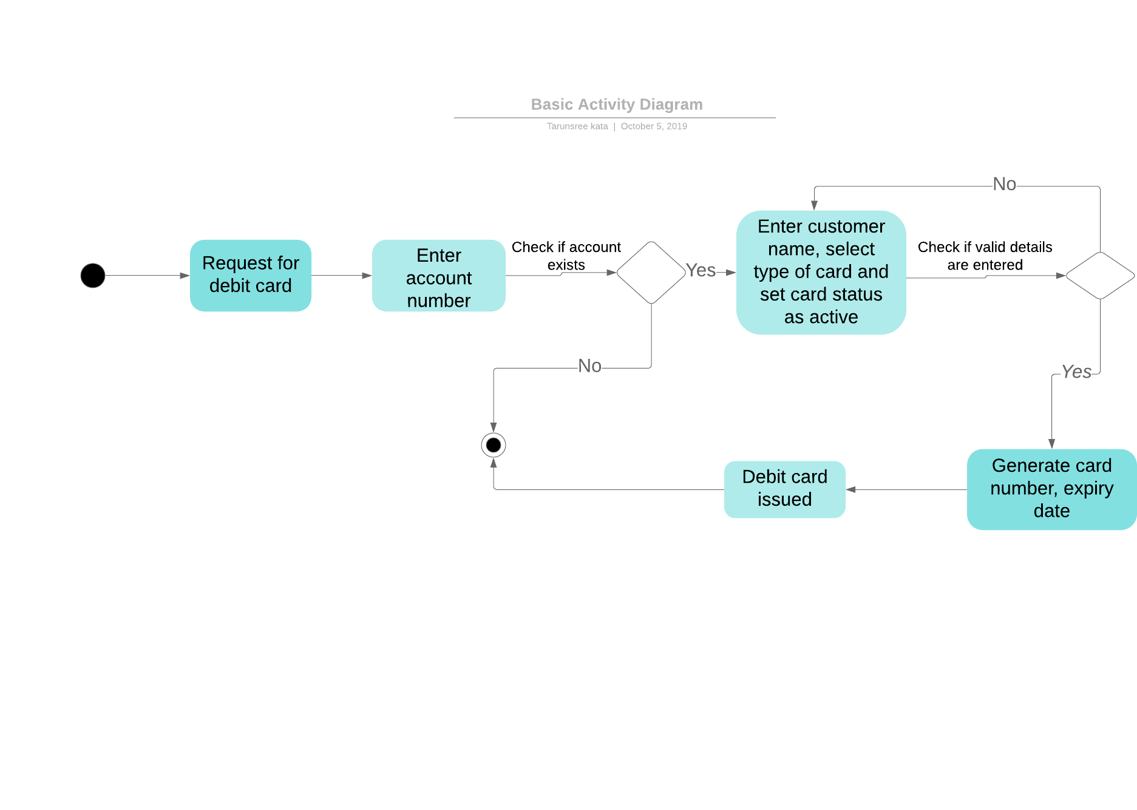
Activity Diagram for Debit Card Issue

Slide 27
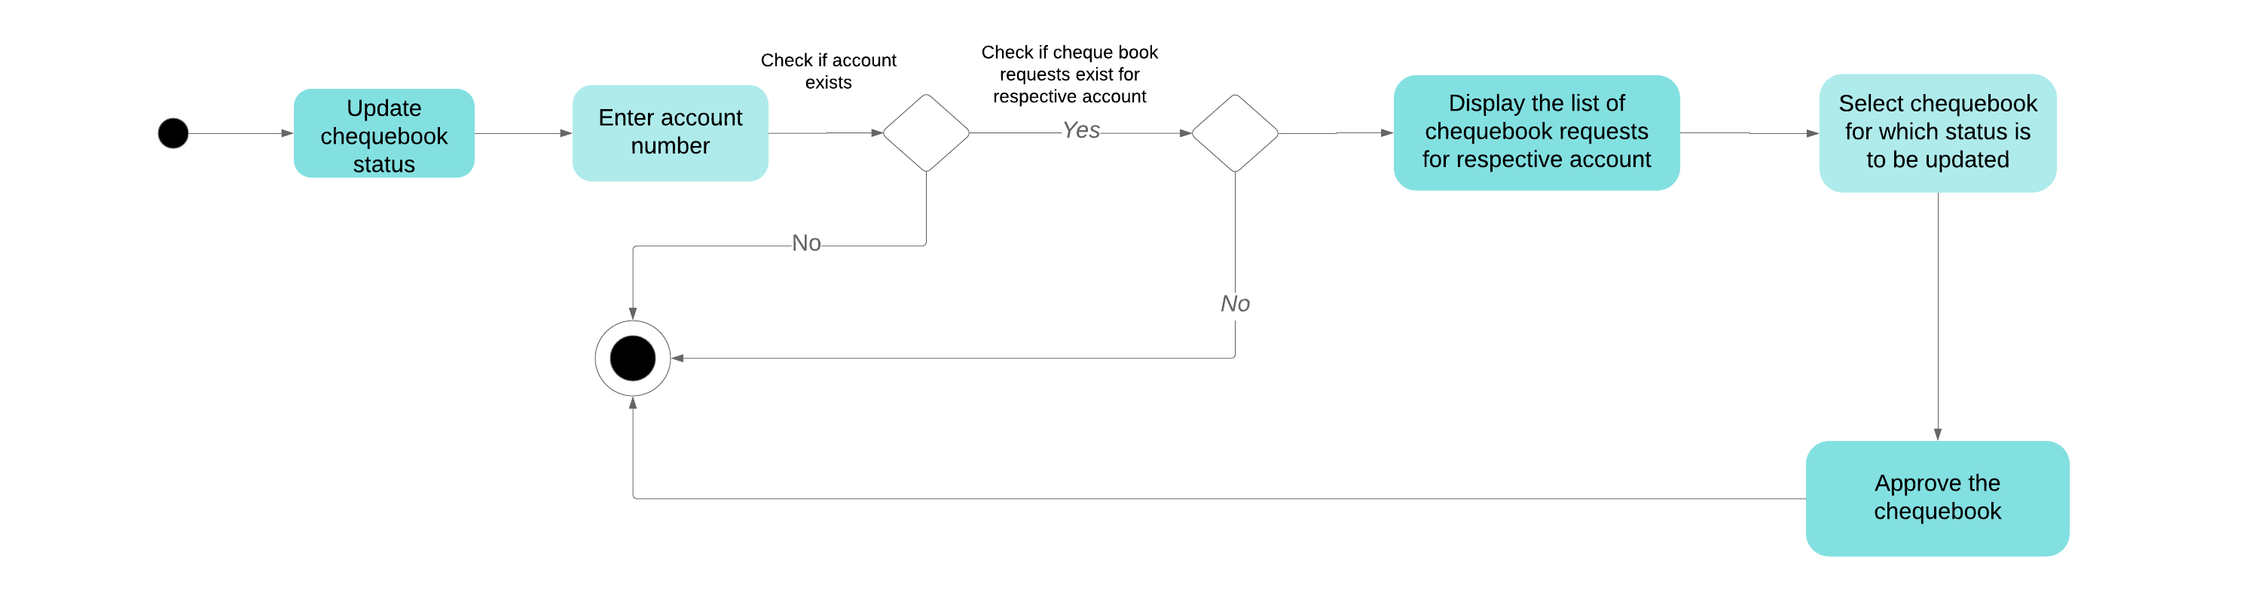
Activity Diagram for Cheque Book Application

Slide 28
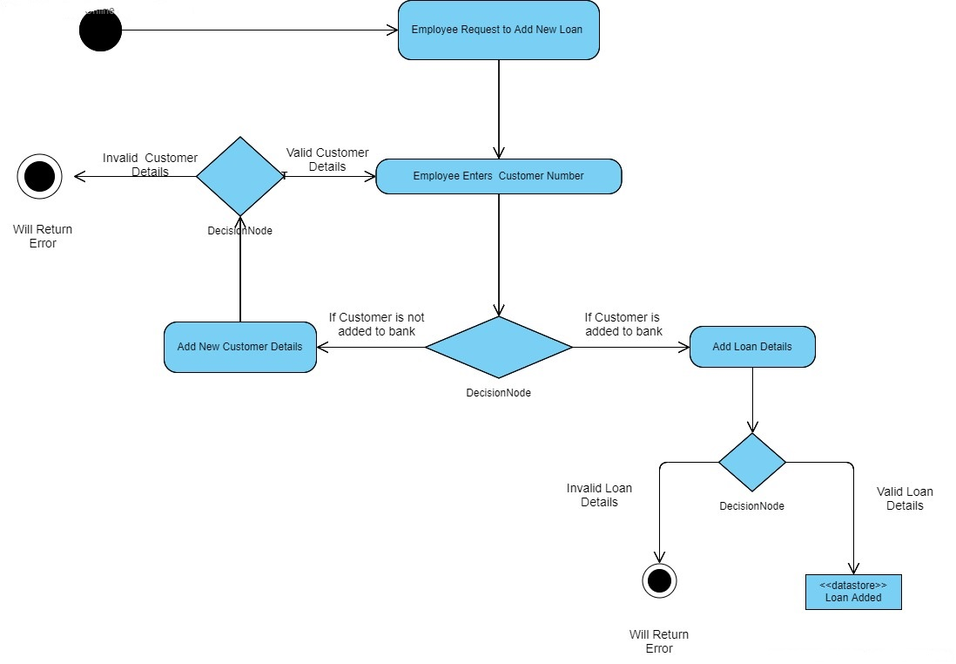
Activity Diagram for new loan application

Slide 29
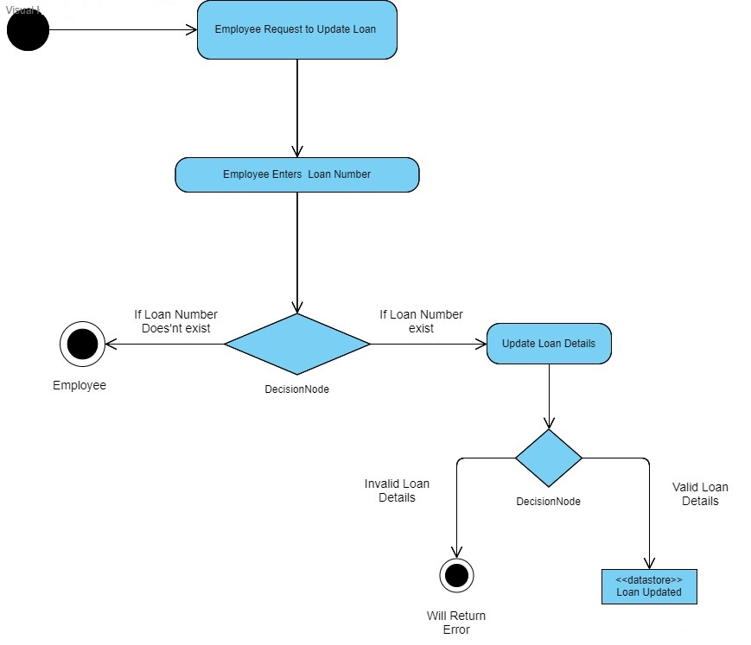
Activity Diagram for loan details updation

Slide 30
Thank You

