Slide 1

Pecunia Bank Case Study
Submitted by:
“Group - E”
Asmita Chandrakar
Akash Kumar Singh
Kata Tarunsree
Shobhit Pitale
Siddharth Taklikar

Slide 2
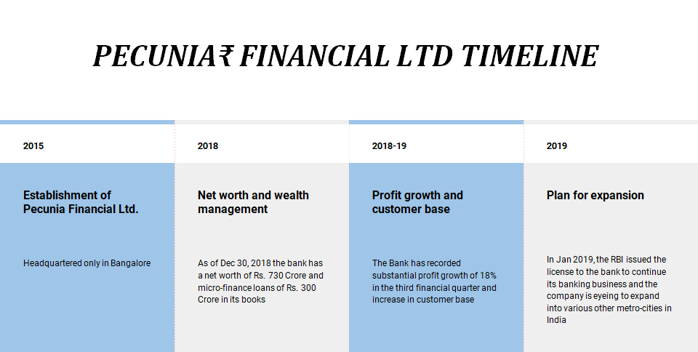

Slide 3
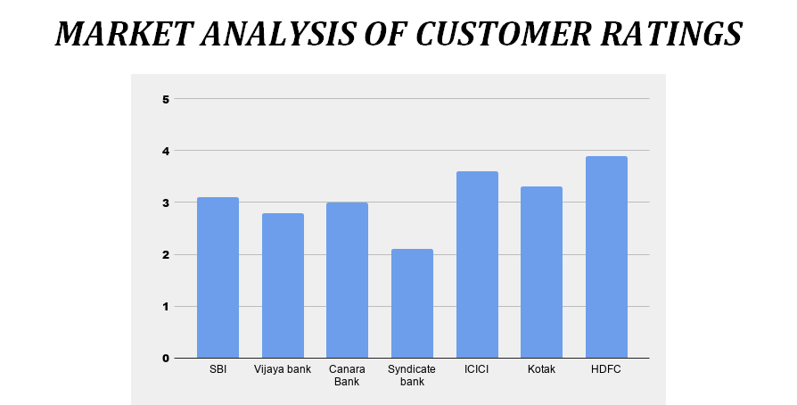

Slide 4
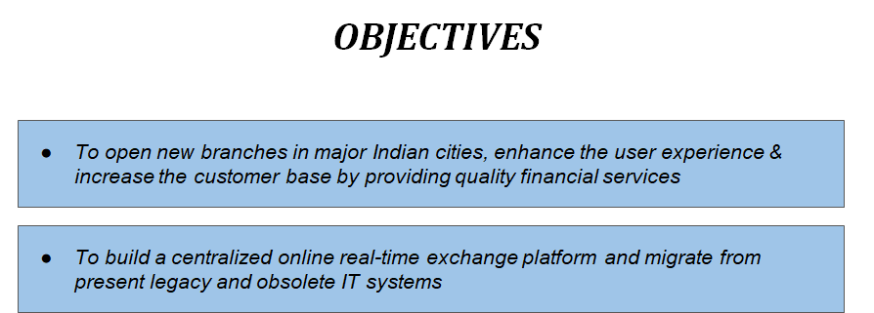

Slide 5
Pecunia Internal Banking System - PIBS
Project Name: Pecunia Internal Banking System - PIBS.
Project Members:
This project is done in a group of 5 people. Project members are:-
1. Shobhit Pitale
2. Siddharth Taklikar
3. Asmita Chandrakar
4. Kata Tarunsree
5. Akash Kumar Singh
Problem Statement:
To operate in the above mentioned cities, Pecunia₹ Finance Limited is expanding its business and is looking for centralized application which helps them to offer financial services in other cities too.
Pecunia₹ Finance Limited has a target of opening 20 new branches in the current financial year across major cities of India.

Slide 6
Strategy:
In an ideal Core Banking scenario, products, processes, channels, customer information and management tools are integrated and administered through a central database of the bank with branches and channels as delivery points. This helps in achieving economies of scale by data integration for various purposes such as cross selling, CRM, Regulatory Reporting and internal MIS. Banks can adopt information technology to manage business and performing assets effectively.
To maintain a competitive edge in a market, migrating the organization at the earliest on a Core Banking platform is of utmost importance. Implementation of Core Banking solutions paves the way for the introduction of the electronic funds transfer mechanism in a secure way. Increased regulatory requirements have put pressure on banks. To sustain growth under continued regulatory requirements, it is essential for banks to have the right Core Banking System in place.

Slide 7
Why PIBS:
So Centralized Online real-time Exchange banking application offers Pecunia₹ truly browser based / web based solution with the opportunity to meet present challenges with reduced costs and enhanced customer management measures. Information management and Risk Management is the key.
Core Banking Solution will help streamline the current business processes with a supporting technology.
Bottlenecks and inefficiencies in the present system requiring process changes will be addressed.

Slide 8
Project Scope:
From an end-user perspective, the Online Internal Banking System Project consists of several functional elements:
Admin Module:
Adding a new employee
Removing an employee
Employee Module:
Accessing various functionalities of other sub modules
mentioned below:
Customer Module:
      Adding a new customer
      Searching a particular customer
      Updating customer details

Slide 9
Account Module:
      Creating a new account
      Updating/Modifying account
      Deleting an existing account
      Searching a particular account
Utilities Module:
      Applying for various utility services like credit card, cheque book, etc.
      Searching for cards and chequebooks
      Blocking cards
Loan Module:
      Applying for loans
      Checking for loan eligibility

Slide 10
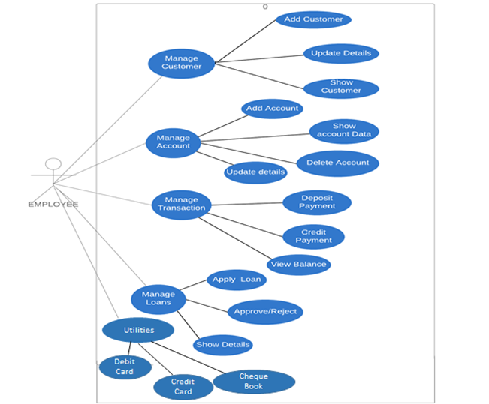
Use Case Diagram for Employee

Slide 11
Use Case Diagram for Admin
Add Employee
Update Employee
Delete Employee
ADMIN
Show Employee Details

Slide 12
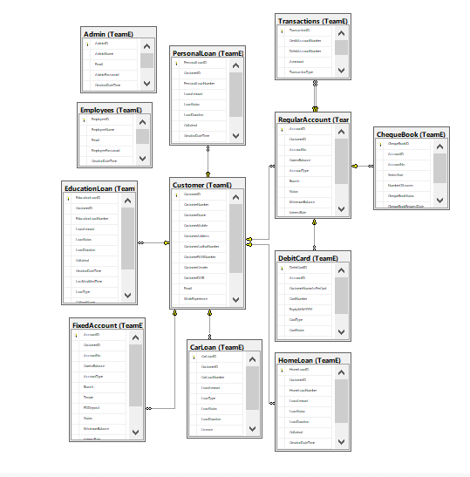
DB Diagram
Notes:
Add instructor notes here.

Slide 13
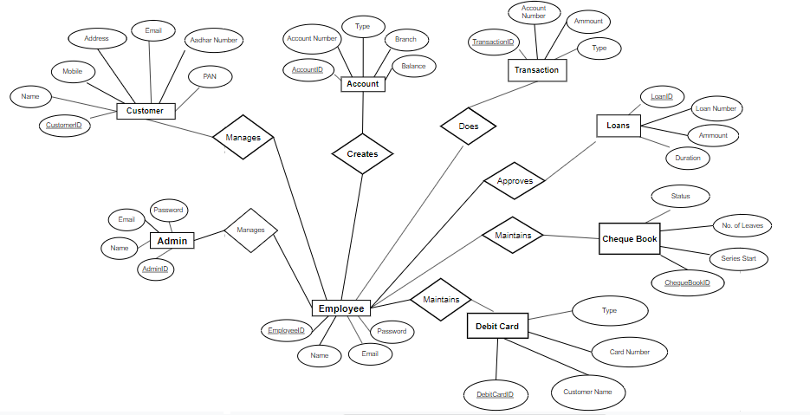
ER Diagram

Slide 14
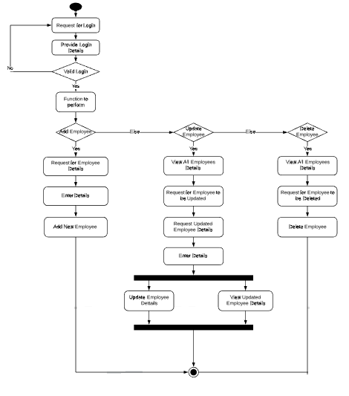
Activity diagram for managing employee

Slide 15
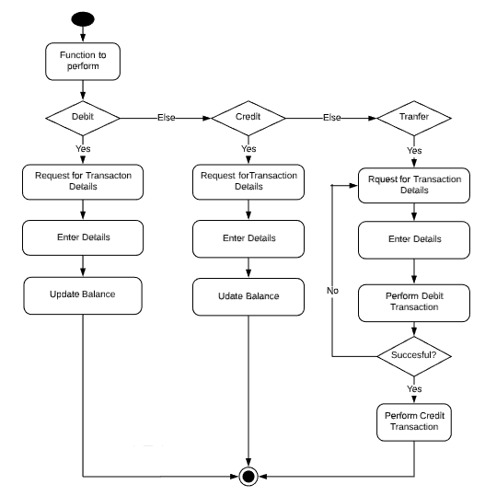
Activity Diagram for Transactions

Slide 16
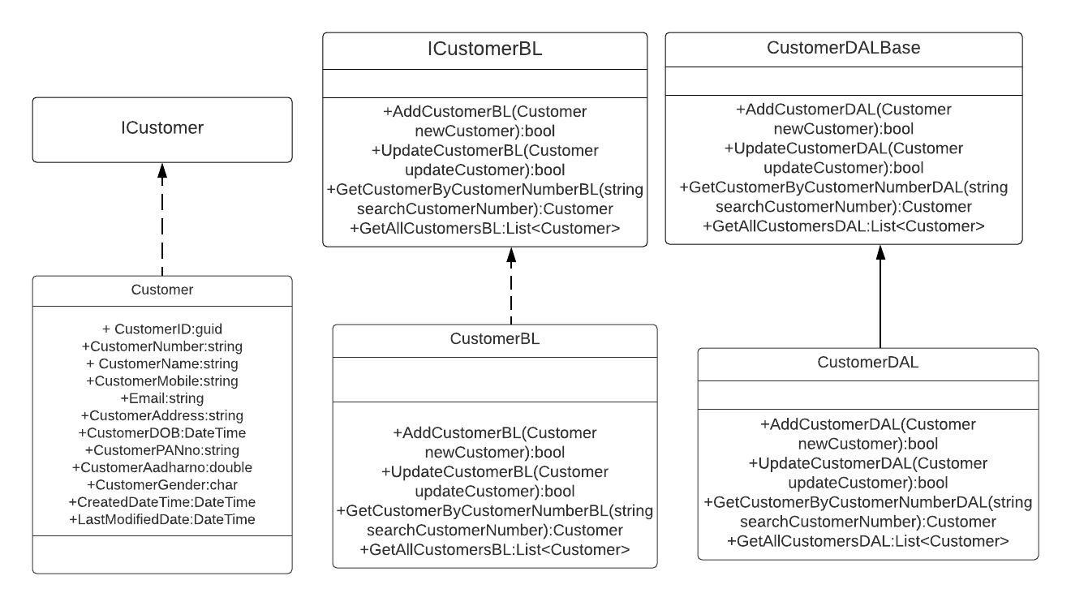
Class Diagram of Customer Class

Slide 17
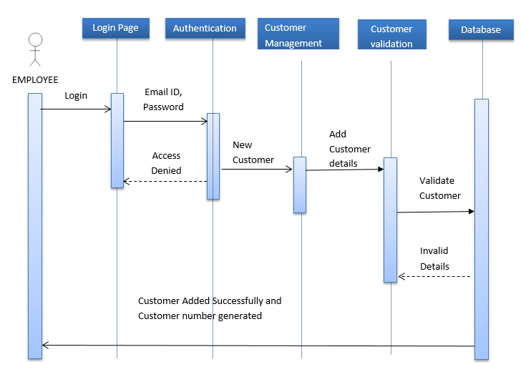
Sequence diagram for Adding Customer

Slide 18
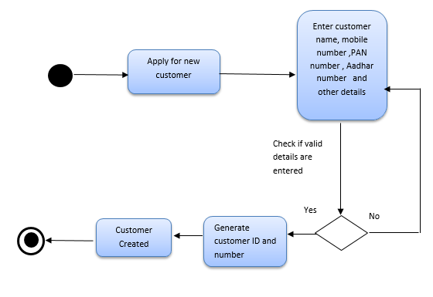
Activity diagram for Adding Customer

Slide 19
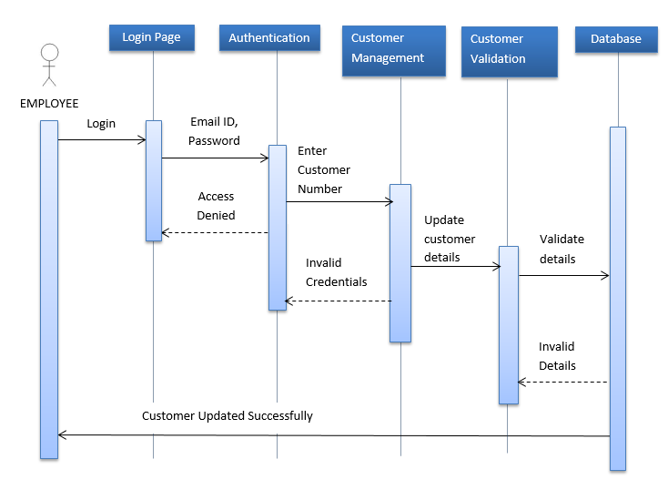
Sequence diagram for Updating Customer details

Slide 20
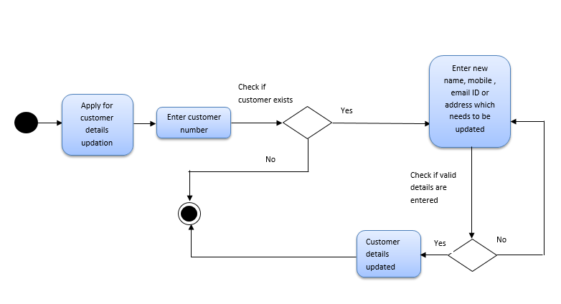
Activity diagram for Updating Customer details

Slide 21
Class Diagram of Regular Account Class
iRegularAccount
+AccountID: Guid
+CustomerID: Guid
+AccountNo: string
+CurrentBalance: double
+AccountType: string
+Branch: string
+status: string
+MinimumBalance: double
+InterestRate: double
+CreationDateTime: DateTime
+LastModifiedDateTime: DateTime
iRegularAccountBL
+CreateAccountBL (Account): bool
+GetAllAccountsBL (): List<Account>
+SearchaccountByAccountNoBL (string): Account
+GetAccountsByCustomerIDBL (Guid): List<Account>
+GetAccountsByTypeBL (string): List<Account>
+GetAccountsByBranchBL (string): List<Account>
+GetAccountsByaccountOpeningDateBL (DateTime, DateTime): List<Account>
+GetBalanceBL (string): double
+UpdateBalanceBL (string, double): bool
+UpdateBranchBL (RegularAccount): bool
+UpdateAccountTypeBL (RegularAccount): bool
+DeleteAccountBL (string): bool
RegularAccountDALBase
+CreateAccountDAL (Account): bool
+GetAllAccountsDAL (): List<Account>
+SearchaccountByAccountNoDAL (string): Account
+GetAccountsByCustomerIDDAL (Guid): List<Account>
+GetAccountsByTypeDAL (string): List<Account>
+GetAccountsByBranchDAL (string): List<Account>
+GetAccountsByaccountOpeningDateDAL (DateTime, DateTime): List<Account>
+GetBalanceDAL(string): double
+UpdateBalanceDAL (string, double): bool
+UpdateBranchDAL (RegularAccount): bool
+UpdateAccountTypeDAL (RegularAccount): bool
+DeleteAccountDAL (string): bool
RegularAccount
+AccountID: Guid
+CustomerID: Guid
+AccountNo: string
+CurrentBalance: double
+AccountType: string
+Branch: string
+status: string
+MinimumBalance: double
+InterestRate: double
+CreationDateTime: DateTime
+LastModifiedDateTime: DateTime
RegularAccountBL
+CreateAccountBL (Account): bool
+GetAllAccountsBL (): List<Account>
+SearchaccountByAccountNoBL (string): Account
+GetAccountsByCustomerIDBL (Guid): List<Account>
+GetAccountsByTypeBL (string): List<Account>
+GetAccountsByBranchBL (string): List<Account>
+GetAccountsByaccountOpeningDateBL (DateTime, DateTime): List<Account>
+GetBalanceBL (string): double
+UpdateBalanceBL (string, double): bool
+UpdateBranchBL (RegularAccount): bool
+UpdateAccountTypeBL (Account): bool
+DeleteAccountBL (string): bool
RegularAccountDAL
+CreateAccountDAL (Account): bool
+GetAllAccountsDAL (): List<Account>
+SearchaccountByAccountNoDAL (string): Account
+GetAccountsByCustomerIDDAL (Guid): List<Account>
+GetAccountsByTypeDAL (string): List<Account>
+GetAccountsByBranchDAL (string): List<Account>
+GetAccountsByaccountOpeningDateDAL (DateTime, DateTime): List<Account>
+GetBalanceDAL(string): double
+UpdateBalanceDAL (string, double): bool
+UpdateBranchDAL (Account): bool
+UpdateAccountTypeDAL (RegularAccount): bool
+DeleteAccountDAL (string): bool

Slide 22
Class Diagram of Fixed Account Class
iFixedAccountBL
+CreateAccountBL (Fixed): bool
+GetAllAccountsBL (): List<Fixed>
+SearchaccountByAccountNoBL (string): Fixed
+GetAccountsByCustomerIDBL (Guid): List<Fixed>
+GetAccountsByTypeBL (string): List<Fixed>
+GetAccountsByBranchBL (string): List<Fixed>
+GetAccountsByaccountOpeningDateBL (DateTime, DateTime): List<Account>
+GetBalanceBL (string): double
+UpdateBalanceBL (string,double): bool
+UpdateBranchBL (FixedAccount): bool
+DeleteAccountBL (string): bool
FixedAccountDALBase
+CreateAccountDAL (Fixed): bool
+GetAllAccountsDAL (): List<Fixed>
+SearchaccountByAccountNoDAL (string): Fixed
+GetAccountsByCustomerIDDAL (Guid): List<Fixed>
+GetAccountsByTypeDAL (string): List<Fixed>
+GetAccountsByBranchDAL (string): List<Fixed>
+GetAccountsByaccountOpeningDateDAL (DateTime, DateTime): List<Fixed>
+GetBalanceDAL(string): double
+UpdateBalanceDAL (string, double): bool
+UpdateBranchDAL (FixedAccount): bool
+DeleteAccountDAL (string): bool
iRegularAccount
+AccountID: Guid
+CustomerID: Guid
+AccountNo: string
+CurrentBalance: double
+AccountType: string
+Branch: string
+status: string
+MinimumBalance: double
+InterestRate: double
+CreationDateTime: DateTime
+LastModifiedDateTime: DateTime
iFixedAccount
+Tenure: double
+FDDeposit: double
FixedAccount
+AccountID: Guid
+AccountNo: string
+CurrentBalance: double
+AccountType: string
+Branch: string
+status: string
+MinimumBalance: double
+InterestRate: double
+Tenure: double
+FDDeposit: double
+CreationDateTime: DateTime
+LastModifiedDateTime: DateTime
FixedAccountBL
+CreateAccountBL (Fixed): bool
+GetAllAccountsBL (): List<Fixed>
+SearchaccountByAccountNoBL (string): Fixed
+GetAccountsByCustomerIDBL (Guid): List<Fixed>
+GetAccountsByTypeBL (string): List<Fixed>
+GetAccountsByBranchBL (string): List<Fixed>
+GetAccountsByaccountOpeningDateBL (DateTime, DateTime): List<Account>
+GetBalanceBL (string): double
+UpdateBalanceBL (string, double): bool
+UpdateBranchBL (FixedAccount): bool
+DeleteAccountBL (string): bool
FixedAccountDAL
+CreateAccountDAL (Fixed): bool
+GetAllAccountsDAL (): List<Fixed>
+SearchaccountByAccountNoDAL (string): Fixed
+GetAccountsByCustomerIDDAL (Guid): List<Fixed>
+GetAccountsByTypeDAL (string): List<Fixed>
+GetAccountsByBranchDAL (string): List<Fixed>
+GetAccountsByaccountOpeningDateDAL (DateTime, DateTime): List<Fixed>
+GetBalanceDAL(string): double
+UpdateBalanceDAL (FixedAccount): bool
+UpdateBranchDAL (FixedAccount): bool
+DeleteAccountDAL (string): bool

Slide 23
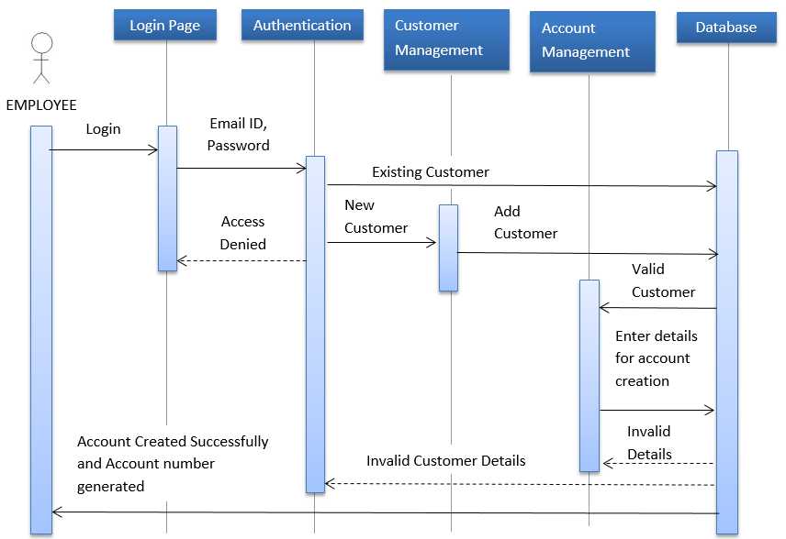
Sequence Diagram for Account Creation

Slide 24
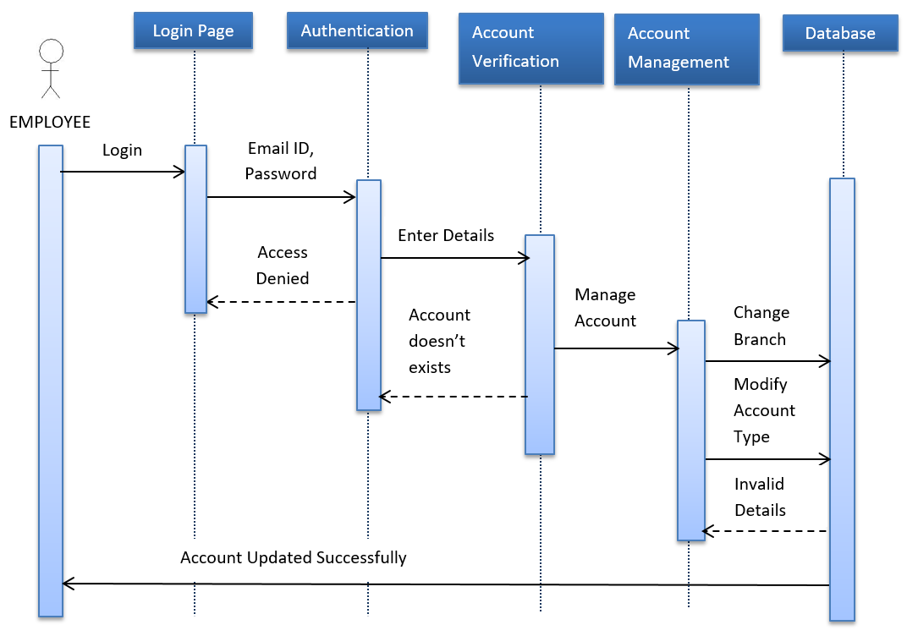
Sequence Diagram for Account Details Updation

Slide 25
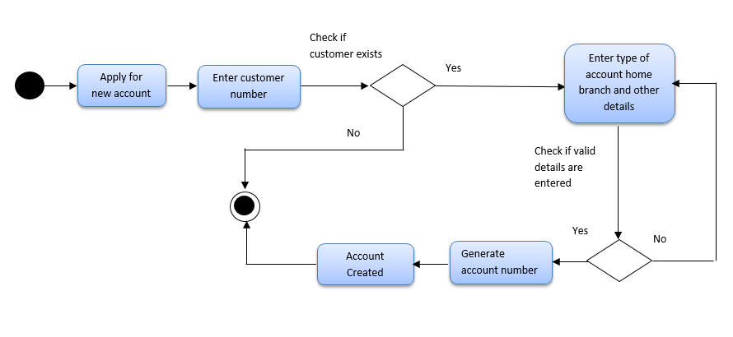
Activity Diagram for Account Creation

Slide 26
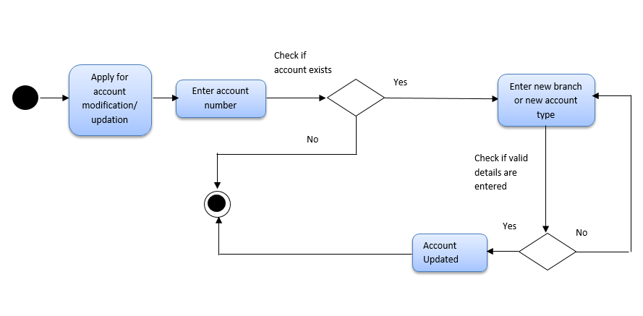
Activity Diagram for Account Updation / Modification

Slide 27
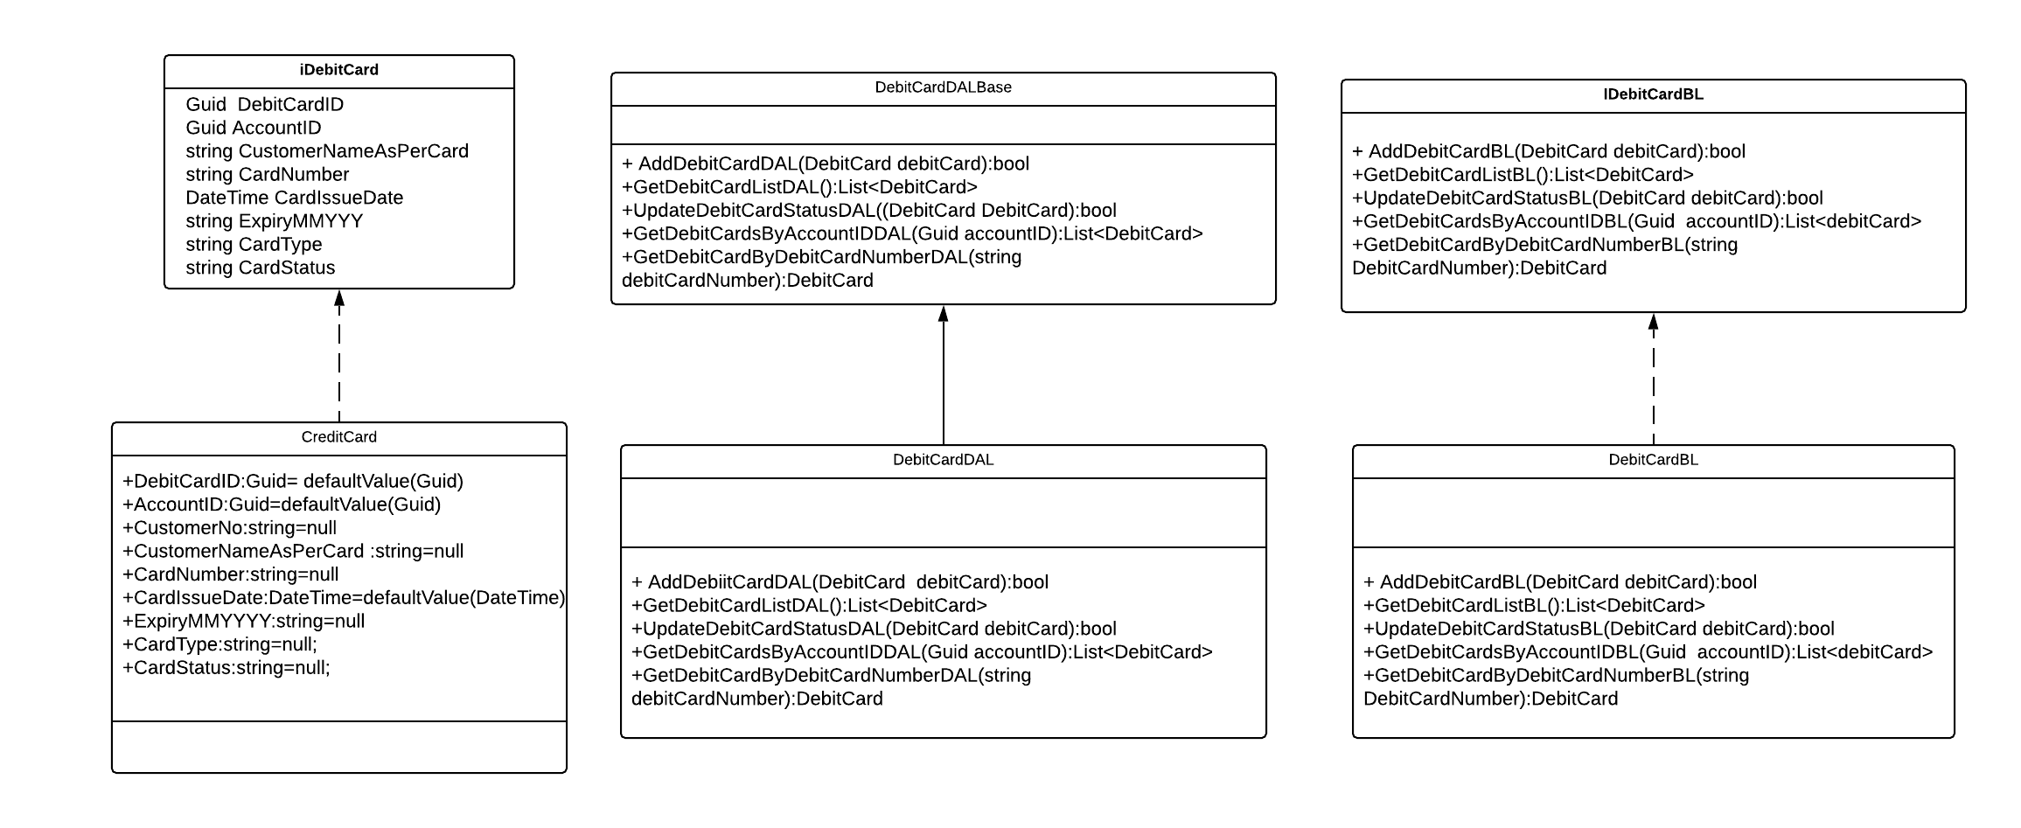
Class Diagram of Debit Card Class

Slide 28
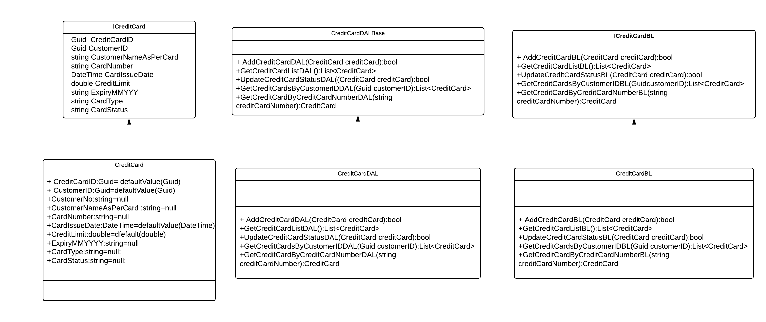
Class Diagram of Cheque Book Class

Slide 29
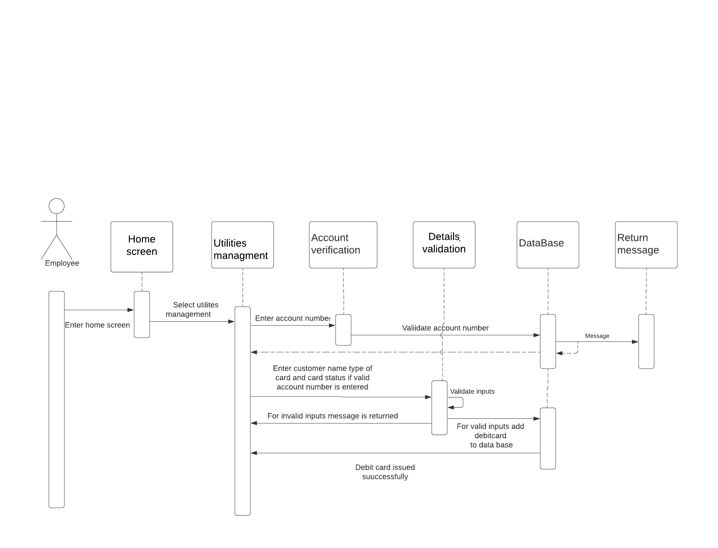
Sequence Diagram for Debit Card Issue

Slide 30
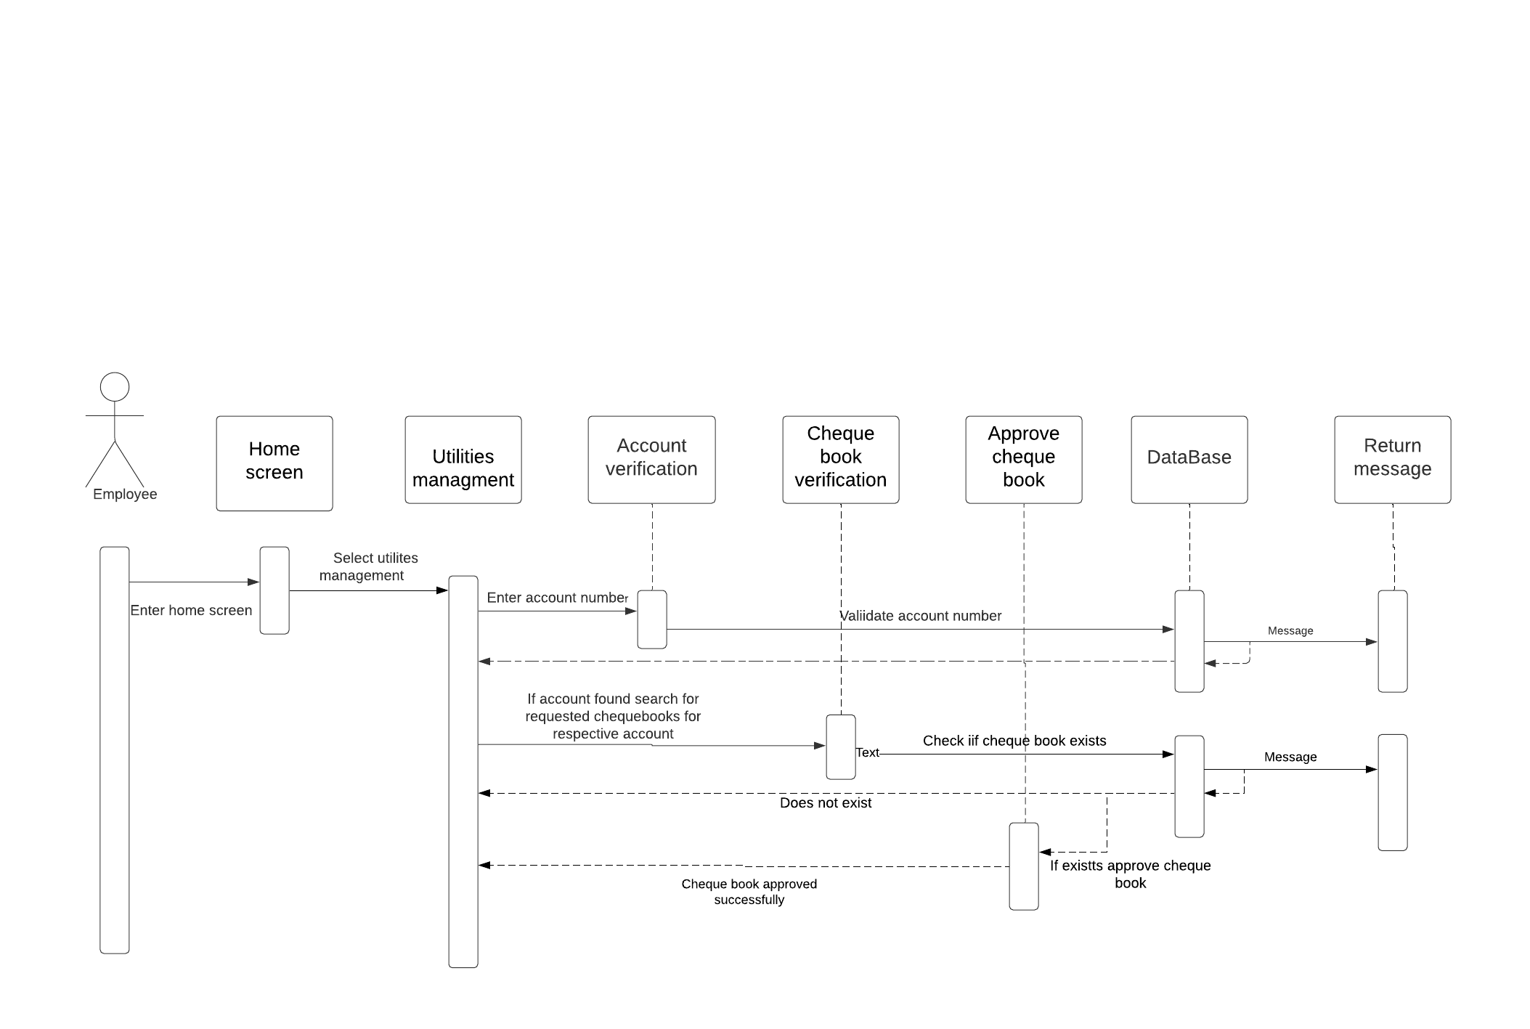
Sequence Diagram of Cheque Book Application

Slide 31
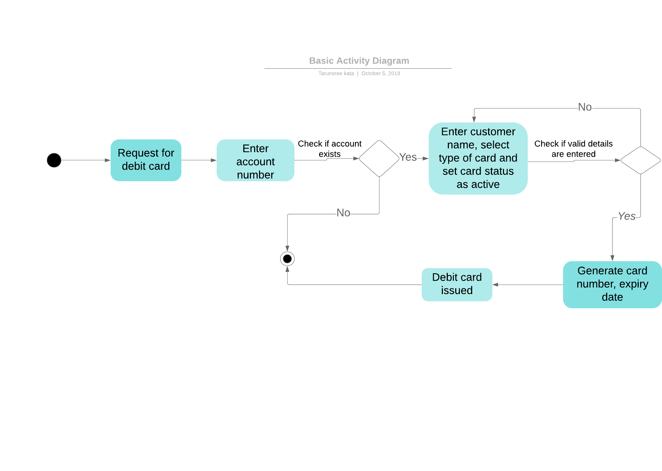
Activity Diagram for Debit Card Issue

Slide 32
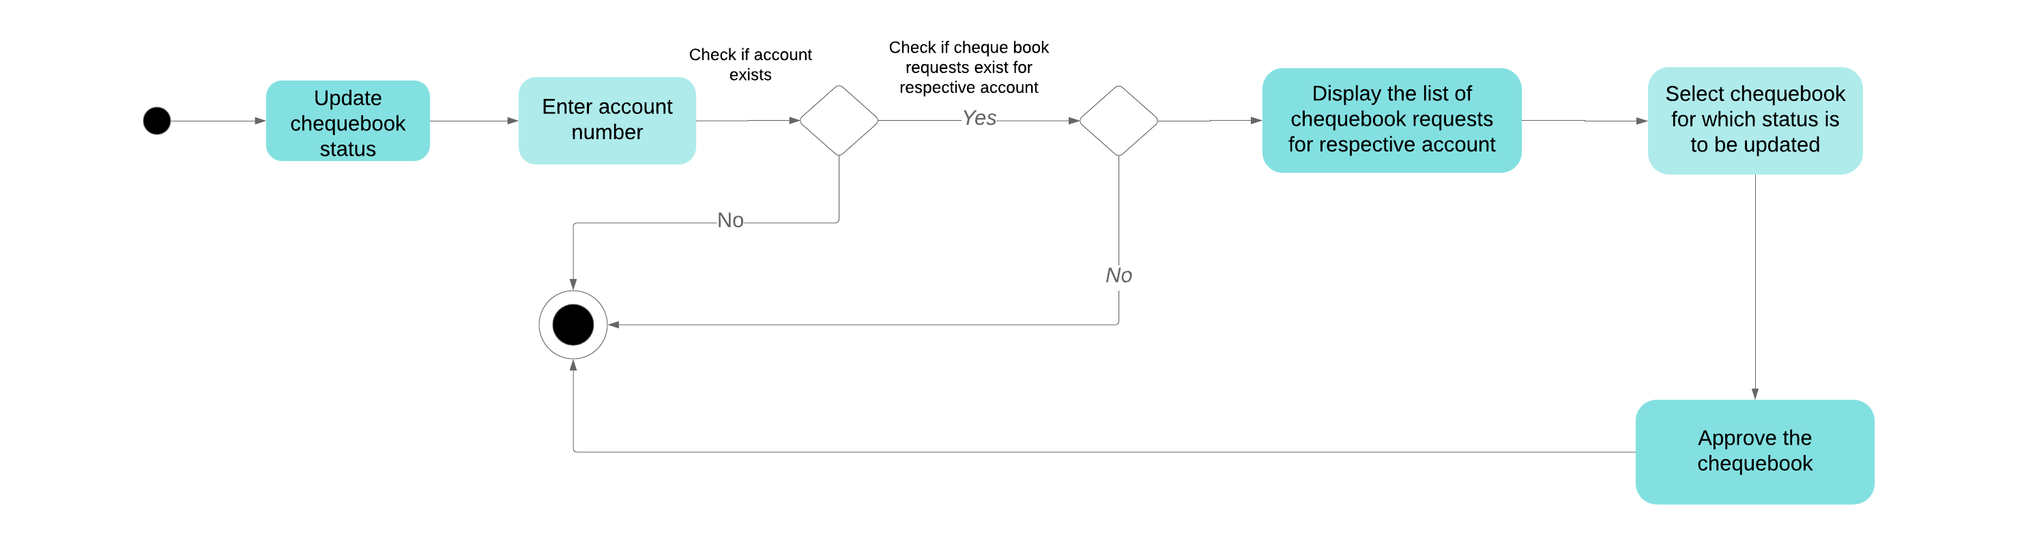
Activity Diagram for Cheque Book Application

Slide 33
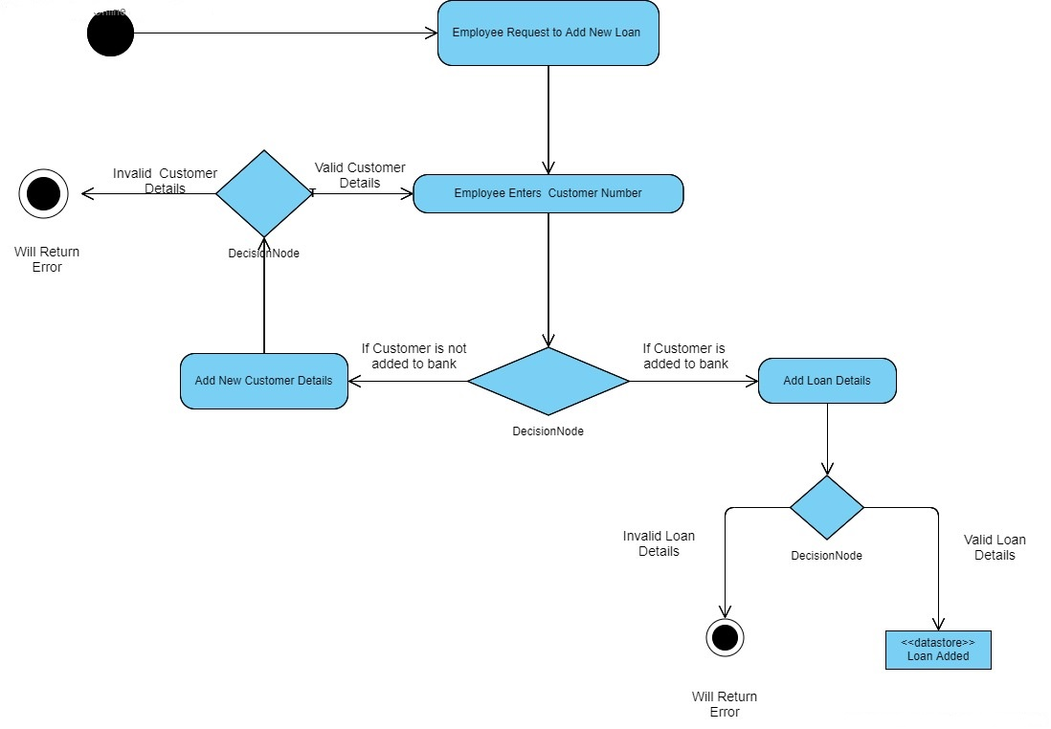
Activity Diagram for new loan application

Slide 34
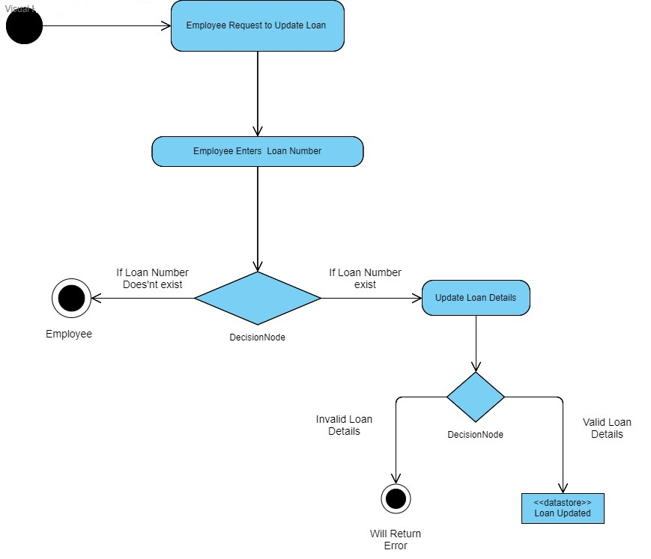
Activity Diagram for loan details updation

Slide 35
Thank You

