Slide 1

Pecunia Bank Case Study
Submitted by:
“Group - E”

Slide 2
Team Members
Asmita Chandrakar
Akash Kumar Singh
Kata Tarunsree
Shobhit Pitale
Siddharth Taklikar

Slide 3
Introduction
Pecunia₹ Finance Limited, established in the year 2015, is an Indian private sector bank headquartered in Bangalore and is functioning only in Bangalore, India. In January 2019, Reserve Bank of India (RBI) issued the license to Pecunia₹ Finance Limited, to carry on banking business.
They have one of the largest and most respected Wealth Management teams in India providing the widest range of solutions to individuals and employed professionals. As of December 30, 2018 Pecunia₹ has a net-worth of approximately ₹ 730 crore and micro-finance loans of ₹ 300 crore in its books.
It offers a wide range of banking products and financial services for retail customers through a variety of delivery channels in the areas of personal finance, life insurance etc.

Slide 4
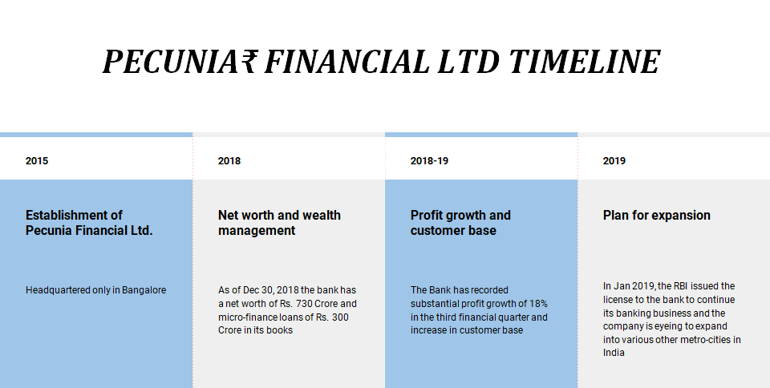

Slide 5
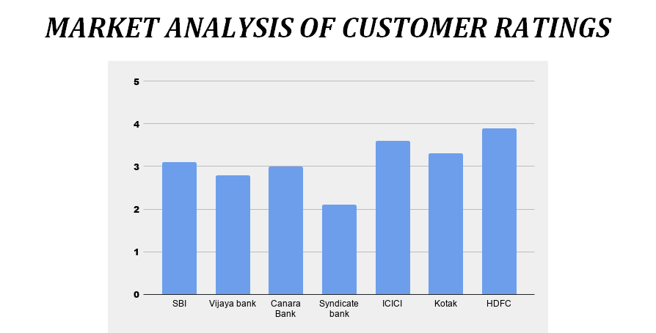

Slide 6
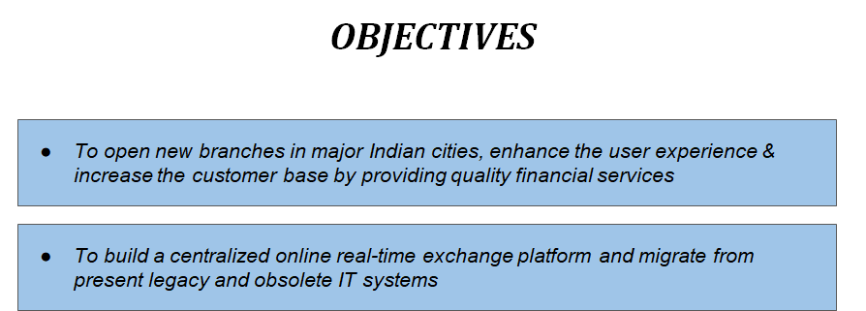

Slide 7
Pecunia Internal Banking System - PIBS
Project Name: Pecunia Internal Banking System - PIBS.
Problem Statement:
To operate in the above mentioned cities, Pecunia₹ Finance Limited is expanding its business and is looking for centralized application which helps them to offer financial services in other cities too.
Pecunia₹ Finance Limited has a target of opening 20 new branches in the current financial year across major cities of India.

Slide 8
Strategy:
In an ideal Core Banking scenario, products, processes, channels, customer information and management tools are integrated and administered through a central database of the bank with branches and channels as delivery points. This helps in achieving economies of scale by data integration for various purposes such as cross selling, CRM, Regulatory Reporting and internal MIS. Banks can adopt information technology to manage business and performing assets effectively.
To maintain a competitive edge in a market, migrating the organization at the earliest on a Core Banking platform is of utmost importance. Implementation of Core Banking solutions paves the way for the introduction of the electronic funds transfer mechanism in a secure way. Increased regulatory requirements have put pressure on banks. To sustain growth under continued regulatory requirements, it is essential for banks to have the right Core Banking System in place.

Slide 9
Why PIBS:
So Centralized Online real-time Exchange banking application offers Pecunia₹ truly browser based / web based solution with the opportunity to meet present challenges with reduced costs and enhanced customer management measures. Information management and Risk Management is the key.
Core Banking Solution will help streamline the current business processes with a supporting technology.
Bottlenecks and inefficiencies in the present system requiring process changes will be addressed.

Slide 10
Project Scope:
From an end-user perspective, the Online Internal Banking System Project consists of several functional elements:
Admin Module:
Adding a new employee
Removing an employee
Employee Module:
Accessing various functionalities of other sub modules
mentioned below:
Customer Module:
      Adding a new customer
      Searching a particular customer
      Updating customer details

Slide 11
Account Module:
      Creating a new account
      Updating/Modifying account
      Deleting an existing account
      Searching a particular account
Transaction Module:
      Performing a credit transaction
      Performing a debit transaction
Utilities Module:
      Applying for various utility services like credit card, cheque book, etc.
      Searching for cards and chequebooks
      Blocking cards
Loan Module:
      Applying for loans
      Checking for loan eligibility

Slide 12
Technology Road Map
Console Application
Using SQL Server for Database and connect using ADO.NET
Angular Application
Using Entity Framework for connecting to Database
WPF application
ASP.NET MVC application
Using WCF Services
Creating SQL Databases in Azure and Deploying MVC application in Azure
Using Web API and Deploy the same to Azure.

Slide 13
Thank You

