Slide 1
CS 5020W Computer Organization and Architecture
Dr. Clincy
Professor of CS
Dr. Clincy
Intro

Slide 2
Course Overview Agenda
Part 1: Course Info, Tentative Course Schedule, Course Assessment
Part 2: Course Description
Part 3: Course Assessment, How the grading scale and curves are calculated, General policies and expectations, and Org & Arch Course Insights for CS students
Dr. Clincy
Lecture

Slide 3
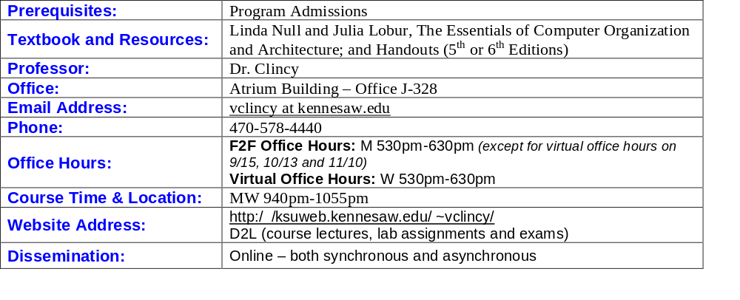
Course Info
Synchronous Dissemination: scheduled day and time lectures are posted – scheduled day and time exams are given – help pace students, like in-class F2F course, can be very helpful to online students in keeping on track.
Asynchronous Dissemination: [1] can watch lectures whenever you want after the lecture is released, [2] can take exams whenever you want to prior to the scheduled exam day and time – Professor will need to receive email notice from the student atleast 24 hours prior to the desired day and time the student wants to take the exam.
Virtual office hours – await email – prompt reply
Dr. Clincy
Intro

Slide 4
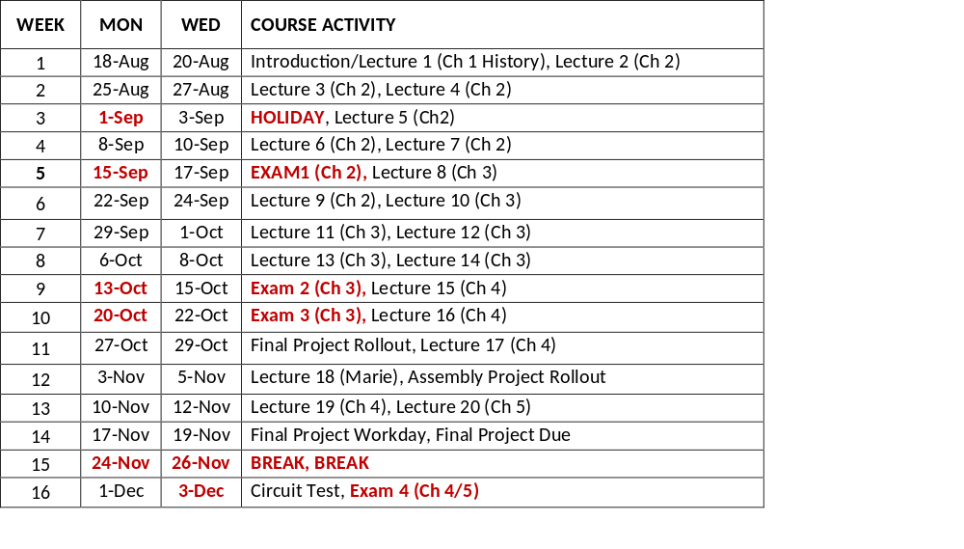
Tentative Course Schedule
NOTE 1: Check D2L daily for lab/assignment posting – lab/assignments are course flow based and not time-based
NOTE 2: Labs/assignments (including the assembly project) will be done individually
NOTE 3: Final project will be a group project
Dr. Clincy
Intro

Slide 5
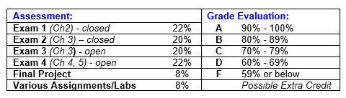
Assessment
If average score is less than 80, will curve score to an average grade of 85 (explain in more details later).
Ch 3’s topics are the most important and challenging topics of the course and you will be examined in two parts (one part open book and another part closed book) – worth 40%
Must have a book for the course – will need it for open book exams – if you have an ebook (or pdf), you will need to print the chapters for the open book exams – letting you know the very first day – can’t use your phone, tablet or some other PC or Laptop during an exam.
Should use a calculator on ALL open-book and closed-book exams – cannot use your phone – will receive a zero if you use your phone.
For online exams, can take anywhere (outside of the classroom) that has a good Internet connection.
For online exams, there will be no in-class reviews. Students can stop by during office hours to see and review exams
Possibility for extra credit - research
Dr. Clincy
Intro

Slide 6
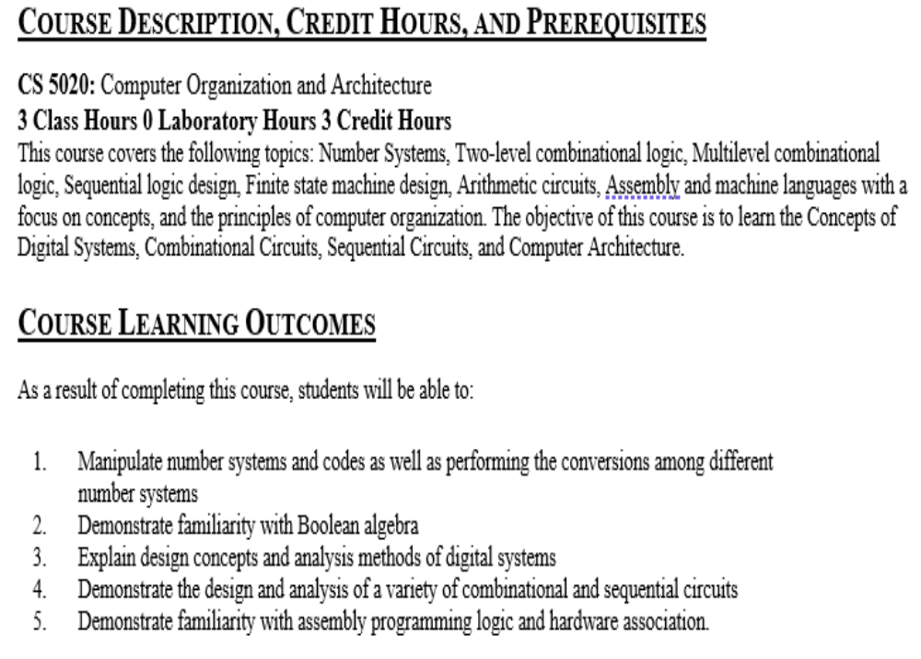
Course Description & Outcome
Learn about the low-level “science” of the computer – not the major components of the computer - especially not how to use the computer
CH1: History and Background [no exam]
CH2: Mathematics behind the computer: Number systems, mathematical operations, error control, floating point [exam 1]
CH3: Basis to how computers are built: Boolean algebra, kmaps, gates, devices, circuits [exams 2 and 3]
CH4/5: Computer architecture fundamentals: connection between circuits and low-level SW, machine language, assembly language, memory, internal working of the CPU [exam 4]
Dr. Clincy
Intro

Slide 7
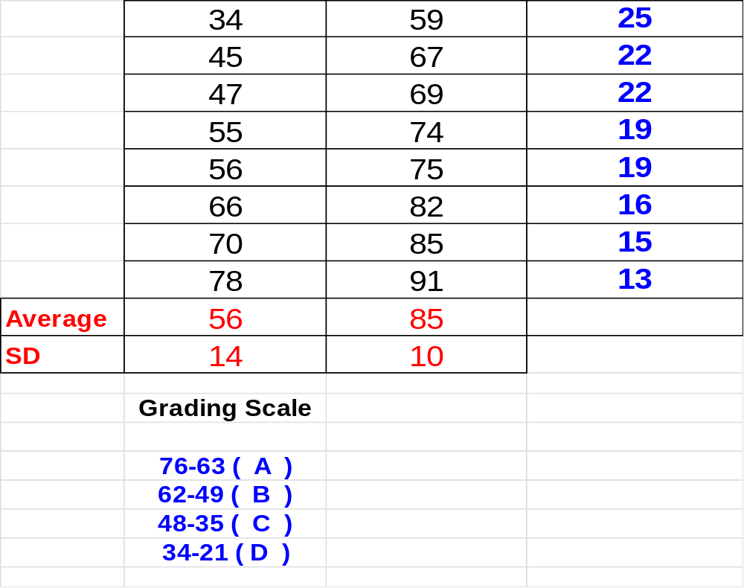
Lesson in Stats – Example of Curving Grades –
Raw Score to Exam Grade
What is an Avg ?
What is the SD ?
This is the curve
Fitting raw scores to a curve
Curve if avg is below 80
If SD is less than 10, use 10
? = 90 + (RS-63)/1.4
? = 80 + (RS-49)/1.4
? = 70 + (RS-35)/1.4
Can all As, Bs or Cs be made with such a grading approach ? YES
Dr. Clincy
Lecture

Slide 8
General Policies and Expectations:
Attendance at all classes is highly encouraged but NOT required. Concepts and ideas discussed in one class are used as building blocks for more concepts and ideas in the next class.
Any class session missed by the student is the student's responsibility to make up.
Makeup exams will NOT be given; instead, the last exam will count in place of one missed exam. Will not drop the lowest grade. If last exam is the only exam missed, instead of a zero, 70% of the average of the other exams will be used.
Project (lab) assignments MUST be turned in on time to receive full credit. Late project assignments will be graded severely – for each hour the assignment is late, the assignment’s grade will be reduced by 5%. Students will not be allowed to makeup missed project assignments.
Go to course’s D2L daily for assignments’ releases and due dates - assignments are course-flow based and not time-based.
The Professor expects students to take advantage of office hours when needing clarification or help.
If the student requires additional materials to read or additional problems to solve in better understanding the topics and concepts, the Professor expects the student to take the initiative in locating additional materials or problems. The book’s website has solutions to some of the chapter problems.
In being successful in this subject, expect a minimum of 2-3 hours of study per hour of lecture (6-9 hours per week)
The Professor greatly supports students sending emails at any time – it will be the goal of the Professor to reply to emails within a 24-hour time span (not counting weekends). If you send an email on Friday, worst case it will be answered by Monday. Use KSU email – not D2L email – can’t reply to D2L email
Dr. Clincy
Intro

Slide 9
NOTE: CS majors find Computer Architecture to be a more a challenging topic – stereotypically, historically and Nationally – more rigid in understanding and answers; a definite process to the solution (like engineering, physics and math) – less creative and flexible than programming related topics
Dr. Clincy
Intro

