Slide 1
CS 3510 - Chapter 1 (1 of 2)
Dr. Clincy
Professor of CS
Dr. Clincy
Lecture 3
Slide <number>

Slide 2
Computer Organization & Architecture
Chapter 1
Introduction & History
Dr. Clincy

Slide 3
Chapter 1 Objectives
Know the difference between computer organization and computer architecture.
Understand units of measure common to computer systems.
Appreciate the evolution of computers.
Understand the computer as a layered system.
Be able to explain the von Neumann architecture and the function of basic computer components.
Dr. Clincy

Slide 4
Introduction
Why study computer organization and architecture?
  Design better programs, including system software such as compilers, operating systems, and device drivers.
  Optimize program behavior.
  Evaluate (benchmark) computer system performance.
  Understand time, space, and price tradeoffs in comparing systems.
Dr. Clincy

Slide 5
Introduction
What is Computer Organization ?
  Encompasses all physical aspects of computer systems.
  E.g., circuit design, control signals (how the computer is controlled), signaling methods, memory types.
  Computer Organization helps us answer the question: “How does a computer operate ?”
What is Computer Architecture ?
  Focuses on the structure and behavior of the computer system
  Refers to the logical aspects of system implementation as seen by the programmer.
  E.g., instruction sets, instruction formats, data types, number and types of registers, memory access methods, addressing modes, and I/O mechanisms.
  The instruction set architecture (ISA) is the interface between the machine and all the software that runs on the machine
  The “architecture” directly effects the logical execution of the programs
  Computer Architecture helps us answer the question: “How do I design a computer?”
  Not really clear-cut - Different perspectives of Org and Arch between Computer Scientists and Computer Engineers
Dr. Clincy

Slide 6
Org Versus Arch
There is no clear distinction between matters related to computer organization and matters relevant to computer architecture.
Highlevel language algorithms are implemented by lower level languages which are implemented by machine-level algorithms implemented electronically
Principle of Equivalence of Hardware and Software:
  Any task done by software can also be done using hardware, and any operation performed directly by hardware can be done using software.*
* Assuming speed is not a concern.
Dr. Clincy

Slide 7
Computer Components
At the most basic level, a computer is a device consisting of three pieces:
  A processor to interpret and execute programs
  A memory to store both data and programs
  A mechanism for transferring data to and from the outside world.
  This course will explore these three major pieces/parts in some details
  Before doing so, lets explore some terminology
Dr. Clincy

Slide 8
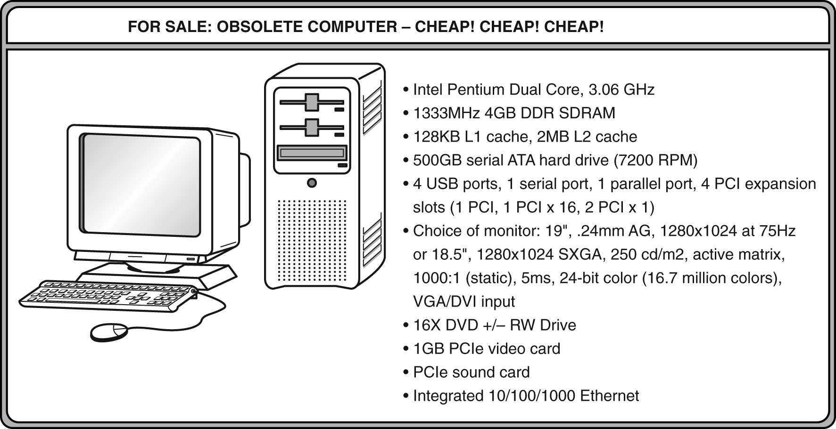
An Example System - Terminology
Consider this advertisement:
GHz??
L1 Cache??
GB??
PCI??
USB??
What does it all mean??
Dr. Clincy

Slide 9
Before going over the Ad’s terminology – let’s talk about measurements
Measures of capacity and speed:
  Kilo- (K) = 1 thousand = 10³ and 2¹⁰ (Actually 1024)
  Mega- (M) = 1 million = 10⁶ and 2²⁰ (Actually 1,485,576)
  Giga- (G) = 1 billion = 10⁹ and 2³⁰ (Actually 1,073,741,824)
  Tera- (T) = 1 trillion = 10¹² and 2⁴⁰
  Peta- (P) = 1 quadrillion = 10¹⁵ and 2⁵⁰
  Exa- (E) = 1 quintillion = 10¹⁸ and 2⁶⁰
  Zetta- (Z) = 1 sextillion = 10²¹ and 2⁷⁰
  Yotta- (Y) = 1 septillion = 10²⁴ and 2⁸⁰
Whether a metric refers to a power of ten or a power of two typically depends upon what is being measured.
Dr. Clincy

Slide 10
Measurements
Hertz = clock cycles per second (frequency)
  1MHz = 1,000,000Hz
  Processor speeds are measured in MHz or GHz.
Byte = a unit of storage
  1KB = 2¹⁰ = 1024 Bytes
  1MB = 2²⁰ = 1,048,576 Bytes
  1GB = 2³⁰ = 1,073,741,824 Bytes
  Main memory (RAM) is measured in GB
  Disk storage is measured in GB for small systems, TB (2⁴⁰) for large systems.
  Lower case k and b, kilo bits = 10³ = 1000 bits, Uppercase K and B, Kilobyte = 2¹⁰ (ie. 3 KB = 3 x 1024 bytes = 3072 bytes)
  Don’t think of “Kilobyte” in terms of a “byte” – two different units – byte is 8 bits and Kilobyte is 1024 bytes
  Kilo vs Milli, Mega vs Micro, Giga vs Nano, Tera vs Pico, etc…
Dr. Clincy

Slide 11
Measurements
Measures of time and space:
  Milli- (m) = 1 thousandth = 10 ⁻³
  Micro- (μ) = 1 millionth = 10 ⁻⁶
  Nano- (n) = 1 billionth = 10 ⁻⁹
  Pico- (p) = 1 trillionth = 10 ⁻¹²
  Femto- (f) = 1 quadrillionth = 10 ⁻¹⁵
  Atto- (a) = 1 quintillionth = 10 ⁻¹⁸
  Zepto- (z) = 1 sextillionth = 10 ⁻²¹
  Yocto- (y) = 1 septillionth = 10 ⁻²⁴
Dr. Clincy

Slide 12
Measurements
Millisecond = 1 thousandth of a second
  Hard disk drive access times are often 10 to 20 milliseconds.
Nanosecond = 1 billionth of a second
  Main memory access times are often 50 to 70 nanoseconds.
Micron (micrometer) = 1 millionth of a meter
  Circuits on computer chips are measured in microns.
Dr. Clincy

Slide 13
Measurements
We note that cycle time is the reciprocal of clock frequency.
A bus operating at 133MHz has a cycle time of 7.52 nanoseconds:
133,000,000 cycles/second = 7.52ns/cycle
Now back to the advertisement ...
Dr. Clincy

Slide 14
Computer Ad’s Terminology
The microprocessor is the “brain” of the system. It executes program instructions. This one is a Pentium (Intel) running at 3.06GHz.
Dr. Clincy

Slide 15
Computer Ad’s Terminology
This system has 4GB of (fast) synchronous dynamic RAM (SDRAM) . . .
… and two levels of cache memory, the level 1 (L1) cache is smaller and (probably) faster than the L2 cache. Note that these cache sizes are measured in KB and MB.
Computers with large main memory capacity can run larger programs with greater speed than computers having small memories.
RAM is an acronym for random access memory. Random access means that memory contents can be accessed directly if you know its location.
Cache is a type of temporary memory that can be accessed faster than RAM.
Dr. Clincy

Slide 16
Computer Ad’s Terminology
Hard disk capacity determines the amount of data and size of programs you can store.
This one can store 500GB. 7200 RPM is the rotational speed of the disk. Generally, the faster a disk rotates, the faster it can deliver data to RAM. (There are many other factors involved.)
Dr. Clincy

Slide 17
Computer Ad’s Terminology
ATA stands for advanced technology attachment, which describes how the hard disk interfaces with (or connects to) other system components.
A DVD can store about 4.7GB of data. This drive supports rewritable DVDs, +/-RW, that can be written to many times.. 16x describes its speed.
Dr. Clincy

Slide 18
Computer Ad’s Terminology
Ports allow movement of data between a system and its external devices.
System buses can be augmented by dedicated I/O buses. PCI, peripheral component interface, is one such bus.
This system has ten ports.
Serial ports send data as a series of pulses along one or two data lines.
Parallel ports send data as a single pulse along at least eight data lines.
USB, Universal Serial Bus, is an intelligent serial interface that is self-configuring. (It supports “plug and play.”)
Dr. Clincy

Slide 19
Computer Ad’s Terminology
This system has two PCI devices: a video card and a sound card.
Dr. Clincy

Slide 20
Computer Ad’s Terminology
The number of times per second that the image on a monitor is repainted is its refresh rate. The dot pitch of a monitor tells us how clear the image is.
This one has a dot pitch of 0.24mm and a refresh rate of 75Hz.
The video card contains memory and programs that support the monitor.
Dr. Clincy

Slide 21
Computer Ad’s Terminology
Throughout the remainder of the book you will see how SOME of these components work and how they interact with software to make a complete computer systems.
This raises two important questions:
1. What assurance do we have that computer components will operate as we expect?
2. And what assurance do we have that computer components will operate together?
Answer: Standards
Dr. Clincy

Slide 22
Standards Organizations
There are many organizations that set computer hardware standards-- to include the interoperability of computer components.
Throughout this book, and in your career, you will encounter many of them.
Some of the most important standards-setting groups are . . .
The Institute of Electrical and Electronic Engineers (IEEE)
  Establishes standards for computer components, data representation, and signaling protocols, among many other things.
The International Telecommunications Union (ITU)
  Concerns itself with the interoperability of telecommunications systems, including data communications and telephony.
National groups establish standards within their respective countries:
  The American National Standards Institute (ANSI)
  The British Standards Institution (BSI)
The International Organization for Standardization (ISO)
  Is influential in formulating standards for data comm, computer hardware and software, including their methods of manufacture.
Dr. Clincy

Slide 23
CS 3510 - Chapter 1 (2 of 2)
Dr. Clincy
Professor of CS
Dr. Clincy
Lecture 3
Slide <number>

Slide 24
Historical Development
To fully appreciate the computers of today, it is helpful to understand how things got the way they are.
The evolution of computing machinery has taken place over several centuries.
In modern times, computer evolution is usually classified into four generations according to the salient technology of the era.
We note that many of the following dates are approximate.
Dr. Clincy

Slide 25
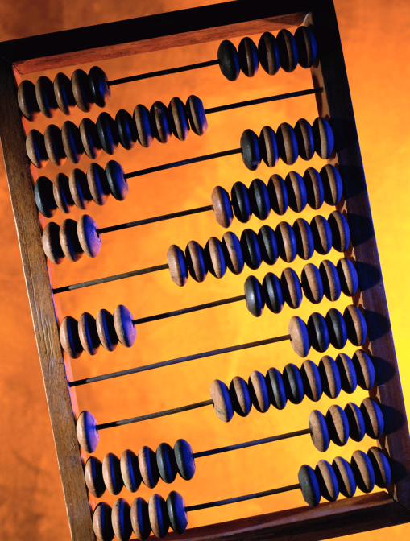
History of Computers
Generation Zero of Modern Computing (1642-1945)
Pre-computer Era
  An Abacus (ab-ah-cus) was used
    Also known as counting frame
    Made with a bamboo frames and beads
    Can find them in daycare centers today
After the decimal numbering system replaced the Roman numbering system, a number of people invented devices to make decimal calculations faster and more accurate
  Calculating Clock - Wilhelm Schickard (1592 - 1635).
  Mechanical calculator - Blaise Pascal (1623 - 1662).
  More advanced calculator - Charles Babbage (1791 - 1871)
  Punched card tabulating machines - Herman Hollerith (1860 - 1929).
Dr. Clincy

Slide 26
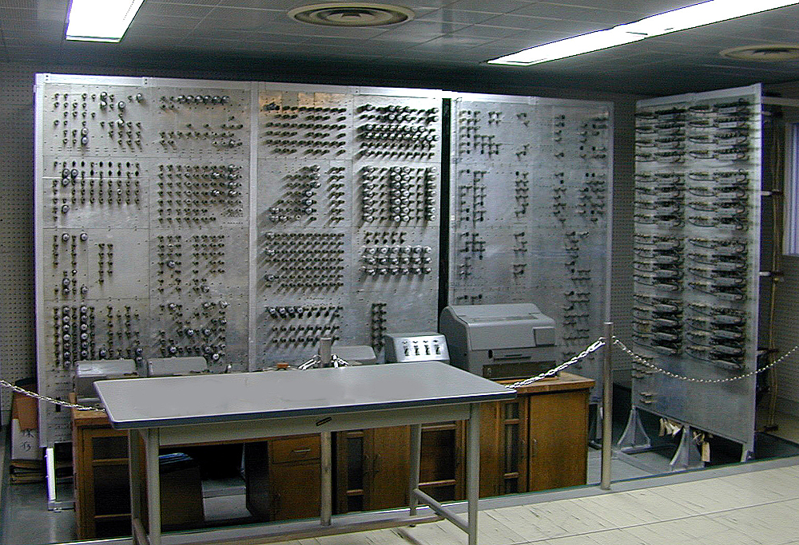
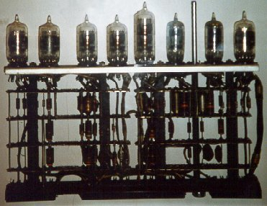
History of Computers
1st Generation of Modern Computing (1940s-1950s)
During mid-1940s
The 2nd World War needed strategic type calculations performed and this lead to the 1st generation of computers
Vacuum tubes
Magnetic storage
Filled entire room
Dr. Clincy

Slide 27
Historical Development
The First Generation: Vacuum Tube Computers (1945 - 1953)
  Electronic Numerical Integrator and Computer (ENIAC)
  John Mauchly and J. Presper Eckert
  University of Pennsylvania, 1946
The ENIAC was the first general-purpose computer.
Dr. Clincy

Slide 28
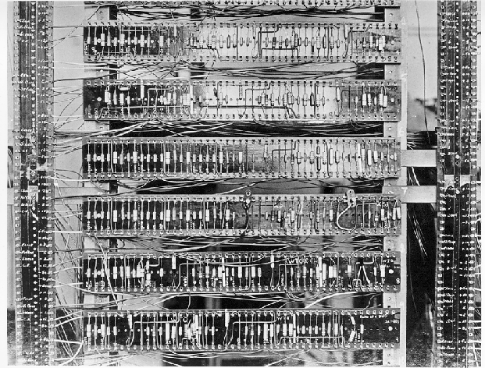
History of Computers
2nd Generation of Modern Computing (1950s-1960s)
AT&T Bell Labs’ invention of the transistor occurred
Made the computer smaller, faster and more reliable
Software industry was born during this era (Fortran, Cobol)
Compiler invented
Punch cards
Dr. Clincy

Slide 29
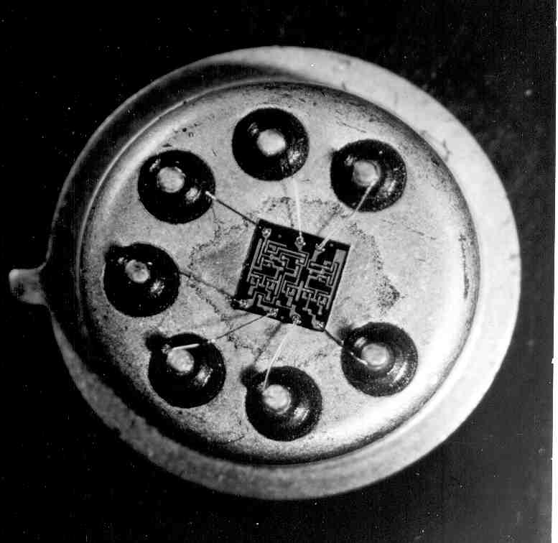
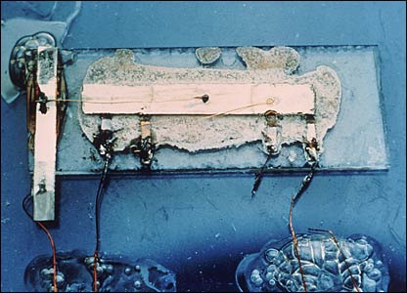
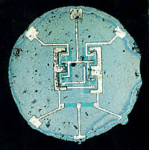
History of Computers
3rd Generation of Modern Computing (1960s-1980s)
Transistors were made smaller to fit on a chip – semiconductor chips (integrated circuit introduced)
Mouse and keyboard introduced
Operating Systems were developed – could run multiple programs at the same time
Microprogramming, parallelism, pipelining
Cache and virtual memory
Dr. Clincy

Slide 30
History of Computers
4th Generation of Modern Computing (1980s to ???)
Chips continued to get smaller and smaller (and faster and faster)
For 3rd-Gen-Era, many transistors on a single chip to form an IC – for 4th-Gen-Era, many ICs on a single chip – Very Large Scale Integration (VLSI)
For what filled an entire room during the 1st Era – now fills a palm of a hand
Microprocessor was introduced
All major components of a computer fit on a single chip
Home Computer was introduced during this era – IBM developed the PC in 1981 and Apple developed the Mac in 1984
Computer manufacturers brought computing to the general consumer market (Embedded Systems)
Dr. Clincy

Slide 31
History of Computers
5th Generation of Modern Computing (Future)
Make use of AI and voice recognition - devices that respond to natural languages input and are capable of learning and self-organization.
Quantum computers (based on quantum mechanics and physics versus transistors/digital)
Nanotechnology – processing done at an atomic and molecular level
Wireless networking and mobile apps (not only LAN level, but MAN level)
Embedded systems will continue to grow and find its way into smaller and smaller devices
Dr. Clincy

Slide 32
Historical Development
Moore’s Law (1965)
  Gordon Moore, Intel founder
  “The density of transistors in an integrated circuit will double every year.”
Contemporary version:
  “The density of silicon chips doubles every 18 months.”
But this “law” cannot hold forever ...
Dr. Clincy

Slide 33
Historical Development
Rock’s Law
  Arthur Rock, Intel financier
  “The cost of capital equipment to build semiconductors will double every four years.”
  In 1968, a new chip plant cost about $12,000.
At the time, $12,000 would buy a nice home in the suburbs.
An executive earning $12,000 per year was “making a very comfortable living.”
  In 2010, a chip plants under construction cost well over $4 billion.
  NOTE: For Moore’s Law to hold, Rock’s Law must fall, or vice versa. But no one can say which will give out first.
$4 billion is more than the gross domestic product of some small countries, including Barbados, Mauritania, and Rwanda.
Dr. Clincy

Slide 34
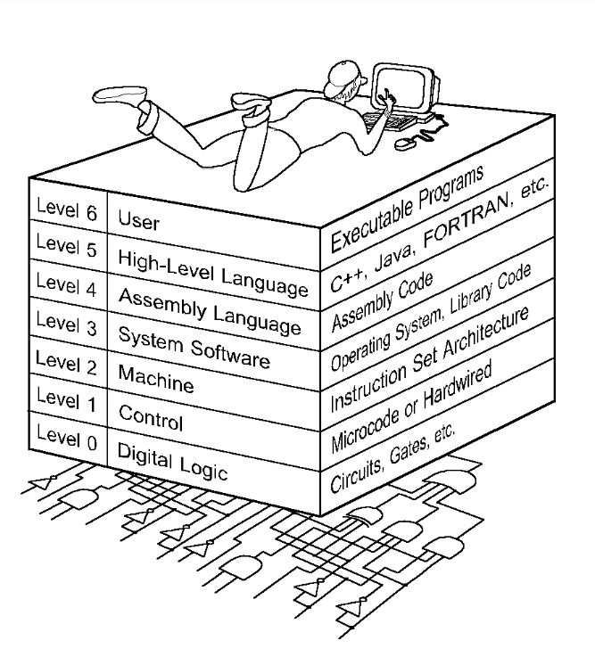
The Computer Level Hierarchy
Computers consist of many things besides chips.
Before a computer can do anything worthwhile, it must also use software.
Writing complex programs requires a “divide and conquer” approach, where each program module solves a smaller problem.
Complex computer systems employ a similar technique through a series of virtual machine layers.
Each virtual machine layer is an abstraction of the level below it (Hmmm – recall OSI Model).
The machines at each level execute their own particular instructions, calling upon machines at lower levels to perform tasks as required.
Computer circuits ultimately carry out the work.
Dr. Clincy

Slide 35
The Computer Level Hierarchy
Level 6: The User Level
  Program execution and user interface level.
  The level with which we are most familiar.
Level 5: High-Level Language Level
  The level with which we interact when we write programs in languages such as C, Pascal, Lisp, and Java.
Level 4: Assembly Language Level
  Acts upon assembly language produced from Level 5, as well as instructions programmed directly at this level.
Level 3: System Software Level
  Controls executing processes on the system.
  Protects system resources.
  Assembly language instructions often pass through Level 3 without modification.
Level 1: Control Level
  A control unit decodes and executes instructions and moves data through the system.
  Control units can be microprogrammed or hardwired.
  A microprogram is a program written in a low-level language that is implemented by the hardware.
  Hardwired control units consist of hardware that directly executes machine instructions.
Level 2: Machine Level
  Also known as the Instruction Set Architecture (ISA) Level.
  Consists of instructions that are particular to the architecture of the machine.
  Programs written in machine language need no compilers, interpreters, or assemblers.
Dr. Clincy

Slide 36
The von Neumann Model
Inventors of the ENIAC, John Mauchley and J. Presper Eckert, conceived of a computer that could store instructions in memory.
The invention of this idea has since been ascribed to a mathematician, John von Neumann, who was a contemporary of Mauchley and Eckert.
Stored-program computers have become known as von Neumann Architecture systems.
Today’s stored-program computers have the following characteristics:
  Three hardware systems:
    A central processing unit (CPU)
    A main memory system
    An I/O system
  The capacity to carry out sequential instruction processing.
  A single data path between the CPU and main memory.
    This single path is known as the von Neumann bottleneck.
Dr. Clincy

Slide 37
The von Neumann Model
On the ENIAC, all programming was done at the digital logic level.
Programming the computer involved moving plugs and wires.
A different hardware configuration was needed to solve every unique problem type.
Configuring the ENIAC to solve a “simple” problem required many days labor by skilled technicians.
Dr. Clincy

Slide 38
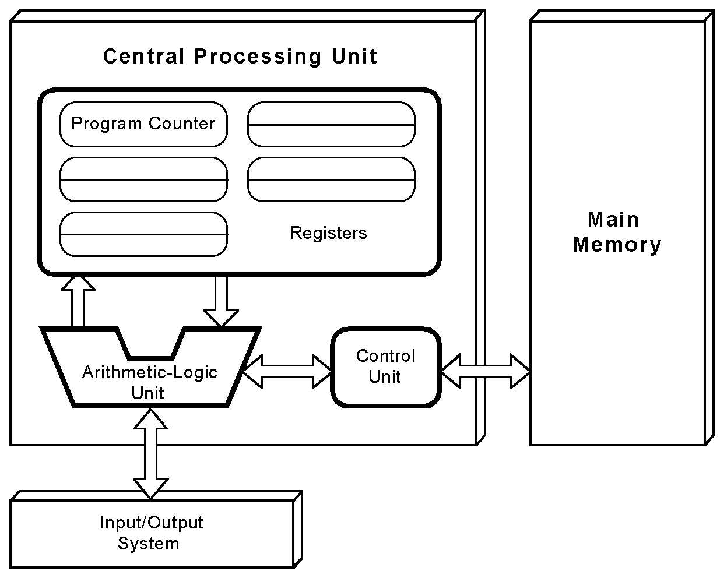
The von Neumann Model
This is a general depiction of a von Neumann system:
These computers employ a fetch-decode-execute cycle to run programs as follows . . .
Dr. Clincy

Slide 39
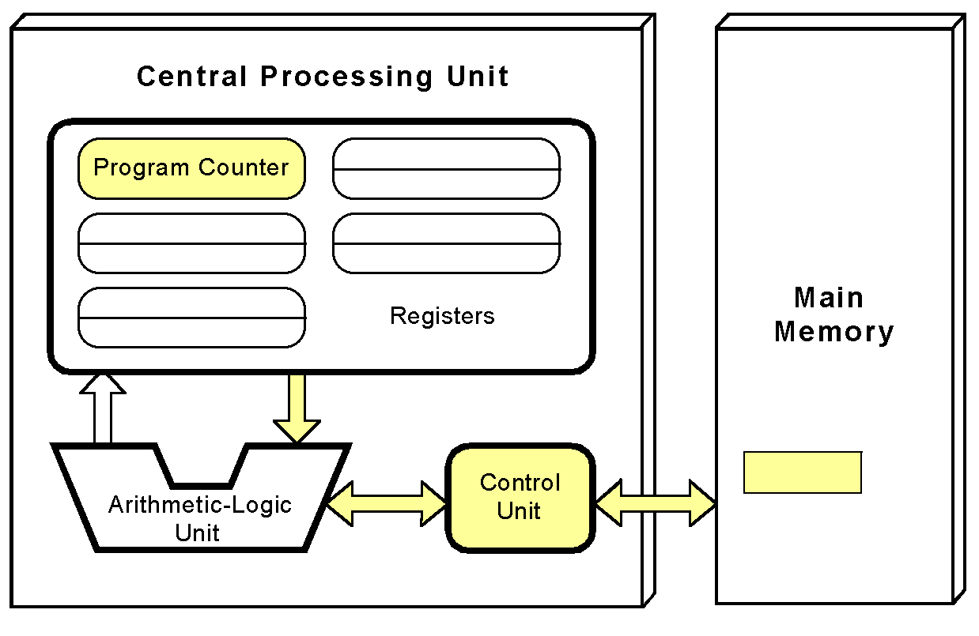
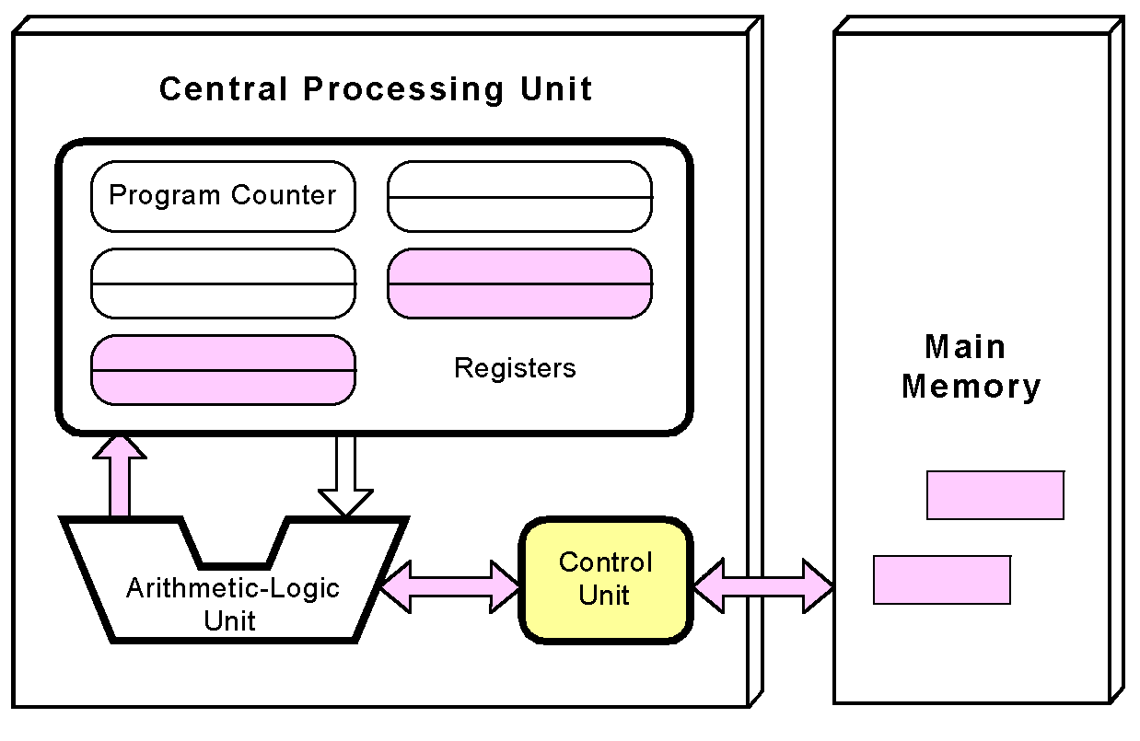
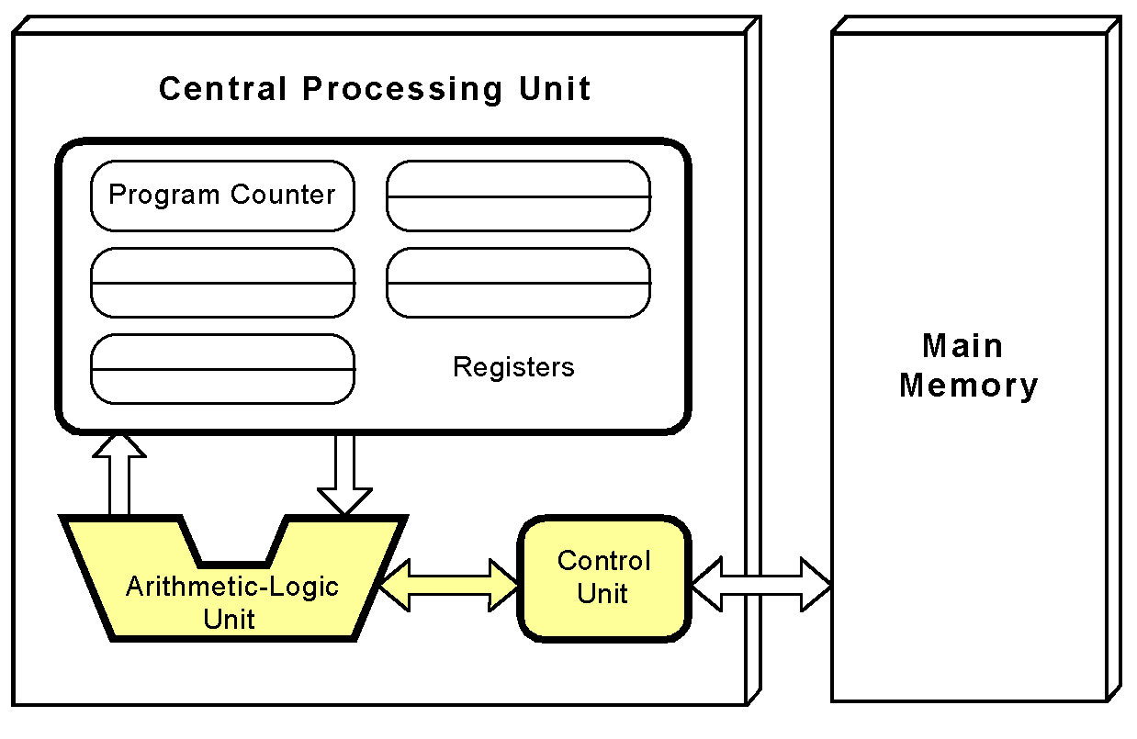
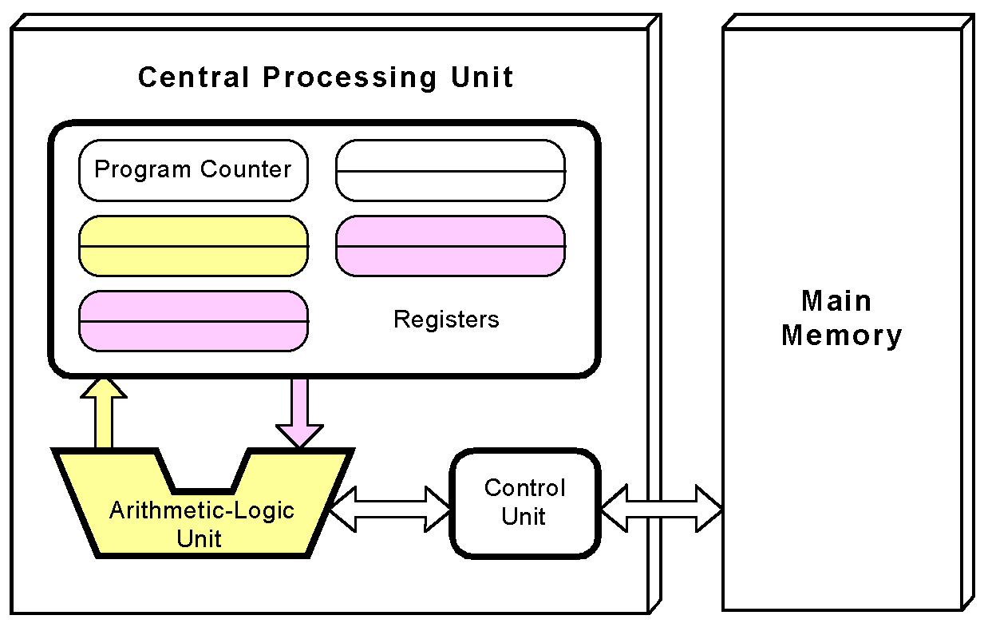
The von Neumann Model
(1) The control unit fetches the next instruction from memory using the program counter to determine where the instruction is located.
(3) Any data operands required to execute the instruction are fetched from memory and placed into registers within the CPU.
(2) The instruction is decoded into a language that the ALU can understand.
(4) The ALU executes the instruction and places results in registers or memory.
Dr. Clincy

Slide 40
Non-von Neumann Models
Conventional stored-program computers have undergone many incremental improvements over the years.
These improvements include adding specialized buses, floating-point units, and cache memories, to name only a few.
But enormous improvements in computational power require departure from the classic von Neumann architecture.
Adding processors is one approach.
Dr. Clincy

Slide 41
Non-von Neumann Models
In the late 1960s, high-performance computer systems were equipped with dual processors to increase computational throughput.
In the 1970s supercomputer systems were introduced with 32 processors.
Supercomputers with 1,000 processors were built in the 1980s.
In 1999, IBM announced its Blue Gene system containing over 1 million processors.
Dr. Clincy

Slide 42
Non-von Neumann Models
Multicore architectures have multiple CPUs on a single chip.
Dual-core and quad-core chips are commonplace in desktop systems.
Multi-core systems provide the ability to multitask
  E.g., browse the Web while burning a CD
Multithreaded applications spread mini-processes, threads, across one or more processors for increased throughput.
Dr. Clincy

Slide 43
Conclusion
This chapter has given you an overview of the subject of computer architecture.
You should now be sufficiently familiar with general system structure to guide your studies throughout the remainder of this course.
Subsequent chapters will explore many of these topics in great detail.
Dr. Clincy

