Slide 1
Introduction
A bit is the most basic unit of information in a computer.
  Sometimes these states are “high” or “low” voltage or “on” or “off..”
A byte is a group of eight bits.
  A byte is the smallest possible addressable unit of computer storage.
A word is a contiguous group of bytes.
  Words can be any number of bits or bytes.
  Word sizes of 16, 32, or 64 bits are most common.
  In a word-addressable system, a word is the smallest addressable unit of storage.
A group of four bits is called a nibble.
  Bytes, therefore, consist of two nibbles: a “high-order nibble,” and a “low-order” nibble.
Dr. Clincy
Notes:
*

Slide 2
Positional Numbering Systems
Review – Base 10 Numbers (Decimal)
Base-10
The decimal number system is based on power of the base 10. For example, for the number 1259,
the 9 is in the 10^0 column - 1s column
the 5 is in the 10^1 column - 10s column
the 2 is in the 10^2 column - 100s column
the 1 is in the 10^3 column - 1000s column
1259 is
9 X 1 = 9
+ 5 X 10 = 50
+ 2 X 100 = 200
+ 1 X 1000 = 1000
-----
1259
Dr. Clincy

Slide 3
Positional Numbering Systems
Introducing Base 2 (Binary) and Base 16 (Hex) Number Systems
Base-2 (Binary)
The Binary number system uses the same mechanism and concept however, the base is 2 versus 10
The place values for binary are based on powers of the base 2:
… 2^7 2^6 2^5 2^4 2^3 2^2 2^1 2^0
128 64 32 16 8 4 2 1
Base-16 (Hex)
The hexadecimal number system is based 16, and uses the same mechanisms and conversion routines we have already examined. The place values for hexadecimal are based on powers of the base 16
The digits for 10-15 are the letters A - F (A is 10, …….., F is 15)
…….. 16^3 16^2 16^1 16^0
4096 256 16 1
Dr. Clincy

Slide 4
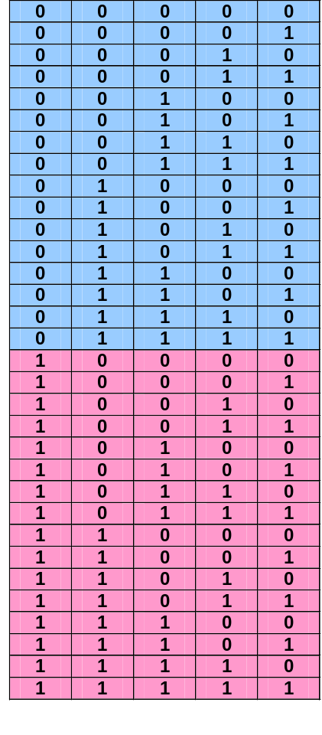
5-bit Binary Number System
2⁴, 2³, 2², 2¹, 2⁰
16, 8, 4, 2, 1
Dr. Clincy

Slide 5
Different Number Systems
Base-10 (Decimal) – what are the characters ?
Example = 659
Base-2 (Binary) – what are the characters ?
Example = 1101
Base-16 (Hex) – what are the characters ?
Example = AE
Base-8 (Octal) – what are the characters ?
Example = 73
Dr. Clincy

Slide 6
Converting Between Bases
Why Decimal, Binary and Hex ?
Give subscripts for Decimal, Binary, Hex, Octal
Dr. Clincy

Slide 7
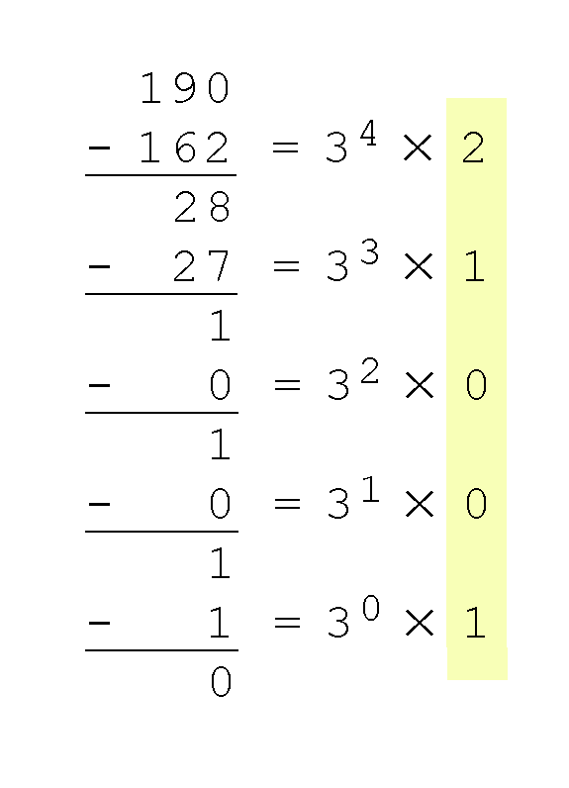
Converting Between Bases – Subtraction Method
Converting 190 to base 3...
  3 ⁵ = 243 is too large, so we try 3 ⁴ = 81. And 2 times 81 doesn’t exceed 190
  The last power of 3, 3 ⁰ = 1, is our last choice, and it gives us a difference of zero.
  Our result, reading from top to bottom is:
  190₁₀ = 21001₃
Dr. Clincy

Slide 8
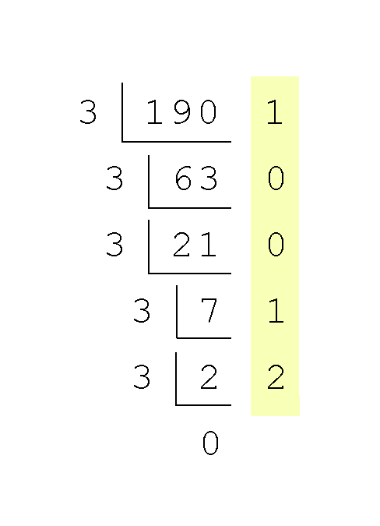
Converting Between Bases –Division Method
Converting 190 to base 3...
  Continue in this way until the quotient is zero.
  In the final calculation, we note that 3 divides 2 zero times with a remainder of 2.
  Our result, reading from bottom to top is:
  190₁₀ = 21001₃
Dr. Clincy

Slide 9
Converting from Binary to Decimal
So, the binary number 10110011 can be converted to a decimal number
1 X 1 = 1 (right most bit or position)
1 X 2 = 2
0 X 4 = 0
0 X 8 = 0
1 X 16 = 16
1 X 32 = 32
0 X 64 = 0
1 X 128 = 128 (left most bit or position)
------
179 in decimal
Dr. Clincy

Slide 10
Converting from Decimal to Binary
To convert from decimal to some other number system requires a different method called the division/remainder method. The idea is to repeatedly divide the decimal number and resulting quotients by the number system’s base. The answer will be the remainders.
Example: convert 155 to binary (Start from the top and work down)
155/2 Q = 77, R = 1 (Start)
77/2 Q = 38, R = 1
38/2 Q = 19, R = 0
19/2 Q = 9, R = 1
9/2 Q = 4, R = 1
4/2 Q = 2, R = 0
2/2 Q = 1, R = 0
1/2 Q = 0, R = 1 (Stop)
Answer is 10011011. Be careful to place the digits in the correct order.
Dr. Clincy

Slide 11
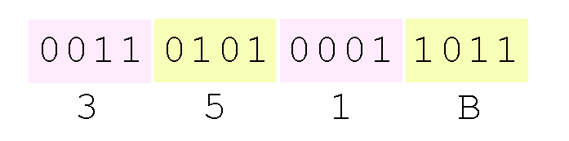
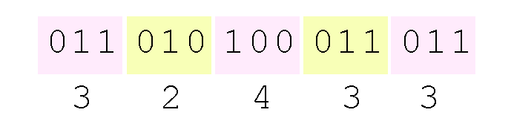
Converting Between Bases of Power 2
Using groups of hextets, the binary number 11010100011011₂ (= 13595₁₀) in hexadecimal is:
Octal (base 8) values are derived from binary by using groups of three bits (8 = 2³):
If the number of bits is not a multiple of 4, pad on the left with zeros.
Octal was very useful when computers used six-bit words.
Dr. Clincy

Slide 12
Converting Between Bases
Fractional decimal values have nonzero digits to the right of the decimal point.
Fractional values of other radix systems have nonzero digits to the right of the radix point.
Numerals to the right of a radix point represent negative powers of the radix:
  0.47₁₀ = 4 × 10 ⁻¹ + 7 × 10 ⁻²
  0.11₂ = 1 × 2 ⁻¹ + 1 × 2 ⁻²
  = ½ + ¼
  = 0.5 + 0.25 = 0.75
Dr. Clincy

Slide 13
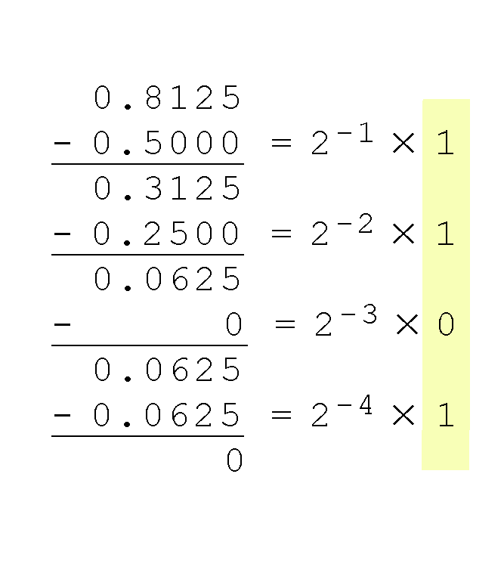
Subtraction - Converting Between Bases
The calculation to the right is an example of using the subtraction method to convert the decimal 0.8125 to binary.
  Our result, reading from top to bottom is:
  0.8125₁₀ = 0.1101₂
  Of course, this method works with any base, not just binary.
Dr. Clincy

Slide 14
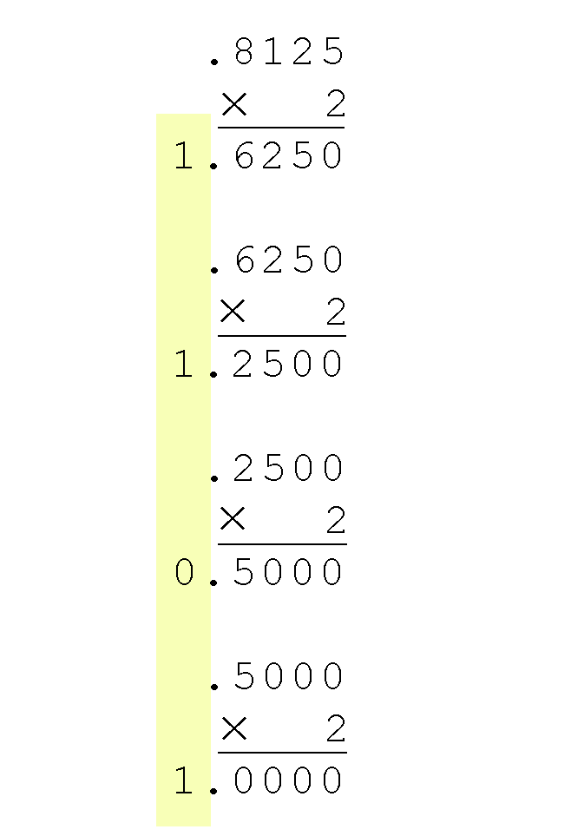
Multiplication - Converting Between Bases
Converting 0.8125 to binary . . .
  Multiplication Method: You are finished when the product is zero, or until you have reached the desired number of binary places.
  Our result, reading from top to bottom is:
  0.8125₁₀ = 0.1101₂
  This method also works with any base. Just use the target radix as the multiplier.
Dr. Clincy

Slide 15
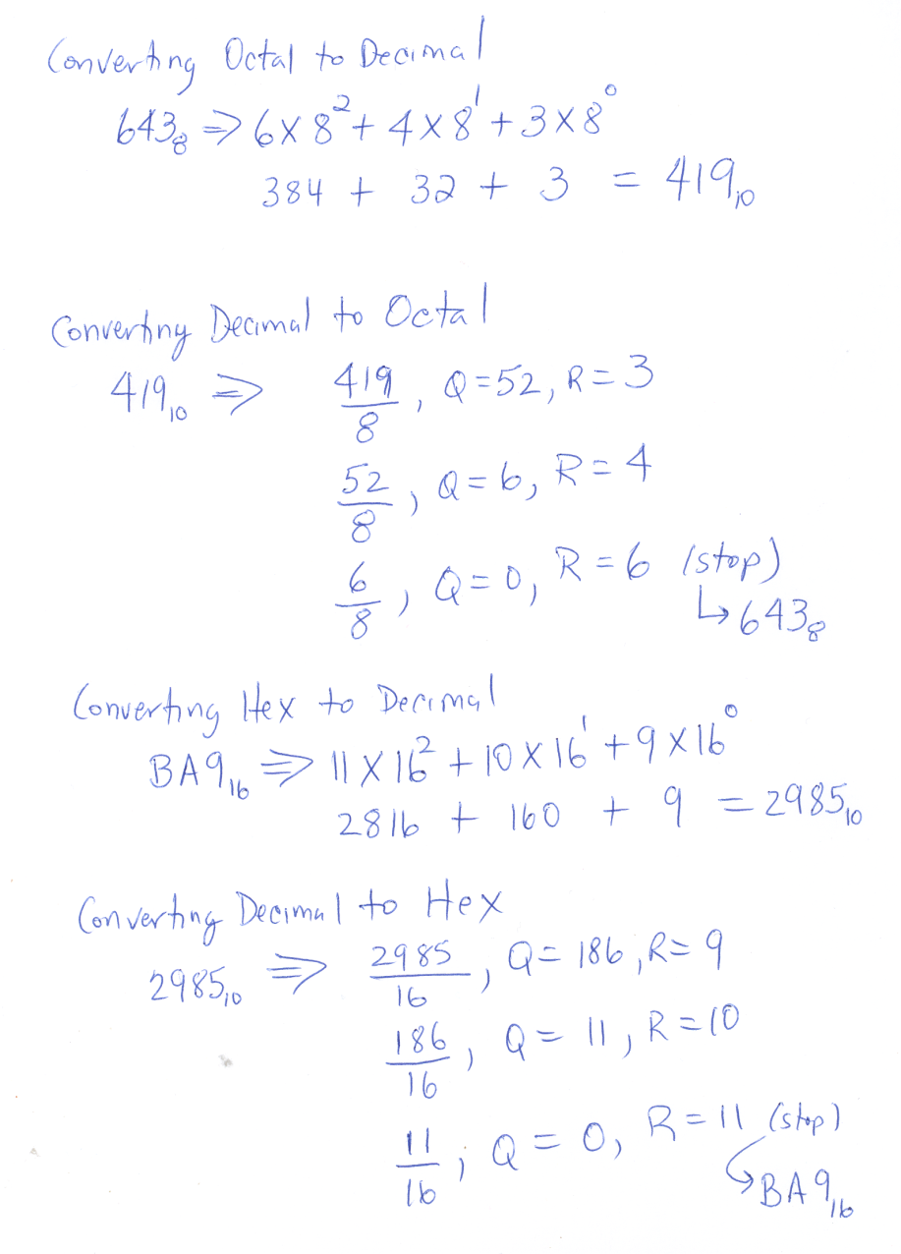
Converting Number Systems
Dr. Clincy

Slide 16
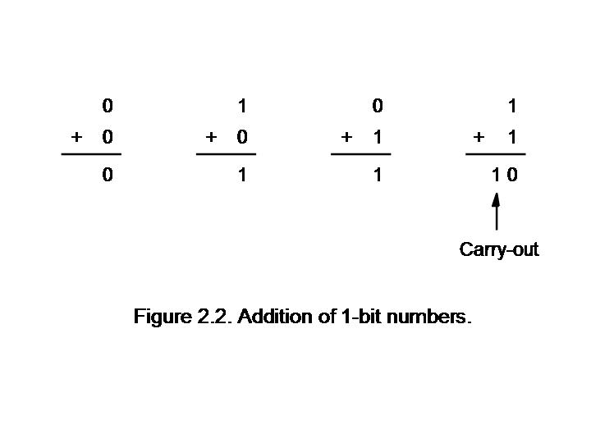
Addition
Dr. Clincy
Dr. Clincy
Lecture

Slide 17
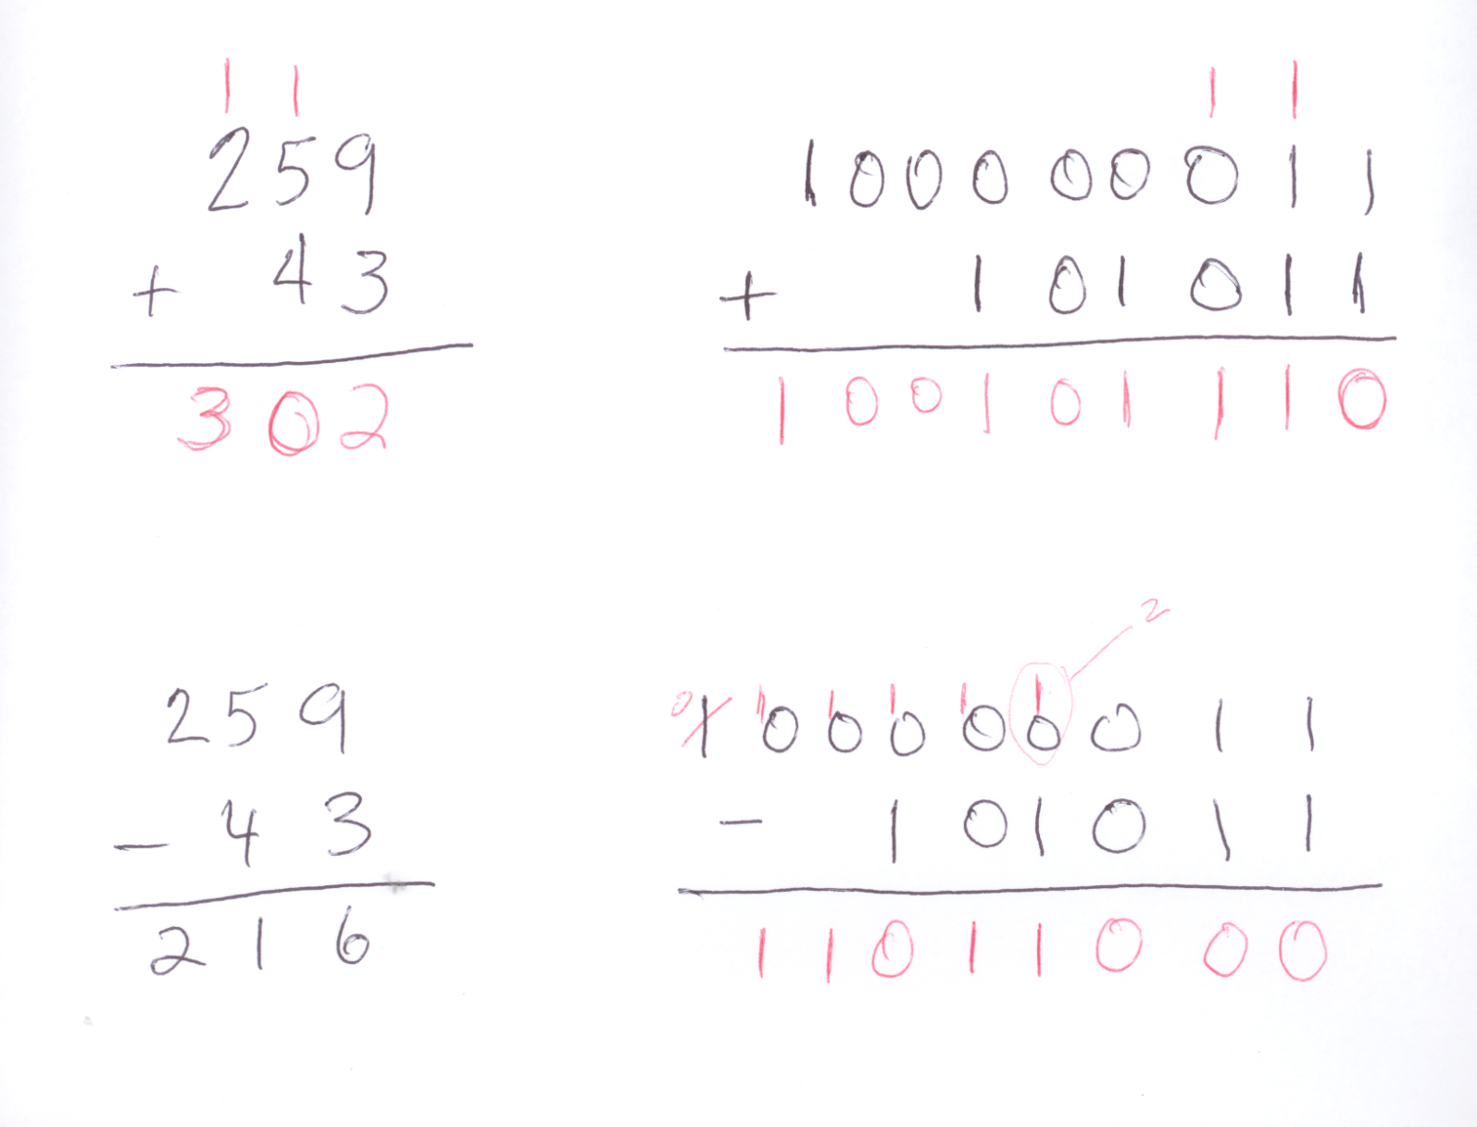
Addition & Subtraction
Dr. Clincy
Dr. Clincy
Lecture

Slide 18
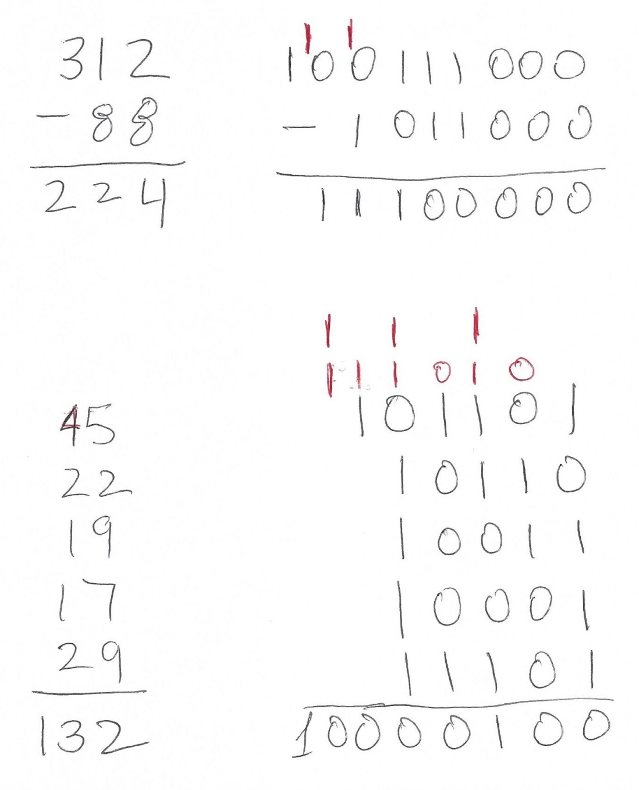
Addition & Subtraction – more examples
Dr. Clincy
Dr. Clincy
Lecture

Slide 19
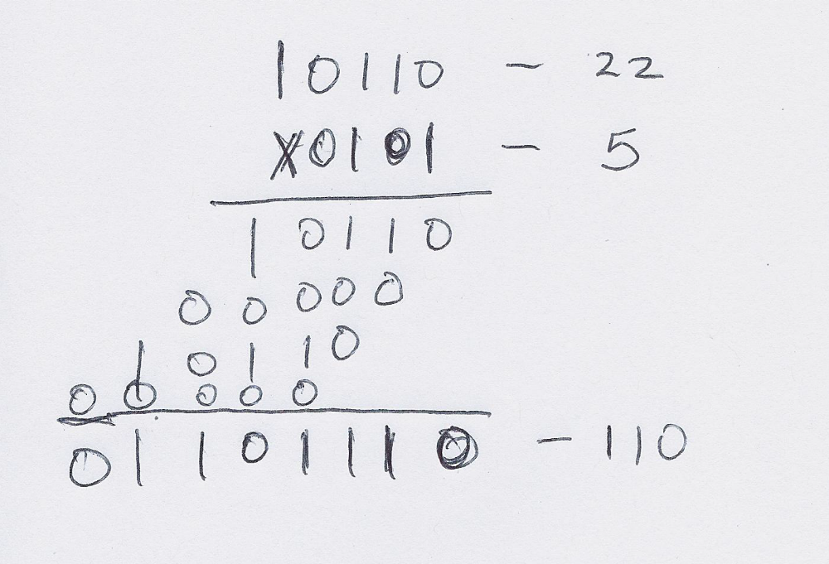
What about multiplication in base 2
By hand - For unsigned case, very similar to base-10 multiplication
Dr. Clincy
Dr. Clincy
Lecture

Slide 20
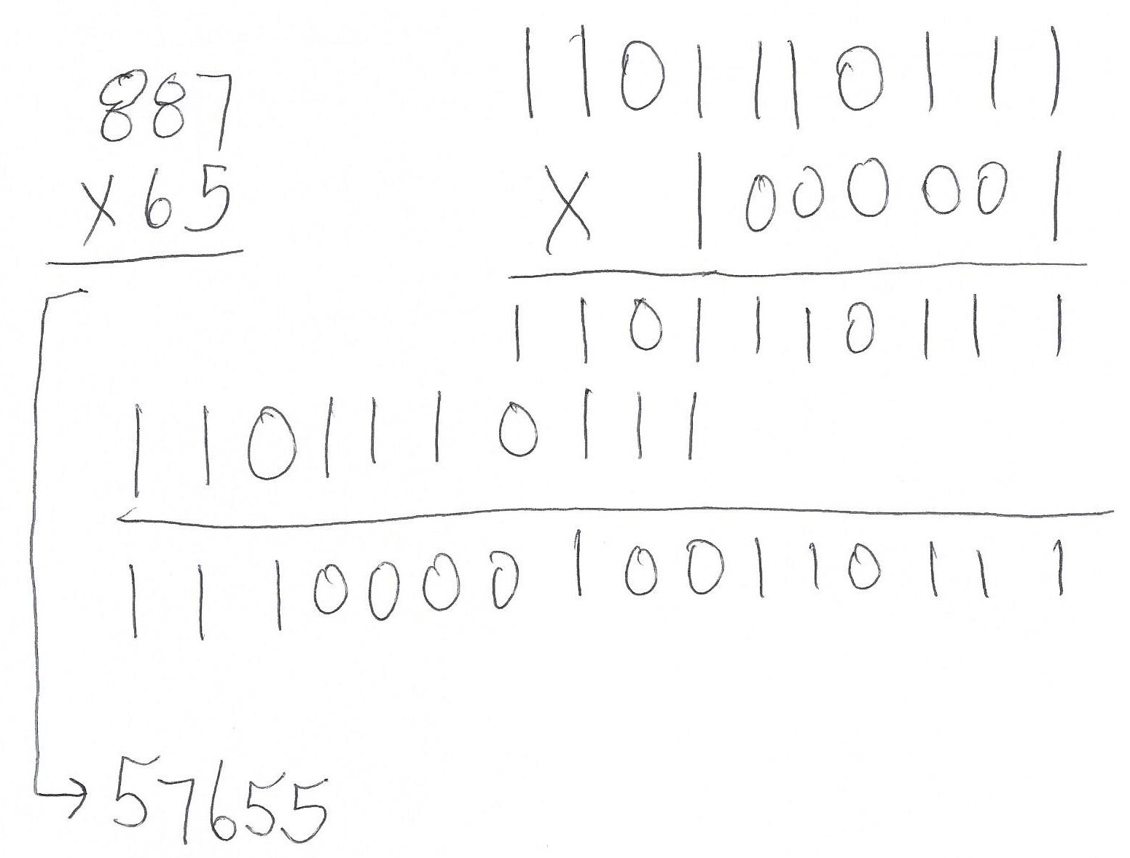
Multiplication – another example
Dr. Clincy
Dr. Clincy
Lecture

Slide 21
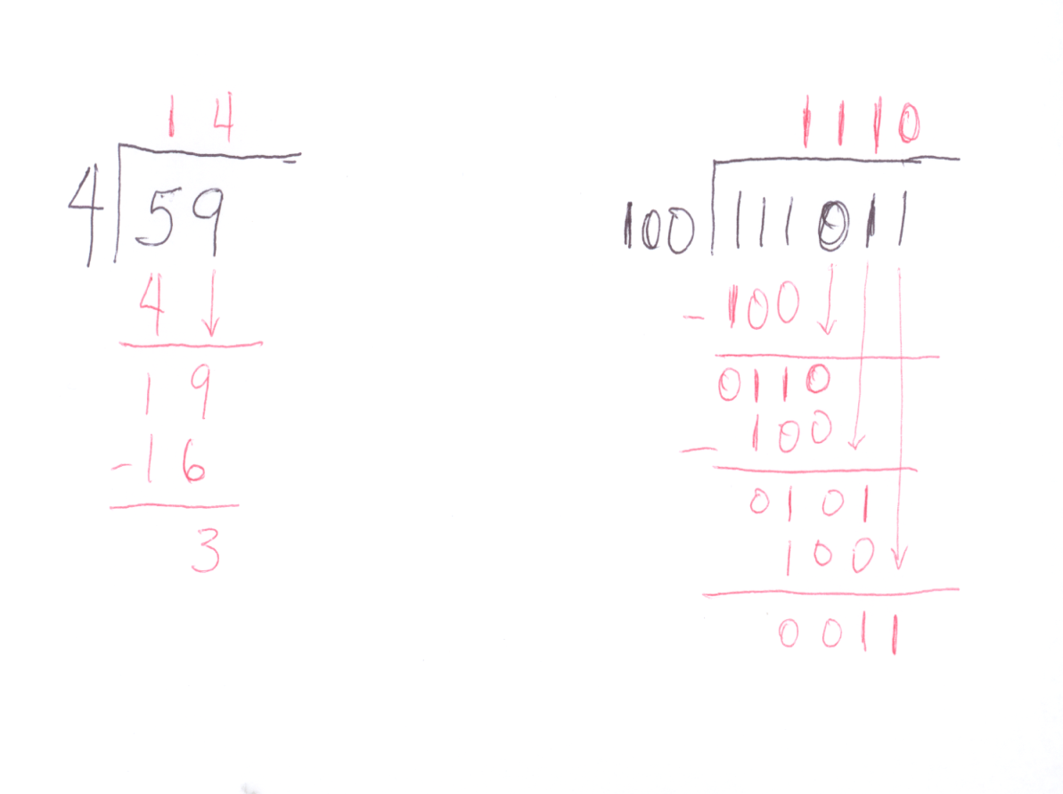
Division
Dr. Clincy
Dr. Clincy
Lecture

Slide 22
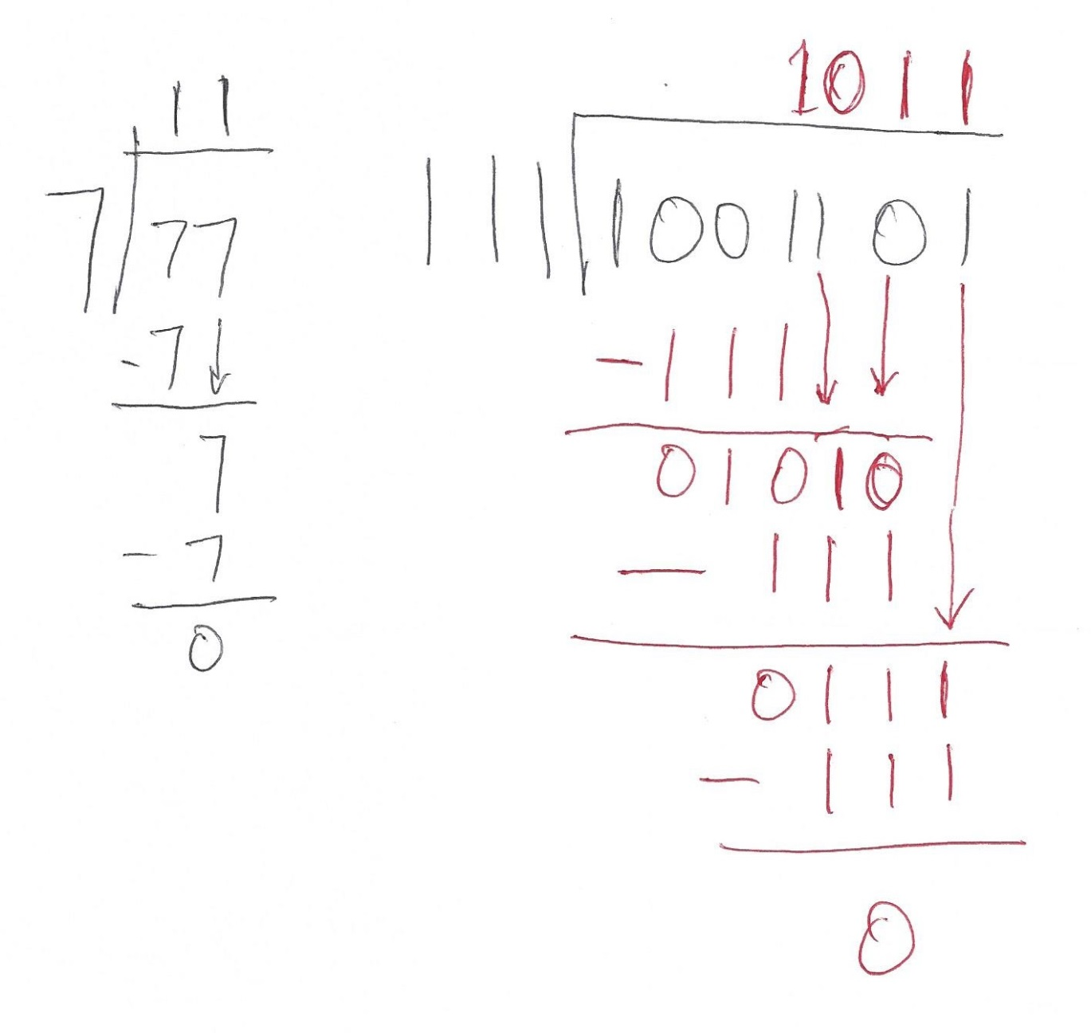
Division – another example
Dr. Clincy
Dr. Clincy
Lecture

