Slide 1
Computers can not SUBTRACT
Therefore, need approaches to represent “signed” numbers
Dr. Clincy

Slide 2
Changing only b₃ makes +/-
Complementing makes +/-
B
V
alues represented
Complementing plus 1 makes +/-
Sign and
b
3
b
2
b
1
b
0
magnitude
1'
s complement
2'
s complement
0
1
1
1
+
7
+
7
+
7
0
1
1
0
+
6
+
6
+
6
0
1
0
1
+
5
+
5
+
5
0
1
0
0
+
4
+
4
+
4
0
0
1
1
+
3
+
3
+
3
0
0
1
0
+
2
+
2
+
2
0
0
0
1
+
1
+
1
+
1
0
0
0
0
+
0
+
0
+
0
1
0
0
0
-
0
-
7
-
8
1
0
0
1
-
1
-
6
-
7
1
0
1
0
-
2
-
5
-
6
1
0
1
1
-
3
-
4
-
5
1
1
0
0
-
4
-
3
-
4
1
1
0
1
-
5
-
2
-
3
1
1
1
0
-
6
-
1
-
2
1
1
1
1
-
7
-
0
-
1
More used and more efficient
.
Dr. Clincy

Slide 3
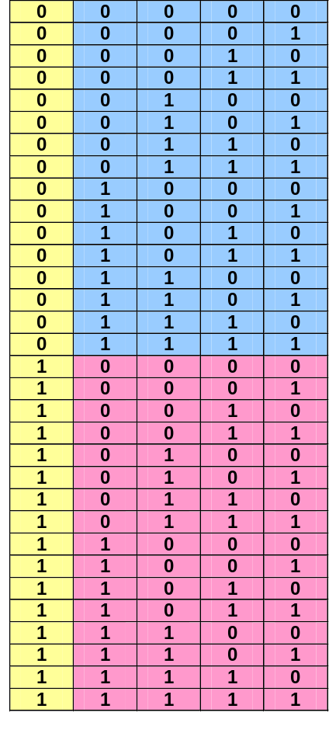
5-bit Binary Number System with SIGN
Sign
X⁴, X³, X², X¹, X⁰
Dr. Clincy

Slide 4
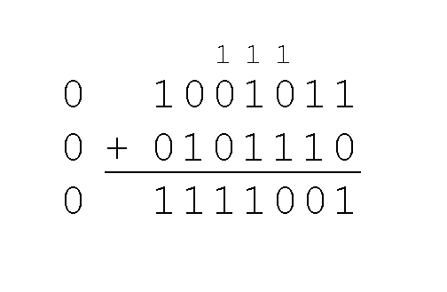
Sign Magnitude Approach
Example:
  Using signed magnitude binary arithmetic, find the sum of 75 and 46.
Once we have worked our way through all eight bits, we are done.
In this example, we were careful to pick two values whose sum would fit into seven bits. If that is not the case, we have a problem.
Dr. Clincy

Slide 5
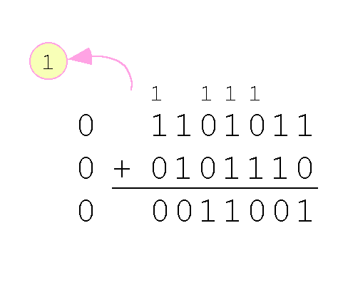
Sign Magnitude Approach
Example:
  Using signed magnitude binary arithmetic, find the sum of 107 and 46.
We see that the carry from the seventh bit overflows and is discarded, giving us the erroneous result: 107 + 46 = 25.
Dr. Clincy

Slide 6
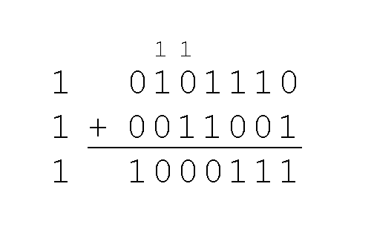
Sign Magnitude Approach
The signs in signed magnitude representation work just like the signs in pencil and paper arithmetic.
  Example: Using signed magnitude binary arithmetic, find the sum of - 46 and - 25.
Because the signs are the same, all we do is add the numbers and supply the negative sign when we are done.
Dr. Clincy

Slide 7
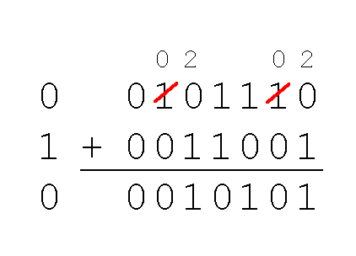
Sign Magnitude Approach
Mixed sign addition (or subtraction) is done the same way.
  Example: Using signed magnitude binary arithmetic, find the sum of 46 and - 25.
The sign of the result gets the sign of the number that is larger.
  Note the “borrows” from the second and sixth bits.
  SM is good for “representing signed binary” but not so good for mixed sign computation
Dr. Clincy

Slide 8
Sign Magnitude Approach
Signed magnitude representation is easy for people to understand, but it requires complicated computer hardware.
Another disadvantage of signed magnitude is that it allows two different representations for zero: positive zero and negative zero.
For these reasons (among others) computers systems employ 1’s and 2’s complement approaches
Dr. Clincy

Slide 9
One’s Complement Approach
For example, using 8-bit one’s complement representation:
  + 3 is: 00000011
  - 3 is: 11111100
In one’s complement representation, as with signed magnitude, negative values are indicated by a 1 in the high order bit.
Complement systems are useful because they eliminate the need for subtraction.
Dr. Clincy

Slide 10
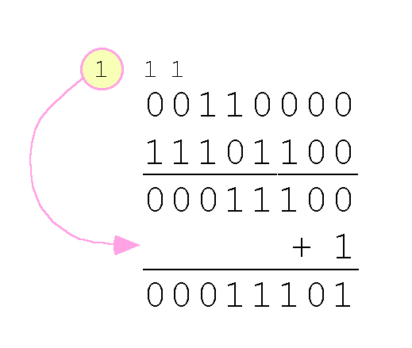
One’s Complement Approach
With one’s complement addition, the carry bit is “carried around” and added to the sum.
  Example: Using one’s complement binary arithmetic, find the sum of 48 and -19
  We note that 19 in binary is : 00010011,
  So -19 in one’s complement is: 11101100.
Dr. Clincy

Slide 11
One’s Complement - Binary Addition
1010 (neg 5)
+0010 (pos 2)
1100 (neg 3)
1101 (neg 2)
+0111 (pos 7)
10100 (overflow – add the 1 back)
0101 (pos 5)
Recall complement
0011
Dr. Clincy

Slide 12
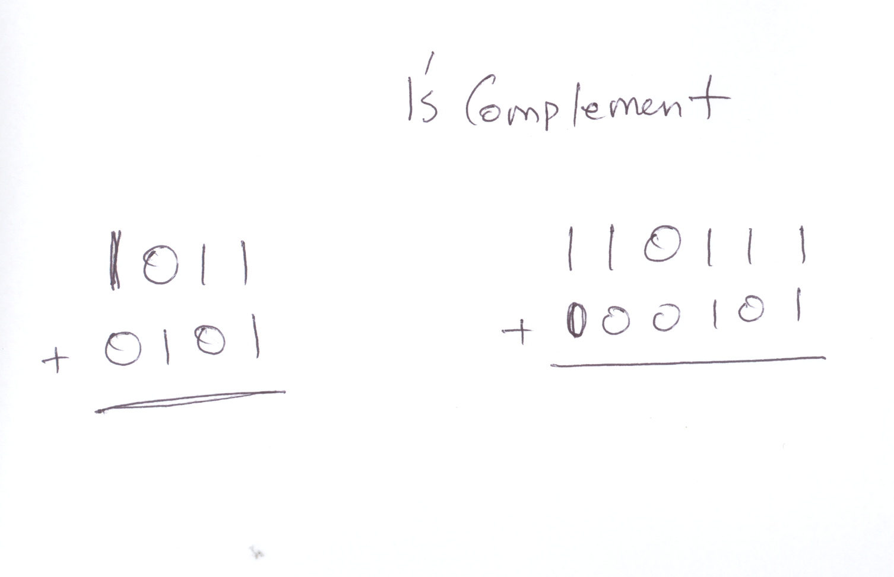
1’s Complement
Dr. Clincy

Slide 13
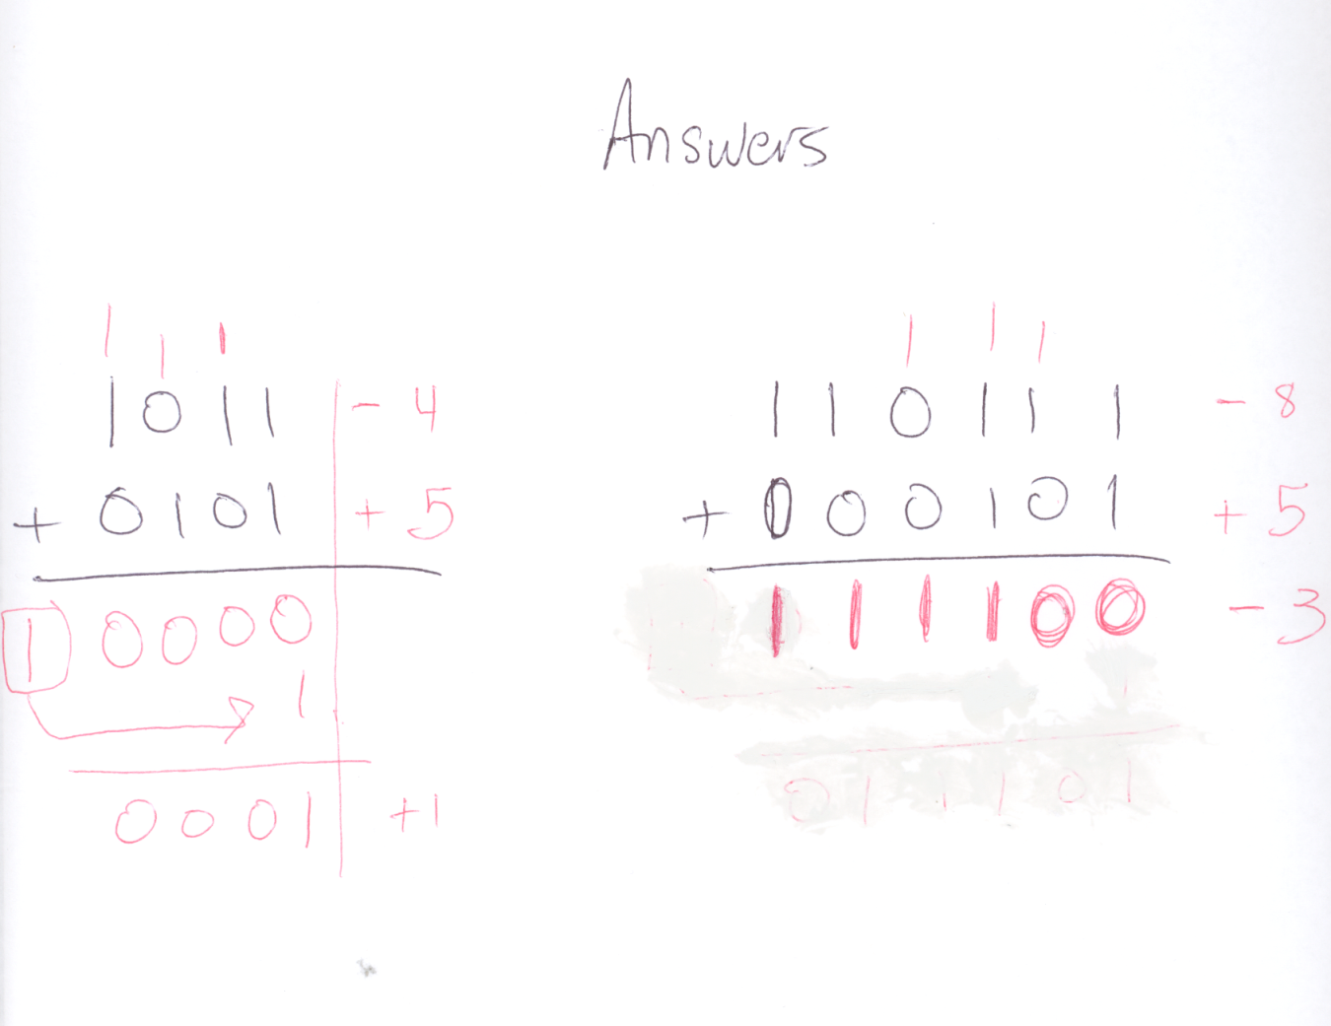
1’s Complement
Dr. Clincy

Slide 14
One’s Complement Approach
Although the “end carry around” adds some complexity, one’s complement is simpler to implement than signed magnitude.
But it still has the disadvantage of having two different representations for zero: positive zero and negative zero.
Two’s complement solves this problem.
Dr. Clincy

Slide 15
Two’s Complement Approach
To express a value in two’s complement representation:
  If the number is positive, just convert it to binary and you’re done.
  If the number is negative, find the one’s complement of the number and then add 1.
Example:
  In 8-bit binary, 3 is: 00000011
  -3 using one’s complement representation is: 11111100
  Adding 1 gives us -3 in two’s complement form: 11111101.
Dr. Clincy

Slide 16
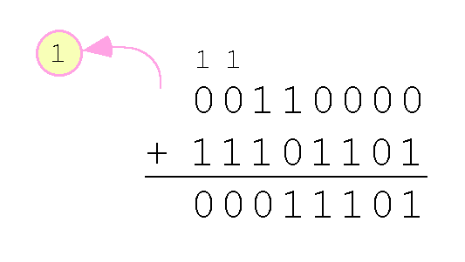
Two’s Complement Approach
With two’s complement arithmetic, all we do is add our two binary numbers. Just discard any carries emitting from the high order bit.
Example: Using two’s complement binary arithmetic, find the sum of 48 and - 19.
  We note that 19 in binary is: 00010011,
  So -19 using one’s complement is: 11101100,
  So -19 using two’s complement is: 11101101.
Dr. Clincy

Slide 17
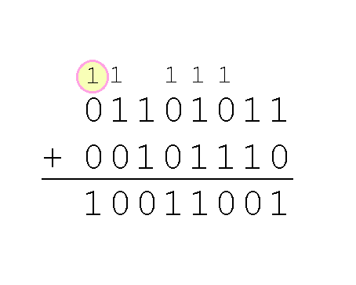
Two’s Complement Approach
Example:
  Using two’s complement binary arithmetic, find the sum of 107 and 46.
We see that the nonzero carry from the seventh bit overflows into the sign bit, giving us the erroneous result: 107 + 46 = -103.
Sign-bit: Carry-in of 1 and Carry-out of 0
0
An overflow into the sign bit does not always mean that we have an error.
Rule for detecting signed two’s complement overflow: When the “carry in” and the “carry out” of the sign bit differ, overflow has occurred. If the carry-in to the sign bit equals the carry out of the sign bit, no overflow has occurred.

Slide 18
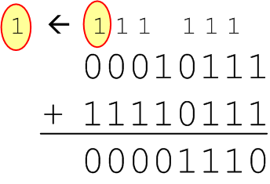
Two’s Complement Approach
Example:
  Using two’s complement binary arithmetic, find the sum of 23 and -9.
  We see that there is carry into the sign bit and carry out. The final result is correct: 23 + (-9) = 14.
  Sign-bit: Carry-in of 1 and Carry-out of 0
Rule for detecting signed two’s complement overflow: When the “carry in” and the “carry out” of the sign bit differ, overflow has occurred. If the carry-out of the sign bit equals the carry-in to the sign bit, no overflow has occurred.
Dr. Clincy

Slide 19
One’s & Two’s Complement Relationship
For negative numbers, it’s easier to first determine the 1’s complement number, then determine the 2’s complement
To go from a negative 1’s Comp to 2’s Comp from a magnitude perspective: 2’s complement is 1 more than the 1’s complement (keeping the bits the same) – clarity: 1 less in value (-19 vs -20) or 1 more in magnitude (19 vs 20)
To go from a negative 1’s Comp to 2’s Comp from a bit perspective: 2’s complement is 1 bit added to the 1’s complement (keeping the magnitude or value the same)
  We note that 19 in binary is: 00010011
  So -19 using one’s complement is: 11101100
  So -20 using two’s complement is: 11101100
  So -19 using one’s complement is: 11101100
  So -19 using two’s complement is: 11101101
Dr. Clincy

