Slide 1
Floating Point Numbers
Dr. Clincy
Professor of CS
Dr. Clincy

Slide 2
Floating-Point Representation
The signed magnitude, one’s complement, and two’s complement representation that we have just presented deal with signed integer values only.
Without modification, these formats are not useful in scientific or business applications that deal with real number values.
Floating-point representation solves this problem.
For example, how would 123.44 be stored compared to 12344 ?
How can we use the existing infrastructure of the computer to store real numbers ?
Dr. Clincy

Slide 3
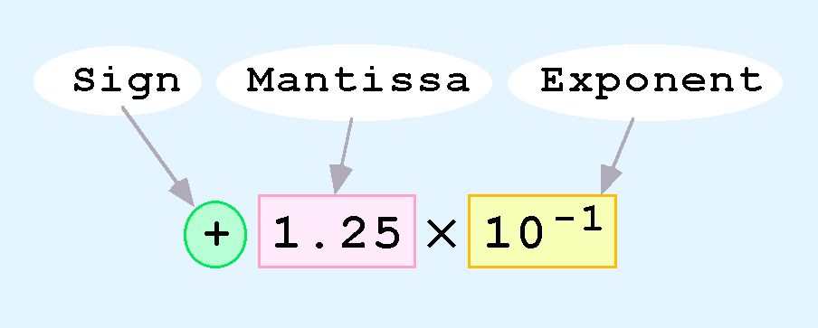
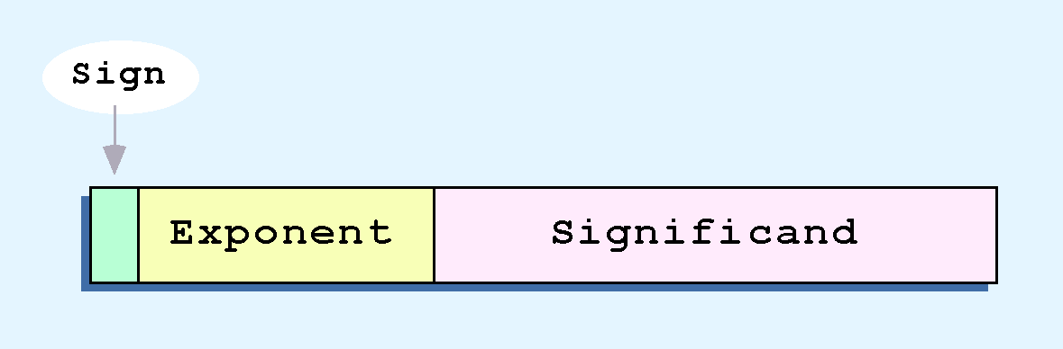
Scientific-Notation Vs Floating-Point Representation
Computers use a form of scientific notation for floating-point representation
Numbers written in scientific notation have three components:
Computer representation of a floating-point number consists of three fixed-size fields:
Size determines range
Size determines precision
Dr. Clincy

Slide 4
Floating-Point Representation
Floating-point numbers allow an arbitrary number of decimal places to the right of the decimal point.
  For example: 0.5 × 0.25 = 0.125
They are often expressed in scientific notation.
  For example:
    0.125 = 1.25 × 10⁻¹
    5,000,000 = 5.0 × 10⁶
Dr. Clincy

Slide 5
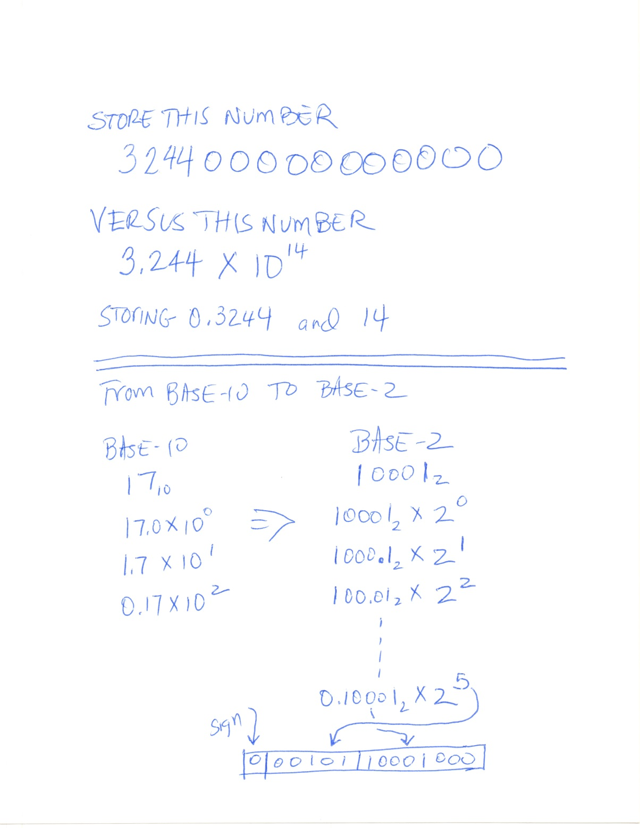
The Concept
Dr. Clincy

Slide 6
The Simple Model
We introduce a hypothetical “Simple Model” to explain the concepts
In this model:
  A floating-point number is 14 bits in length
  The exponent field is 5 bits
  The significand field is 8 bits
The significand is always preceded by an implied binary point.
Thus, the significand always contains a fractional binary value.
The exponent indicates the power of 2 by which the significand is multiplied.
Dr. Clincy

Slide 7
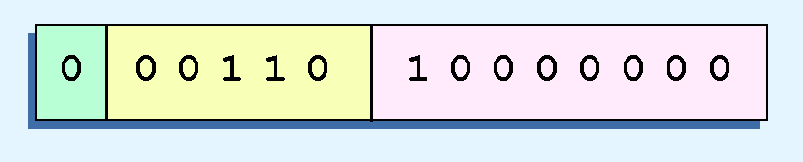
Simple Model Illustrated
Example:
  Express 32₁₀ in the simplified 14-bit floating-point model.
We know that 32 is 2⁵. So in (binary) scientific notation 32 = 1.0 x 2⁵ = 0.1 x 2⁶.
  In a moment, we’ll explain why we prefer the second notation versus the first.
Using this information, we put 110 (= 6₁₀) in the exponent field and 1 in the significand as shown.
Dr. Clincy

Slide 8
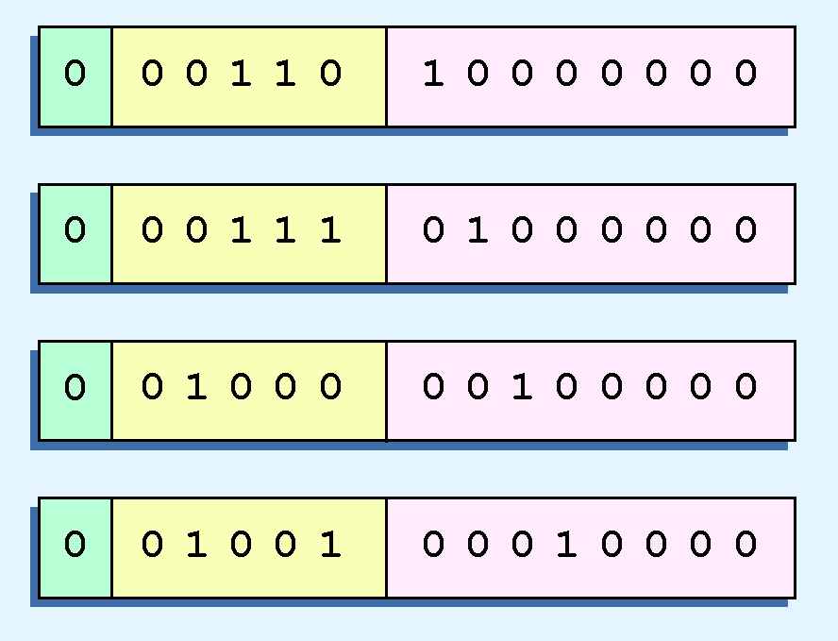
Problems with the Simple Model
The illustrations shown at the right are all equivalent representations for 32 using our simplified model.
Not only do these synonymous representations waste space, but they can also cause confusion.
Another problem with our system is that we have made no allowances for negative exponents. We have no way to express 0.5 (=2 ⁻¹)! (Notice that there is no sign in the exponent field.)
All of these problems can be fixed with no changes to our basic model.
Dr. Clincy

Slide 9
Normalization
To resolve the problem of synonymous forms, we establish a rule that the first digit of the significand must be 1, with no ones to the left of the radix point.
This process, called normalization, results in a unique pattern for each floating-point number.
  In our simple model, all significands must have the form 0.1xxxxxxxx
  For example, 4.5 = 100.1 x 2⁰ = 1.001 x 2² = 0.1001 x 2³. The last expression is correctly normalized.
In our simple instructional model, we use no implied bits.
Dr. Clincy

Slide 10
Negative Exponents
To provide for negative exponents, we will use a biased exponent.
A bias is a number that is approximately midway in the range of values expressible by the exponent. We subtract the bias from the value in the exponent to determine its true value.
  In our case, we have a 5-bit exponent. We will use 16 for our bias. This is called excess-16 representation.
In our model, exponent values greater than 16 are positive.
  an exponent of 4, would be 16+4=20
  an exponent of 10, would be 16+10=26
In our model, exponent values less than 16 are negative, representing fractional numbers.
  an exponent of -4, would be 16-4=12
  an exponent of -10, would be 16-10=6
Dr. Clincy

Slide 11
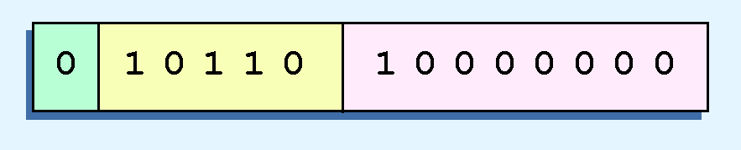

Examples
Example 1:
  Express 32₁₀ in the revised 14-bit floating-point model.
We know that 32 = 1.0 x 2⁵ = 0.1 x 2⁶.
To use our excess 16 biased exponent, we add 16 to 6, giving 22₁₀ (=10110₂).
So we have:
Example 2:
  Express 0.0625₁₀ in the revised 14-bit floating-point model.
We know that 0.0625 is 2⁻⁴. So in (binary) scientific notation 0.0625 = 1.0 x 2⁻⁴ = 0.1 x 2 ⁻³.
To use our excess 16 biased exponent, we add 16 to -3, giving 13₁₀ (=01101₂).
Dr. Clincy

Slide 12

Another Example
Example:
  Express -26.625₁₀ in the revised 14-bit floating-point model.
We find 26.625₁₀ = 11010.101₂. Normalizing, we have: 26.625₁₀ = 0.11010101 x 2 ⁵.
To use our excess 16 biased exponent, we add 16 to 5, giving 21₁₀ (=10101₂). We also need a 1 in the sign bit.
Dr. Clincy

Slide 13
IEEE Standards
The IEEE has established a standard for floating-point numbers
The IEEE-754 single precision floating point standard uses an 8-bit exponent (with a bias of 127) and a 23-bit significand.
The IEEE-754 double precision standard uses an 11-bit exponent (with a bias of 1023) and a 52-bit significand.
In both the IEEE single-precision and double-precision floating-point standard, the significand has an implied 1 to the LEFT of the radix point.
  The format for a significand using the IEEE format is: 1.xxx…
  For example, 4.5 = .1001 x 2³ in IEEE format is 4.5 = 1.001 x 2². The 1 is implied, which means is does not need to be listed in the significand (the significand would include only 001).
Dr. Clincy

Slide 14
Example
Example: Express -3.75 as a floating point number using IEEE single precision.
First, let’s normalize according to IEEE rules:
  3.75 = -11.11₂ = -1.111 x 2¹
  The bias is 127, so we add 127 + 1 = 128 (this is our exponent)
  The first 1 in the significand is implied, so we have:
  Since we have an implied 1 in the significand, this equates to
    -(1).111₂ x 2 ^{(128 – 127)} = -1.111₂ x 2¹ = -11.11₂ = -3.75.
(implied)
Dr. Clincy

Slide 15
The Zero Issue
Both the 14-bit model that we have presented and the IEEE-754 floating point standard allow two representations for zero.
  Zero is indicated by all zeros in the exponent and the significand, but the sign bit can be either 0 or 1.
This is why programmers should avoid testing a floating-point value for equality to zero.
  Negative zero does not equal positive zero.
Dr. Clincy

Slide 16
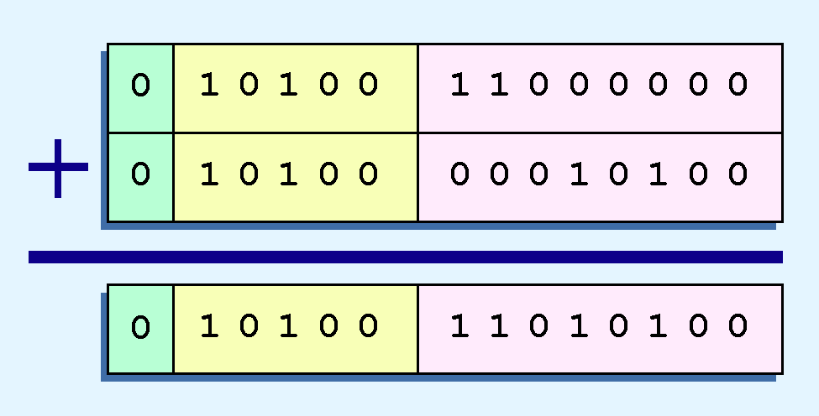
Addition and Subtracting
Floating-point addition and subtraction are done using methods analogous to how we perform calculations using pencil and paper.
The first thing that we do is express both operands in the same exponential power, then add the numbers, preserving the exponent in the sum.
If the exponent requires adjustment, we do so at the end of the calculation.
Example:
  Find the sum of 12₁₀ and 1.25₁₀ using the 14-bit “simple” floating-point model.
We find 12₁₀ = 0.1100 x 2 ⁴. And 1.25₁₀ = 0.101 x 2 ¹ = 0.000101 x 2 ⁴.
In Excess-16 form
Thus, our sum is 0.110101 x 2 ⁴.
Dr. Clincy

Slide 17
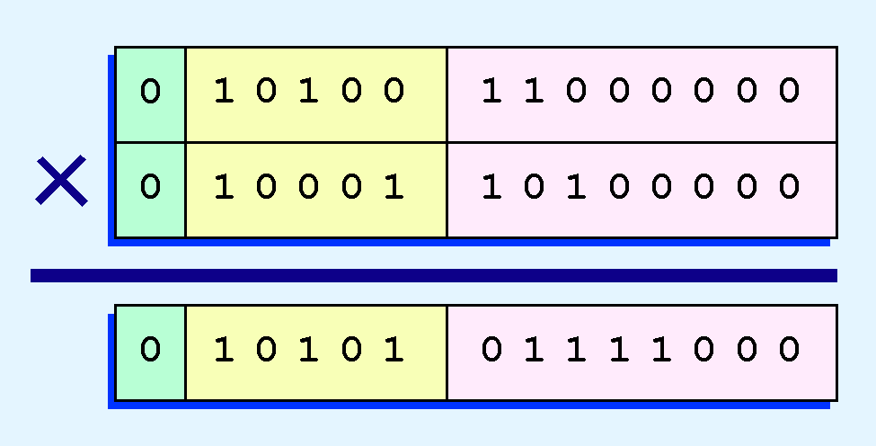
Multiplication
Floating-point multiplication is also carried out in a manner akin to how we perform multiplication using pencil and paper.
We multiply the two operands and add their exponents.
If the exponent requires adjustment, we do so at the end of the calculation.
Example:
  Find the product of 12₁₀ and 1.25₁₀ using the 14-bit floating-point model.
We find 12₁₀ = 0.1100 x 2 ⁴. And 1.25₁₀ = 0.101 x 2 ¹.
In Excess-16 form
Thus, our product is 0.0111100 x 2 ⁵ ⁼ 0.1111 x 2 ⁴.
The normalized product requires an exponent of 20₁₀ = 10100₂.
Dr. Clincy

Slide 18
Error Issue
No matter how many bits we use in a floating-point representation, our model must be finite.
The real number system is, of course, infinite, so our models can give nothing more than an approximation of a real value.
At some point, every model breaks down, introducing errors into our calculations.
By using a greater number of bits in our model, we can reduce these errors, but we can never totally eliminate them.
We must also be aware that errors can compound through repetitive arithmetic operations.
For example, our 14-bit model cannot exactly represent the decimal value 128.5. In binary, it is 9 bits wide:
  10000000.1₂ = 128.5₁₀
When we try to express 128.5₁₀ in our 14-bit model, we lose the low-order bit, giving a relative error of:
If we had a procedure that repetitively added 0.5 to 128.5, we would have an error of nearly 2% after only four iterations.
^{128.5 - 128}
^{128.5}
^{≈ 0.39%}
Dr. Clincy

Slide 19
Overflow and Underflow
Floating-point overflow and underflow can cause programs to crash.
Overflow occurs when there is no room to store the high-order bits resulting from a calculation.
Underflow occurs when a value is too small to store, possibly resulting in division by zero.
Experienced programmers know that it’s better for a program to crash than to have it produce incorrect, but plausible, results.
Dr. Clincy

