Slide 1
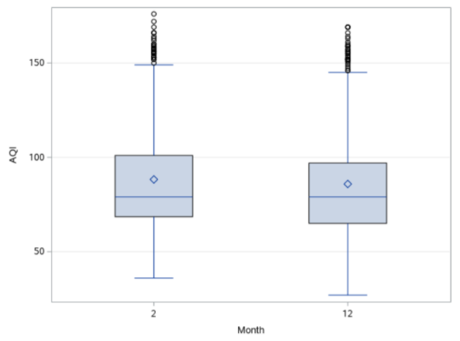
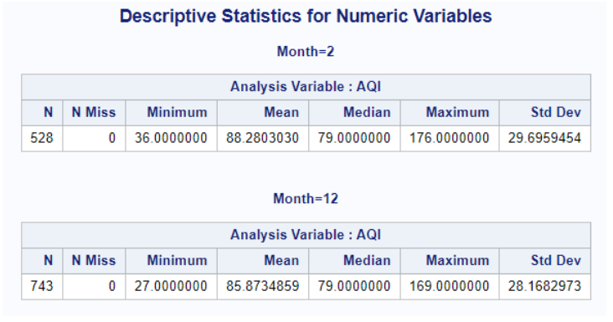
February 2021 vs December 2020 Air Quality
AQI Changes

Slide 2
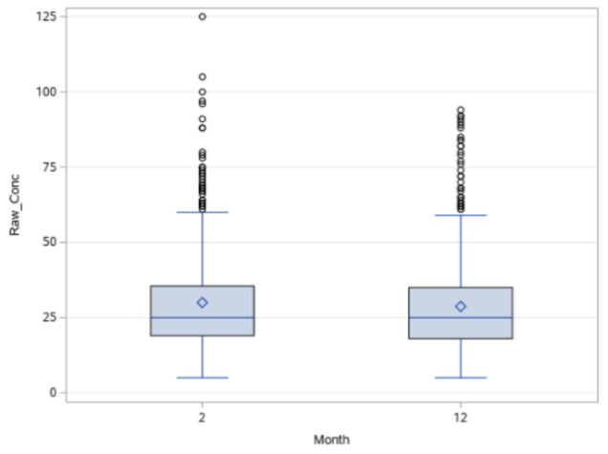
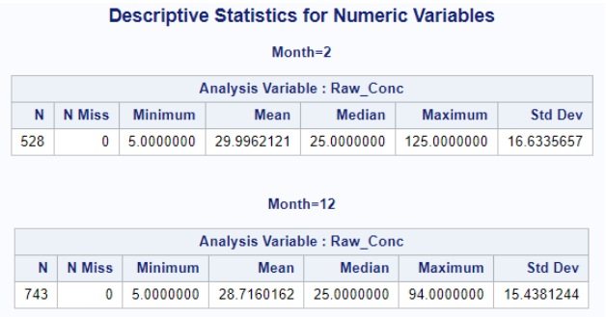
February 2021 vs December 2020 Air Quality
Raw Concentration Changes

Slide 3
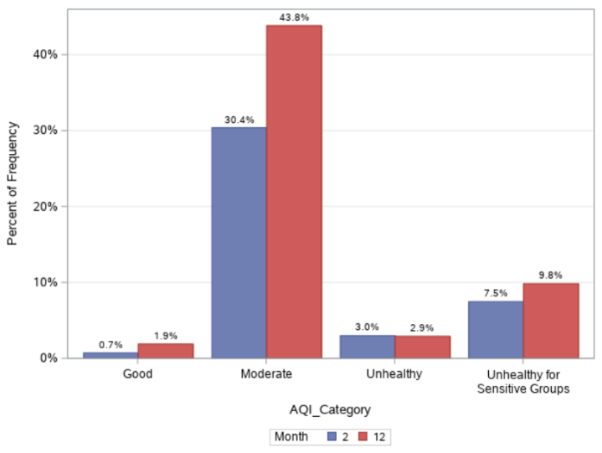
February 2021 vs December 2020 Air Quality
AQI category distribution
Similar distribution
Majorly the air quality lies between moderate and Unhealthy for sensitive group category.

Slide 4
February 2021 vs December 2020 Air Quality
Conclusion
February 2021 had only slightly higher levels of air pollution than in December 2020.
One might expect to see significantly higher levels in February due to:
before and during Tet festival, city usually experiences high levels of travel, tourism, and the use of fireworks and firecrackers. However, due to the COVID-19 pandemic, these activities were largely curtailed in 2021, reducing the potential impact they have on air pollution levels.

Slide 5
Recommendations
Providing advance notice to people about worsening air quality, which is difficult to predict for a day so rather predict based on weather patterns, including precipitation, wind speed, humidity, and temperature to provide advisories to people, to avoid any strenuous activities especially those more susceptible to the health impacts of air pollution. This would also enable the government to put in temporary measures to reduce activities that generate pollution, such as demolitions of old buildings or reducing traffic congestion at such times.
Government can also take temporary measures to suspend construction-related work, requiring work places stagger start and end times, or prohibiting certain types of traffic at specific times of the for better air quality.

