Slide 1
Fake News Classification
-Ankita Singh (A20491911)
-Anjali Shukla (A20497656)

Slide 2
Discussion Topics
Problem Statement
Data Preprocessing
Models
Representation of Results
References

Slide 3
Problem Statement
Social media has become a substantial avenue for individuals to acquire news and information.
The utilization of social media has progressively become more widespread for people searching for news and information.
Currently, a large number of individuals depend on social media as their primary source of obtaining news and information.
In our project, we will use a classification model to sort news articles into categories like real or fake( unrelated, agreed, disagreed)
There are a total of 256,422 training pairs provided and 64,110 testing pairs.

Slide 4
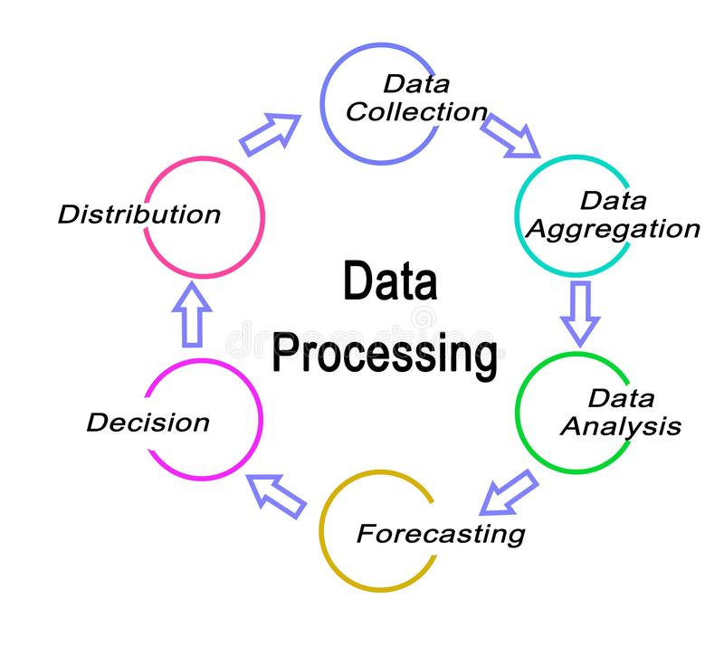
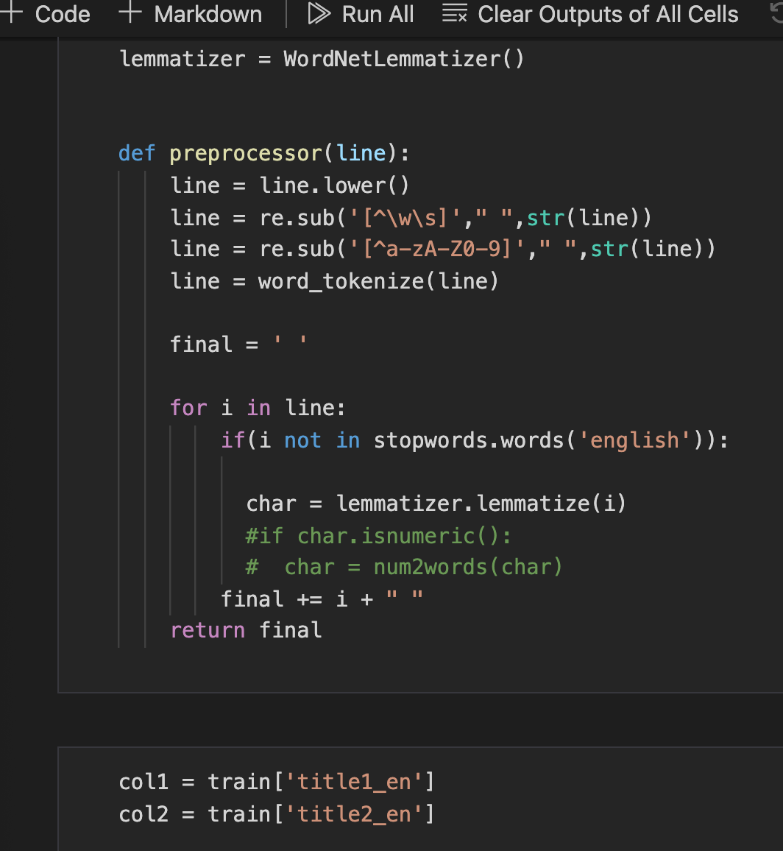
Data Processing
The process of preparing data involves several steps. First, we need to remove stop words and punctuation from the data. To do this, we create a list of stop words and punctuation using the stopword package of nltk.corpus for the English language. Once we have this list, we can remove these words and characters from the data.
Next, we tokenize and stem the data using the WhitespaceTokenizer and PorterStemmer from the nltk library. This helps us to break the text into individual words and reduce them to their base form, respectively.
Finally, we lemmatize the data using the WordNetLemmatizer, which helps us to reduce words to their base form based on their part of speech. We then remove the title1_id and title2_id from the data and store the remaining preprocessed data in two separate files, train_preprocessed.csv and test_preprocessed.csv.

Slide 5
Natural Language processing
NLP (Natural Language Processing) is required to parse the titles of the articles to extract meaningful information and analyze them for fake news detection.
Python's Natural Language Toolkit (NLTK) is a popular library used for NLP tasks, such as tokenization, stemming, and stop word removal.
Extensive preprocessing : It’s required to prepare the text data for analysis, which includes removing special characters, lowercasing the text, and removing stop words.
Stop words are common words such as "a", "an", "the", "and", etc., which do not add much meaning to the text and can be safely removed without affecting the overall meaning of the text.
Stemming : A process of reducing words to their base or root form by removing prefixes and suffixes. This helps to reduce the number of unique words in the text and improve the accuracy of the analysis.

Slide 6
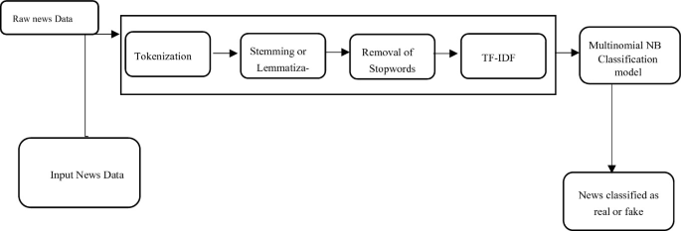
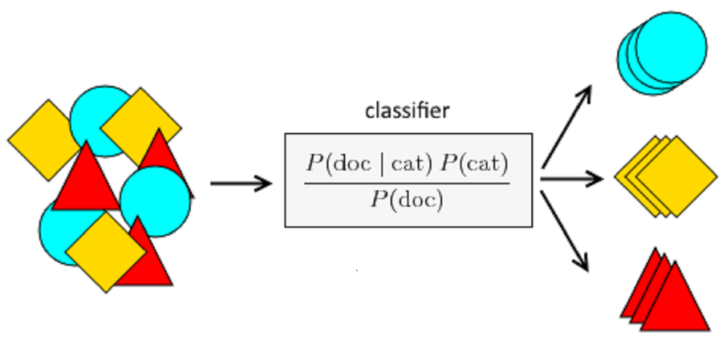
Why Naive Bayes Classifier ?
Efficient and Fast: Naive Bayes is a simple and efficient algorithm, which means it can quickly classify news articles as either real or fake, even with large datasets.
Effective with Text Data: Naive Bayes works well with text data because it is based on the probability of words appearing together in a document. This makes it effective in identifying patterns in news articles that may indicate whether it is real or fake.
Handles Missing Data: Another advantage of Naive Bayes is that it can handle missing data well, which is common in text data. It can still make accurate predictions even if some of the words are missing from an article.
Scalable: Naive Bayes is also scalable, which means it can handle a large number of features and can be easily trained on large datasets.

Slide 7
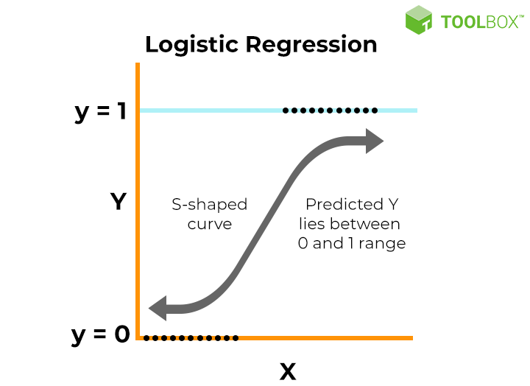
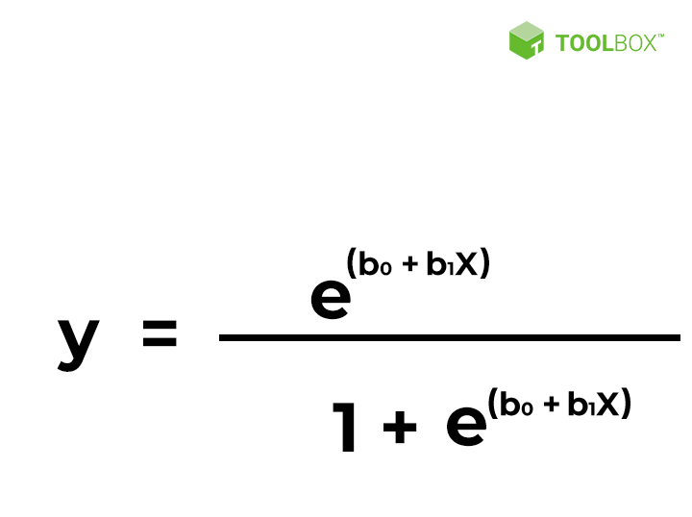
Why Logistic Regression?
Logistic regression is used as a second model after Naive Bayes to improve the accuracy of the prediction.
The trained data and the labels are passed to the logistic regression model using the fit method, and the score method is used to calculate the accuracy of the model.
Logistic regression is a powerful algorithm that can handle a large number of input features and provides a clear understanding of the relationship between the input features and the output variable.
Most often used for categorical labels.
Very fast to implement and train.
Assumes linearity between the dependent and independent variables.

Slide 8
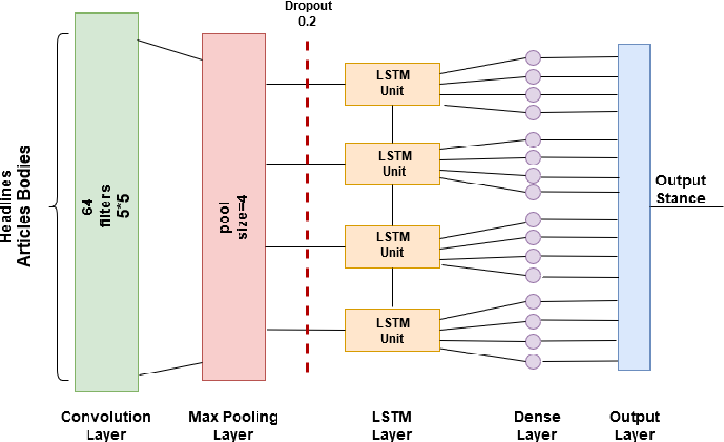
Why LSTM?
Ability to model context: LSTMs can capture long-term dependencies in the input data, which is important for understanding the context of the text. For example, a word in the beginning of the article can have an impact on the meaning of a word at the end of the article.
Flexibility in input length: Unlike traditional machine learning algorithms, LSTMs can handle variable length inputs, which is important for working with natural language text, where the length of the input can vary greatly.
Feature extraction: LSTMs can extract features automatically from the input data, which can be particularly useful when dealing with text data that has a high dimensionality.
Generalization: LSTMs can generalize well to unseen data, which is important for fake news detection, as new fake news stories can be created constantly.
Performance: In many cases, LSTMs have been shown to outperform other models on a variety of natural language processing tasks, including sentiment analysis and text classification.

Slide 9
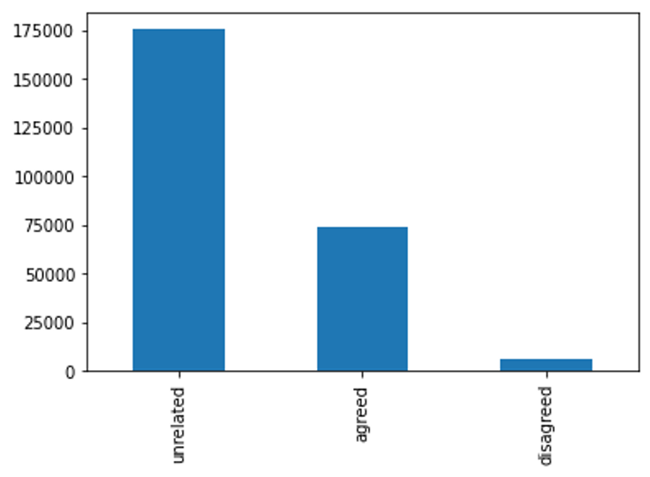
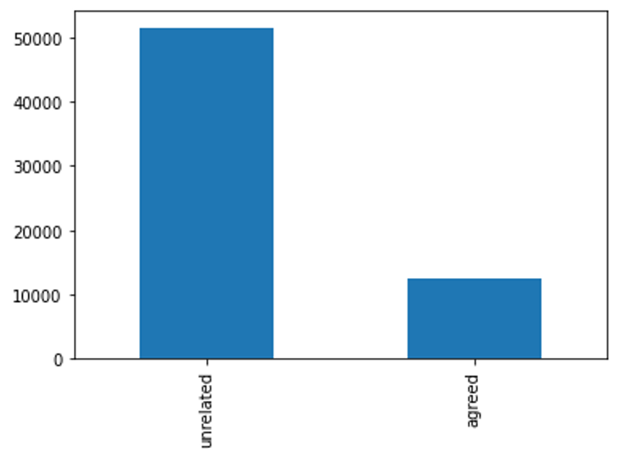
Representation: Training Data and Submission Data
Training Data : Total number of training datasets that are trained under Unrelated, Agreed and Disagreed.
Submission Data : After processing the data, here is the result that obtained using the datasets.

Slide 10
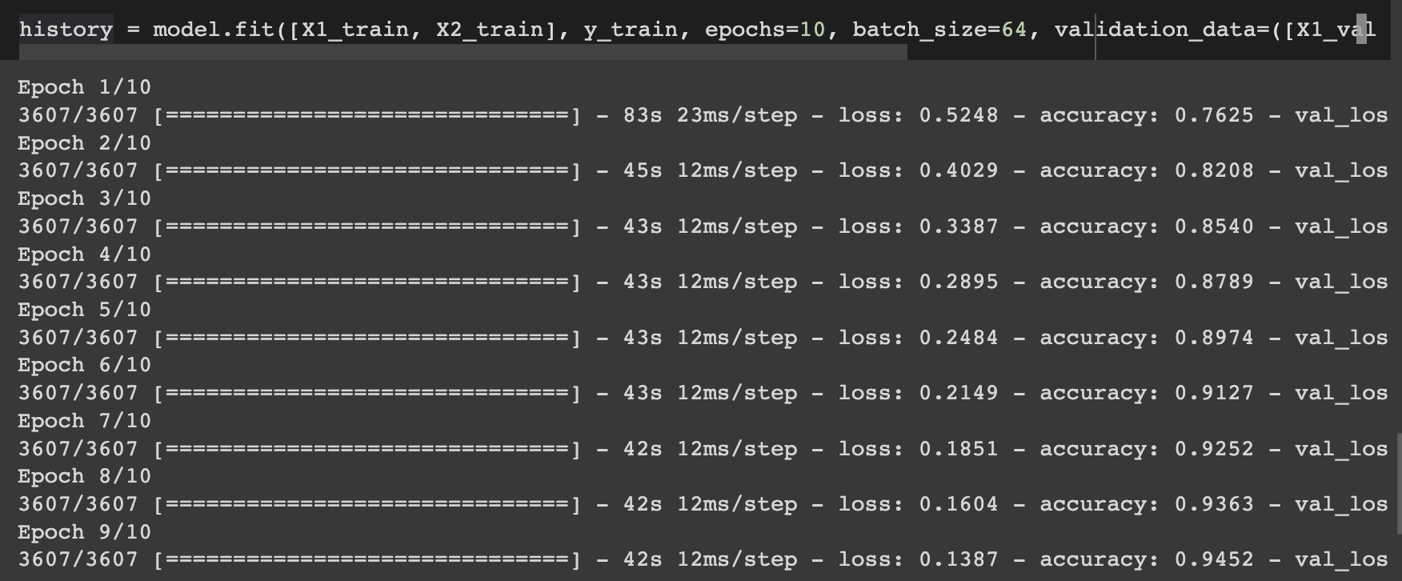
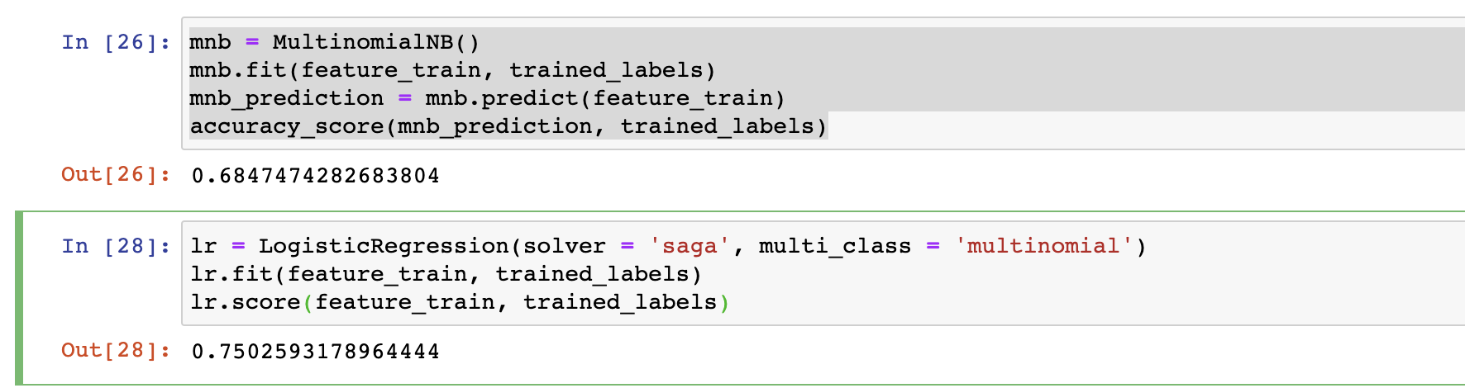
Results using base and other models
Naïve Bayes classifier: 68% accuracy.
Logistic Regression classifier: 75% accuracy.
LSTM : 94%
LSTM was used to perform predictions on the testing dataset as its training accuracy was higher.

Slide 11
References
Brownlee, J. (2016, April 1). Logisitc Regression for Machine Learning. Machine Learning Mastery. Retrieved from: https://machinelearningmastery.com/logistic-regression-for-machine-learning/.
Kumari, K. (2021, July 19). Detecting Fake News with Natural Language Processing. Analytics Vidhya.
Jurafsky, D. & Martin, J. (2021, December 29). Speech and Language Processing, 3rd edition. Retrieved from: https://web.stanford.edu/~jurafsky/slp3/.
Menczer, F., & Hills, T. (2020, December 1). Information Overload Helps Fake News Spread, and Social Media Knows It. Scientific American.
NLTK Project. (2022, Feb 09). Documentation. https://www.nltk.org.
Shukla, P., & Iriondo, R. (2020, July 22). Natural Language Procesasing (NLP) with Python. Towards AI.

Slide 12
THANK YOU

