Slide 1



InboundCalls
InboundCalls.XML
OutboundCalls
OutboundCalls.XML

Slide 2

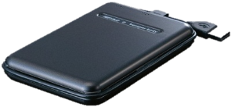
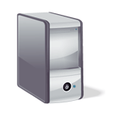


HCP-DM via REST
Tool Log DB
Web Access
Scan files (NFS)
Search for Calls
Virtual or Physical Machine
Add Custom Metadata
(REST)
Tool Log File
COMET Tool
Web Access
Perform Audit
Search and Remove Driver Files

