Slide 1
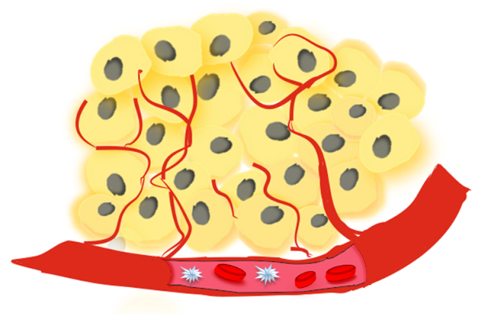

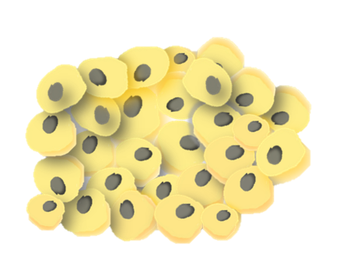


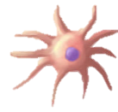



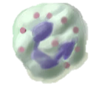
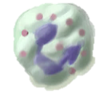
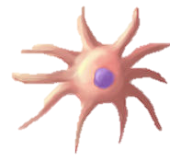



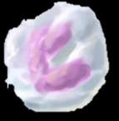


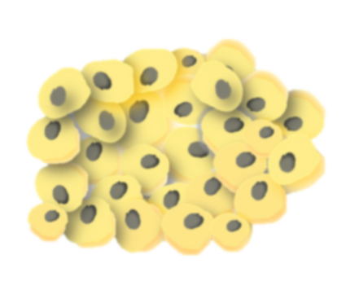








Cyclooxygenase-Dependent Tumor Growth through Evasion of Immunity
COX-2 driven cancer-promoting
inflammation
Cancer-inhibitory inflammation
PGE₂
PGE₂
IL-6,
CXCL1
G-CSF
IFNs
Immune
infiltrate
Immune
infiltrate
TUMOR GROWTH
T-CELLS DEPENDENT CONTROL
AND TUMOR DESTRUCTION
B. Pucelik, L.G. Arnaut, J. M. Dabrowski J. Clin. Med. 2020

Slide 2
This work is supported by the National Science Centre grant
no 2020/37/B/NZ7/04157 given to JMD
Photodynamic therapy combined with PD-1/PD-L1 blockade immunotherapy: new possibilities for the treatment of immunogenic cancers
Notes:
2
2

