Slide 1
https://getakka.net
Adrian

Slide 2
ACTOR – fundamental unit
All communication is done via message passing
All messages are immutable
Sender and Recipient are decoupled, asynchronous

Slide 3
ACTOR – fundamental unit
All communication is done via message passing
All messages are immutable
Sender and Recipient are decoupled, asynchronous

Slide 4
ACTOR – can
Process messages
Create other actors (children)
Contain private state

Slide 5
ACTOR – promise
One message processed at a time
Message processed in FIFO order
Messages are immutable, state as well

Slide 6
Actor model is used to build multithreaded apps
No sync
No locks
Smash complex problem into small actors that are doing simple operation

Slide 7
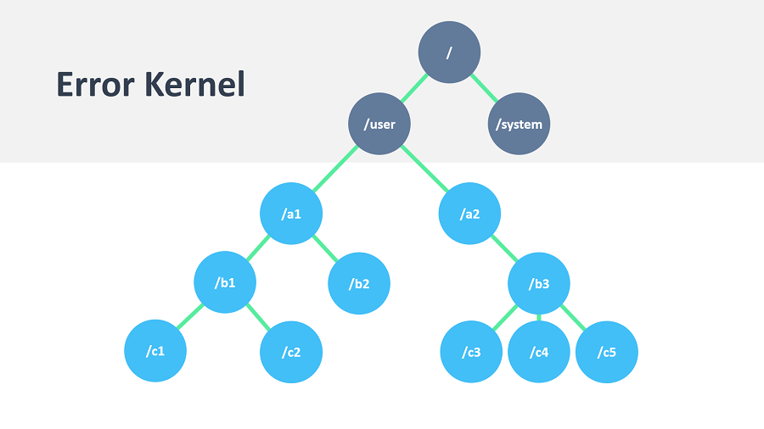

Slide 8
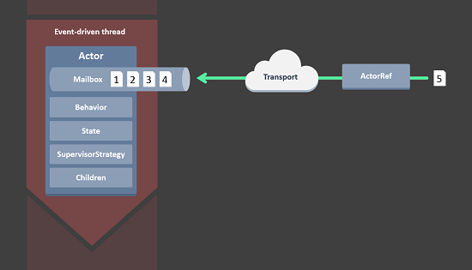
FLOW

Slide 9
Supervisor Strategy
strategy for handling faults of its children
describes a dependency relationship between actors

Slide 10
Strategies
Resume the subordinate, keeping its accumulated internal state
Restart the subordinate, clearing out its accumulated internal state
Stop the subordinate permanently
Escalate the failure to the next parent in the hierarchy, thereby failing itself

Slide 11
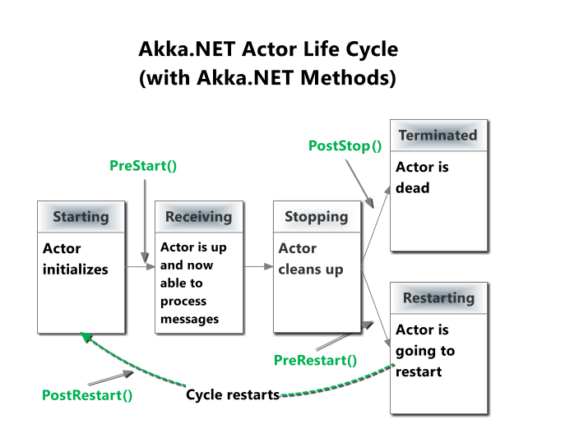

Slide 12
Actor Path
actors are created in a strictly hierarchical fashion
actor names given by recursively following the supervision links between child and parent down towards the root of the actor system
Context.ActorSelection("/user/serviceA/actor");

Slide 13
"akka://my-sys/user/service-a/worker1" // purely local
"akka.tcp://my-sys@host.example.com:5678/user/service-b"
// remote

Slide 14
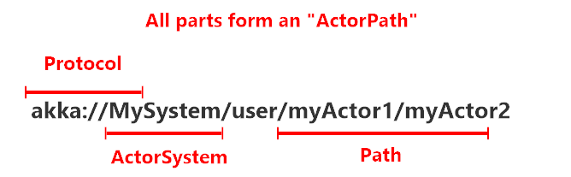
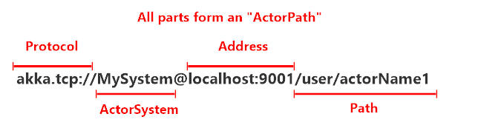

Slide 15
Distributed by Default
Akka.NET is designed to work in a distributed setting
all functions are available equally when running within a single machine or on a cluster of hundreds of machines

Slide 16
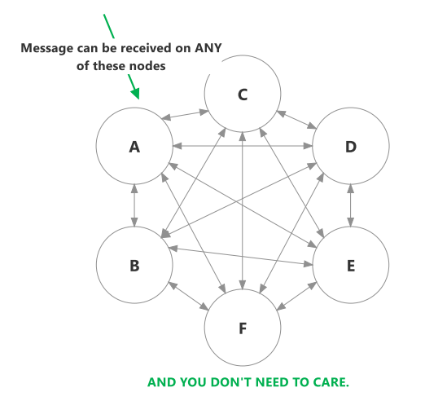
Cluster
Peer 2 Peer
Nodes discover
Remove dead nodes

