Slide 1
Relational Database Design
Dr. k. m. azharul hasan
Dept. of cse, kuet

Slide 2
Pitfalls in Relational Database Design
Relational database design requires to find
a “good” collection of relation schemas.
A bad design may lead to
repetition of information.
inability to represent certain or all information.
Design Goals:
avoid redundant data
ensure that relationships among attributes
facilitate the checking of updates for violation of database integrity constraints.

Slide 3
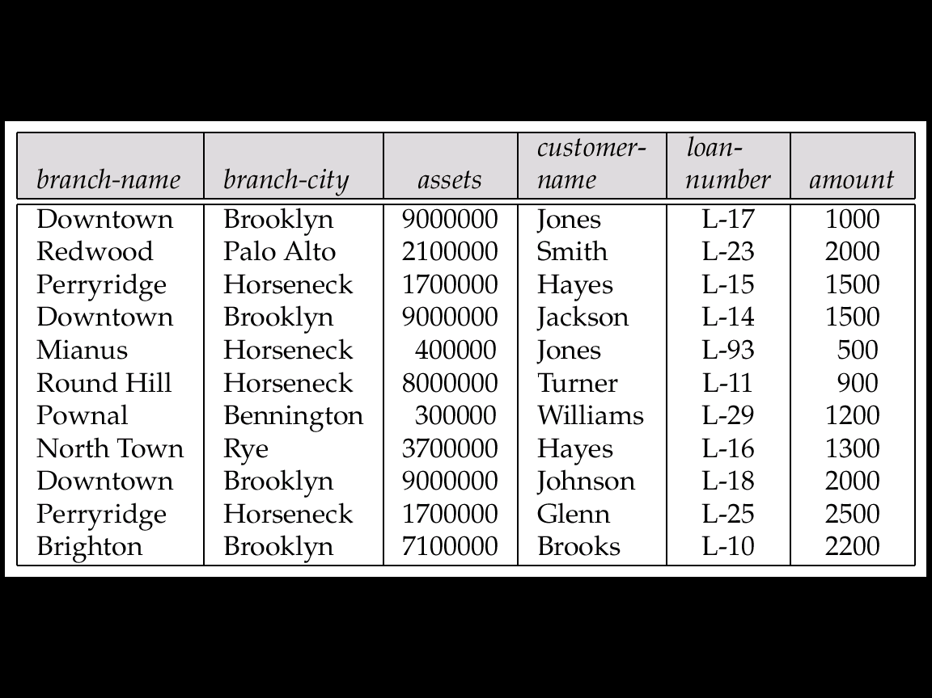
Pitfall Example
Consider the relation schema Lending-schema = (branch-name, branch-city, assets, customer-name, loan-number, amount)
Redundancy:
Data for branch-name, branch-city, assets are repeated for each loan that a branch makes
Wastes space
Complicates updating, introducing possibility of inconsistency of assets value as many rows to update
Null values
Cannot store information about a branch if no loans exist
Can use null values, but they are difficult to handle.

Slide 4
Decomposition
The only way to avoid the repetition-of-information problem is
to decompose it into two schemas.
Not all decompositions are good.
Suppose we decompose
employee(ID, name, street, city, salary)
into
employee1 (ID, name)
employee2 (name, street, city, salary)
The problem arises when we have two employees with the same name

Slide 5
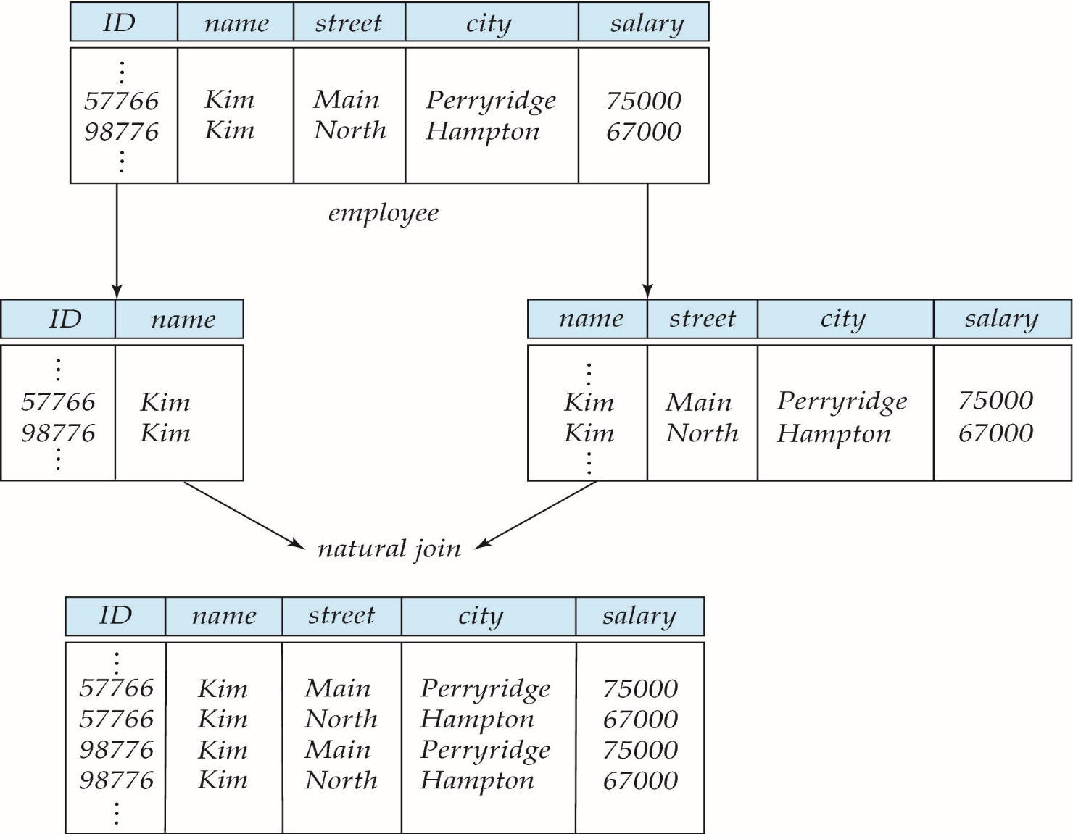
A Lossy Decomposition

Slide 6
Lossless Decomposition
Let R be a relation schema and let R₁ and R₂ form a decomposition of R . That is R = R₁ ∪R₂
We say that the decomposition is a lossless decomposition if there is no loss of information by replacing R with the two relation schemas R₁ ∪R₂
Formally,
∏ _{R1}(r) ∏ _{R2}(r) = r
And, conversely a decomposition is lossy if we get a superset of r
r ⊂ ∏ _{R1} (r) ∏ _{R2} (r)

Slide 7
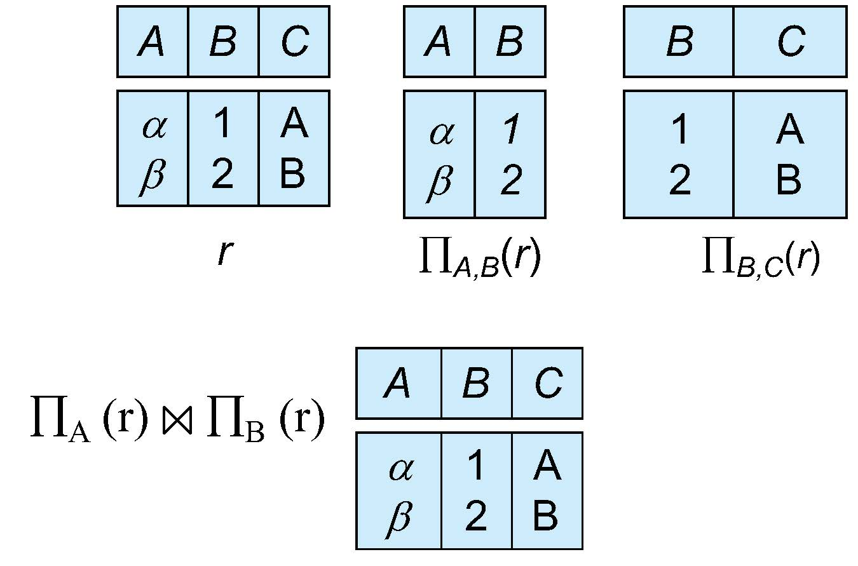
Example of Lossless Decomposition
Decomposition of R = (A, B, C) R₁ = (A, B) R₂ = (B, C)

Slide 8
Normalization Theory
Decide whether a particular relation R is in “good” form.
In the case that a relation R is not in “good” form, decompose it into set of relations {R₁, R₂, ..., R_{n}} such that
Each relation is in good form
The decomposition is a lossless decomposition
The theory is based on:
Functional dependencies
Multivalued dependencies
Redundancy is minimized : avoids storing the same data in multiple places.
Data anomalies are prevented : reduces problems during insert, update, or delete operations.
Data integrity is ensured : keeps data consistent and accurate.
Database normalization is a process of organizing data in a relational database to reduce redundancy and improve data integrity.

Slide 9
Importance
If a database is not normalized, it may suffer from
Insertion anomalies
can’t insert data without other unnecessary data
Update anomalies
same data updated in multiple places → inconsistency
Deletion anomalies
deleting one record unintentionally removes important related data.

Slide 10
First Normal Form
Domain is atomic if its elements are considered to be indivisible units
attribute would not be able to hold various values-
it will only be able to hold an attribute of a single value.
Examples of non-atomic domains:
Set of names, composite attributes
Identification numbers like CSE1101 that can be broken up into parts
A relational schema R is in first normal form if the domains of all attributes of R are atomic
Non-atomic values complicate storage and encourage redundant storage of data
Composite attribute address makes non atomic, children (if name is entered) in employee relation non atomic.

Slide 11
First Normal Form
StudentID | StudentName | Course Description
101 | Ali | DBMS - Dr. Rahman (12345), AI - Dr. Khan (67890)
102 | Riya | AI - Dr. Khan (67890), Networking - Dr. Das (11111)
Multiple values in one column (Course Description)
Redundant instructor info (Dr. Khan appears multiple times).
StudentID | StudentName | Course | Instructor | InstructorPhone
101 | Ali | DBMS | Dr. Rahman | 12345
101 | Ali | AI | Dr. Khan | 67890
102 | Riya | AI | Dr. Khan | 67890
102 | Riya | Networking | Dr. Das | 11111
Atomic values but still redundancy

Slide 12
Functional Dependencies
Constraints on the set of legal relations.
The value for a certain set of attributes determines uniquely the value for another set of attributes.
Students and instructors are uniquely identified by their ID.
Each student and instructor has only one name.
Each instructor and student is (primarily) associated with only one department.
An instance of a relation that satisfies all such real-world constraints is called a legal instance of the relation;
A legal instance of a database is one where all the relation instances are legal instances
Require that the value for a certain set of attributes determines uniquely the value for another set of attributes.
Functional dependency (FD) describes the relationship between two sets of attributes in a table.

Slide 13
Functional Dependencies (Cont.)
Let R be a relation schema
α ⊆ R and β ⊆ R
The functional dependency
α → β holds on R if and only if for any legal relations r(R), whenever any two tuples t₁ and t₂ of r agree on the attributes α, they also agree on the attributes β. That is,
t₁[α] = t₂ [α] ⇒ t₁[β ] = t₂ [β ]
For a super key K, if t₁[K] = t₂ [K] it indicates t₁[R ] = t₂ [R ] (i.e t₁=t₂)
A functional dependency is a generalization of the notion of a super key.

Slide 14
Functional Dependencies (Cont.)
Example: Consider r( A, B ) with the following instance of r.
A B
On this instance, A → B does NOT hold, but B → A does hold.
4
1 5
3 7
A functional dependency X → Y means that if two rows have the same value for attribute X, then they must also have the same value for attribute Y.
FD implies
“This column (or group of columns) uniquely determines another column (or group of columns)”

Slide 15
Functional Dependencies (Cont.)
Importance
Foundation of database normalization
Help us decide how to split tables into smaller relations
Prevent data redundancy and update anomalies.
FDs tell us the hidden rules in the data
2NF removes partial dependency FDs.
3NF removes transitive dependency FDs.
BCNF ensures all determinants are candidate keys.
Without functional dependencies, normalization rules wouldn’t exist.

Slide 16
Keys and Functional Dependencies(Cont.)
K is a super key for relation schema R if and only if K → R
K is a candidate key for R if and only if
K → R, and
For no α ⊂ K, α → R
Functional dependencies allow us to express constraints that cannot be expressed using superkeys. Consider the schema:
in_dep (ID, name, salary, dept_name, building, budget ).
We expect these functional dependencies to hold:
dept_name→ building
ID → building
but would not expect the following to hold
dept_name → salary

Slide 17
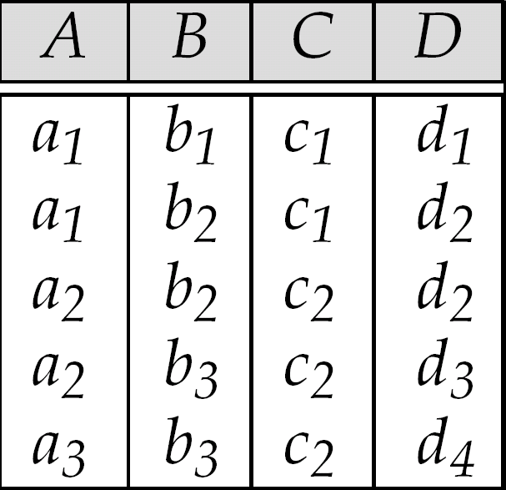
Functional Dependencies (Cont.)
A->C ??
How about C->A ???
AB->D ??
Find all the FDs!!! F⁺
Home task

Slide 18
Use of Functional Dependencies
We use functional dependencies to
test relations to see if they are legal under a given set of functional dependencies.
If a relation r is legal under a set F of functional dependencies, we say that r satisfies F.
specify constraints on the set of legal relations
We say that F holds on R if all legal relations on R satisfy the set of functional dependencies F.

Slide 19
Functional Dependencies (Cont.)
A functional dependency is trivial if it is satisfied by all instances of a relation
Example:
customer_name, loan_number → customer_name
customer_name → customer_name
In general, α → β is trivial if β ⊆ α

Slide 20
Closure of a Set of Functional Dependencies
Given a set F of functional dependencies, there are other functional dependencies that are logically implied by F.
Example: If A → B and B → C, then we can derive that A → C
The set of all functional dependencies logically implied by F is the closure of F.
We denote the closure of F by F⁺.
F⁺ is a superset of F.

Slide 21
Closure of a Set of Functional Dependencies
We can find all of F⁺ by applying Armstrong’s Axioms:
if β ⊆ α, then α → β (reflexivity)
if α → β, then γ α → γ β (augmentation)
if α → β, and β → γ, then α → γ (transitivity)
These rules are
sound (generate only functional dependencies that actually hold) and
complete (generate all functional dependencies that hold).

Slide 22
Example
R = (A, B, C, G, H, I) F = { A → B A → C CG → H CG → I B → H}
some members of F⁺
A → H
by transitivity from A → B and B → H
AG → I
by augmenting A → C with G, to get AG → CG and then transitivity with CG → I
CG → HI
by augmenting CG → I to infer CG → CGI,
and augmenting of CG → H to infer CGI → HI,
and then transitivity

Slide 23
Procedure for Computing F⁺
To compute the closure of a set of functional dependencies F
F ⁺ = F repeat for each functional dependency f in F⁺ apply reflexivity and augmentation rules on f add the resulting functional dependencies to F ⁺ for each pair of functional dependencies f₁ and f₂ in F ⁺ if f₁ and f₂ can be combined using transitivity then add the resulting functional dependency to F ⁺ until F ⁺ does not change any further

Slide 24
Closure of Functional Dependencies (Cont.)
We can further simplify manual computation of F⁺ by using the following additional rules.
If α → β holds and α → γ holds, then α → β γ holds (union)
If α → β γ holds, then α → β holds and α → γ holds (decomposition)
If α → β holds and γ β → δ holds, then α γ → δ holds (pseudotransitivity)
The above rules can be inferred from Armstrong’s axioms.

Slide 25
Closure of Attribute Sets
Given a set of attributes α, define the closure of α under F (denoted by α⁺) as the set of attributes that are functionally determined by α under F
Algorithm to compute α⁺, the closure of α under F
result := α; while (changes to result) do for each β → γ in F do begin if β ⊆ result then result := result ∪ γ end

Slide 26
Example of Attribute Set Closure
R = (A, B, C, G, H, I)
F = {A → B A → C CG → H CG → I B → H}
(AG)⁺
1. result = AG
2. result = ABCG (A → C and A → B)
3. result = ABCGH (CG → H and CG ⊆ AGBC)
4. result = ABCGHI (CG → I and CG ⊆ AGBCH)

Slide 27
Uses of Attribute Closure
There are several uses of the attribute closure algorithm:
Testing for superkey:
To test if α is a superkey, we compute α^{+,} and check if α⁺ contains all attributes of R.
Testing functional dependencies
To check if a functional dependency α → β holds (or, in other words, is in F⁺), just check if β ⊆ α⁺.
That is, we compute α⁺ by using attribute closure, and then check if it contains β.
Is a simple and cheap test, and very useful
Computing closure of F
For each γ ⊆ R, we find the closure γ⁺, and for each S ⊆ γ⁺, we output a functional dependency γ → S.

Slide 28
Canonical Cover
Set of functional dependencies may have redundant dependencies that can be inferred from the others
For example: A → C is redundant in: {A → B, B → C}
Parts of a functional dependency may be redundant
E.g.: on RHS: {A → B, B → C, A → CD} can be simplified to {A → B, B → C, A → D}
E.g.: on LHS: {A → B, B → C, AC → D} can be simplified to {A → B, B → C, A → D}
Intuitively, a canonical cover of F is a “minimal” set of functional dependencies equivalent to F, having no redundant dependencies or redundant parts of dependencies

Slide 29
Extraneous Attributes
Consider a set F of functional dependencies and the functional dependency α → β in F.
Attribute A is extraneous in α if A ∈ α and F logically implies (F – {α → β}) ∪ {(α – A) → β}.
Attribute A is extraneous in β if A ∈ β and the set of functional dependencies (F – {α → β}) ∪ {α →(β – A)} logically implies F.
Example: Given F = {A → C, AB → C }
B is extraneous in AB → C because {A → C, AB → C} logically implies A → C (i.e. the result of dropping B from AB → C).
Example: Given F = {A → C, AB → CD}
C is extraneous in AB → CD since AB → C can be inferred even after deleting C

Slide 30
Testing if an Attribute is Extraneous
Consider a set F of functional dependencies and the functional dependency α → β in F.
To test if attribute A ∈ α is extraneous in α
compute ({α} – A)⁺ using the dependencies in F
check that ({α} – A)⁺ contains β; if it does, A is extraneous in α
To test if attribute A ∈ β is extraneous in β
compute α⁺ using only the dependencies in F′ = (F – {α → β}) ∪ {α →(β – A)},
check if α⁺ contains A; if it does, A is extraneous in β

Slide 31
Canonical Cover
A canonical cover for F is a set of dependencies F_{c} such that
F logically implies all dependencies in F_{c,} and
F_{c} logically implies all dependencies in F, and
No functional dependency in F_{c} contains an extraneous attribute, and
Each left side of functional dependency in F_{c} is unique.
Every FD in the canonical cover is needed, otherwise some dependencies are lost

Slide 32
Computing a Canonical Cover
R = (A, B, C) F = {A → BC B → C A → B AB → C}
Combine A → BC and A → B into A → BC
Set is now {A → BC, B → C, AB → C}
A is extraneous in AB → C
Check if the result of deleting A from AB → C is implied by the other dependencies
Yes: in fact, B → C is already present!
Set is now {A → BC, B → C}
C is extraneous in A → BC
Check if A → C is logically implied by A → B and the other dependencies
Yes: using transitivity on A → B and B → C.
Can use attribute closure of A in more complex cases
The canonical cover is: A → B B → C

Slide 33
Goals of Normalization
Let R be a relation scheme with a set F of functional dependencies.
Decide whether a relation scheme R is in “good” form.
In the case that a relation scheme R is not in “good” form, decompose it into a set of relation scheme {R₁, R₂, ..., R_{n}} such that
each relation scheme is in good form
the decomposition is a lossless-join decomposition
preferably, the decomposition should be dependency preserving.

Slide 34
Boyce-Codd Normal Form
A relation schema R is in BCNF with respect to a set F of functional dependencies if for all functional dependencies in F⁺ of the form
α → β
where α ⊆ R and β ⊆ R, at least one of the following holds:
α  → β is trivial (i.e., β ⊆ α)
α is a super key for R

Slide 35
Boyce-Codd Normal Form (Cont.)
Example schema that is not in BCNF:
in_dep (ID, name, salary, dept_name, building, budget )
because :
dept_name→ building, budget
holds on in_dep
but
dept_name is not a superkey
When decompose in_dept into instructor and department
instructor is in BCNF
department is in BCNF

Slide 36
Decomposing a Schema into BCNF
Let R be a schema that is not in BCNF.
Let α →β be the FD that causes a violation of BCNF.
We decompose R into:
(α U β )
( R - ( β - α ) )
In our example of in_dep,
α = dept_name
β = building, budget
and in_dep is replaced by
(α U β ) = ( dept_name, building, budget )
( R - ( β - α ) ) = ( ID, name, dept_name, salary )

Slide 37
BCNF and Dependency Preservation
It is not always possible to achieve both BCNF and dependency preservation
Consider a schema:
dept_advisor(s_ID, i_ID, department_name)
With function dependencies:
i_ID → dept_name
s_ID, dept_name → i_ID
dept_advisor is not in BCNF
i_ID is not a superkey.
Any decomposition of dept_advisor will not include all the attributes in
s_ID, dept_name → i_ID
Thus, the composition is NOT be dependency preserving
Ex. (s_ID, i_ID) & (i_ID, dept_name) does not preserve s_ID, dept_name → i_ID

Slide 38
Lossless-join Decomposition
For the case of R = (R₁, R₂), we require that for all possible relations r on schema R
r = ∏_{R1} (r ) ∏_{R2} (r )
A decomposition of R into R₁ and R₂ is lossless join if and only if at least one of the following dependencies holds is in F⁺:
R₁ ∩ R₂ → R₁
R₁ ∩ R₂ → R₂

Slide 39
Example
R = (A, B, C) F = {A → B, B → C)
Can be decomposed in two different ways
R₁ = (A, B), R₂ = (B, C)
Lossless-join decomposition:
R₁ ∩ R₂ = {B} and B → BC
R₁ = (A, B), R₂ = (A, C)
Lossless-join decomposition:
R₁ ∩ R₂ = {A} and A → AB
Not dependency preserving (cannot check B → C without computing R₁ R₂)

Slide 40
Dependency Preservation
Let F_{i} be the set of dependencies F ⁺ that include only attributes in R_{i}
A decomposition is dependency preserving, if
(F₁ ∪ F₂ ∪ … ∪ F_{n} )⁺ = F ⁺
If it is not, then checking updates for violation of functional dependencies
require computing joins, which is expensive.

Slide 41
Testing for Dependency Preservation
To check if a dependency α → β is preserved in a decomposition of R into R₁, R₂, …, R_{n} we apply the following test
result = α while (changes to result) do for each R_{i} in the decomposition t = (result ∩ R_{i})⁺ ∩ R_{i} result = result ∪ t
If result contains all attributes in β, then the functional dependency α → β is preserved.
We apply the test on all dependencies in F to check if a decomposition is dependency preserving

Slide 42
Example
R = (A, B, C ) F = {A → B B → C} Key = {A}
R is not in BCNF
Decomposition R₁ = (A, B), R₂ = (B, C)
R₁ and R₂ in BCNF
Lossless-join decomposition
Dependency preserving

Slide 43
Testing for BCNF
To check if a non-trivial dependency α →β causes a violation of BCNF
1. compute α⁺ (the attribute closure of α), and
verify that it includes all attributes of R, that is, it is a superkey of R.
Simplified test: To check if a relation schema R is in BCNF, it suffices to check only the dependencies in the given set F for violation of BCNF, rather than checking all dependencies in F⁺.
If none of the dependencies in F causes a violation of BCNF, then none of the dependencies in F⁺ will cause a violation of BCNF either.

Slide 44
Example of BCNF Decomposition
R = (A, B, C ) F = {A → B B → C} Key = {A}
R is not in BCNF (B → C but B is not superkey)
Decomposition
R₁ = (B, C)
R₂ = (A,B)

Slide 45
Example of BCNF Decomposition
Original relation R and functional dependency F
R = (branch_name, branch_city, assets,
customer_name, loan_number, amount )
F = {branch_name → assets branch_city
loan_number → amount branch_name }
Key = {loan_number, customer_name}
Decomposition
R₁ = (branch_name, branch_city, assets )
R₂ = (branch_name, customer_name, loan_number, amount )
R₃ = (branch_name, loan_number, amount )
R₄ = (customer_name, loan_number )
Final decomposition R₁, R₃, R₄
Test for BCNF .. Home task

Slide 46
BCNF and Dependency Preservation
It is not always possible to get a BCNF decomposition that is dependency preserving
R = (J, K, L ) F = {JK → L L → K } Two candidate keys = JK and JL
R is not in BCNF
Any decomposition of R will fail to preserve
JK → L

Slide 47
Third Normal Form: Motivation
Because it is not always possible to achieve both BCNF and dependency preservation, we consider a weaker normal form, known as third normal form.
There are some situations where
BCNF is not dependency preserving, and
Efficient checking for FD violation on updates is important

Slide 48
Third Normal Form
Solution: define a weaker normal form, called Third Normal Form (3NF)
Allows some redundancy
But functional dependencies can be checked on individual relations without computing a join.
There is always a lossless-join, dependency-preserving decomposition into 3NF.

Slide 49
Third Normal Form
A relation schema R is in third normal form (3NF) if for all:
α → β in F⁺ at least one of the following holds:
α → β is trivial (i.e., β ∈ α)
α is a super key for R
Each attribute A in β – α is contained in a candidate key for R.
Each attribute may be in a different candidate key
If a relation is in BCNF it is in 3NF (since in BCNF one of the first two conditions above must hold).
Third condition is a minimal relaxation of BCNF to ensure dependency preservation .

Slide 50
3NF Example
Relation R:
R = (J, K, L ) F = {JK → L, L → K }
Two candidate keys: JK and JL
R is in 3NF
JK → L JK is a superkey L → K K is contained in a candidate key

Slide 51
Comparison of BCNF and 3NF
It is always possible to decompose a relation into a set of relations that are in 3NF such that:
the decomposition is lossless
the dependencies are preserved
It is always possible to decompose a relation into a set of relations that are in BCNF such that:
the decomposition is lossless
it may not be possible to preserve dependencies.

Slide 52
Design Goals
Goal for a relational database design is:
BCNF.
Lossless join.
Dependency preservation.
If we cannot achieve this, we accept one of
Lack of dependency preservation
Redundancy due to use of 3NF

Slide 53
Normalization performance
A store has 20 buyers, 50 products and 100 companies?
20 x 50 x 100 = 1,00,000 total records,
if only one table

Slide 54
The Normalization Solution
Buyers
*Buyer | *Product
Chris | Jeans
Chris | Shirts
Lori | Jeans
Products
Companies
*Product | *Company
Jeans | Wrangler
Jeans | Levi
Shirts | Levi
*Buyer | *Company
Chris | Wrangler
Chris | Levi
Lori | Levi

Slide 55
Normalization performance
If our company has 20 buyers, 50 products and 100 companies?
Buyers = 20 x 50 = 1000
Products = 50 x 100 = 5000
Companies = 20 x 100 = 2000
8,000 total records instead of 100,000!

Slide 56
Normalization
Unnormalized Relations
First normal form
Second normal form
Third normal form
Boyce-
Codd and
Higher

Slide 57
Multivalued Dependencies (MVDs)
A multivalued dependency is a constraint between two sets of attributes in a relation.
Let R be a relation schema and let α ⊆ R and β ⊆ R. The multivalued dependency
α →→ β
holds on R if in any legal relation r(R), for all pairs for tuples t₁ and t₂ in r such that t₁[α] = t₂ [α], there exist tuples t₃ and t₄ in r such that:
t₁[α] = t₂ [α] = t₃ [α] = t₄ [α] t₃[β] = t₁ [β] t₄ [β] = t₂[β]
t₃[R – β] = t₂[R – β] t₄[R – β] = t₁[R – β]

Slide 58
Example
Let R be a relation schema with a set of attributes that are partitioned into 3 nonempty subsets.
Y, Z, W
We say that Y →→ Z (Y multidetermines Z ) if and only if for all possible relations r (R )
< y₁, z₁, w₁ > ∈ r and < y₁, z₂, w₂ > ∈ r
then
< y₁, z₁, w₂ > ∈ r and < y₁, z₂, w₁ > ∈ r

Slide 59
Example (Cont.)
course →→ teacher course →→ book
The above formal definition is supposed to formalize the notion that is given a particular value of course it has associated with it a set of teacher and a set of books, and these two sets are in some sense independent of each other.

Slide 60
Theory of MVDs
From the definition of multivalued dependency, we can derive the following rule:
If α → β, then α →→ β
That is, every functional dependency is also a multivalued dependency
The closure D⁺ of D is the set of all functional and multivalued dependencies logically implied by D.
We can compute D⁺ from D, using the formal definitions of functional dependencies and multivalued dependencies.

Slide 61
Fourth Normal Form
A relation schema R is in 4NF with respect to a set D of functional and multivalued dependencies if for all multivalued dependencies in D⁺ of the form α →→ β, where α ⊆ R and β ⊆ R, at least one of the following hold:
α →→ β is trivial (i.e., β ⊆ α or α ∪ β = R)
α is a superkey for schema R
If a relation is in 4NF it is in BCNF

Slide 62
Example
R =(A, B, C, G, H, I)
D ={ A →→ B
B →→ HI
CG →→ H }
R is not in 4NF since A →→ B and A is not a superkey for R
Decomposition
a) R₁ = (A, B) (R₁ is in 4NF)
b) R₂ = (A, C, G, H, I) (R₂ is not in 4NF)
c) R₃ = (C, G, H) (R₃ is in 4NF)
d) R₄ = (A, C, G, I) (R₄ is not in 4NF)

Slide 63
Overall Database Design Process
We have assumed schema R is given
R may be generated when converting E-R diagram to a set of tables.
R may be a single relation containing all attributes that are of interest (called universal relation).
R may be the result of some ad hoc design of relations, which we test/convert to normal form.
Normalization breaks R into smaller relations.

Slide 64
Thank You

