Slide 1
Sorting Algorithms Bubble Sort and Insertion Sort
CSE 2105: Data Structures and Algorithms
Md Mehrab Hossain Opi

Slide 2
Sorting
What does the word sort mean?
To put a number of things in an order.
To separate them into groups.
It can have other meanings too.
Not related to computer science.

Slide 3
Sorting
In terms of computer science
The process of arranging elements in a specific order within a data structure.
What does the ‘specific order’ mean?
It can be any logical order.
Sort person by age.
Sort students by their results.
Sort video by number of views (ascending/descending)
Sort songs by the singer’s name. ( It’s grouping).

Slide 4
Sorting Algorithms
Sorting algorithms are step-by-step procedures used for arranging elements in a specific order within a data structure, typically in ascending or descending order.

Slide 5
Classification of Sorting Algorithms
Algorithms can be classified by many criteria.
Number of Comparisons.
Recursion.
Memory Usage.
Adaptability.
Stability.
Online / Offline.
Serial / Parallel.

Slide 6
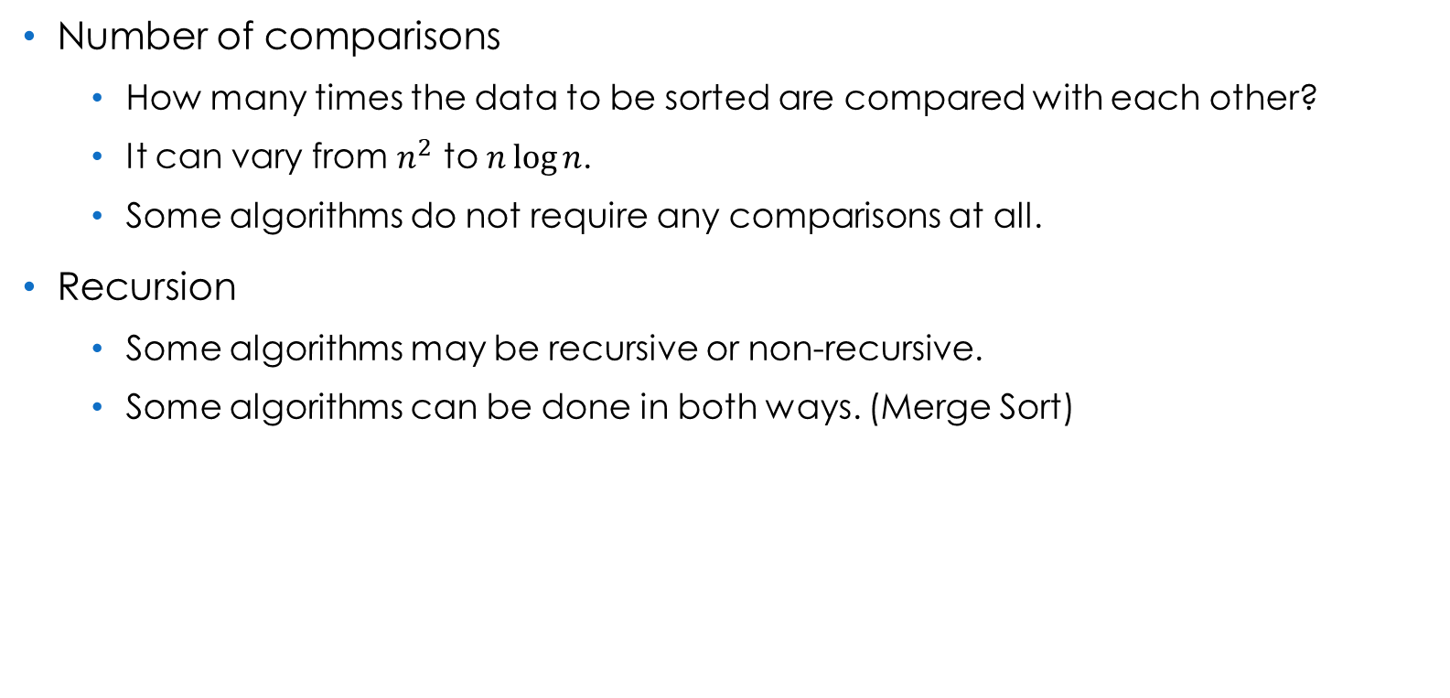
Classification Criteria
Number of comparisons
How many times the data to be sorted are compared with each other?
It can vary from $n^{2}$ to $n\log{n}$.
Some algorithms do not require any comparisons at all.
Recursion
Some algorithms may be recursive or non-recursive.
Some algorithms can be done in both ways. (Merge Sort)

Slide 7
Classification Criteria
Memory Usage
Some algorithms require additional memory to sort.
Some require no extra memory – called in-place sorting.
Adaptability
Does the algorithm take advantage of existing order in its input?

Slide 8
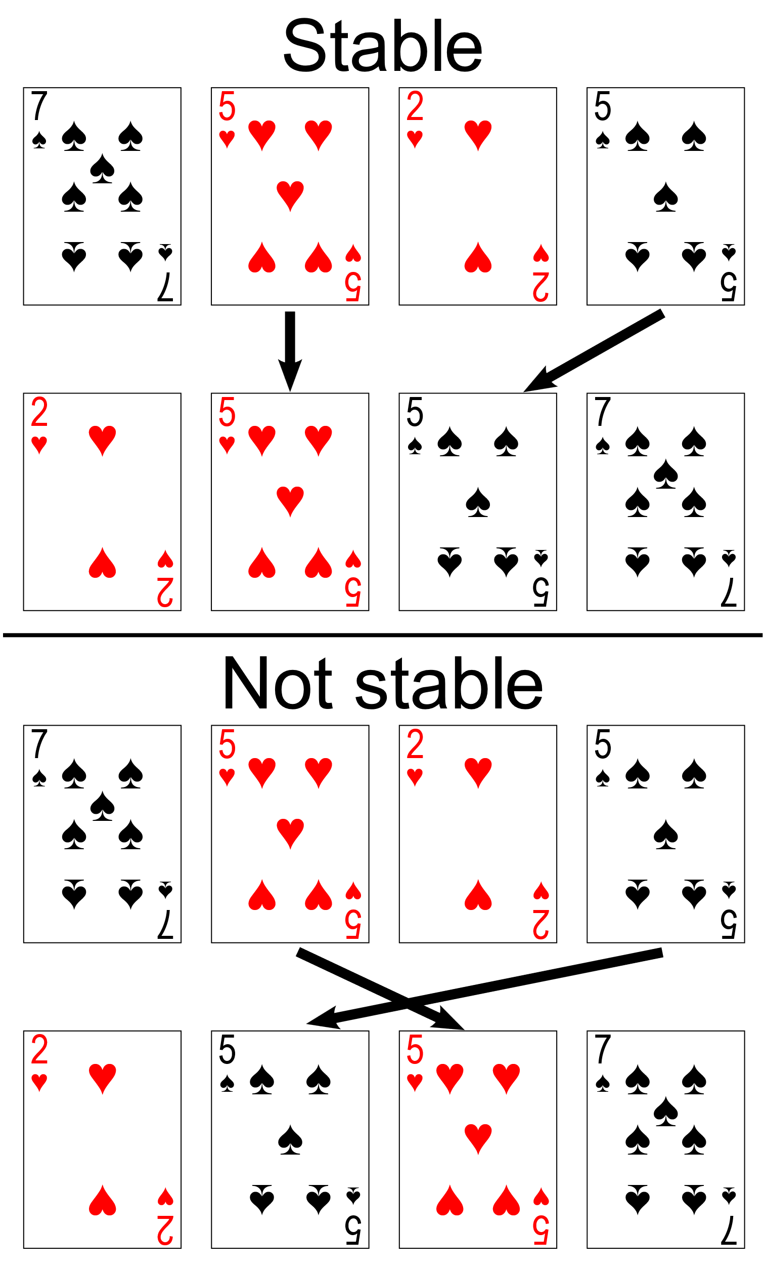
Classification Criteria
Stability
Does equal elements appear in the same order that they appear in the input?

Slide 9
Classification Criteria
Online / Offline
Can the sorting be done in real time?
Do we need the whole data before performing the sort?
Serial / Parallel
Is it possible to perform the sorting parallelly?

Slide 10
Popular Sorting Algorithms
Bubble Sort
Selection Sort
Insertion Sort
Quick Sort
Merge Sort
Heap Sort
Bucket Sort
Radix Sort
Shell Sort
We will sort our data in ascending order.

Slide 11
Bubble Sort
Let’s talk about the name first.
Why is it called “Bubble” sort?
Alternatively it is also known as “Sinking” sort.
Bubble
Elements tend to move up into the correct order like bubbles rising to the surface.
Sinking
The larger values might be regarded as heavier and therefore be seen to progressively sink to the bottom of the list

Slide 12
Bubble Sort Algorithm
C++ implementation

Slide 13
Bubble Sort Working Procedure
Consider the array
In each pass we will send the heaviest (largest) object at the bottom (last).
5 | 1 | 4 | 2 | 3

Slide 14
Simulation of Single Pass
In a single pass,
the largest element is placed at correct place.
pass =
4
a[i]>a[i+1]
5
1
4
2
3
swap(a[i],a[i+1])
i
i+1

Slide 15
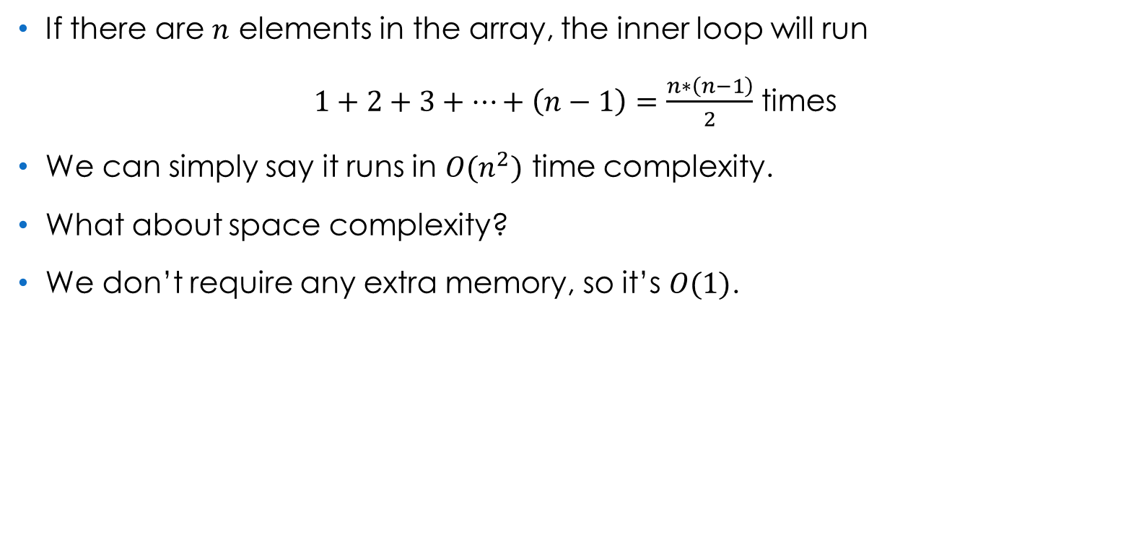
Complexity Analysis
If there are $n$ elements in the array, the inner loop will run
$1+2+3+…+\left(n−1\right)=\frac{n∗\left(n−1\right)}{2}$ times
We can simply say it runs in $O(n^{2})$ time complexity.
What about space complexity?
We don’t require any extra memory, so it’s $O(1)$.

Slide 16
Optimization
Let’s consider the previous example.
After single pass we got
And after second pass we will get
What will happen in rest of the pass?
The loop will execute, but with no swaps. It’s a waste.
5 | 1 | 4 | 2 | 3
1 | 4 | 2 | 3 | 5
1 | 2 | 3 | 4 | 5

Slide 17
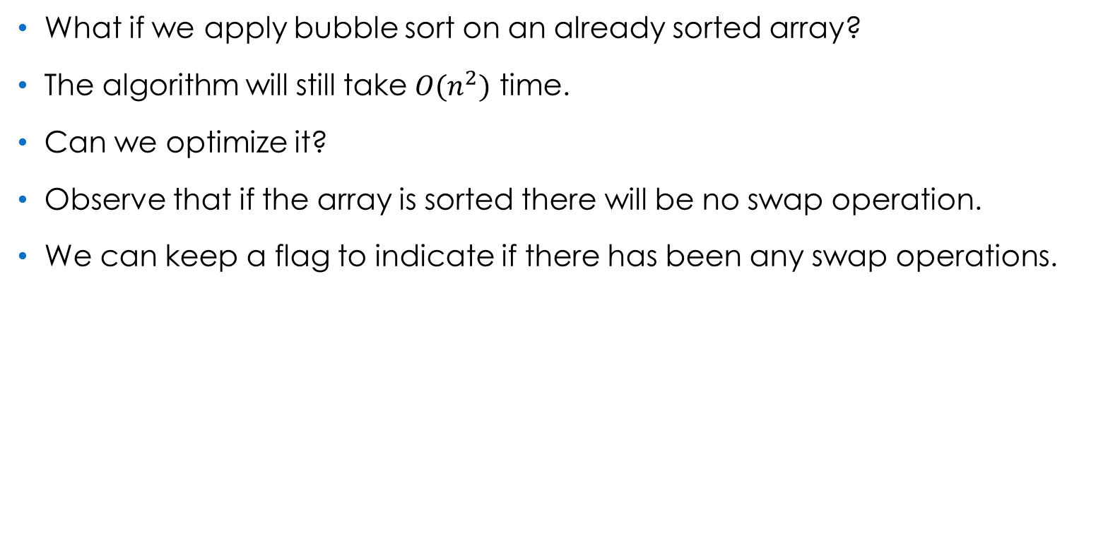
Optimization
What if we apply bubble sort on an already sorted array?
The algorithm will still take $O(n^{2})$ time.
Can we optimize it?
Observe that if the array is sorted there will be no swap operation.
We can keep a flag to indicate if there has been any swap operations.

Slide 18
Optimization
What will be the best case of this version?
O(n)

Slide 19
Insertion Sort
As the name suggests at each pass we will insert an item.
Where?
Let’s see a real life example.
Hopefully most of you guys have been in a local bus.
You ever noticed how the conductor carries the money?
He tries to keep the money in his hand sorted.
In ascending order.
And when he collects fare he puts the money in appropriate position.

Slide 20
Insertion Sort
Let’s represent the hand of the conductor as an array.
Now you give the conductor 20 Taka.
How will the array be updated?
So we insert an element such that the array remains sorted.
This is the main idea of insertion sort.
5 | 5 | 10 | 10 | 10 | 20 | 20 | 50 | 100 | 500
5 | 5 | 10 | 10 | 10 | 20 | 20 | 20 | 50 | 100 | 500

Slide 21
Insertion Sort Algorithm
Let’s see how the algorithm works now.
Consider the array.
We will take each element and insert it in a sorted array.
But we don’t want to take extra memory.
We will virtually partition the array into sorted and non-sorted portion
4 | 5 | 1 | 3 | 2

Slide 22
Insertion Sort Algorithm
As a single element is always sorted, we consider the first element is in sorted portion.
Now we will take one element from the unsorted portion and insert it into the appropriate position in the sorted data.
4 | 5 | 1 | 3 | 2
sorted data
unsorted data

Slide 23
Insertion Sort Algorithm
So we start with 5.
Remember how we performed insertion in array?
We right shift elements till we reach our desired index.
In this case we will shift all the elements that is greater than our new value.
As there is no element greater than 5 we don’t need to do anything.
4 | 5 | 1 | 3 | 2
5
4 | 5 | 1 | 3 | 2

Slide 24
Insertion Sort Algorithm
The next value is 1.
Now we shift all the elements greater than 1.
Then we put 1 in the blank space.
4 | 5 | 1 | 3 | 2
1
 | 4 | 5 | 3 | 2
1 | 4 | 5 | 3 | 2

Slide 25
Insertion Sort Algorithm
The next value is 3.
Shift all the elements greater than 3.
Then we put 3 in the blank space.
1 | 4 | 5 | 3 | 2
3
1 |  | 4 | 5 | 2
1 | 3 | 4 | 5 | 2

Slide 26
Insertion Sort Implementation
Implementation in C++

Slide 27
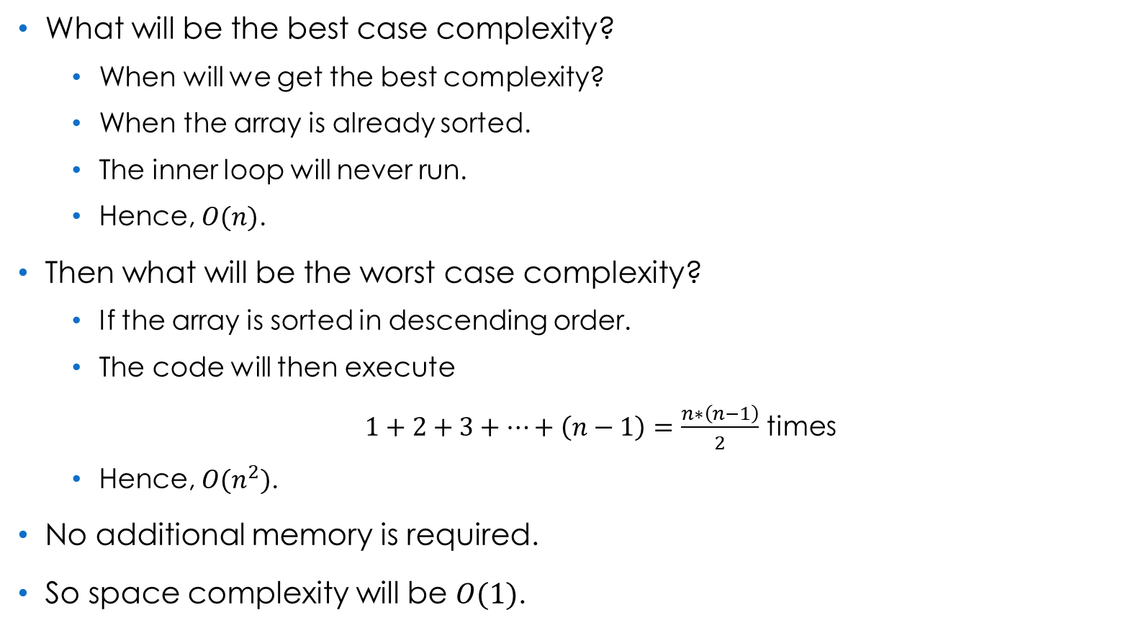
Complexity Analysis
What will be the best case complexity?
When will we get the best complexity?
When the array is already sorted.
The inner loop will never run.
Hence, $O(n)$.
Then what will be the worst case complexity?
If the array is sorted in descending order.
The code will then execute
$1+2+3+…+\left(n−1\right)=\frac{n∗\left(n−1\right)}{2}$ times
Hence, $O(n^{2})$.
No additional memory is required.
So space complexity will be $O(1)$.

Slide 28
References
Sorting algorithm – Wikipedia
Non-Recursive Merge Sort - Stack Overflow
Bubble sort – Wikipedia
Insertion sort – Wikipedia
Data Structures And Algorithms Made Easy - Narasimha Karumanchi

Slide 29
Thank You.

