Slide 1
Sorting Algorithms Counting Sort and Radix Sort
CSE 2105: Data Structures and Algorithms
Md Mehrab Hossain Opi

Slide 2
Non-comparison Sorts
Today we will learn about some sorting algorithms that do not use any comparison.
Some popular algorithms are
Counting Sort
Radix Sort
Bucket Sort
Spread Sort
Burst Sort

Slide 3
Counting Sort
Let’s start with counting sort.
As the name suggests, we need to count the values in the array.
We need an auxiliary array that will store the frequency of each number.
Then we will use the idea of the prefix sum to place each element in its correct position.

Slide 4
Counting Sort Algorithm
Consider the array
To count the frequency of each number we will need to declare another array – count[]
What should be the size of the count[]?
To make the algorithm memory efficient we will find the maximum of the array, say ‘max_val’ and declare count[] with max_val size.
Here the maximum value is 8.
Hence we will declare the auxiliary array with size 9.
8 | 3 | 1 | 7 | 8 | 4 | 1 | 4 | 1 | 7

Slide 5
Counting Sort Algorithm
Let’s go back to our array
And we initialize a new array of size 9 with 0.
Now we will count the frequency of each number by traversing.
8 | 3 | 1 | 7 | 8 | 4 | 1 | 4 | 1 | 7
Index | 0 | 1 | 2 | 3 | 4 | 5 | 6 | 7 | 8
value | 0 | 0 | 0 | 0 | 0 | 0 | 0 | 0 | 0

Slide 6
Counting Sort Algorithm
Array to Sort
8
3
1
7
8
4
1
4
1
7
count[] array
Index
0
1
2
3
4
5
6
7
8
2
1
1
1
2
1
value
0
0
0
0
1
3
0
0
0
0
0
2
2

Slide 7
Counting Sort Algorithm
Now that we have finished traversing the array
We will now apply the prefix sum technique on the count array.
So what is prefix sum?
Given an index i
Prefix sum is the sum of all the elements from 0 to i’th index.
Each time an index i is given we can calculate the prefix sum simply by running a loop and adding all the numbers up to index i.
But we want to create an array of prefix sum, where each index i will have the prefix sum up to index i.

Slide 8
Prefix Sum
Consider the array
The prefix sum array will be
We can also write it like
We can write prefix[i] = prefix[i-1]+a[i]
If we don’t use extra memory, a[i] = a[i-1]+a[i].
The original array will be then converted to prefix sum array.
4 | 1 | 5 | 2 | 3 | 6
4 | 5 | 10 | 12 | 15 | 21
4 | 4+1 | 4+1+5 | 4+1+5+2 | 4+1+5+2+3 | 4+1+5+2+3+6
4 | 5 | 10 | 12 | 15 | 21
4 | 4+1 | 5+5 | 10+2 | 12+3 | 15+6

Slide 9
Counting Sort Algorithm
Let’s go back to our algorithm.
We created the count array and got this
We will convert it into a prefix sum array now.
Index | 0 | 1 | 2 | 3 | 4 | 5 | 6 | 7 | 8
value | 0 | 3 | 0 | 1 | 2 | 0 | 0 | 2 | 2
Index | 0 | 1 | 2 | 3 | 4 | 5 | 6 | 7 | 8
value | 0 | 3 | 3 | 4 | 6 | 6 | 6 | 8 | 10

Slide 10
Counting Sort Algorithm
Okay now we have a new array.
Does this array have any meaning?
If our array was 1-based, then count[i] indicates the last position of number i in the sorted array.
Let’s see how it works.
Index | 0 | 1 | 2 | 3 | 4 | 5 | 6 | 7 | 8
value | 0 | 3 | 3 | 4 | 6 | 6 | 6 | 8 | 10

Slide 11
Counting Sort Algorithm
At first we will create a new array
This array will be the sorted one.
Then we will traverse the main array and use the count array to fill the new array.
Each time we insert an element in the array, we will decrease its count.

Slide 12
Counting sort algorithm
Array to Sort
8
3
1
7
8
4
1
4
1
7
Count array
Index
0
1
2
3
4
5
6
7
8
2
1
8
value
0
0
7
9
3
3
4
6
4
6
6
8
3
5
6
10
Final Aray
Index | 1 | 2 | 3 | 4 | 5 | 6 | 7 | 8 | 9 | 10
value
1
1
1
3
4
4
7
7
8
8

Slide 13
Counting Sort Implementation

Slide 14
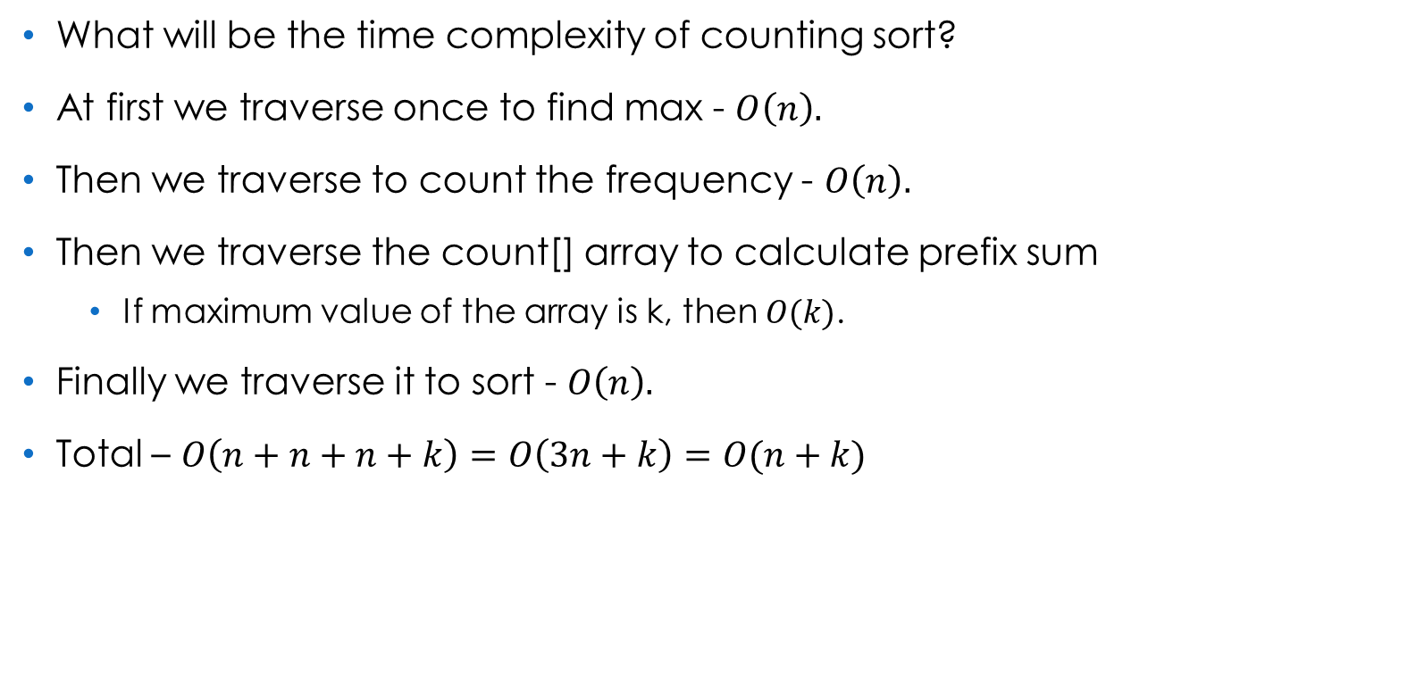
Complexity Analysis
What will be the time complexity of counting sort?
At first we traverse once to find max - $O\left(n\right).$
Then we traverse to count the frequency - $O\left(n\right).$
Then we traverse the count[] array to calculate prefix sum
If maximum value of the array is k, then $O(k)$.
Finally we traverse it to sort - $O\left(n\right).$
Total – $O\left(n+n+n+k\right)=O\left(3n+k\right)=O(n+k)$

Slide 15

Complexity Analysis
What about memory?
To create the frequency array we need $O(k)$ memory.
We also created a second array to store the answer - $O(n)$.
So total memory $O(n+k)$.

Slide 16
Problem of Counting Sort
Can we handle decimal numbers?
What happens if the value of k is very large?
How will you handle negative numbers?

Slide 17
Radix Sort
Have you heard the word ‘radix’ before?
We also call it the ‘base’ of a number.
It represents the number of unique digits used in a number system.
Hence, the radix of the binary system is 2.
The radix of the decimal system is 10.
In radix sort we will apply counting sort for each digit, starting from the Least Significant Digit (LSD) to the Most Significant Digit(MSD) or vice versa.
The result of previous sorting will be preserved.
Remember each counting sort must be stable.

Slide 18
Radix Sort
Consider the array
At first we will find the maximum number.
Here, the maximum is 809, containing 3 digits.
So we will do counting sort 3 times.
12 | 4 | 809 | 67 | 505 | 360 | 9 | 88

Slide 19
Radix Sort
We will start from the least significant digit
We will create a count[] array of size 10.
As our numbers are in the decimal system.
The count array will look like below after traversal
12 | 4 | 809 | 67 | 505 | 360 | 9 | 88
12 | 4 | 809 | 67 | 505 | 360 | 9 | 88
Index | 0 | 1 | 2 | 3 | 4 | 5 | 6 | 7 | 8 | 9
value | 1 | 0 | 1 | 0 | 1 | 1 | 0 | 1 | 1 | 2

Slide 20
Radix Sort
After performing counting sort for first digit
Next we will focus on the second LSD.
For single-digit numbers we can imagine 0 before them.
12 | 4 | 809 | 67 | 505 | 360 | 9 | 88
360 | 12 | 4 | 505 | 67 | 88 | 809 | 9
360 | 12 | 04 | 505 | 67 | 88 | 809 | 09

Slide 21
Radix Sort
After the second counting sort
Then we focus on the third digit.
360 | 12 | 04 | 505 | 67 | 88 | 809 | 09
04 | 505 | 809 | 09 | 12 | 360 | 67 | 88
004 | 505 | 809 | 009 | 012 | 360 | 067 | 088

Slide 22
Radix Sort
After the third counting sort
Now the array is sorted.
004 | 505 | 809 | 009 | 012 | 360 | 067 | 088
004 | 009 | 012 | 067 | 088 | 360 | 505 | 809

Slide 23
Radix Sort Implementation

Slide 24
Radix Sort Implementation

Slide 25
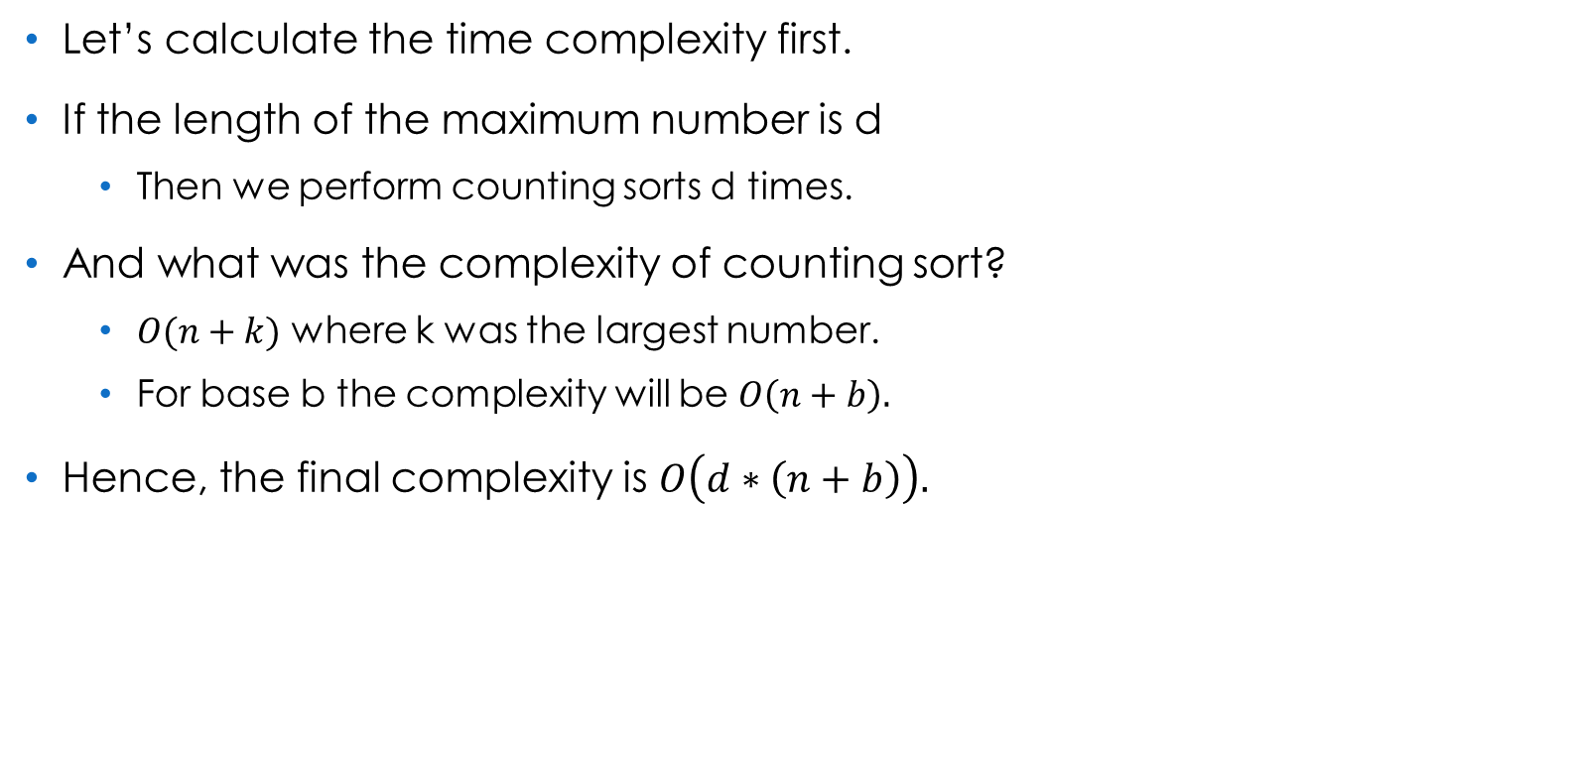
Complexity Analysis
Let’s calculate the time complexity first.
If the length of the maximum number is d
Then we perform counting sorts d times.
And what was the complexity of counting sort?
$O(n+k)$ where k was the largest number.
For base b the complexity will be $O\left(n+b\right).$
Hence, the final complexity is $O\left(d∗\left(n+b\right)\right).$

Slide 26
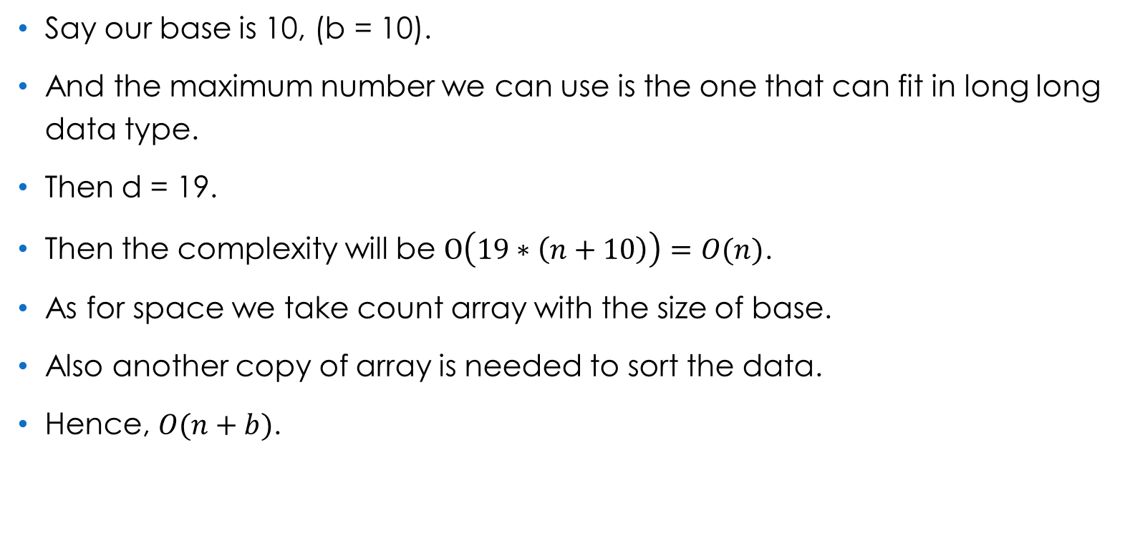
Complexity Analysis
Say our base is 10, (b = 10).
And the maximum number we can use is the one that can fit in long long data type.
Then d = 19.
Then the complexity will be $O\left(19∗\left(n+10\right)\right)=O(n)$.
As for space we take count array with the size of base.
Also another copy of array is needed to sort the data.
Hence, $O(n+b)$.

Slide 27
References
sorting - Why quicksort is more popular than radix-sort? - Stack Overflow
Radix sort – Wikipedia
Counting sort - Wikipedia

Slide 28
Thank You.

