Slide 1
Introduction to Linked List
CSE 2105: Data Structures and Algorithms
Md Mehrab Hossain Opi

Slide 2
Introduction
We have two terms here – ‘linked’ and ‘list’.
So what is a list?
a collection of items presented in a particular order.
Shopping list, to-do list
What does the word ‘linked’ mean?
Connection or relationship between two or more things.
So we have a collection of items which are connected to each other.

Slide 3
Recap
Before we dive into details of linked list let’s recap some concepts we have learnt before.

Slide 4
Memory Address and Pointers
If I ask you to say your address what will you reply?
You will probably say like this
District: X, Sub-district: Y, Road No: A, House No: B
But if your friend from the same sub-district ask your address?
You will just say road no, and house no.
And if it’s a neighbor from the same road?
You will just say your house no.

Slide 5
Memory Address and Pointers
Consider the memory of computer as a long road consisting of many rooms.
Each room is made up of 1 byte.
Multiple rooms make up one house.
So what happens when we declare a variable?
Say we declare an integer x.
How many bytes does an integer take?
4 bytes.
The variable will take 4 free consecutive bytes (4 rooms) from the memory.
When we ask, “Where does x live?”, we will get the address of first byte.

Slide 6
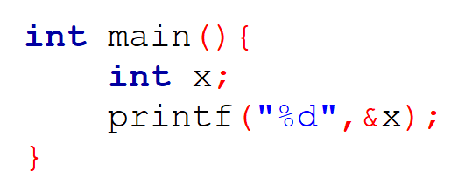
Memory Address and Pointers
In C/C++ we show the address of variable x using &.
We write
And pointer is another variable that will store this address.

Slide 7
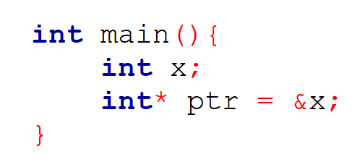
Pointers
What is a pointer?
A variable that stores the memory address of another variable.
Use * to define a pointer.
How many bytes does a pointer take?

Slide 8
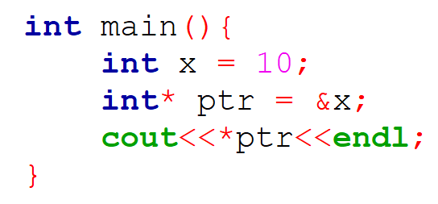
Pointers
What if we ask who lives in the address ptr?
What is the value stored in the address stored in ptr?
Again we use the * operator.

Slide 9
Arrays
So what happens when we declare an array.
It’s like you have a big family, you want to live together, so you buy a really big house consisting of many rooms.

Slide 10
Arrays
But what if there’s not enough memory?
You need a house of 5 rooms.
Instead of buying a large house you now buy a house for everyone.
A |  |  |  | D |  |  | B |  |  | C
A | F |  | F | D | F |  | B | F |  | C | F

Slide 11
Arrays
Now you need to know where your family members live.
But remembering the address of every member can be hard.
So each one just remembers where the next family member lives.
And the neighbors will only know your address who is the head of this family.
A | F |  | F | D | F |  | B | F |  | C | F

Slide 12
Linked List
In computer we will call this family a linked list.
We will call each family member a node.
Each node has information about itself, we will call this information data.
A node also knows where the next node lives.
We will call this information reference.

Slide 13
Formal Definition
A linked list is a linear data structure consisting of a sequence of elements called nodes, where each node contains data and a reference (link or pointer) to the next node in the sequence.
Linear Data Structure
A way of organizing and storing data where the elements are arranged in a sequential order.
relationship between the elements is one-dimensional, forming a straight line.

Slide 14
Disadvantages of Array
Fixed Size.
Inefficient insertion/deletion.
Dynamic array is also inefficient.

Slide 15
Implementation Details
Let’s see how we can implement linked list now.
What does a node contains?
A node may contain a lot of data.
For simplicity let’s talk about our CSE family.
Each node represents one student.
Let’s just store his/her roll no for the moment.
What about the reference?
Each student will store where the student with next roll no lives.

Slide 16
Implementation Details
To store multiple information we use structure/class.
Let’s create a structure.
Do you remember self-referential structure?

Slide 17
Implementation Details
Now let’s create a class for our linked list.
It’s just the address of the head.

Slide 18
Operations on Linked List
The operations we will learn
Linked List Creation / Initialization
Insertion
Deletion
Traversal
Search
Update
Length
These operations will be discussed in detail in the lab.

Slide 19
Types of Linked List
We can only move in a single direction with our current linked list structure.
Roll 005 can’t give me the information of roll 004.
As the nodes only contain a single reference or link we will call it a singly linked list.
Let’s see some other variations of the linked list.

Slide 20
Doubly Linked List
As nodes in a singly linked list contain just one reference/ link value
Nodes in the doubly linked list contain two references.
The first reference will point to the next node in the list.
The second one will point to the previous node in the list.

Slide 21
Doubly Linked List
What will be the content of the previous pointer of the first node?
NULL
prev | data | next
NULL | 001 | 0x12
0x08 | 002 | 0x34
0x12 | 003 | 0x41
0x34 | 004 | NULL
0x08
0x12
0x34
0x41

Slide 22
Pros and Cons of Doubly Linked List
What is the benefit of using two references?
Bidirectional Traversing.
Easy insertion/deletion of nodes.
But there are some disadvantages.
Requires more space.
Insertion/ Deletion takes extra time
More pointer operations.

Slide 23
Circular Linked List
How do we find the end of a linked list?
The last node of the linked list, both singly and doubly holds null in the next reference pointer.
But there’s a variation of the linked list that does not contain a null pointer.
Instead of storing null, the next pointer of the last node will contain the address of the first node.
001
0x32
002
0x43
003
0x41
004
0x52
005
0x21
0x21
0x32
0x43
0x41
0x52

Slide 24
Doubly Circular Linked List
The circular linked we just, is an extended version of the singly linked list.
What if we want to make a circular linked list with a doubly linked list?
What changes do we need to make?
In a doubly linked list, the prev pointer of the first node contained null.
Now it will contain the address of the last node.

Slide 25
XOR Linked List
One big problem of the doubly linked list was it requires extra memory to store two addresses.
This problem can be solved using the XOR linked list.
Before we learn more about it, let’s recap some property of XOR operation.

Slide 26
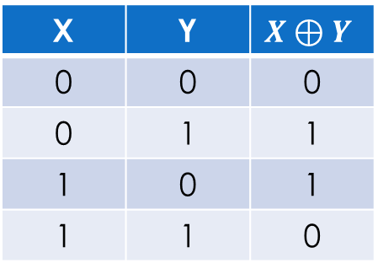

XOR Operation Properties
Some important properties:
$X⊕0=X$
$X⊕X=0$
If $A⊕B=C$ then $C⊕A=B$ and $C⊕B=A$
X | Y | $$X⊕Y$$
0 | 0 | 0
0 | 1 | 1
1 | 0 | 1
1 | 1 | 0

Slide 27
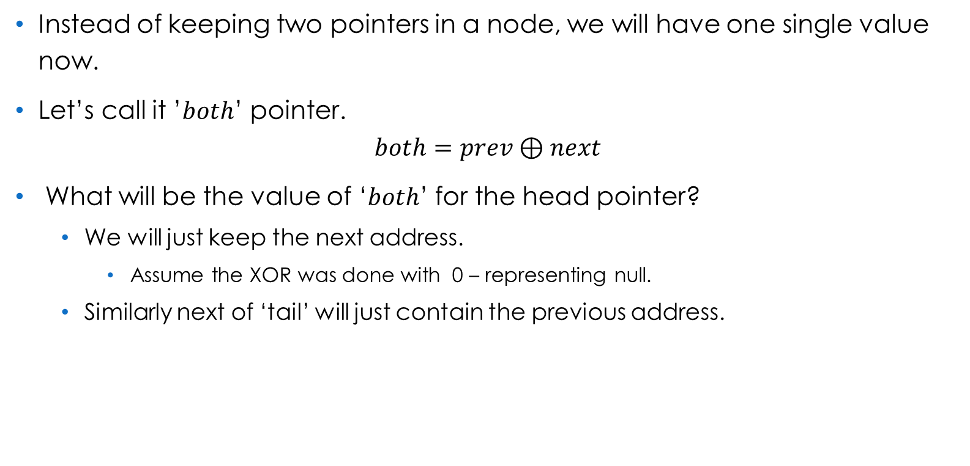
XOR Linked List Structure
Instead of keeping two pointers in a node, we will have one single value now.
Let’s call it ’$both$’ pointer.
$$both=prev⊕next$$
What will be the value of ‘$both$’ for the head pointer?
We will just keep the next address.
Assume the XOR was done with 0 – representing null.
Similarly next of ‘tail’ will just contain the previous address.

Slide 28




XOR Linked List
Traditional Doubly Linked List
NULL | val | next
prev | val | next
prev | val | next
prev | val | NULL
XOR Linked List
val | $$0⊕next$$
val | $$prev⊕next$$
val | $$prev⊕next$$
val | $$prev⊕0$$

Slide 29
XOR Linked List Traversal

Slide 30
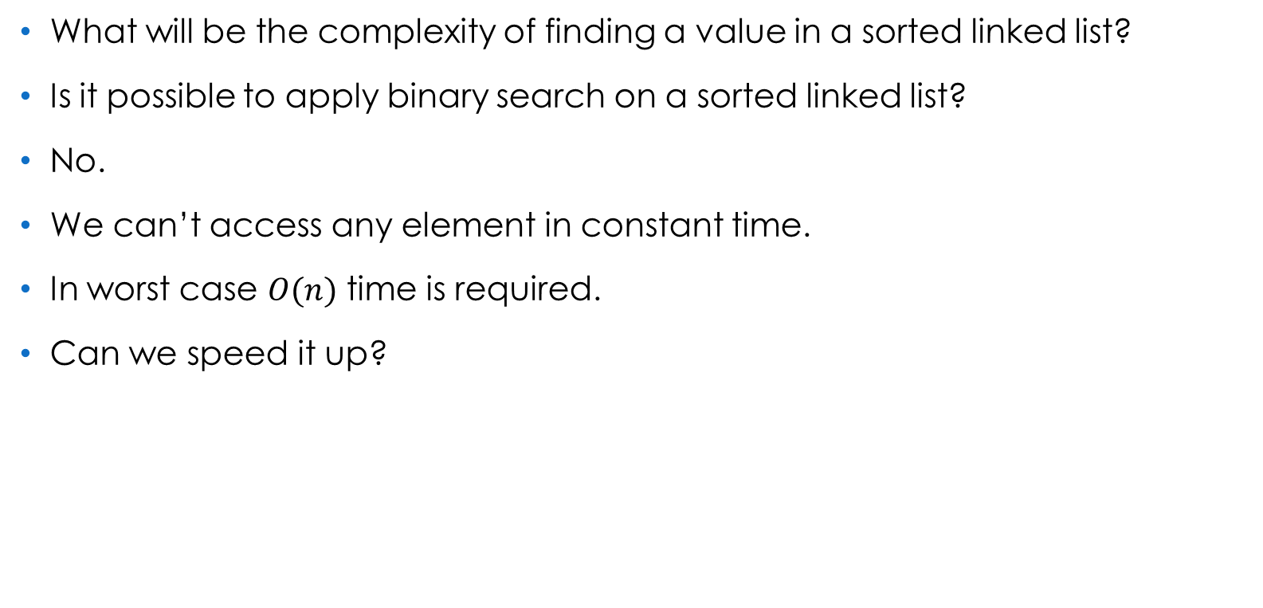
Search on Sorted Linked List
What will be the complexity of finding a value in a sorted linked list?
Is it possible to apply binary search on a sorted linked list?
No.
We can’t access any element in constant time.
In worst case $O(n)$ time is required.
Can we speed it up?

Slide 31

Two Linked List
We will create another linked list $(L_{2})$ from our linked list $(L_{1})$.
$L_{2}$ will be a subset of $L_{1}$.
Consider each value will be distinct in the list.
Similar values of $L_{2}$ and $L_{1}$ will be connected.
3
8
26
30
53
3
5
8
14
17
26
30
33
46
53

Slide 32

Searching in Two Linked Lists
Search(x):
Walk right in top linked list $(L_{2})$
Until going right would go too far.
Walk down to bottom linked list ($L_{1})$
Walk right in $L_{2}$ until element found (or not)

Slide 33



Searching in Two Linked List
Let’s find 17.
Start from the first node of $L_{2}.$
Value greater than 17, Go Back and then Down
Keep Going Right until found(or not)
Value less than 17, Go Right
$$L_{2}$$
3
8
26
30
53
$$L_{1}$$
3
5
8
14
17
26
30
33
46
53

Slide 34
Design of Two Linked List
How should we create the new linked list?
Which nodes should be there?
How many nodes should be there?
How should we distribute them?
Best approach is two distribute the nodes evenly.
3
8
26
30
53
3
5
8
14
17
26
30
33
46
53

Slide 35

Complexity using Two Linked List
What will be the complexity of the algorithm we just followed?
It is roughly $O(\left|L_{2}\right|+\frac{\left|L_{1}\right|}{\left|L_{2}\right|})$
Assuming $\left|L_{1}\right|=n,$ We can achieve the best complexity when $\left|L_{2}\right|=\sqrt{n}$
Then the complexity becomes $O\left(2\sqrt{n}\right)$
3
8
26
30
53
3
5
8
14
17
26
30
33
46
53

Slide 36

Optimal Structure
We require to visit at most $O\left(2\sqrt{n}\right)$nodes to find any value.
Can we make it better?
3
14
30
53
3
5
8
14
17
26
30
33
46
53

Slide 37

Extending the Structure
We can keep on adding more layers to improve the time complexity.
For best performance
We will create $\log{n }$linked list.
In each layer we double the number of nodes.
The last layer will contain all the nodes.

Slide 38
Skip List
An ideal Skip List consists of $\log{n}$ link lists where we can search any value in $O(\log{n)}$ time.
3
99
3
65
99
3
47
65
83
99
3
34
47
60
65
75
83
95
99
3
12
34
43
47
53
60
62
65
70
75
79
83
89
95
97
99

Slide 39
Skip List
Let’s Find 79.
3
99
3
65
99
3
47
65
83
99
3
34
47
60
65
75
83
95
99
3
12
34
43
47
53
60
62
65
70
75
79
83
89
95
97
99

Slide 40
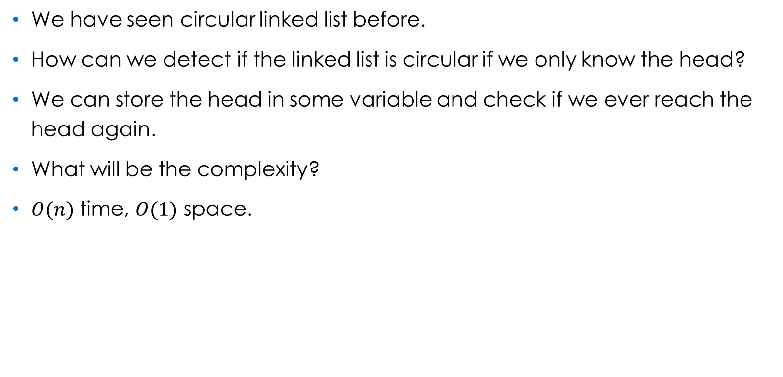
Cycle Detection in Linked List
We have seen circular linked list before.
How can we detect if the linked list is circular if we only know the head?
We can store the head in some variable and check if we ever reach the head again.
What will be the complexity?
$O(n)$ time, $O(1)$ space.

Slide 41
Cycle Detection in Linked List
What if the last node is connected to some other node?
Can you detect the cycle now?
2
8
1
7
4

Slide 42
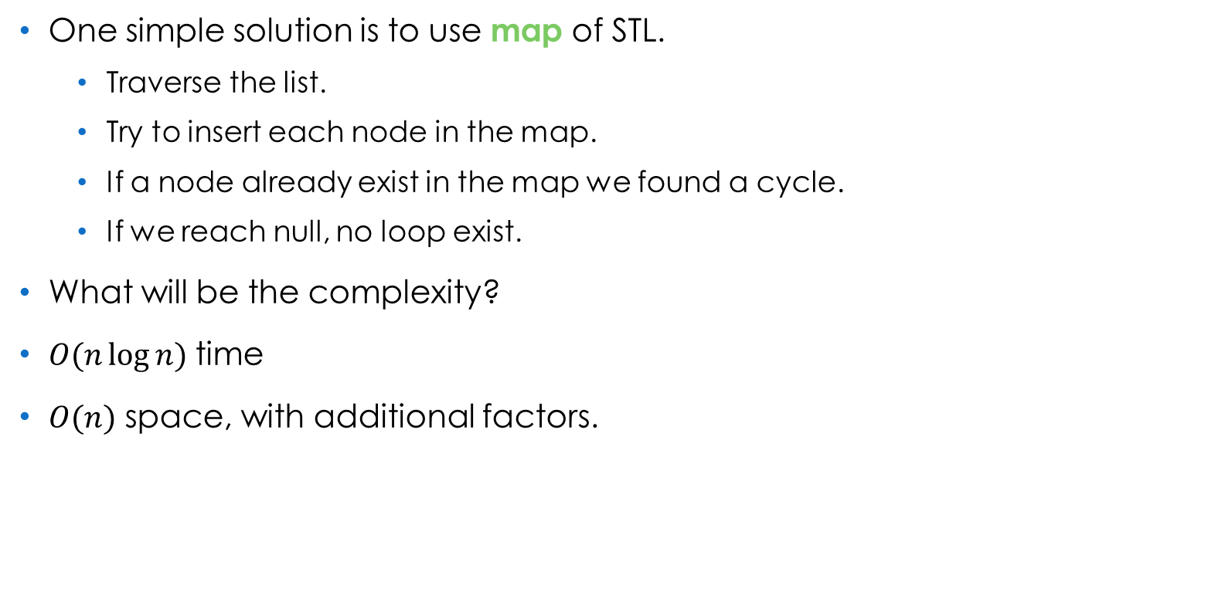
Cycle Detection in Linked List
One simple solution is to use map of STL.
Traverse the list.
Try to insert each node in the map.
If a node already exist in the map we found a cycle.
If we reach null, no loop exist.
What will be the complexity?
$O(n\log{n)}$time
$O(n)$ space, with additional factors.

Slide 43

Floyd Cycle Detection Algorithm
Let’s look at a better approach now.
The algorithm works in
$O(1)$ space and
$O(n)$ time complexity.
Also known as Hare-Tortoise algorithm.

Slide 44
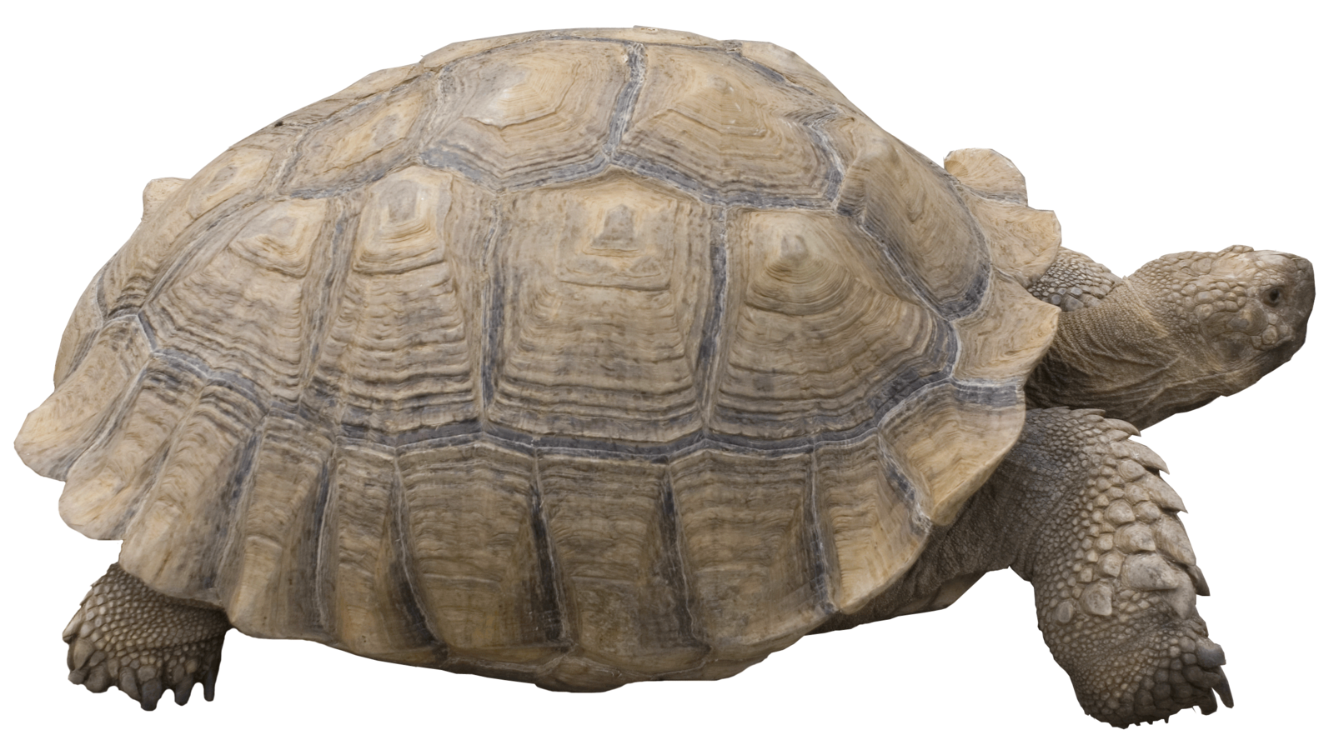

Floyd’s Cycle Detection Algorithm
2
8
1
7
4
If the pointers meet at the same node again,
then we can say there’s a cycle in the list.
The algorithm starts by taking two pointers
(tortoise and hare) initialized to head.
As the hare is faster it will two nodes at a time.
The tortoise will go one node at a time.

Slide 45
Algorithm Implementation

Slide 46
Algorithm Correctness
Why does the algorithm work?
Without diving into mathematical proof
We will prove it with our intuition.
When we are not in a cycle,
Difference between hare and tortoise increases by one in each step.
But when we are in a cycle
The difference decreases by one.
Hence at some point it will converge.
What if the jumping ratio was not 2:1?

Slide 47
References
“Data Structures and Algorithms in C++” – Adam Drozdek
“Data Structures and Algorithms Made Easy” – Narasimha Karumanchi
Lec 12 | MIT 6.046J / 18.410J Introduction to Algorithms (SMA 5503), Fall 2005 – YouTube
Mathematical Proof of Floyds Cycle Detection Algorithm - medium.com
XOR Linked List - A Memory Efficient Doubly Linked List | Set 1 – GeeksforGeeks
ChatGPT

Slide 48
Thank You.

