Slide 1
Lab 1 Tutorial (HTML & CSS)
CSE 3100 : Web Programming
Subah Nawar
Lecturer,
Dept of CSE, KUET
Email: nawar@cse.kuet.ac.bd
Kazi Saeed Alam
Assistant Professor,
Dept of CSE, KUET
Email: saeed.alam@cse.kuet.ac.bd

Slide 2
HTML Introduction
HTML is the standard markup language for creating Web pages.
HTML stands for Hyper Text Markup Language.
HTML describes the structure of a Web page.
HTML consists of a series of elements.
HTML elements tell the browser how to display the content

Slide 3
A Simple HTML Document
<!DOCTYPE html> <html> <head> <title>Page Title</title> </head> <body> <h1>My First Heading</h1> <p>My first paragraph.</p> </body> </html>
The <!DOCTYPE html> declaration defines that this document is an HTML5 document
The <html> element is the root element of an HTML page
The <head> element contains meta information about the HTML page
The <title> element specifies a title for the HTML page (which is shown in the browser's title bar or in the page's tab)
The <body> element defines the document's body, and is a container for all the visible contents, such as headings, paragraphs, images, hyperlinks, tables, lists, etc.
The <h1> element defines a large heading
The <p> element defines a paragraph

Slide 4
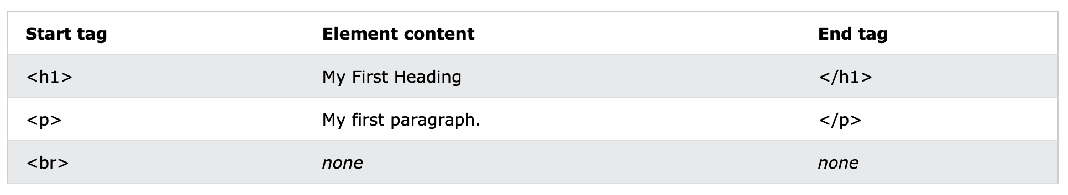
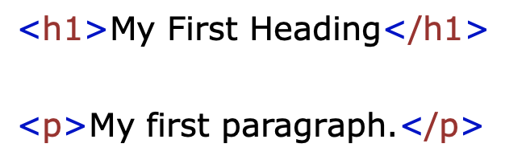
What is an HTML Element?
An HTML element is defined by a start tag, some content, and an end tag:
The HTML element is everything from the start tag to the end tag:

Slide 5
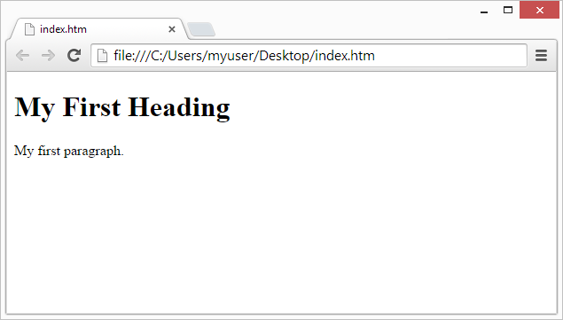
Web Browsers
The purpose of a web browser (Chrome, Edge, Firefox, Safari) is to read HTML documents and display them correctly.
A browser does not display the HTML tags, but uses them to determine how to display the document:

Slide 6
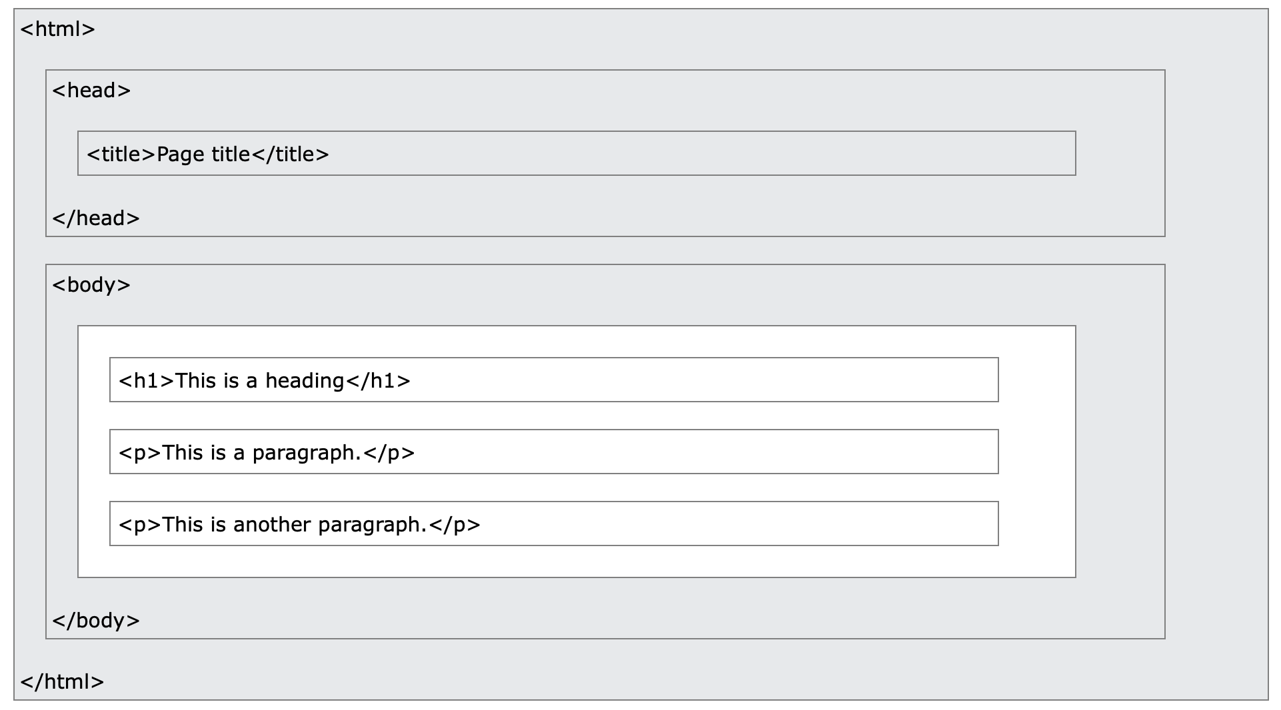
HTML Page Structure
Below is a visualization of an HTML page structure:
The content inside the <body> section (the white area) will be displayed in a browser. The content inside the <title> element will be shown in the browser's title bar or in the page's tab.

Slide 7
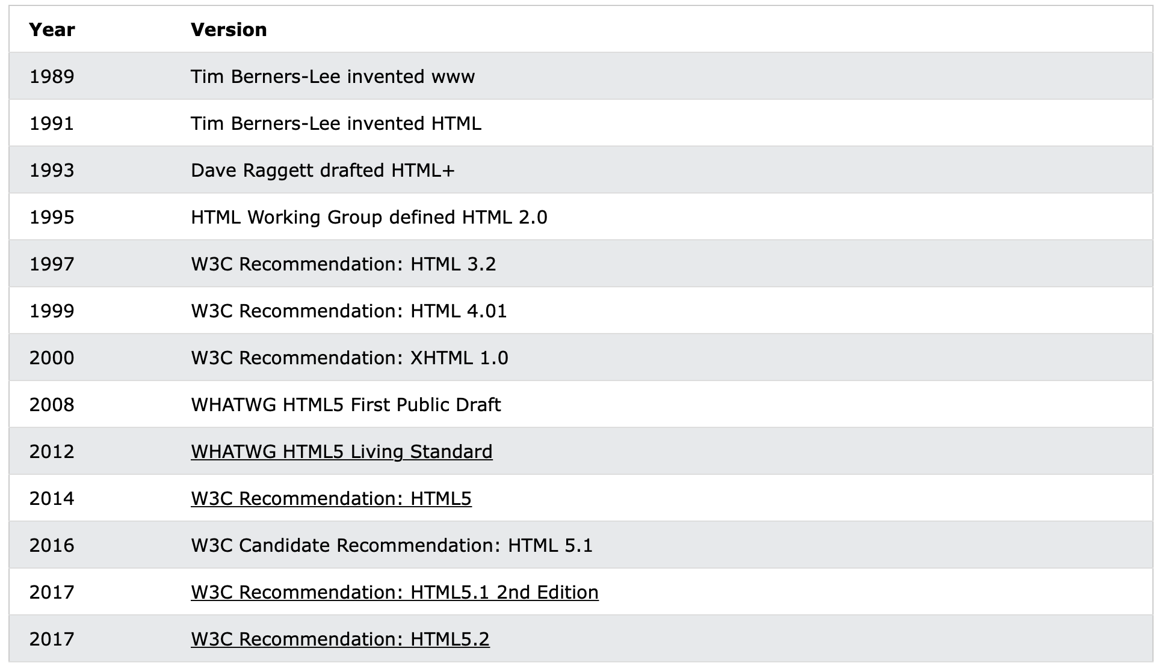
HTML History

Slide 8
HTML Documents
All HTML documents must start with a document type declaration: <!DOCTYPE html>.
The HTML document itself begins with <html> and ends with </html>.
The visible part of the HTML document is between <body> and </body>.

Slide 9
HTML is Not Case Sensitive
HTML tags are not case sensitive: <P> means the same as <p>.

Slide 10

The <!DOCTYPE> Declaration
The <!DOCTYPE> declaration represents the document type, and helps browsers to display web pages correctly.
It must only appear once, at the top of the page (before any HTML tags).
The <!DOCTYPE> declaration is not case sensitive.
The <!DOCTYPE> declaration for HTML5 is:

Slide 11
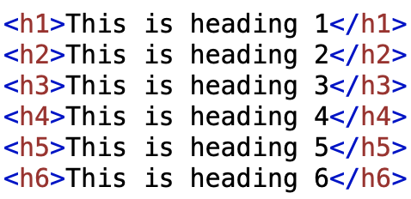
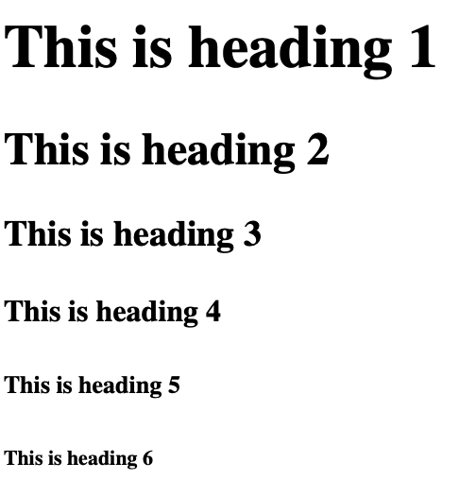
HTML Headings
HTML headings are defined with the <h1> to <h6> tags.
<h1> defines the most important heading. <h6> defines the least important heading:

Slide 12
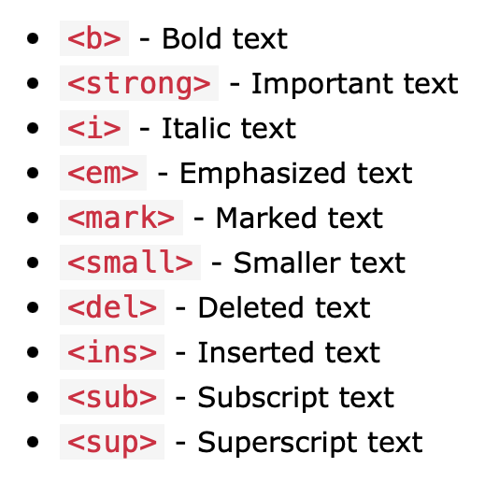
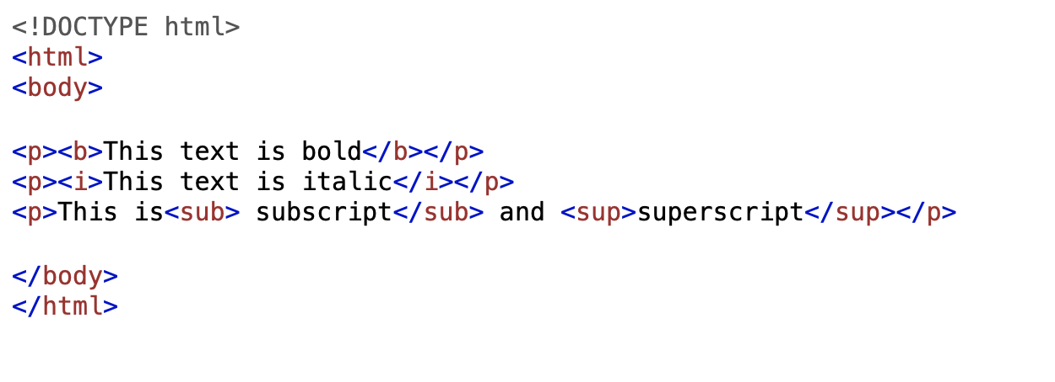
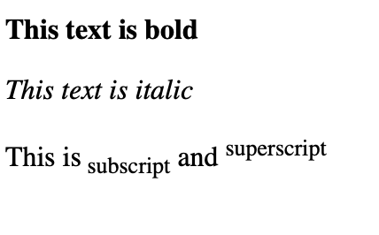
HTML Text Formatting
HTML contains several elements for defining text with a special meaning.

Slide 13
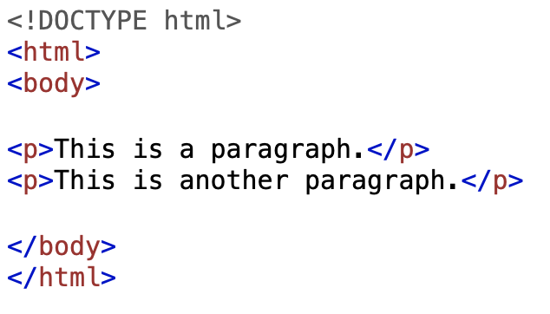
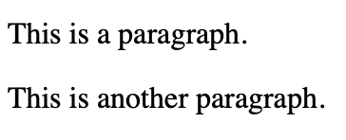
HTML Paragraphs
HTML paragraphs are defined with the <p> tag:

Slide 14
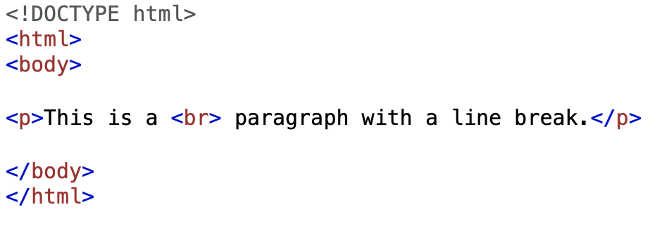
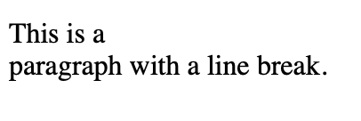
Empty HTML Elements
HTML elements with no content are called empty elements.
The <br> tag defines a line break, and is an empty element without a closing tag:

Slide 15
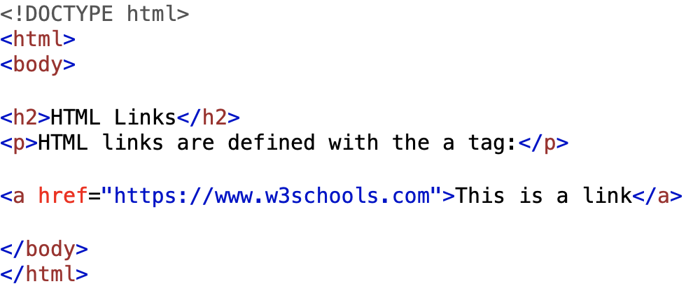
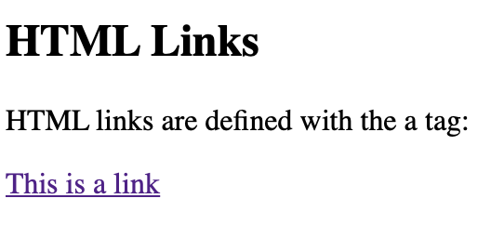
HTML Links
HTML links are defined with the <a> tag:
The link's destination is specified in the href attribute.
Attributes are used to provide additional information about HTML elements.
You will learn more about attributes later.

Slide 16
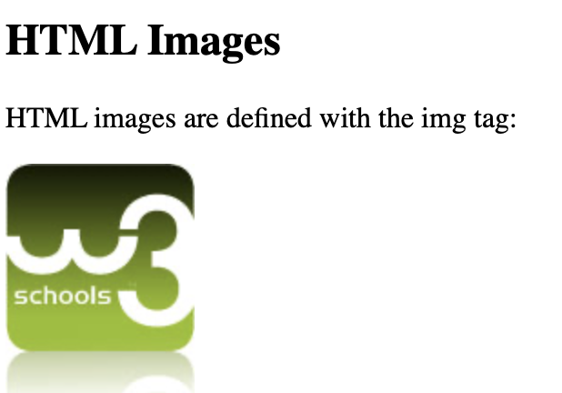
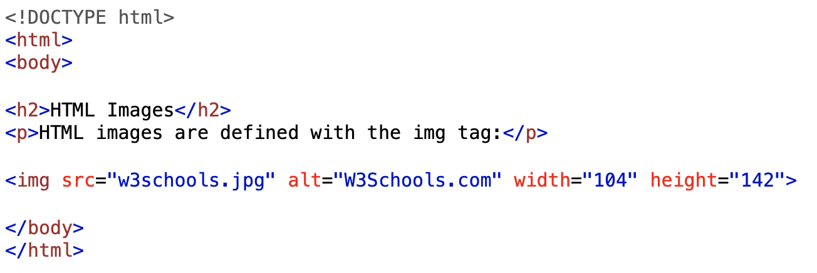
HTML Images
HTML images are defined with the <img> tag.
The source file (src), alternative text (alt), width, and height are provided as attributes:

Slide 17
HTML Attributes
HTML attributes provide additional information about HTML elements.
All HTML elements can have attributes
Attributes are always specified in the start tag
Attributes usually come in name/value pairs like: name="value"

Slide 18
The href Attribute
The <a> tag defines a hyperlink. The href attribute specifies the URL of the page the link goes to:
<a href="https://www.google.com">Visit Google</a>

Slide 19
The src Attribute
The <img> tag is used to embed an image in an HTML page. The src attribute specifies the path to the image to be displayed:
<img src="img_boy.jpg">

Slide 20
The width and height Attribute
The <img> tag should also contain the width and height attributes, which specifies the width and height of the image (in pixels):
<img src="img_boy.jpg" width="500" height="600">

Slide 21
The alt Attribute
The required alt attribute for the <img> tag specifies an alternate text for an image, if the image for some reason cannot be displayed. This can be due to slow connection, or an error in the src attribute, or if the user uses a screen reader.
<img src="img_boy.jpg" alt=”Boy with a jacket">

Slide 22
The style Attribute
The style attribute is used to add styles to an element, such as color, font, size, and more.
<tagname style="property:value;">
The property is a CSS property. The value is a CSS value.
<p style="color:red;">This is a red paragraph.</p>

Slide 23
The title Attribute
The title attribute defines some extra information about an element.
The value of the title attribute will be displayed as a tooltip when you mouse over the element:
<p title="I'm a tooltip">This is a paragraph.</p>

Slide 24
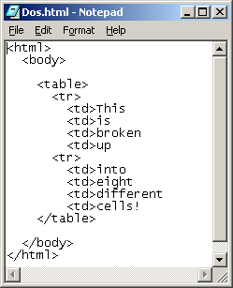
HTML Tables
HTML tables allow web developers to arrange data into rows and columns.
A table in HTML consists of table cells inside rows and columns

Slide 25
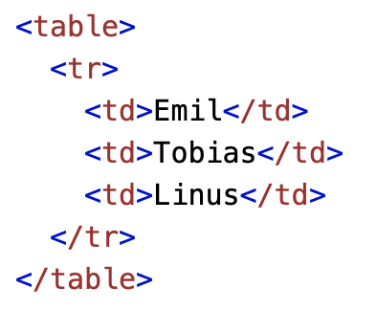
Table Cells
Each table cell is defined by a <td> and a </td> tag.
td stands for table data.
Everything between <td> and </td> are the content of the table cell.

Slide 26
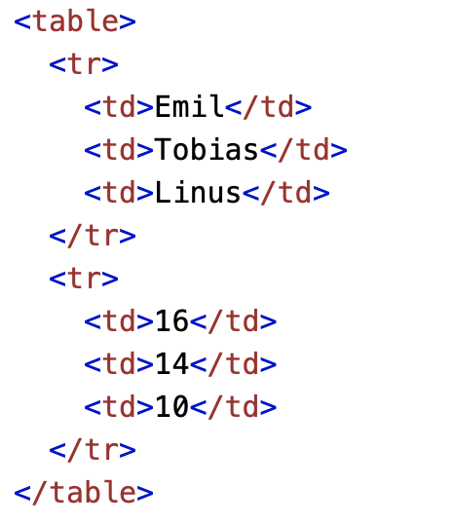
Table Rows
Each table row starts with a <tr> and end with a </tr> tag.
tr stands for table row.

Slide 27
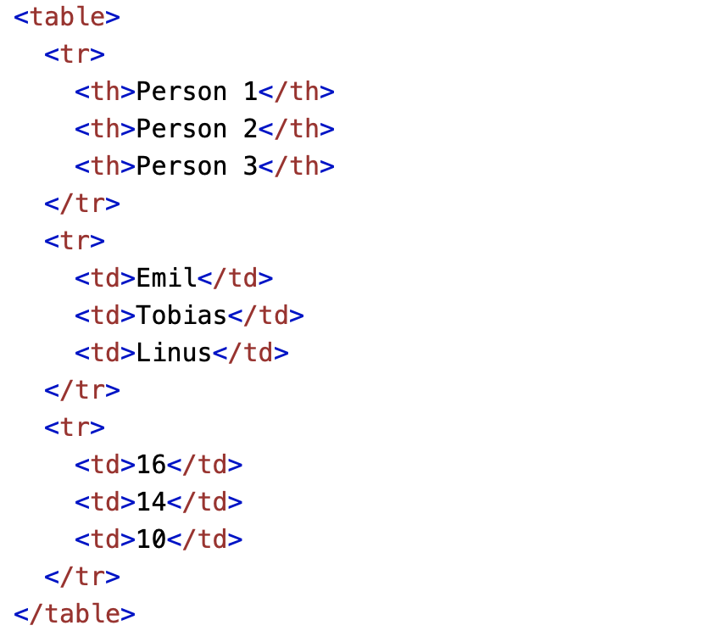
Table Header
Sometimes you want your cells to be headers, in those cases use the <th> tag instead of the <td> tag.
By default, the text in <th> elements are bold and centered, but you can change that with CSS.
HW: Try Merging or Splitting Rows/Columns

Slide 28
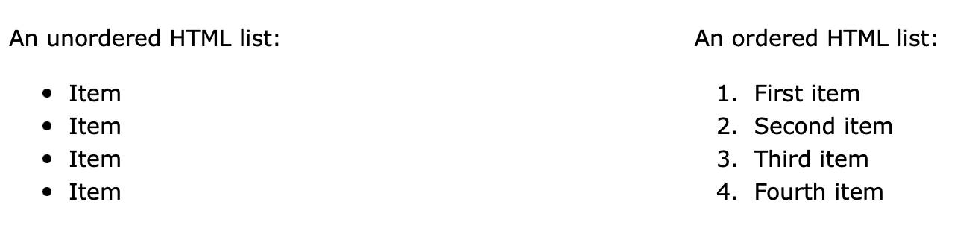
HTML Lists
HTML lists allow web developers to group a set of related items in lists.

Slide 29
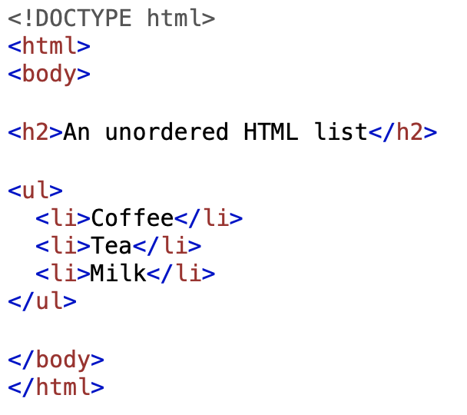
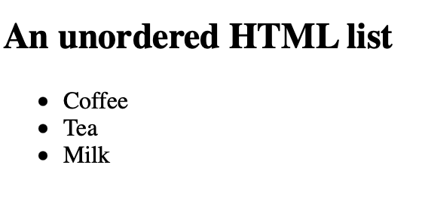
Unordered Lists
The HTML <ul> tag defines an unordered (bulleted) list.
An unordered list starts with the <ul> tag. Each list item starts with the <li> tag.
The list items will be marked with bullets (small black circles) by default:

Slide 30
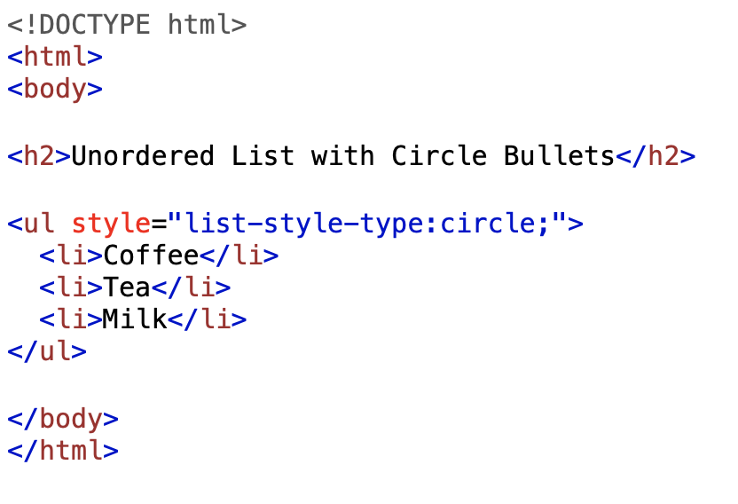
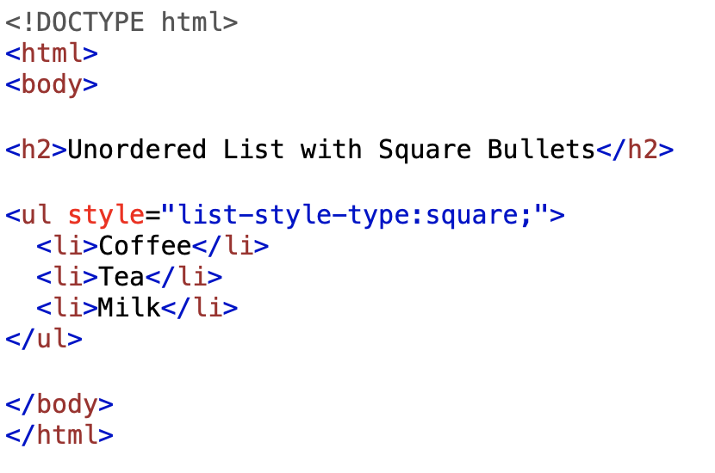
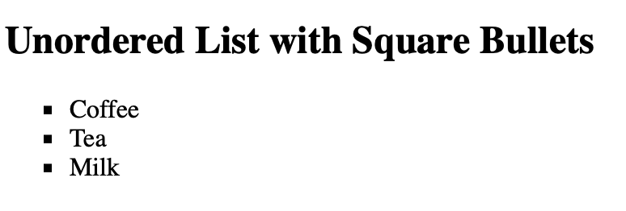
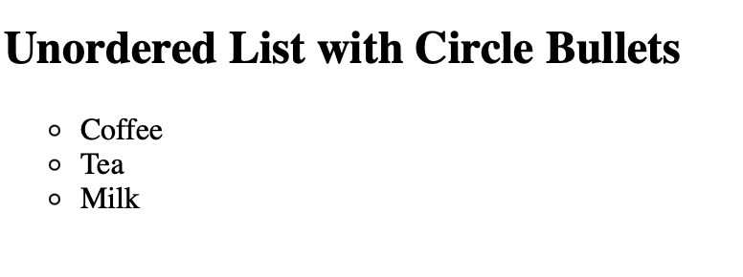
Unordered Lists

Slide 31
Ordered Lists
The HTML <ol> tag defines an ordered list. An ordered list can be numerical or alphabetical.
An ordered list starts with the <ol> tag. Each list item starts with the <li> tag.
The list items will be marked with numbers by default:
The type attribute of the <ol> tag, defines the type of the list item marker:

Slide 32
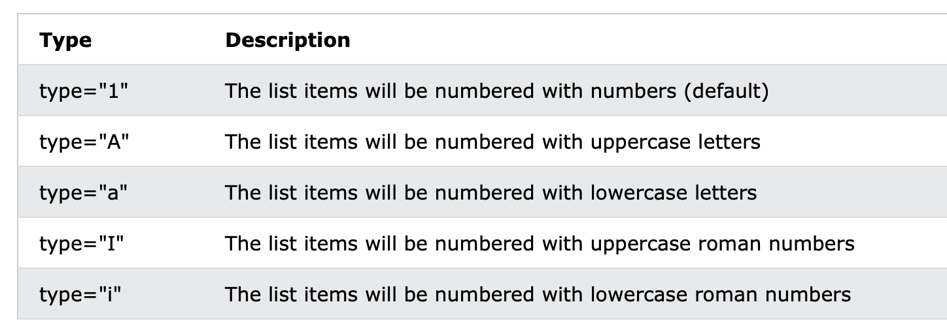
Ordered Lists

Slide 33
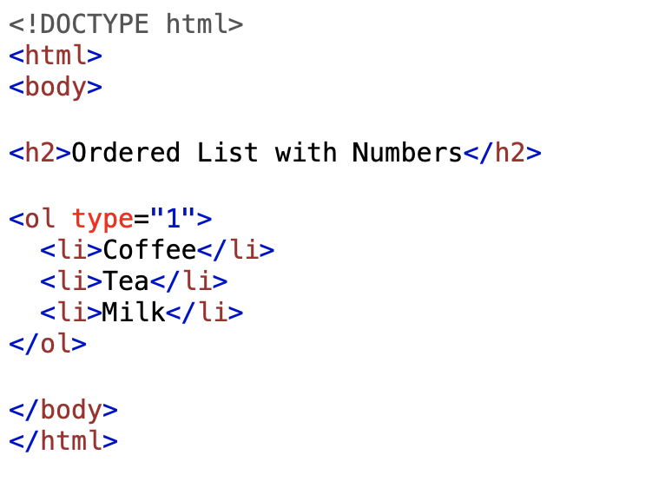
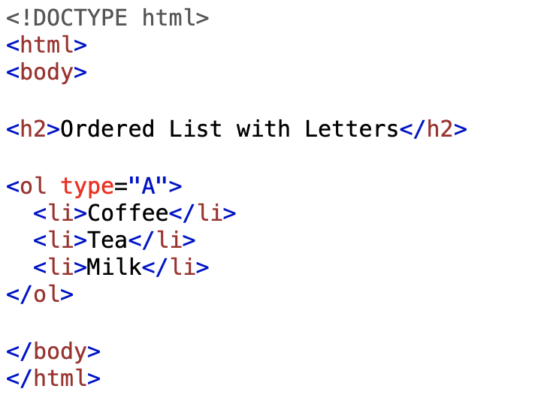
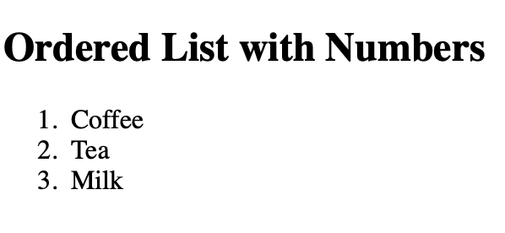
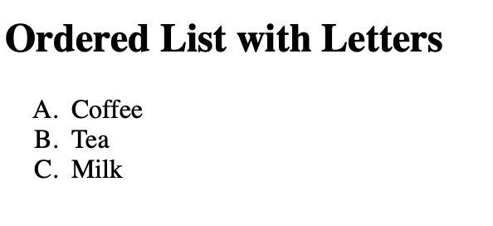
Ordered Lists

Slide 34
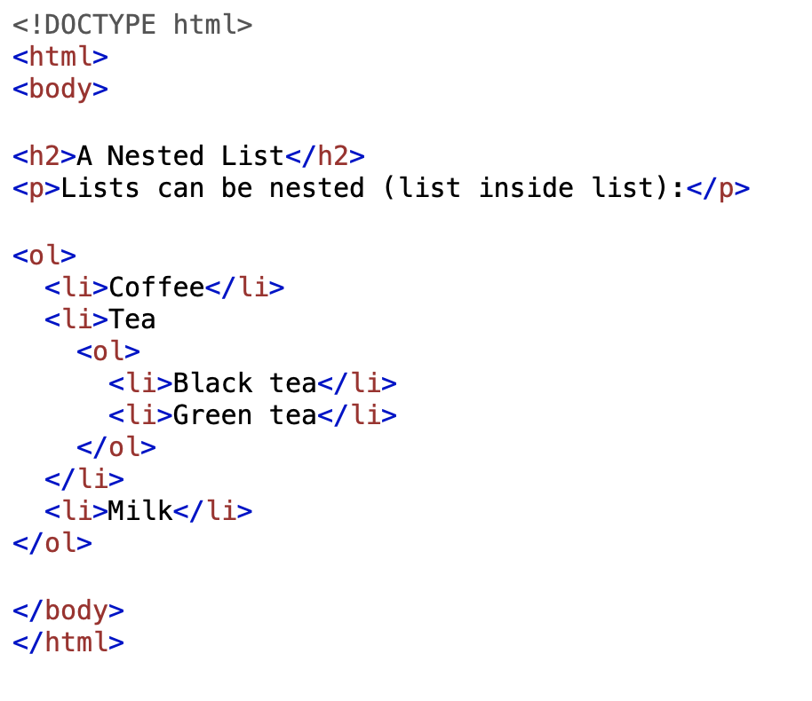
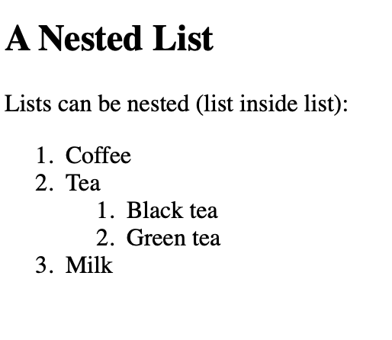
Nested Lists
Lists can be nested (list inside list):

Slide 35
HTML Block-level Elements
A block-level element always starts on a new line, and the browsers automatically add some space (a margin) before and after the element.
A block-level element always takes up the full width available (stretches out to the left and right as far as it can).
Two commonly used block elements are: <p> and <div>.
The <p> element defines a paragraph in an HTML document.
The <div> element defines a division or a section in an HTML document.

Slide 36
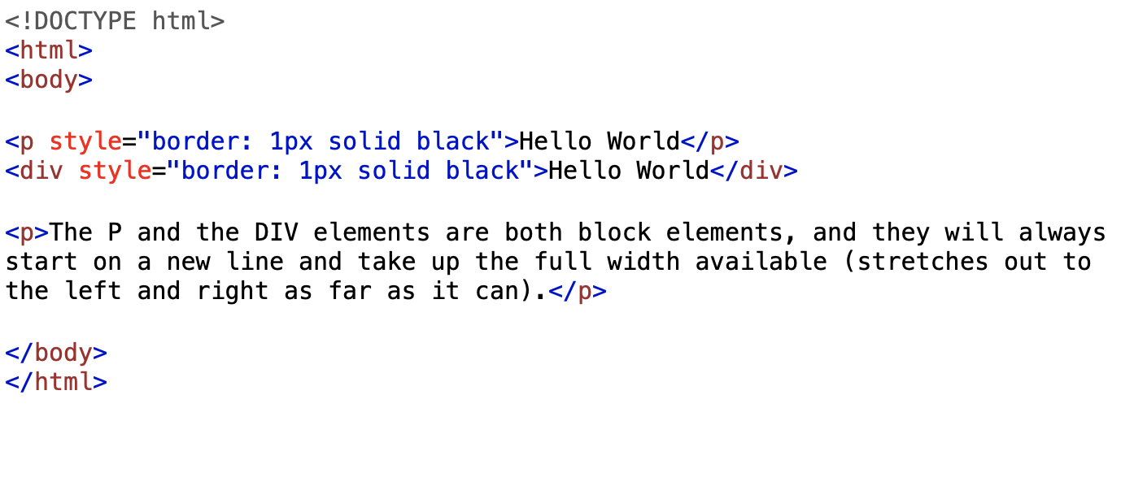
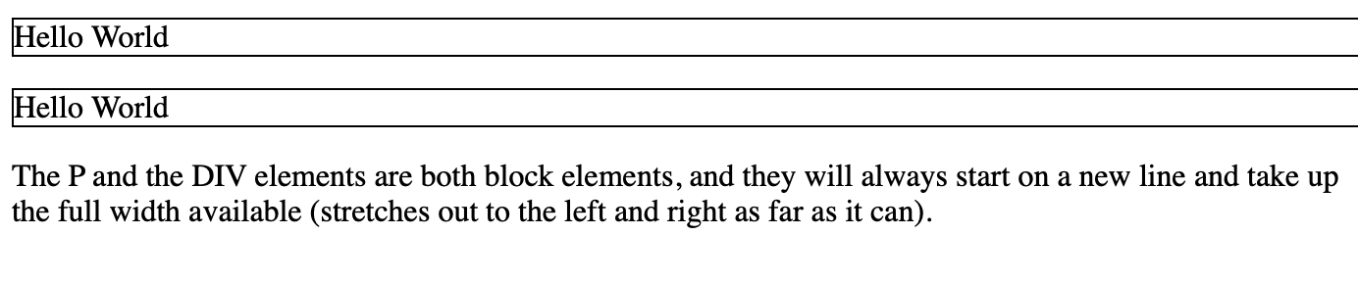
HTML Block-level Elements

Slide 37
HTML Inline Elements
An inline element does not start on a new line.
An inline element only takes up as much width as necessary.
This is a <span> element inside a paragraph.

Slide 38
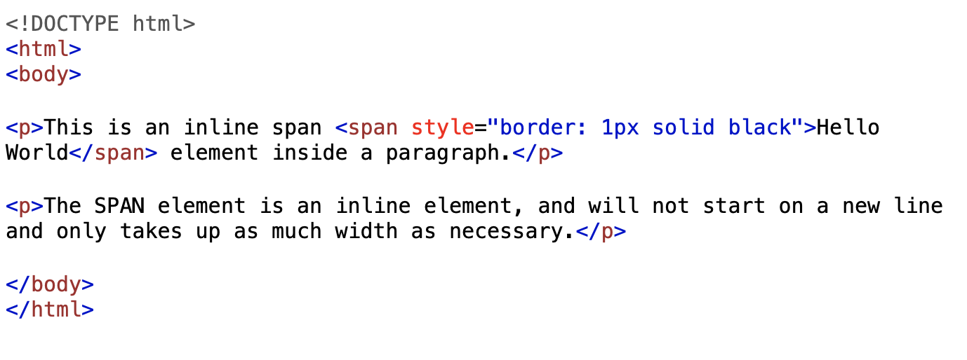
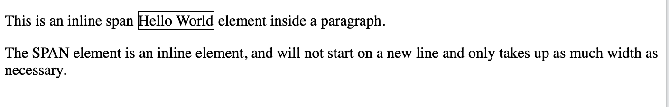
HTML Inline Elements

Slide 39
The <div> Element
The <div> element is often used as a container for other HTML elements.
The <div> element has no required attributes, but style, class and id are common.
When used together with CSS, the <div> element can be used to style blocks of content:

Slide 40
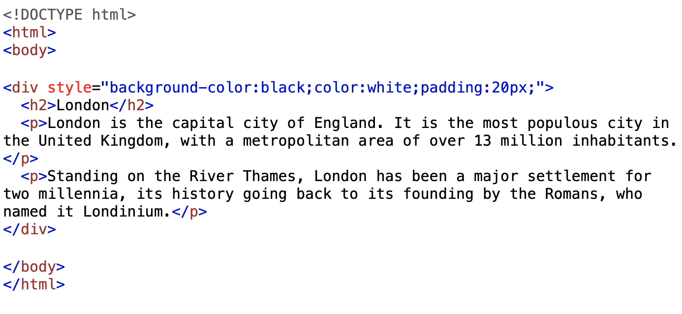
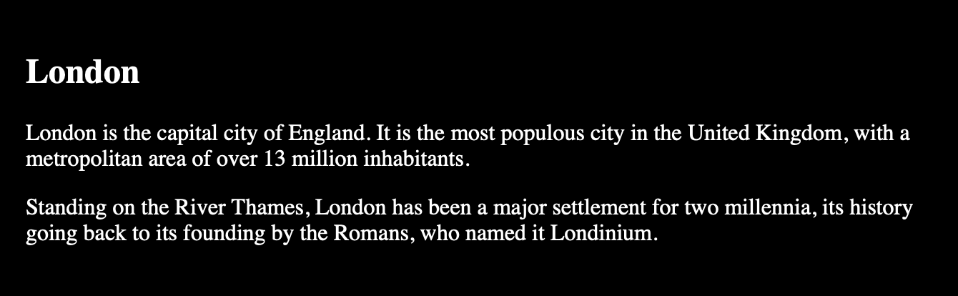
The <div> Element

Slide 41
The <span> Element
The <span> element is an inline container used to mark up a part of a text, or a part of a document.
The <span> element has no required attributes, but style, class and id are common.
When used together with CSS, the <span> element can be used to style parts of the text:

Slide 42
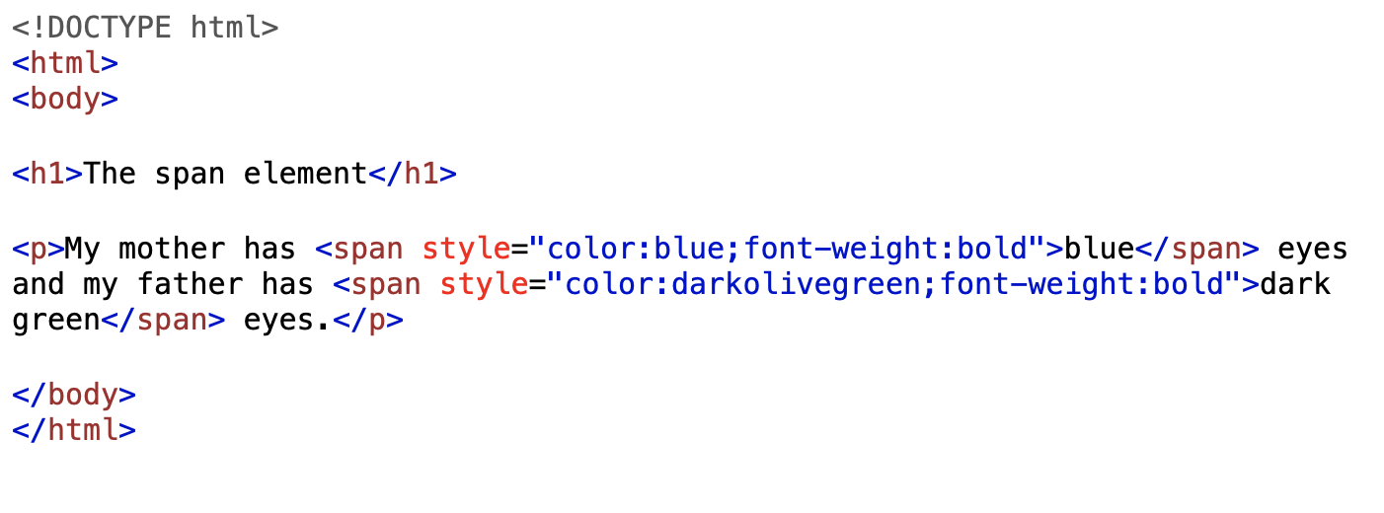
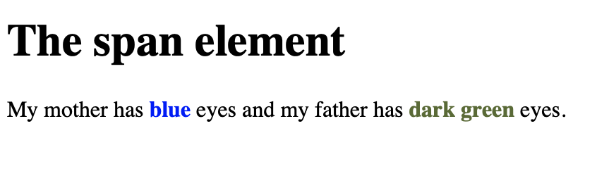
The <span> Element

Slide 43
HTML Classes
The HTML class attribute is used to specify a class for an HTML element.
Multiple HTML elements can share the same class.
The class attribute is often used to point to a class name in a style sheet. It can also be used by a JavaScript to access and manipulate elements with the specific class name.
The class name is case sensitive!
The class attribute can be used on any HTML element.

Slide 44
HTML Class Syntax
To create a class; write a period (.) character, followed by a class name. Then, define the CSS properties within curly braces {}:
[explained later in CSS]
In the following example we have three <div> elements with a class attribute with the value of "city". All of the three <div> elements will be styled equally according to the .city style definition in the head section:

Slide 45
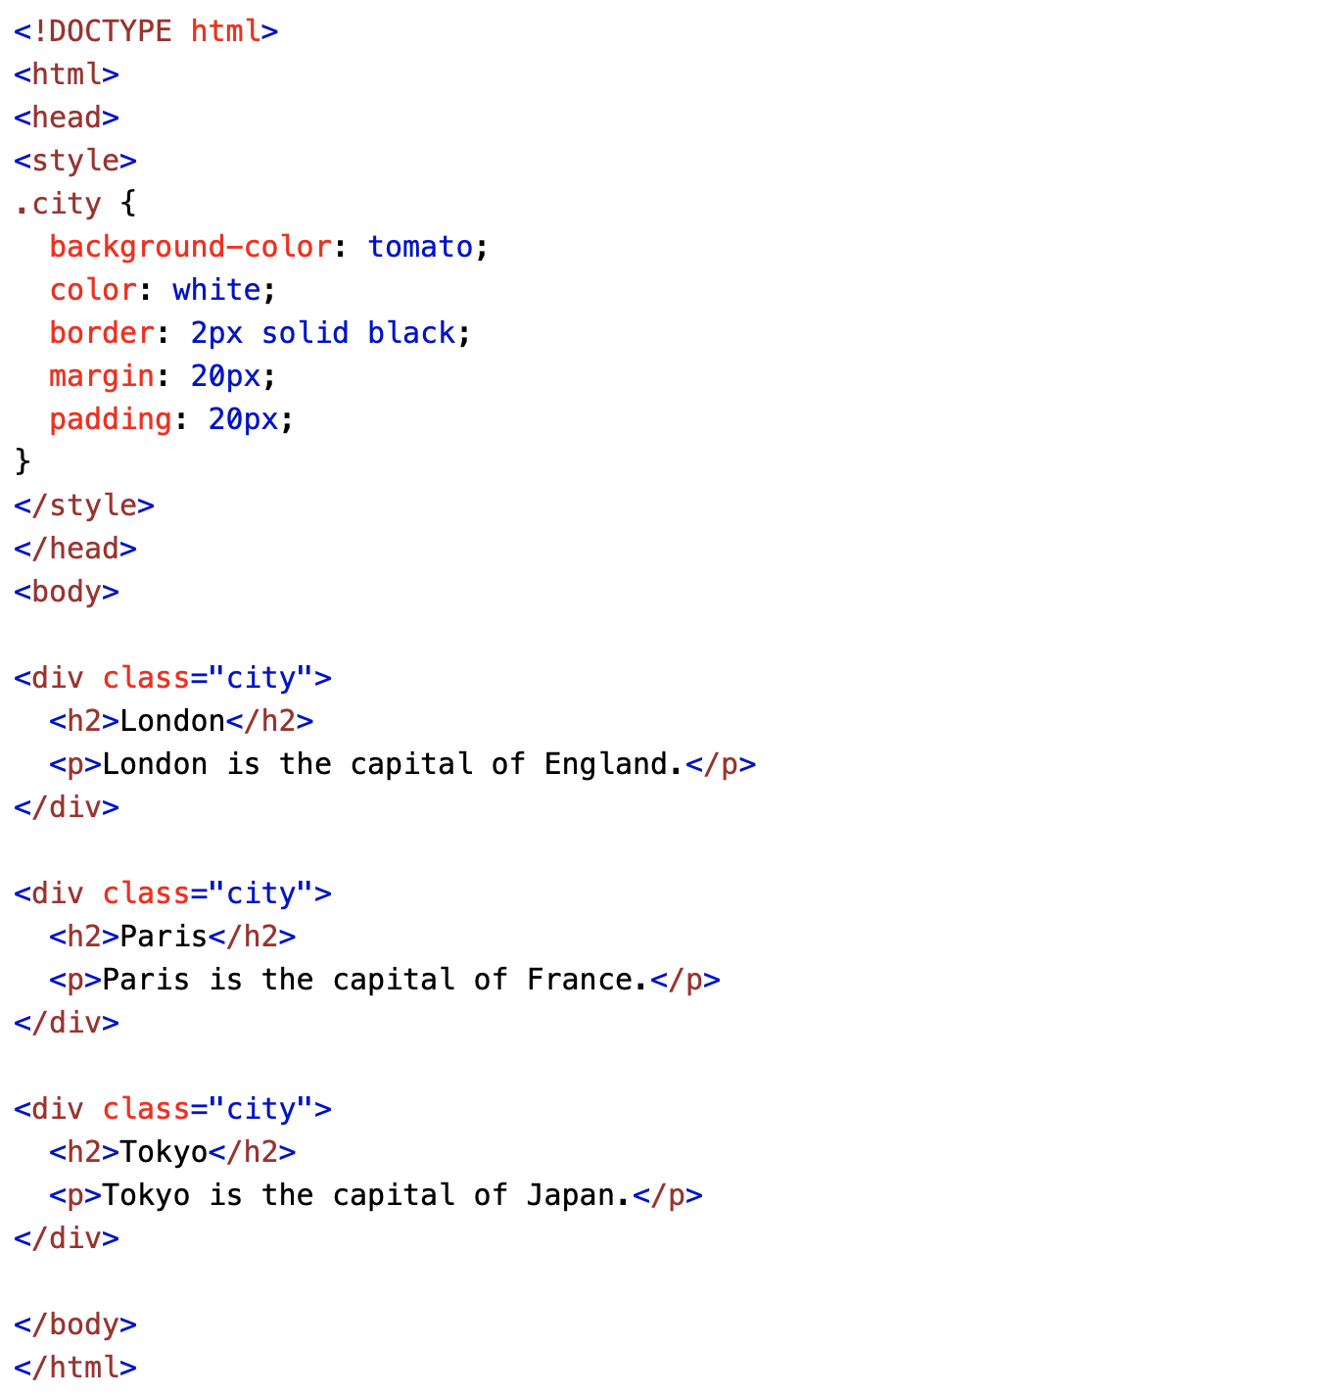
HTML Class Syntax

Slide 46
HTML id Attribute
The HTML id attribute is used to specify a unique id for an HTML element.
You cannot have more than one element with the same id in an HTML document.
The id attribute is used to point to a specific style declaration in a style sheet. It is also used by JavaScript to access and manipulate the element with the specific id.
The id name is case sensitive!
The id name must contain at least one character, cannot start with a number, and must not contain whitespaces (spaces, tabs, etc.).

Slide 47
HTML id Syntax
The syntax for id is: write a hash character (#), followed by an id name. Then, define the CSS properties within curly braces {}.
In the following example we have an <h1> element that points to the id name "myHeader". This <h1> element will be styled according to the #myHeader style definition in the head section:

Slide 48
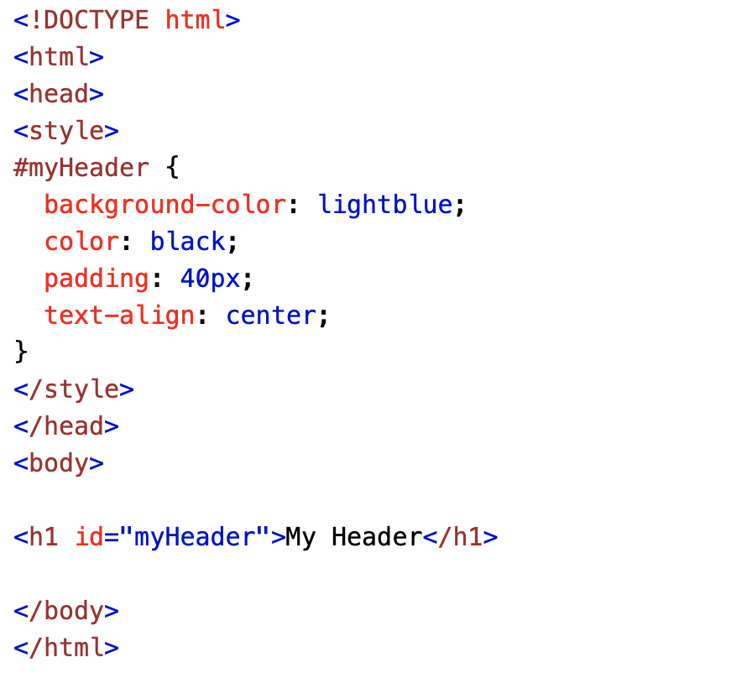
HTML id Syntax

Slide 49
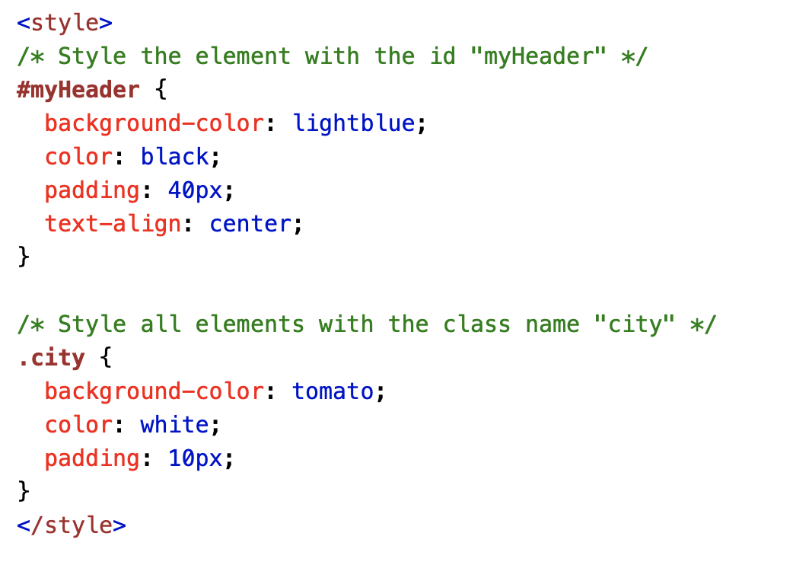
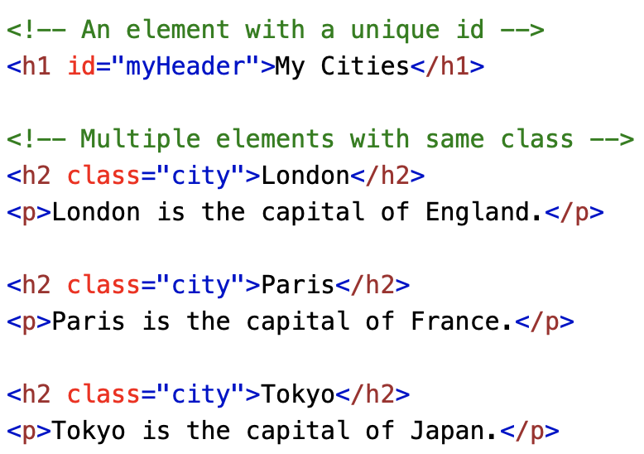
Difference Between Class and ID
A class name can be used by multiple HTML elements, while an id name must only be used by one HTML element within the page:

Slide 50
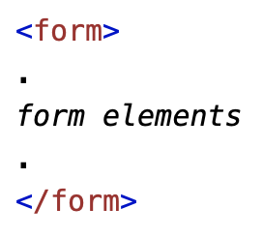
HTML Forms
An HTML form is used to collect user input. The user input is most often sent to a server for processing.
The <form> element is a container for different types of input elements, such as: text fields, checkboxes, radio buttons, submit buttons, etc.

Slide 51
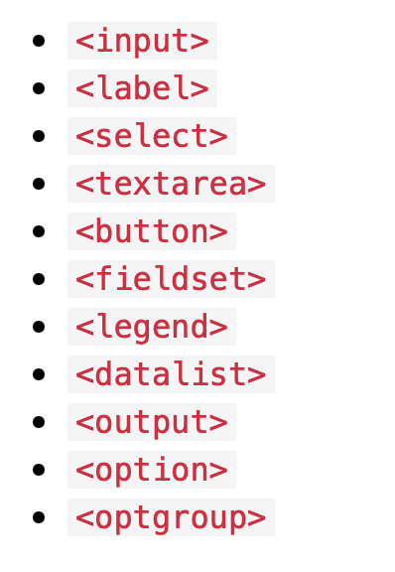
HTML Form Elements
The HTML <form> element can contain one or more of the following form elements:

Slide 52

The <input> Element
The HTML <input> element is the most used form element.
An <input> element can be displayed in many ways, depending on the type attribute.

Slide 53

HTML Input Types
Here are the different input types you can use in HTML:

Slide 54


Input Type Text
<input type="text"> defines a single-line text input field:

Slide 55


Input Type Password
<input type="password"> defines a password field:

Slide 56


Input Type Submit
<input type="submit"> defines a button for submitting form data to a form-handler.

Slide 57


Input Type Radio
<input type="radio"> defines a radio button.

Slide 58


Input Type Checkbox
<input type="checkbox"> defines a checkbox.

Slide 59


Input Type Button
<input type="button"> defines a button:

Slide 60
The <label> Element
The <label> element defines a label for several form elements.
The <label> element is useful for screen-reader users, because the screen-reader will read out loud the label when the user focus on the input element.
The <label> element also help users who have difficulty clicking on very small regions (such as radio buttons or checkboxes) - because when the user clicks the text within the <label> element, it toggles the radio button/checkbox.
The for attribute of the <label> tag should be equal to the id attribute of the <input> element to bind them together.

Slide 61


The <select> Element
The <select> element defines a drop-down list:

Slide 62
The <option> Element
The <option> elements defines an option that can be selected.
By default, the first item in the drop-down list is selected.
To define a pre-selected option, add the selected attribute to the option:

Slide 63


The <textarea> Element
The <textarea> element defines a multi-line input field (a text area):
The rows attribute specifies the visible number of lines in a text area.
The cols attribute specifies the visible width of a text area.

Slide 64


The <button> Element
The <button> element defines a clickable button:

Slide 65


The <fieldset> and <legend> Element
The <fieldset> element is used to group related data in a form.
The <legend> element defines a caption for the <fieldset> element.

Slide 66


The <output> Element
The <output> element represents the result of a calculation (like one performed by a script (here php (will be shown in later labs)).

Slide 67
HTML Form Attribute
The Action Attribute
The Target Attribute
The Method Attribute

Slide 68
The Action Attribute
The action attribute defines the action to be performed when the form is submitted.
Usually, the form data is sent to a file on the server when the user clicks on the submit button.
In the example below, the form data is sent to a file called "action_page.php". This file contains a server-side script that handles the form data:

Slide 69



The Action Attribute

Slide 70

The Target Attribute
The target attribute specifies where to display the response that is received after submitting the form.
The target attribute can have one of the following values:

Slide 71

The Target Attribute

Slide 72
The Method Attribute
The method attribute specifies the HTTP method to be used when submitting the form data.
The form-data can be sent as URL variables (with method="get") or as HTTP post transaction (with method="post").
The default HTTP method when submitting form data is GET.

Slide 73



The Method Attribute (GET)

Slide 74



The Method Attribute (POST)

Slide 75
Reference
https://www.w3schools.com/

Slide 76
CSS Introduction
CSS is the language we use to style a Web page.
CSS stands for Cascading Style Sheets.
CSS describes how HTML elements are to be displayed on screen, paper, or in other media.
CSS saves a lot of work. It can control the layout of multiple web pages all at once.
External stylesheets are stored in CSS files.

Slide 77
Why use CSS?
CSS is used to define styles for your web pages, including the design, layout and variations in display for different devices and screen sizes.
HTML was NEVER intended to contain tags for formatting a web page!
HTML was created to describe the content of a web page.
CSS Saves a Lot of Work!
The style definitions are normally saved in external .css files.
With an external stylesheet file, you can change the look of an entire website by changing just one file!

Slide 78

CSS Syntax
A CSS rule consists of a selector and a declaration block.
The selector points to the HTML element you want to style.
The declaration block contains one or more declarations separated by semicolons.
Each declaration includes a CSS property name and a value, separated by a colon.
Multiple CSS declarations are separated with semicolons, and declaration blocks are surrounded by curly braces.

Slide 79


CSS Example

Slide 80
Example Explained
p is a selector in CSS (it points to the HTML element you want to style: <p>).
color is a property, and red is the property value.
text-align is a property, and center is the property value.

Slide 81
CSS Selectors
CSS selectors are used to "find" (or select) the HTML elements you want to style.
We can divide CSS selectors into five categories:
Simple selectors (select elements based on name, id, class)
Combinator selectors (select elements based on a specific relationship between them)
Pseudo-class selectors (select elements based on a certain state)
Pseudo-elements selectors (select and style a part of an element)
Attribute selectors (select elements based on an attribute or attribute value) *Click on each of them for examples

Slide 82


The CSS Element Selector
The element selector selects HTML elements based on the element name.
Here, all <p> elements on the page will be center-aligned, with a red text color:

Slide 83
The CSS id Selector
The id selector uses the id attribute of an HTML element to select a specific element.
The id of an element is unique within a page, so the id selector is used to select one unique element!
To select an element with a specific id, write a hash (#) character, followed by the id of the element.

Slide 84


The CSS id Selector
The CSS rule below will be applied to the HTML element with id="para1":

Slide 85


The CSS class Selector
The class selector selects HTML elements with a specific class attribute.
To select elements with a specific class, write a period (.) character, followed by the class name.
In this example all HTML elements with class="center" will be red and center-aligned:

Slide 86


The CSS Universal Selector
The universal selector (*) selects all HTML elements on the page.
The CSS rule below will affect every HTML element on the page:

Slide 87

The CSS Grouping Selector
The grouping selector selects all the HTML elements with the same style definitions.
Look at the following CSS code (the h1, h2, and p elements have the same style definitions):

Slide 88

The CSS Grouping Selector
It will be better to group the selectors, to minimize the code.
To group selectors, separate each selector with a comma.

Slide 89

How to add CSS?
Three Ways to Insert CSS
External CSS
Internal CSS
Inline CSS

Slide 90

How to add CSS?
Three Ways to Insert CSS
External CSS
Internal CSS
Inline CSS

Slide 91

How to add CSS?
Three Ways to Insert CSS
External CSS
Internal CSS
Inline CSS

Slide 92
CSS Box Model
All HTML elements can be considered as boxes.
In CSS, the term "box model" is used when talking about design and layout.
The CSS box model is essentially a box that wraps around every HTML element. It consists of: margins, borders, padding, and the actual content. The image below illustrates the box model:

Slide 93

CSS Box Model

Slide 94

CSS Borders
The CSS border properties allow you to specify the style, width, and color of an element's border.

Slide 95

Border Width
The border-width property can have from one to four values (for the top border, right border, bottom border, and the left border):

Slide 96


CSS Border – Shorthand Property

Slide 97


CSS Margins
The CSS margin properties are used to create space around elements, outside of any defined borders.
With CSS, you have full control over the margins. There are properties for setting the margin for each side of an element (top, right, bottom, and left).

Slide 98



CSS Margin – Shorthand Property

Slide 99


CSS Padding
The CSS padding properties are used to generate space around an element's content, inside of any defined borders.
With CSS, you have full control over the padding. There are properties for setting the padding for each side of an element (top, right, bottom, and left).

Slide 100


Padding – Shorthand Property

Slide 101

CSS Text : Text Color
The color property is used to set the color of the text. The color is specified by:
a color name - like "red"
a HEX value - like "#ff0000"
an RGB value - like "rgb(255,0,0)"

Slide 102

CSS Text : Text Alignment
The text-align property is used to set the horizontal alignment of a text.
A text can be left or right aligned, centered, or justified.
The following example shows center aligned, and left and right aligned text (left alignment is default if text direction is left-to-right, and right alignment is default if text direction is right-to-left):

Slide 103

CSS Fonts
In CSS there are five generic font families:
Serif fonts have a small stroke at the edges of each letter. They create a sense of formality and elegance.
Sans-serif fonts have clean lines (no small strokes attached). They create a modern and minimalistic look.
Monospace fonts - here all the letters have the same fixed width. They create a mechanical look.
Cursive fonts imitate human handwriting.
Fantasy fonts are decorative/playful fonts.

Slide 104

Google Fonts
If you do not want to use any of the standard fonts in HTML, you can use Google Fonts.
Google Fonts are free to use, and have more than 1000 fonts to choose from.

Slide 105
CSS Icons
The simplest way to add an icon to your HTML page, is with an icon library, such as Font Awesome.
Add the name of the specified icon class to any inline HTML element (like <i> or <span>).
All the icons in the icon libraries below, are scalable vectors that can be customized with CSS (size, color, shadow, etc.)

Slide 106


Font Awesome Icons
To use the Font Awesome icons, go to fontawesome.com, sign in, and get a code to add in the <head> section of your HTML page:

Slide 107
CSS Links
Links can be styled with any CSS property (e.g. color, font-family, background, etc.).
In addition, links can be styled differently depending on what state they are in.
The four links states are:
a:link - a normal, unvisited link
a:visited - a link the user has visited
a:hover - a link when the user mouses over it
a:active - a link the moment it is clicked

Slide 108

CSS Link Example

Slide 109
CSS Lists
In HTML, there are two main types of lists:
unordered lists (<ul>) - the list items are marked with bullets
ordered lists (<ol>) - the list items are marked with numbers or letters
The CSS list properties allow you to:
Set different list item markers for ordered lists
Set different list item markers for unordered lists
Set an image as the list item marker
Add background colors to lists and list items

Slide 110

Different List Item Markers
The list-style-type property specifies the type of list item marker.
The following example shows some of the available list item markers:

Slide 111

CSS Tables
The look of an HTML table can be greatly improved with CSS:

Slide 112

Table Borders
To specify table borders in CSS, use the border property.
The example below specifies a solid border for <table>, <th>, and <td> elements:

Slide 113

Table Size
The width and height of a table are defined by the width and height properties.
The example below sets the width of the table to 100%, and the height of the <th> elements to 70px:

Slide 114

Table Alignment : Horizontal
The text-align property sets the horizontal alignment (like left, right, or center) of the content in <th> or <td>.
By default, the content of <th> elements are center-aligned and the content of <td> elements are left-aligned.
To center-align the content of <td> elements as well, use text-align: center:

Slide 115

Table Alignment : Vertical
The vertical-align property sets the vertical alignment (like top, bottom, or middle) of the content in <th> or <td>.
By default, the vertical alignment of the content in a table is middle (for both <th> and <td> elements).
The following example sets the vertical text alignment to bottom for <td> elements:

Slide 116


CSS Table Style : Table Padding
To control the space between the border and the content in a table, use the padding property on <td> and <th> elements:

Slide 117


CSS Table Style : Horizontal Dividers
Add the border-bottom property to <th> and <td> for horizontal dividers:

Slide 118

CSS Table Style : Hoverable Table
Use the :hover selector on <tr> to highlight table rows on mouse over:

Slide 119

CSS Table Style : Stripped Table
For zebra-striped tables, use the nth-child() selector and add a background-color to all even (or odd) table rows:

Slide 120


CSS Layout - The z-index Property
When elements are positioned, they can overlap other elements.
The z-index property specifies the stack order of an element (which element should be placed in front of, or behind, the others).
An element can have a positive or negative stack order:

Slide 121
CSS Layout – float
The CSS float property specifies how an element should float.
Float Property:
Left - The element floats to the left of its container.
Right - The element floats to the right of its container.
None - The element does not float (will be displayed just where it occurs in the text).
Inherit - The element inherits the float value of its parent.

Slide 122


Example – float: right
The following example specifies that an image should float to the right in a text:

Slide 123


Example – float: left
The following example specifies that an image should float to the left in a text:

Slide 124


CSS Opacity
The opacity property specifies the opacity/transparency of an element.
The opacity property can take a value from 0.0 - 1.0. The lower value, the more transparent:

Slide 125


CSS Navigation Bars
A navigation bar needs standard HTML as a base.
In our examples we will build the navigation bar from a standard HTML list.
A navigation bar is basically a list of links, so using the <ul> and <li> elements makes perfect sense:

Slide 126




CSS Dropdowns

Slide 127
Reference
https://www.w3schools.com/

Slide 128
Thank You!!!

