Slide 1
DATA SCIENCE · SPORTS ANALYTICS · PRIVACY
Forgettable Athlete
Privacy-Preserving Injury Risk Prediction
Machine Learning
Explainable AI
Machine Unlearning
Asir Abdullah – 24224511
Talha MD Abu – 24224559
Nazmul Islam - 23229531
Tokyo International University · Data Science & AI Project (Spring)

Slide 2
01 · THE PROBLEM
Why this is hard
Predicting injuries
while respecting
player privacy.
Player welfare
Injuries can end careers — early warning helps medical staff act.
Privacy law
Athletes have a right to be forgotten — data must be deletable.
Clubs collect huge amounts of athlete data.
But players can ask to be forgotten
(GDPR, retirement, transfer).
Compute cost
Retraining models from scratch on every request is expensive at season scale.
Forgettable Athlete · Privacy-Preserving Injury Risk
02 / 15

Slide 3
02 · PROJECT GOALS
What we set out to build
01
02
Predict next-season injury
Compare ML algorithms
A supervised classifier on player health and workload data.
Logistic Regression vs Random Forest vs XGBoost vs LightGBM.
03
04
Explain each prediction
Forget a player fast
SHAP shows which features drive every individual decision.
SISA machine unlearning honours deletion requests in seconds.
Forgettable Athlete · Privacy-Preserving Injury Risk
03 / 15

Slide 4
03 · DATASET
Real injury data + synthetic privacy IDs
University Football Injury Prediction Dataset (yuanchunhong / Kaggle)
800
25
50%
4
3
players
features
injury rate
playing positions
synthetic ID columns
Target variable
Injury_Next_Season → 1 = injury, 0 = no injury
Balanced: 400 injured vs 400 healthy — accuracy is a meaningful metric, no resampling needed.
Forgettable Athlete · Privacy-Preserving Injury Risk
04 / 15

Slide 5
04 · FEATURES
Five families of features
Demographics
Age · Height · Weight · BMI · Position
Workload
Training hours/week · Matches played · Previous injuries
Physical tests
Knee strength · Hamstring · Reaction time · Balance · Sprint · Agility
Lifestyle
Sleep hours · Stress · Nutrition · Warmup adherence
Privacy (synthetic)
Player_ID · Team_ID · Deletion_Request
Forgettable Athlete · Privacy-Preserving Injury Risk
05 / 15

Slide 6
05 · PREPROCESSING
From raw CSV to model-ready matrix
1
2
3
4
5
Missing values
Duplicates
Encode position
Drop IDs
Final
Median fill
(none found)
Drop dupes
(none found)
One-hot →
4 dummy cols
Keep aside for
unlearning
800 rows ×
28 cols
Why keep ID columns separately?
Player_ID, Team_ID and Deletion_Request are not predictors — they are needed later to identify which rows to forget.
Forgettable Athlete · Privacy-Preserving Injury Risk
06 / 15

Slide 7
06 · FEATURE ENGINEERING
Four sports-science
signals built
on top of the raw
features.
A
ACWR
Acute-Chronic Workload Ratio. Current load vs 5-row rolling average. >1.3 = elevated risk.
RS
Recovery Score
Weighted blend: sleep + nutrition + warmup − stress.
FI
Fatigue Index
Training load + matches played offset by recovery.
IF
Injury Freq. Score
Previous injuries ÷ age — chronic-injury proxy.
Forgettable Athlete · Privacy-Preserving Injury Risk
07 / 15

Slide 8
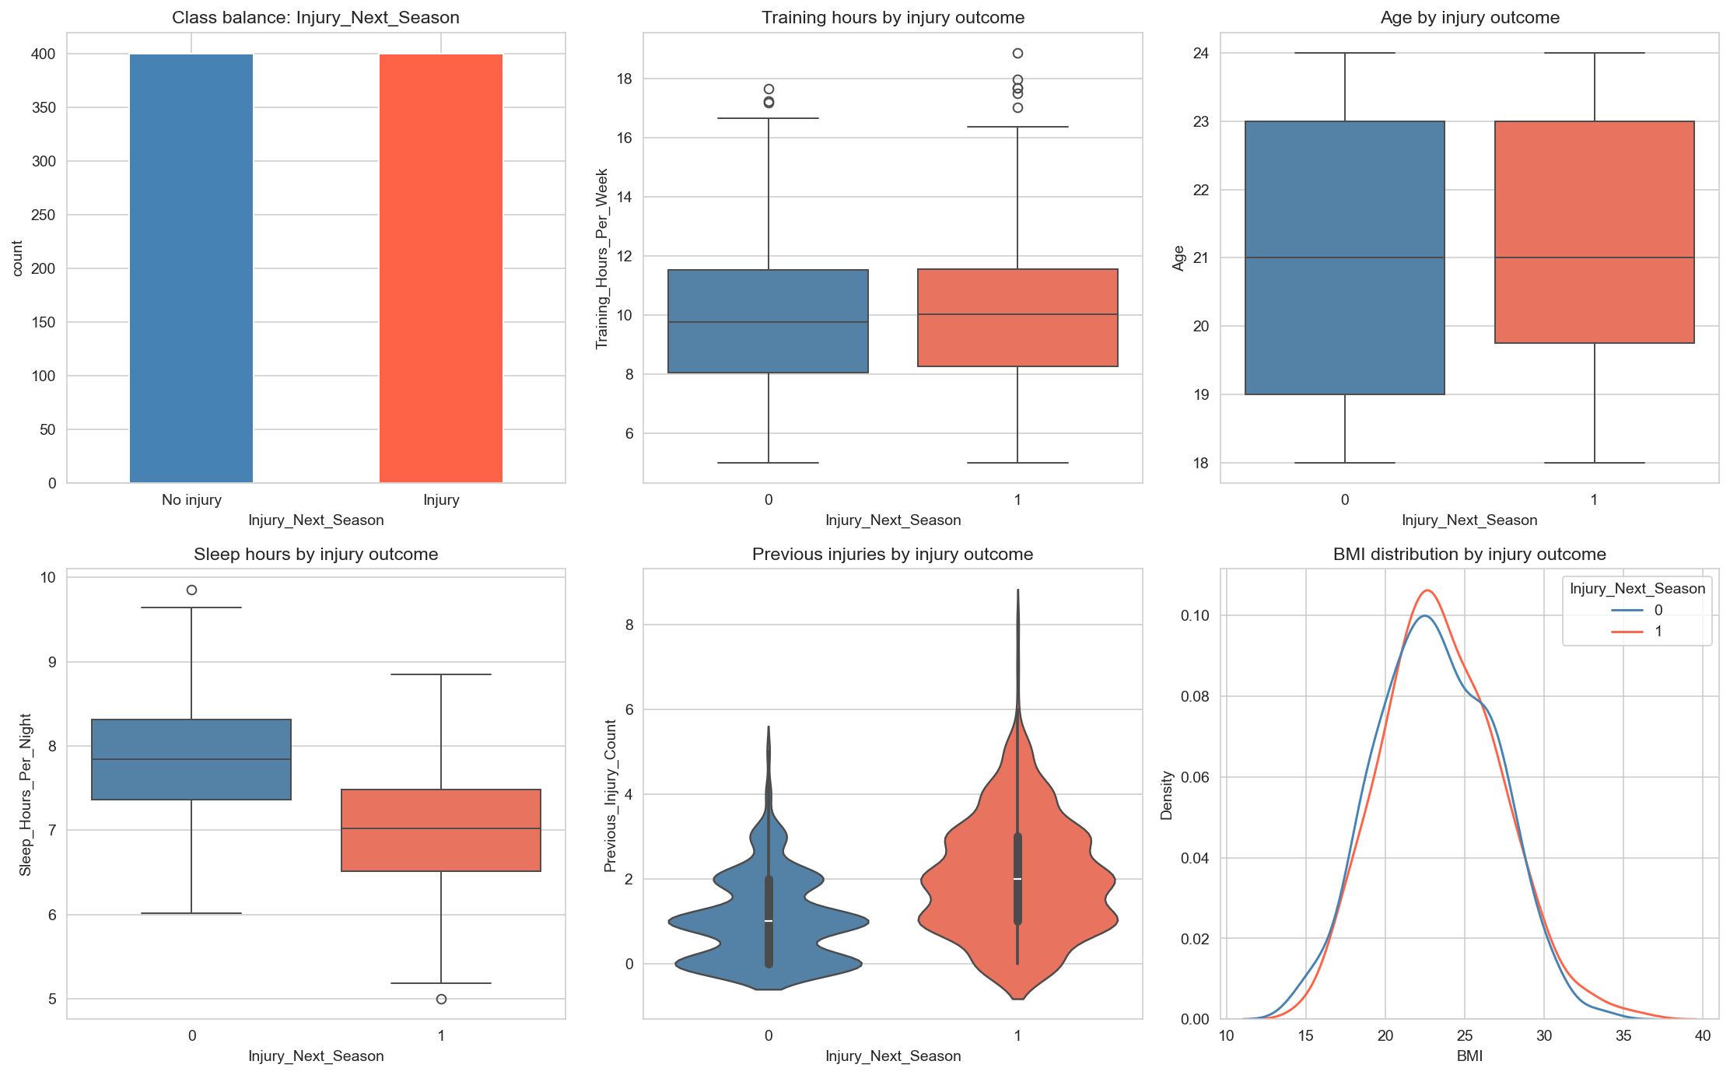
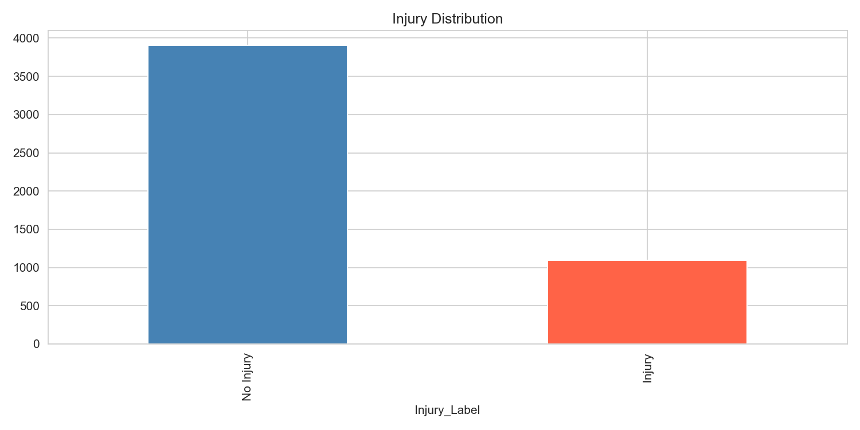
07 · EXPLORATORY DATA ANALYSIS
What the data tells us
Key insights
▍ Classes are balanced (50 / 50).
▍ Injured players train slightly more on average.
▍ Sleep tends to be lower in the injured group.
▍ Age alone does not separate the classes.
▍ BMI distributions overlap — weak signal.
Forgettable Athlete · Privacy-Preserving Injury Risk
08 / 15

Slide 9
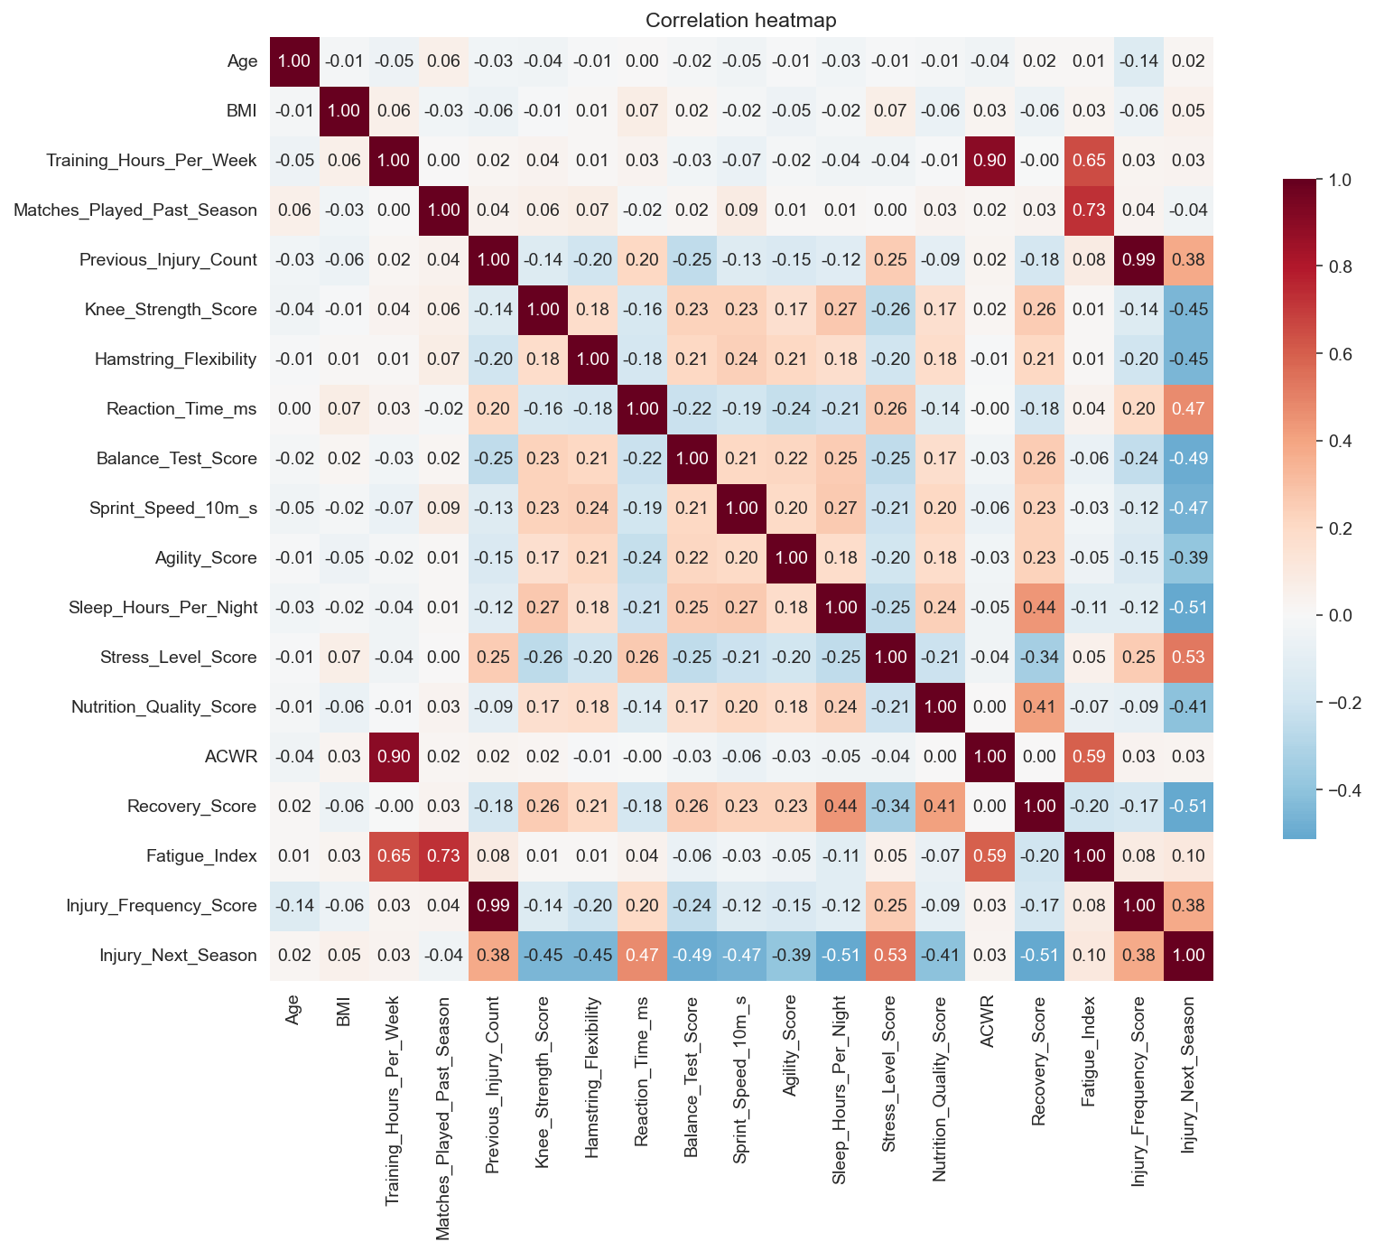
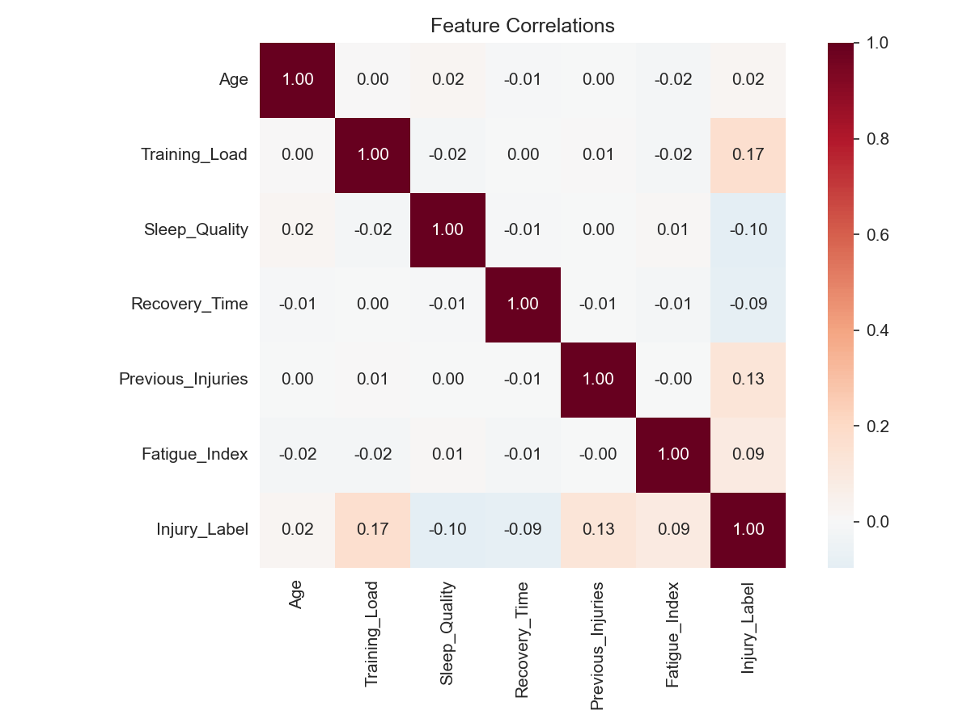
08 · CORRELATIONS
No single feature dominates
Reading the map
Weak correlations are normal
Injury data is multi-causal; no obvious silver bullet.
Engineered features add lift
Fatigue_Index and Injury_Frequency_Score carry novel signal.
Linear model is enough
Engineered features encode the interactions — Logistic Regression captures them linearly.
Forgettable Athlete · Privacy-Preserving Injury Risk
09 / 15

Slide 10
09 · TRAIN / TEST SPLIT
80 / 20, stratified on the target
TRAIN · 640 rows
TEST · 160
25
50% / 50%
StandardScaler
3 ID cols
predictor features
injury rate in train AND test
applied (fit on train only)
held aside for unlearning
Forgettable Athlete · Privacy-Preserving Injury Risk
10 / 15

Slide 11
10 · MODELS
Four algorithms, one fair comparison
Model
Family
Strength
Watch-out
Logistic Regression
Linear
Fast and interpretable
Misses unmodeled interactions (handled here)
Random Forest
Bagging
Robust, no tuning needed
Larger, less explainable
XGBoost
Boosting
Top tabular performance
Overfits small datasets without tuning
LightGBM
Boosting
Fastest, low memory
Can overfit small data
Primary metric: ROC-AUC — both false negatives (missed injury) and false positives (wasted rest) matter.
Forgettable Athlete · Privacy-Preserving Injury Risk
11 / 15

Slide 12
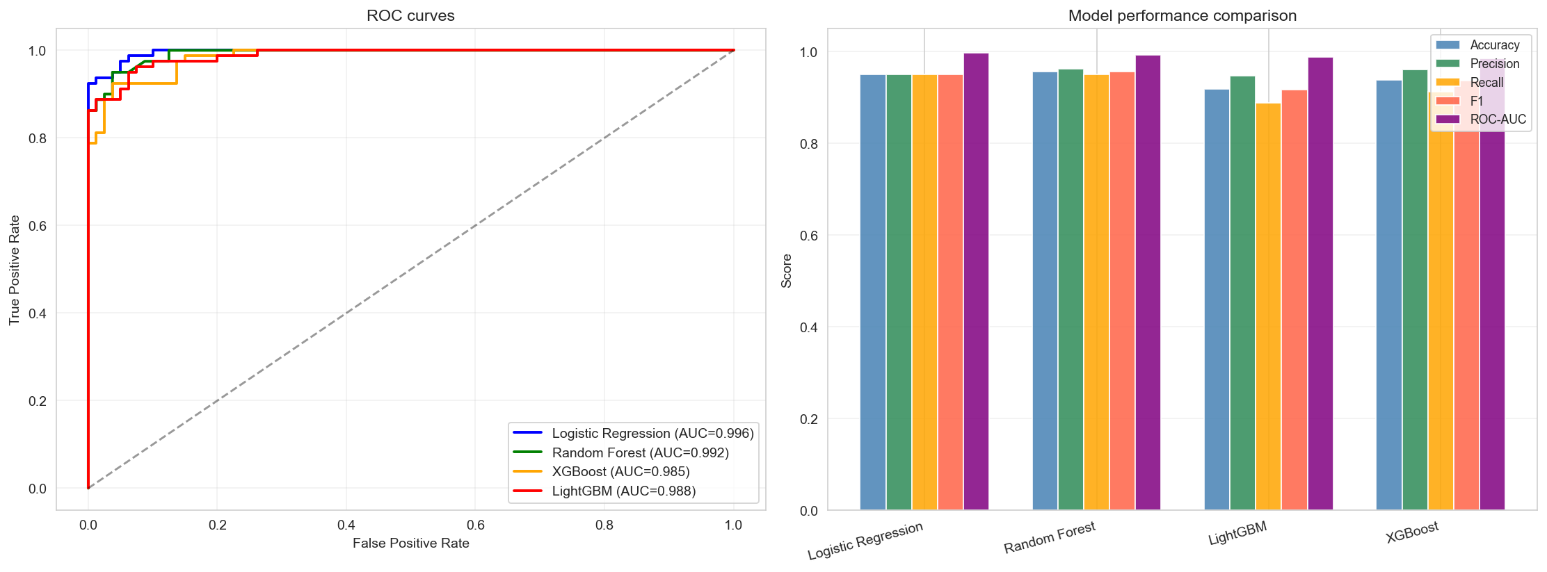
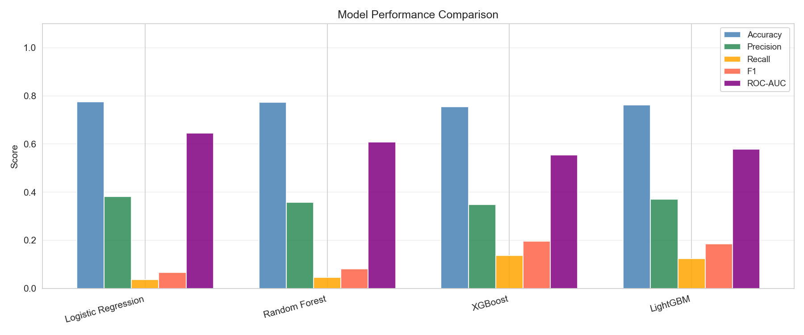
11 · RESULTS
All four models clear 0.95 accuracy
Logistic Reg.
0.996
AUC
Random Forest
0.993
AUC
LightGBM
0.988
AUC
XGBoost
0.985
AUC
Logistic Regression edged AUC; Random Forest edged accuracy — the dataset is well-separated.
Forgettable Athlete · Privacy-Preserving Injury Risk
12 / 15

Slide 13
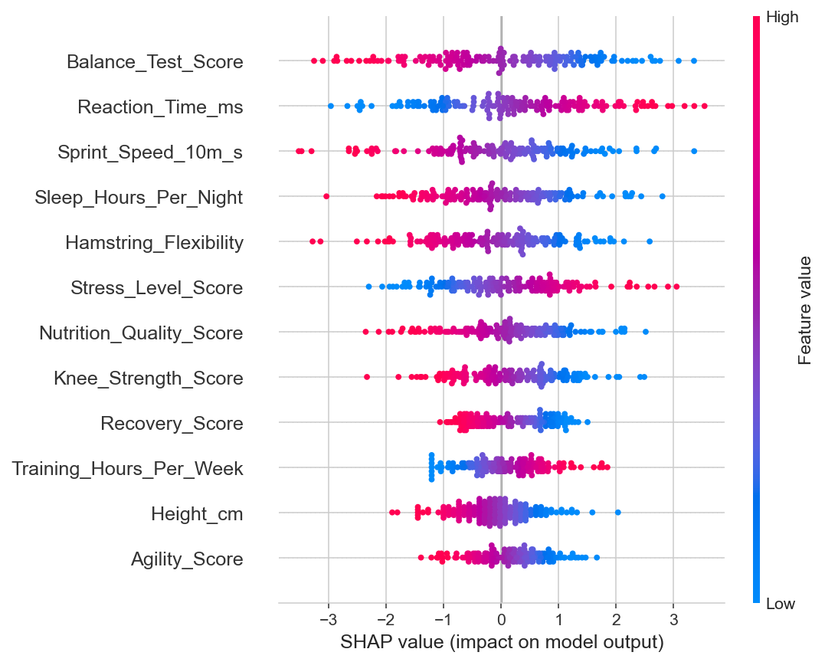
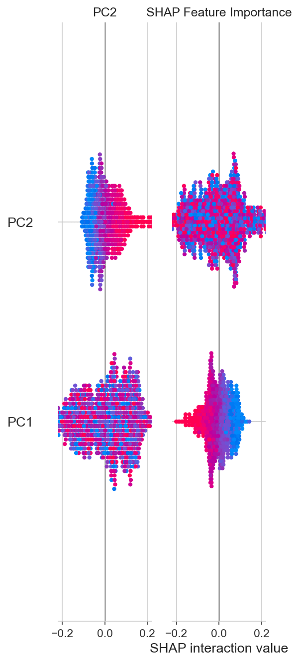
12 · EXPLAINABLE AI
SHAP on Logistic Regression — exact, auditable attributions
In plain words
Global view
Which features matter most across all players.
Local view
Per-player breakdown — auditable decisions.
Top drivers (LR)
Balance, Reaction Time, Sprint Speed, Sleep hours.
For medical staff
Justifies why a player should rest this week.
Forgettable Athlete · Privacy-Preserving Injury Risk
13 / 15

Slide 14
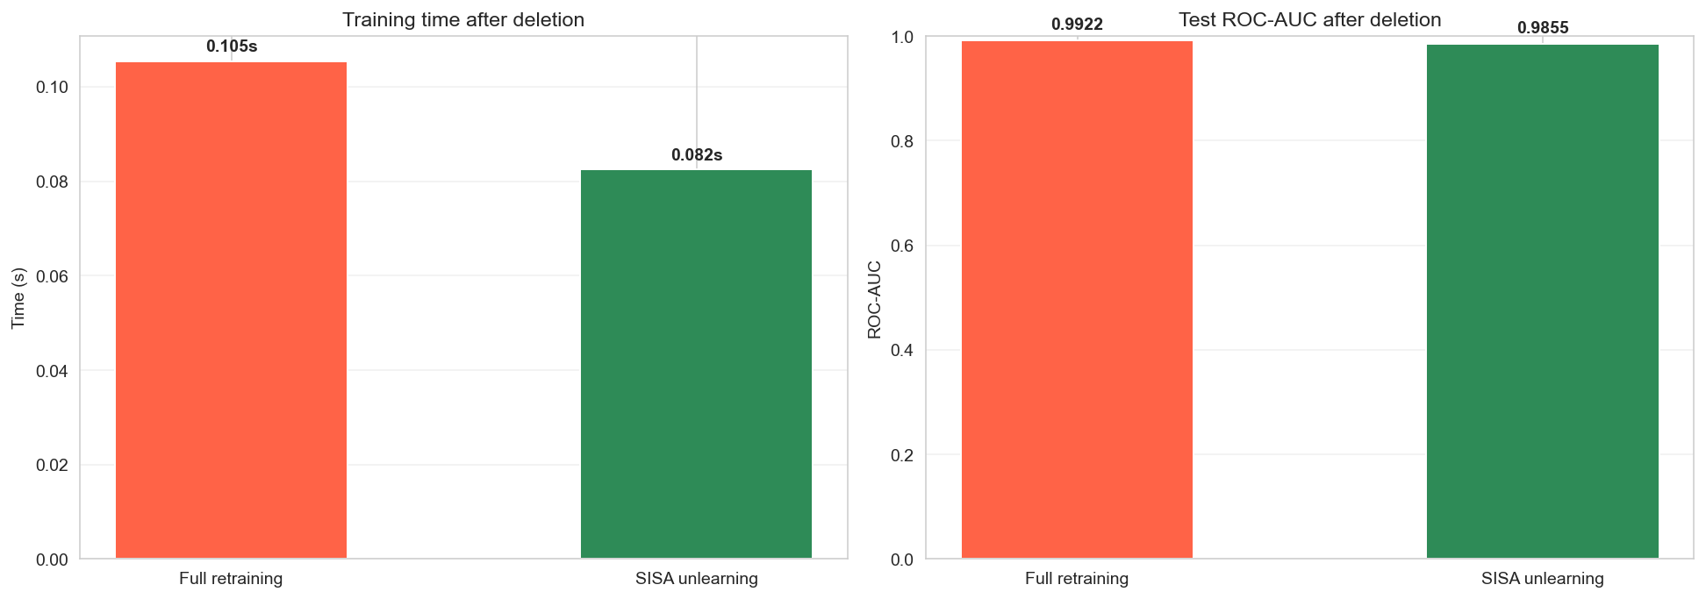
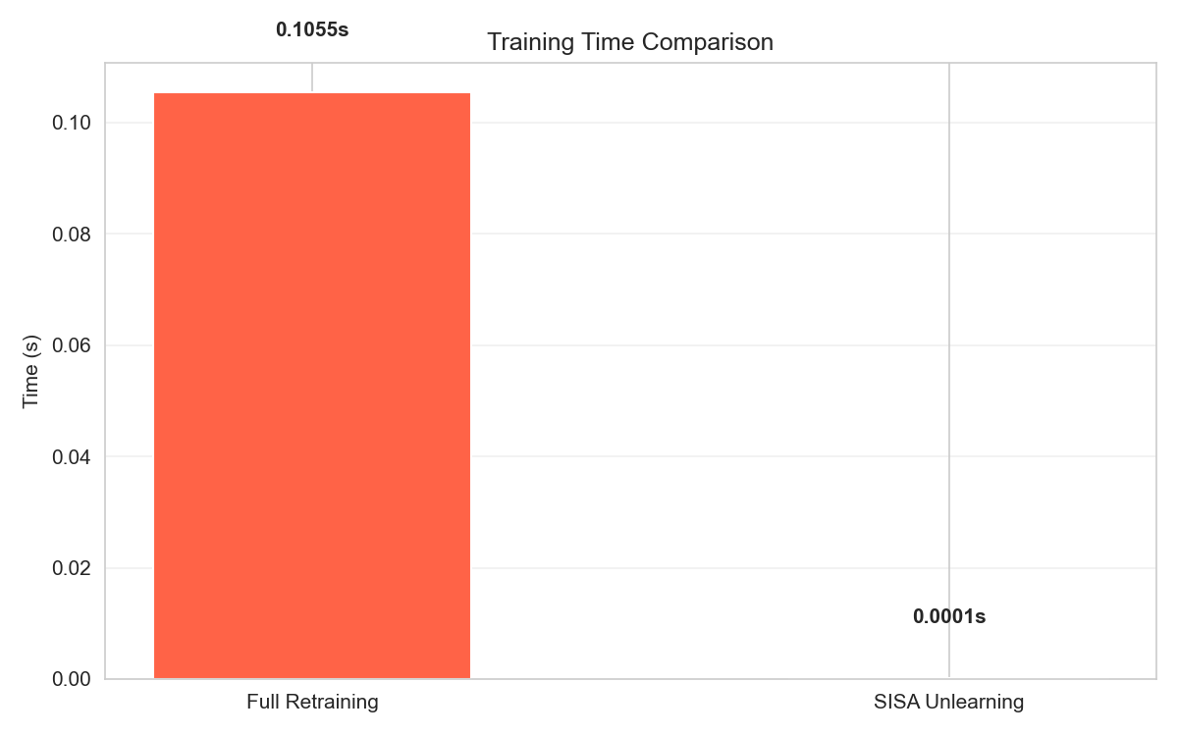
13 · MACHINE UNLEARNING
SISA: forget a player without rebuilding everything
Sharded · Isolated · Sliced · Aggregated
Shard 1
Shard 2
Shard 3
Shard 4
Shard 5
128 rows
128 rows
128 rows
128 rows
128 rows
Deletion request → only retrain the affected shards.
Batch case touched all 5 shards (~20% saving); single-player deletion would save ~80%.
What we measured
Full retraining time
0.105 s
SISA unlearn time
0.082 s
Accuracy after deletion
0.9375
ROC-AUC after deletion
0.9855
Forgettable Athlete · Privacy-Preserving Injury Risk
14 / 15

Slide 15
14 · FINAL FINDINGS
Accurate prediction + privacy by design
Real data, end-to-end
Workload + recovery matter most
Logistic Regression wins
800 university footballers, 18 raw + 4 engineered features.
Confirmed by correlations and SHAP.
LR leads ROC-AUC (0.996); RF, LightGBM, XGBoost follow.
SHAP makes it auditable
SISA honours deletion
Dual goal met
Every prediction has a per-feature reason.
Forget a player fast, keep AUC ≈ baseline.
Accurate predictions and privacy-preserving maintenance.
Thank you · Questions?
Forgettable Athlete · Tokyo International University

