Slide 1
CHRONOFORGE / PULSE
PRESENTATION 2 · 18 SLIDES
BUSINESS ANALYTICS & AI · DBI
PRESENTATION 2 · EDA & PREPROCESSING
Exploring the data.
GROUP · DBI MAJOR
COURSE PROJECT
Muhammad Kawser Ibn Khurshid Khan
24224525
EDA & data preprocessing for demand forecasting in an AI-native supply chain.
Asir Abdullah Chowdhury
24224511
Labib Mashfiq Rahman
23229564
Islam MD Mujahidul
23229550
DATASET
PERIOD
Telecom Market in Bangladesh
Jan 2008 – Dec 2015 · 96 months
ENGINE
THEN
ARIMA · LSTM · XGBoost ensemble
3 lot-sizing algorithms
Course · Business Analytics and AI Project
ChronoForge Pulse
01 / 18

Slide 2
CHRONOFORGE / PULSE
01
RECAP
01 / WHAT IS CHRONOFORGE PULSE?
ENSEMBLE OF THREE MODEL FAMILIES
An AI-native engine for forecasting & lot-sizing.
ARIMA
Classical statistical model — captures seasonality and trend.
LSTM
Deep learning — long-range temporal dependencies.
XGBoost
Gradient-boosted trees — non-linear interactions.
A decision platform for supply-chain planning. Inputs are demand signals — telecom subscribers; outputs are forecasts plus buy plans. This presentation prepares the data so the engine can learn from it.
+ Lot-sizing
Three algorithms turn forecasts into order quantities.
INPUTS
Demand signals · e.g., telecom subscribers
OUTPUTS
Forecasts + buy plans · feeds ARIMA · LSTM · XGB + 3 lot-sizers
What is ChronoForge Pulse?
02 / 18

Slide 3
CHRONOFORGE / PULSE
02
PROJECT ROADMAP
02 / THREE PRESENTATIONS, ONE PLATFORM
Where today fits.
01
TODAY
02
03
PRESENTATION 1
PRESENTATION 2
PRESENTATION 3
Problem Framing & Business Context
EDA & Data Preprocessing
ML Modelling & Lot-Sizing
Define ChronoForge Pulse, the use case, and the data source.
Clean, reshape, profile, and engineer features for the model.
Train ARIMA, LSTM, XGBoost; run three lot-sizing algorithms.
→
→
Project Roadmap
03 / 18

Slide 4
CHRONOFORGE / PULSE
03
SCOPE
03 / WHAT WE DO TODAY VS. WHAT COMES NEXT
From raw CSV to model-ready.
In Scope
TODAY
Next
PRESENTATION 3
Load raw telecom CSV header=None
Train ARIMA, LSTM, XGBoost forecasts
Reshape wide → long (tidy)
Build the ensemble blend
Type casting & date parsing
Evaluate — MAPE / RMSE / MAE
Missing-value & duplicate checks
Apply 3 lot-sizing algorithms — EOQ, Wagner-Whitin, Silver-Meal
Feature engineering — MoM_Growth_%, Market_Share_%
Generate order plans & compare scenarios
Descriptive statistics & visual EDA (5 charts)
Deploy ChronoForge Pulse
Outlier detection (IQR) & export model-ready dataset
Scope of This Presentation
04 / 18

Slide 5
CHRONOFORGE / PULSE
04
PIPELINE · INPUTS & OUTPUTS
04 / WHAT THE PREPROCESSING BLOCK TAKES AND PRODUCES
Wide & messy in. Tidy & tabular out.
INPUT
78 × 112
EDA + PREPROCESSING
10 steps
OUTPUT
576 × 7
GP Model.xlsx — Telecom Mkt. in Bangladesh.csv
Load raw CSV
telecom_clean.csv
Slice subscriber block
RAW FEATURES
Reshape wide → long (melt)
COLUMNS
Operator — 6: GP, Banglalink, Robi, Airtel, Citycell, Teletalk. Year 2008–2015, Month Jan–Dec, Subs in millions across 96 columns.
Parse Date, Year, Month
Operator · Date (datetime64) · Year · Month · Subscribers_Mn · MoM_Growth_% · Market_Share_%
Coerce numerics; check NaN
DROPPED
Drop duplicates
Sector-total row · Avg-12M / assumption columns · blank padding rows & cols. Granularity: monthly.
Engineer features
Compute stats & IQR outliers
Visualise (line / box / bar / heat)
Save telecom_clean.csv
IQR outliers flagged
51
Nulls / duplicates
0 / 0
Ready for
ARIMA · LSTM · XGB
HEADER NOTE
Multi-row header: Year row stacked above Month row · coerced into a single Period string before .melt()
Pipeline · Inputs & Outputs
05 / 18

Slide 6
CHRONOFORGE / PULSE
05
DATASET OVERVIEW
05 / TELECOM MARKET IN BANGLADESH
Eight years of subscriber demand.
Grameenphone internal market model (based on BTRC data)
RAW LAYOUT
AFTER CLEANING
SOURCE
78×112
576×7
PERIOD
January 2008 – December 2015 · 96 months
wide · mixed with assumption rows
one row per Operator × Month
OPERATORS
Grameenphone · Banglalink · Robi · Airtel · Citycell · Teletalk
"Why telecom data?"
UNITS
Subscribers in millions, one value per operator per month
Subscribers are a strong proxy for downstream demand — SIM cards, handsets, recharge logistics, tower equipment.
SECTOR GROWTH
506 → 1,536 Mn-months · ~3× over 8 years
PROXY FOR
SIM cards · handsets · recharge · tower equipment
Dataset Overview
06 / 18

Slide 7
CHRONOFORGE / PULSE
06
RAW DATA STRUCTURE
06 / WIDE FORMAT — MONTHS AS COLUMNS
A spreadsheet, not a table.
RAW LAYOUT (SIMPLIFIED)
VALUES IN MILLIONS
OPERATOR
JAN-08
FEB-08
…
DEC-15
CSV loaded with header=None — multi-row header layout
Grameenphone
16.88
17.20
…
56.54
Rows 4–10 contain operator subscriber data
Banglalink
7.45
7.88
…
33.39
Columns 2–97 hold monthly values (Jan-2008 → Dec-2015)
Robi
7.28
7.36
…
28.94
Subscriber values in millions
Airtel
2.37
2.60
…
9.82
Extra trailing columns hold averages / assumptions — dropped
Citycell
1.45
1.51
…
1.05
Teletalk
1.00
1.00
…
4.28
Raw Data Structure
07 / 18

Slide 8
CHRONOFORGE / PULSE
07
RESHAPING · WIDE → LONG
07 / ONE ROW PER (OPERATOR, MONTH)
Unpivot to tidy.
Sliced rows 4–10 and columns 2:98 into an operator × month matrix, coerced to numeric, then pandas .melt() unpivots into long format. 6 operators × 96 months = 576 tidy rows.
WIDE · 78 × 112
BEFORE
LONG · 576 × 7
AFTER
OPERATOR
JAN-08
FEB-08
…
OPERATOR
DATE
SUBS_MN
Grameenphone
16.88
17.20
…
.MELT()
Grameenphone
2008-01
16.88
Banglalink
7.45
7.88
…
→
Grameenphone
2008-02
17.20
Robi
7.28
7.36
…
Banglalink
2008-01
7.45
Airtel
2.37
2.60
…
Banglalink
2008-02
7.88
Reshaping · Wide → Long
08 / 18

Slide 9
CHRONOFORGE / PULSE
08
DATA QUALITY CHECKS
08 / MISSING VALUES, DUPLICATES, TYPES
Clean by construction.
576
7
Missing values per column: all zero after tidying
ROWS · OPERATOR × MONTH
COLUMNS
Safety net: groupby-interpolate → ffill → bfill on Subscribers_Mn
Types verified: Date is datetime64, Subscribers_Mn is float64
0
0
Numerical: Year, Subscribers_Mn, MoM_Growth_%, Market_Share_%
Categorical: Operator, Month
NULLS AFTER TIDYING
DUPLICATE (OPERATOR, DATE) KEYS
ROW MATH
576 rows = 6 operators × 96 months · zero loss vs. raw 78×112 source
Data Quality Checks
09 / 18

Slide 10
CHRONOFORGE / PULSE
09
FEATURE ENGINEERING
09 / NEW VARIABLES THE MODELS WILL USE
Two features that carry the signal.
Year + Month name extracted → seasonality & calendar features
MoM_Growth_%
These features feed directly into Presentation 3 forecasting models
= pct_change(Subscribers_Mn) within each Operator
Final dataset saved as telecom_clean.csv (576 × 7)
Captures monthly growth dynamics — a key input for XGBoost and LSTM.
Market_Share_%
= Subscribers_Mn / Sector total (per Date) × 100
Captures relative competitive position over time.
Feature Engineering
10 / 18

Slide 11
CHRONOFORGE / PULSE
10
STATISTICAL SUMMARY
10 / PER-OPERATOR SUBSCRIBER STATISTICS (MILLIONS)
A market with one giant.
OPERATOR
MIN
MEAN
MAX
STD
Grameenphone
16.88
36.03
56.54
12.16
Banglalink
7.45
21.68
33.39
8.08
Grameenphone leads on every measure — mean 36.03 Mn, peak 56.54 Mn
Robi
7.28
17.22
28.94
7.20
High std (12.16, 8.08, 7.20) for the top three → strong growth, not noise
Airtel
2.20
5.69
9.82
2.43
Citycell is flat & tiny — std 0.27, range barely 1 Mn
Teletalk
0.84
1.93
4.28
1.18
Citycell
1.05
1.61
2.00
0.27
GAP
Leader-to-laggard: Grameenphone mean (36.03 Mn) ≈ 22× Citycell (1.61 Mn) · the top three (GP · Banglalink · Robi) carry ~89% of sector demand.
Statistical Summary
11 / 18

Slide 12
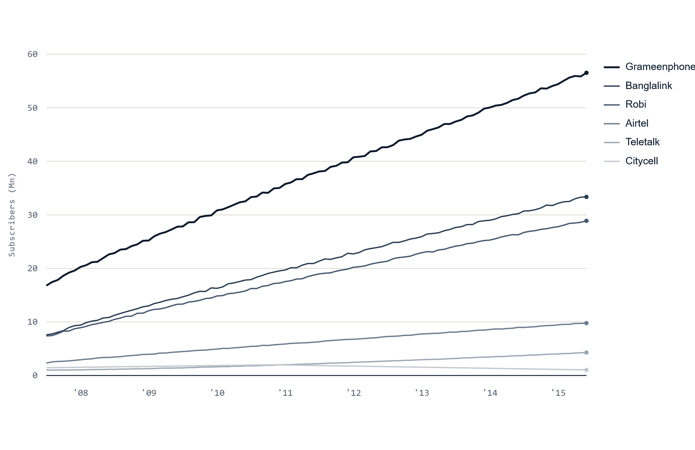
CHRONOFORGE / PULSE
11
SUBSCRIBER GROWTH
11 / MONTHLY SUBSCRIBERS PER OPERATOR · 2008–2015
The whole market is climbing.
SUBSCRIBERS (MN) OVER TIME
LINE · 6 OPERATORS
Three clear winners.
Grameenphone, Banglalink, Robi show strong monotonic growth — ideal for trend models.
Citycell is the exception.
It rises then declines toward 2015 — a candidate for a downward forecast.
Wide dynamic range.
From sub-1 Mn to 56 Mn on one axis — the spread itself motivates an ensemble.
Subscriber Growth Over Time
12 / 18

Slide 13
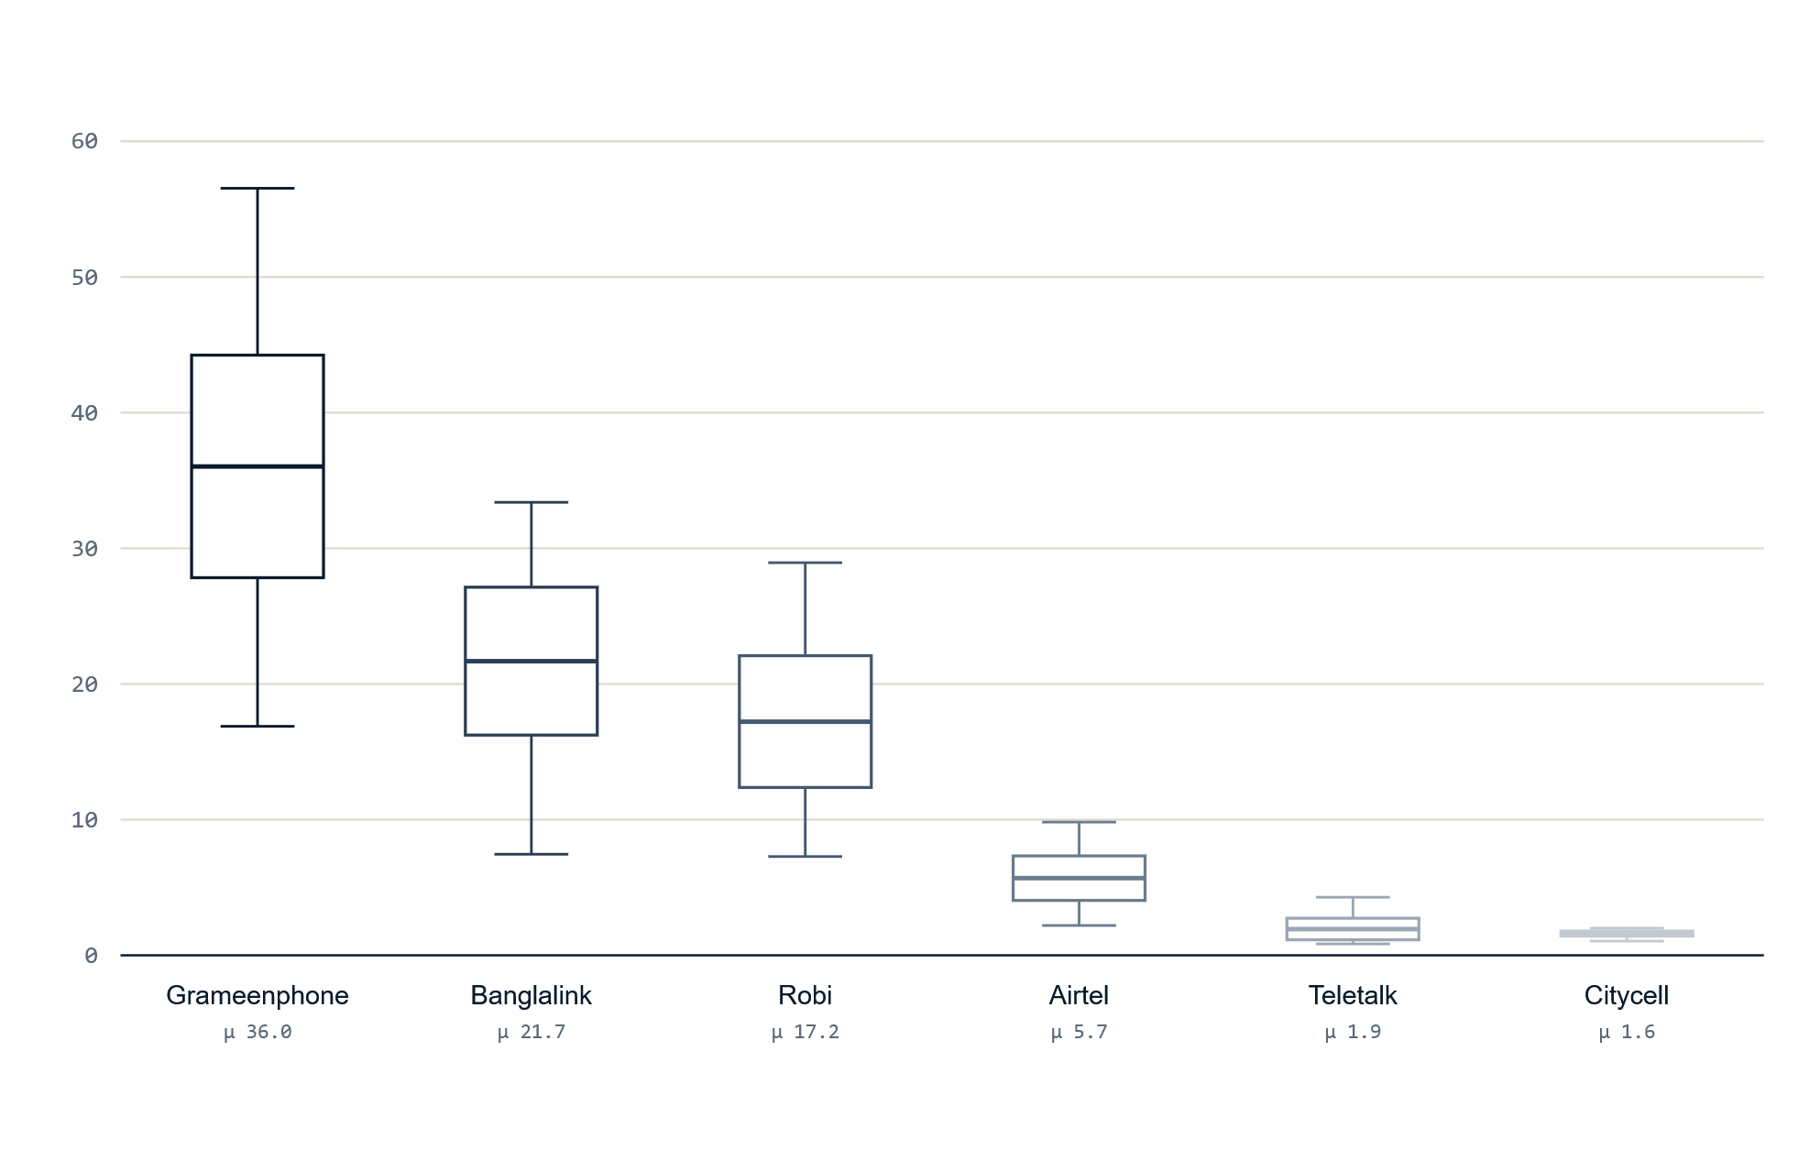
CHRONOFORGE / PULSE
12
DISTRIBUTION BY OPERATOR
12 / BOXPLOT REVEALS SPREAD & RANGE
Spread tells the growth story.
SUBSCRIBER DISTRIBUTION (MN)
BOX · PER OPERATOR
Tall boxes = big movers.
Grameenphone spans 17–57 Mn; the height is the eight-year growth made visible.
Tight boxes = stable players.
Citycell sits in a thin band near 1.6 Mn — almost no variation.
Box ≈ μ ± 0.67σ.
Whiskers mark min/max; the median line approximates each operator's mean.
Subscriber Distribution by Operator
13 / 18

Slide 14
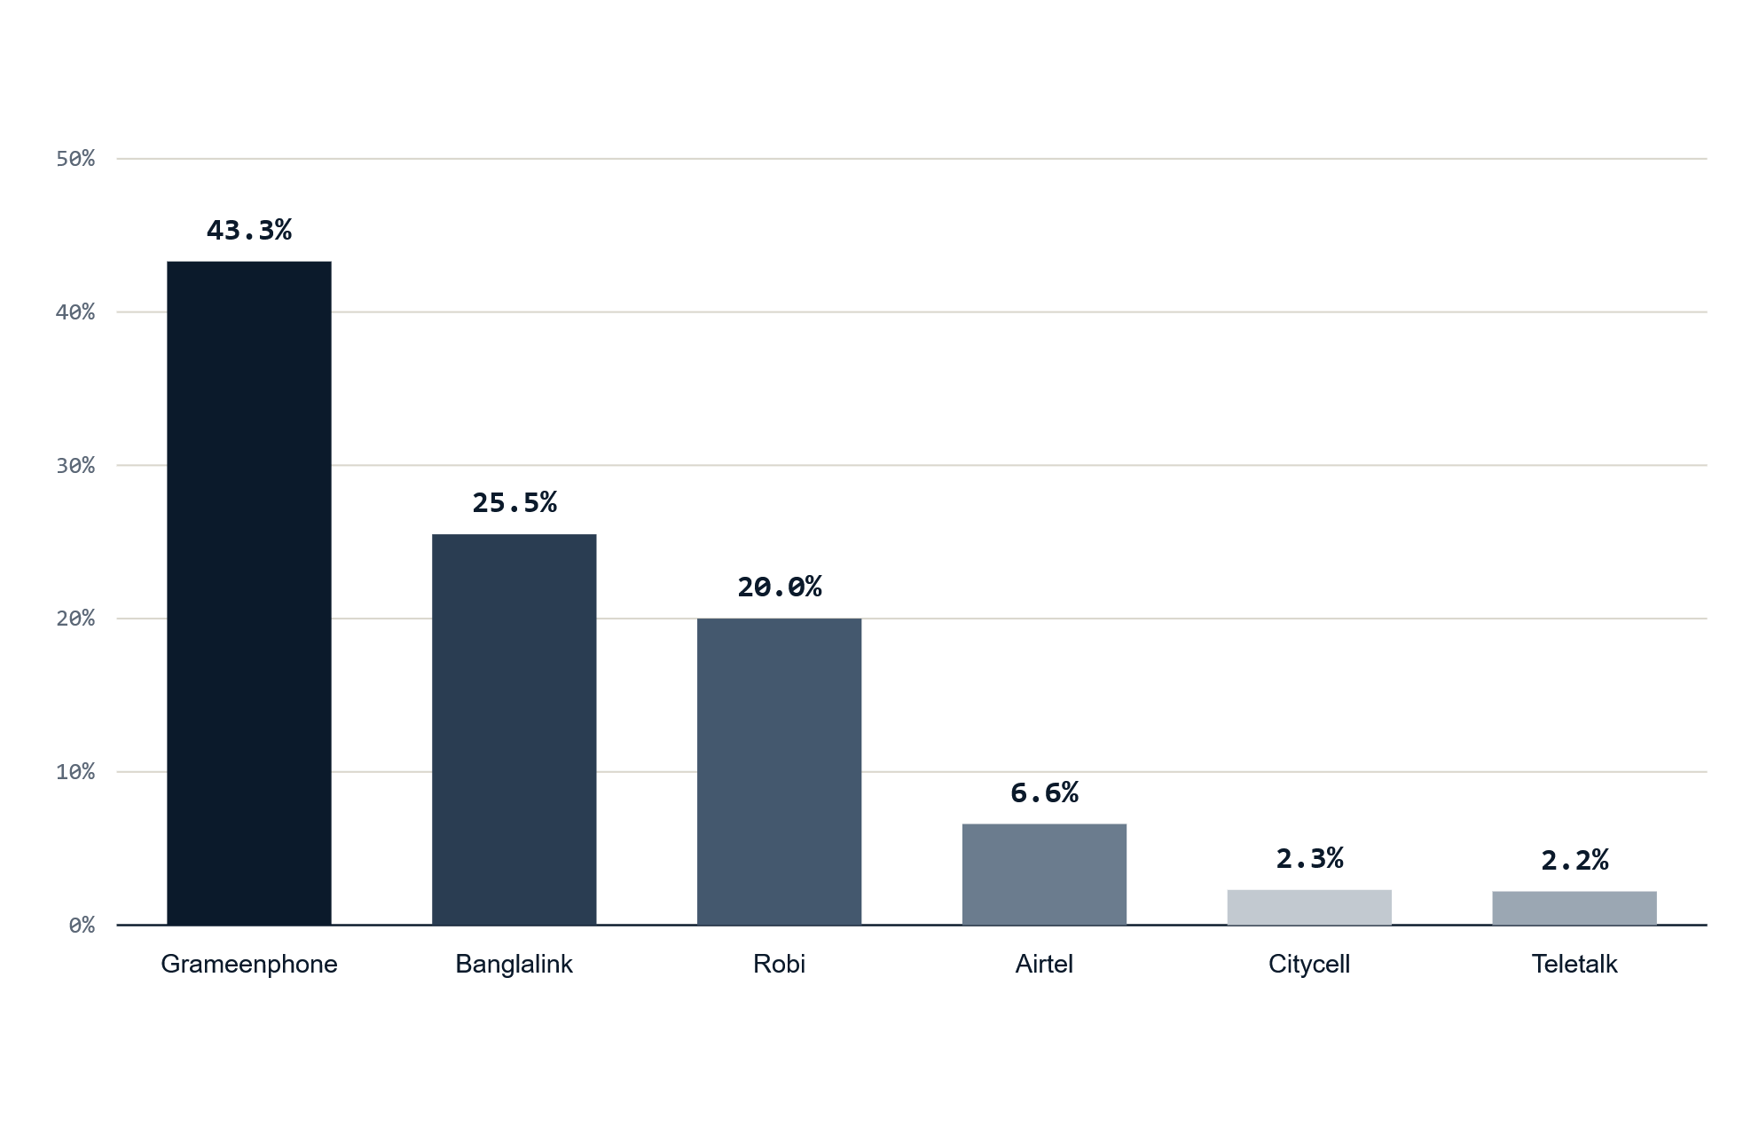
CHRONOFORGE / PULSE
13
AVERAGE MARKET SHARE
13 / WHO DOMINATES THE TELECOM SECTOR?
Three operators own 89%.
AVERAGE MARKET SHARE (%)
BAR · PER OPERATOR
A clear leader.
Grameenphone at 43.3% holds nearly half the market on its own.
The top three.
GP + Banglalink (25.5%) + Robi (20.0%) = ~89% of all subscribers.
The long tail.
Airtel, Citycell, Teletalk together hold barely 11% — lumpy, low-volume demand.
Average Market Share
14 / 18

Slide 15
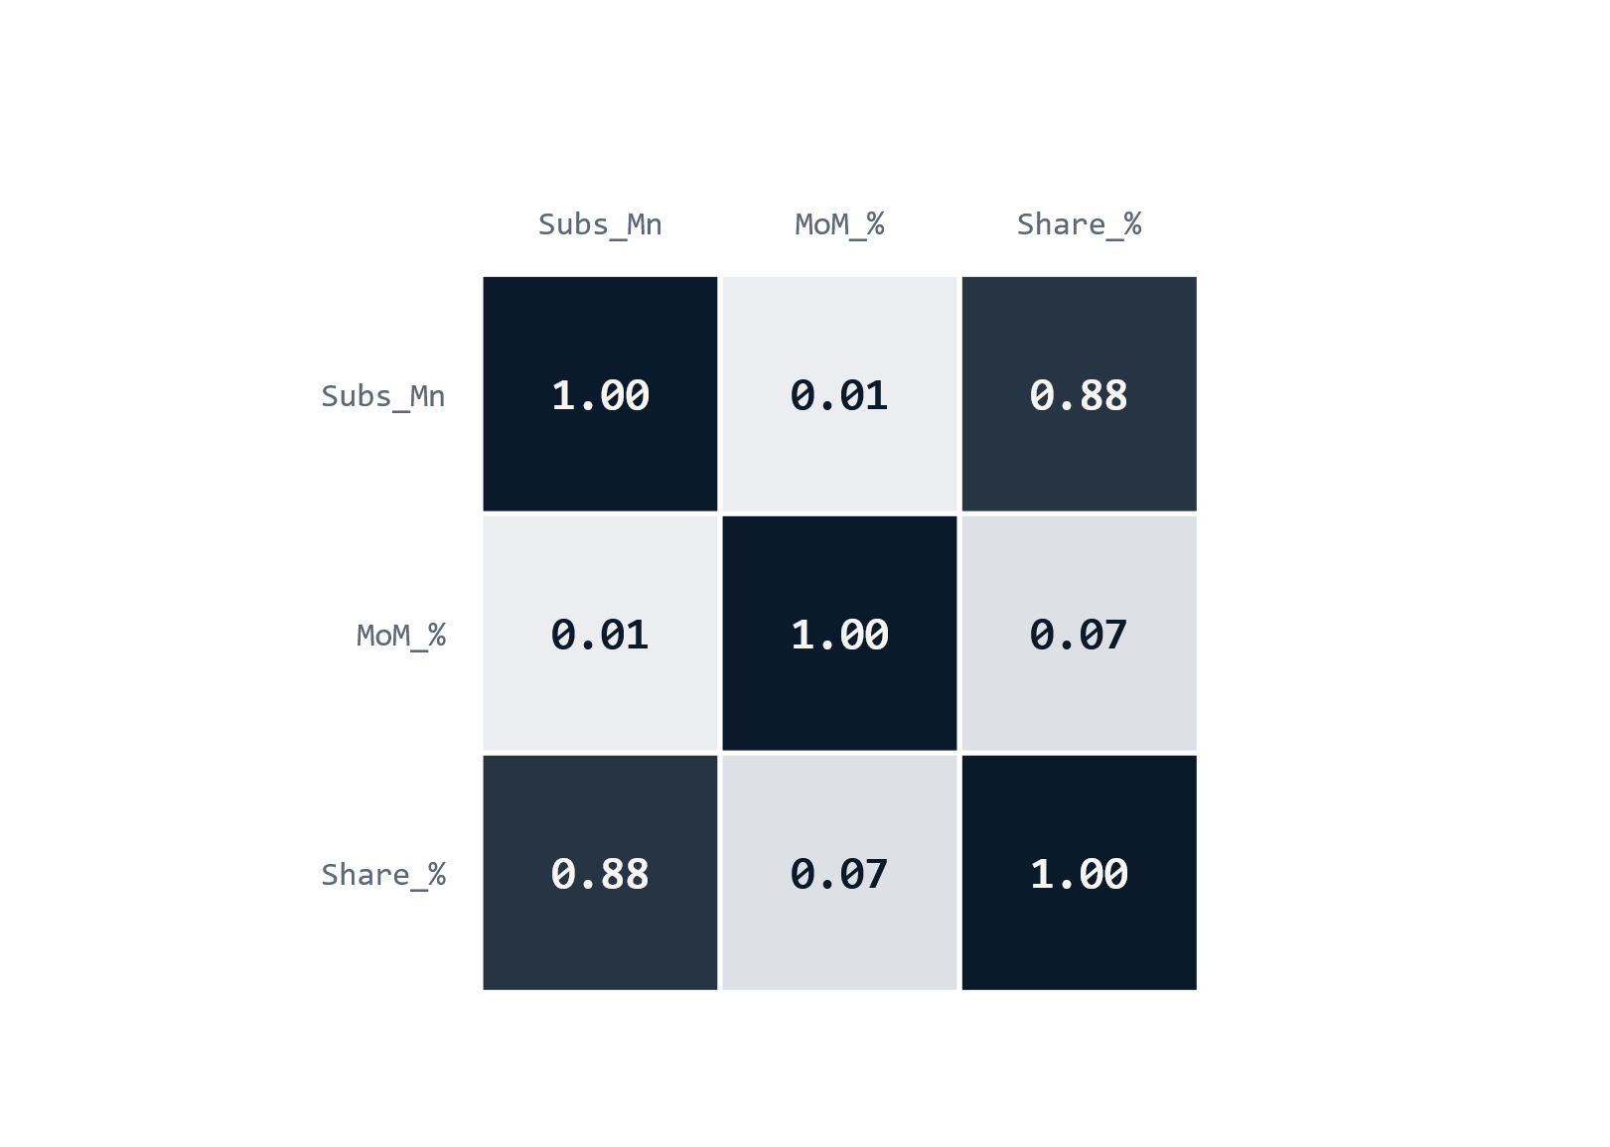
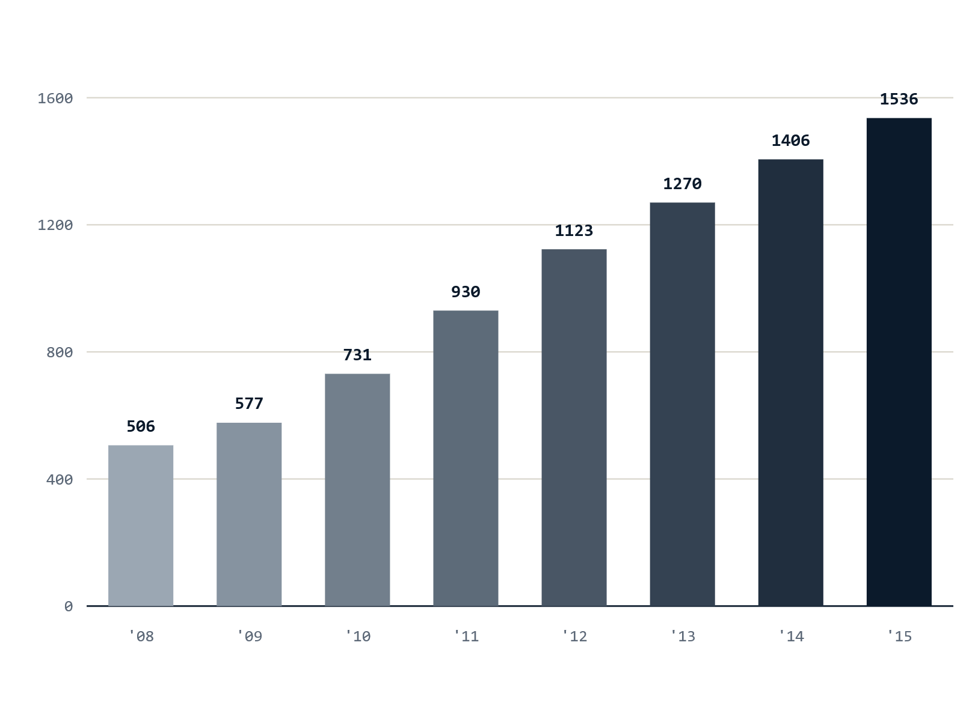
CHRONOFORGE / PULSE
14
CORRELATION & SECTOR GROWTH
14 / TWO VIEWS THAT CONFIRM THE DEMAND STORY
Share is demand. Demand is rising.
CORRELATION MATRIX
YEARLY SECTOR TOTAL (MN, SUMMED MONTHLY)
Subscribers ↔ Market_Share = 0.88 — forecasting share is essentially forecasting demand mix. MoM growth is near-independent of level (0.01).
Total demand grew ~3× in eight years — 506 → 1,536 Mn-months. A strong upward trend for ARIMA & LSTM to project.
Correlation & Sector-Wide Growth
15 / 18

Slide 16
CHRONOFORGE / PULSE
15
OUTLIER DETECTION · IQR
15 / DEMAND SHOCKS ANY FORECASTER MUST HANDLE
51 outliers — real shocks, not errors.
IQR ON MOM_GROWTH_% · Q1 − 1.5·IQR … Q3 + 1.5·IQR
Lower bound
−3.07%
Concentrated in early-period growth spurts — Airtel, Banglalink, Robi. These are not data errors; they are recurring demand shocks.
Upper bound
5.50%
LSTM & XGBoost must model this volatility.
51
Lot-sizing must keep safety stock for surge months.
Observations outside the band
CONSEQUENCE
Shocks are not noise · LSTM + XGBoost must learn the volatility · lot-sizing must hold safety stock for surge months.
Outlier Detection (IQR Method)
16 / 18

Slide 17
CHRONOFORGE / PULSE
16
WHAT THE EDA LETS US PREDICT
16 / HYPOTHESES PRESENTATION 3 WILL QUANTIFY
From patterns to predictions.
SECTOR TREND
OPERATOR SHAPE
VOLATILITY
~3× growth in 8 years
Three trends, one decline
Shocks are recurring
506 → 1,536 Mn-months. ARIMA + LSTM should project continued upward trend into 2016+.
GP, Banglalink, Robi → strong monotonic growth. Citycell declining — candidate for exit.
51 MoM outliers → the ensemble lets each model cover a different regime.
MARKET-SHARE SIGNAL
LOT-SIZING
LOW-VOLUME
Share ≈ demand
Big vs. lumpy
Teletalk: slow & steady
Subscribers ↔ share correlation 0.88 → forecasting share forecasts the demand mix.
Top 3 (~89% share) dominate order quantities. EOQ for stable giants; Silver-Meal / Wagner-Whitin for lumpy small ops.
A low-volume forecast — small absolute numbers, modest but positive trend.
What the EDA Lets Us Predict
17 / 18

Slide 18
CHRONOFORGE / PULSE
17
THANK YOU
17 / THE DATA IS READY
"Presentation 2 — EDA & Data Preprocessing for demand forecasting."
Clean data. Ready to forecast.
— CHRONOFORGE PULSE · DBI
Next · ARIMA + LSTM + XGBoost
→
Then · 3 lot-sizing algorithms
→
576 tidy rows, zero nulls, two engineered features, and 51 flagged shocks — a model-ready foundation for the ensemble.
Questions & discussion
↗
Thank You
18 / 18

