Slide 1
Nexora

Slide 2







Data Storage
Azure AI Studio
chunking
(Blob storage)
ADA Embeddingmodel
OpenAI GPT 4
📁 DataSources
Container 2
Container 1
PDF/TXT →
files container
CSV/Excel → 'table' container
Process files
Pinecone/Chroma DB/Qdrant
Vector Database
csv
excel
pdf
Txt/word
user
Retreiver
SQL Agent/Table Interpreter
Output refinement gpt 4O
Chat history and logging

Slide 3


Login & Identify User
Chainlit UI
User inputs PDF or word document
📁 DataSources
Check if user container already exists
Process files
Data Storage
csv
excel
pdf
Txt/word
Chunk based on headings using docling/Marker
New user
Returning user
Marker
Create container
Existing container
Does content under heading exceed
No
📁 Create and upload folder with current timestamp
yes
PDF/TXT
CSV/Excel
Semantically chunk that paragraph
Semantic kernel
Stire each heading and corresponding chunks in vector database
Table agent

Slide 4

[User opens Chainlit UI]
Authentication Flow
[User enters username & password]
Python checks in SQLite DB or excel : Does user exist?
container
Password Encryption
Yes
No
Invalid Password
[Get current UTC timestamp]
Create Azure container: username + timestamp
📁 Create and upload folder with current timestamp
Proceed with upload

Slide 5
Installation
SQLite3:
  Already included with Python (import sqlite3).
  No installation needed unless you’re on a very old/stripped-down Python build.
SQLAlchemy:
  Must install separately:
  pip install sqlalchemy
  If you’re going to use it with SQLite, that’s enough.
  If you want Postgres/MySQL later, you’ll also install their drivers:
    Postgres → pip install psycopg2-binary
    MySQL → pip install mysqlclient or pip install pymysql
When to Choose Which?
SQLite3 (raw SQL) → Fast, simple, fewer dependencies. Great for a POC.
SQLAlchemy → Cleaner, scalable, DB-agnostic. Great for a production app where you might later move from SQLite → Postgre

Slide 6
[Chunk by Heading using Docling/Marker]
• SK custom skill wraps Docling/Marker parser
• Extract top-level sections (H1, H2, etc.)
• Maintain heading-hierarchy map:
[PDF / Word]
• Input via Chainlit
• File type detection
PDF/text/Word
[Check content length under each heading]
• For each heading’s content:
- If > vector model token limit (e.g., 1000–2000 tokens)
- Requires further semantic chunking
• Decision point for deep chunking or table processing
[Yes: Too Long]
• Requires more chunking
Semantic Chunk Paragraph]
• Further splits paragraphs semantically
• Uses language-based breaks
• Retains heading ref in metadata
[User can now chat via Chainlit using SK Planner]
• SK decides which skill to call:
- retrieve answer from vector DB
- fetch table data
• Chat becomes dynamic + multi-modal
Embed and Store (Vector DB)]
• Each chunk is embedded using embedding model
• Store in Vector DB (e.g., Chroma / Qdrant / Azure Cognitive Search)
• Metadata includes: heading, filename, timestamp, user_id

Slide 7
CSV / Excel file
• Triggered via Chainlit or UI
• File passed to CSV Agent
SK invokes a Skill: describe_table(file_path)]
CSV/Excel
CSV Agent extracts metadata
• Example:
[
{ "name": "employee_data", "description": "Employee info like name, dept, salary" },
{ "name": "attendance", "description": "Daily attendance logs" }
]
• Metadata is stored in memory or temporary DB (Pandas Dataframe)
[User sends a question]
• Natural language input from user
[Orchestrator Agent receives question]
• Reads metadata
• Matches question intent with metadata.description
• Decides which table/sheet/file best fits the query
[CSV Agent fetches actual information]
• Executes logic
• Returns structured answer (JSON or text)
[Response sent back to user]
• Via Chainlit UI
• Optionally saves interaction in memory/log
[CSV Agent is invoked with sheet context]
• CSV Agent opens the selected table
• Performs SQL-like query or pandas filtering

Slide 8
CSV / Excel file
• Triggered via Chainlit or UI
• File passed to CSV Agent
SK invokes a Skill: describe_table(file_path)]
CSV/Excel
Pydantic extracts metadata
• Example:
[
{ "name": "employee_data", "description": "Employee info like name, dept, salary" },
{ "name": "attendance", "description": "Daily attendance logs" }
]
• Metadata is stored in memory or temporary DB (Pandas Dataframe)
[User sends a question]
• Natural language input from user
[Orchestrator Agent receives question]
• Reads metadata
• Matches question intent with metadata.description
• Decides which table/sheet/file best fits the query
[CSV Agent fetches actual information]
• Executes logic
• Returns structured answer (JSON or text)
[Response sent back to user]
• Via Chainlit UI
• Optionally saves interaction in memory/log
[CSV Agent is invoked with sheet context]
• CSV Agent opens the selected table
• Performs SQL-like query or pandas filtering

Slide 9
(START)
│
▼
[User Logs In]
│
▼
[Fetch All Sessions for user_id from SQLite]
│
▼
[User Clicks on a Session → session_id = "abc123"]
│
▼
[Initialize Workspace for session_id "abc123"]
│
▼
[→ Fetch Stored Data Sources]
│
|──► [Fetch PDF Chunks from Vector DB]
│ └── query: where session_id = "abc123", filename LIKE *.pdf
│ └── result: List of document chunks, headings, metadata
│
└──► [Fetch CSV Profile Metadata]
── Option 1: From Vector DB (stored under special metadata)
└── Option 2: From SQLite Table `csv_profiles`
where user_id = "deepankar" AND filename in (“filename.pdf”, "attendance.csv“)
▼
[Store Retrieved Data in Memory for Session (not chunk content, just pointers)]
│
▼
[User Asks a Question]
│
▼
[LLM Router / SK Planner Decides Route]
│
|──► If tabular logic detected → route to Table Agent using CSV Profile
│
└──► Else → route to PDF Vector Search
└── query in vectorstore where session_id = "abc123" + similarity
│
▼
[LLM Generates Answer based on Retrieved Info]
│
▼
[Display Response in Chat UI]
│
▼
(END)

Slide 10
User inputs PDF or word document
Chunk based on headings using docling/Marker
Marker
[SK Memory Updated → chunk info, source heading, file ref]
• Semantic Kernel memory updated
• Could be volatile (session) or persistent (Cosmos DB, Redis)
• Helpful for future retrieval and context tracking
Does content under heading exceed
yes
Semantically chunk that paragraph
Stire each heading and corresponding chunks in vector database

Slide 11
Authentication will be managed through a SQLite database for user sign-in.
Upon activation of the "Process Files" function, PDF files will undergo vectorization, while CSV data will be securely stored within a specified container.
Following this, a prompt will be presented to the user, enabling them to pose a question.
The Semantic Kernel framework will subsequently decide which conversational agent to engage.
Docling → JSON → Embedding → Chroma?

Slide 12
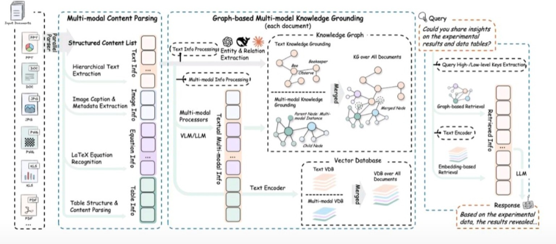
RAG Anything

Slide 13
RAG ANYTHING
🔹 1. Chunking in this architecture
Chunking here is not just plain "split text into 512 tokens" (as in simple RAG). It’s multi-modal chunking:
Structured Content Parsing (left block):
  Hierarchical Text Extraction → Text is broken into chunks based on document structure (e.g., headings, paragraphs, sections).
  Image Caption & Metadata Extraction → Each image is treated as a "chunk" with its own semantic meaning (caption + OCR text + metadata).
  LaTeX Equation Recognition → Equations are extracted as separate chunks.
  Table Structure & Content Parsing → Each table is parsed into row/column sub-chunks (table schema + cell values).
So, instead of just linear text chunks, this creates multi-modal structured chunks:
Text Info chunks
Image Info chunks
Equation Info chunks
Table Info chunks
All these chunks are then passed downstream as "multi-modal instances".
🔹 2. How Chunks Are Hierarchical
Instead of flat token windows, chunks form a tree:
Document
  Section A
    Subsection A.1
      Paragraph 1
      Paragraph 2
    Subsection A.2
  Section B
    Table 1
This “tree” becomes your Structured Content List (SCL).

Slide 14
Great point, Deepankar 👌 You’re asking the right question:
➡️ What exactly is used for text chunking here?
➡️ What happens if we split paragraphs and lose semantics?
1. What is being used for text chunking here?
Looking at the diagram:
The “Hierarchical Text Extraction” block is the chunking mechanism.
  It does not just blindly split by tokens (like 512/1024 token chunks).
  Instead, it preserves document structure → sections, headings, paragraphs, list items.
  This is why they call it a Structured Content List (SCL).
So chunking here = structure-aware:
Each heading + paragraph = one chunk.
Lists, captions, footnotes, references → kept as individual chunks.
Equations, tables, and images are extracted separately but linked back to their surrounding paragraph.
This is different from a flat sliding-window tokenizer split.
2. What if a paragraph is broken → semantic meaning loss?
Yes, if you split text naively in the middle of a sentence, you lose context. That’s why this system avoids raw token-based chunking at first.
Here’s how it deals with it:
Hierarchical Parsing (first layer)
  Keeps natural boundaries (e.g., by paragraph, heading).
  This ensures semantic meaning isn’t broken at source.
Knowledge Grounding (second layer)
  Even if a chunk is incomplete, entities and relations are extracted.
  These are then connected in the knowledge graph, so semantics are preserved across chunks.
  Example:
    Chunk 1: “Plumber fixes …”
    Chunk 2: “… water leakage in pipelines.”
    Even if broken, the KG links Plumber → fixes → water leakage.
Vector Embeddings (backup layer)
  Each chunk is also embedded. During retrieval, semantically close chunks are pulled together even if they were split.

Slide 15
1. What is it using for chunking?
From the diagram:
“Hierarchical Text Extraction” → means chunking is structure-aware (paragraphs, headings, tables, figures).
But once extracted, these text chunks still have to be embedded → and embedding models have a token limit (e.g., 512 or 1024 tokens).
👉 So:
First layer: structural parsing (keeps semantic units like paragraphs intact).
Second layer: long paragraphs are further split using sliding window or semantic-aware chunking (like sentence-BERT splitting on sentence boundaries).
This hybrid approach ensures you don’t break mid-sentence if avoidable.
2. What happens if a paragraph > embedding model limit?
This is where embedding strategy matters:
If paragraph length < model limit → embed directly.
If paragraph length > model limit →
  Sentence-level split (use NLP sentence segmentation).
  Chunk by tokens with overlap (sliding window: e.g., 300 tokens per chunk with 50 overlap).
  Each chunk gets its own embedding vector.
Then during retrieval:
Similar chunks are pulled together.
LLM can re-stitch them back into coherent context.

Slide 16
How Hierarchical Chunking Really Works
Rule 1: Paragraphs are the atomic unit
Each paragraph is normally treated as one chunk, as long as it’s within embedding token limit (e.g., 512–1024 tokens).
If a paragraph > embedding limit → it gets split into smaller overlapping chunks (by sentences or token windows).
Rule 2: Headings are attached as metadata (and sometimes prepended)
Section/heading text is not a standalone chunk (usually too short), but it is:
  Stored as metadata → e.g., "section": "Section A.1".
  Sometimes prepended to the paragraph text → "Section A.1: [Paragraph text]" to preserve context.
So retrieval knows which section a paragraph belongs to.
Rule 3: Sections are not normally separate chunks
You don’t embed an entire section (with multiple paragraphs) as a single chunk → too long.
Instead, you keep paragraph chunks and rely on metadata to group them back.
BUT → some hybrid systems (like LlamaIndex) do store a parent embedding (section-level summary). This is optional.

Slide 17
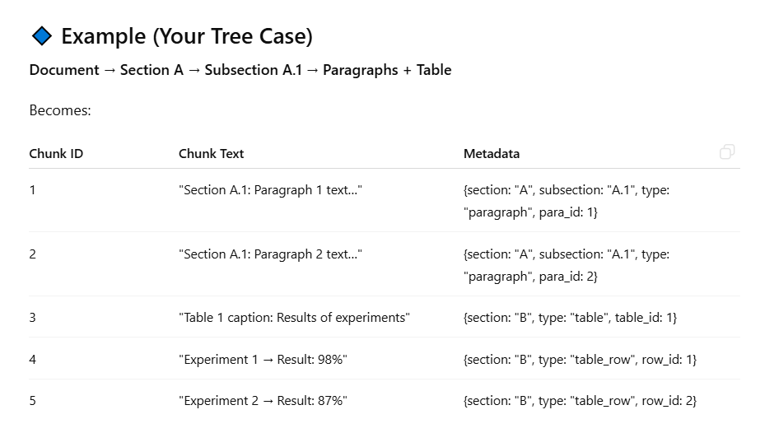
Model token limits
Model | Max Tokens | Embedding Dimension | Notes
text-embedding-ada-002 (OpenAI) | 8,191 | 1,536 | Legacy model
text-embedding-3-small (OpenAI) | 8,191 | 1,536 | Newer, more efficient
text-embedding-3-large (OpenAI) | 8,191 | 3,072 | Highest performance, larger vectors
Jina Embeddings 2 (open-source) | 8,192 | — | Matches Ada performance
jina-embeddings-v3 (open-source) | 8,192 | 1,024 (default) | Multilingual, flexible embedding dimensions
nomic-embed-text-v1 (open-source) | 8,192 | — | Long context model, best-in-class

Slide 18
Chat History Summarization Process
Message is stored in
the database
Append to Cosmos DB
Fetch Chat History
Retrieve chat history
using user and
session IDs
Determine if
summarization is
needed based on
message count
Check Message Count
Split History
Divide chat history
into older and recent
messages
Summarize Older
Messages
Generate a summary
of older messages
using LLM
Compose Final
Prompt
Combine summary
with recent messages
for LLM input

Slide 19
Technical Requirement
previous session of a person should get retain ? once he login

Slide 20
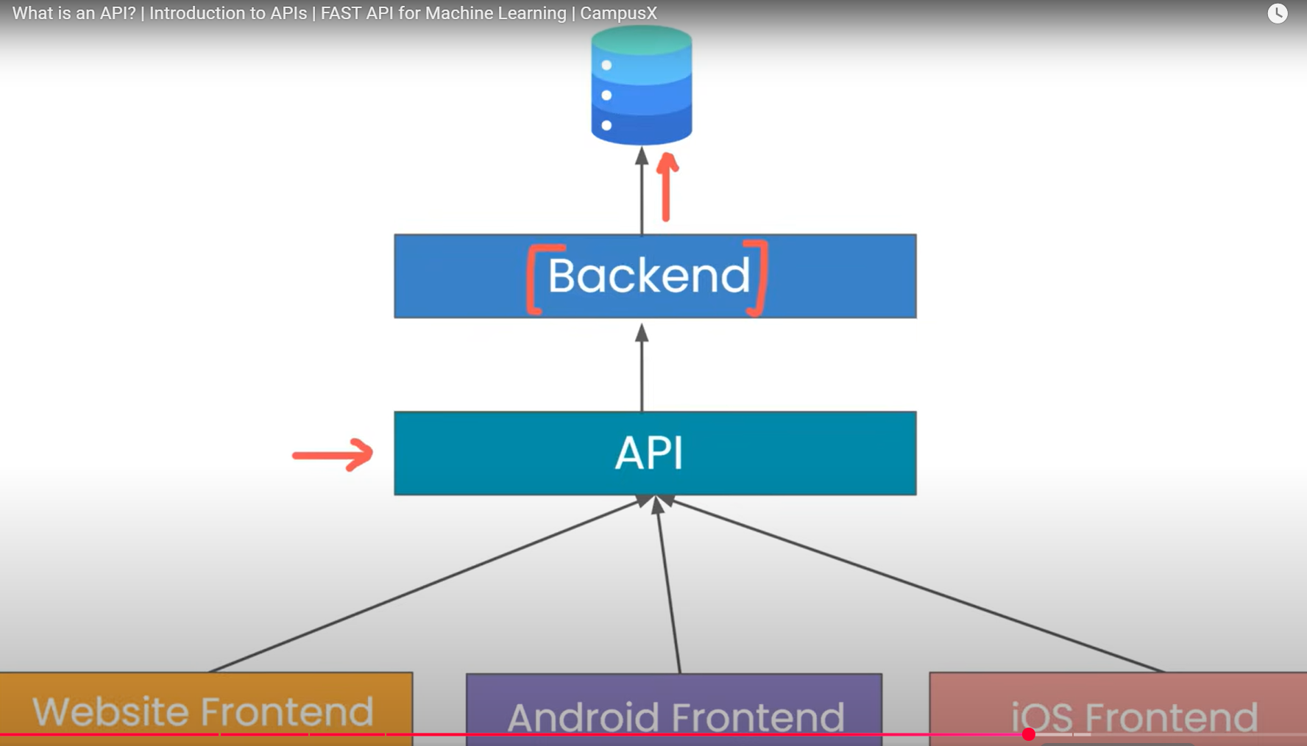
Standard Way

Slide 21
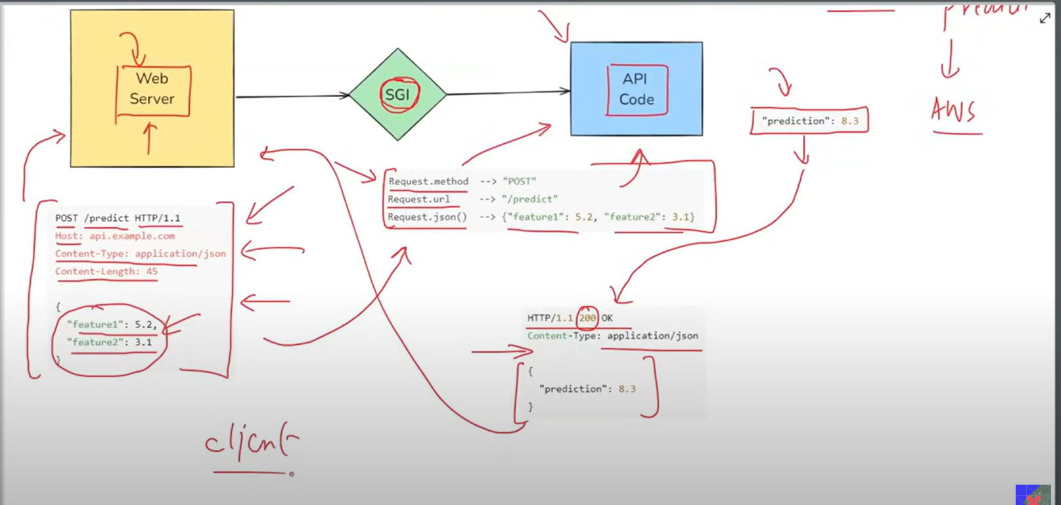
API FLOW

