Slide 1
Impact Dev Mapping Project
Automated Impact Analysis using LLM + JSON Repair + Reporting

Slide 2
Problem Statement
  Manual impact analysis is slow and error‑prone
  Developers must search across modules, files, and dependencies
  Hard to identify regression areas and test cases
  No centralized mapping between requirements and codebase

Slide 3
Overview
Automated analyzer to read Jira requirements
  LLM-based impact analysis using Groq + JSON repair
  Developer–module mapping for precise impact prediction (developer_mapping.json)
  Automated file-level regression identification
  Generates PDF reports

Slide 4
Architecture
main.py orchestrates full flow
  groq_client.py handles LLM requests
  analyzer.py performs logic + JSON repair
  report_generator.py exports PDF
  developer_mapping.json maps ownership

Slide 5
Key Features
LLM response repair to avoid JSON failures
  Deterministic structure: impact_report{}
  Generates human-ready PDF report
  Supports any future model (Llama3.3 etc.)

Slide 6
Flow Diagram
  Jira Text → Analyzer → Groq LLM → Impact JSON → Report Generator → PDF/PPT

Slide 7
Folder Structure
developer_mapping.json – Developer ownership map
  analyzer.py – Impact analyzer
  groq_client.py – Groq API handler
  report_generator.py – PDF generator
  main.py – Program entrypoint

Slide 8
Sample Input
Jira Story: Add new limit validation

Slide 9
Sample Output Summary
  Impacted Modules: ModuleA, ModuleB, ModuleC
  Regression Areas: 5 file-level hotspots
  Risk Level: Medium
  Auto-generated test cases

Slide 10
Benefits
  90% reduction in effort for analysis
  Consistent and audit-ready impact reports
  Easy onboarding for new developers
  Exportable insights for QA and leadership

Slide 11
Impact Analysis System - Flow Overview
Modules A, B, C, D • Use Case Demonstration

Slide 12
Module Overview
• Module A – Transfer Service
• Module B – Risk & Compliance
• Module C – Core Banking System
• Module D – Notification

Slide 13
System Flow (Simplified Diagram)
Module A
Transfer Service
Module B
Risk & Compliance
Module C
Core Banking System
Module D
Notification
OutBound Feeds
(External Systems)

Slide 14
Use Case 1 — New business rule: Add weekly transfer limit
JIRA Text:
Add a new weekly transfer limit validation on top of existing daily and per-transaction limits.
AI Expected Impact:
Hits transfer_limit_check in Module A
Downstream impacts: Module B, C, D
Risk scoring, ledger posting, notifications all impacted
Regression widely impacted

Slide 15
Use Case 2 — Enable partner validation before beneficiary approval
JIRA Text:
Before validating a beneficiary, perform a partner system validation check with new risk parameters.
AI Expected Impact:
Hits partner_validation in Module B (upstream of beneficiary_validation)
Impacts Module A → beneficiary_validation
Downstream: Module C + Module D (notifications + audit logging)

Slide 16
Use Case 3 — Enhance transaction posting to support new external outbound feed format
JIRA Text:
Update transaction posting so that it generates an additional outbound feed in the new XML format for regulatory reporting.
AI Expected Impact:
Hits transaction_posting_trigger + ledger_posting in Module C
Outbound feeds also impacted
Notifications still triggered
No effect on limit checks or fraud scoring

Slide 17
Use Case 4 — Revamp transaction posting logic including limit validation and risk scoring pipeline.
JIRA Text:
Revamp transaction posting logic including limit validation and risk scoring pipeline.
AI Expected Impact:
Expected impacted modules: A, B, C, D
Risk: HIGH
Why high-risk?
Touches transfer_limit_check
Touches transaction_posting_trigger
Touches fraud_risk_scoring
Impacts notifications + outbound feeds
Ledger posting highly affected

Slide 18
Developer Mapping JSON – Structure Explanation
The mapping file works as a Knowledge Graph of your application architecture.
It captures:
Modules → high-level system components
Features → business features inside each module
Descriptions → what each feature does
Code locations → exact files & functions related to that feature
Dependencies
  upstream → feature depends on another module
  downstream → feature changes affect other modules
  depends_on → internal logical link
This ensures AI can return consistent impact analysis without scanning code.

Slide 19
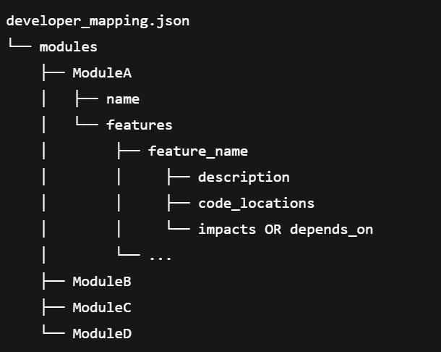

Slide 20
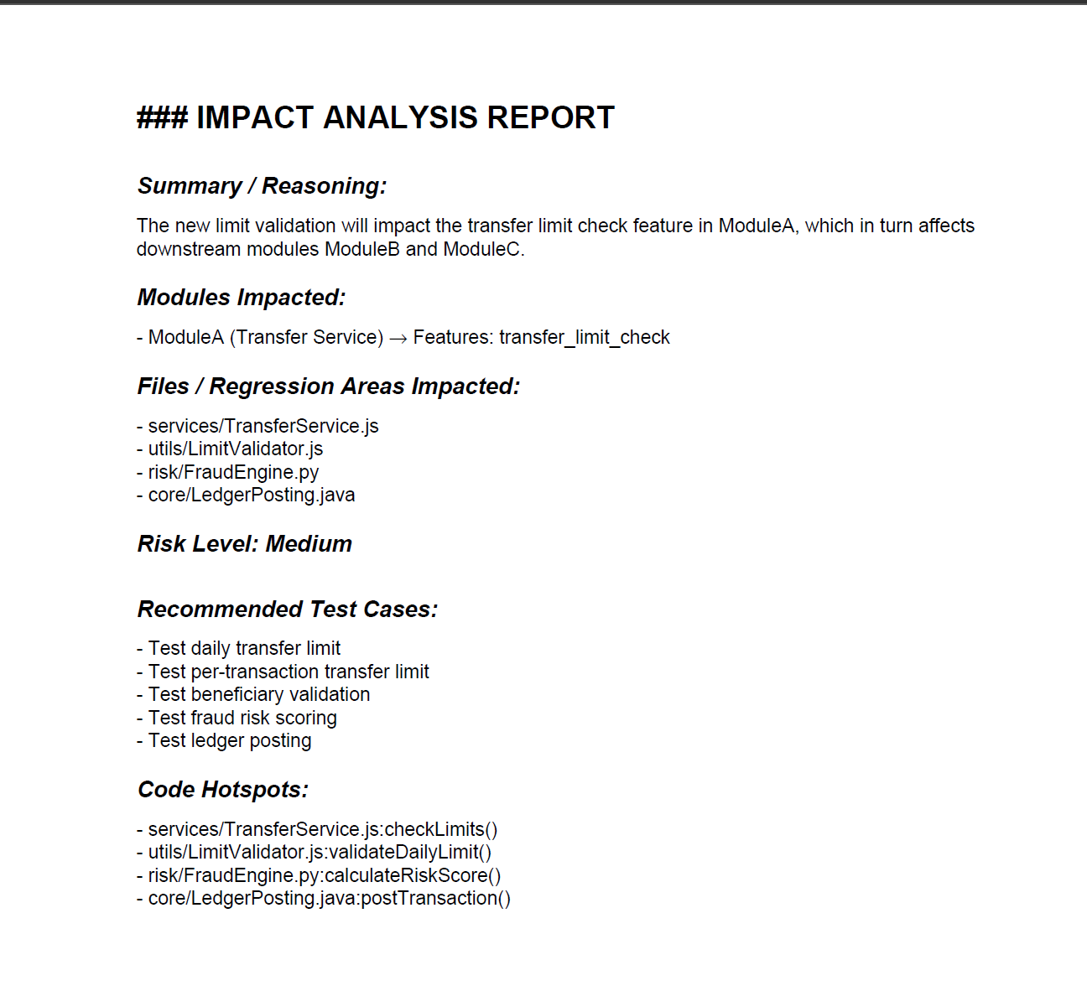
Generated Impact Analysis PDF Report:

