Slide 1

Applications of the Pfaffian state to Topological Phases
Alexander Sirota

Slide 2




Collaborators
Syed Raza
Jeffrey Teo
Gil Young Cho
Sharmistha Sahoo

Slide 3
Outline
Background
- Quantum Hall effect
- Topological Insulators
Dirac semimetal construction
Fractional topological insulator construction

Slide 4
Classical Hall Effect
2D Electron Gas in a Magnetic Field
E
B

Slide 5
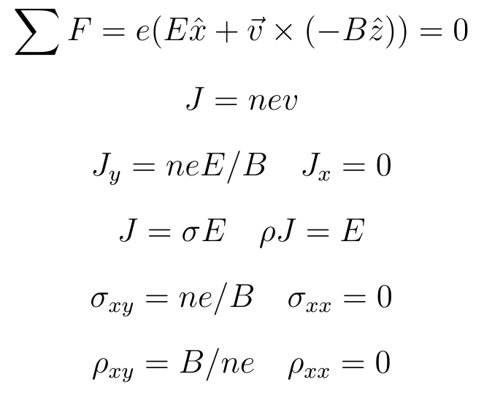
Quantum Hall Effect

Slide 6
Quantum Hall Effect

Slide 7
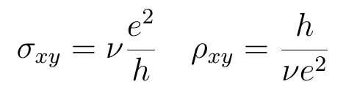
Quantum Hall Effect
https://en.wikipedia.org/wiki/Quantum_Hall_effect

Slide 8
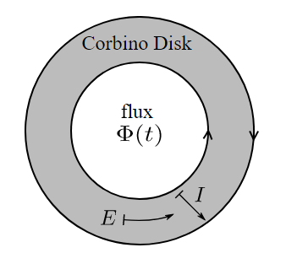



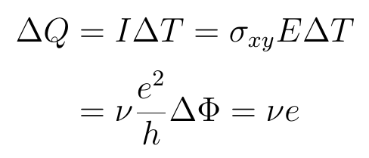
Quantum Hall Effect
The A.B phase of an electron around a flux is
If then this is 2π
or

Slide 9

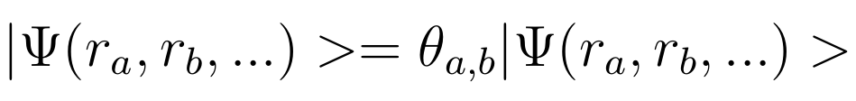
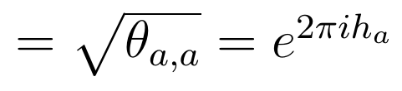
Quantum Hall Effect
If we can get ν = fraction, then we have local fractional charges!
These need not have fermi/bose exchange statistics!
a b
a b
This leads us to define the topological spin
“exchange”

Slide 10
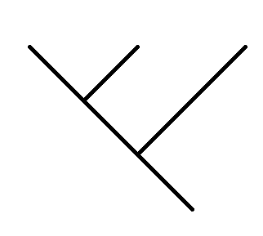
Topological Order
On top of these “braiding” statistics, we have fusion, or the idea that 2 local excitations that are close are also a single excitation.
We can specify states based on a “Fusion Tree”
a
b
c
i
d
These can serve as a basis for the quantum states. Once we put this on some manifold they are classified by Modular Tensor Categories.

Slide 11
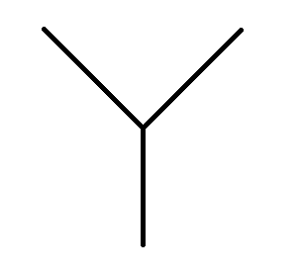
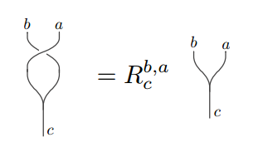
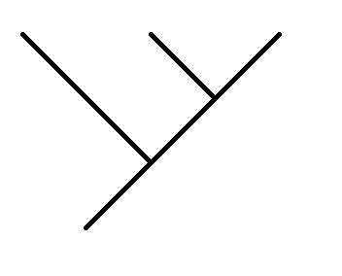
Topological Order
A Modular Tensor Category Theory is:
A set of elements (excitations)
{a,b,c,...}
Fusions Rules
a
b
a x b = Σ N^{c}_{a,b} c
c
Basis transformations (F moves)
Braiding statistics (R moves)
a
b
c
a
b
c
F_{ij}
i
j
d
d

Slide 12
Topological Insulator
Normal Insulators are defined by having a “band gap”
?
=
E
E
P
P
We say two insulators are topologically distinct if the Hamiltonian can't be adiabatically changed from one to another, while keeping the gap nonzero and not breaking any symmetries.

Slide 13
Topological Insulator
If we have a junction from one phase to another while preserving symmetries, we must have a gap close on the boundary by definition, hence get edge modes.
B

Slide 14
Topological Insulator
If instead of spatially changing the Hamiltonian to different phases, if we change it in time, we again go through a closed gap
E
E
E
P
P
P
Phase 1
Semi-metal
Phase 2

Slide 15
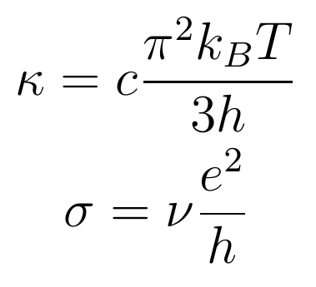
Topological Insulator
Say we have a TI where you gap the interface by breaking symmetries You can gap them in different ways so that symmetry is preserved at the interface
This mode is characterized by it's electrical and thermal conductance. In a conventional TI, this is a single gapless electron,i.e. c=1, ν=1.

Slide 16
Topological Insulator
Everything so far has been in the band theory approximation (single body interactions). If we introduce many-body interactions we can get a 3rd symmetry preserving way to gap the surface. The price to pay are these fractional quasiparticles.
In the conventional case, an electron mode splits evenly into two modes with c=1/2 and ν=1/2

Slide 17
Pfaffian State
In this symmetric many body surface, we have fractional excitations. One such state is the particle hole symmetric Pfaffian.
 | U(1) Charge Sector
 |  | e⁰ | e¹ | e² | e³ | e⁴ | e⁵ | e⁶ | e⁷
 | I | 0 |  | 1/4 |  | 0 |  | 1/4
 | σ |  | 0 |  | 1/2 |  | 1/2 |  | 0
 | ψ | 1/2 |  | 3/4 |  | 1/2 |  | 3/4
 | q | 0 | e/4 | e/2 | 3e/4 | e | 5e/4 | 3e/2 | 7e/4
Neutral Ising Sector
[Chen, Fidkowski, Vishwanath, 2013] [Read, Moore, 1992]

Slide 18
Pfaffian State
Here is a the front surface of the above picture.
In low energy we can view this as (1+1) d wires splitting into two, or two (1+1) theories coupling, leaving one.

Slide 19
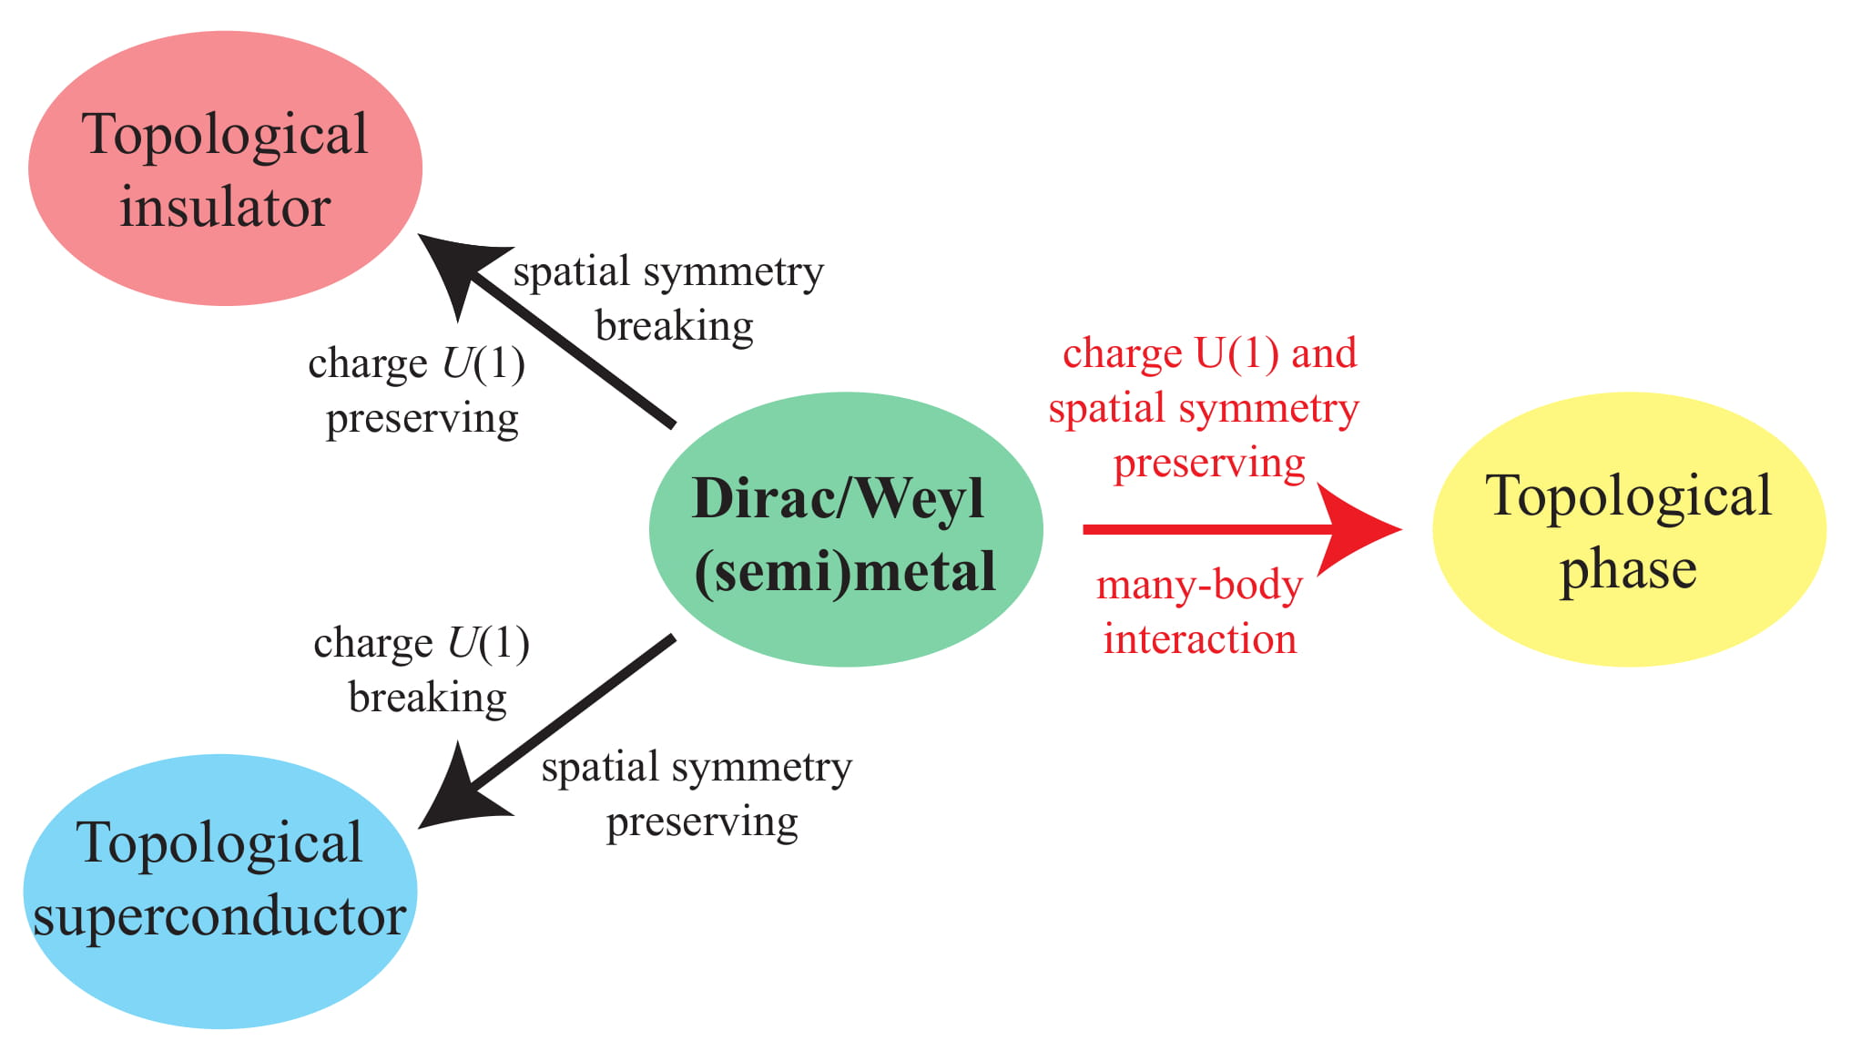
Dirac Semimetal
What if we build a Semi-metal out of (1+1)d wires?

Slide 20
Fractional topological insulator
So these surface states are all on the surface of a topological insulator. We can also ask what would the analogue be for fractional topological insulators.
ν = 1/(2n+1)

Slide 21
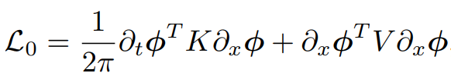
K Matrix Descriptions
These (1+1)d modes can described by a cherns simon's conformal field theory. In some abelian cases they follow this Lagrangian
The primary fields of these fields correspond to excitations in the (2+1)d theory, and you can derive the braiding statistics and spin information from it, and with the charge of the fields also ν and σ.

Slide 22
Parton Construction
To do the parton construction you write the electron field as
Ψ=ψ₁ψ₂...ψ_{2n+1}
seen as 2n+1 equal parts.
If we only take this assumtion, then partons are free particles in the vaccum as well which is unphysical.
To fix this we add gauge fluxes which confine the partons in vaccum.
Then we have a Z_{2n+1} gauge fluxes Φ.

Slide 23
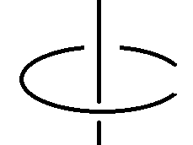

Parton Construction
We can think about these anyons as a topological order described by:
ψª x ψ^{b} = ψ^{a+b mod 2(2n+1)} Φª x Φ^{b} = Φ^{a+b mod 2n+1}
where the modulus is up to charge 2e.
Each parton is a fermion with electric charge e/2n+1 and some
gauge charge g. Each flux is a neutral boson.
The only nontrivial braiding is the following
ψ =

Slide 24
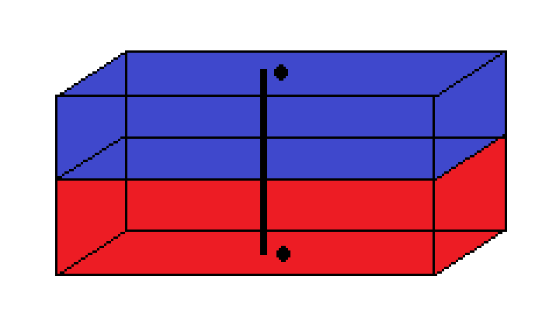
(3+1)-D model
Now we just need to look at different types of surfaces on an FTI that supports these exciations.
?
?
?
Φ
ψ
?
?

Slide 25
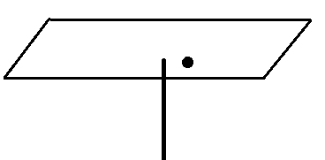
TR Breaking Surface
When a flux goes through a TR breaking surface it can bind a particle to it like in a chern insulator. Our gauge flux can bind gauge charges denoted ζª So our fluxes become dyons; magnetic monopoles with charge.
TR
ζª

Slide 26

Time Reversal Breaking Surface
If we have the top and bottom be opposite time reversal breaking surfaces our full theory is just fluxes with gauge charge a on both surfaces, with partons. One choice is the decoupled tensor product
which is the same as Laughlin's ν=1/(2n+1) state tensored with some neutral gauge theory, which is a fractional Chern insulator!
= U(1)_{(2n+1)/2} x SU(2n+1)₁
ζª
TR
TR
Φ
ν = 1/(2n+1)
c = 2n+1
ψ
ζª

Slide 27
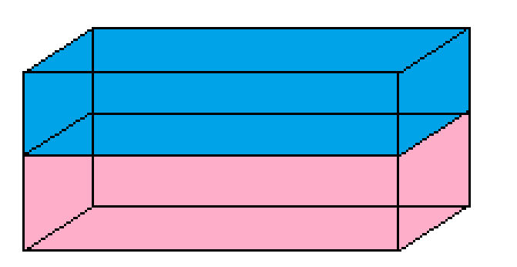
Superconducting Surface
If we take our TR breaking FTI as previously described and break U(1) by the proximity effect with a superconductor, we must condense cooper pairs.
In the simplest case we would condense all parton pairs.
The only thing left is the electron, but it is nontrivial because the edge mode still carries the same thermal current.
SC-TR
SC-TR

Slide 28
Superconducting Surface
TR
TR
SC
If partons live on the TR interface, they must split into two majorana modes on the TR/SC interfaces

Slide 29
Symmetric Surface
Symmetric
TR breaking
If we build the Pfaffian state out of partons as opposed to electrons we get all the same particles as the Pfaffian, but with all charges divided by 2n+1.
We also have fluxes that bind gauge charge across the TR breaking surface.

Slide 30
Symmetric Surface
If we include π fluxes, the normal Pfaffian becomes
If we build this from partons with the gauge fluxes it is
~note there are inequivalent ways of gauging fermion parity, i.e. different top. spins you can assign to π fluxes.
U(1)₄ x Ising
U(1)_{4(2n+1)} x Ising x Z_{2n+1}

Slide 31
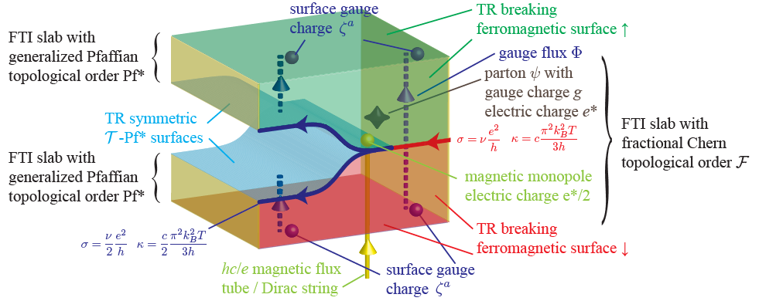
Gluing
In fact you can glue two of these surfaces along the T-P* surfaces

Slide 32
Conclusions
We studied FTI's that support fractional parton excitations and saw
TR breaking surfaces make a fractional chern insulator and laughlin ν=1/(2n+1)
Superconducting surfaces take away topological order, but still leave edge modes
T-Pfaffian surfaces make a novel topological order with ν=1/2(2n+1)

Slide 33
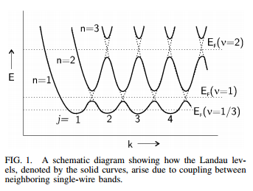
Coupled Wire Construction of Weyl/Dirac Semimetals
A typical (2+1)D quantum hall state gives chiral edge modes.
You can take a series of spatially separated chiral wires, and add interaction terms to gap out the bulk of the insulator to create landau levels, which can describe these quantum hall states.
[Kane, Mukhopadhyay, and Lubensky DOI: 10.1103/PhysRevLett.88.036401]

Slide 34

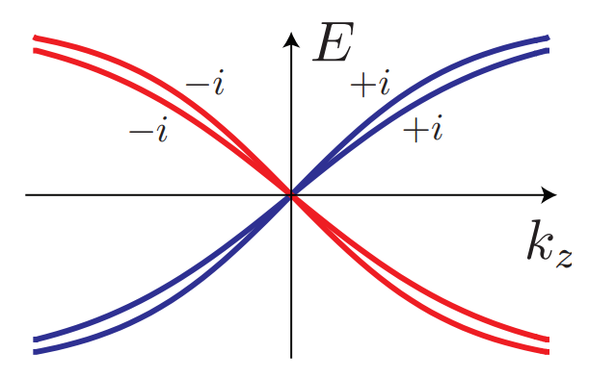


Dirac Semimetals
C2 prevents red and blue backscattering, T pin degeneracy to k=0.

Slide 35
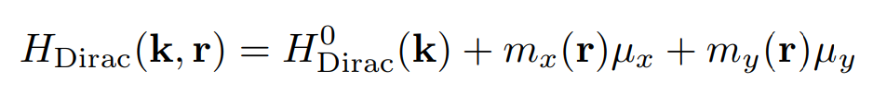

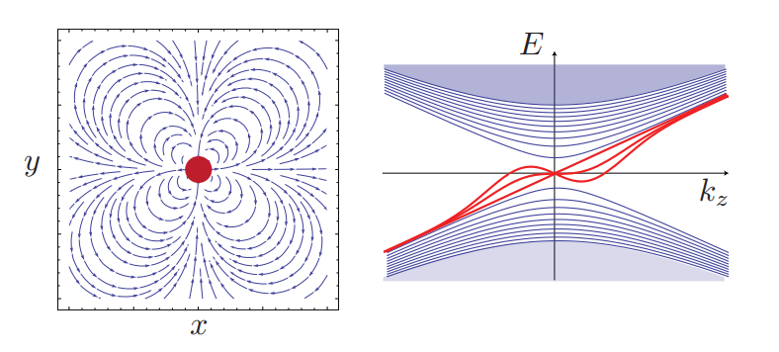
Dirac Semimetals
Mass terms gap the system when nonzero and finite

Slide 36
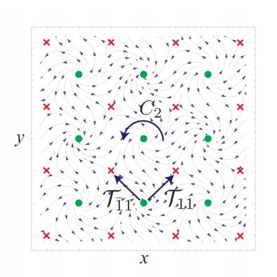
Dirac Semimetals
Chiral = moves in one direction only
(Coupled wire construction - Kane, Lubensky, Mukhopadhyay 2001)

Slide 37
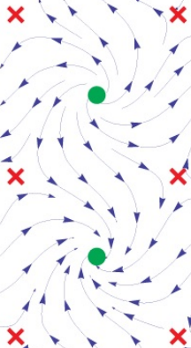
Dirac Semimetals
Notice the high energy mass parameters do not have the same symmetries as the the bare wires.

Slide 38
Symmetries of the model
Anti ferromagnetic
Time Reversal T
C2 rotation
Each Dirac mode has a central charge c=1
this tells you about heat current
Each Dirac mode has a electric current σ=1

Slide 39

The model Hamiltonian
t2
t1
Notes:
Make dotted line smaller, font of equations too bold, discuss with Jeffrey if replace this with k.p expression or is this more instructive

Slide 40
The model Hamiltonian
t2
t1
Notes:
Make dotted line smaller, font of equations too bold, discuss with Jeffrey if replace this with k.p expression or is this more instructive

Slide 41
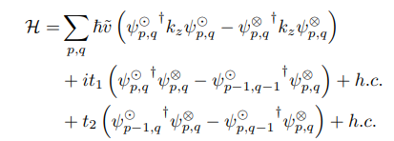
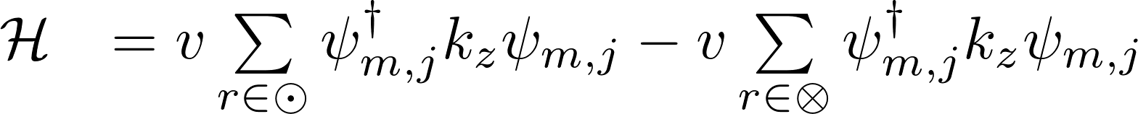
The model Hamiltonian
t2
t1
Notes:
Make dotted line smaller, font of equations too bold, discuss with Jeffrey if replace this with k.p expression or is this more instructive

Slide 42
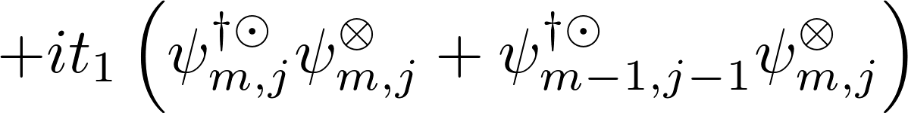
The model Hamiltonian
t2
t1
Notes:
Make dotted line smaller, font of equations too bold, discuss with Jeffrey if replace this with k.p expression or is this more instructive

Slide 43
The model Hamiltonian
t2
t1
Notes:
Make dotted line smaller, font of equations too bold, discuss with Jeffrey if replace this with k.p expression or is this more instructive

Slide 44
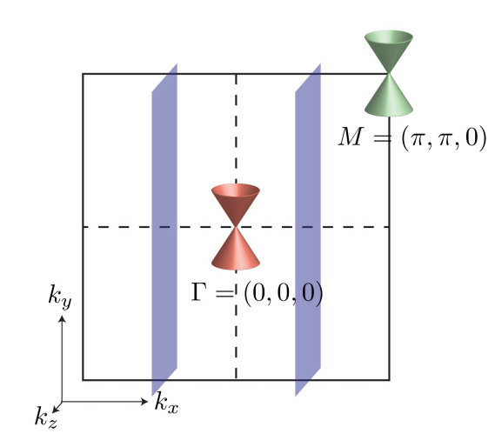
Weyl or Dirac
Notes:
BZ is halved and rotated

Slide 45
Weyl or Dirac
Notes:
BZ is halved and rotated

Slide 46
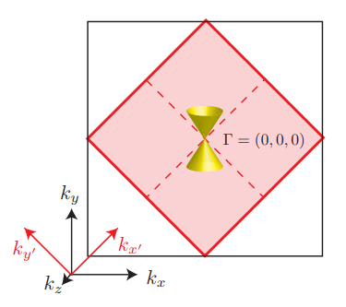
Weyl or Dirac
Notes:
BZ is halved and rotated

Slide 47
Weyl or Dirac
Notes:
BZ is halved and rotated

Slide 48
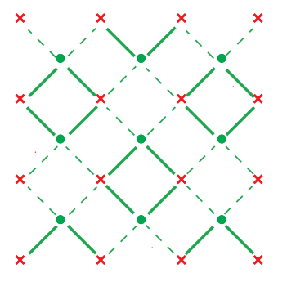
Coarse graining
In our 4 wire unit cell, we can dimerize couplings to gap out the model

Slide 49
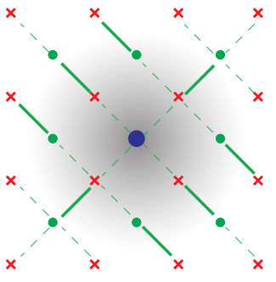
Coarse graining
In our 4 wire unit cell, we can dimerize couplings to gap out the model
or we can dimerize in a pattern and leave some uncoupled wires

Slide 50
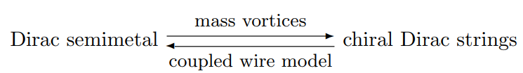
Coarse graining
In our 4 wire unit cell, we can dimerize couplings to gap out the model
or we can dimerize in a pattern and leave some uncoupled wires

Slide 51
Plan
Coupled Wires
Dirac Semimetal

Slide 52
Plan
Coupled Wires
break symmetries
Dirac Semimetal
Gapped Phase

Slide 53
Plan
Coupled Wires
break symmetries
break symmetries
Dirac Semimetal
Gapped Phase

Slide 54
Plan
many body interactions
Coupled Wires
Something New?
break symmetries
break symmetries
Dirac Semimetal
Gapped Phase

Slide 55
Symmetry Preserving gapping interaction

Slide 56
Symmetry Preserving gapping interaction
c = 1/2
c = 1
c = - 1/2

Slide 57
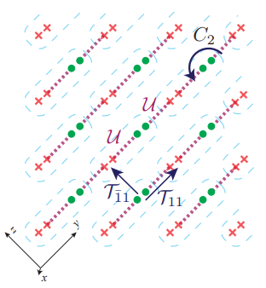
Symmetry Preserving gapping interaction
c = 1/2
c = 1
c = - 1/2

Slide 58
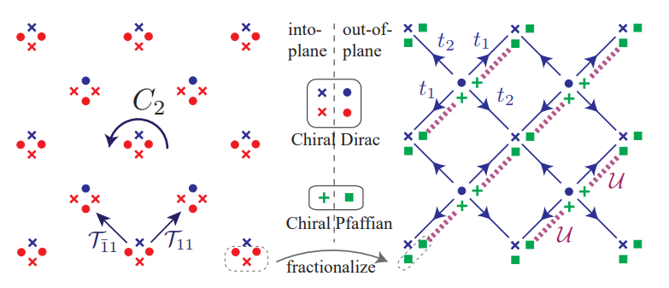
Interaction Enabled Phase

Slide 59
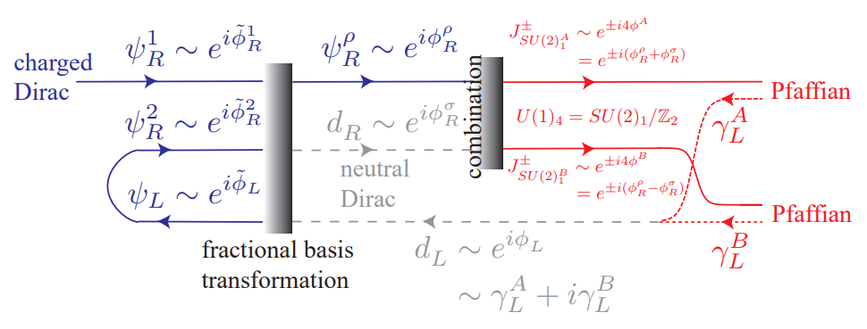
Splitting and Gluing Details

Slide 60
Conclusions
We have an exactly solvable model involving manybody interactions of Dirac/Weyl semimetals
We have a new anomalous interaction-enabled phase.
Thank you!

