Slide 1

Applications of the Pfaffian state to Topological Phases
Alexander Sirota

Slide 2




Collaborators
Syed Raza
Jeffrey Teo
Gil Young Cho
Sharmistha Sahoo

Slide 3
Outline
Background
- Quantum Hall effect
- Topological Insulators
Dirac semimetal construction
Fractional topological insulator construction

Slide 4
Classical Hall Effect
2D Electron Gas in a Magnetic Field
E
B

Slide 5
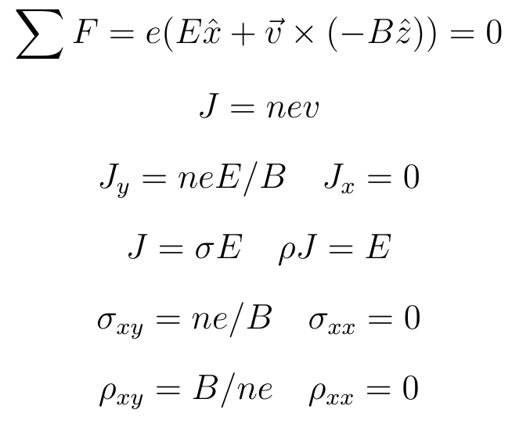
Quantum Hall Effect

Slide 6
Quantum Hall Effect

Slide 7
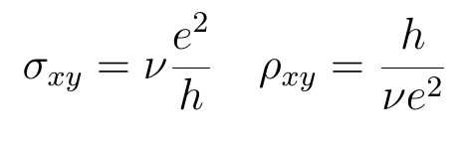
Quantum Hall Effect

Slide 8
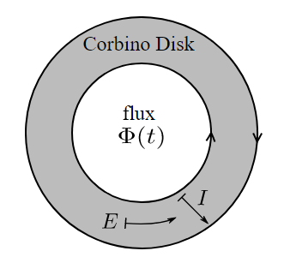



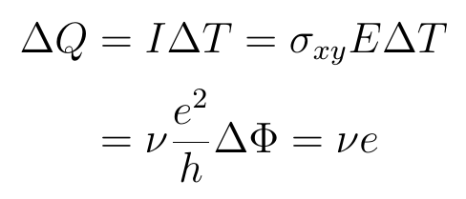
Quantum Hall Effect
The A.B phase of an electron around a flux is
If then this is 2π
or

Slide 9

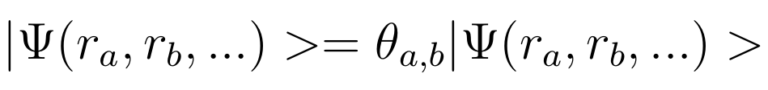
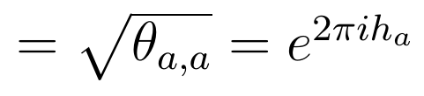
Quantum Hall Effect
If we can get ν = fraction, then we have local fractional charges!
These need not have fermi/bose exchange statistics!
a b
a b
This leads us to define the topological spin
“exchange”

Slide 10
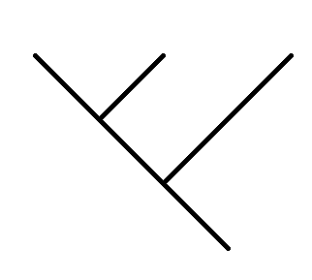
Topological Order
On top of these “braiding” statistics, we have fusion, or the idea that 2 local excitations that are close are also a single excitation.
We can specify states based on a “Fusion Tree”
a
b
c
i
d
These can serve as a basis for the quantum states. Once we put this on some manifold they are classified by Modular Tensor Categories.

Slide 11
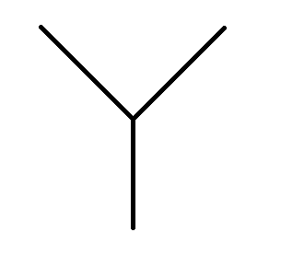
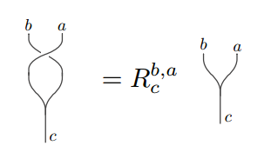
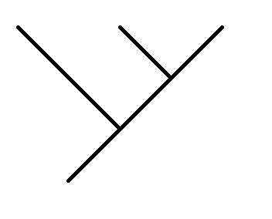
Topological Order
A Modular Tensor Category Theory is:
A set of elements (excitations)
{a,b,c,...}
Fusions Rules
a
b
a x b = Σ N^{c}_{a,b} c
c
Basis transformations (F moves)
Braiding statistics (R moves)
a
b
c
a
b
c
F_{ij}
i
j
d
d

Slide 12
Topological Insulator
Normal Insulators are defined by having a “band gap”
?
=
E
E
P
P
We say two insulators are topologically distinct if the Hamiltonian can't be adiabatically changed from one to another, while keeping the gap nonzero and not breaking any symmetries.

Slide 13
Topological Insulator
If we have a junction from one phase to another while preserving symmetries, we must have a gap close on the boundary by definition, hence get edge modes.
B

Slide 14
Topological Insulator
If instead of spatially changing the Hamiltonian to different phases, if we change it in time, we again go through a closed gap
E
E
E
P
P
P
Phase 1
Semi-metal
Phase 2

Slide 15
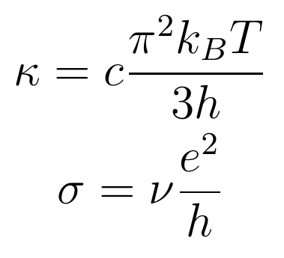
Topological Insulator
Say we have a TI where you gap the interface by breaking symmetries You can gap them in different ways so that symmetry is preserved at the interface
This mode is characterized by it's electrical and thermal conductance. In a conventional TI, this is a single gapless electron,i.e. c=1, ν=1.

Slide 16
Topological Insulator
Everything so far has been in the band theory approximation (single body interactions). If we introduce many-body interactions we can get a 3rd symmetry preserving way to gap the surface. The price to pay are these fractional quasiparticles.
In the conventional case, an electron mode splits evenly into two modes with c=1/2 and ν=1/2

Slide 17
Pfaffian State
In this symmetric many body surface, we have fractional excitations. One such state is the particle hole symmetric Pfaffian.
 | U(1) Charge Sector
 |  | e⁰ | e¹ | e² | e³ | e⁴ | e⁵ | e⁶ | e⁷
 | I | 0 |  | 1/4 |  | 0 |  | 1/4
 | σ |  | 0 |  | 1/2 |  | 1/2 |  | 0
 | ψ | 1/2 |  | 3/4 |  | 1/2 |  | 3/4
 | q | 0 | e/4 | e/2 | 3e/4 | e | 5e/4 | 3e/2 | 7e/4
Neutral Ising Sector
[Chen, Fidkowski, Vishwanath, 2013] [Read, Moore, 1992]

Slide 18
Pfaffian State
Here is a the front surface of the above picture.
In low energy we can view this as (1+1) d wires splitting into two, or two (1+1) theories coupling, leaving one.

Slide 19
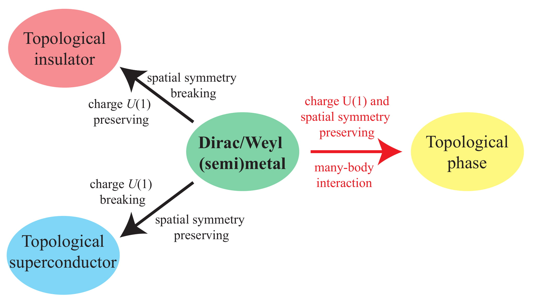
Dirac Semimetal
What if we build a Semi-metal out of (1+1)d wires?

Slide 20
Fractional topological insulator
So these surface states are all on the surface of a topological insulator. We can also ask what would the analogue be for fractional topological insulators.
ν = 1/(2n+1)

Slide 21
Parton Construction
To do the parton construction you write the electron field as
Ψ=ψ₁ψ₂...ψ_{2n+1}
seen as 2n+1 equal parts.
If we only take this assumtion, then partons are free particles in the vaccum as well which is unphysical.
To fix this we add gauge fluxes which confine the partons in vaccum.
Then we have a Z_{2n+1} gauge fluxes Φ.

Slide 22
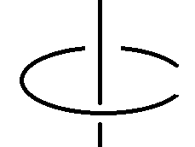

Parton Construction
We can think about these anyons as a topological order described by:
ψª x ψ^{b} = ψ^{a+b mod 2(2n+1)} Φª x Φ^{b} = Φ^{a+b mod 2n+1}
where the modulus is up to charge 2e.
Each parton is a fermion with electric charge e/2n+1 and some
gauge charge g. Each flux is a neutral boson.
The only nontrivial braiding is the following
ψ =

Slide 23
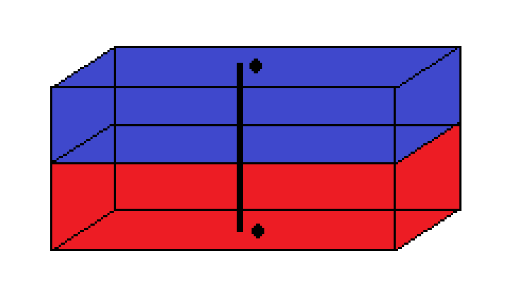
(3+1)-D model
Now we just need to look at different types of surfaces on an FTI that supports these exciations.
?
?
?
Φ
ψ
?
?

Slide 24
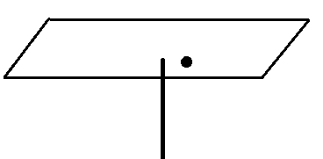
TR Breaking Surface
When a flux goes through a TR breaking surface it can bind a particle to it like in a chern insulator. Our gauge flux can bind gauge charges denoted ζª So our fluxes become dyons; magnetic monopoles with charge.
TR
ζª

Slide 25

Time Reversal Breaking Surface
If we have the top and bottom be opposite time reversal breaking surfaces our full theory is just fluxes with gauge charge a on both surfaces, with partons. One choice is the decoupled tensor product
which is the same as Laughlin's ν=1/(2n+1) state tensored with some neutral gauge theory, which is a fractional Chern insulator!
= U(1)_{(2n+1)/2} x SU(2n+1)₁
ζª
TR
TR
Φ
ν = 1/(2n+1)
c = 2n+1
ψ
ζª

Slide 26
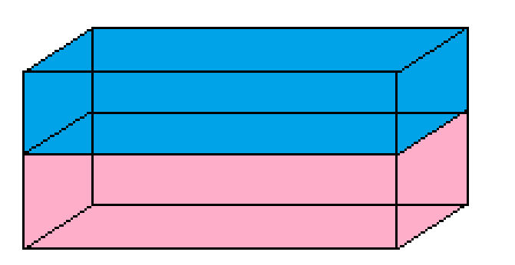
Superconducting Surface
If we take our TR breaking FTI as previously described and break U(1) by perhaps the proximity effect with a superconductor, we must condense cooper pairs.
In the simplest case we would condense all parton pairs.
The only thing left is the electron, but it is nontrivial because the edge mode still carries the same thermal current.
SC-TR
SC-TR

Slide 27
Superconducting Surface
TR
TR
SC
If partons live on the TR interface, they must split into two majorana modes on the TR/SC interfaces

Slide 28
Symmetric Surface
Symmetric
TR breaking
If we build the Pfaffian state out of partons as opposed to electrons we get all the same particles as the Pfaffian, but with all charges divided by 2n+1.
We also have fluxes that bind gauge charge across the TR breaking surface.

Slide 29
Symmetric Surface
If we include π fluxes, the normal Pfaffian becomes
If we build this from partons with the gauge fluxes it is
~note there are inequivalent ways of gauging fermion parity, i.e. different top. spins you can assign to π fluxes.
U(1)₄ x Ising
U(1)_{4(2n+1)} x Ising x Z_{2n+1}

Slide 30
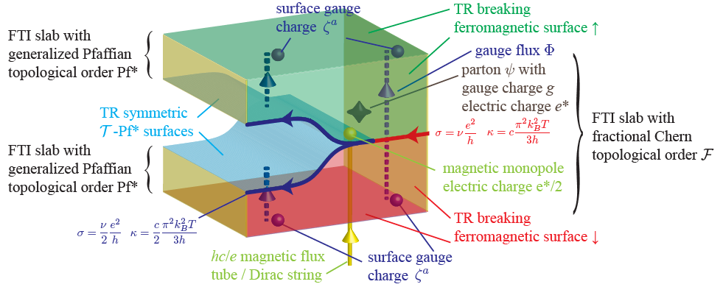
Gluing
In fact you can glue two of these surfaces along the T-P* surfaces

Slide 31
Conclusions
We studied FTI's that support fractional parton excitations and saw
TR breaking surfaces make a fractional chern insulator and laughlin ν=1/(2n+1)
Superconducting surfaces take away topological order, but still leave edge modes
T-Pfaffian surfaces make a novel topological order with ν=1/2(2n+1)

Slide 32
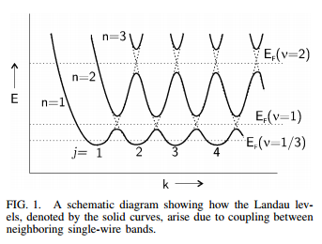
Coupled Wire Construction of Weyl/Dirac Semimetals
A typical (2+1)D quantum hall state gives chiral edge modes.
You can take a series of spatially separated chiral wires, and add interaction terms to gap out the bulk of the insulator to create landau levels, which can describe these quantum hall states.
[Kane, Mukhopadhyay, and Lubensky DOI: 10.1103/PhysRevLett.88.036401]

Slide 33
Outline
Coupled wire model of Weyl and Dirac Semi metals
Symmetry preserving way to gap out the Weyl and Dirac Semi metal
Notes:
Coupled wire gives more insights and you can write a microscopic theory to gap things out

Slide 34
Outline
Coupled wire model of Weyl and Dirac Semi metals
Symmetry preserving way to gap out the Weyl and Dirac Semi metal
Weyl Semimetals
Dirac Semimetals
Theory:
Murakami, 2007; Burkov and Balents, 2011;
Wan, Turner, Vishwanath, Savrasov, 2011
Experiment:
TaAs (Weng et al., 2015; Huang et al., 2015;
Lv et al., 2015; Xu et al., 2015; Zhang et al., 2015)
TaP,NbAs,NbP (Shekhar et al.,2015; Weng et al.,2015)
Cd3As2 (Borisenko et al., 2014; Jeon et al., 2014;
Liang et al., 2015a; Liu et al., 2014d; Neupane et al., 2014)
Na3Bi (Liu et al., 2014e; Wang et al., 2012; Xu et al., 2015)
Notes:
Coupled wire gives more insights and you can write a microscopic theory to gap things out

Slide 35
Coupled wire model of a 3D array of Chiral Dirac wires
Chiral = moves in one direction only
(Coupled wire construction - Kane, Lubensky, Mukhopadhyay 2001)

Slide 36
Coupled wire model of a 3D array of Chiral Dirac wires
Chiral = moves in one direction only
(Coupled wire construction - Kane, Lubensky, Mukhopadhyay 2001)

Slide 37
Symmetries of the model
Anti ferromagnetic
Time Reversal T
Non local and T^2 = (-1)^F . translation
Each Dirac mode has a central charge c=1
this tells you about heat current
Each Dirac mode has a electric current σ=1

Slide 38
Possible non interacting models
Anti ferromagnetic
Time Reversal
Hypersurface of a 4D TI
P2mg space group
C2mm space group
C2mm space group
Notes:
Make either chern or pfaffian of a different color

Slide 39
Symmetries of the model
Anti ferromagnetic
Time Reversal
Mirror

Slide 40
Symmetries of the model
Anti ferromagnetic
Time Reversal
Mirror
Glide plane (Mirror + translation)

Slide 41
Symmetries of the model
Anti ferromagnetic
Time Reversal
Mirror
Glide plane (Mirror + translation)
Anti Ferromagnetic Glide plane

Slide 42
Symmetries of the model
Anti ferromagnetic
Time Reversal
Mirror
Glide plane (Mirror + translation)
Anti Ferromagnetic Glide plane
Rotation Centers

Slide 43
Coupled wire model Hamiltonian
Notes:
Make dotted line smaller, font of equations too bold, discuss with Jeffrey if replace this with k.p expression or is this more instructive

Slide 44
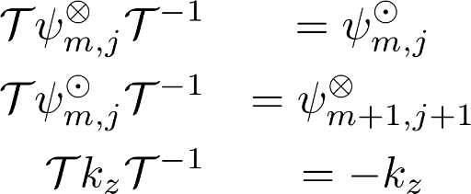
Coupled wire model Hamiltonian
TR
Notes:
Make dotted line smaller, font of equations too bold, discuss with Jeffrey if replace this with k.p expression or is this more instructive

Slide 45
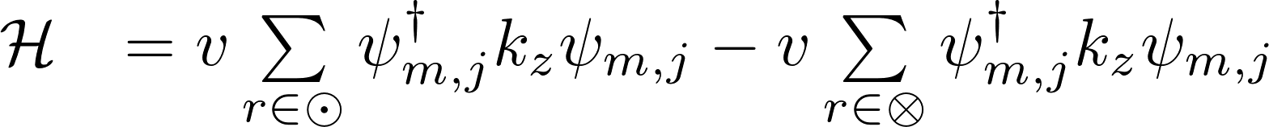
Coupled wire model Hamiltonian
TR
Notes:
Make dotted line smaller, font of equations too bold, discuss with Jeffrey if replace this with k.p expression or is this more instructive

Slide 46
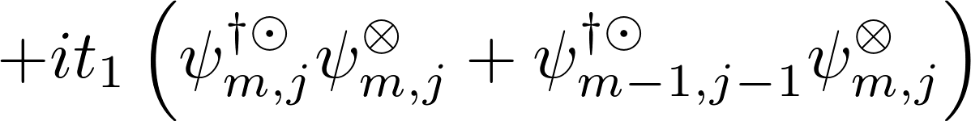
Coupled wire model Hamiltonian
TR
t1
Notes:
Make dotted line smaller, font of equations too bold, discuss with Jeffrey if replace this with k.p expression or is this more instructive

Slide 47
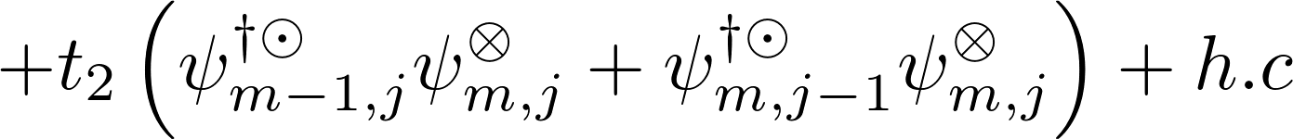
Coupled wire model Hamiltonian
TR
t2
t1
Notes:
Make dotted line smaller, font of equations too bold, discuss with Jeffrey if replace this with k.p expression or is this more instructive

Slide 48

Symmetry of the Weyl points
Weyl points of opposite chiralities at
are
spatially protected by symmetries

Slide 49
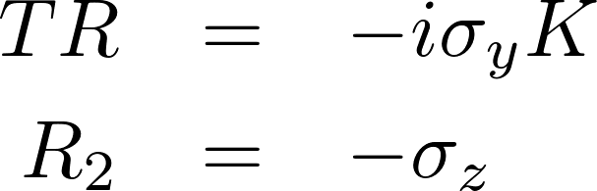
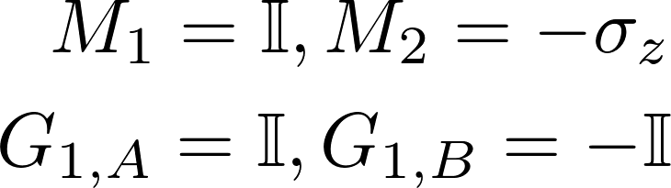
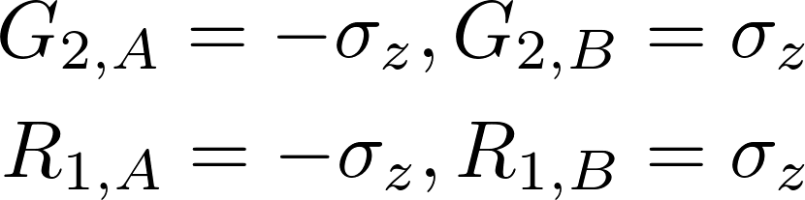
Symmetry of the Weyl points
Weyl points of opposite chiralities at
are
spatially protected by symmetries

Slide 50
How to get Dirac semi metal from this Weyl Semi metal?
Notes:
Double the Brilluioun zone

Slide 51
Lower symmetry and it will double the unit cell
Notes:
Double the Brilluioun zone

Slide 52
It halves the Brillouin zone and rotates the axis
Notes:
BZ is halved and rotated

Slide 53
Weyl cones overlap and we get Dirac cones
Notes:
BZ is halved and rotated

Slide 54
2 band model
Notes:
BZ is halved and rotated

Slide 55
4 Band model corresponds to lowered symmetry
Notes:
BZ is halved and rotated

Slide 56
Gapping the Weyl Semi metal
Gapping by symmetry breaking dimerization (trivial)
Gapping by symmetry preserving many body interaction (more interesting!)

Slide 57
Gapping the Weyl Semi metal
Gapping by symmetry breaking dimerization (trivial)
Gapping by symmetry preserving many body interaction (more interesting!)
Pfaffian mode c = 1/2, σ = 1/2
Chiral Dirac mode c=1, σ=1
Pfaffian mode c = 1/2, σ = 1/2
(Moore, Read 1991; Chen, Fidkowski, Vishwanath 2013; Wang, Senthil 2014)

Slide 58
Gapping the Weyl Semi metal
Gapping by symmetry breaking dimerization (trivial)
Gapping by symmetry preserving many body interaction (more interesting!)
Pfaffian mode c = 1/2, σ = 1/2
Chiral Dirac mode c=1, σ=1
Pfaffian mode c = 1/2, σ = 1/2
Edge mode of ν=1 Chern Insulator
Edge mode of ν=1/2 Pfaffian state
(Moore, Read 1991; Chen, Fidkowski, Vishwanath 2013; Wang, Senthil 2014)

Slide 59
Fractionalization
Dirac c=1

Slide 60
Fractionalization
Dirac c=1
Pfaffian c=1/2

Slide 61
Fractionalization
Dirac c=1
Pfaffian c=1/2
Pfaffian c=1/2, σ = 1/2
Dirac c=1, σ=1

Slide 62
Fractionalization
Inserting slabs
Dirac c=1
Pfaffian c=1/2
Pfaffian c=1/2, σ = 1/2
Dirac c=1, σ=1

Slide 63
Fractionalization
Inserting slabs
Dirac c=1
Pfaffian c=1/2
Pfaffian c=1/2, σ = 1/2
Dirac c=1, σ=1

Slide 64

Fractionalization
Inserting slabs
A coupled wire model of topological Weyl and Dirac semimetal I:
topological insulating texture and gapping interaction
Dirac c=1
Pfaffian c=1/2
Syed Raza, Alex Sirota, Jeffrey Teo
University of Virginia
c = 1/2
c = 1
c = 1/2
Pfaffian c=1/2 slabs
c = - 1/2
(To be published soon)
c = -1
c = 1/2

Slide 65
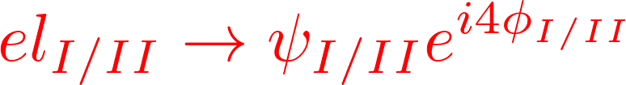
Gapping by Bosonization
Pfaffian - Pf I
Dirac d
L
Neutral Dirac fermion
Charged Boson
Pfaffian - Pf II
(Spin Charge separation)

Slide 66

Gapping by Bosonization
Pfaffian - Pf I
Dirac d
L
Neutral Dirac fermion
Charged Boson
Pfaffian - Pf II
(Spin Charge separation)
(Gapping term)
Charged boson
in 1st Pf
Neutral Dirac fermion
Left moving Charged Chiral Dirac fermion
Dirac d
L
1st Pf
2nd Pf

Slide 67
Conclusion
Non interacting coupled wire model of a 3D array of wires to
make Weyl and Dirac Semi metals
Gapping out Weyl and Dirac Semi metal bulk by interactions
while preserving symmetries
Next Talk:
Microscopic theory of gapping by interaction
Topological order
Geometric Topological phases

