Slide 1



Ask the Tower
“Is my line OK?” for Alexa+, answered from the carrier network.
01 • Ask the Tower
Notes:
This is Ask the Tower. You ask Alexa Plus, "is my line OK?", and the answer isn't a guess or a web search. It comes from the carrier's own network, over standard CAMARA APIs, and only for lines whose owners have said yes. First, a quick look at why anyone would need to ask that question. Then the demo, and after it, how it's built.

Slide 2



The problem: you find out too late
SIM moved to another device
Calls and texts reach the attacker
Bank codes go to the attacker
971
SIM-swap complaints to the FBI in 2025 · $17.4 million lost
The network knows at once. The person can't ask.
02 • Ask the Tower
Notes:
Here's the problem. A sim swap doesn't announce itself. At first it feels like bad signal: the phone goes quiet, while the network has already logged that your number moved to another sim. Call forwarding is quieter still; your calls just go somewhere else. The FBI logged nine hundred and seventy-one sim-swap complaints in 2025, with seventeen point four million dollars lost, and those are only the reported cases. Older people are hit hard, and their families usually hear about it too late. The network knows right away. The person whose line it is can't ask.

Slide 3




What Tower does
line_is_ok
is_reachable
watch_line
SIM moved? Calls forwarded?
Is this phone on the network?
Text a watcher when it changes
CAMARA: one open set of carrier network APIs, under the Linux Foundation
Consent first · bound with one tap · granted per tool · revocable
03 • Ask the Tower
Notes:
Tower is an MCP server with three tools, and its answers come from CAMARA. CAMARA is an open-source project under the Linux Foundation, where carriers agree on one common set of network APIs, like sim swap and call forwarding, so the same request works with any carrier that offers them. Line-is-OK asks two of those questions: was the sim moved, and are calls being forwarded. Is-reachable asks whether the phone is on the network. Watch-line texts a second person, say a son watching his mother's line, when either fact changes. All of it is consent first: a line is bound with one tap on the phone, and each tool is granted per person, and can be revoked.

Slide 4


Over to the demo
“Is my line OK?”
→ SIM moved: don't call from that phone
“Is anything forwarding my calls?”
→ Forwarding set: call your carrier
“Is Mom's line OK?”
→ As it was; a text if it changes
Alexa+ or the web chat
Three moments, answered from the carrier
Let's hear it
04 • Ask the Tower
Notes:
Now the demo, in three moments. First, a phone loses signal, and its owner asks whether the line is OK. The sim was moved, and Alexa says not to call from that phone. Second, they ask whether anything is forwarding their calls. Third, a son checks on his mother's line, which she chose to share with him. It's as it was, and he'll get a text if that changes. Every answer you're about to hear came from a carrier API, passed a consent check, and was audited before it was spoken. After the demo, we'll show how it's built.

Slide 5
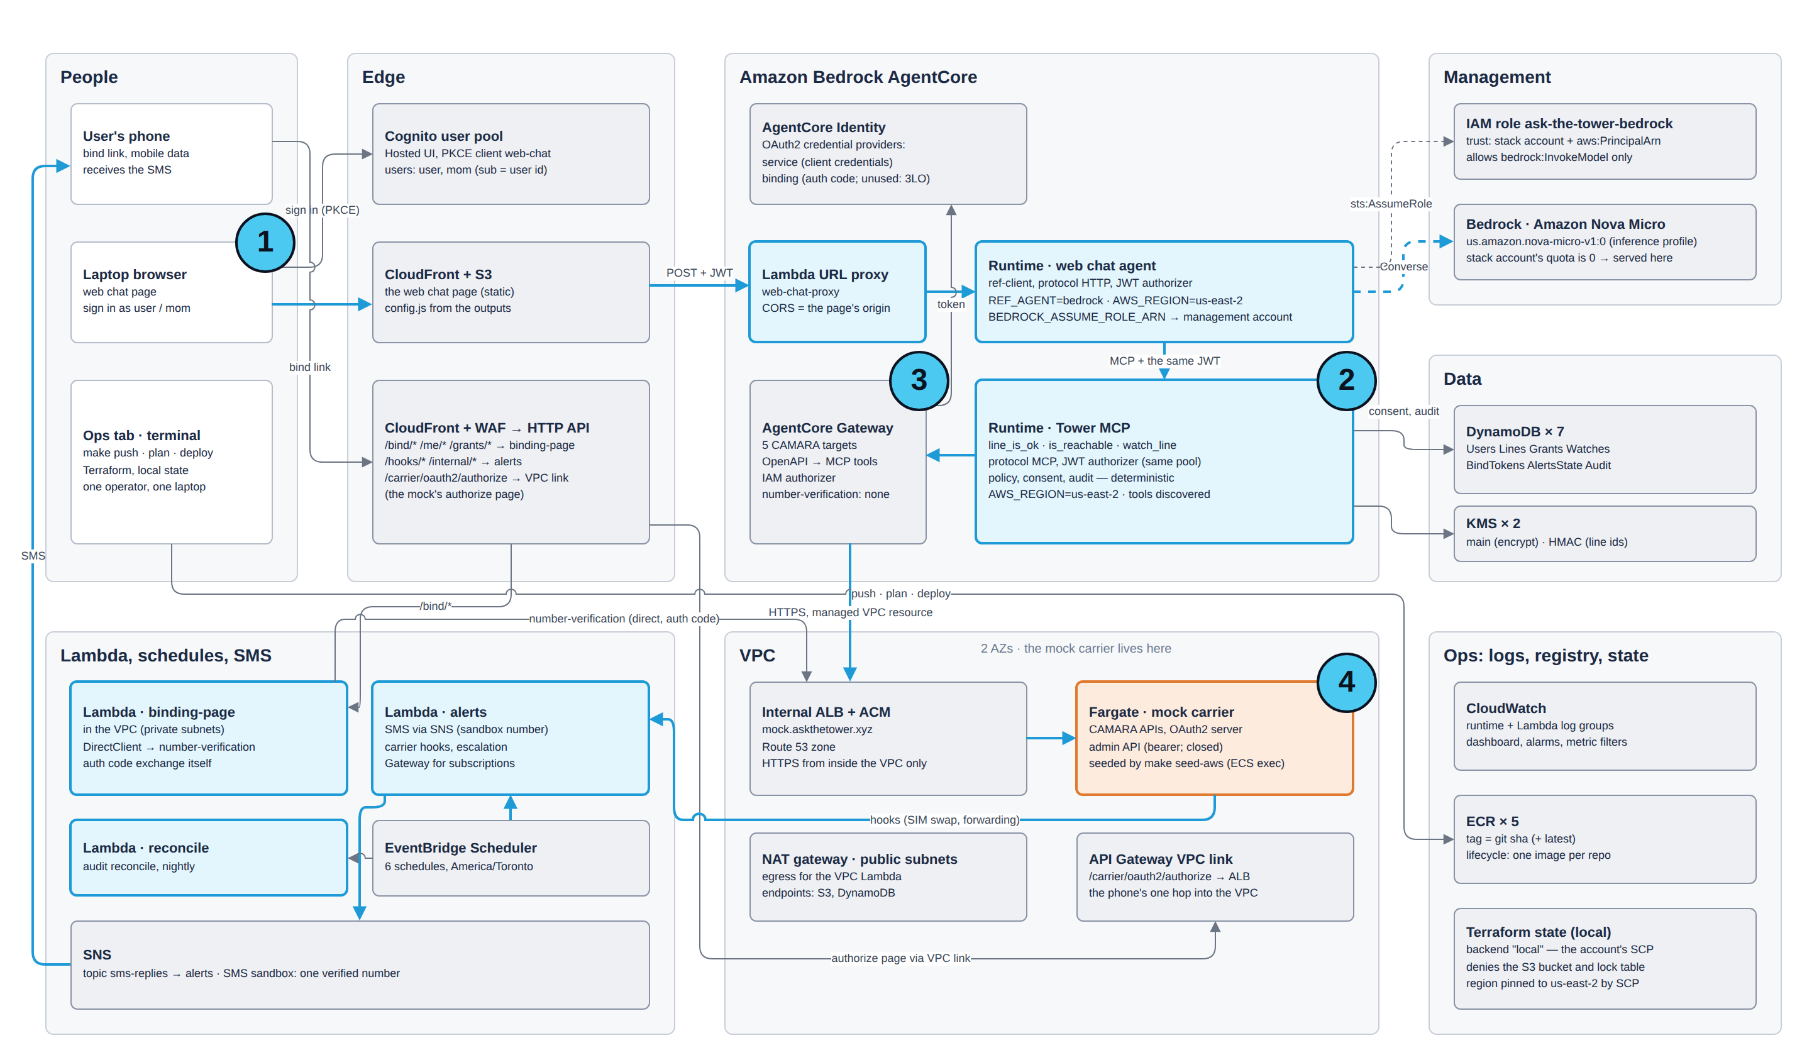
How it runs on AWS
1
Alexa+ or web chat asks
2
Tower, our MCP server, on Runtime
3
Gateway + Identity: CAMARA as MCP tools
4
Carrier: CAMARA mock on Fargate
accent = our code · grey = AWS managed · amber = carrier boundary
05 • Ask the Tower
Notes:
Here's how what you just heard runs on AWS. A question comes in from Alexa Plus, or from our web chat page, signed in with Cognito. It lands on Tower, our MCP server on AgentCore Runtime. Tower reads consent from DynamoDB, and asks the carrier through AgentCore Gateway, which turns the CAMARA API specs into MCP tools and gets its carrier credentials from AgentCore Identity. The carrier is our CAMARA-conformant mock, on Fargate. The proactive path, the texts, runs on Lambda, EventBridge Scheduler and SNS. Here are the choices behind it.

Slide 6




Stateless MCP on AgentCore Runtime
DECISION
A stateless MCP server on AgentCore Runtime
Managed MCP hosting; all state in DynamoDB
Alexa+ or web chat
Sign-in token from Cognito
Runtime checks it at the door
Tower checks it again
TRADE-OFF No server session, so each client sends a session id
06 • Ask the Tower
Notes:
First, where Tower lives. It's an MCP server on AgentCore Runtime, which hosts it for us: stateless, with plain JSON responses. Runtime checks the Cognito sign-in token at the door, and Tower checks it again itself, because it never assumes that someone else did. All state lives in DynamoDB, so any copy of Tower can answer any request. Being stateless has one cost: each client has to send its own session id, and you'll see why that matters in a moment.

Slide 7




The carrier only via Gateway
DECISION
Tower reaches the carrier only through Gateway
Standard CAMARA: an operator swaps in, Tower unchanged
REJECTED
A direct client, secret in Runtime config
BEFORE
AFTER
5 CAMARA targets become MCP tools
Tower holds carrier credentials
Gateway + Identity hold them
TRADE-OFF One more network hop
07 • Ask the Tower
Notes:
Second, Tower never talks to the carrier directly. AgentCore Gateway turns the CAMARA API specs into MCP tools, and AgentCore Identity holds the carrier credentials, so Tower holds no carrier secret at all. Because these are standard CAMARA APIs, a real operator's sandbox can replace our mock with a configuration change, and Tower doesn't notice. The price is one more network hop.

Slide 8




Consent and privacy by construction
DECISION
Privacy is enforced by construction
KMS, AWS's key service, holds the keys; no plain-text numbers
REJECTED
Trusting a typed number; redacting logs later
Phone number
KMS HMAC → line id
KMS encrypts the number
Never in a log
grants per tool
AUDIT, BEFORE EVERY ANSWER
#1
#2
#3
#4
hash-linked
Mom
Son
revokes any time
TRADE-OFF Binding needs mobile data, so not on Wi-Fi
08 • Ask the Tower
Notes:
Third, privacy by construction. A line is bound with CAMARA Number Verification: you open a link on your phone, over mobile data, and tap once, and the carrier itself confirms the number. After that, the number never sits anywhere in plain text. KMS, AWS's Key Management Service, holds two keys for us. One encrypts the number before it's stored. The other turns it into a keyed hash, an H-MAC, which is the only id our tables and logs use. Grants are per person and per tool, and every check goes into a hash-chained audit before the answer leaves. The catch: binding needs mobile data, so it won't work on Wi-Fi.

Slide 9

Plain code decides, with fixed words
DECISION
Plain code decides, then picks a fixed sentence
Safety advice must never drift
REJECTED
A model decides, or paraphrases the advice
Reason code | Spoken, word for word (phrasing.py)
SIM_SWAPPED_RECENT | “Your SIM was moved to another device at ‹time›. If that wasn't you, don't call from your phone — I can call your carrier's support line for you from here.”
CALL_FORWARDING_SET | “All your calls have been forwarding since ‹time›. If you didn't set that, I can call your carrier's support line for you from here.”
NO_CONSENT | “‹Name› hasn't shared that with you.”
TRADE-OFF Fixed wording can sound stiff
09 • Ask the Tower
Notes:
Fourth, no model decides anything that matters. The policy engine is plain Python: facts from the carrier in, one outcome and a reason code out. Every decision it can make is written out as a table and tested. Each outcome comes with a fixed sentence. After a sim swap it says: don't call from your phone. I can call your carrier's support line for you from here. Because the phone may be the thing that was taken. We chose not to let a model reword safety advice. The cost is wording that can sound stiff.

Slide 10


Fast enough for voice
DECISION
Keep sessions warm; skip the carrier when we can
A spoken answer has to feel instant
REJECTED
A new session for every question
BEFORE
AFTER
Watched line: no carrier call
New session every time: about 7 s
Warm session: under half a second
TRADE-OFF Warm sessions have to be kept alive
10 • Ask the Tower
Notes:
Fifth, speed. A spoken answer has to feel instant. At first, a question without a session id started a cold copy of Tower, and took about seven seconds. With one session per client, and one warm connection to the Gateway, a typical answer now comes back in under half a second. And if a line is already being watched, Tower answers from what it already knows, and doesn't call the carrier at all.

Slide 11



What AWS taught us
Gateway arguments are flat
No 3LO behind IAM
Bedrock quota is 0
No body wrapper: fields at the top
The binding page exchanges its own code
New account: a cross-account role serves it
11 • Ask the Tower
Notes:
Finally, what AWS taught us. Gateway passes tool arguments flat, not wrapped in a body. A Gateway behind I-A-M refuses three-legged OAuth, so our binding page exchanges the sign-in code itself. And a brand-new account's daily Bedrock quota is zero, so the web chat agent uses a role in another account. Everything is built with Terraform, and torn down when we're done. Thank you.

