Slide 1



Ask the Tower
“Is my line OK?” for Alexa+, answered from the carrier network.
Asish Bose & Badhrinath Padmanabhan · Canada
01 • Ask the Tower • Alexa+ MCP track
Notes:
This is Ask the Tower, built by Asish Bose and Badhrinath Padmanabhan. Before the demo video, we want to spend a few minutes on how it's built, because most of the interesting work is in the parts you can't hear. The idea is simple. You ask Alexa Plus, "is my line OK?", and the answer isn't a guess or a web search. It comes from the carrier's own network, over standard CAMARA APIs, and only for lines whose owners have said yes. Let's start with why anyone would need to ask that question at all.

Slide 2



The problem: you find out too late
SIM moved to another device
Calls and texts reach the attacker
Bank codes go to the attacker
971
SIM-swap complaints to the FBI in 2025 · $17.4 million lost
The network knows at once. The person can't ask.
02 • Ask the Tower • The problem
Notes:
Here's the problem. A SIM swap doesn't announce itself. At first it feels like bad signal: the phone goes quiet, while the network has already logged that your number moved to another SIM. Call forwarding is quieter still; your calls just go somewhere else. The FBI logged nine hundred and seventy-one SIM-swap complaints in 2025, with seventeen point four million dollars lost, and those are only the reported cases. Older people are hit hard, and their families usually hear about it too late. The network knows right away. The person whose line it is can't ask.

Slide 3




What Tower does
line_is_ok
is_reachable
watch_line
SIM moved? Calls forwarded?
Is this phone on the network?
Text a watcher when it changes
Consent first · bound with one tap · granted per tool · revocable
03 • Ask the Tower • What Tower does
Notes:
Tower is an MCP server with exactly three tools. Line-is-OK asks two CAMARA questions: was the SIM moved, and are calls being forwarded. Is-reachable asks whether the phone is on the network. And watch-line asks our Alerts service to text a second person, say a son watching his mother's line, when either fact changes. Alexa Plus can't speak first through MCP, so the proactive part is an SMS, not a voice. All of it is consent first: a line is bound once, with one tap on the phone, and each tool is granted per person, and can be revoked. Here's how it runs on AWS.

Slide 4
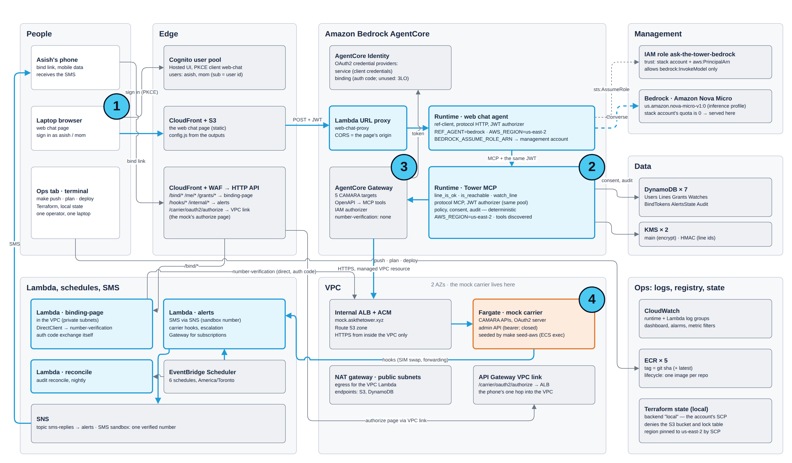
Architecture, as deployed on AWS
1
Alexa+ or web chat asks
2
Tower, our MCP server, on Runtime
3
Gateway + Identity: CAMARA as MCP tools
4
Carrier: CAMARA mock on Fargate
accent = our code · grey = AWS managed · amber = carrier boundary
04 • Ask the Tower • Architecture
Notes:
This is the deployment as it actually runs. A question comes in from Alexa Plus, or from our web chat page, signed in with Cognito. It lands on Tower, our MCP server on AgentCore Runtime. Tower reads consent from DynamoDB, with numbers protected by KMS, and asks the carrier through AgentCore Gateway, which turns the CAMARA OpenAPI specs into MCP tools and gets its OAuth tokens from AgentCore Identity. The carrier is our CAMARA-conformant mock, on Fargate behind an internal load balancer. The amber line is the proactive path: Lambdas, EventBridge Scheduler, and SNS. Now, the six decisions behind it.

Slide 5





Decision 1: stateless MCP on AgentCore Runtime
DECISION
A stateless MCP server on AgentCore Runtime
Managed MCP hosting; all state in DynamoDB
REJECTED
Our own containers on EKS, ~$150 a month
Alexa+ or web chat
Bearer JWT from Cognito
Runtime authorizer checks it
Tower verifies it again
TRADE-OFF No server session id, so clients must send one
05 • Ask the Tower • Decisions
Notes:
Decision one: where Tower lives. We host it as an MCP server on AgentCore Runtime: Streamable HTTP, stateless, with plain JSON responses. Runtime's J-W-T authorizer checks the Cognito token at the edge, and we pass the Authorization header through so Tower verifies it again itself. Tower never assumes that someone else checked. All state lives in DynamoDB, so any instance can answer. We rejected running our own containers on EKS. The Helm charts exist and pass on kind, but left up, EKS costs about a hundred and fifty dollars a month. Being stateless has a cost, and you'll see it on the latency slide.

Slide 6



Decision 2: the carrier only via Gateway
DECISION
Tower reaches the carrier only through Gateway
Standard CAMARA: an operator swaps in, Tower unchanged
REJECTED
A direct client, secret in Runtime config
BEFORE
AFTER
5 CAMARA targets become MCP tools
Tower holds carrier credentials
Gateway + Identity hold them
TRADE-OFF One more hop, and a session to keep warm
06 • Ask the Tower • Decisions
Notes:
Decision two: Tower never talks to the carrier directly. AgentCore Gateway turns our vendored CAMARA OpenAPI specs into MCP tools, and AgentCore Identity holds the outbound OAuth credentials, so Tower holds no carrier secret at all. And because these are standard CAMARA APIs, an operator's sandbox replaces our mock as a configuration change that Tower can't even see. The alternative, a direct client with the secret in Runtime config, is still there as our cut line, but we didn't need it. The price is one more network hop, and a Gateway session that we have to keep warm.

Slide 7




Decision 3: consent and privacy by construction
DECISION
Privacy is enforced by construction
Number Verification binds the line: one tap, mobile data
REJECTED
Trusting a typed number; redacting logs later
Phone number
HMAC → line id
KMS → ciphertext
Never in a log
grants per tool
AUDIT, BEFORE EVERY ANSWER
#1
#2
#3
#4
hash-linked
Mom
Asish
revokes any time
TRADE-OFF Binding fails on Wi-Fi
07 • Ask the Tower • Decisions
Notes:
Decision three: privacy by construction. A line is bound with CAMARA Number Verification. You open a link on your phone, over mobile data, and tap once, and the carrier itself confirms the number. From then on, the tables key the line by an H-MAC, the number is stored only as KMS-encrypted ciphertext, and a test greps every log and transcript for anything shaped like a phone number. Grants are per line and per tool, and can be revoked. Every check, allowed or refused, goes into a hash-chained audit before the answer leaves. The trade-off is real friction: binding won't work on Wi-Fi.

Slide 8

Decision 4: deterministic policy, fixed words
DECISION
Plain code decides, then picks a fixed sentence
Safety advice must never drift
REJECTED
A model decides, or paraphrases the advice
Reason code | Spoken, word for word (phrasing.py)
SIM_SWAPPED_RECENT | “Your SIM was moved to another device at ‹time›. If that wasn't you, don't call from your phone — I can call your carrier's support line for you from here.”
CALL_FORWARDING_SET | “All your calls have been forwarding since ‹time›. If you didn't set that, I can call your carrier's support line for you from here.”
NO_CONSENT | “‹Name› hasn't shared that with you.”
TRADE-OFF Fixed wording can sound stiff
08 • Ask the Tower • Decisions
Notes:
Decision four: no model decides anything that matters. The policy engine is plain Python: facts from the carrier in, one outcome and a reason code out, like SIM swapped recent, or call forwarding set. Every decision it can make is printed as a table and tested. Each outcome carries a summary sentence written to be read out word for word. After a SIM swap it says: don't call from your phone. I can call your carrier's support line for you from here. Because the phone may be the thing that was taken. We rejected letting a model paraphrase safety advice. The cost is wording that sometimes sounds stiff.
[not spoken] TODO(verify) Whether Alexa+ reads `summary` verbatim or paraphrases is still open (01 §open questions); the web chat agent is instructed to read it verbatim (`services/ref-client/prompts/ref-client/system.md`).

Slide 9


Decision 5: latency by design
DECISION
Budget the call; skip the carrier when we can
A voice answer has to feel instant
REJECTED
A fresh Gateway session per call, ~460 ms
Target p95 400 ms
Fixed cost: network, authorizer, store, audit
528 ms
≈ 360 ms
≈ 168
line_is_ok p95 on AWS
Carrier calls, 300 ms timeout each
0
100
200
300
400
500
600
Watched line, fresh state: no carrier call (0 ms carrier)
TRADE-OFF One warm session per process to keep alive
09 • Ask the Tower • Decisions
Notes:
Decision five: latency. A voice answer has to feel instant, so each carrier call gets a hard three hundred millisecond timeout. If Alerts is already watching a line, Tower answers from the stored state and skips the carrier entirely. On AWS we found two hidden costs. Opening a fresh Gateway session per call took about four hundred and sixty milliseconds, so Tower keeps one session open, and a warm call takes about one hundred and fifty. And because Tower is stateless, any request without a session id landed on a cold micro-VM: about seven seconds. One session id per client brought that to about point four seconds.
[not spoken] The budget bar is derived from `artifacts/latency-aws.md`: fixed ≈ 360 ms = `watch_line` p95 (no carrier call); carrier ≈ 168 ms = `line_is_ok` p95 (528 ms) minus that. TODO(verify) the split inside the fixed cost (network, authorizer, store, audit) is not measured.
[not spoken] TODO(verify) "0.4 s" is the measured p50 of `line_is_ok` in `artifacts/latency-aws.md` (429.6 ms), taken with the session id in place; the repo has no before/after pair measured in one run. The "≈ 7 s" is from Tower's log on 2026-10-14, quoted in `services/ref-client/src/ref_client/mcp_client.py`.

Slide 10




Decision 6: operating it, and what AWS taught us
Gateway arguments are flat
No 3LO behind IAM
7 s → 0.4 s
Bedrock quota is 0
No body wrapper: fields at the top
The binding page exchanges its own code
Client session id: no cold start per call
New account: a cross-account role serves it
Terraform via a 14-step Ops pipeline · admin path: one /32, then closed
10 • Ask the Tower • What AWS taught us
Notes:
Decision six is how two people operate this, and it's also where AWS taught us the most. Everything is Terraform, run from an Ops tab that walks the AWS pipeline as fourteen steps, one click each. For the live demo, an admin path to the mock opens for exactly one address, behind a bearer token, and closes right after. Lessons from the first apply: Gateway passes tool arguments flat, not wrapped in a body. A Gateway with an IAM authorizer refuses three-legged OAuth targets, so the binding page exchanges the code itself. And a new account's daily Bedrock token quota is zero, so the web chat agent uses a cross-account role.
[not spoken] TODO(verify) That the demo admin path was closed after the recorded demo: `deploy/terraform/envs/aws.tfvars` has `demo_admin_cidrs = []` after `make admin-close` (deployment-agentcore.md step 12b is still marked TODO(human)).

Slide 11

Evidence
3 Moments pass end to end on AWS
Chaos on AWS: 9/9, never wrong
line_is_ok p95 528 ms; target 400
11 • Ask the Tower • Evidence
Notes:
So does it work? Nine hundred and ninety-nine unit tests and one thousand two hundred and thirty-six integration tests pass, including CAMARA conformance with zero failing operations, and privacy tests with zero hits. On AWS, the demo stories match the golden transcripts end to end, and chaos on every tool, timeouts, server errors and rate limits, never gives a wrong answer. Latency, honestly: our target is four hundred milliseconds at the ninety-fifth percentile. Is-reachable makes it, at three eighty-five. Line-is-OK misses, at five twenty-eight. Watch-line, which never calls the carrier, still takes about three hundred. That's a fixed cost on every call.
[not spoken] TODO(verify) Where the ~300 ms fixed cost goes (laptop → Runtime network, the authorizer, consent read, audit write): `artifacts/latency-aws.md` measures client-side wall time only; the per-step split needs a `LOG_LEVEL=debug` run, which is not recorded in the repo.
[not spoken] Counts: `artifacts/test-report.md` (2026-10-14): unit 999/999; integration 1236 passed, 1 skipped; e2e local 30 passed, 3 skipped; e2e aws 13 passed, 20 skipped, 0 failed.

Slide 12


Over to the demo
“Is my line OK?”
→ SIM moved: don't call from that phone
“Is anything forwarding my calls?”
→ Forwarding set: call your carrier
“Is Mom's line OK?”
→ As it was; a text if it changes
Echo, on home Wi-Fi
Here is what Asish hears on his Echo…
Let's hear it
12 • Ask the Tower • Demo
Notes:
That's the architecture. Now the demo. Here is what Asish hears on his Echo, in three moments. First, his phone loses signal and he asks Alexa whether his line is OK. His SIM was moved, and Alexa tells him not to call from that phone. Second, he asks whether anything is forwarding his calls. Third, he checks on Mom's line, which she chose to share with him. It's as it was, and he'll get a text if that changes. Every answer you're about to hear came from a carrier API, passed a consent check, and was audited before it was spoken. Let's watch.
[not spoken] TODO(verify) The demo footage is on an Echo: `docs/architecture/alexa/registration.md` still says "Status: not run" (the toolkit is US-only; the fallback is the reference client / web chat). Change "on his Echo" if the video shows the simulator or the web chat page.

